Slide 1
Foundations of Programming – Spring 1 2022 March 1 , 2021 Capstone Project Presentation
By Group 1:
Zaiba Bhaidani
Abdoul-Salam Boundaogo
Vy Ngan Dinh
Seojeong Ko
Karim Liaquat
Muhammad Maarij Mufti

Slide 2
Introduction
The threat profile that businesses face is continuously moving, and the cybersecurity landscape is ever-changing.
The introduction of captcha and the widespread use of two-factor authentication appeared to have reduced account creation fraud.
Fraudulent account creation is on the rise once more, mainly to the advent of sophisticated and inexpensive hacking tools.

Slide 3
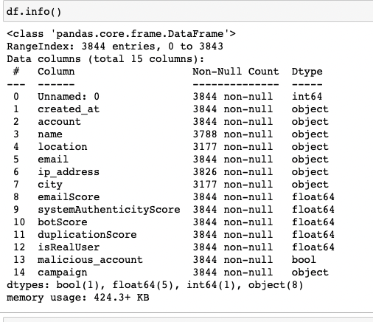
Analyzing data
Step 1 - Convert categorical data into numerical
Step 2 - add new column in df for each categorical data
Step 3 - sum the score and divide by total number of scenarios considered
Step 4 - assign each row with campaign and malicious values

Slide 4
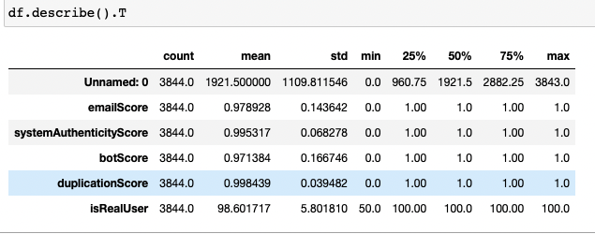
Rules taken into consideration
( final values for score would be between 1 or 0 )
- Email score : valid or fake email address
- Geography score : look for ip address from which account is created valid or not
Duplication score : if more than one account is created with same email and same account name
Bot score : look for patterns in name account name, and email if found the it might be script running against system

Slide 5
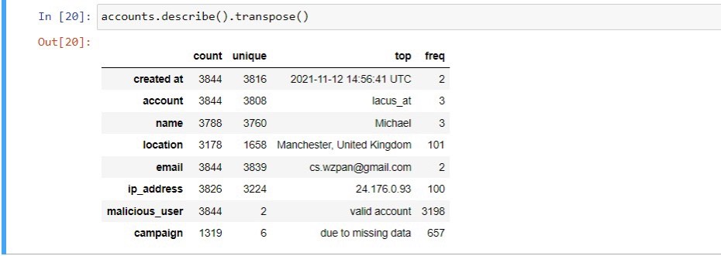

Data Cleaning & Underlying Assumptions
Accounts with missing IP address are considered invalid
All the IP addresses are validated based on numerical values not exceeding 255 in each segment of the IP address format

Slide 6
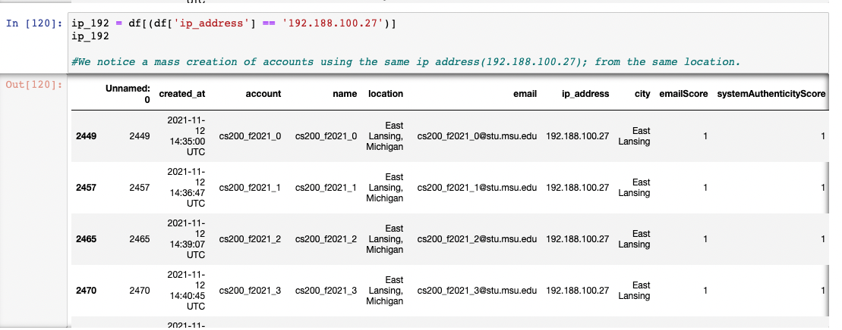
Detecting edge case
We found that some accounts were created with same patterns so it means there might be a bot who is creating those.

Slide 7
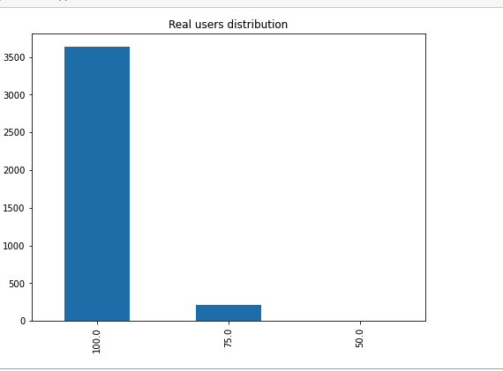
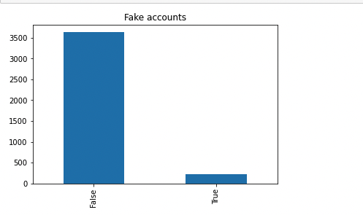
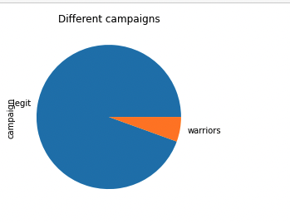
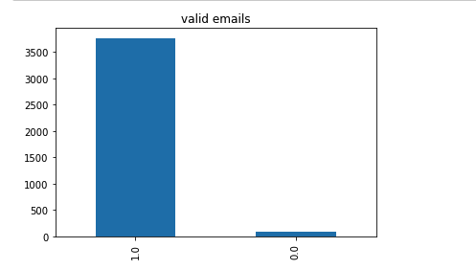
Visualization

Slide 8
Recommendations
To avoid getting numerous fake accounts into Github, we recommend:
Add email validation into system.
we should not allow user to create multiple accounts with in x minute. ( to make sure it’s not a bot or script )
Before allowing user to enter into system we should check if user is not using VPN to fake the location.
Not allowed user to create account with same account name and same email.

Slide 9
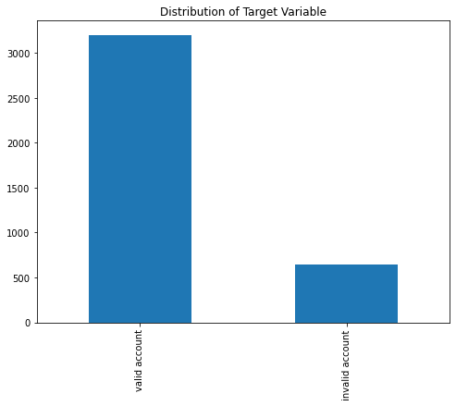
Conclusion
In this project, we as a group have done cleaning of the data and provided diagnostical Data Analysis in order to obtain some understanding of the data for further analysis of the final output. We can summarize that:
The given data has 213 malicious accounts
Only IP address and timestamp were the reliable data attributes to pull final conclusion
Source code https://github.com/karimkhamwani/python-data-analysis

Slide 10


