Slide 1
Data Analytics
Elective Surgery Schedule – VU Medical Center
Uzman Karim
Contact: karimuzman@gmail.com

Slide 2

Data Analytics
Background:
Uzman Karim
Masters in Economics and Financail Markets
More than 5 years of experience in Management Consulting
Studying Data Analytics Hybrid – ReDI School Munich
Interested in the Data Analyst - BI field

Slide 3
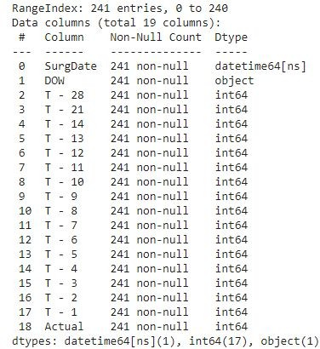


Exploratory Data Analysis
The given data set is a 48-week surgery schedule for VU Medical Center
The data set has a schedule of surgery 28, 21, 14,13….1 day prior to the actual surgery date and the count of actual surgeries on that day
Data has been captured for weekdays from Oct 10, 2011 to Sept. 14, 2012
● | 241 |  | data |  |  | points:
 | 1 | Datetime | data | type |  | (SurgDate),
 | 1 | Object | data | type |  | (DOW) and
17 Integer data types (‘T-28’, ‘T-21’ ,…., ‘T-1’, ‘Actual’)

Slide 4
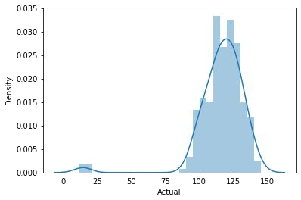
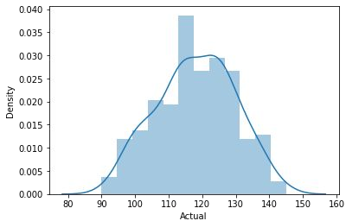
Exploratory Data Analysis
Four outliers
11/25/2011 Fri
12/26/2011 Mon
12/23/2011 Fri
12/30/2011 Fri

Slide 5
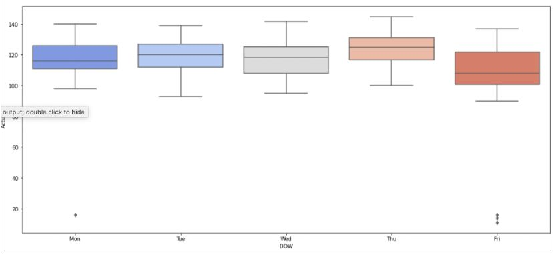
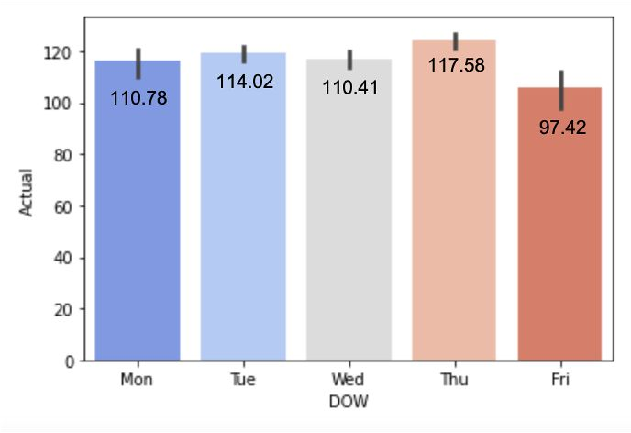
Exploratory Data Analysis
Fridays have lowest number of surgeries
Thursdays have highest number of surgeries
Alternatively, the high number of surgeries on Thursday might be due to add-on (urgent) cases or fewer no. of cancellations for accommodating emergency cases

Slide 6
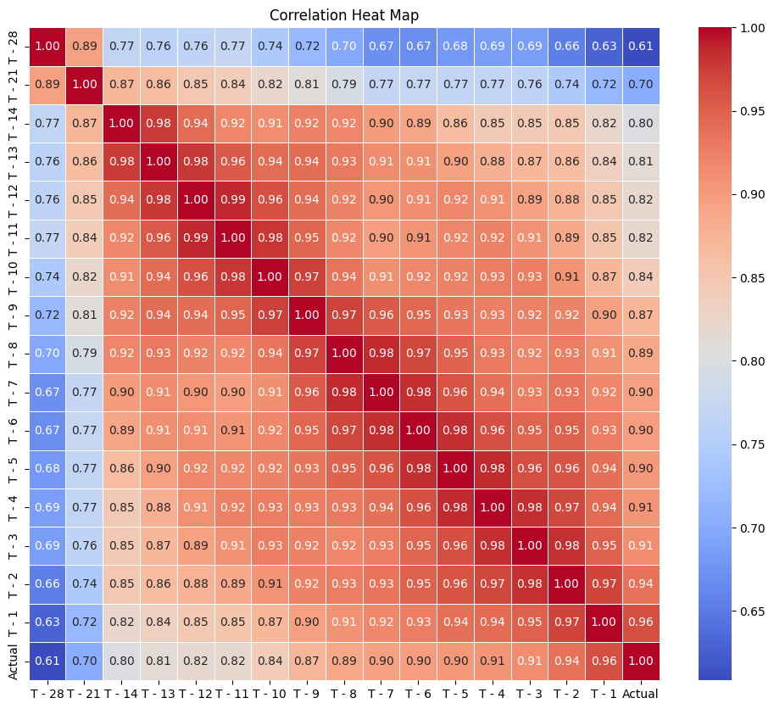
Exploratory Data Analysis - Correlation

Slide 7
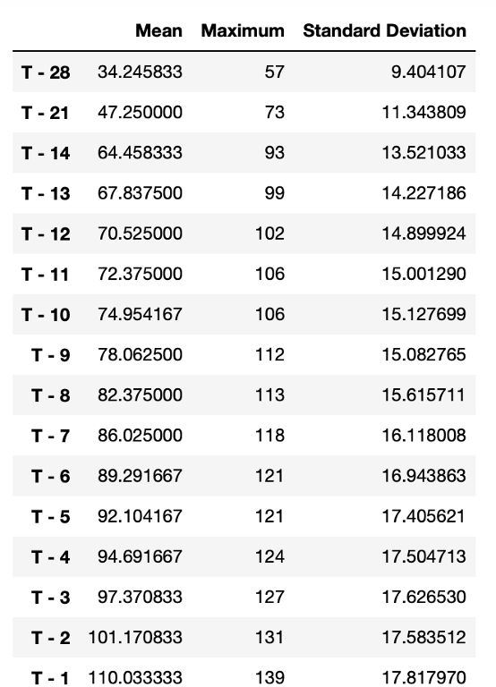
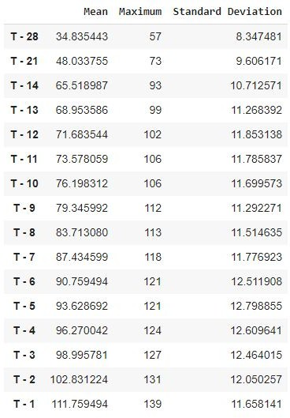
Exploratory Data Analysis
Observations:
The average number of surgery cases increase as we move closer to actual day
Days nearer to the actual surgery date have the strongest correlation
Average of actual surgeries is 116 with standard deviation of 17.63
Average of actual surgeries (after removing outlier) is 118 with standard deviation of 11.67

Slide 8
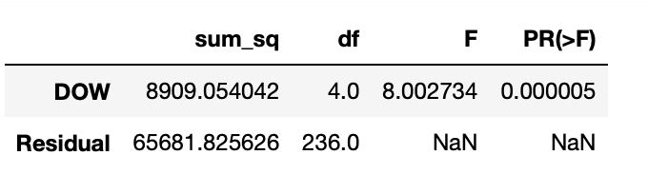
Surgical Volume vs Day of Week
Null Hypothesis: Total surgical case volume does not differ based on the day of week
Alternative Hypothesis: Total surgical case volume differs based on the day of week
By ANOVA test result, we can reject our null hypothesis with 99% conﬁdence
The p-value obtained from ANOVA analysis is < 0.05
We can conclude that there are signiﬁcant differences among surgeries and day of week
Thus, we reject the null hypothesis and accept alternative hypothesis that total surgical case volume differs by Day of Week

Slide 9
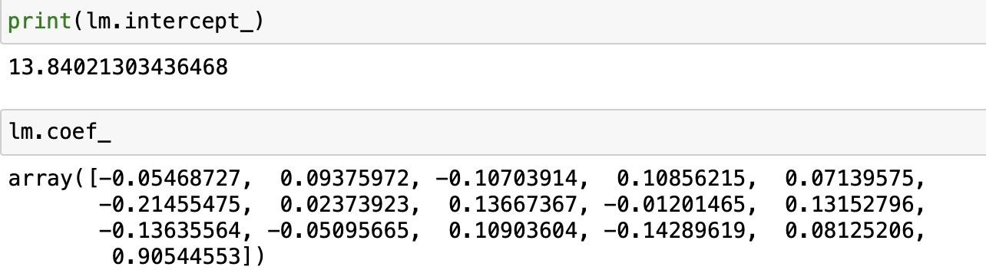
Data Modelling
Data Type: Continuous variables
Dependent variable: Actual Surgery
Independent variables: T - 28 to T – 1
Regression Equation:
y = (a₁* T – 28) + (a₂* T - 21) + ..... + (a_{x - 1}* T – 2) + (a_{x}* T – 1)

Slide 10
Model Performance
Model | Independent Variables | Residual Standard Error | Multiple R-squared | Adjusted R-squared | Average Prediction Error
Baseline | T– 28 to T - 1 | 4.687 | 0.9372 | 0.9324 | 2 surgeries
3 Days prior | T – 28 to T - 4 | 6.905 | 0.8617 | 0.8532 | 3 surgeries
7 Days prior | T – 28 to T - 8 | 8.106 | 0.8059 | 0.7977 | 3 surgeries
3 Days prior (test) | T – 28 to T - 4 | 2.021 | 0.9952 | 0.9642 | 2 surgeries
7 Days prior (test) | T – 28 to T - 8 | 4.876 | 0.9306 | 0.7918 | 2 surgeries

Slide 11
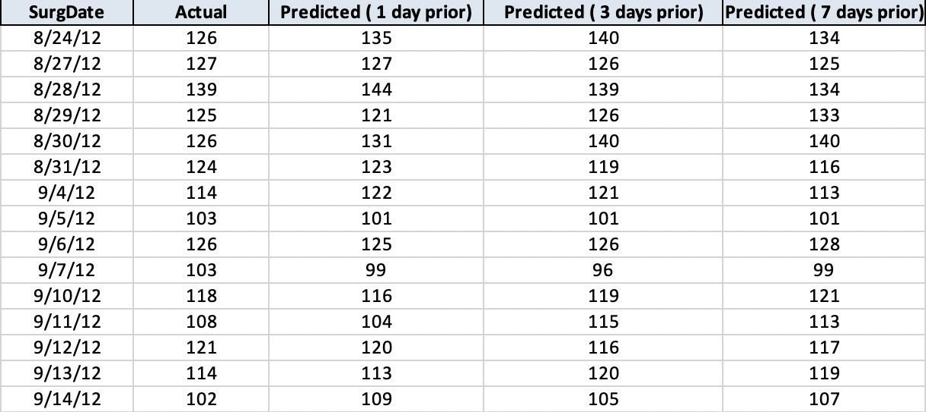
Predictions (from 45 weeks of data)

Slide 12
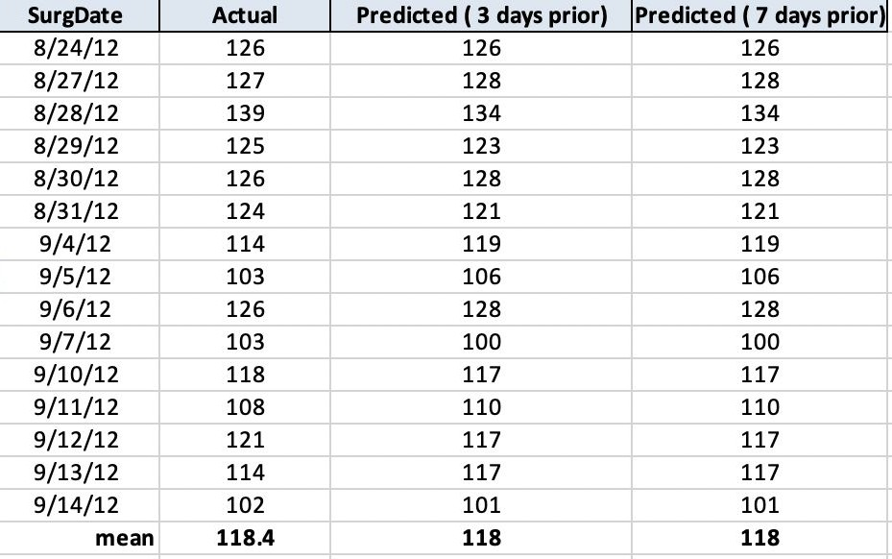
Predictions (from 3weeks of data)

Slide 13
Recommendations
VU Medical Center can predict surgery volume 3 days prior to the actual surgery day:
The prediction values have least error
Business would want to know the surgery volume a few days before actual day
Technical: Last 3 days will be highly correlated with actual surgery day

Slide 14

Data Analytics - Learning
Learning Outcomes:
Developing skills required to become a Data Analyst. The core are as follows:
Programing Skills
Data Analyzing
Ability to reason about Data
Data Modeling
Data Prediction
Team work
Communication

Slide 15


Thank you for your Attention!
Contact
Uzman Karim Student – Data Analytics Hybrid 2023 winter
karimuzman@gmail.com

