Slide 1
Data Analytics - Python
Crawl Restaurants Data
Fast Food Chains
Uzman Karim
Contact: karimuzman@gmail.com

Slide 2

Data Analytics - Python
Background:
Uzman Karim
Masters in Economics and Financail Markets
More than 5 years of experience in Management Consulting
Student of Python intermediate online 2023 – ReDI School Munich
Interested in the Data Analyst – Business Intelligence field

Slide 3
Data Analytics - Python
Overview:
Fast Food Restaurant Chains in Munich
Crawl Address data of the Major Players from Web
Nevigation and Automation of the Project using Python Selenium
Initial idea was to fast access to restaurants addresses at one place
As a future project we can extend it to a dashboard with extra services e.g. menu

Slide 4


Data Analytics – Approach & Methodology
Approach:
Scrape Restaurant addresses data from the Web using Python. The Dataset consists of 3 Major Restaurants in Munich:
Starbucks
McDonald’s
Subway
Methodology:
Web Searching for Data
Navigating through web browser
Automate the Process
Crawling the search Data
Analyzing Restaurants Data
Saving the clean data in CSV file

Slide 5
Data Analytics - EDA
Exploratory Data Analysis - EDA
Data Collection
Data Analyse - to identify Market presence
A Handy addressbook by one click
Worked with Python Selenium, web driver, google colaboratory, Chrome developer Console
Also worked with Pakages/Librares: Selenium, Time, CSV
Task Performed:
Analysing the Restaurants Outlet finder for Addresses
Analysing the Dataset
Navigating the Dataset
Automating the Dataset
Crawling the Dataset
Scrap the data in to a CSV file
Saving the data

Slide 6
Project Visuals – Market Presence
Major Players – Sample Data
Major Players – Market Presence in Munich (%)
Major Players | Outlets | Market Presence %
McDonalds | 50 | 63.29
Subway | 19 | 24.05
Starbucks | 10 | 12.66

Slide 7
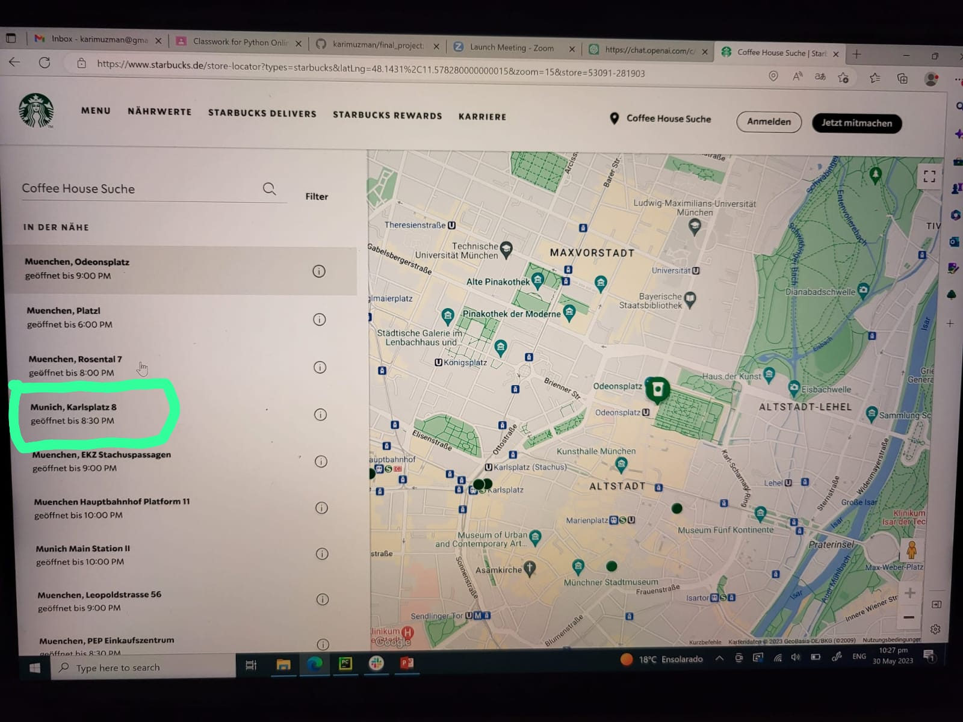
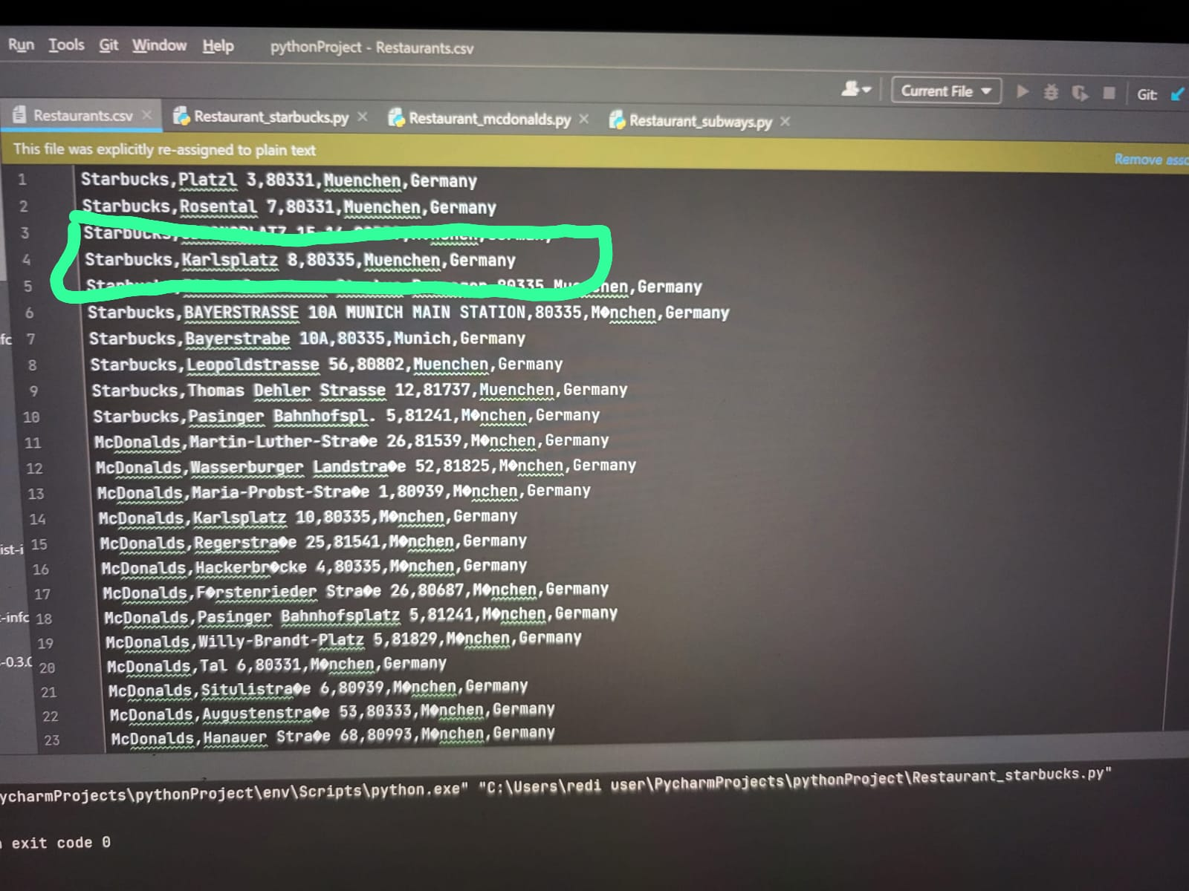
Project Visuals - Starbucks
Web Portal – Restaurants Locations in Munich
Python – CSV file database

Slide 8
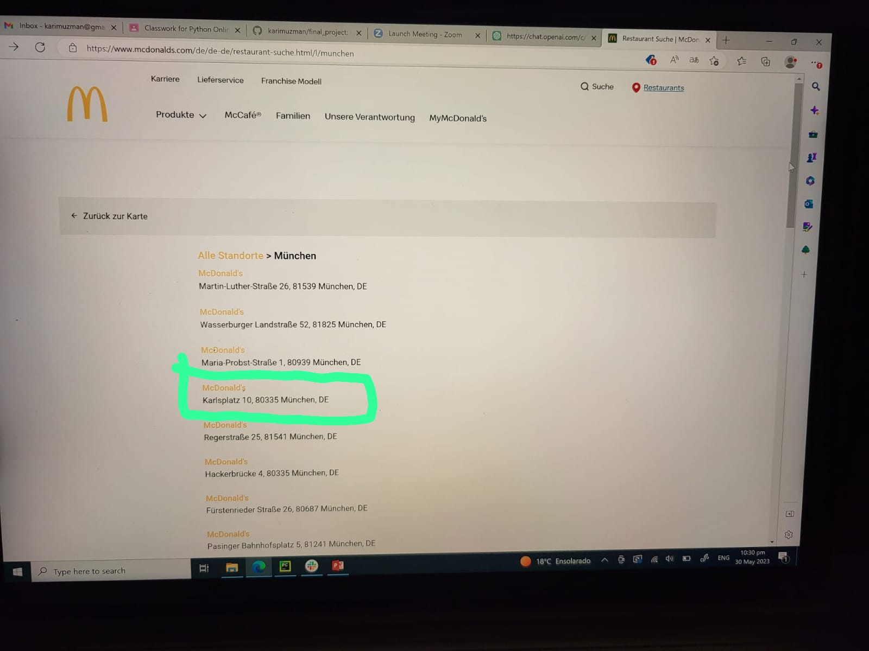
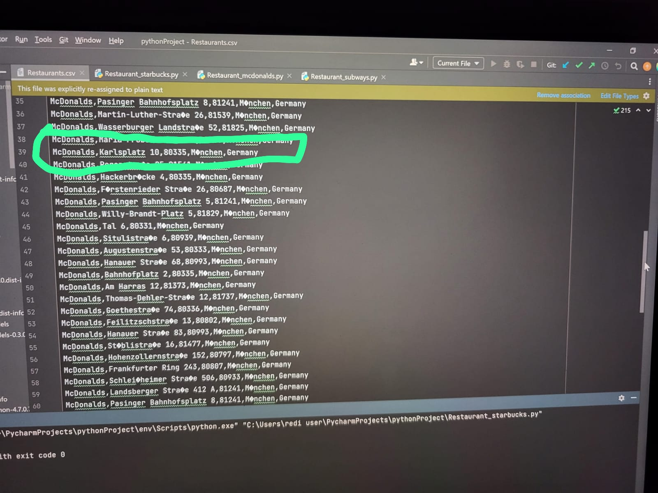
Project Visuals – McDonald’s
Web Portal – Restaurant Locations in Munich
Python – CSV file database

Slide 9
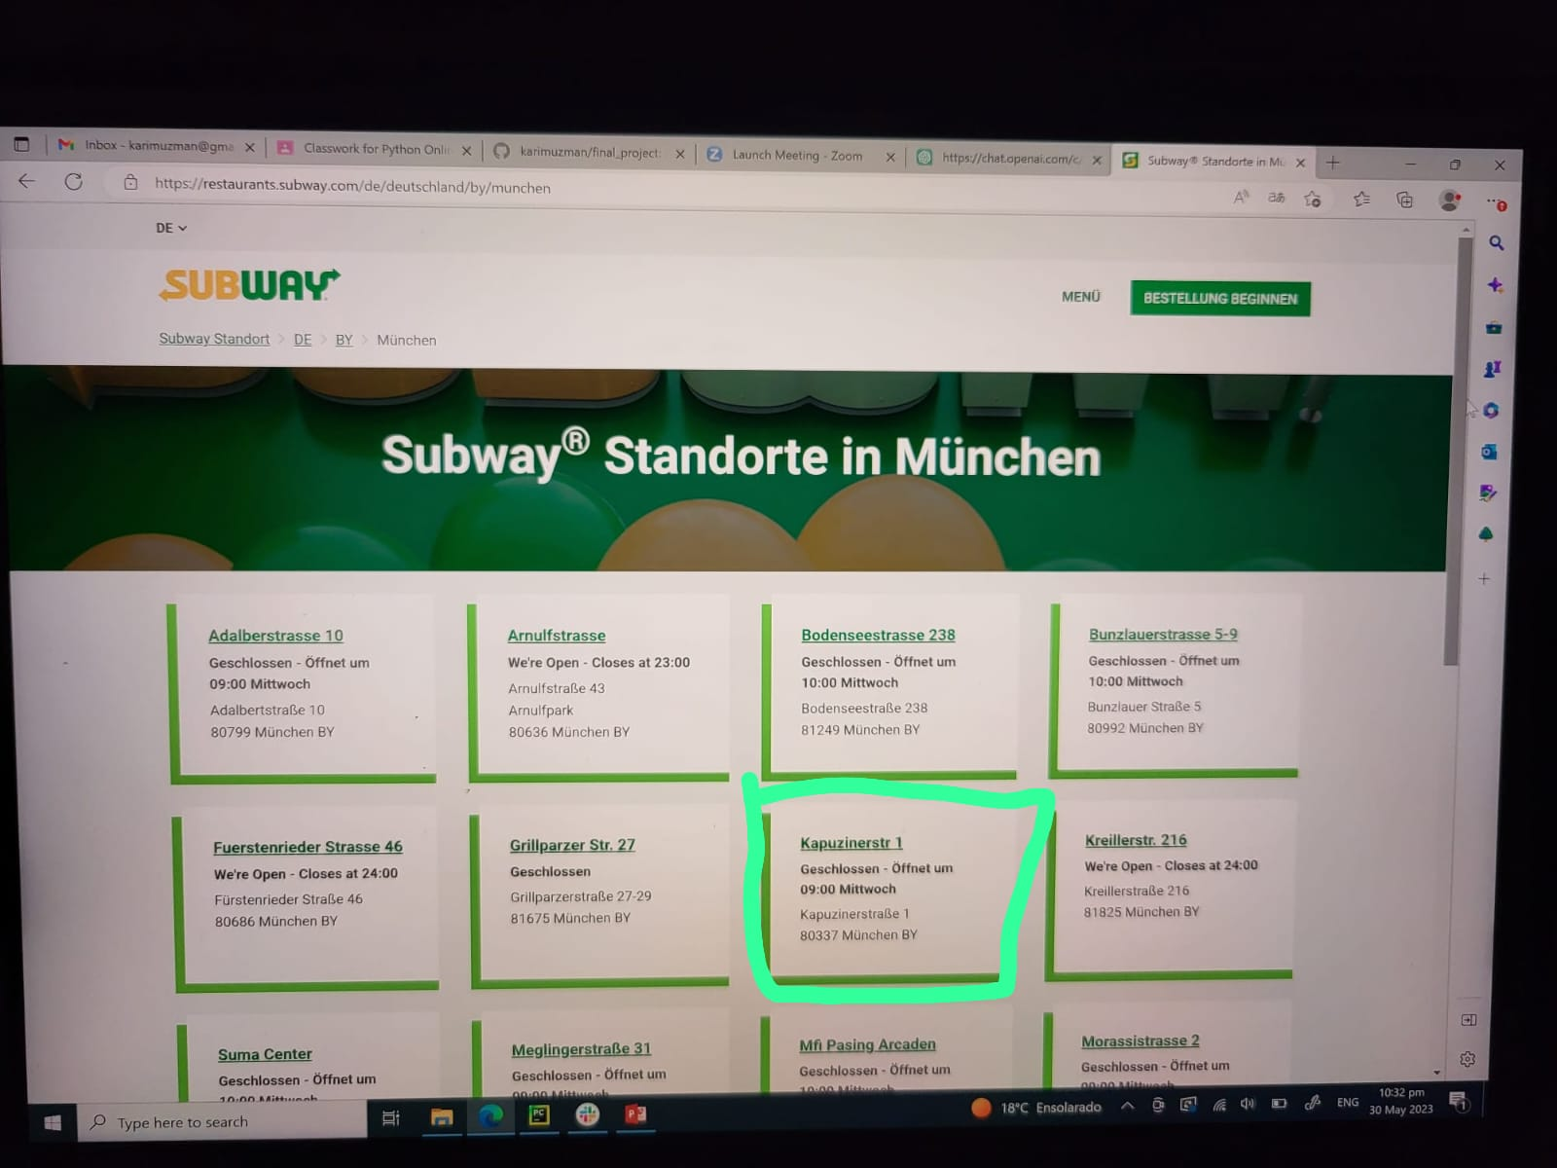
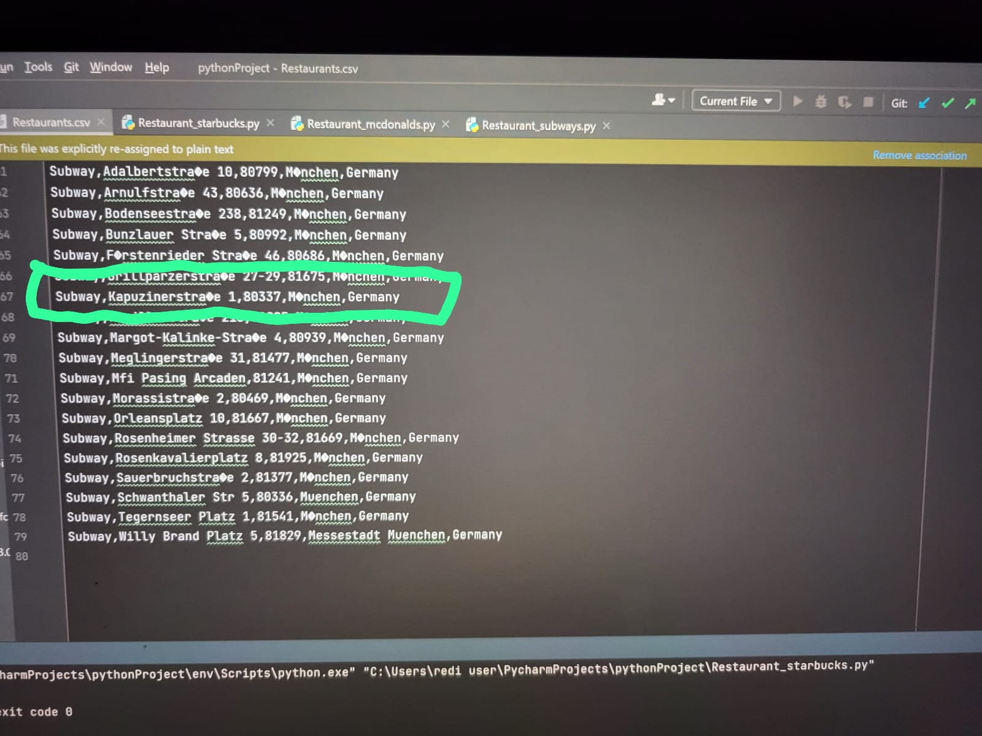
Project Visuals - Subways
Web Portal - Restaurant Locations in Munich
Python – CSV file database

Slide 10
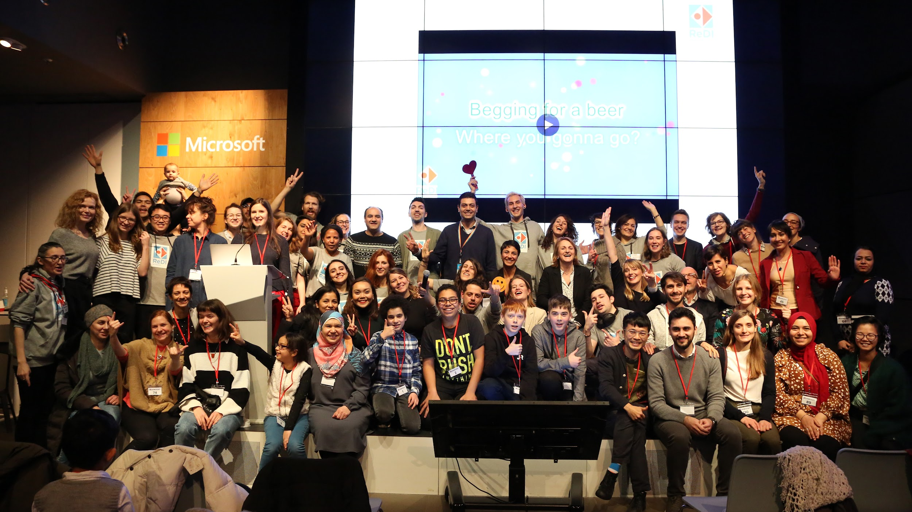
Data Analytics - Learning
Learning Outcomes:
Developing skills required to become a Data Analyst. The core are as follows:
Research and Analytical Skills
Programing Skills
Data Analyzing
Ability to reason about the Data
Synergies
Communication

Slide 11


Thank you for the Attention!
Contact
Uzman Karim Student – Python Intermediate online 2023 summer
karimuzman@gmail.com

