Slide 1

How to Comply with the Regulatory Process: EAR and AES
Adrienne Braumiller
adrienneb@globaltradelaw.net
214-348-9303
© Braumiller Schulz LLP.
Any Copying or Distribution is Prohibited
Notes:
October 17, 2003
Braumiller Schulz & Co., LLP

Slide 2




Authorities - Who Controls U.S. Exports?
State Department’s Directorate of Defense Trade Controls (DDTC) controls defense articles, defense services, and related technical data, including most space-related articles - ITAR.
Commerce Department’s Bureau of Industry and Security (BIS) controls “dual-use” items – EAR; and the
Bureau of Census controls trade-statistics and SEDs
Treasury Department’s Office of Foreign Assets Control (OFAC) oversees embargo and sanction lists - OFAC regulations.
Homeland Security Department’s U.S. Customs and Border Protection enforces all exports at U.S. borders.
© Braumiller Schulz LLP.
Any Copying or Distribution is Prohibited
Notes:
October 17, 2003
Braumiller Schulz & Co., LLP

Slide 3

Import/Export Licensing Authorities
Export: DDTC, BIS
Import: CBP
© Braumiller Schulz LLP.
Any Copying or Distribution is Prohibited

Slide 4
Overview:
Who Regulates What?
Customs & Border Protection
“Policemen” to enforce regulations
19CFR
“Dual Use” Items
Bureau of Industry & Security
Export Administration Regulations (EAR)
15CFR
Defense Items
Directorate of Defense
Trade Controls
International Traffic in Arms Regulations (ITAR)
22CFR
Other Agencies
Census Bureau
Foreign Trade Regulations
(FTR)
15 CFR
© Braumiller Schulz LLP.
Any Copying or Distribution is Prohibited
Notes:
October 17, 2003
Braumiller Schulz & Co., LLP

Slide 5
Overview: What are Exports?
Tangible Exports
    Shipments through a US port via air, ocean, truck, rail, mail, etc.
Intangible Exports
    Electronic transfers (including email, fax and Internet downloads)
    Technical reports, drawings, data or source code released to foreign nationals
    Also includes “deemed” exports
Re-Exports
    Shipments from one foreign country to another of US-origin goods or foreign made goods containing certain US-origin parts, components or materials.
© Braumiller Schulz LLP.
Any Copying or Distribution is Prohibited
Notes:
October 17, 2003
Braumiller Schulz & Co., LLP

Slide 6
Overview:
“Deemed” Exports
The release of technology or software in a foreign country or to a foreign national in the United States.
This release is “deemed” to be an export to the foreign national’s home country.
This could occur when…
  A foreign national employee of your company has access to certain technology or software source code.
  A foreign customer visits your facility.
  An employee of your company (perhaps a salesperson or service technician) visits a customer, distributor or subsidiary abroad.
© Braumiller Schulz LLP.
Any Copying or Distribution is Prohibited

Slide 7
Overview: “Deemed” Exports (Cont.)
FOREIGN NATIONALS
Not U.S. citizens
Not Permanent Residents (“Green Card” holders)
Not Refugees or Asylees (as defined under special provisions of U.S. law)
Canadian citizens
H1-B (work) visa holders
F-1 (student) visa holders
Even persons with US government security clearance could be a foreign national
© Braumiller Schulz LLP.
Any Copying or Distribution is Prohibited

Slide 8
Deemed Export Rule
Must apply for an export license to release technology if:
  Transferring controlled technologies to foreign nationals in the U.S., and
  Transfer to the foreign national’s home country would require an export license
© Braumiller Schulz LLP.
Any Copying or Distribution is Prohibited
Notes:
October 17, 2003
Braumiller Schulz & Co., LLP

Slide 9
Legal Framework
Key Steps
  Classify the item or information
  Screen names, locations, and end-use.
  Get a license or qualify for an exemption.
  Export: Comply with limitations on export authorization and file the information timely to ship the item or to transfer the info.
  Keep records and make reports when required.
  Report violations (Extra step – To be safe)
© Braumiller Schulz LLP.
Any Copying or Distribution is Prohibited
Notes:
October 17, 2003
Braumiller Schulz & Co., LLP

Slide 10
Export Licenses
Required for a small percentage of U.S. exports – approximately 5%
Issued by Department of Commerce
Factors to consider: end user, end use, destination, technical characteristics
Most exports are “NLR”
  (No License Required)
© Braumiller Schulz LLP.
Any Copying or Distribution is Prohibited
Notes:
October 17, 2003
Braumiller Schulz & Co., LLP

Slide 11
Export License Requirements
License requirements are dependent upon:
an item's technical characteristics,
the destination,
the end-user,
and the end-use.
You, as the exporter, must determine whether your export requires a license.
© Braumiller Schulz LLP.
Any Copying or Distribution is Prohibited

Slide 12

License Requirements
When making that determination consider the following questions:
  What are you exporting?
  Where are you exporting?
  Who will receive your item?
  What will your item be used for?
© Braumiller Schulz LLP.
Any Copying or Distribution is Prohibited

Slide 13

Export Licenses
How do I know if I need a license?
  Check the Commerce Control List (CCL) for your product
    EAR Part 774, Supplement 1
  Is there an Export Control Classification Number for that product?
© Braumiller Schulz LLP.
Any Copying or Distribution is Prohibited
Notes:
October 17, 2003
Braumiller Schulz & Co., LLP

Slide 14
Export Licenses
10 Categories in the EAR:
  0) Nuclear materials, facilities, equipment…
  1) Materials, chemicals, microorganisms, toxins
  2) Materials processing
  3) Electronics
  4) Computers
  5) Telecom and information security
  6) Sensors and lasers
  7) Navigation and Avionics
  8) Marine
  9) Propulsions systems, space vehicles, and related equipment
© Braumiller Schulz LLP.
Any Copying or Distribution is Prohibited
Notes:
October 17, 2003
Braumiller Schulz & Co., LLP

Slide 15
Export Licenses
Five groups within each EAR category:
  A. Systems, equipment, components
  B. Test, inspection, and production equipment
  C. Material
  D. Software
  E. Technology
© Braumiller Schulz LLP.
Any Copying or Distribution is Prohibited
Notes:
October 17, 2003
Braumiller Schulz & Co., LLP

Slide 16
License?
NONE
ALWAYS
Commercial------Dual Use--------------------------------Military--
© Braumiller Schulz LLP.
Any Copying or Distribution is Prohibited

Slide 17
Department of Commerce
EAR-99
Subject but not listed
Controlled Item
ECCN
NLR
Exception
License
5%
© Braumiller Schulz LLP.
Any Copying or Distribution is Prohibited

Slide 18
Department of State
Military Products
Exemption
5%
© Braumiller Schulz LLP.
Any Copying or Distribution is Prohibited

Slide 19

Scope of the EAR
Goods in the U.S.
Goods outside the U.S.
Foreign Nationals
U.S. Citizens
© Braumiller Schulz LLP.
Any Copying or Distribution is Prohibited
Notes:
October 17, 2003
Braumiller Schulz & Co., LLP

Slide 20

BIS Classification
Check the Commerce Control Numbers (ECCNs) in the EAR
  Classify the goods,
  Check with your manufacturer, or
  Submit a classification request to the BIS
© Braumiller Schulz LLP.
Any Copying or Distribution is Prohibited
Notes:
October 17, 2003
Braumiller Schulz & Co., LLP

Slide 21

BIS Classification
What if my product isn’t listed?
  Choose EAR 99!
    Usually low technology goods
    Usually no license required
© Braumiller Schulz LLP.
Any Copying or Distribution is Prohibited
Notes:
October 17, 2003
Braumiller Schulz & Co., LLP

Slide 22
Reasons for Control
Look at ECCN Classification Entry in EAR
  Is there a code listed?
  Cross-reference with chart in EAR Part 738
    Look for an “X”
    Examples: chemical and biological weapons, national security, regional stability, missile technology…
© Braumiller Schulz LLP.
Any Copying or Distribution is Prohibited
Notes:
October 17, 2003
Braumiller Schulz & Co., LLP

Slide 23
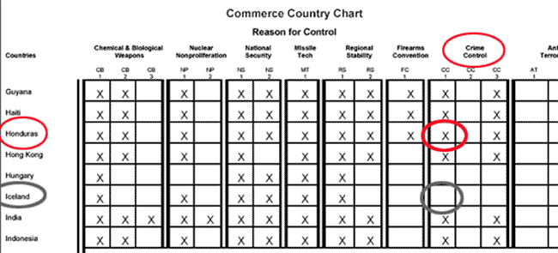
Export Licenses
If there is an “X” in the box based on the reason(s) for control of your item and the country of destination, then a license is required,
unless a License Exception is available.
© Braumiller Schulz LLP.
Any Copying or Distribution is Prohibited
Notes:
October 17, 2003
Braumiller Schulz & Co., LLP

Slide 24
Export Licenses
EXAMPLE
Assume that you have polygraph equipment that is used to help law enforcement agencies. What would be your ECCN?
Start by looking in the Commerce Control List under the category of electronics (Category 3) and product group which covers equipment (Product Group A). Then read through the list to find whether your item is included in the list. In this example the item is 3A981 as shown on the next slide.
© Braumiller Schulz LLP.
Any Copying or Distribution is Prohibited
Notes:
October 17, 2003
Braumiller Schulz & Co., LLP

Slide 25
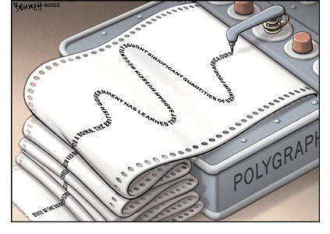
Export Licenses
3A981 Polygraphs (except biomedical recorders designed for use in medical facilities for monitoring biological and neurophysical responses); fingerprint analyzers, cameras and equipment, n.e.s.; automated fingerprint and identification retrieval systems, n.e.s.; psychological stress analysis equipment; electronic monitoring restraint devices; and specially designed parts and accessories, n.e.s.
License Requirements
Reason for Control: CC
Control(s)
CC applies to entire entry
Country Chart
CC Column 1
© Braumiller Schulz LLP.
Any Copying or Distribution is Prohibited
Notes:
October 17, 2003
Braumiller Schulz & Co., LLP

Slide 26

BIS Denied Persons List
Person’s export privileges have been denied.
BIS prohibits export to them
Report to BIS Office of Export Enforcement
© Braumiller Schulz LLP.
Any Copying or Distribution is Prohibited
Notes:
October 17, 2003
Braumiller Schulz & Co., LLP

Slide 27
Applying for an Export License
Apply to the BIS
  Form BIS-748P
  Online: Simplified Network Application Process (SNAP)
  License usually valid two years
  List license number and expiration date on your SED or AES submission
© Braumiller Schulz LLP.
Any Copying or Distribution is Prohibited
Notes:
October 17, 2003
Braumiller Schulz & Co., LLP

Slide 28

AES Filing
Phase 1: Mandated that AES filing is required for all licensable exports – Commerce Control List (CCL) and the U.S. Munitions List (USML)
Phase 2: Effective April 1, 2005 mandated that all 3rd party providers get on board. Data Entry Centers (DEC) were eliminated. AES no longer accepts the DEC indicator on the AES filing as a ‘Y’.
Phase 3: As of July 2, 2008, all exporters must go paperless and use AES.
© Braumiller Schulz LLP.
Any Copying or Distribution is Prohibited
Notes:
October 17, 2003
Braumiller Schulz & Co., LLP

Slide 29
AES Filing
The mandatory paperless AES filing was published in the Federal Register on June 2nd, 2008
The effective date was 30 days later or July 2nd, 2008
Filers will be required to implement the changes within 90 days after the published effective date or by October 1, 2008
The SED is eliminated and the new name is Electronic Export Information (EEI)
If the filers system is down, they will need to hold cargo and find alternative electronic means for filing.
© Braumiller Schulz LLP.
Any Copying or Distribution is Prohibited

Slide 30
AES Filing
Foreign Relations Authorization Act authorized both civil and criminal penalties.
Criminal penalties
  Any person, including U.S. Principal Parties in Interest (USPPIs), authorized agents or carriers, who knowingly fails to file or knowingly submits, directly or indirectly, to the U.S. Government, false or misleading export information through the AES, shall be subject to a fine not to exceed $10,000 or imprisonment for not more than five (5) years, or both, for each violation.
  Any person, including USPPIs, authorized agents or carriers, who knowingly reports, directly or indirectly, to the U.S. Government any information through or otherwise uses the AES to further any illegal activity shall be subject to a fine not to exceed $10,000 or imprisonment for not more than five (5) years or both for each violation.
© Braumiller Schulz LLP.
Any Copying or Distribution is Prohibited
Notes:
October 17, 2003
Braumiller Schulz & Co., LLP

Slide 31

AES Filing
Civil penalties
  Failure to file or delayed filing
    Increases penalties to $1,100 per violation per delinquent day, but not more than $10,000 (up from $1,000).
  Filing false/misleading information
  Furtherance of illegal activities
    Up to $10,000 per violation.
Such penalty may be in addition to any other penalty imposed by law.
Additionally, any property involved in the violation may be subject to forfeiture.
© Braumiller Schulz LLP.
Any Copying or Distribution is Prohibited
Notes:
October 17, 2003
Braumiller Schulz & Co., LLP

Slide 32
AES Filing
Civil penalty procedures.
  The charged party is entitled to receive a formal complaint specifying the charges and, at his or her request, to contest the charges in a hearing before an administrative law judge.
  If any person fails to pay a civil penalty imposed, the Secretary may request the Attorney General to commence a civil action in an appropriate district court of the United States to recover the amount imposed (plus interest at currently prevailing rates from the date of the final order).
© Braumiller Schulz LLP.
Any Copying or Distribution is Prohibited
Notes:
October 17, 2003
Braumiller Schulz & Co., LLP

Slide 33

AES Filing
Civil penalty procedures-
  Must be brought within 5 years from date of imposition.
  Any penalties imposed may be remitted or mitigated, if the penalties were incurred without willful negligence or fraud
Enforcement-
  The BIS's Office of Export Enforcement (OEE) may conduct investigations as well as ICE and CBP.
© Braumiller Schulz LLP.
Any Copying or Distribution is Prohibited
Notes:
October 17, 2003
Braumiller Schulz & Co., LLP

Slide 34
IEEPA Enhancement Act
Under the IEEPA Enhancement Act:
Civil fines under IEEPA increase from $50,000 to $250,000 or twice the amount of the transaction at issue, whichever is greater; and
Criminal penalties increase from $50,000 to up to $1,000,000 per violation, with the potential length of imprisonment (up to 20 years per violation) remaining unchanged.
The new civil penalties apply to violations where an enforcement action is pending or commenced on or after the date of enactment; while the new criminal penalties apply only to enforcement actions commenced after the date of enactment.
© Braumiller Schulz LLP.
Any Copying or Distribution is Prohibited

Slide 35
Export Best Practices
Design Export Compliance Program (Export Management System)
Create Corresponding and Updated Manual/Policies and Product Matrix
Assign a Compliance Coordinator Partner with a knowledgeable Freight Forwarder
Internal reviews with attorney-client privilege Create Corresponding and Updated Manual/Policies and Product Matrix
Periodic Training
© Braumiller Schulz LLP.
Any Copying or Distribution is Prohibited
Notes:
October 17, 2003
Braumiller Schulz & Co., LLP

Slide 36

Export Best Practices
Check the requirements of the destination country
Keep up-to-date on U.S. restrictions, sanctions, licensing, denied parties, country lists
  Review the EAR
  Watch for Federal Register notices
  Refer to BIS and OFAC online resources
Screen all parties to exports
  Employees
  Vendors
  Manufacturers
  Buyers
© Braumiller Schulz LLP.
Any Copying or Distribution is Prohibited
Notes:
October 17, 2003
Braumiller Schulz & Co., LLP

Slide 37
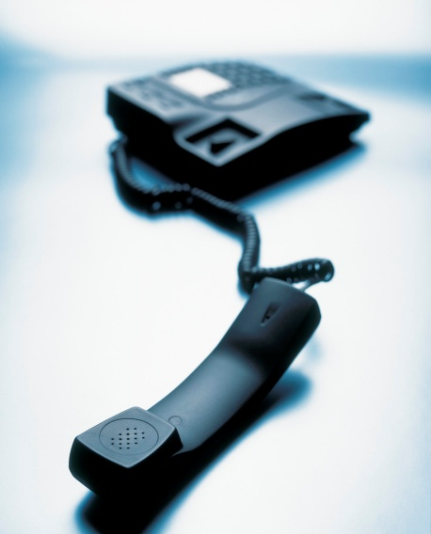
Contact Information
Adrienne Braumiller, Attorney
5220 Spring Valley Road, Suite 200
Dallas, TX 75254
214.348.9306
adrienneb@globaltradelaw.net
© Braumiller Schulz LLP.
Any Copying or Distribution is Prohibited

Slide 38

© Braumiller Schulz LLP.
Any Copying or Distribution is Prohibited

