Slide 1
Texas Broker and Freight Forwarder Conference
U.S. Customs and Border Protection
Customs-Trade Partnership Against Terrorism
(C-TPAT)
Notes:
Good afternoon everyone…I’ll be speaking to you today on what we do in US Customs and Border Protection to secure US borders and the American people by specifically looking at a major anti-terrorism partnership program that we have with the trade –the Customs-Trade Partnership Against Terrorism or C-TPAT.
My talk today will deal with what we are doing in the United States to secure the integrity of the supply chain through CTPAT, and by briefly looking at the World Customs Organization’s Framework of Standards to Facilitate Global Trade.

Slide 2

Layered Enforcement Strategy
Advance electronic information analysis and targeting of high risk shipments.
  The 24-Hour Rule and the National Targeting Center (NTC)
Using advanced inspection technologies.
  Non-intrusive Inspection Technologies (NII)
Pre-screening high-risk shipments prior to arrival in the U.S.
  Container Security Initiative (CSI)
  Secure Freight Initiative / 100% Scanning
Partnering with the trade community to increase supply chain security.
  Customs-Trade Partnership Against Terrorism (C-TPAT)
Notes:
One of Our greatest challenges has been ---
- how to increase & improve border security while continuing to facilitate legitimate trade.
Many felt that taking the necessary steps to secure our borders would only add another barrier to free trade and to the efficient movement of cargo.
However, many of the current initiatives and programs in CBP demonstrate that increased security can lead to a more efficient and cost effective flow of trade.
Since September 11, CBP has developed a host of programs and initiatives designed to extend our zone of security outward beyond our physical borders so that America’s borders are not the first line of defense. Our strategy in implementing these initiatives involves a number of factors, including:
A) Constantly improving and expanding our targeting systems to better screen more people and goods entering and departing the U.S.; By knowing as much information as possible before the goods are loaded on the vessel with the 24 hour rule and by targeting at the NTC.
B) Pushing our “zone of security outward” by partnering with other countries though the CSI and SFI programs and by working with other Customs Organization in the WCO.
(C) Deploying advanced inspection technology and equipment at our ports of entry to detect weapons of mass destruction. So we use Non Intrusive inspection technology to inspect without completely unloading containers. We do 100% screening, 100% scanning (RPM) and we do examinations –NII or physical on high risk cargo.
D) Pushing our “zone of security outward” by partnering with the private sector; to understand their security processes and procedures to ensure the security of the global supply chains.
Example: going to the doctor….to make sure you are ok. An x-ray is taken. Is that it? No. They also do a urine analysis; they draw blood from you to make sure you have the right count of white cells and red cells; they listen to your heart’s rhythm, etc. And after that, they tell you to continue to eat healthy and to exercise. Then they say go home and continue to live a normal life.

Slide 3
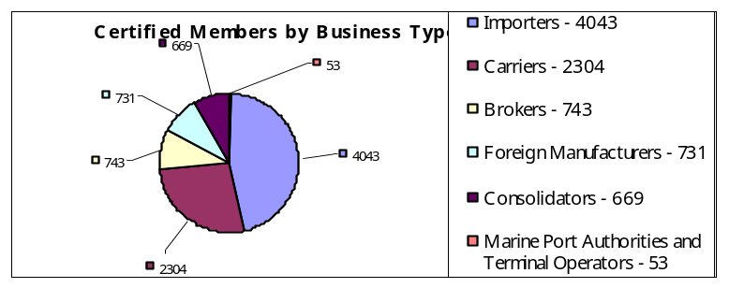
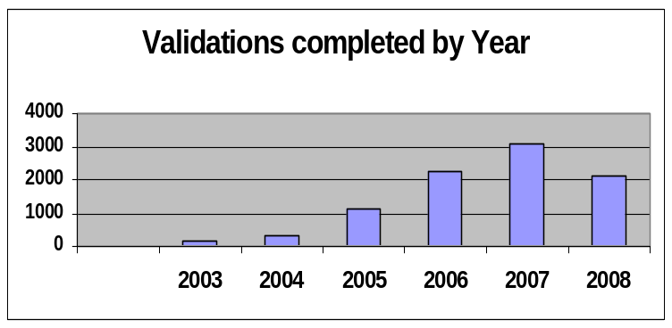
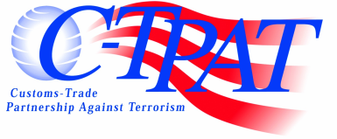
C-TPAT Achievements
August 19, 2008
8,543 Certified Partners to current date:
  Certified Partners at the end of 2007 - 7,948
  New Certified Partners in 2008 - 595
7 Field Offices; Current staffing level is 195
8,978 Total Validations Completed
  Initial Validations Completed - 7,456
  Re-Validations Completed - 1,522
Number of completed validations by year: 2003-137, 2004-294, 2005-1,109
  - 2006 - Initial Validation – 2,253 Revalidations - 16 - Total Validations in 2006 – 2,269
  - 2007 - Initial Validation – 2,515 Revalidations - 576 - Total Validations in 2007 – 3,091
  - 2008 - Initial Validation – 1,147 Revalidations - 931 - Total Validations in 2008 – 2,078
391 Total suspensions (207 Highway Carriers)
238 Total removals (96 Highway Carriers)
Security Criteria Implemented:
  Importers, Sea Carriers, Highway Carriers. Rail Carriers, Foreign Manufacturers,
  Customs Brokers, Mexico Long Haul Highway Carrier , Port Authorities/Terminal Operators,
  Air Carriers
  Under Development: Consolidators
Tiered Benefits Structure – commensurate with security enhancements. Best Practices Catalog.
  Tier 3 Importers: 267

Slide 4
C-TPAT Certification Process
Member Electronically Submits Agreement
Supply Chain gaps identified / security enhancements initiated
Member
Member Submits
Security Profile
(at time of Application)
CBP Profile Review Approval / Denial
Submits
Submits
Security
Review /
Agreement
Profile
Response
CBP
Vetting Process Enforcement /
Compliance
Member resolves Security weaknesses / gaps identified by CBP review
Validation Process
Validation Report
Periodic Self Assessment
Track Progress
Validation
Validation
Periodic
Track
Process
Report
Self-
Assessment
Action plan developed to address
Validation recommendations

Slide 5
C-TPAT Security Criteria (Importers)
Business Partner Requirements
  Documentation that they are a C-TPAT member.
  Non-C-TPAT member, written or electronic confirmation meeting C-TPAT security criteria.
Container Security
  Written sealing procedures (PAS ISO 17712 seal).
  Seven-point inspection of container prior to loading / upon receipt.
  Container Storage - secure locations, preventing unauthorized entry into container or storage area.
Physical Access Controls
  Visitor procedures (including deliveries and mail) – Logbooks, visitor badges, escorted access.
  Employment Procedures – Identification system.
Notes:
Under C-TPAT, companies agree to conduct a comprehensive security self-assessment, which includes reviewing their security practices in the areas you see here. Since over 50% of the CTPAT members are importers, I am giving you the required CTPAT security criteria for importers, but it is almost the same for the other sectors.
The security self-assessment allows companies to assess the level of security they currently have throughout their operations and throughout their supply chains.
It also gives CBP a blue print of what is already in place and where there are potential areas for improvement so then we’ll work along side with the companies to try to ensure that steps are being taken to improve upon the current security practices they have.
Companies are also required to submit a completed supply chain security profile to US Customs and Border Protection, develop and implement programs to enhance security throughout their supply chain, and communicate and promote C-TPAT’s security criteria to other companies in their supply chain.

Slide 6
C-TPAT Security Criteria (Importers)
Personnel Security
  Procedures must be in place to screen prospective employees and to periodically check current personnel (Background, employment history).
  Personnel termination procedures must be in place to remove access.
Procedural Security
  Document processing – accurate, complete & safeguarded.
  Manifesting procedures – accurate and timely.
Security Training and Awareness
  A threat and security awareness program should be established for all employees.
  Employees must be made aware of the procedures the company has in place to address a situation and how to report it.
Notes:
C-TPAT requires the trade community participant to:
Document and validate their supply chain security procedures in relation to existing CBP C-TPAT criteria. The company participants develop an internal validation process to ensure the existence of security measures documented in their Supply Chain Security Profile and in any supplemental information provided to CBP.
As a part of the C-TPAT process, C-TPAT Supply Chain Security Specialists (SCSS) and the C-TPAT participant jointly conduct a validation of the company’s supply chain security procedures. The validation process is essential to verifying the company’s commitment to C-TPAT. We trust, but we need to verify….that those security practices the company claims to have, are indeed being implemented.
Supply chain security specialists travel around the world to validate (verify) what the companies claim on paper. As part of the business partner requirement criteria, for example, an importer in the US who sources from a manufacturer in Chile must make sure that that manufacturer in Chile has C-TPAT like security guidelines in place. So the SCSS goes to Chile to visit the manufacturing plant and verifies that they actually have a fence; that their container yard is secured and has plenty of lightening; that employees have proper IDs; that the gate at the entrance is properly staffed, etc.
The focus of the visit is to determine how C-TPAT partners have worked with their business partners (manufacturers, logistics providers, etc.) on enhancing supply chain security. This is how CTPAT commands a global reach.

Slide 7
C-TPAT Security Criteria (Importers)
Physical Security
  Cargo handling and storage facilities must have physical barriers that guard against unauthorized access.
Information Technology Security
  Anti-virus software/ Firewalls.
  IT security policies, procedures and standards must be in place and provided to employees in the form of training.

Slide 8
Benefits
Reduced Inspections
Front of the line privileges
Stratified Compliance Measurement Exam Benefit
Access to Free and Secure Trade (FAST)
Access to Status Verification Interface (SVI)
Access to Supply Chain Specialist and eligibility to attend CBP training seminars

Slide 9
C-TPAT & Mutual Recognition
The goal of mutual recognition is to link the various international industry partnership programs, so that together they create a unified and sustainable security posture that can assist in securing and facilitating global cargo trade.
The principle behind aligning partnership programs is to create a system whereby all participants in an international trade transaction are approved by Customs as observing specified standards in the secure handling of goods and relevant information.
Internationalization Efforts:
  Mutual Recognition Arrangement: New Zealand, Canada, Jordan
  Mutual Recognition Projects: Australia, European Union, Japan, Singapore
  Technical Assistance Projects: Malaysia, Mexico, Philippines, Guatemala
  Capacity Building Training: (Senior Management Overview of Industry Partnerships):
  Ghana, Brazil, Kenya

Slide 10

Mutual Recognition Security Model
U.S. Customs and Border Protection (CBP) - Customs-Trade Partnership Against Terrorism (C-TPAT)
Authorized Economic Operator (AEO)
LOW
EXPLANATIONS
C-TPAT
& AEO
Business security practices are known to both CBP and foreign program.
Business security practices are known to CBP, but unknown to foreign program.
Business security practices are unknown to CBP, but known to foreign program.
Business security practices are unknown to both CBP and foreign program.
C-TPAT
but No AEO
No C-TPAT but AEO
No C-TPAT & No AEO
HIGH
RISK
Notes:
The following assumptions were used to develop the Transportation Security Model:
Security must be built into the core transportation processes & permeate the entire transportation system
The transportation system is an interconnected network of core business processes present in every mode of transportation
Information sharing is an essential component the security design and is the “mortar” that keeps the pieces in place
Security policies must address both cost & benefit
System security is only as strong as the weakest link, which a threat will use

Slide 11

Bradd Skinner
Director, C-TPAT
Notes:
Good Morning - I am pleased to have this opportunity to be here today and I thank the Association for inviting U.S. Customs and Border Protection to participate and share with you some of what we have been up to post 9/11…
My presentation today:
CBP’s layered enforcement strategy
C-TPAT
FAST
Next steps and future vision
Happy to answer any questions.
Before I get into the details of our current initiatives - I want to give you a sketch of where we are as an agency today.

