Slide 1
Analyzing Ultimate
Karine Hsu, Ryan Kerr, Jackie Martinez, Emily Houlihan

Slide 2
The Game:
The Basics
The Positions
Handler Cutter
The Points
O points, D points
The Players
Stars, twitter, stats

Slide 3
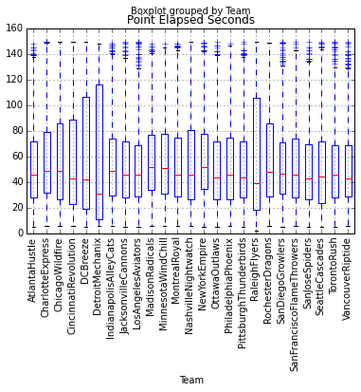
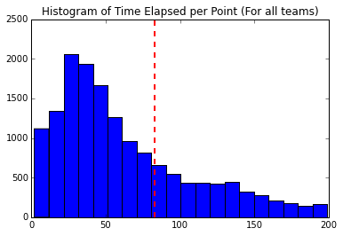
Exploratory Analysis

Slide 4
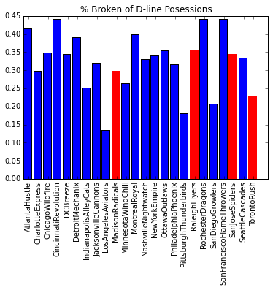
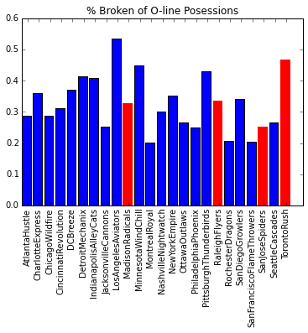

Slide 5
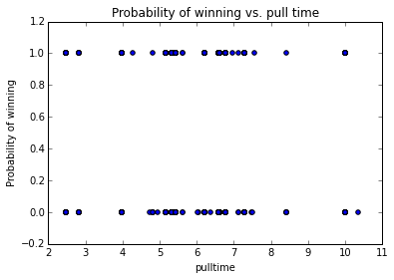
The Pull

Slide 6
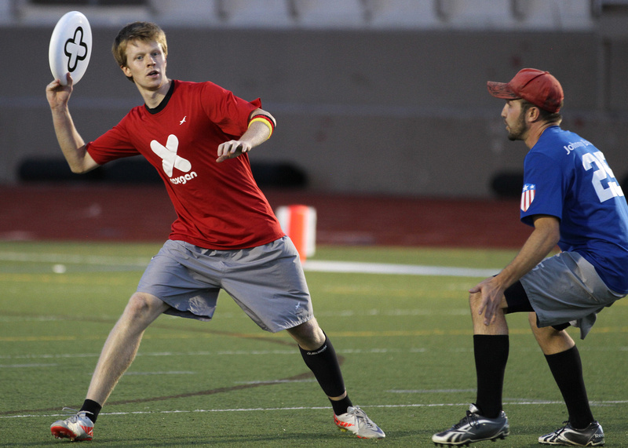
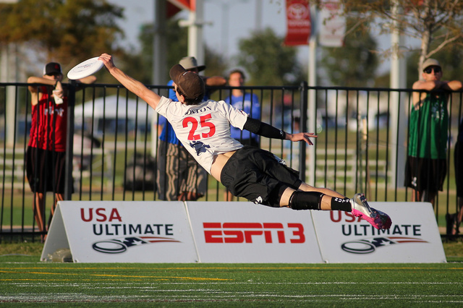
The Players
Handlers
Cutters

Slide 7
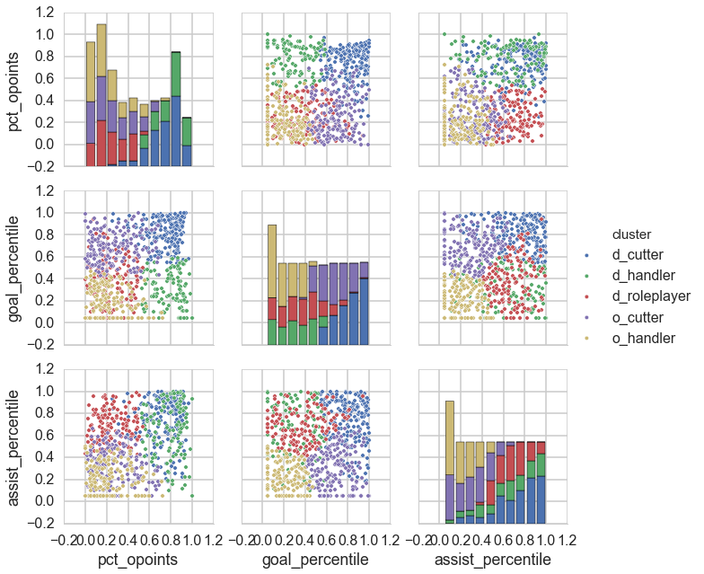
The Players

Slide 8

The Points

Slide 9
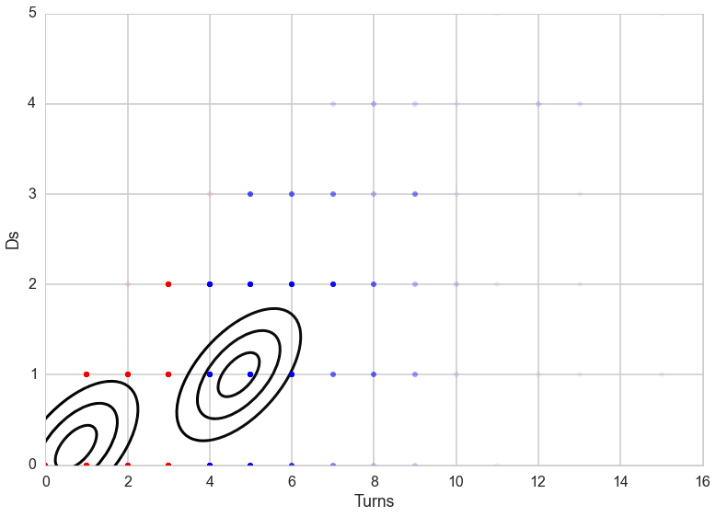
Analysis

Slide 10
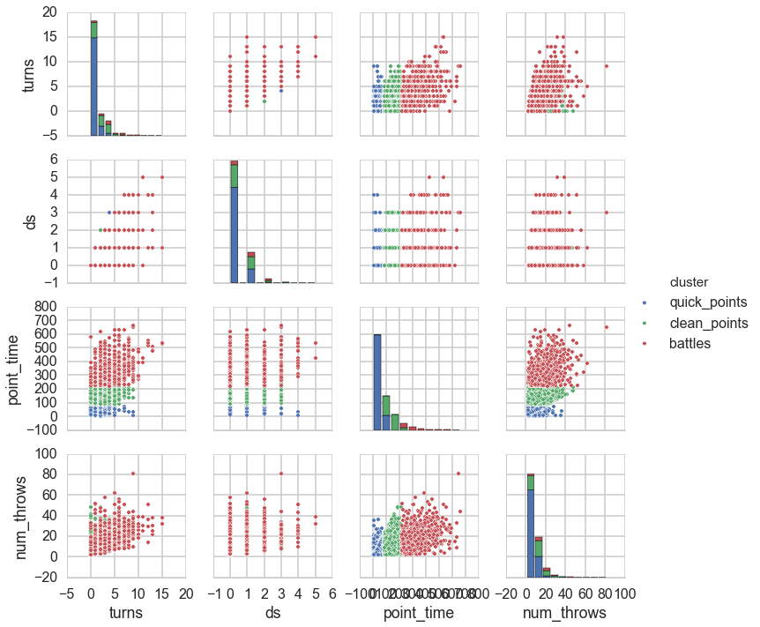
Analysis

Slide 11

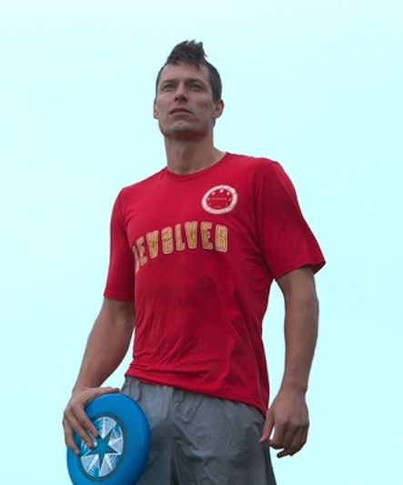
The Stars

