Slide 1


THESIS ADVISORY COMMITEE MEETING· 27 AUGUST 2026
Testbed for Validating Second-Generation TDI and Clock-Noise Correction for LISA
Karin Kruuse
Max Planck Institute for Gravitational Physics (AEI) · Leibniz Universität Hannover
TAC MEETING
27 August 2026 · 01 / 20

Slide 2
Outline of the Talk
W
TAC MEETING
27 August 2026 · 02 / 20
Notes:
Do I have a defined topic
And do I understand that topic, and the physics
The TAC decides if that’s a good topic for a thesis
is it worth a degree
is it realistic
For ambitious goals, what could be a minimum reasonable level
TAC2 –status and results, are there changes, what about publications
TAC3 – so what is the realistic goal now

Slide 3
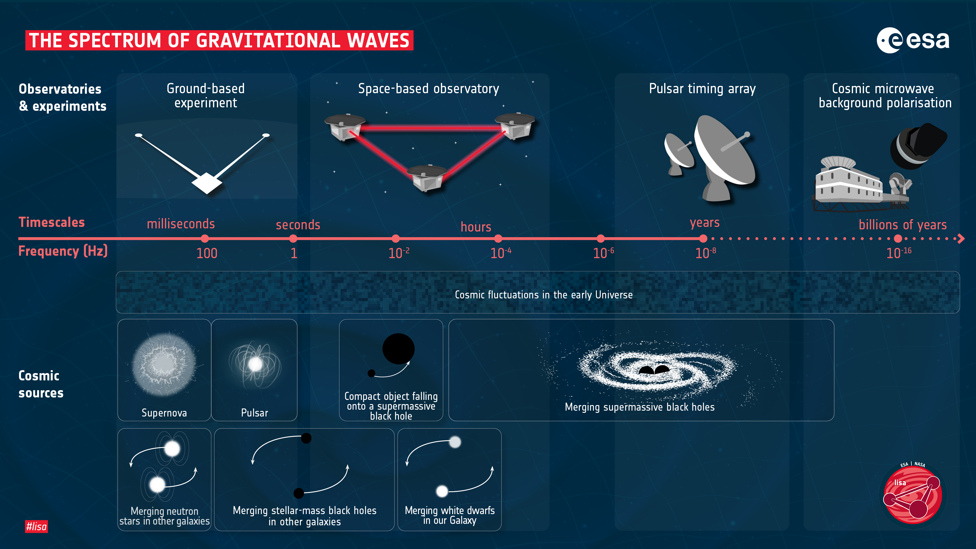
Gravitational waves and LISA
Why do we need LISA
TAC MEETING
27 August 2026 · 03 / 20
Notes:
Which part of the spectrum are we looking at and why?

Slide 4
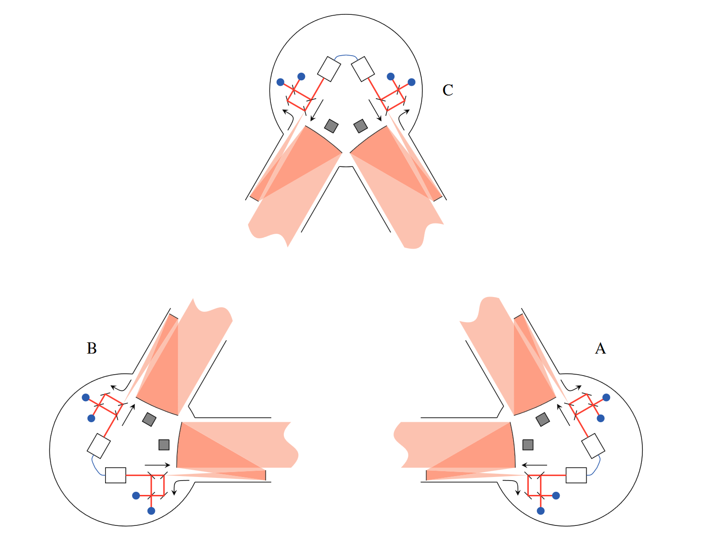
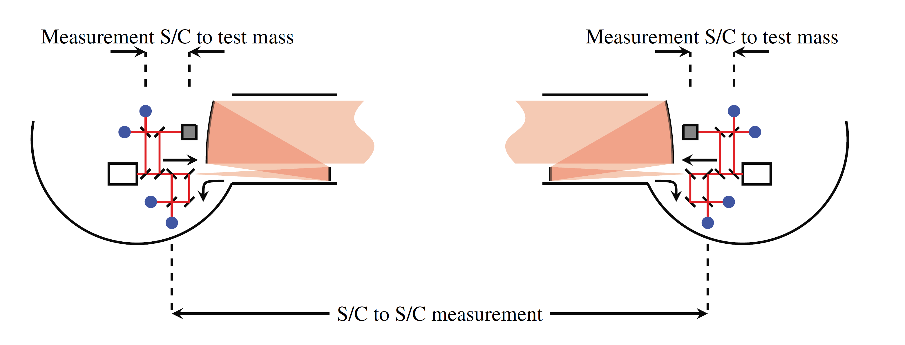
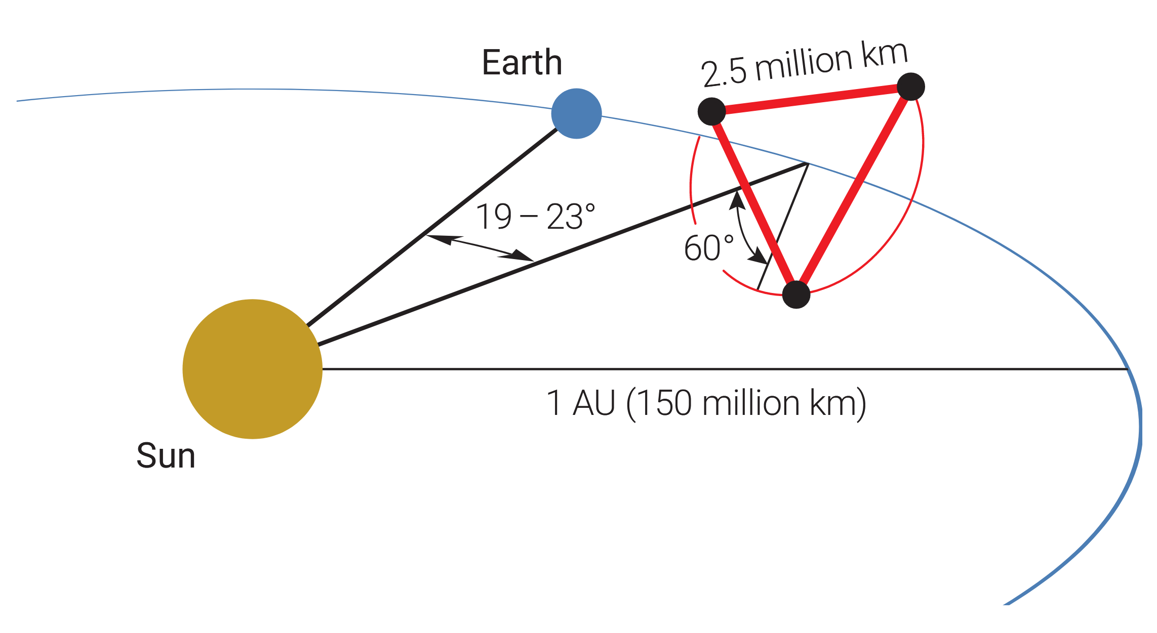
LISA Constellation
Why do we need LISA
Amaro-Seoane et al., 2017
TAC MEETING
27 August 2026 · 04 / 20
Notes:
So what do we do with three satellites?

Slide 5
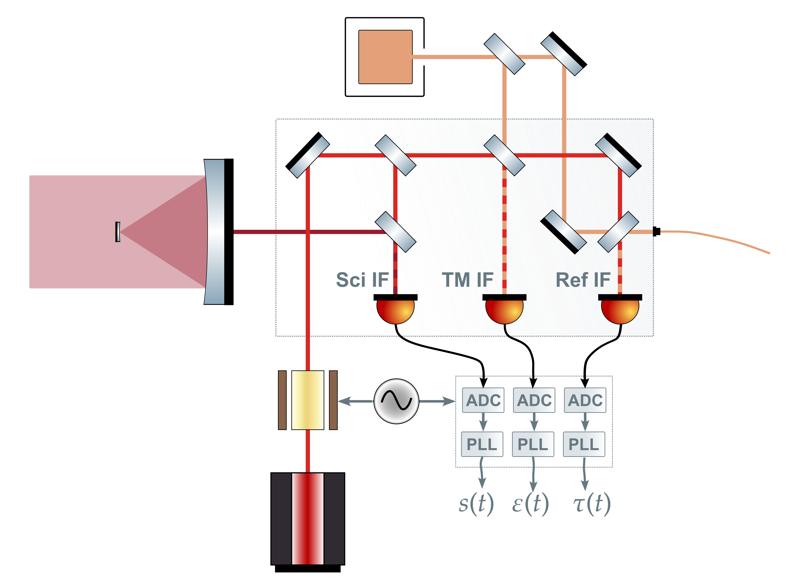
LISA Interferometers overview
Testmasses I guess
TAC MEETING
27 August 2026 · 05 / 20
Notes:
I'm going to jump right into the technical stuff. So we're looking at the LISA inter-satellite interferometer. The raw phase meter data is dominated by two noise sources: laser frequency noise... and clock noise.
I've written down how these enter the phase readout — the laser noise comes from both lasers forming the link, and the clock noise of the local spacecraft couples in via the beat note frequency. These are the two couplings we need to replicate and then remove.
Now — why do this in hardware? [pause] Because simulations only simulate what you think to simulate. LISA has extremely detailed noise models — but a hardware testbed lets you check that those models actually match reality. That the noise couples in the way you think it does, with the structure you assumed, at the level you predicted. [pause] There is no substitute for seeing it in real data.

Slide 6
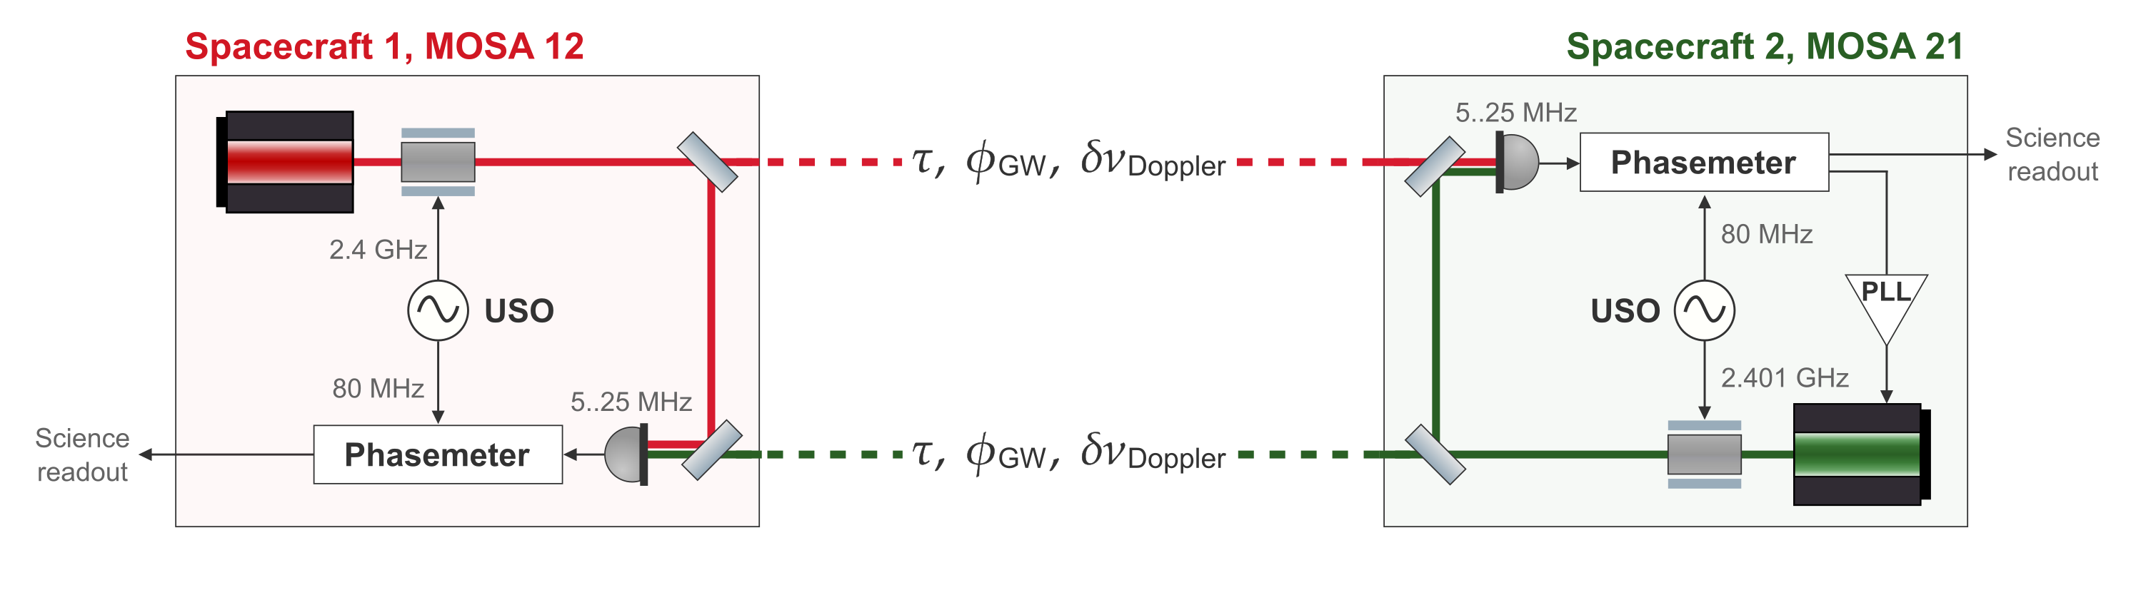

LISA Science Interferometer
This is in phase units. Signal has been demodulated
TAC MEETING
27 August 2026 · 06 / 20

Slide 7
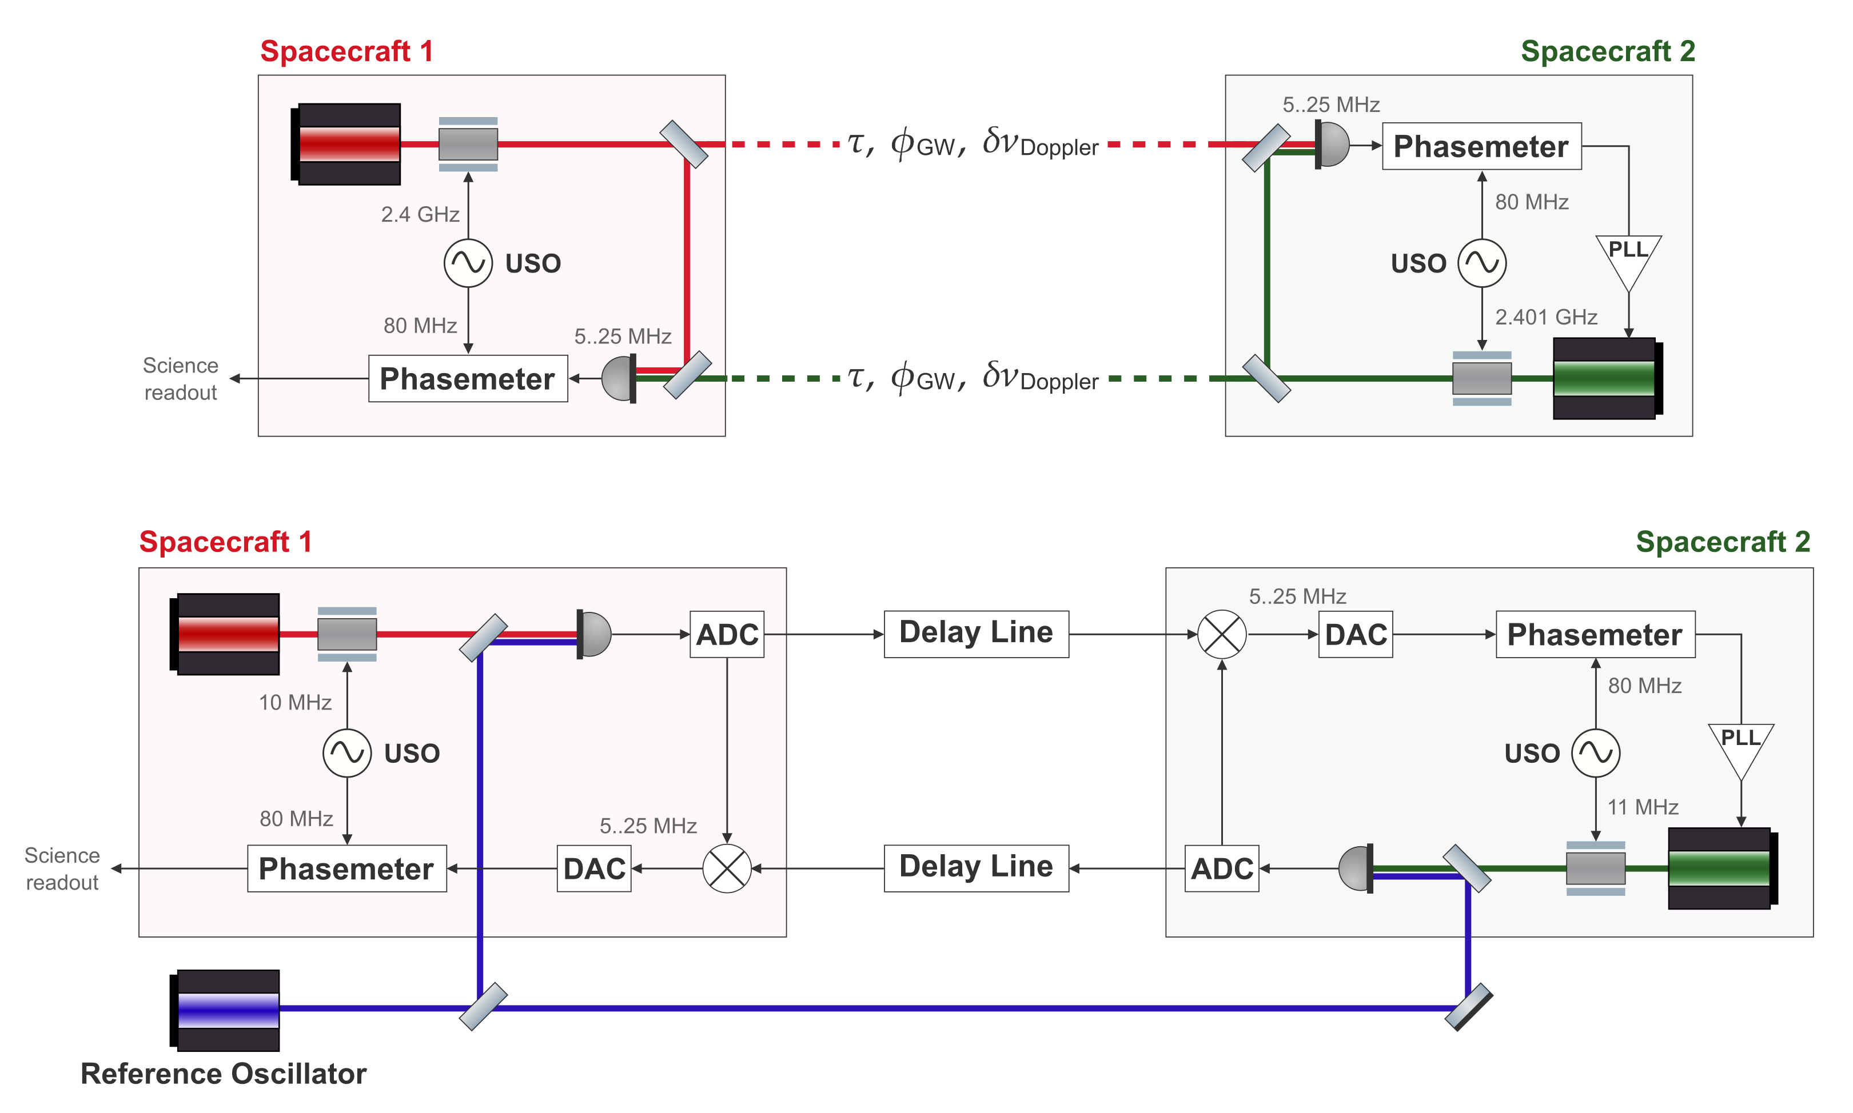
LISA arm
In-flight inter-satellite link
Testbed arm
Benchtop analogue
TAC MEETING
27 August 2026 · 07 / 20

Slide 8
TESTBED CONCEPT
Replicating the LISA Arm in the Lab
LISA arm
In-flight inter-satellite link
Write out the terms
Testbed arm
Benchtop analogue
TAC MEETING
27 August 2026 · 08 / 20
Notes:
So, we start with a laser field — and for an infrared laser that's sitting at about 281 terahertz.
To get it into our electronics [point], we heterodyne it with a reference laser field to produce a beat note in a measurable range.
This is effectively a frequency downconversion — and crucially, it preserves the phase noise around the beat note.
Which is exactly the same thing that happens in LISA — that's why the laser phase noise appears in the phasemeter readout in the first place.
But this is not yet a LISA-like beat note, its just in intermediate frequency that can be passed thouogh the delay line electronics.

Slide 9
TESTBED CONCEPT
Replicating the LISA Arm in the Lab
LISA arm
In-flight inter-satellite link
Write out the terms
Testbed arm
Benchtop analogue
TAC MEETING
27 August 2026 · 09 / 20

Slide 10
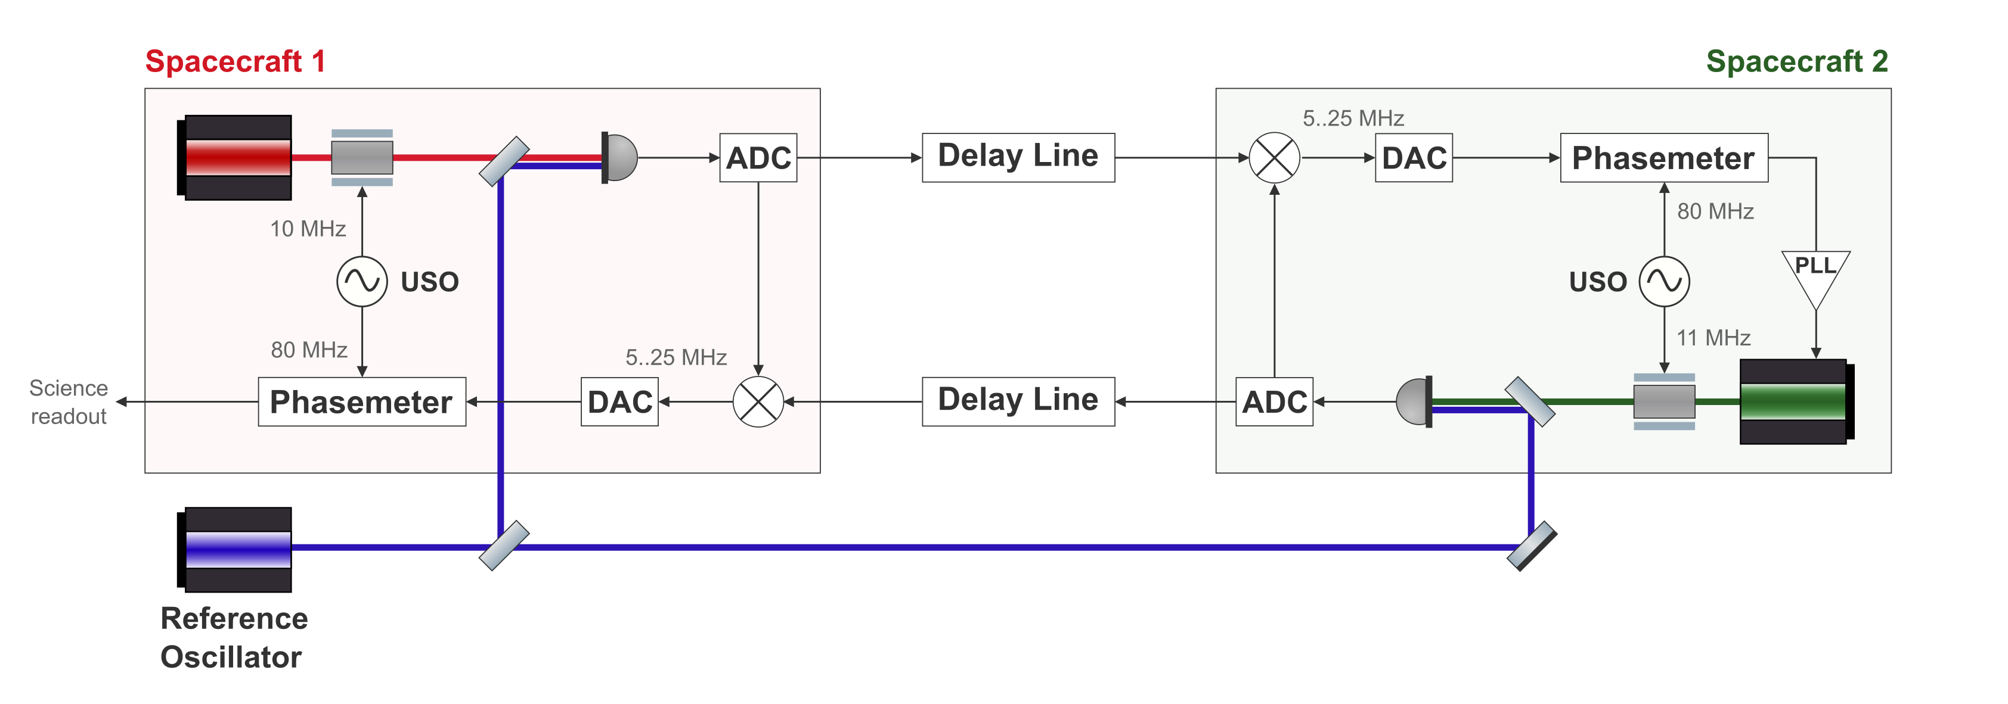

TESTBED CONCEPT
Matching the Interferometric Signal Model
LISA arm
In-flight link
Testbed arm
Benchtop analogue
TAC MEETING
27 August 2026 · 10 / 20

Slide 11
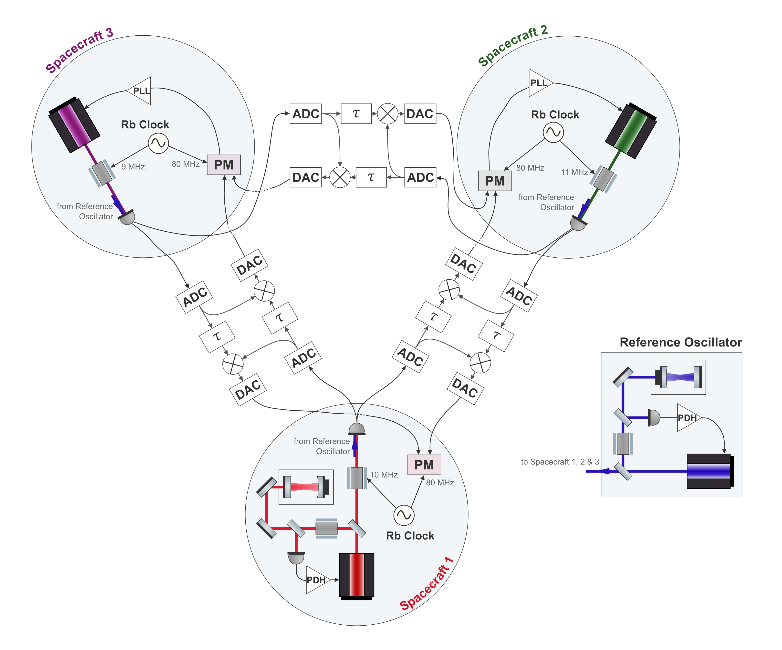
TESTBED CONCEPT
Full Testbed
One laser per spacecraft
An independent source on each satellite
Cavity-locked primary laser
Provides LISA-like laser frequency noise
Independent clocks
Allows to demonstrate clock noise removal
Six separate delay lines
Two per inter-spacecraft link
TAC MEETING
27 August 2026 · 11 / 20
Notes:
This is the goal
The delay status should be included in the presentation
Standing questions there – ex the last measurement, where ever it is
the interpolation/delay implementation
what are the next steps
But how do we properly inject the laser noise and clock noise
understanding the Delay line coding is important
The X combination – next goal, is there anything unexplained happening

Slide 12
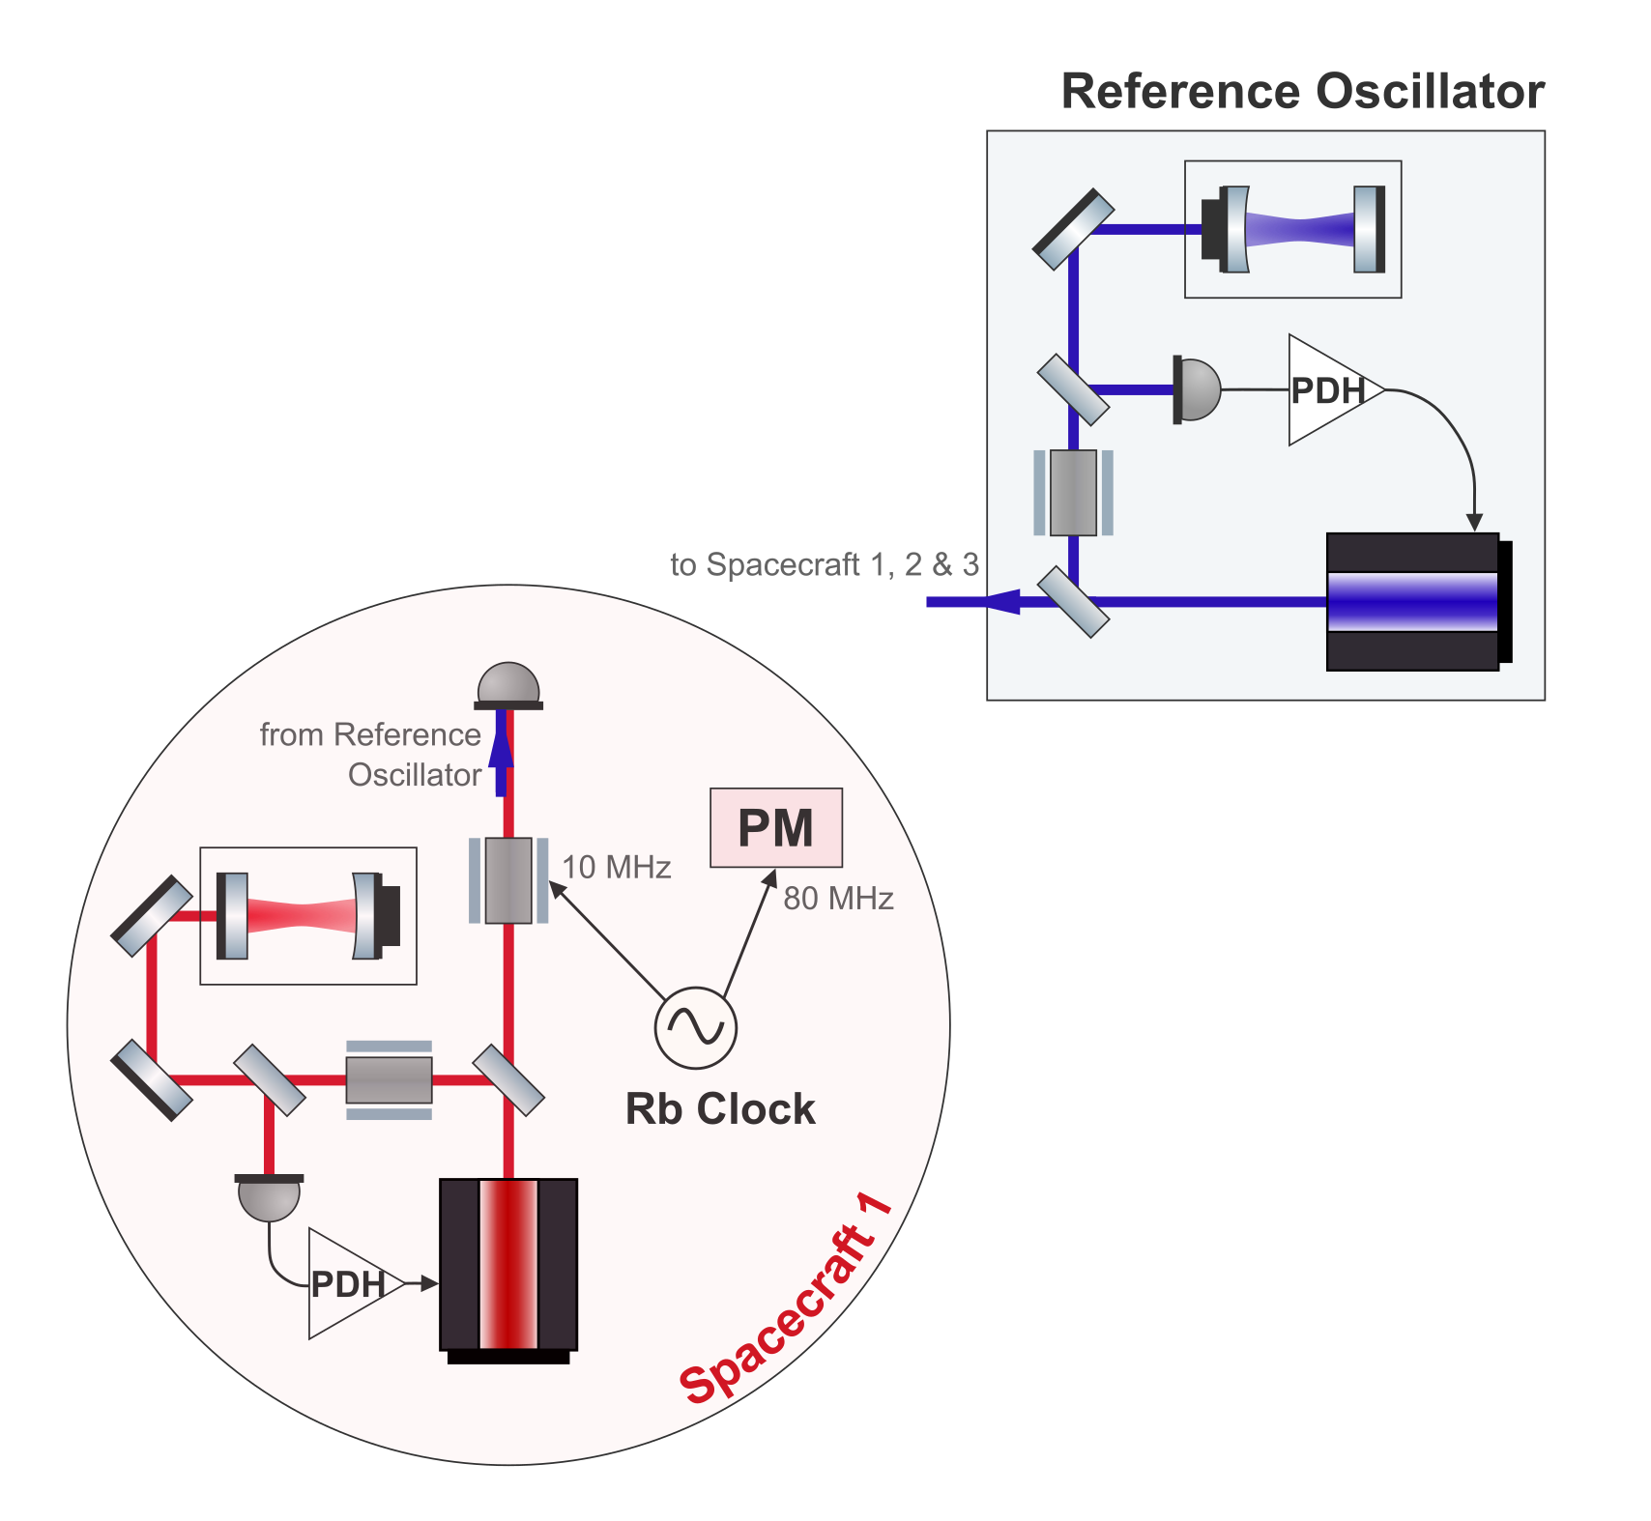
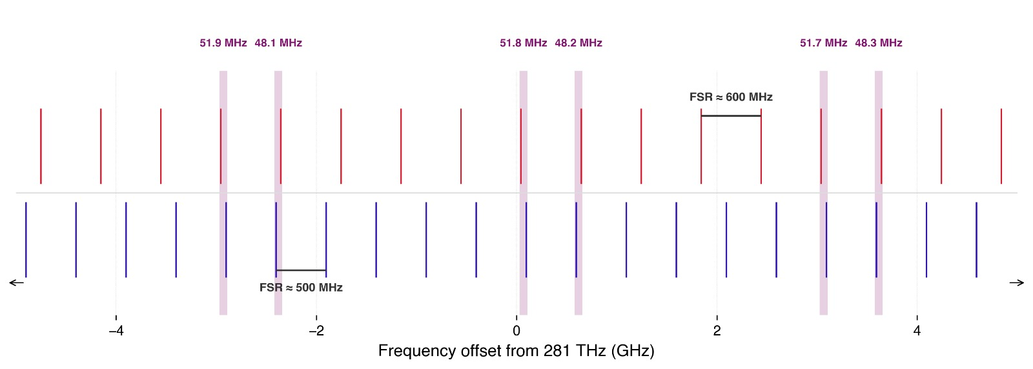
HARDWARE
Cavity Locking Two Lasers
For LISA-like laser noise, the primary laser should be cavity-locked.
Two lasers locked to separate cavities — 25 cm and 30 cm
Two separate Pound–Drever–Hall (PDH) locks
Beat note needs to be below 60 MHz
Illustrative cavity resonances
This is one reason to increase the data rate
And decimate more
TAC MEETING
27 August 2026 · 12 / 20

Slide 13
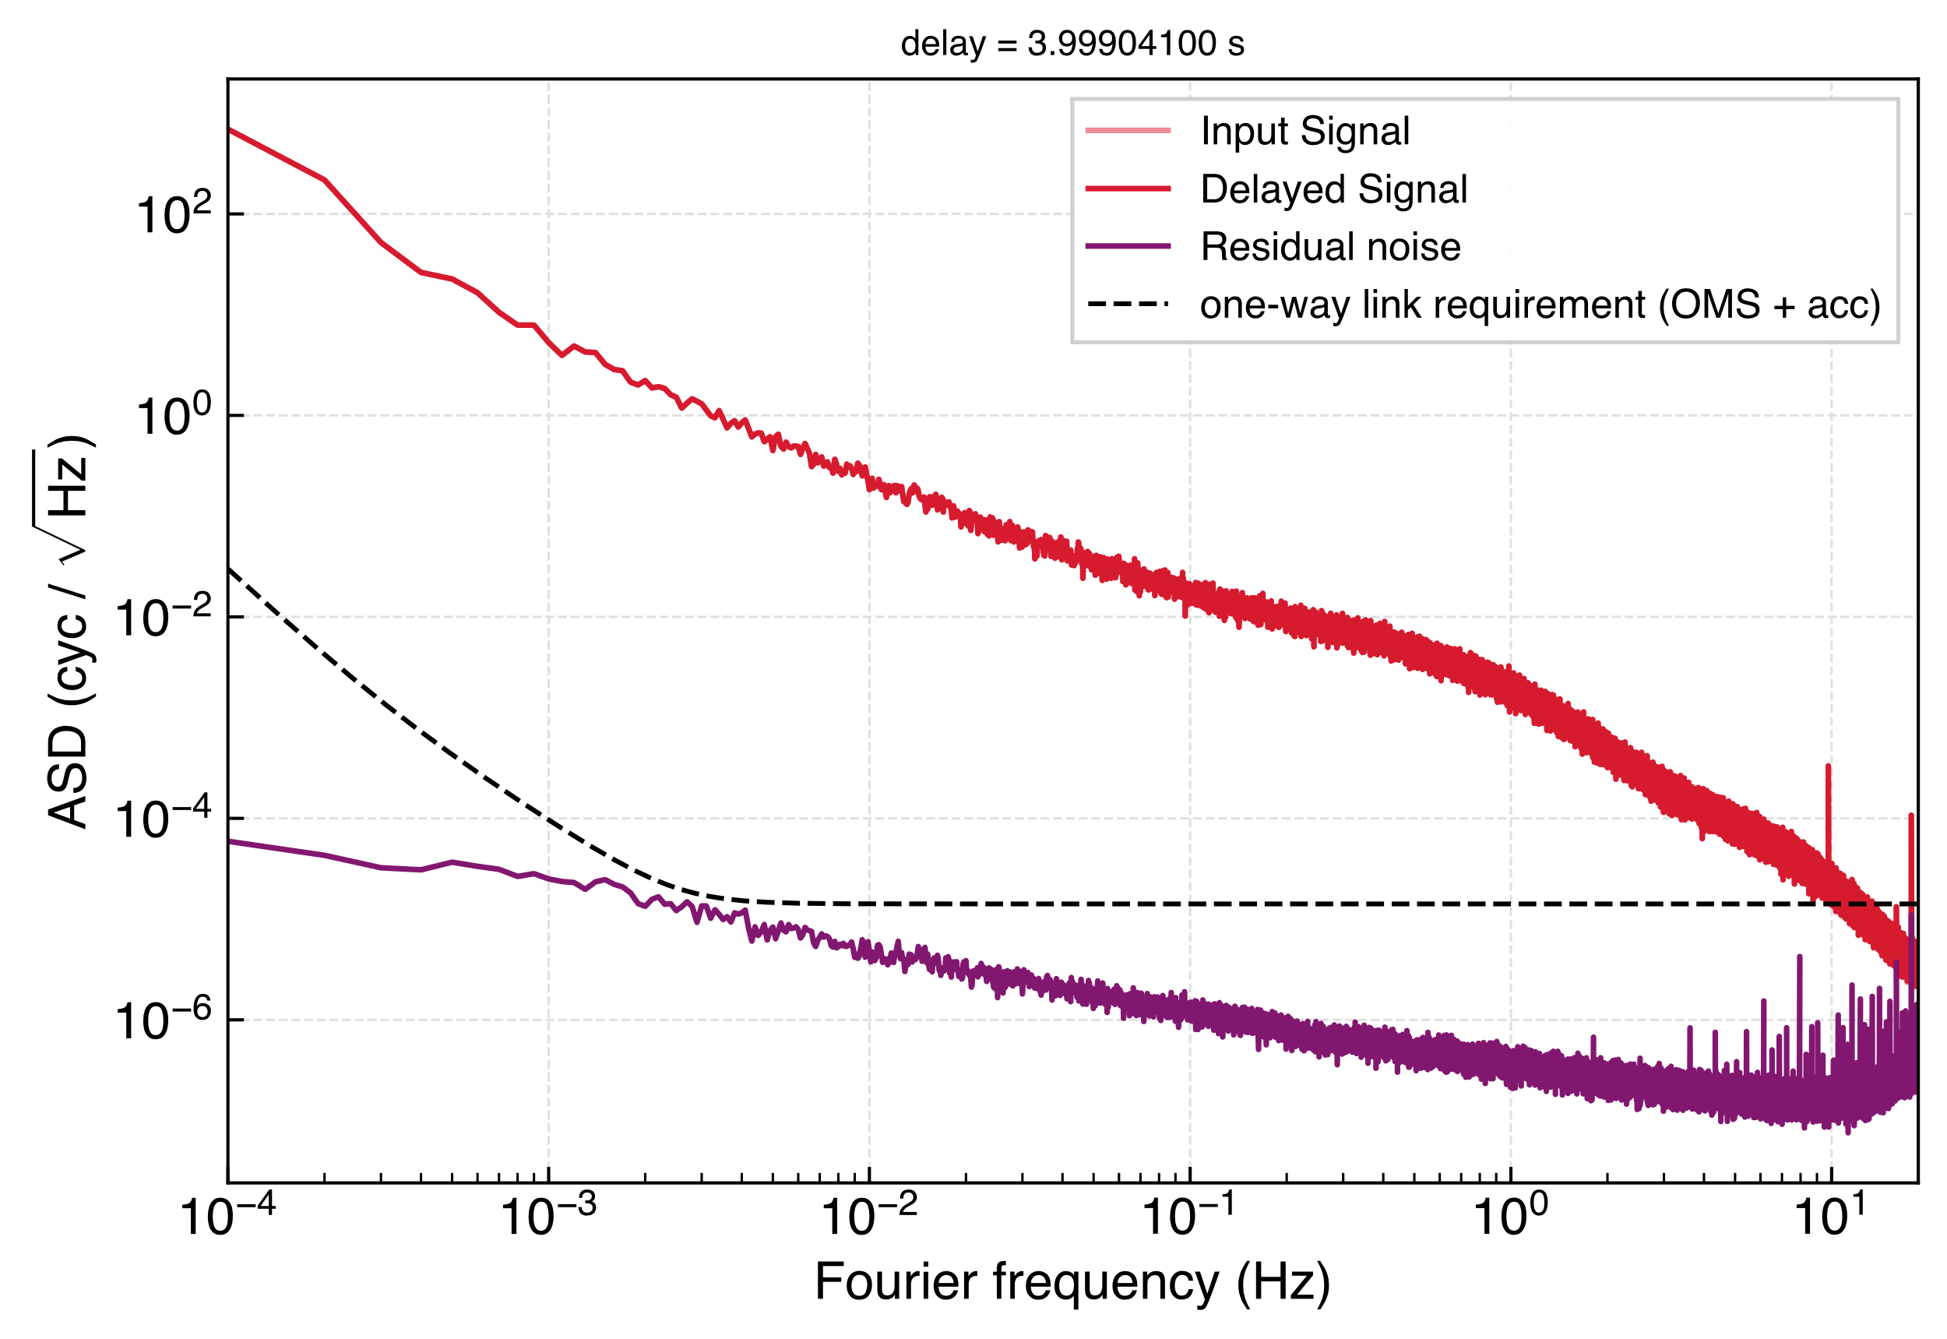
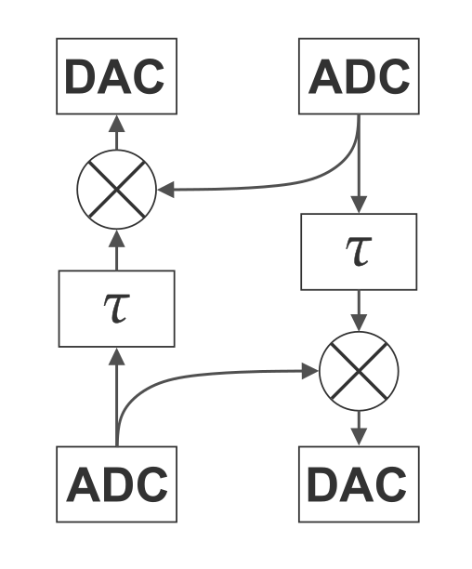
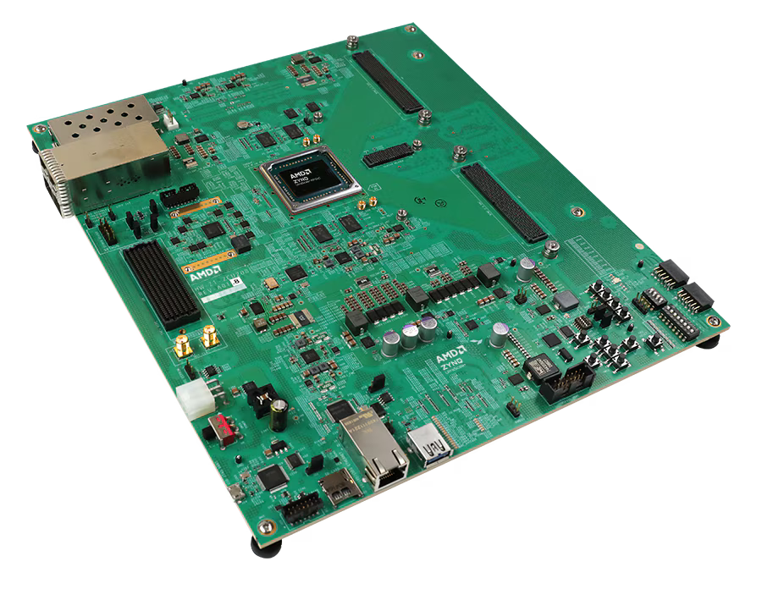
HARDWARE
Delay Line
Time-varying delays
Doppler shifts for both carrier and sidebands
Gravitational-wave injection
AMD Zynq™ UltraScale+™ RFSoC ZCU208 Evaluation Kit
Intrinsic noise floor of one board (purple)
TAC MEETING
27 August 2026 · 13 / 20

Slide 14
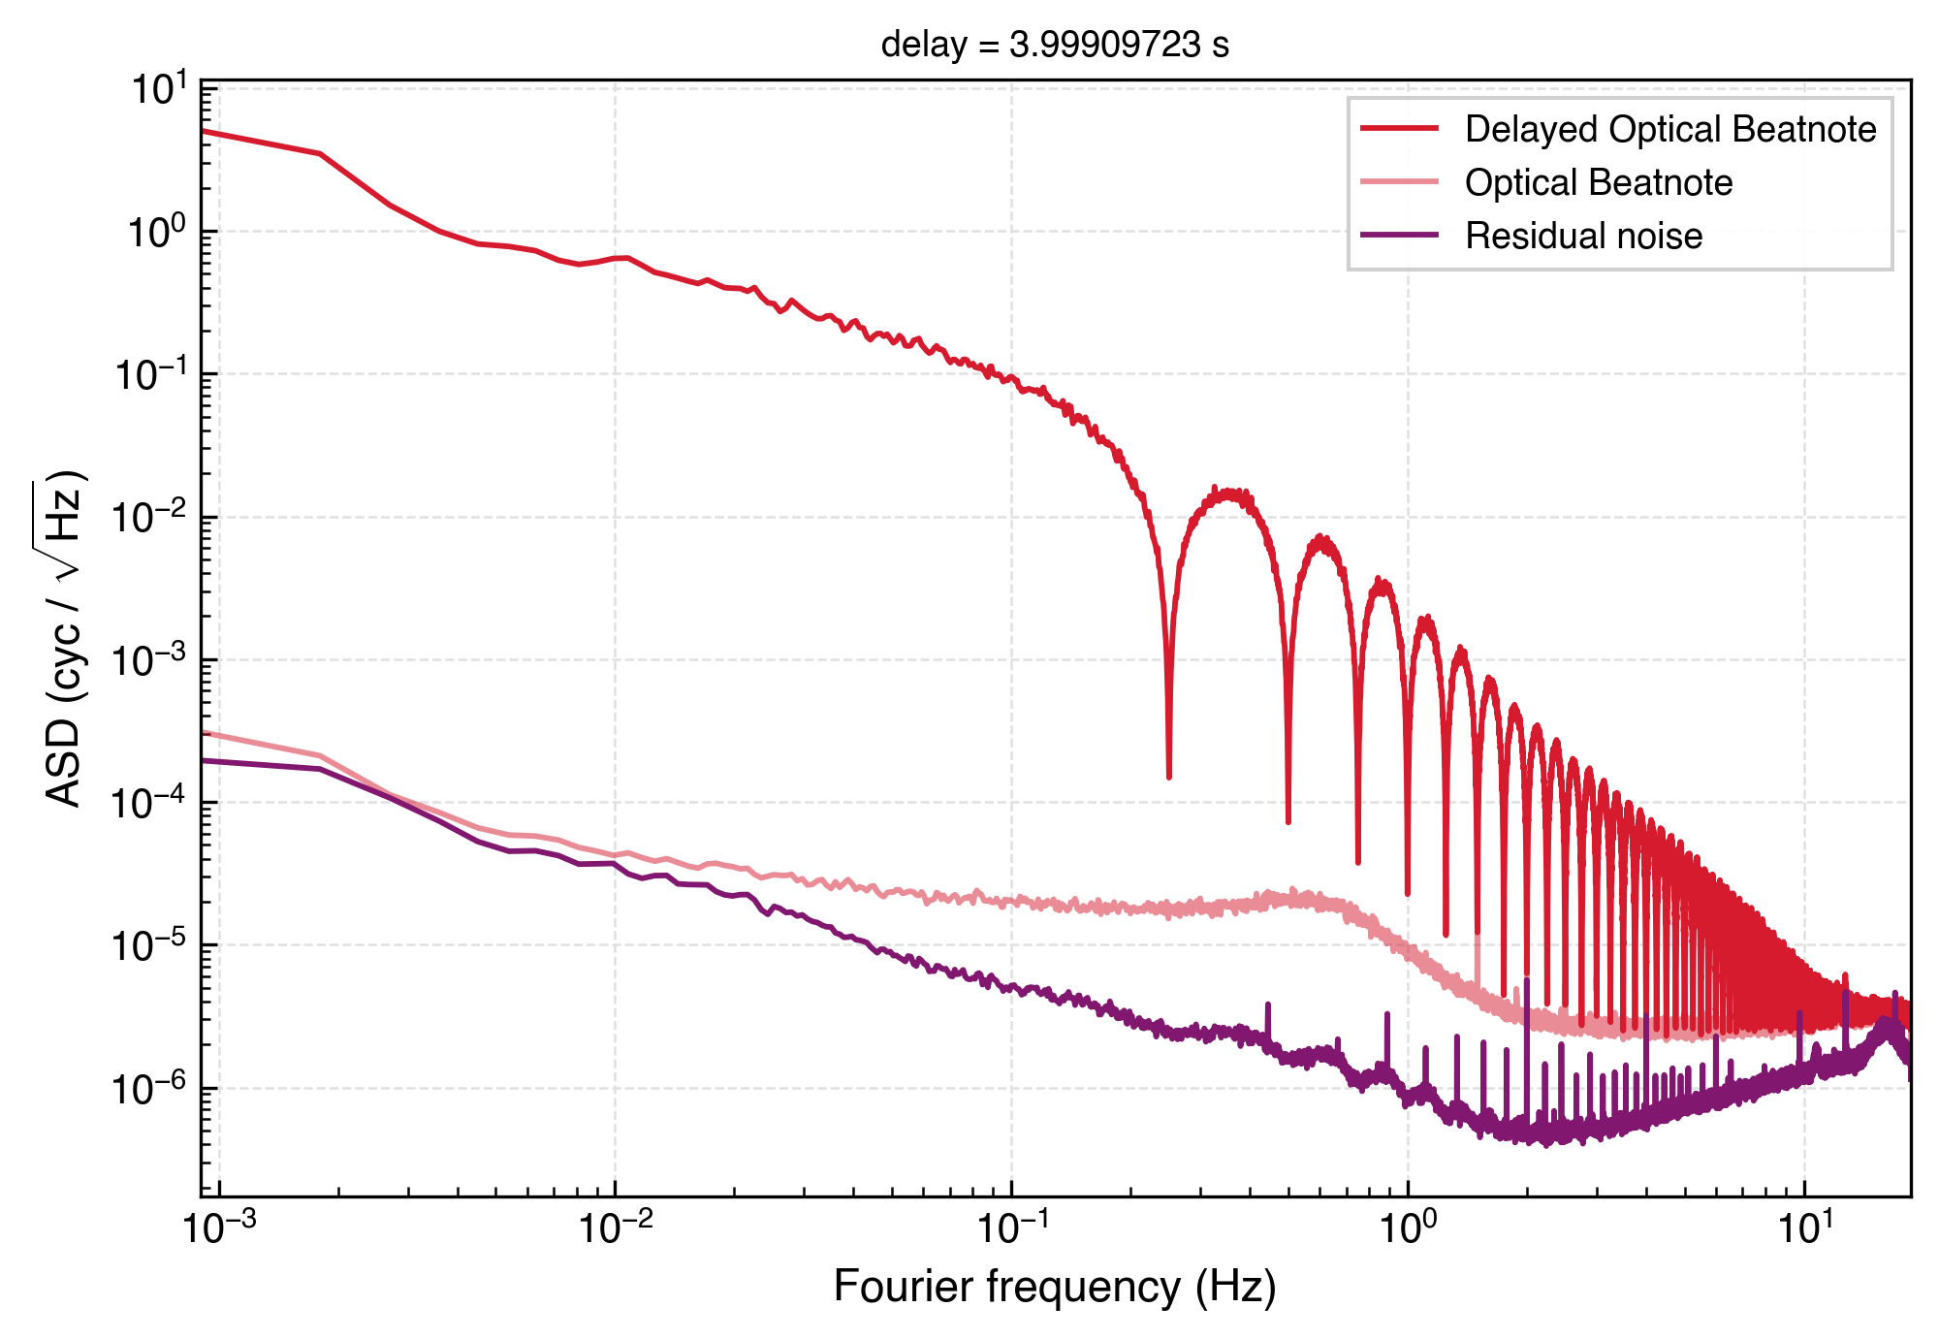
HARDWARE
Delay Line
Clock Noise on the boards
Mainly couples in the ADCs and DACs
But potentially also as ranging error and changing frequency
TAC MEETING
27 August 2026 · 13 / 20

Slide 15
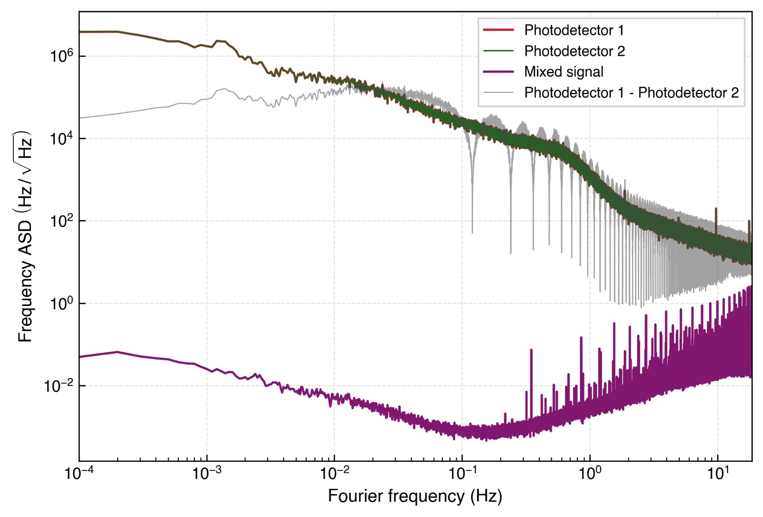
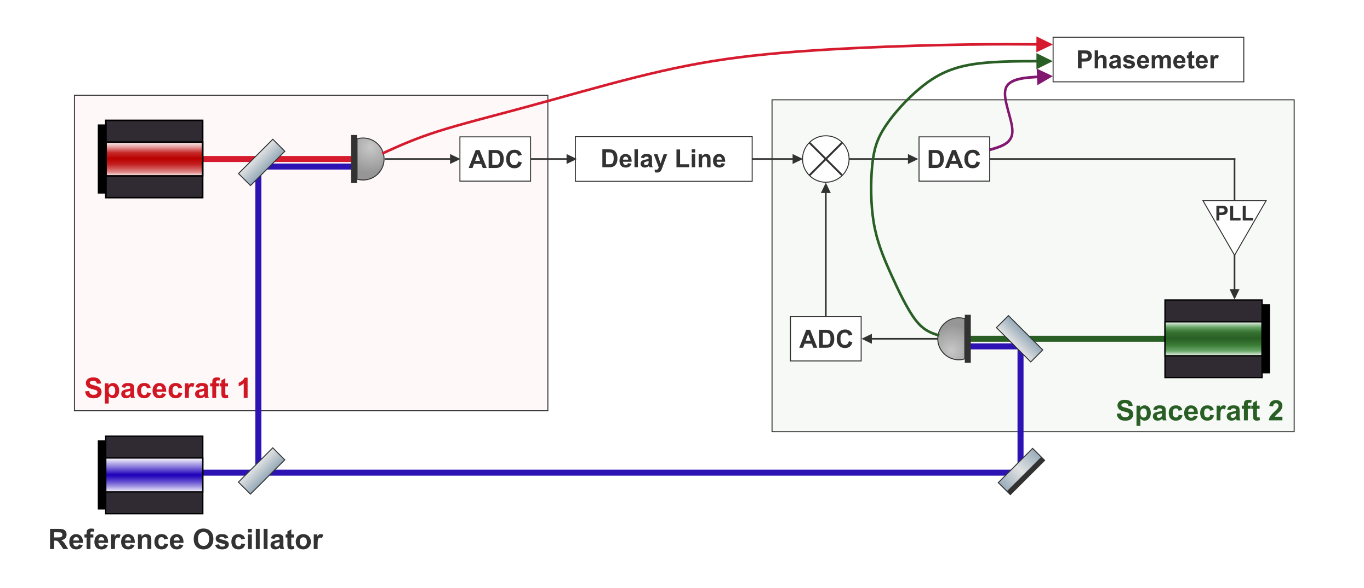


LASER NOISE RESULTS
PLL Lock of Far Spacecraft
Photodetector readings are dominated by free-running laser frequency noise.
The mixed output is orders of magnitude lower.
Free-running photodetector noise vs. mixed output
TAC MEETING
27 August 2026 · 14 / 20
Notes:
We have started integrating the optics with the delay line. One demonstration we did is locking a laser to an incoming laser field as received through the delay line — which is exactly what LISA does via the phase-locked loop on the far spacecraft.
The red and green lines are the raw photodetector readings from the two spacecraft — so essentially the laser phase noise. The grey line is their calculated difference, and you can see the characteristic dips at frequencies corresponding to the inverse of the delay.
The purple line is the mixed signal. And you see that this drops by many orders of magnitude. This tells us that the PLL is working, the laser is successfully following the delay line signal, and the signal chain from the optics through the delay line and back out is functioning as intended.

Slide 16
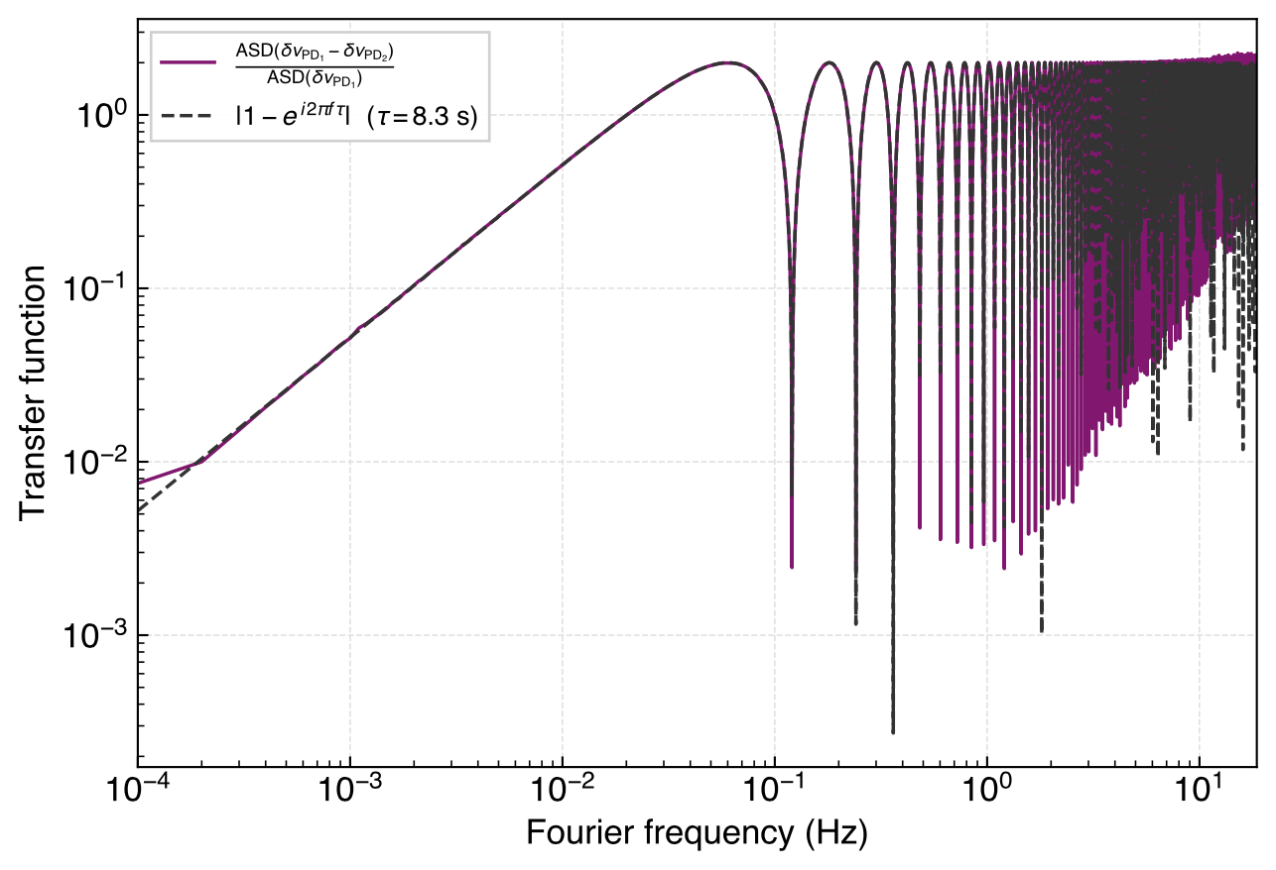

LASER NOISE RESULTS
Recovering the Transfer Function
We can recover a LISA-like one-way laser-noise transfer function.
Recovered one-way laser-noise transfer function
TAC MEETING
27 August 2026 · 15 / 20
Notes:
This is another way to illustrate the same result — we can recover the modelled one-way laser noise transfer function directly from our measurements. We plot the ratio derived from our photodetector data against the analytical model, and the agreement is excellent. At higher frequencies we see some excess noise, which seems to originate from the mixing on the delay line board.

Slide 17

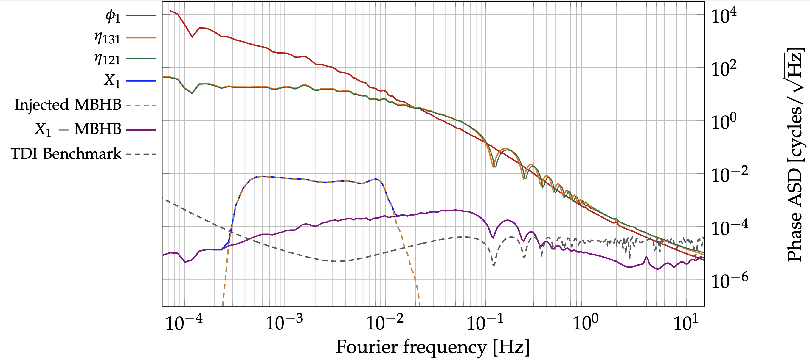
LASER NOISE RESULTS
Tests of TDI so Far
Fully electronic testbed can already demonstrate noise suppression with TDI
Static TDI has been demonstrated — the next step is to add the clock noise correction.
Credit: R. Ferguson et al. (2026)
TAC MEETING
27 August 2026 · 16 / 20
Notes:
So this is where we currently stand with TDI — my colleague has demonstrated static two-arm perfect transponder Michelson X TDI using the purely electronic testbed, so no optics were used for this measurement. But effectively the MHz inputs can now be switched out for ones generated by the lasers. A gravitational wave signal was injected and successfully recovered, and the residual noise floor is shown by the light blue and purple lines. [pause]
Laser noise suppression with TDI is working. The next step is to add the independent clocks and demonstrate clock noise removal on top of that

Slide 18
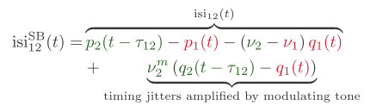
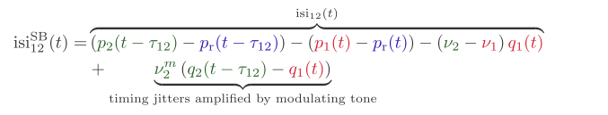
CLOCK-TONE TRANSFER
Sidebands in the Lab
LISA arm
In-flight link
Testbed arm
Benchtop analogue
TAC MEETING
27 August 2026 · 17 / 20
Notes:
Now I'll get into our plans for the clock noise correction. The way LISA removes clock noise is by modulating each spacecrafts timing jitters onto the laser as a sideband, transmitting it to the far spacecraft, and measuring the differential there. [pause]
If you look at the sideband phase readout here — in addition to the usual laser noise and clock noise terms, which is in common mode with the carrier, there is now an extra term where the differential clock noise between the two spacecraft is amplified by the modulating frequency.
As a first approach, we can simply add modulators to the testbed laser fields and get the same coupling in the readout. In principle this already lets us play with clock noise removal. The catch is that, in such a configuration, we are limited to MHz modulation — if we tried to use a GHz sideband here, it would fall outside the ADC measurement range.

Slide 19
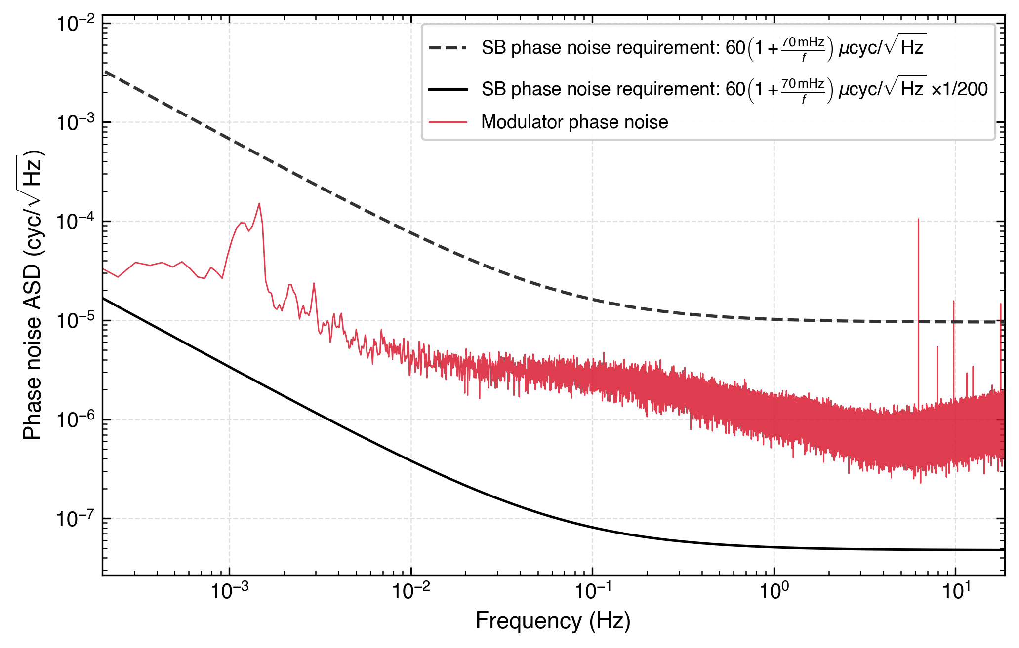
CLOCK-TONE TRANSFER
Clock Tone Transfer Limitation
Modulator noise remains too loud if MHz modulation is used.
The RF sideband phase-noise requirement should be adjusted for the modulating frequency used.
This limitation needs a solution before the clock noise removal can be done with LISA-like performance.
Modulator phase noise against the requirement
TAC MEETING
27 August 2026 · 18 / 20
Notes:
The power starts to matter as well, at least for LISA

Slide 20
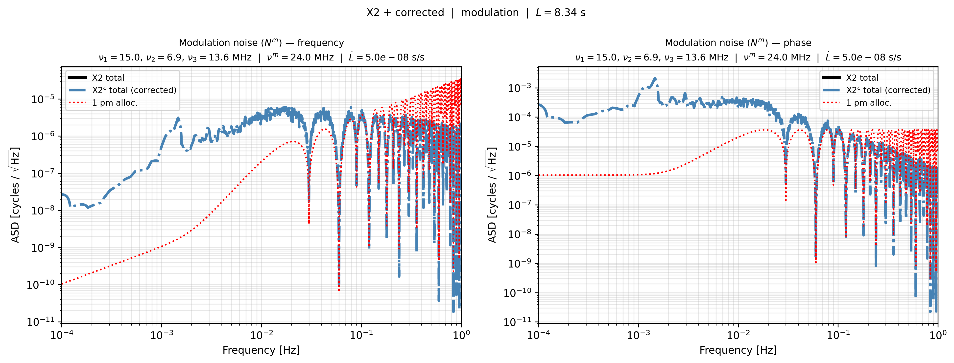
CLOCK-TONE TRANSFER
Clock Tone Transfer Limitation
Modulator noise remains too loud if MHz modulation is used.
The RF sideband phase-noise requirement should be adjusted for the modulating frequency used.
This limitation needs a solution before the clock noise removal can be done with LISA-like performance.
TAC MEETING
27 August 2026 · 18 / 20

Slide 21
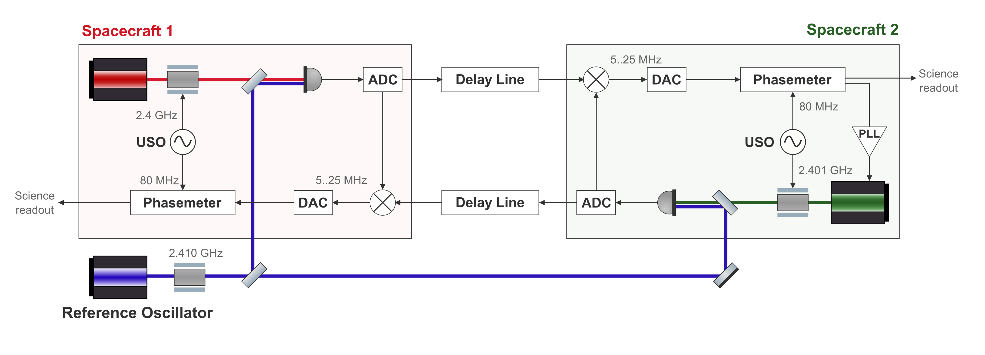
CLOCK-TONE TRANSFER
GHz Modulation
POTENTIAL SOLUTIONS UNDER INVESTIGATION
Driving the PM from the sidebands
Derive the clock phase directly from the RF sidebands.
Reference measurement
A dedicated channel to track the modulation tone.
ADC mixing
Down-mix the GHz tone inside the ADC.
Aliasing
Controlled aliasing of a MHz signal.
GHz modulation measurement scheme
TAC MEETING
27 August 2026 · 19 / 20

Slide 22
CLOCK-TONE TRANSFER
GHz Modulation
The algebra?
TAC MEETING
27 August 2026 · 19 / 20

Slide 23
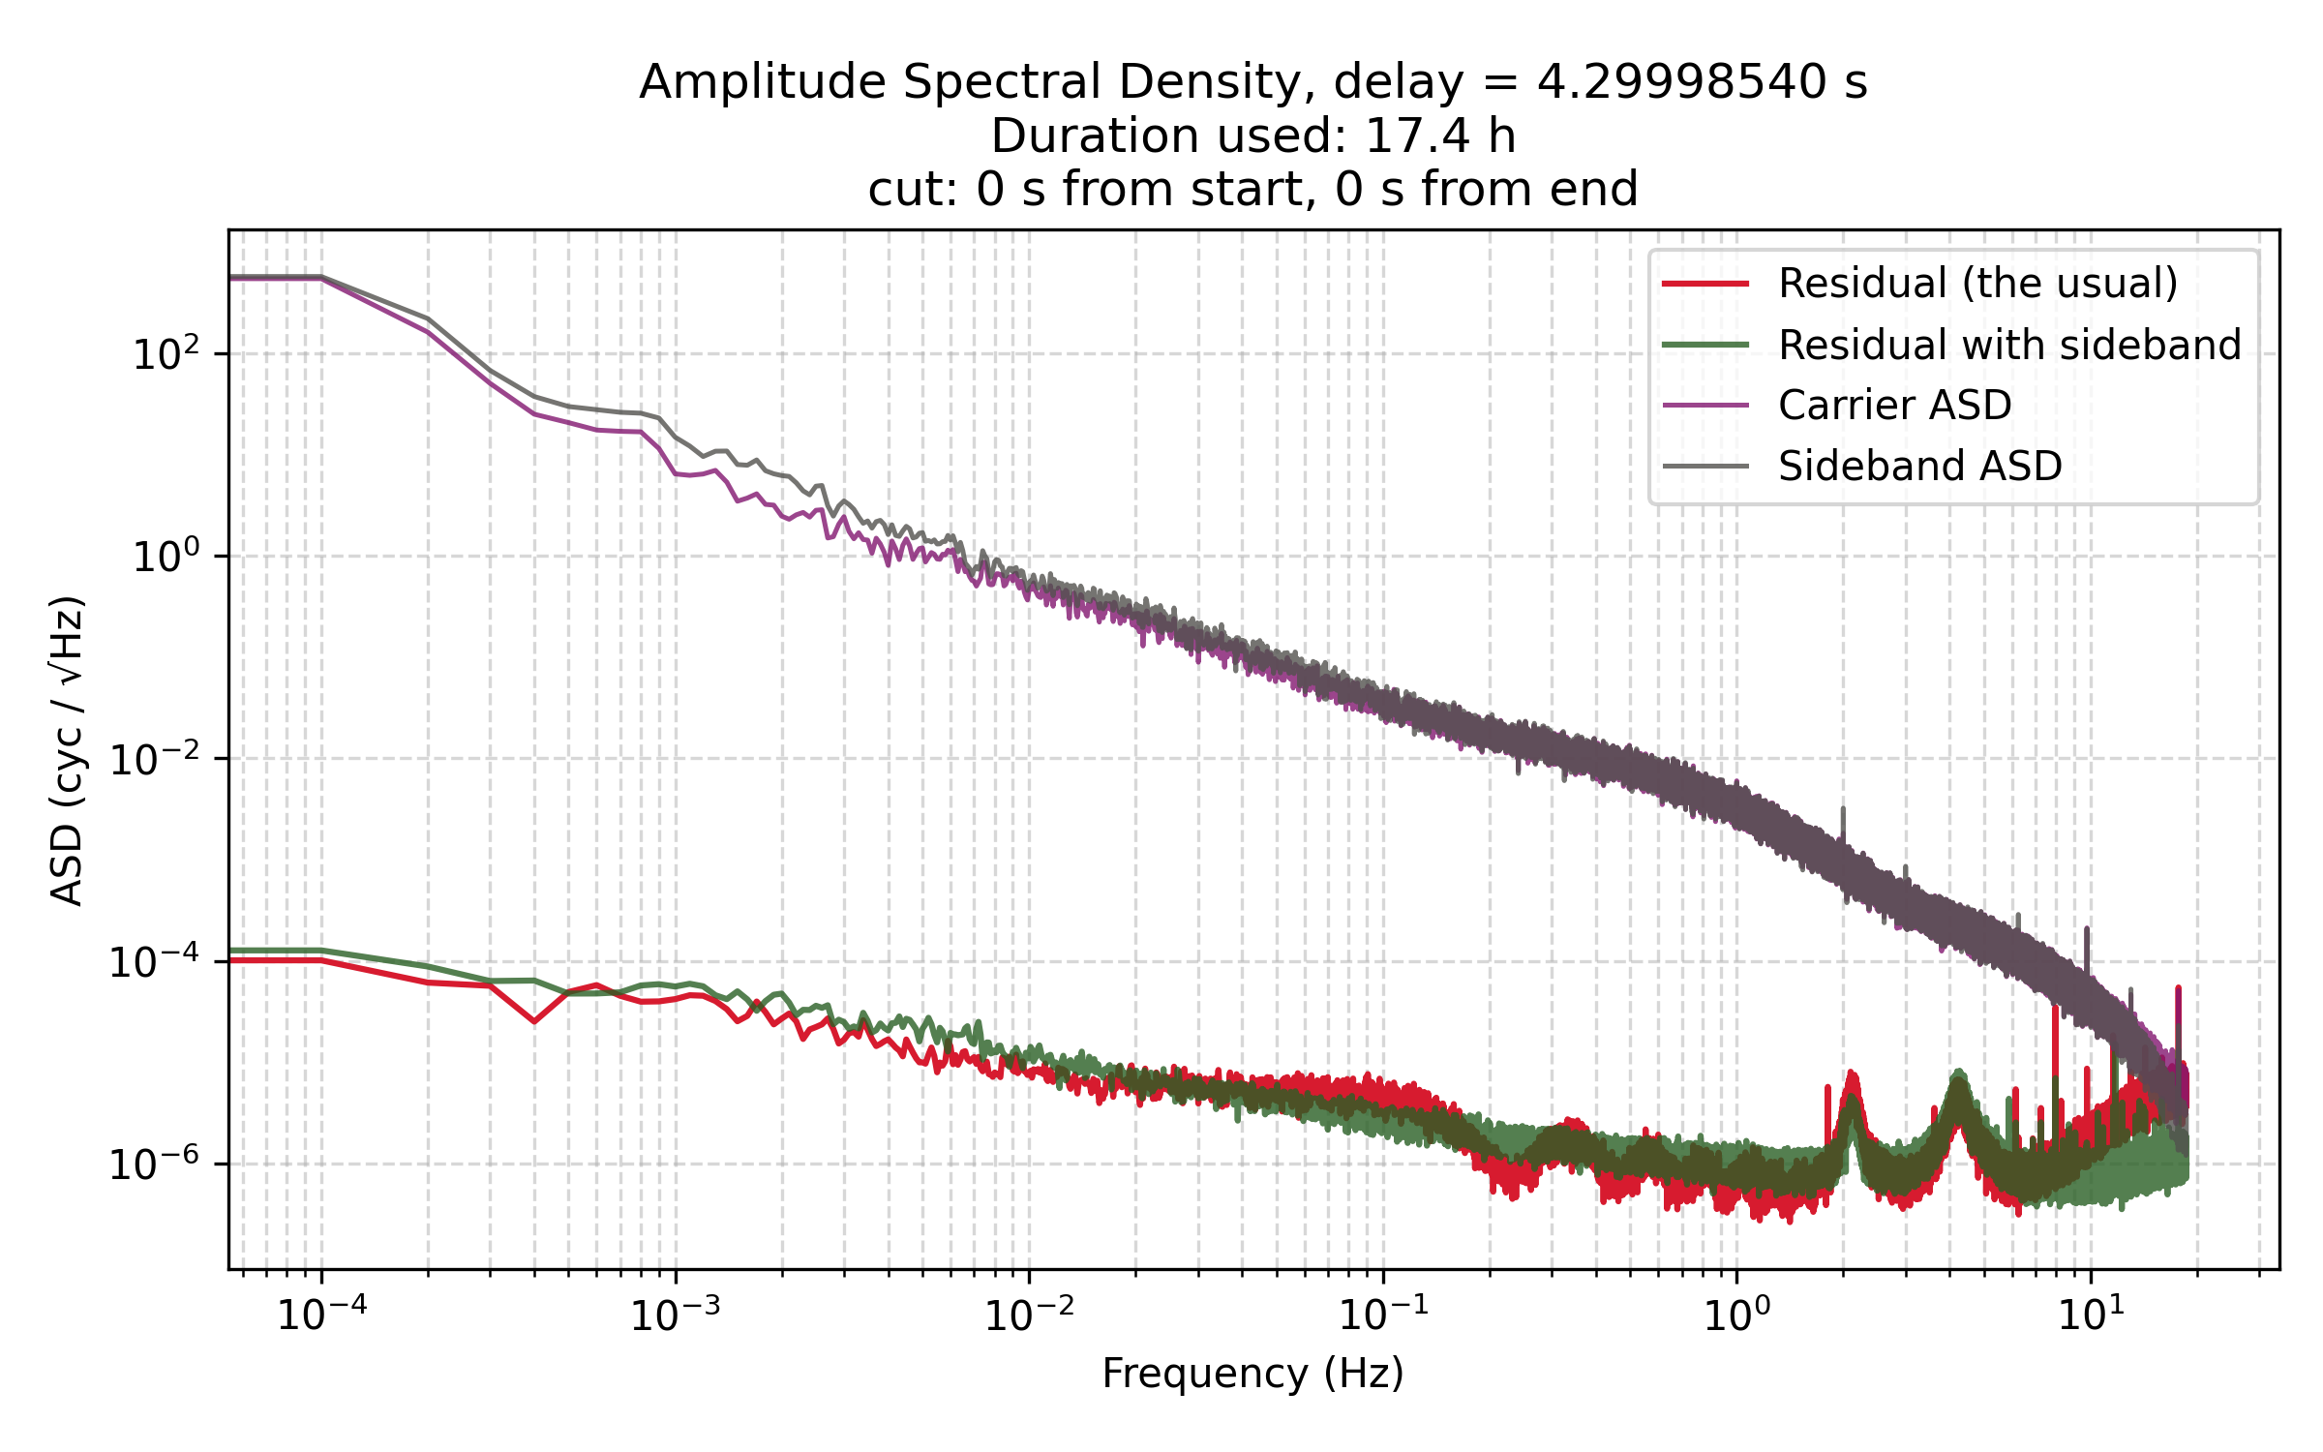
CLOCK-TONE TRANSFER
GHz Modulation
TAC MEETING
27 August 2026 · 19 / 20

Slide 24
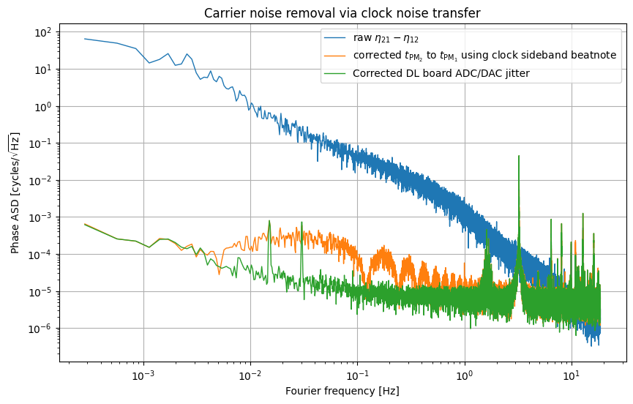
CLOCK-TONE TRANSFER
Preliminary Clock Noise Removal
Two PM measurement
TAC MEETING
27 August 2026 · 19 / 20

Slide 25
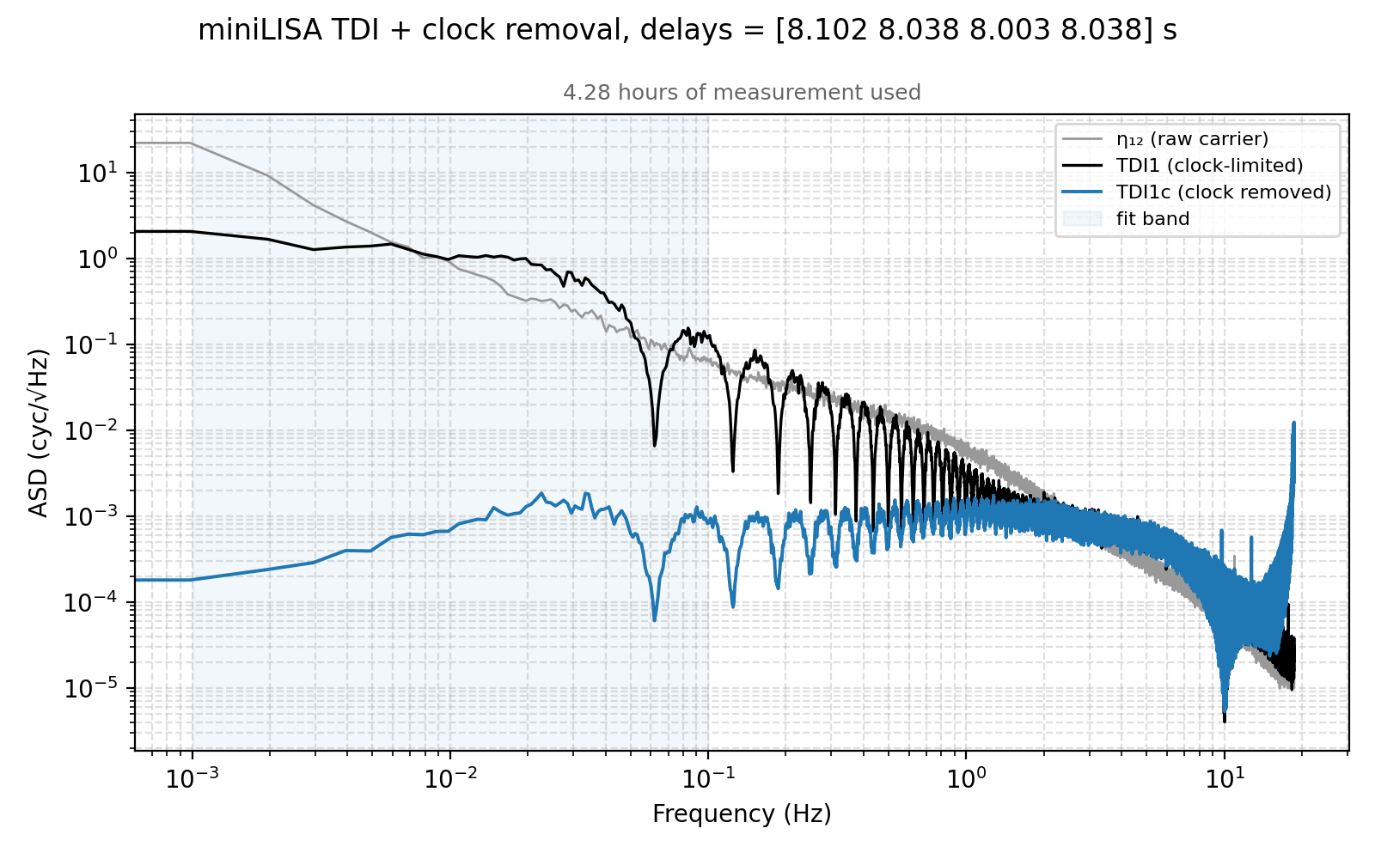
CLOCK-TONE TRANSFER
Preliminary Clock Noise Removal
Full Michelson X combination
TDI is barely doing anything
TAC MEETING
27 August 2026 · 19 / 20
Notes:
This needs to be solved

Slide 26
SUMMARY
Conclusions & Next Steps
DEMONSTRATED
IN PROGRESS
✓
Delay line — working, below requirement
Assembling the optical layout and cavities
✓
PLL lock demonstrated with free-running lasers
GHz sideband chain — under investigation
✓
Gravitational wave recovery with TDI
Delay-board clock-noise removal
Full TDI and clock-noise removal
TAC MEETING
27 August 2026 · 20 / 20
Notes:
So to summarise. We have a working delay line that sits below the LISA requirement, we have demonstrated PLL lock with the optics integrated, and we have demonstrated gravitational wave recovery using TDI [pause]
Looking ahead, we are currently assembling the full optical layout with the cavity locked lasers. On the clock noise side, we have some performance limitations to work out. Once that is resolved, the path forward is clock noise removal on the delay boards, and ultimately a full end-to-end demonstration of second-generation TDI and clock noise correction in hardware. [pause]
Thank you for listening

