Slide 1
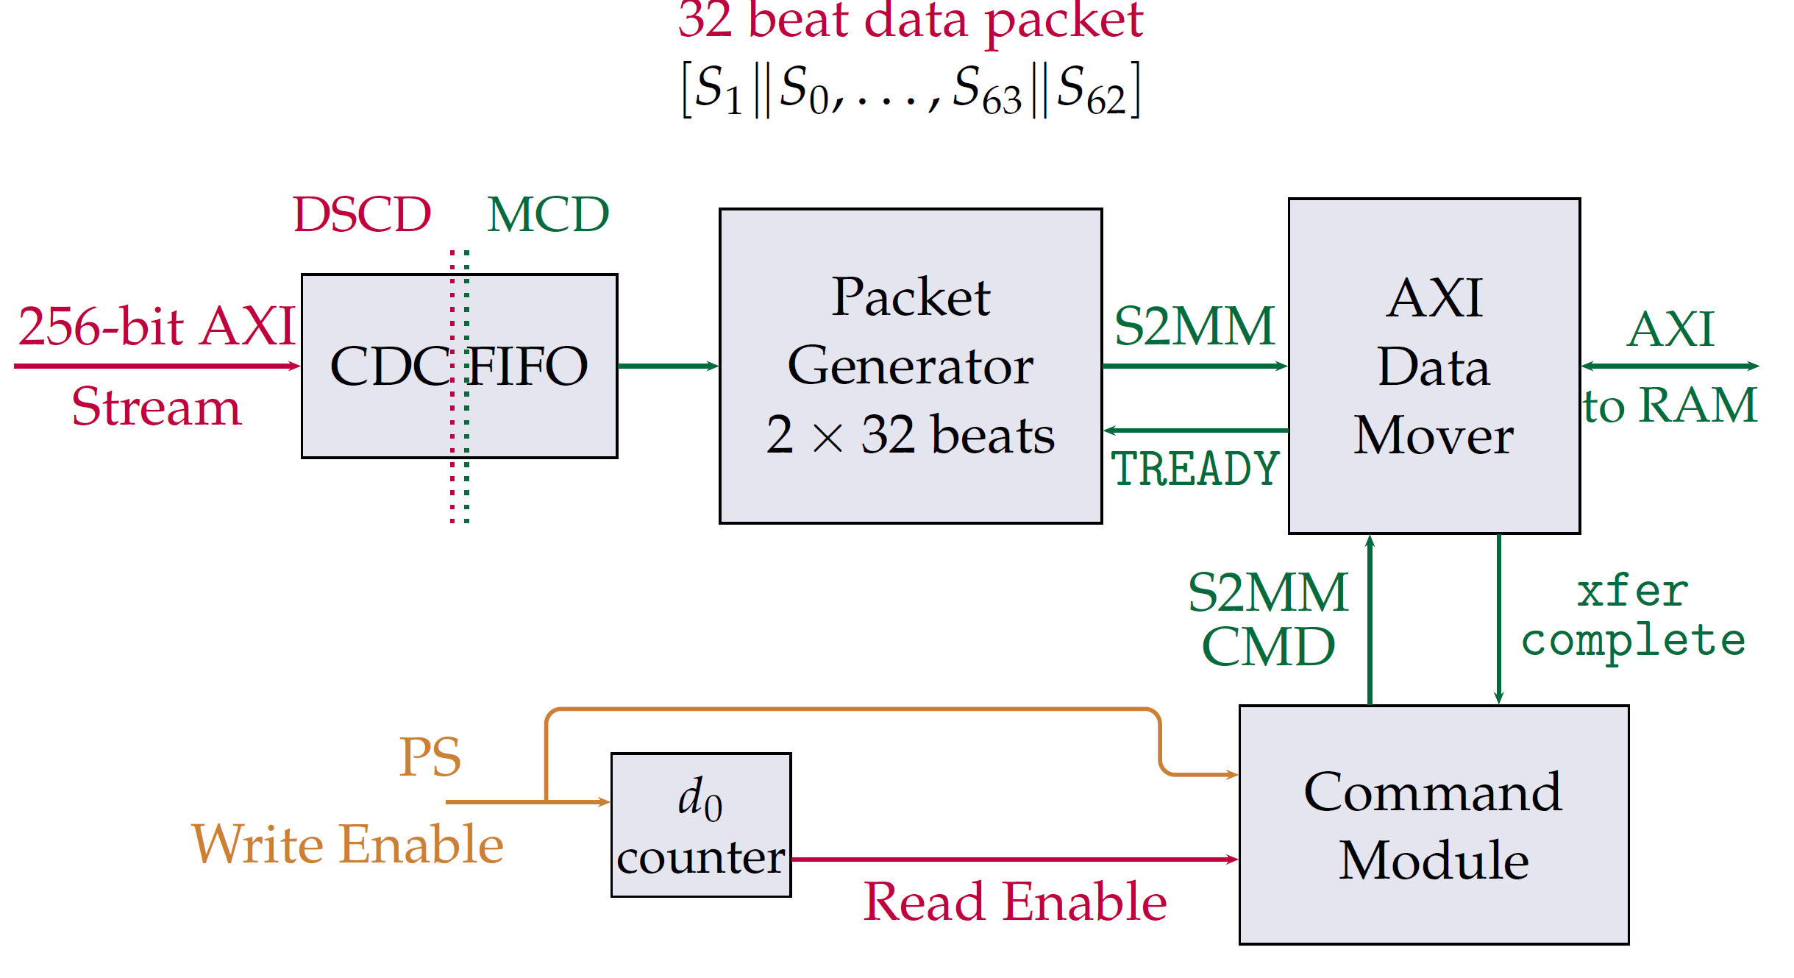
Edits to the Delay Line
Removed the packet generator
But the performance of the system does not change
I learned in the process
And the build time is shorter

Slide 2
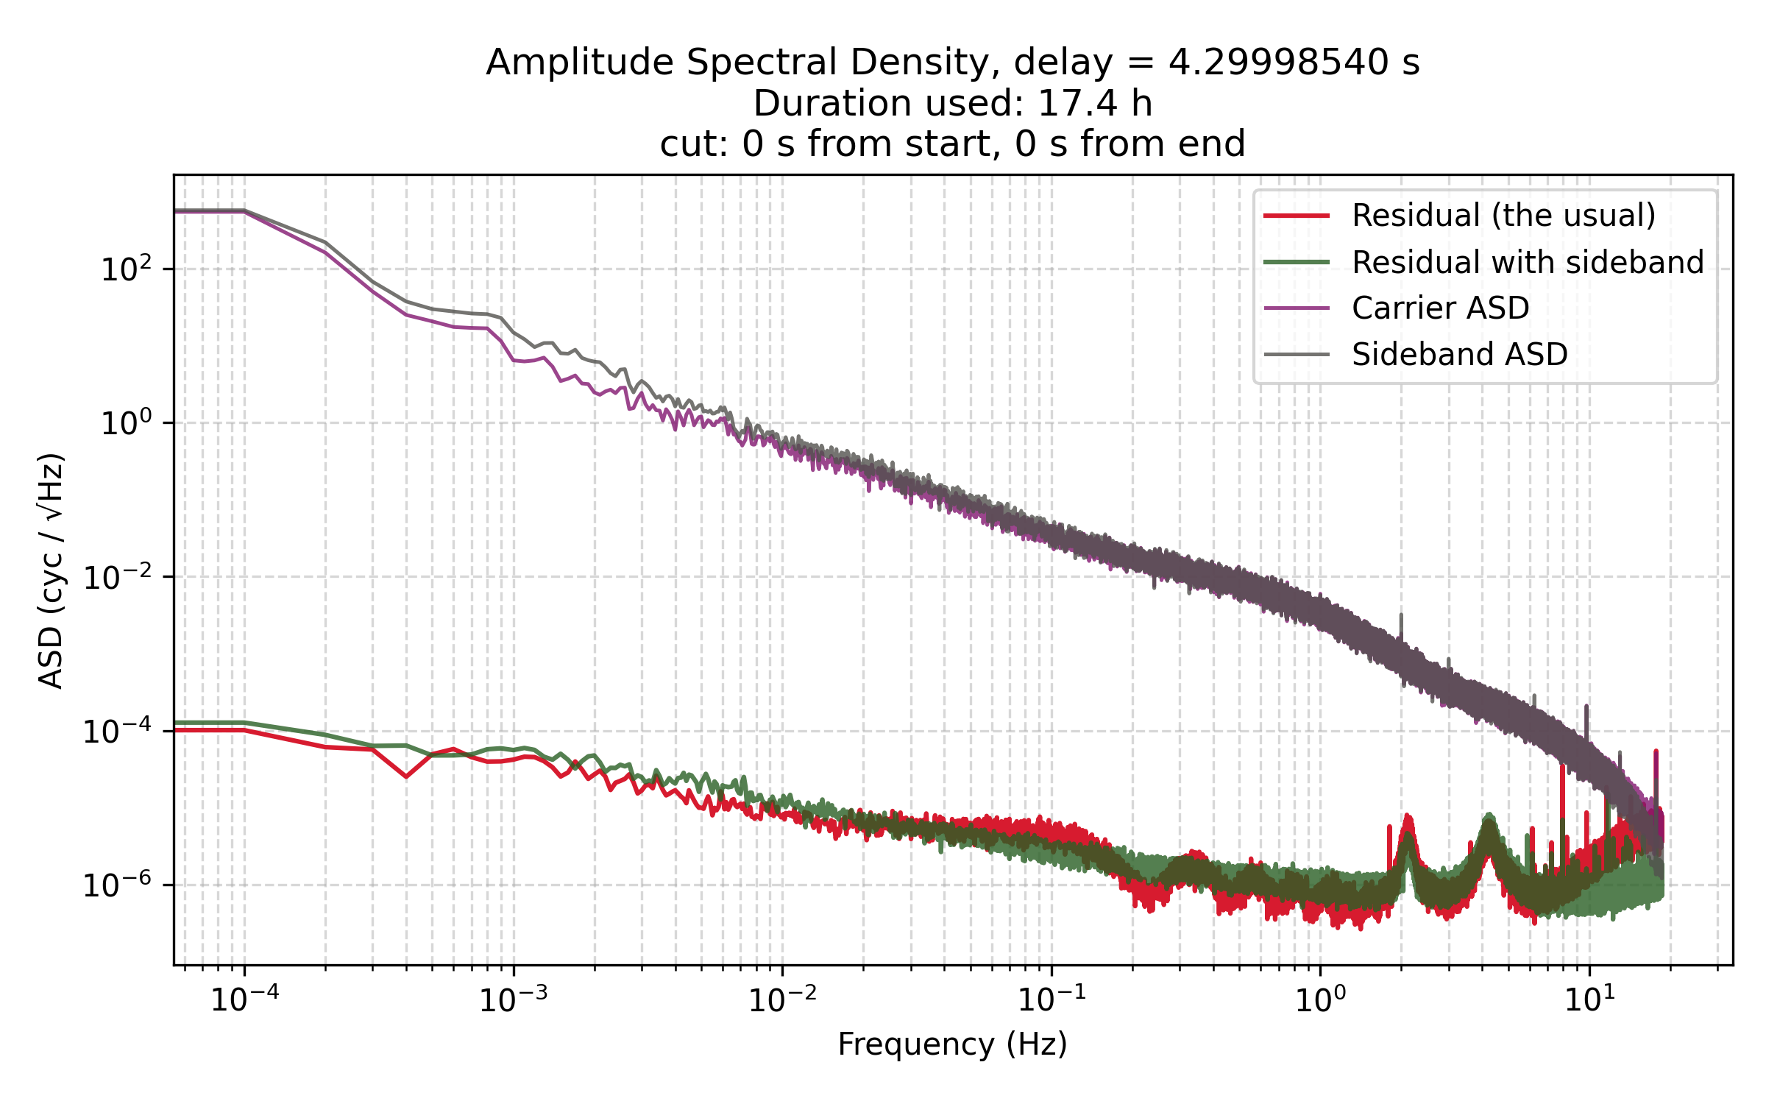
New Baseline Measurement with a Sideband
Free running board clock
Alternative way of forming a “noise free” combination – baseline performance
Measured a delayed sideband that was generated in the signal source (Moku Lab) using the boards own clock (CLK REF out)
Likely lobeing from delay errors

Slide 3
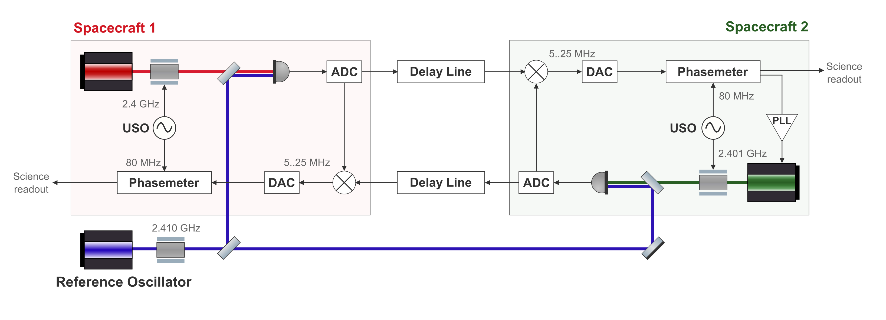
Context: we will likely need GHz modulation for LISA-like clock noise removal
We can get GHz SBs and still use the delay line with a 60 MHz ADC bandwidth by modulating the reference laser as well
Question is, where do we get the modulating tone from?

Slide 4
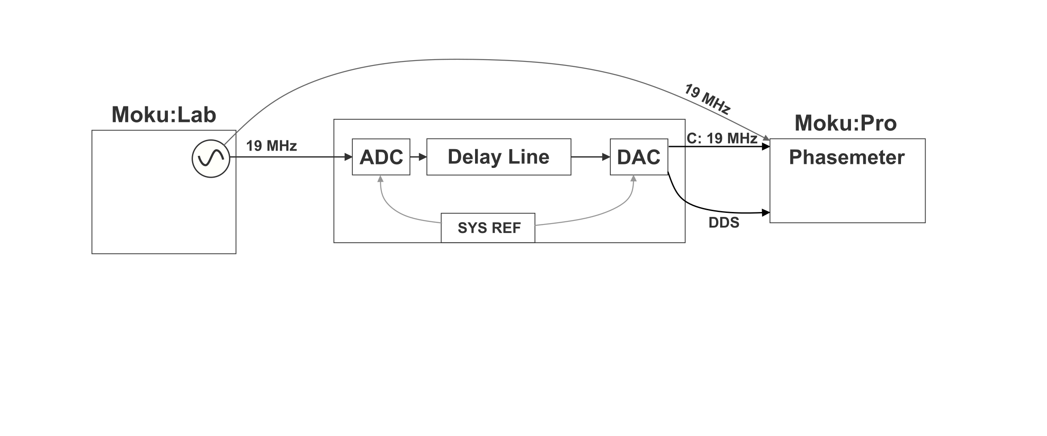
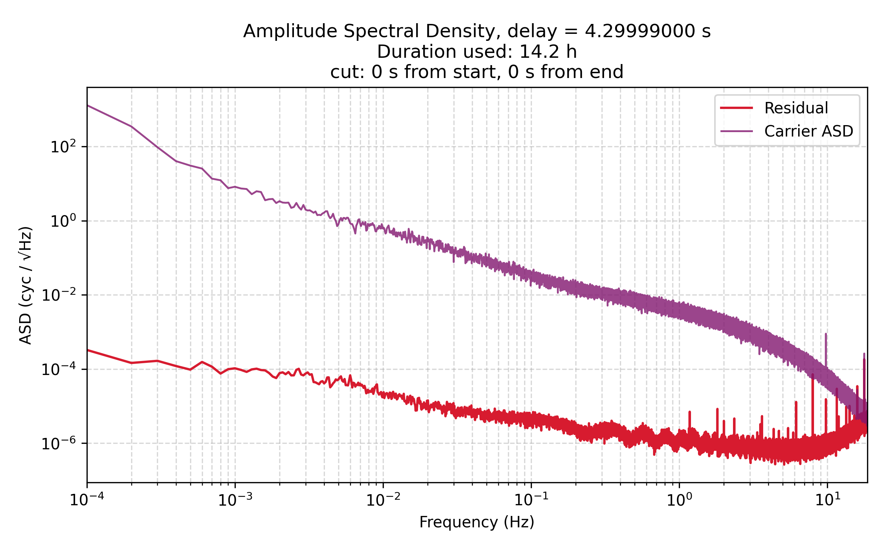
Context: Typical Baseline Measurement

Slide 5
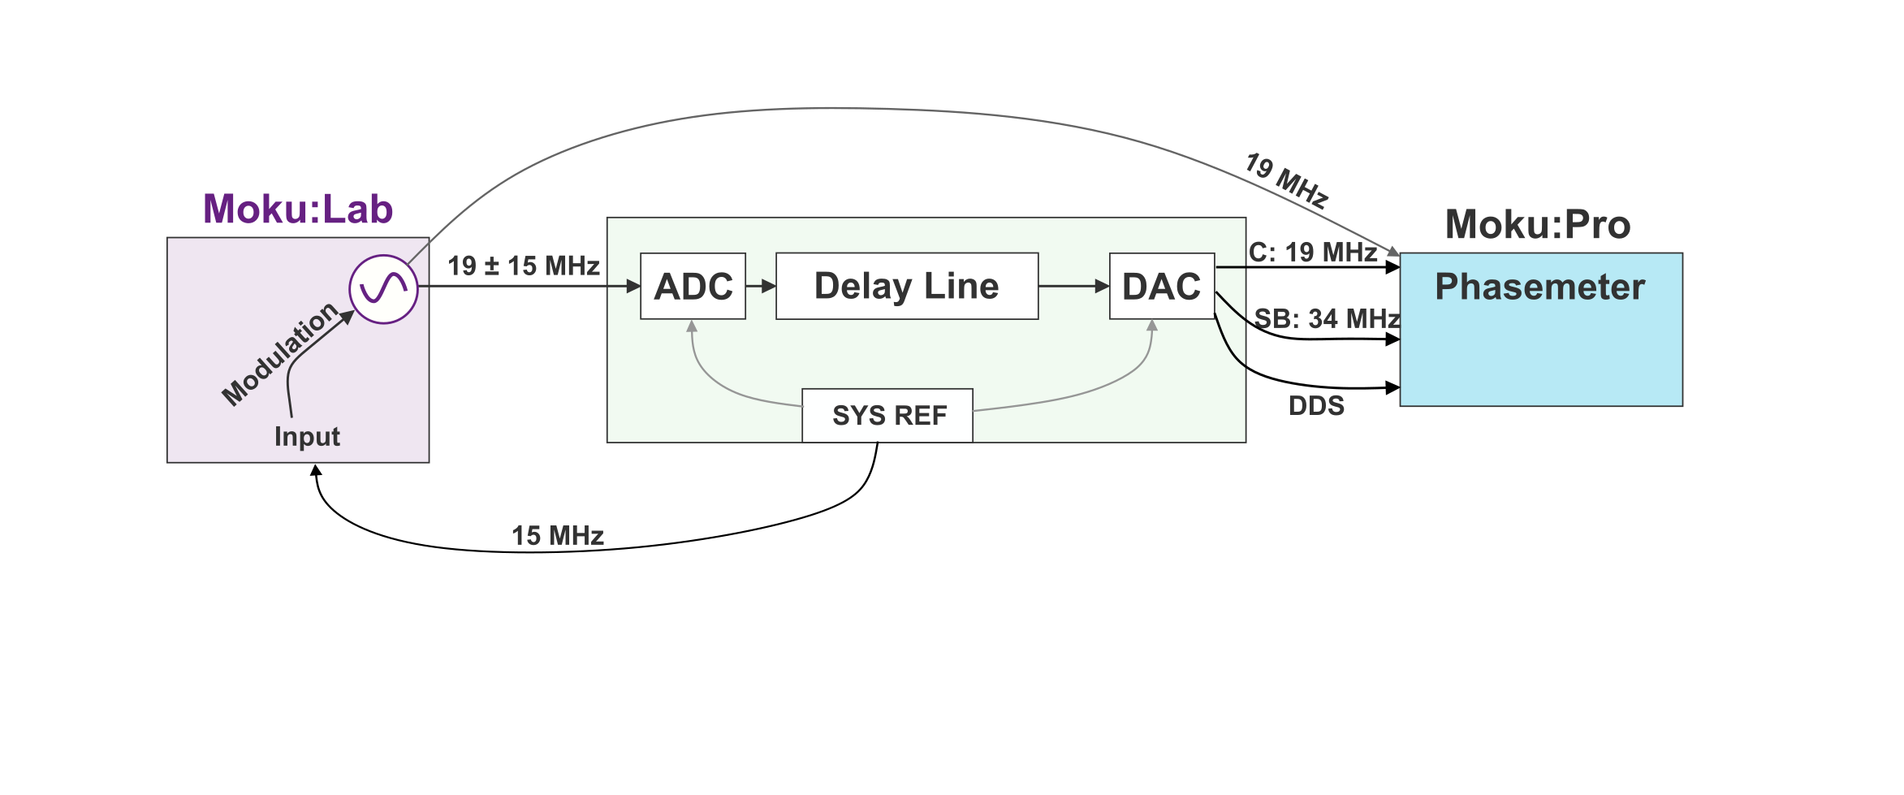
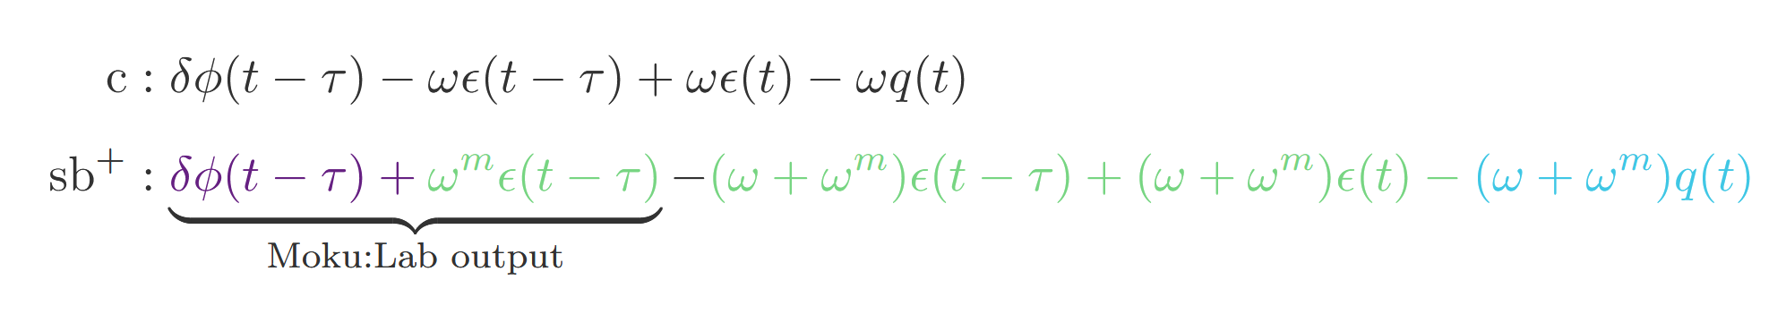
Baseline Measurement with SYS REF modulation
SYS REF is limited to 375 MHz
Phase noise in the PM readout:

Slide 6
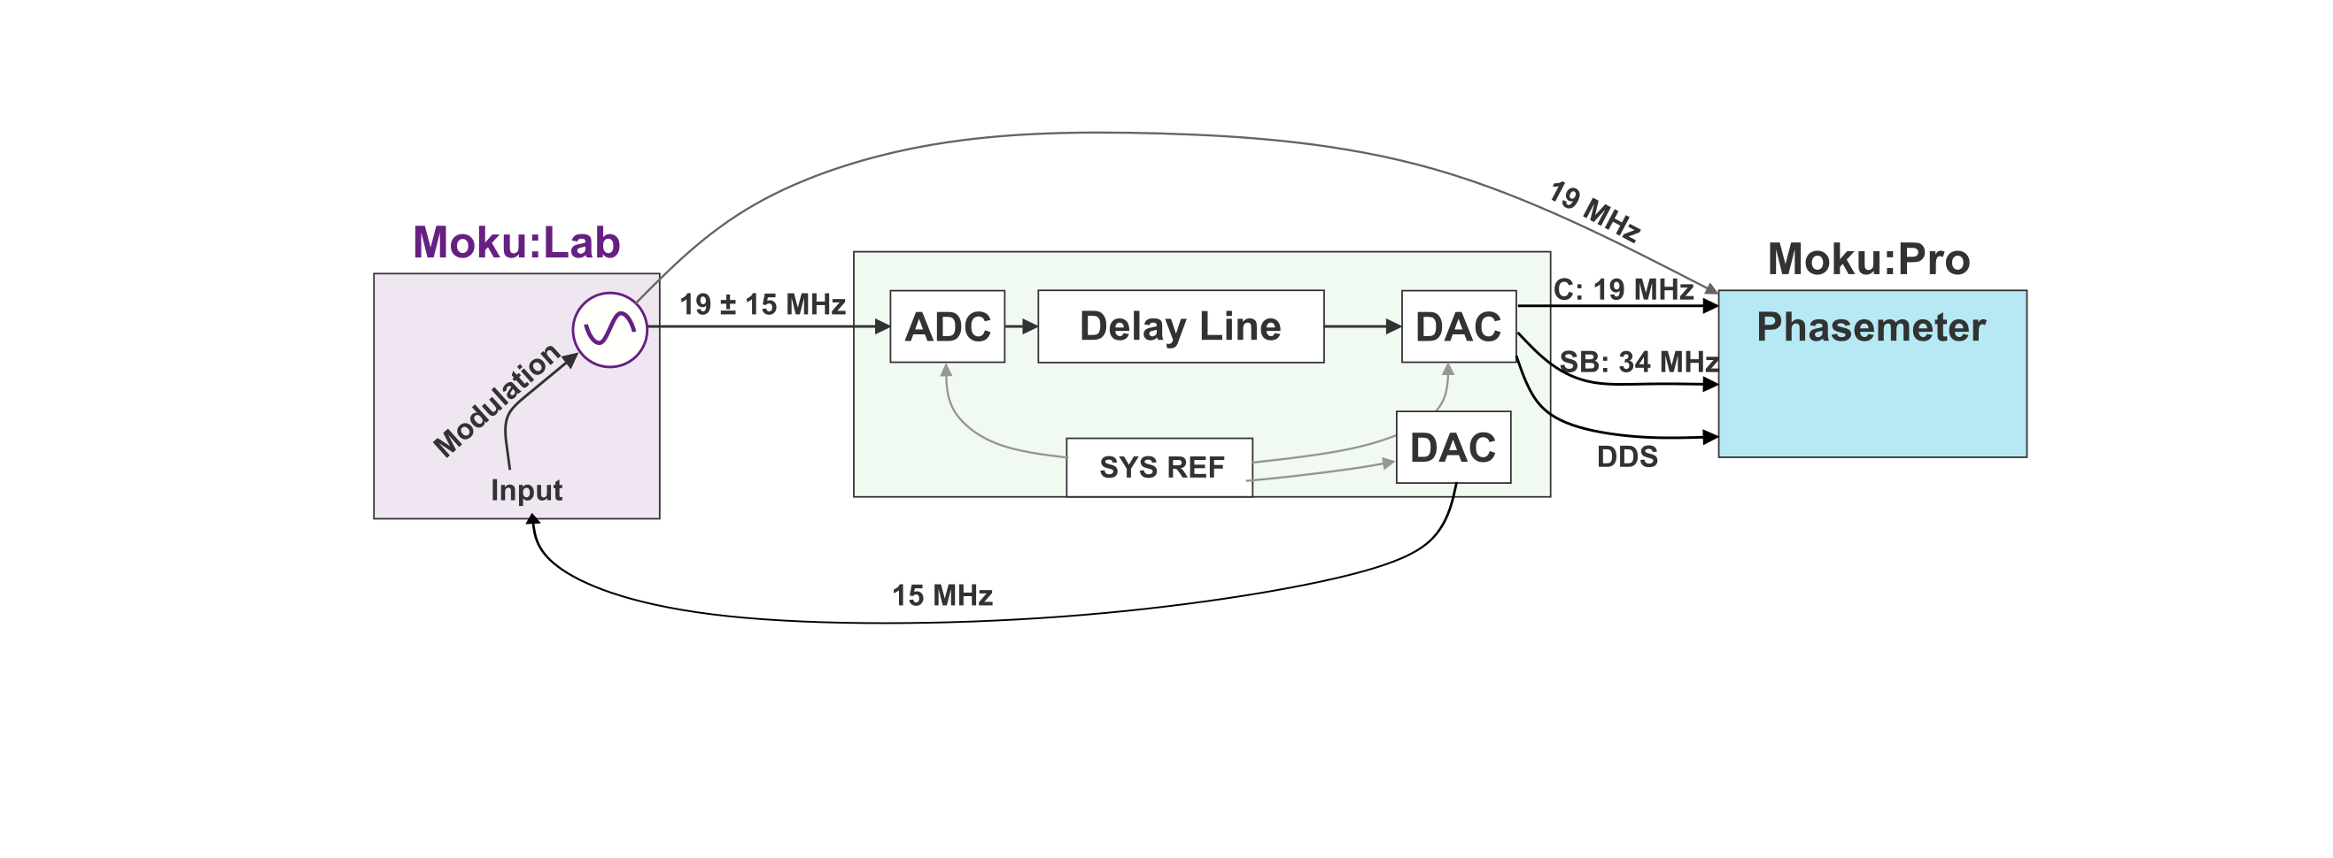
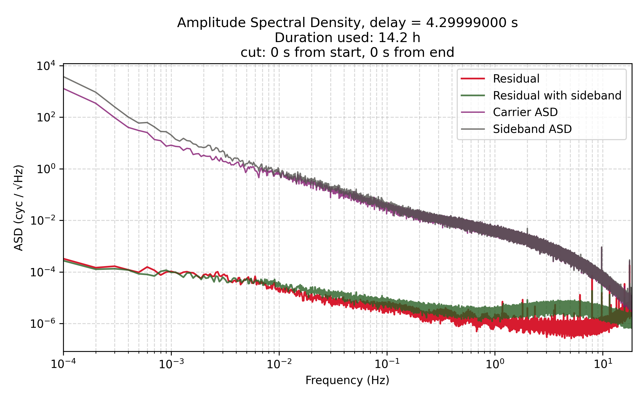
Baseline Measurement with DDS modulation

Slide 7
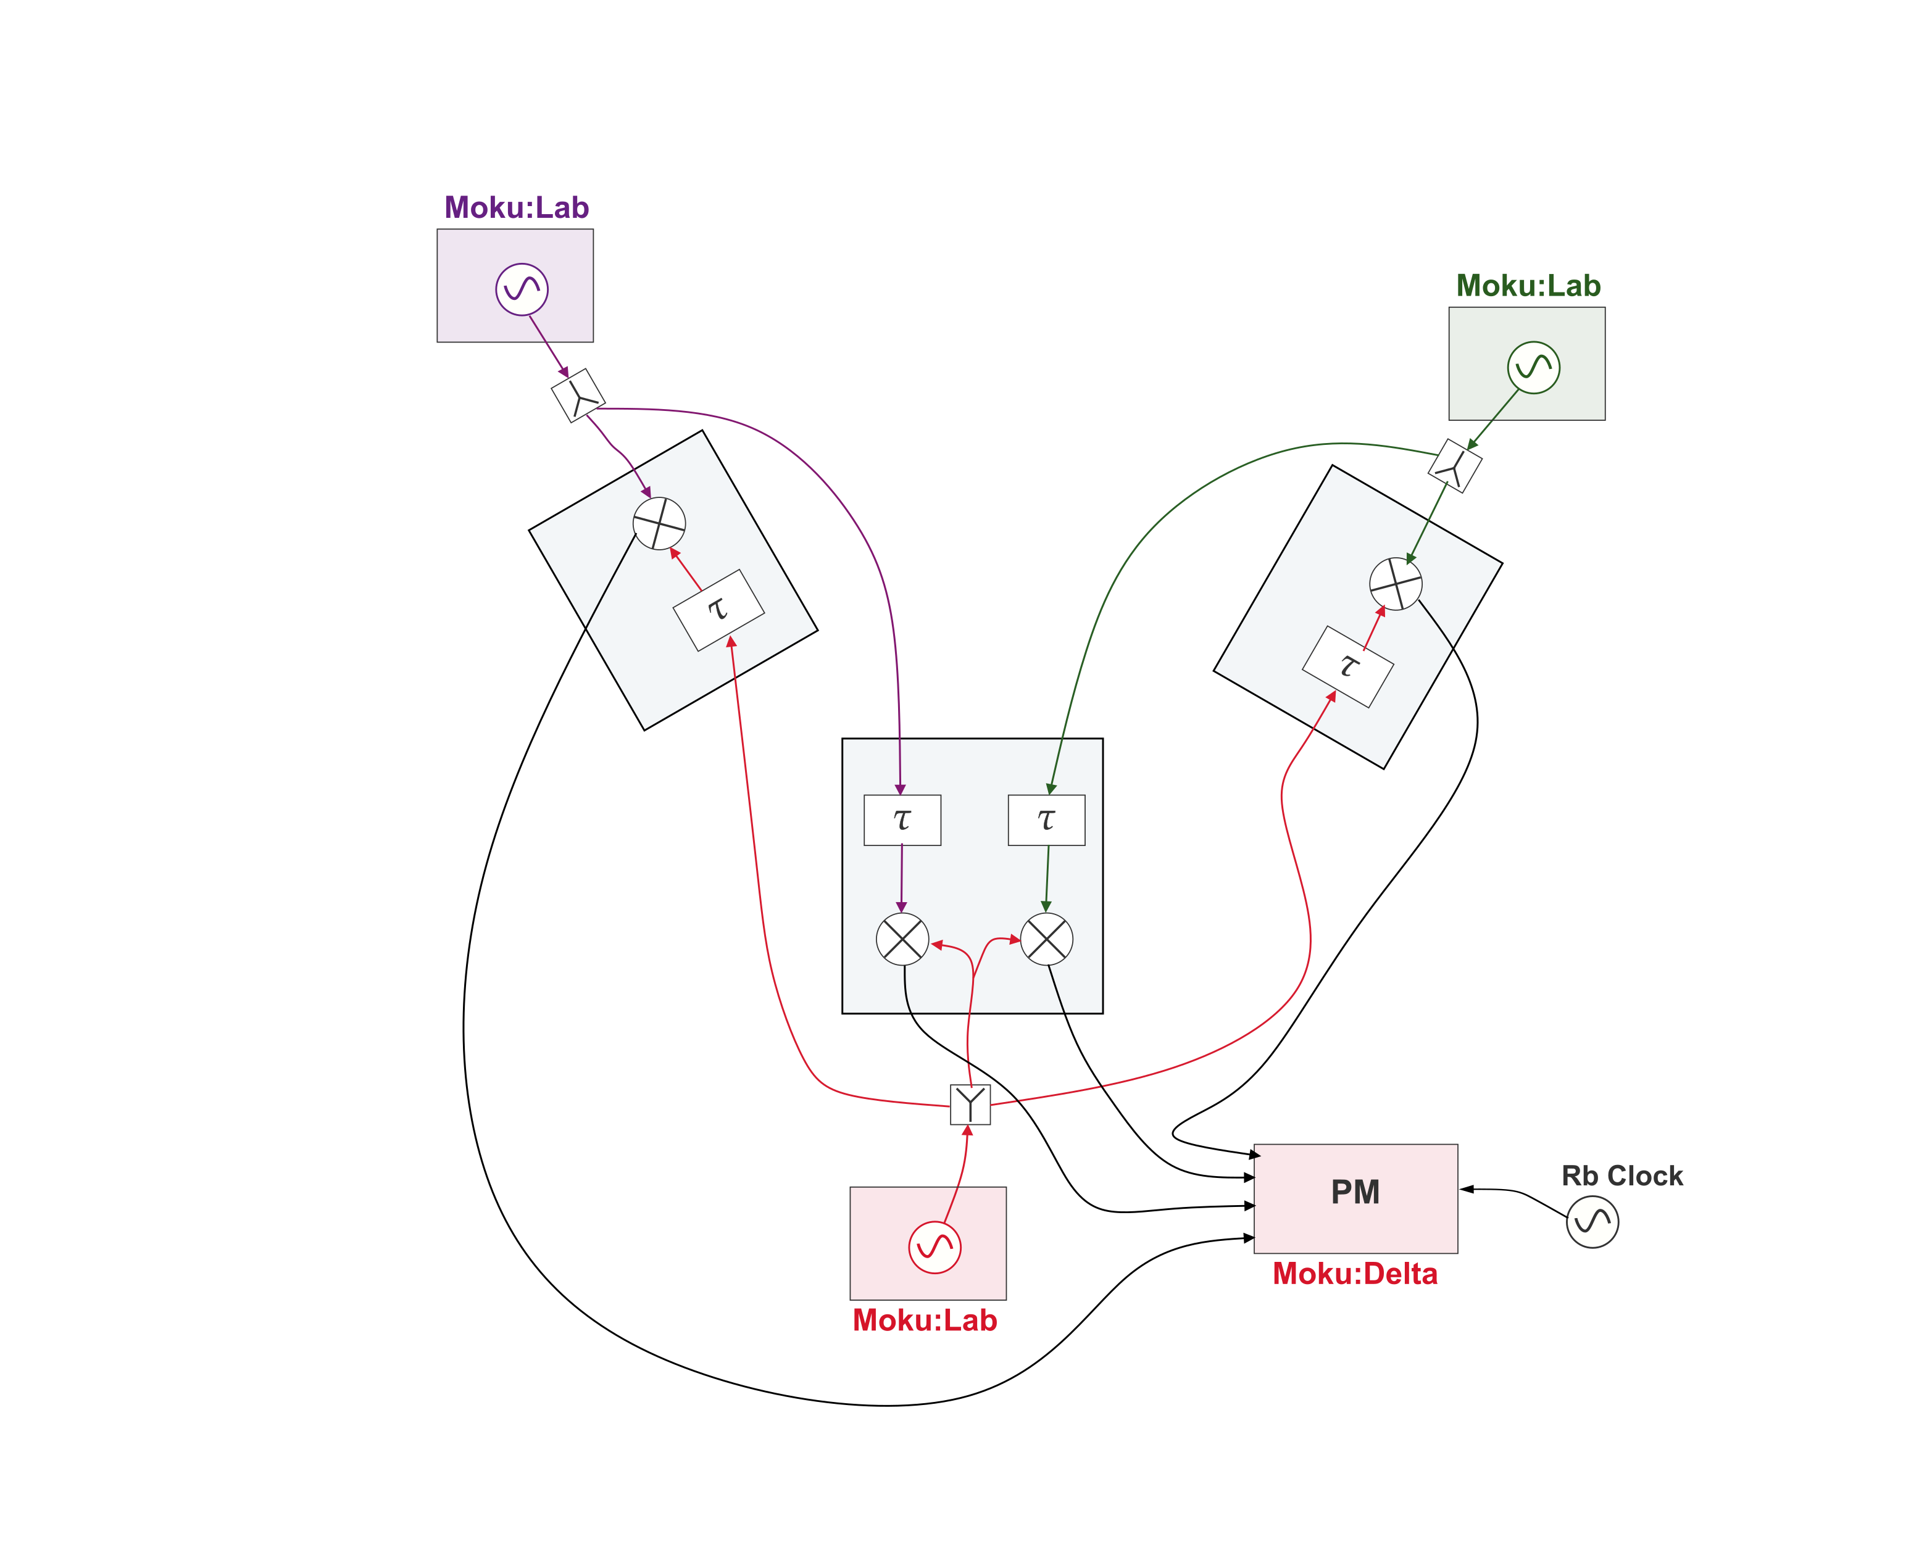
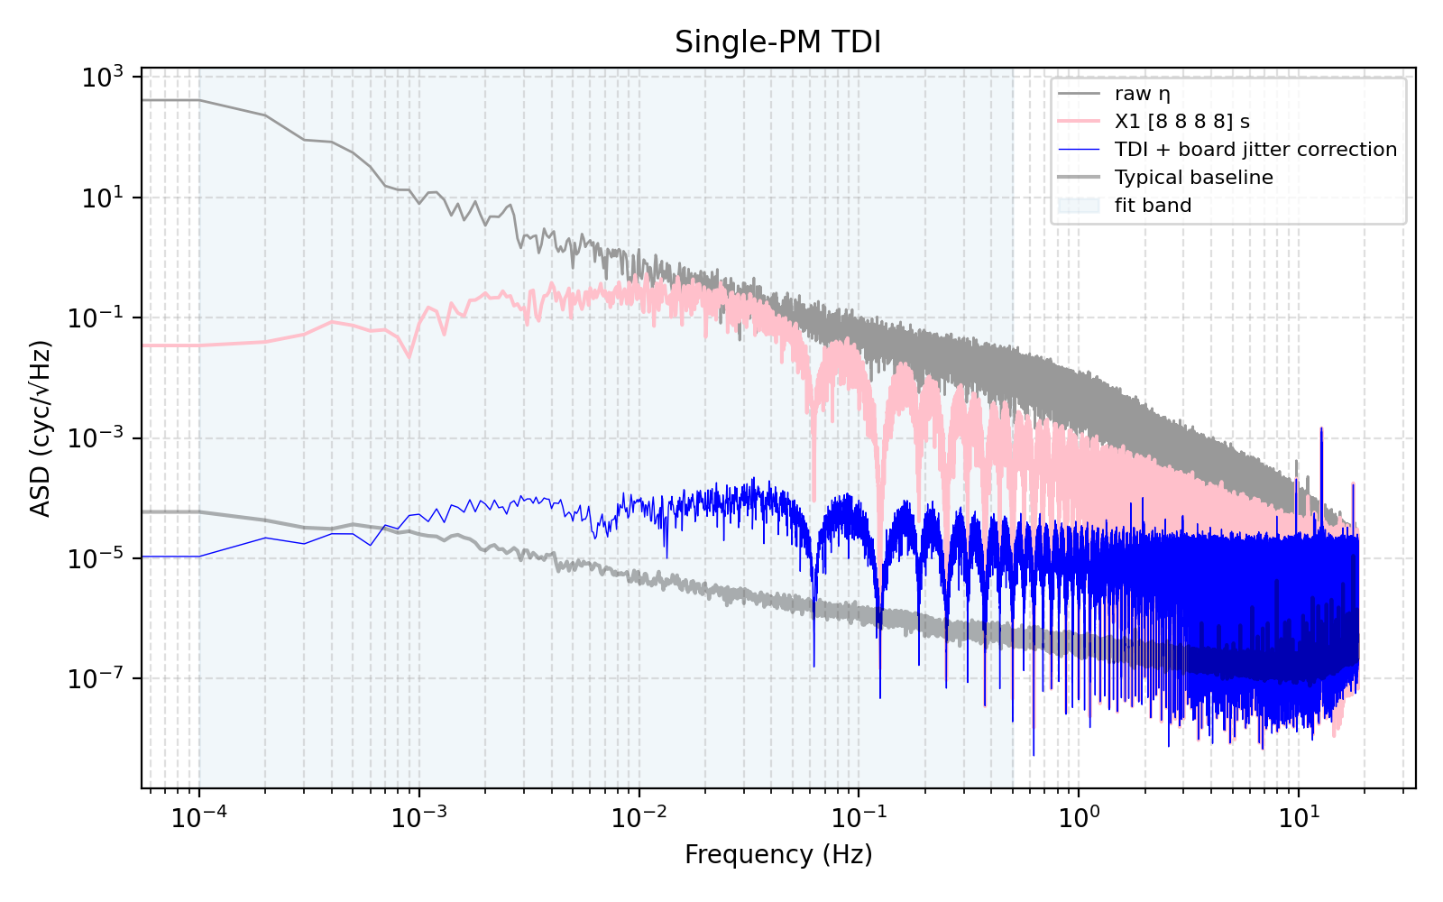
TDI1 Michelson X Combination

Slide 8
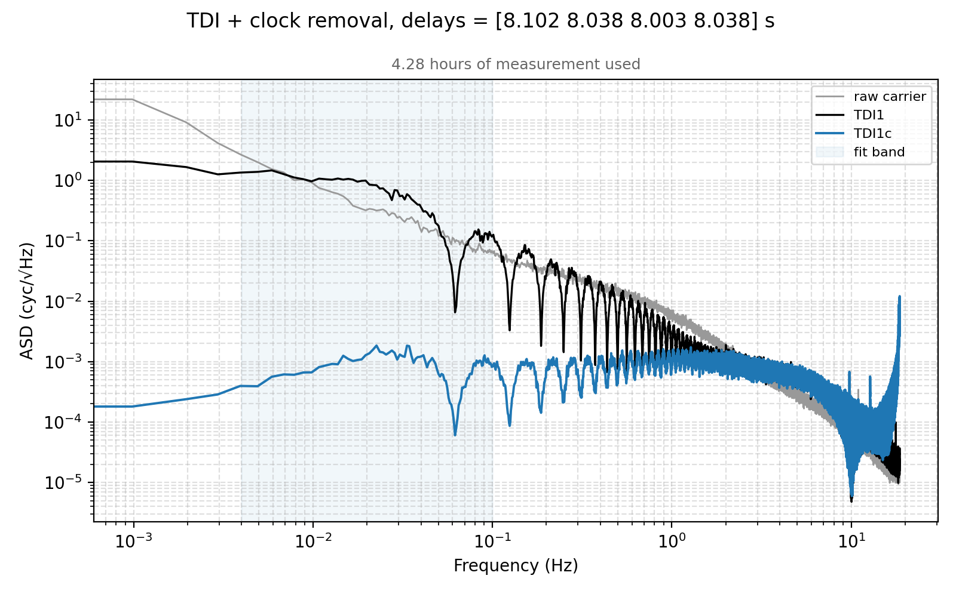
TDI1 Michelson X Combination with sidebands

