Slide 1


THESIS ADVISORY COMMITEE MEETING· 27 AUGUST 2026
Testbed for Validating Second-Generation TDI and Clock-Noise Correction for LISA
Karin Kruuse
Max Planck Institute for Gravitational Physics (AEI) · Leibniz Universität Hannover
STUDENT SEMINAR · TAC MEETING
27 August 2026 · 01 / 42
Notes:
Do I have a defined topic
And do I understand that topic, and the physics
The TAC decides if that’s a good topic for a thesis
is it worth a degree
is it realistic
For ambitious goals, what could be a minimum reasonable level
TAC2 –status and results, are there changes, what about publications
TAC3 – so what is the realistic goal now

Slide 2
Outline of the Talk
Context
Overview of the LISA Measurement System
Testbed Concept
TDI and Laser Frequency Noise: Status
Clock Noise: Status
Next Steps
Conclusions
STUDENT SEMINAR · TAC MEETING
27 August 2026 · 02 / 42

Slide 3
Context
Overview of the LISA Measurement System
Testbed Concept
TDI and Laser Frequency Noise: Status
Clock Noise: Status
Next Steps
Conclusions
STUDENT SEMINAR · TAC MEETING
27 August 2026 · 03 / 42
Notes:
I'll keep the context short, since you all know LISA well. I just want to establish two things before I get to my work: what makes LISA's measurement hard, and why the fix for it lives in post-processing — because that post-processing is exactly what my thesis is built to test.

Slide 4
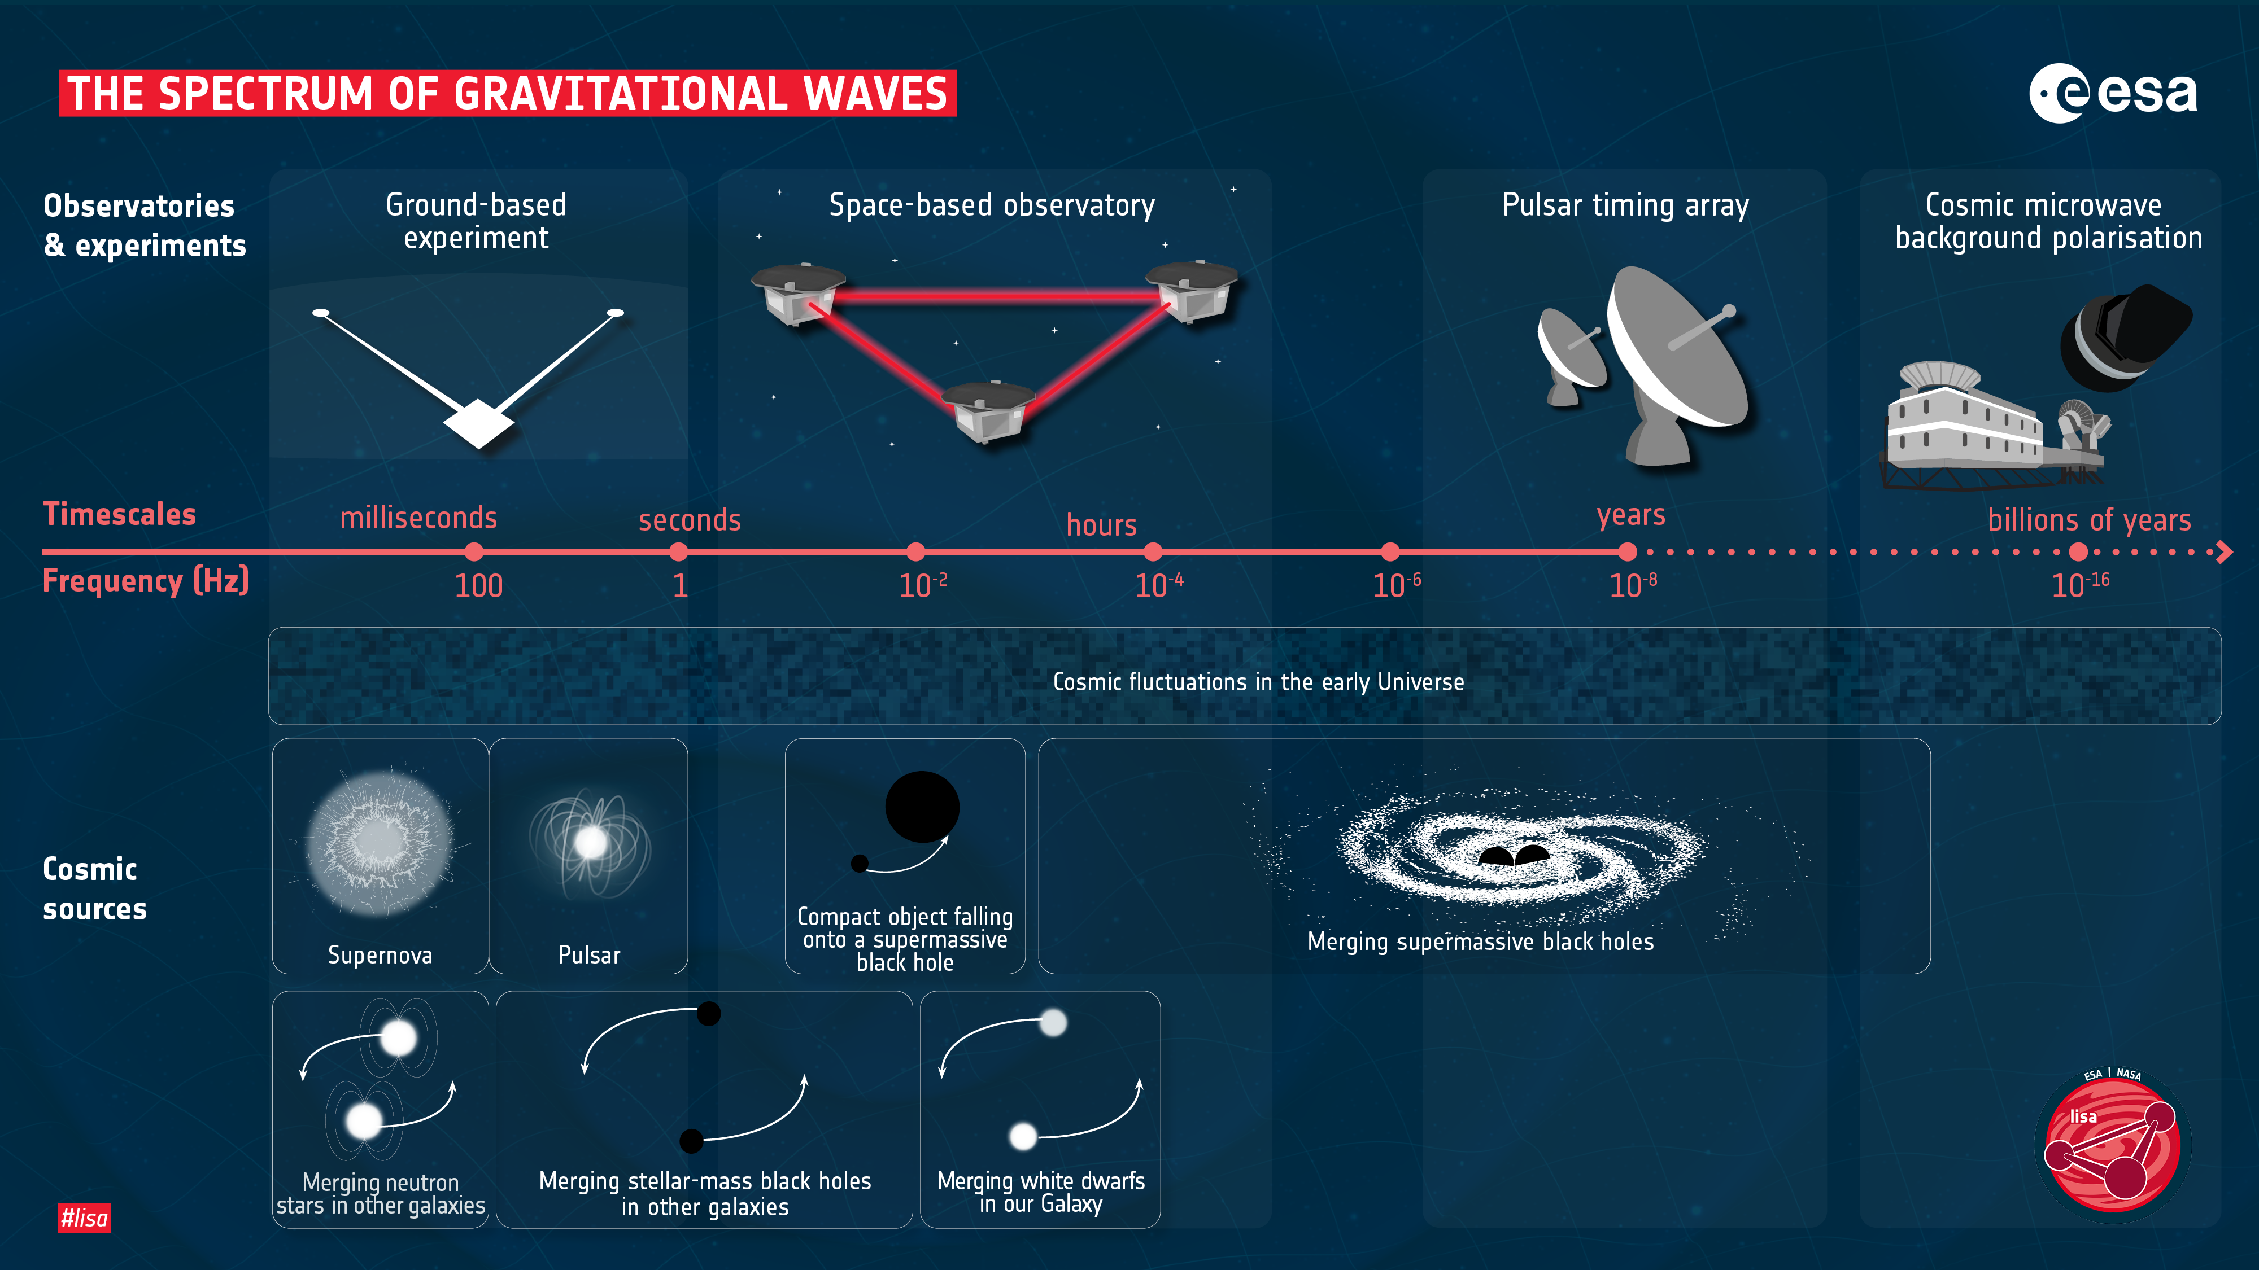
STUDENT SEMINAR · TAC MEETING
27 August 2026 · 04 / 42
Notes:
For LISA we want to put a gravitational-wave detector in space for two reasons: there's no seismic noise or Newtonian noise, and the arms can be made long enough — millions of kilometres — to be sensitive in the millihertz band. That's the regime LISA targets, and it's inaccessible from the ground

Slide 5
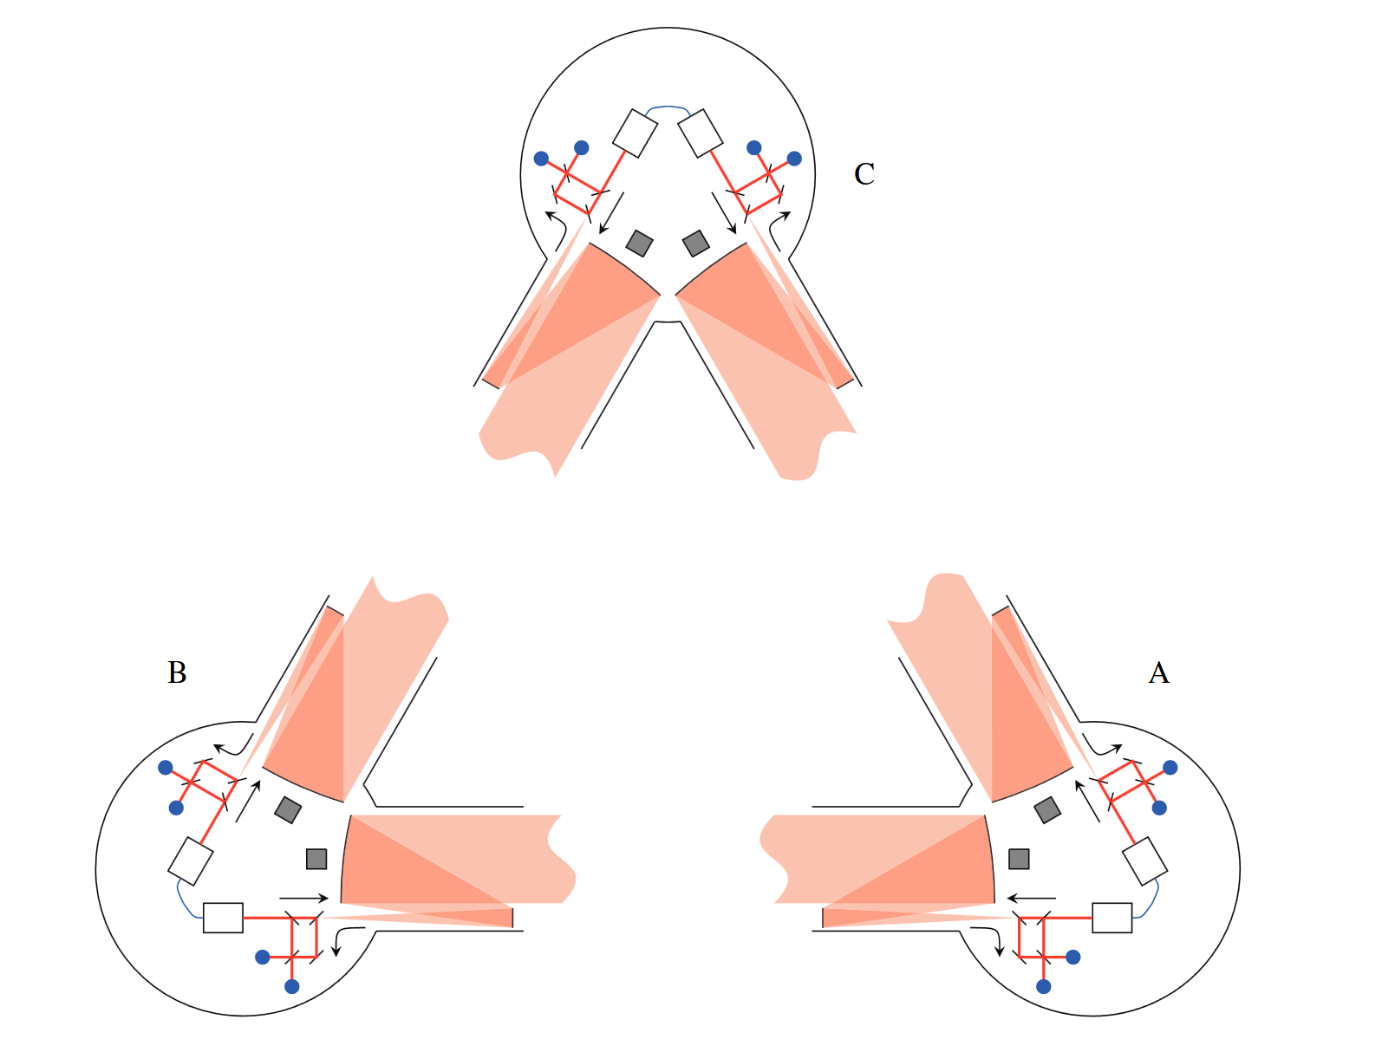
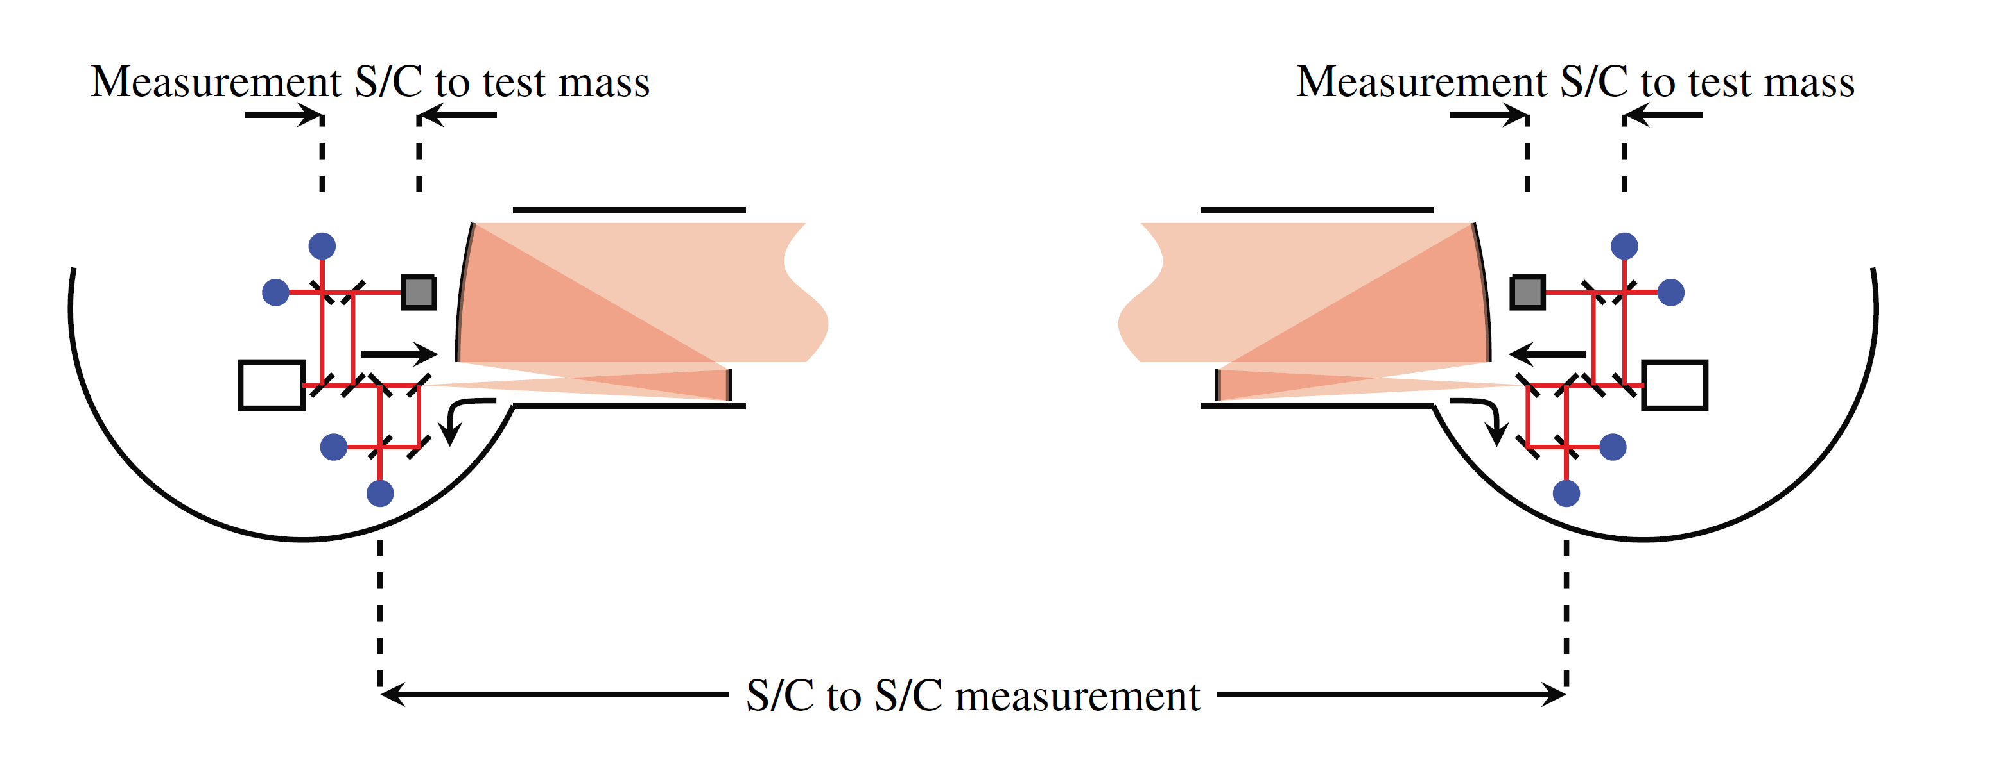
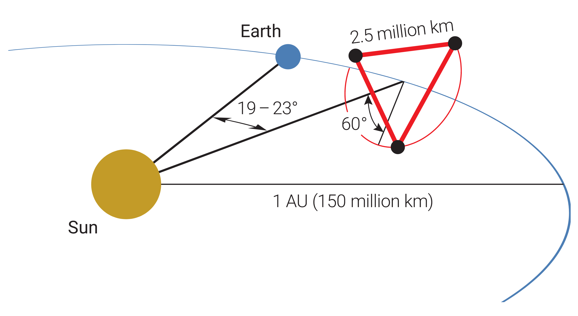
LISA Constellation
CONTEXT
Jennrich, 2010
STUDENT SEMINAR · TAC MEETING
Amaro-Seoane et al., 2017
27 August 2026 · 05 / 42
Notes:
And those long arms are the constellation itself: LISA is three spacecraft, 2.5 million kilometres apart. To measure the distance change along one arm — between the two opposing test masses — LISA actually splits it between three separate interferometers. We call this split interferometry: one arm, several interferometers.
The interferometer we care about for this experiment is the spacecraft-to-spacecraft interferometer — the long-arm link — that’s what Time delay interferometry is most concerned with.

Slide 6
Laser Frequency Noise
CONTEXT
As per LISA laser frequency noise requirements
Hence for the corresponding arm length uncertainty we get
But to be sensitive enough to detect GWs, the needed relative arm length uncertainty gives us
Jennrich, 2010
STUDENT SEMINAR · TAC MEETING
27 August 2026 · 06 / 42
Notes:
Delta L is first the arm length differneces and then its taken to be the ranging error basically we see that for the given amount of laser noise that we will have, the difference between the arm lengths should be 1 m. And we put a pin in that.

Slide 7
Context
Overview of the LISA Measurement System
Testbed Concept
TDI and Laser Noise: Status
Clock Noise: Status
Next Steps
Conclusions
STUDENT SEMINAR · TAC MEETING
27 August 2026 · 07 / 42

Slide 8
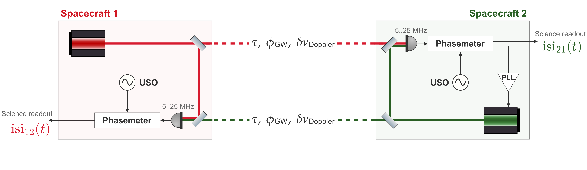
LISA Science Interferometer
OVERVIEW OF THE LISA MEASUREMENT SYSTEM
Demodulated phase readout on spacecraft 1 inter-spacecraft interferometer facing spacecraft 2
STUDENT SEMINAR · TAC MEETING
27 August 2026 · 08 / 42
Notes:
Let's zoom into a single link — two lasers, one on each spacecraft. Each beam is measured locally and, after the arm delay, at the far spacecraft, where it beats against the local laser on the photodiode — we get a heterodyne measurement.
The green spacecraft is PLL-locked to keep that beat note in the phasemeter band, 5 to 25 MHz, as the Doppler shifts it around. We get a similar beatnote here on the red spacecraft as well.
From the photodiode, the signal goes into the phasemeter: it's sampled by an ADC — driven by the onboard ultra-stable oscillator, the USO — and then IQ-demodulated to give the phase fluctuations.
We label this readout isi₁₂: the inter-spacecraft interferometer on spacecraft 1, facing spacecraft 2.
Two noise terms in this readout matter for the rest of the talk. The first is the laser frequency noise, p — the red laser is cavity-locked, which prestabilises it to the requirement level I showed earlier, but it still sits orders of magnitude above the signal. The second is the clock noise, q — the USO's timing jitter gets imprinted when the ADC samples, so the phase error scales with the beatnote frequency, and it's referenced to each satellite's own proper time.
And it's this coupling — how p and q enter the readout — that TDI and the clock-noise removal are built on. So that exact coupling is what we replicate in the lab — and the open question is whether anything else couples in that the current models miss.

Slide 9
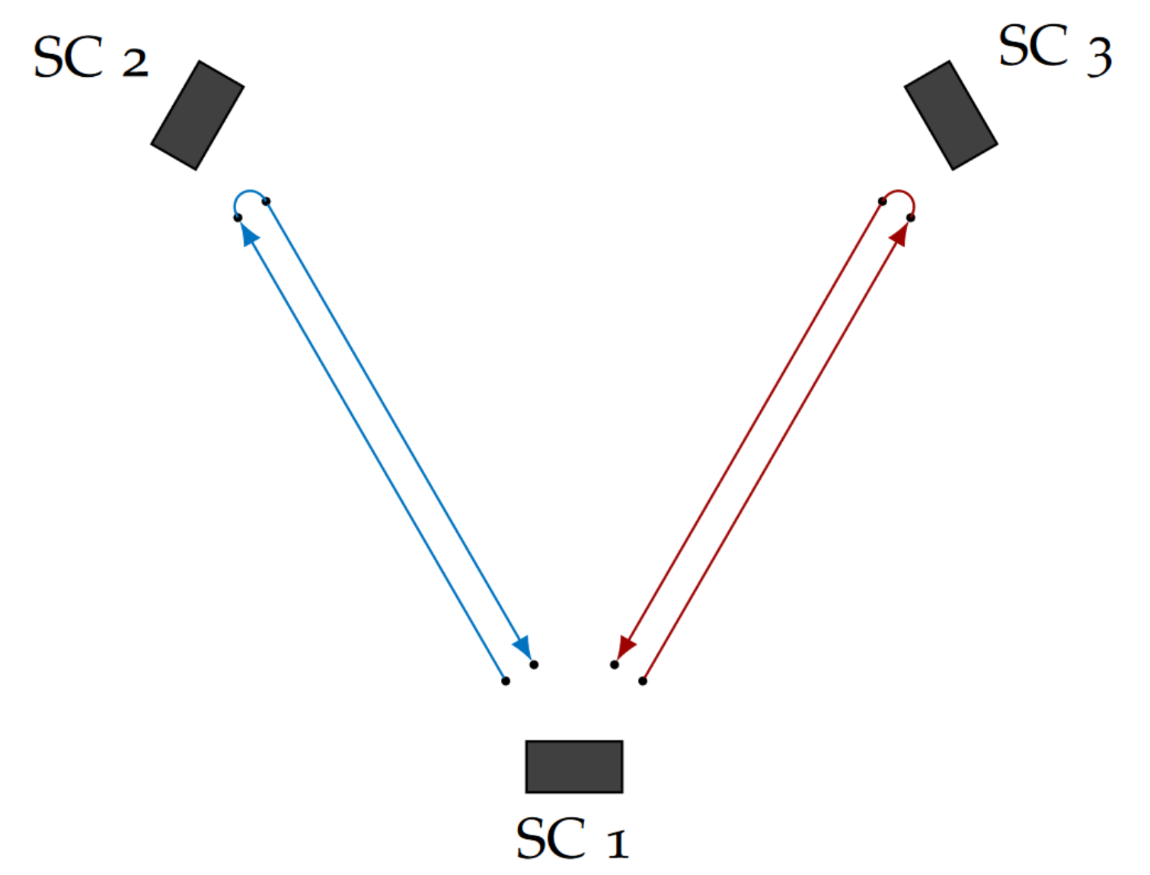
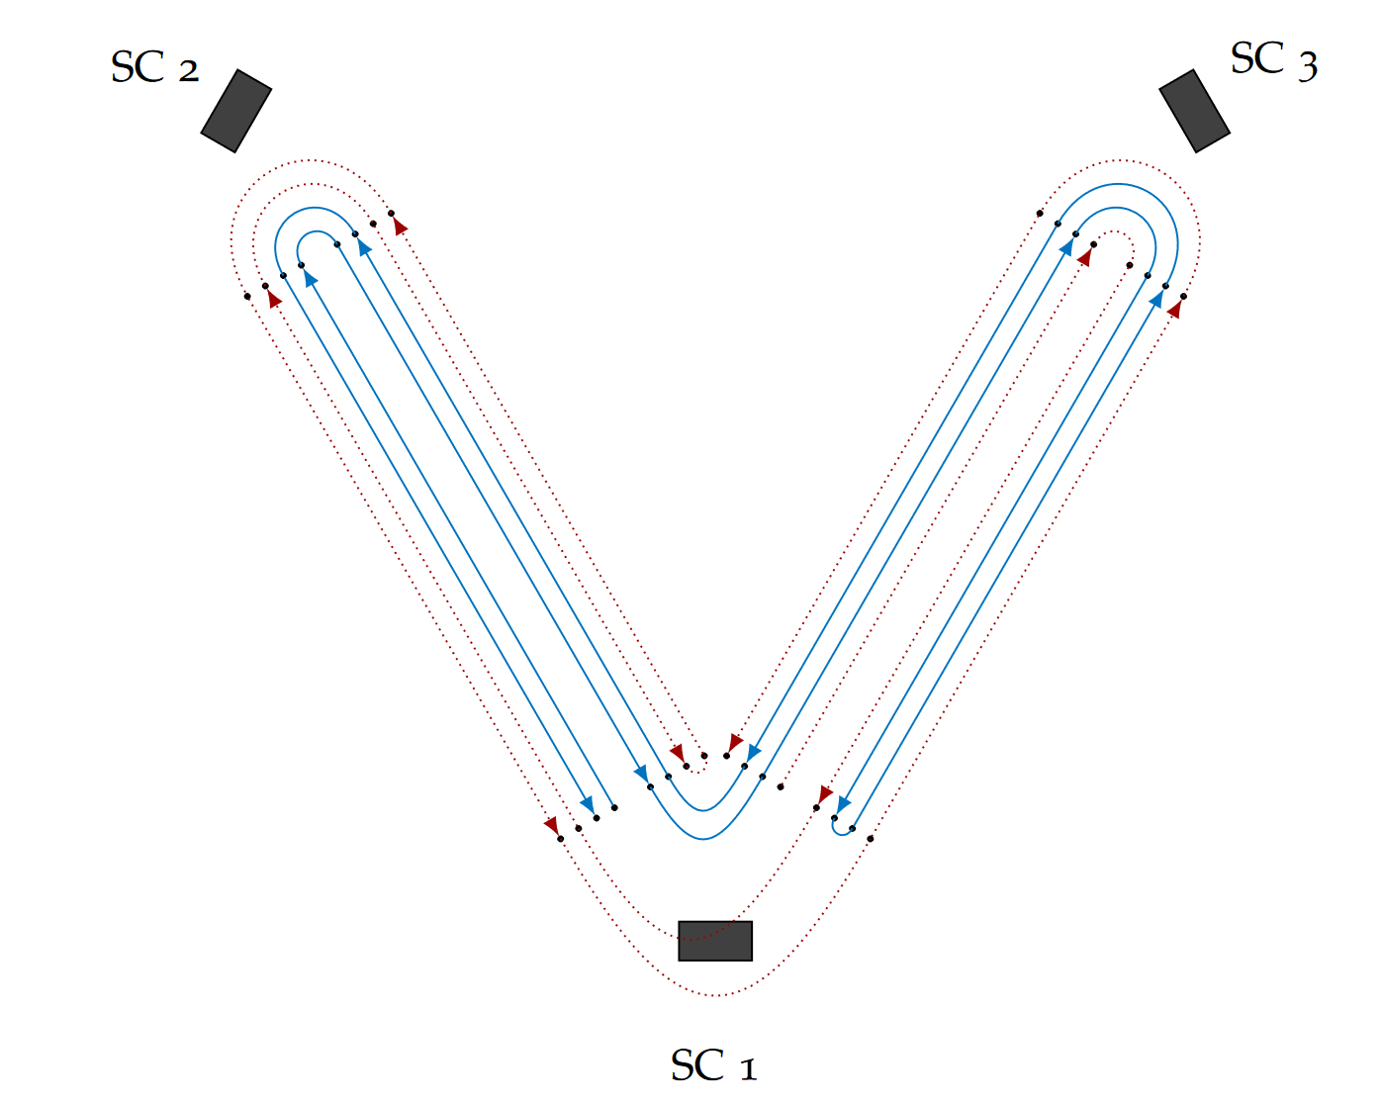
TDI and Laser Frequency Noise
OVERVIEW OF THE LISA MEASUREMENT SYSTEM
TDI synthesizes equal arm interferometers in post-processing
0th generation TDI
2nd generation TDI
Credit: O. Hartwig
STUDENT SEMINAR · TAC MEETING
27 August 2026 · 09 / 42
Notes:
TDI cancels the laser noise in post-processing. We recorded the beatnote phases separately, then time-shift and combine them to synthesize equal arms, so the laser noise lines up and subtracts. But the arms move during the light's round trip — first-generation assumes they're fixed and leaves a residual, so we use second-generation, which nests the delays to stay matched while the arm changes.
Now, if you know the light-travel delays with infinite accuracy, then in theory you can subtract out all of the laser frequency noise between the lasers. But we of course do no know the delays with such accuracies. But what is “guaranteed” by requirements, is the knowledge to about 3 ns – again this is the same 1 m from a separate ranging measurement, which I will not get into here.

Slide 10
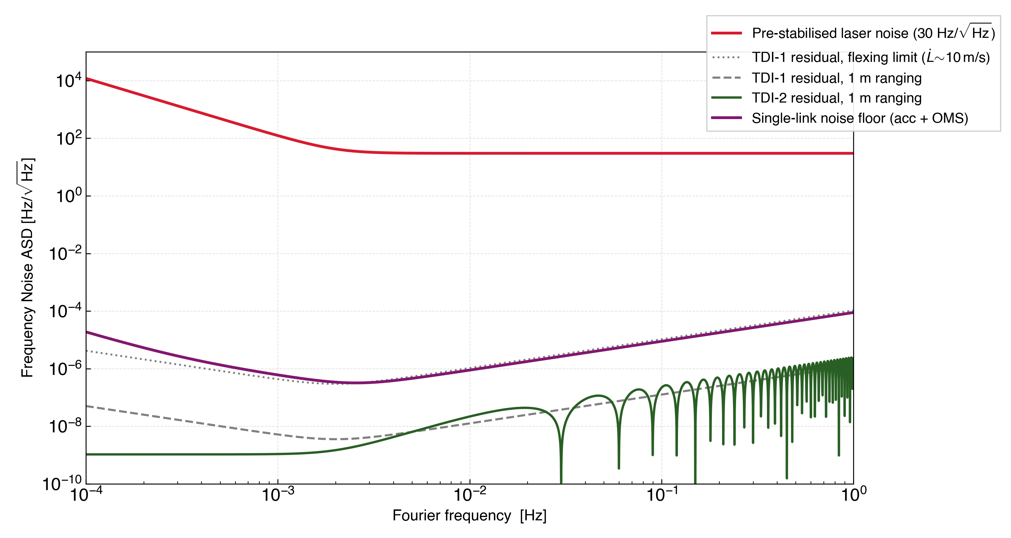
Expected Laser Noise Reduction
OVERVIEW OF THE LISA MEASUREMENT SYSTEM
TDI needs to suppress laser frequency noise by about 8 orders of magnitude to bring it below other, limiting noises.
For LISA, 2nd generation TDI combinations should be able to achieve this.
STUDENT SEMINAR · TAC MEETING
27 August 2026 · 10 / 42
Notes:
This is the budget. Red is the pre-stabilised laser noise, 30 hertz per root-hertz. Second-generation TDI has to bring that down below the single-link floor — the purple curve, which is our benchmark. Blue is the residual after TDI-2: comfortably below the floor, limited by metre-level ranging. So TDI has to suppress laser noise by about eight orders, and second-generation reaches it.

Slide 11
Context
Overview of the LISA Measurement System
Testbed Concept
TDI and Laser Frequency Noise: Status
Clock Noise: Status
Next Steps
Conclusions
STUDENT SEMINAR · TAC MEETING
27 August 2026 · 11 / 42

Slide 12
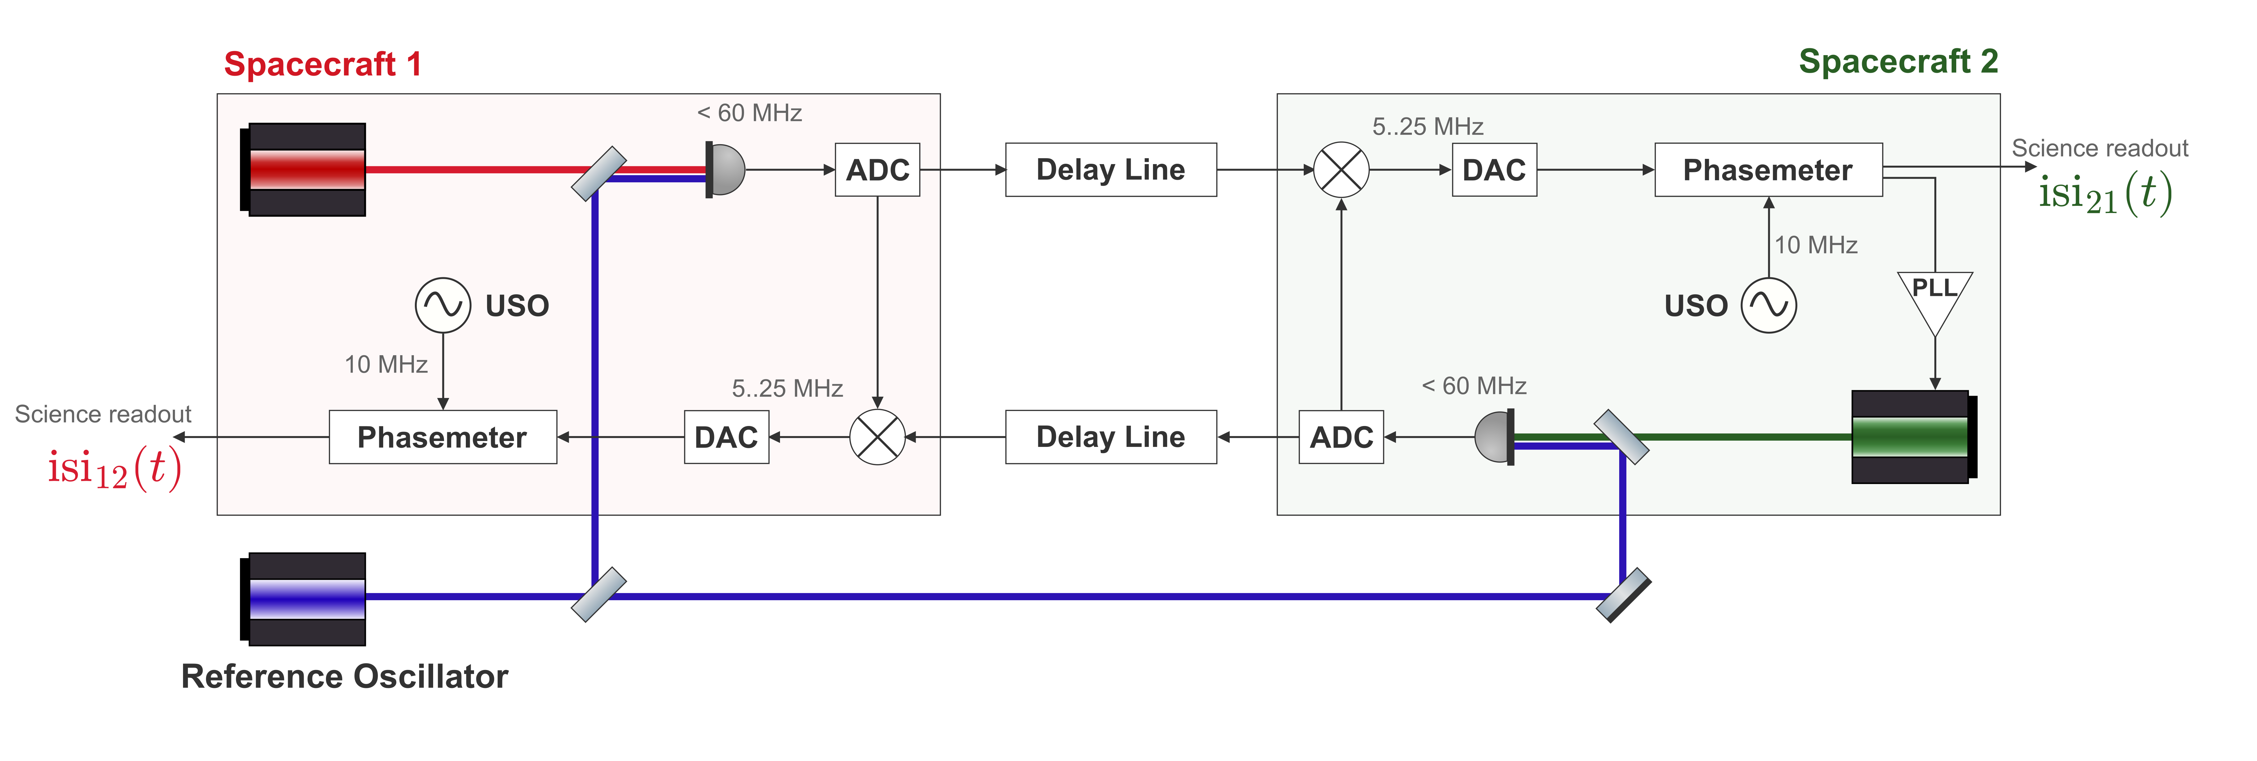
Testbed One Arm Link
TESTBED CONCEPT
STUDENT SEMINAR · TAC MEETING
27 August 2026 · 12 / 42
Notes:
Blah blah about the digital delay line.
ADC nyquist limit
Mixing on the electronics
Delay line can inject the GW signal and Doppler shift

Slide 13

Comparison of the Readouts
TESTBED CONCEPT
LISA arm
In-flight link
Testbed arm
Benchtop analogue
STUDENT SEMINAR · TAC MEETING
27 August 2026 · 13 / 42
Notes:
Laser noise still actually has TDI structure

Slide 14
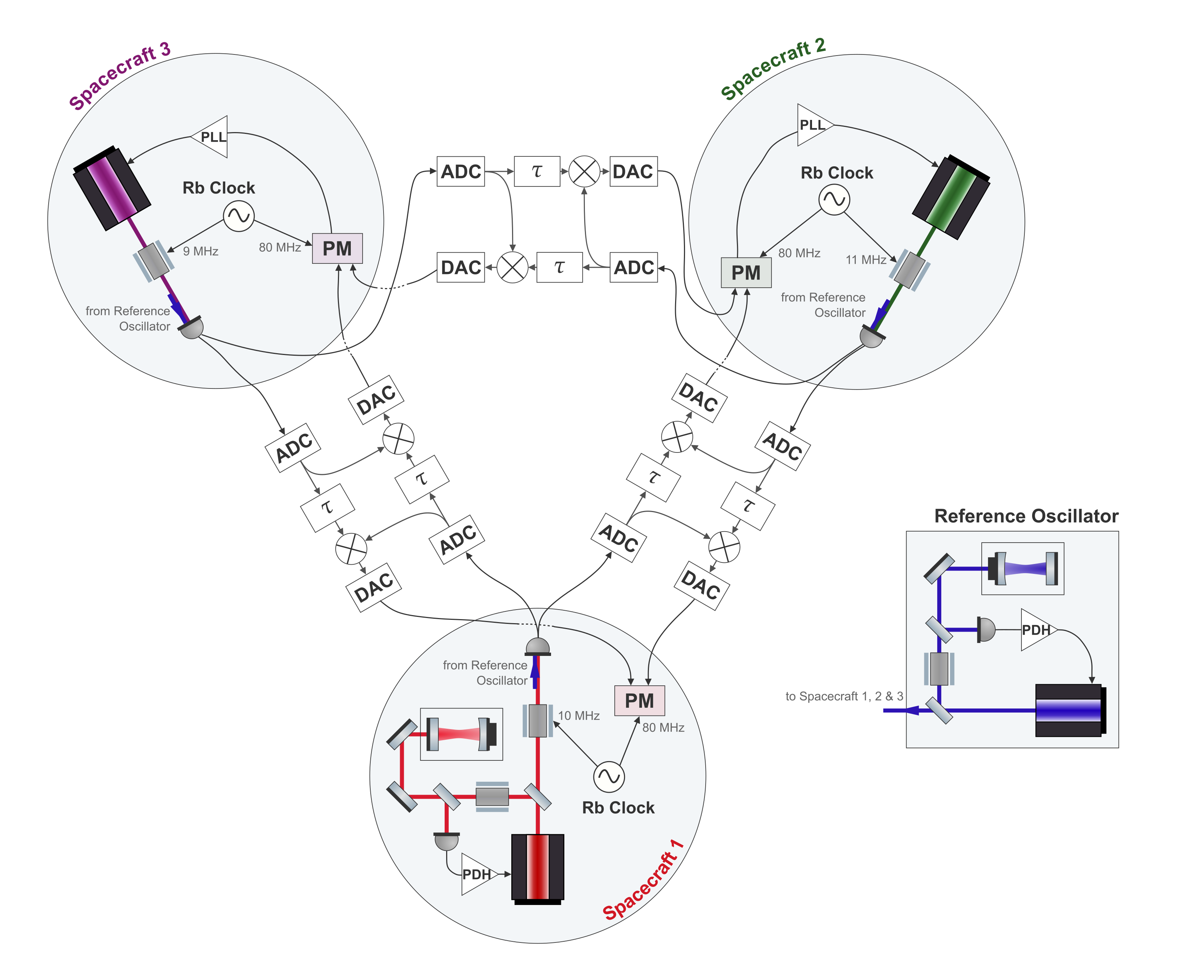
The Full Setup
TESTBED CONCEPT
One laser per spacecraft
An independent source on each satellite
Cavity-locked primary laser
Provides LISA-like laser frequency noise
Independent clocks
Allows to demonstrate clock noise removal
Six separate delay lines
Two per inter-spacecraft link
STUDENT SEMINAR · TAC MEETING
27 August 2026 · 14 / 42
Notes:
This is the full testbed we're building toward — three spacecraft, one cavity-locked laser and an independent clock each, connected by six delay lines.
What we deliberately leave out is anything that doesn't affect the post-processing: there are no test masses or test-mass interferometers here. We reproduce the inter-spacecraft measurement, and that's what TDI and clock removal act on.
Working out which parts of LISA are relevant to reproduce, and how faithfully, is the subject of a paper we're currently drafting. And it's this configuration that lets us run TDI and clock-noise removal together, on real optical signals."

Slide 15
Context
Overview of the LISA Measurement System
Testbed Concept
TDI and Laser Frequency Noise: Status
Clock Noise: Status
Next Steps
Conclusions
STUDENT SEMINAR · TAC MEETING
27 August 2026 · 15 / 42

Slide 16
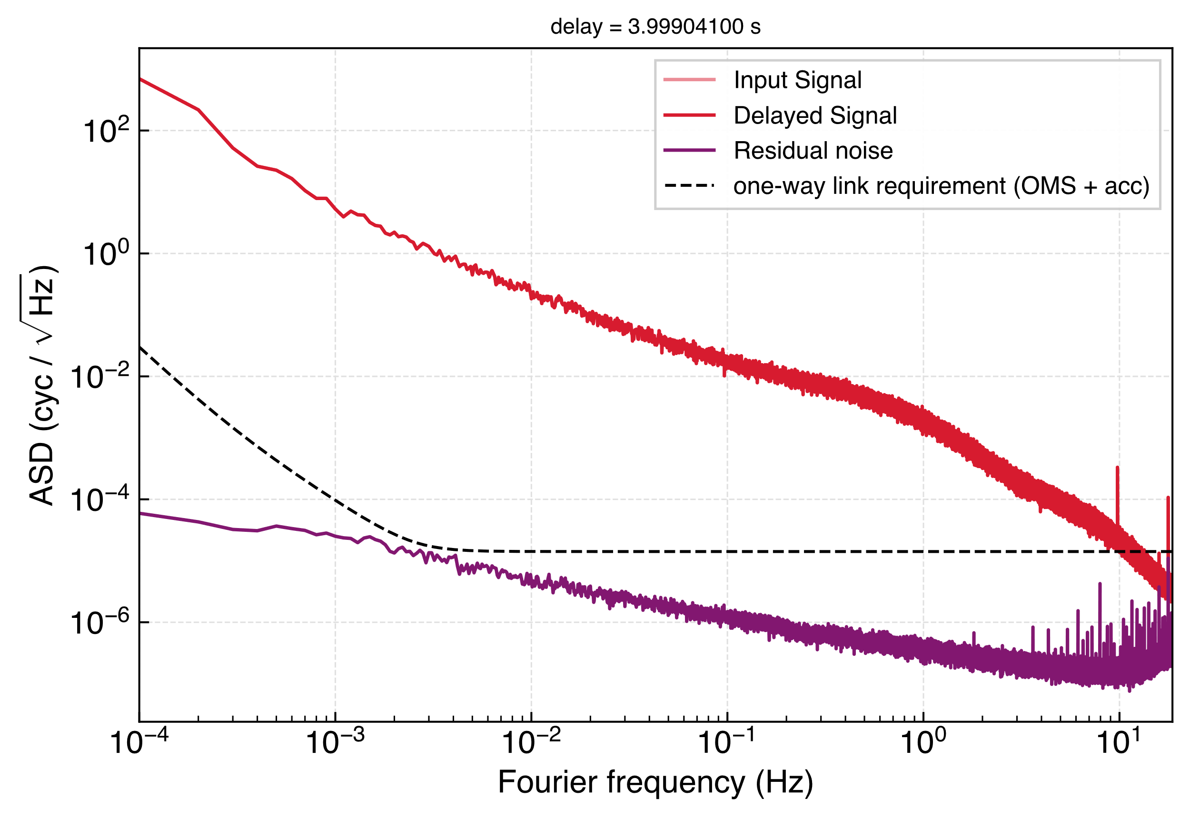
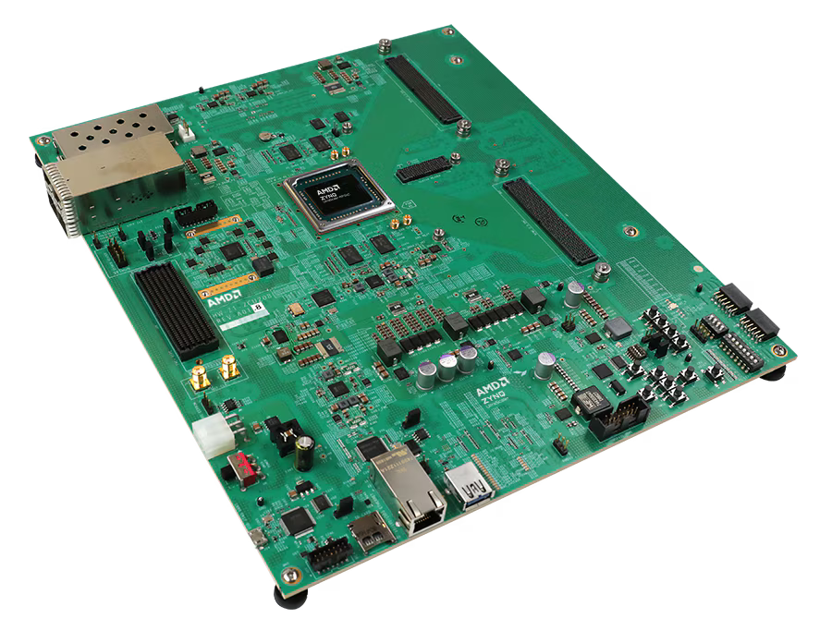
The Delay Line
TDI AND LASER FREQUENCY NOISE: STATUS
Digitally delays MHz signals and mixes the LISA-like beat notes.
Applies Doppler shifts
Injects the GW signal
AMD Zynq™ UltraScale+™ RFSoC ZCU208 Evaluation Kit
STUDENT SEMINAR · TAC MEETING
27 August 2026 · 16 / 42
Notes:
"The delay line itself was built by my colleague Reid Ferguson, programmed in VHDL on the RFSoC board. It's what makes the testbed work: it applies the time-varying delays between the arms, adds the Doppler shifts, and injects the gravitational-wave signal. And here's the baseline noise measurement — it sits below the single-link floor, so the delay line isn't what limits us.

Slide 17
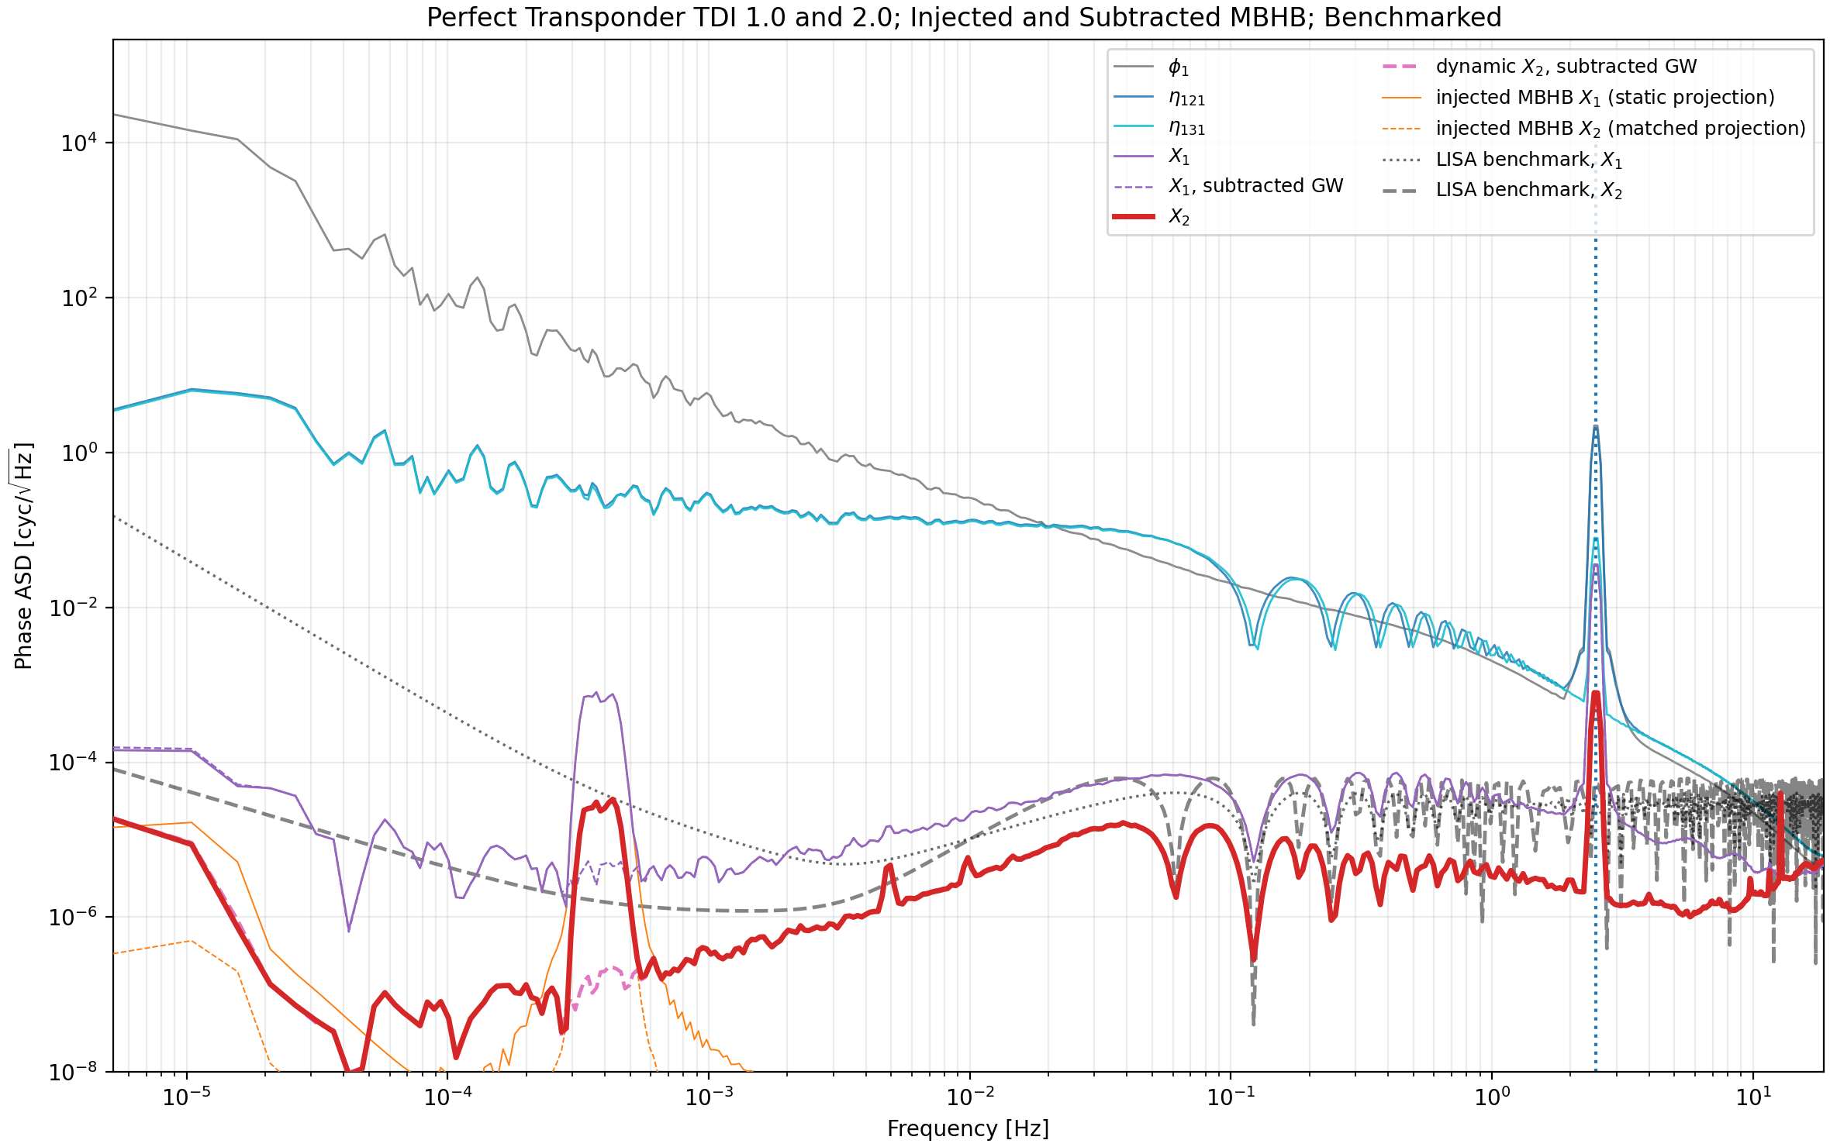
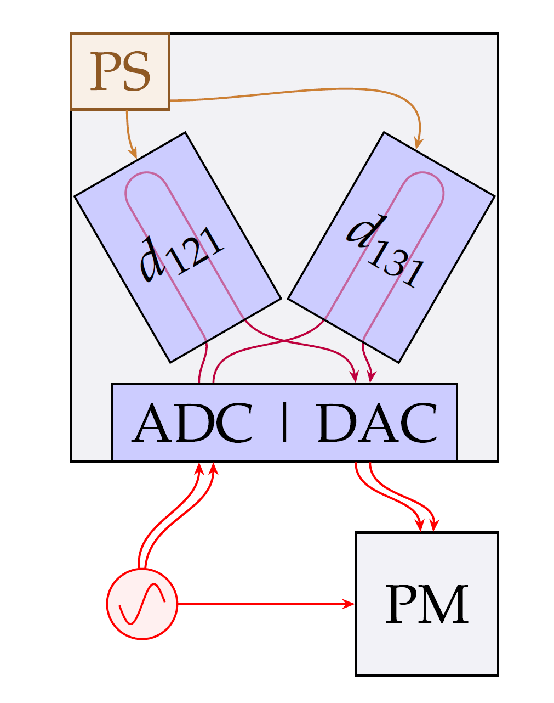
Demonstration of TDI 2 with Signal Injection
TDI AND LASER FREQUENCY NOISE: STATUS
Credit: R. Ferguson
STUDENT SEMINAR · TAC MEETING
27 August 2026 · 17 / 42
Notes:
The TDI 2 measurement
The injected noise level is low, so the level of noise removed might be better with more noise
Calculate the order of magnitude of noise removed

Slide 18
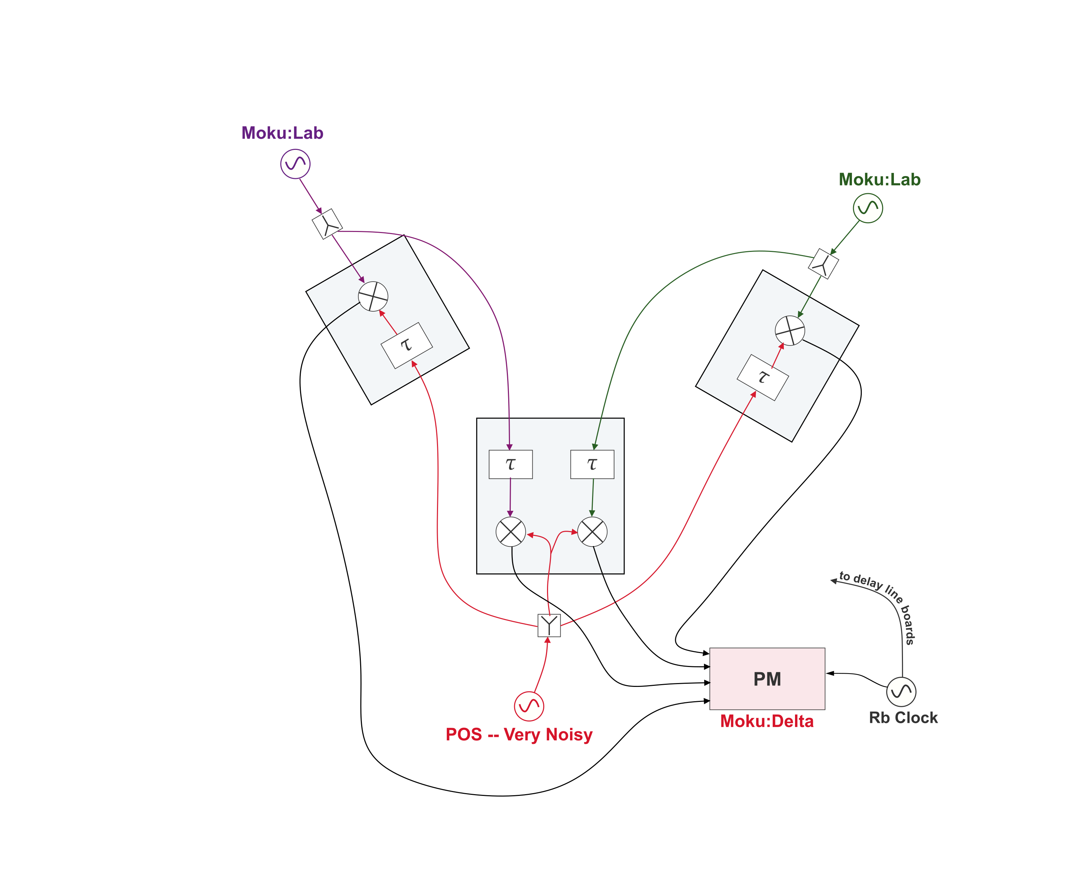
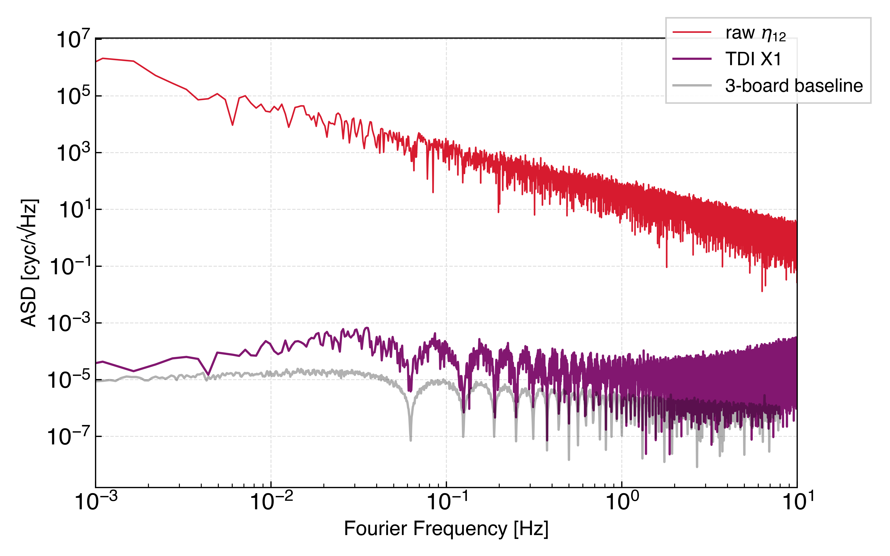
TDI Michelson X with a Multi-board Setup
TDI AND LASER FREQUENCY NOISE: STATUS
Latest results with higher injected noise levels and three delay line boards
Injected noise is reduced by 7 to 8 orders of magnitude
Is the floor due to ranging error?
STUDENT SEMINAR · TAC MEETING
27 August 2026 · 18 / 42

Slide 19
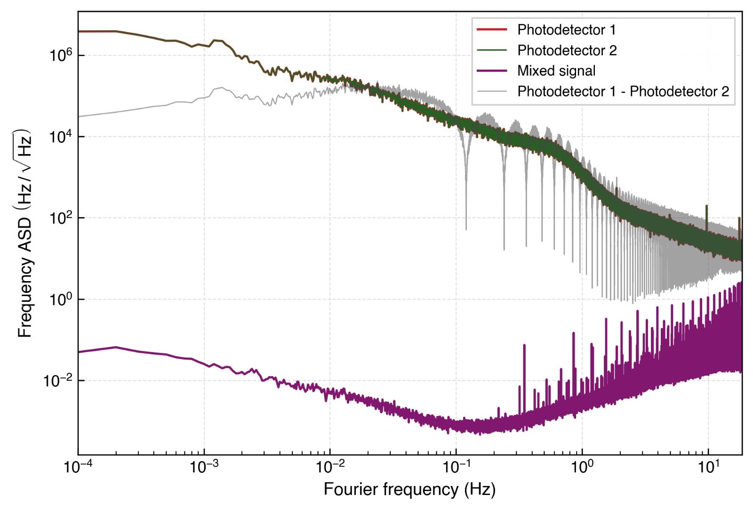
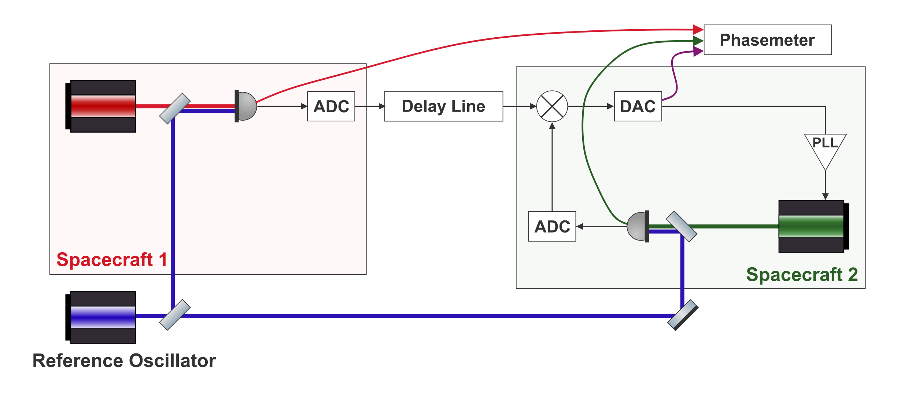
Injecting Laser Noise: PLL Lock of Far Spacecraft
TDI AND LASER FREQUENCY NOISE: STATUS
For TDI, the next piece is injecting real laser noise. We've already made a start: the far laser locks through the delay line, and the readout behaves as expected
Free-running photodetector noise vs. mixed output
STUDENT SEMINAR · TAC MEETING
27 August 2026 · 19 / 42
Notes:
Why don’t the peaks come to 0?
Photodetector readings are dominated by free-running laser frequency noise.

Slide 20
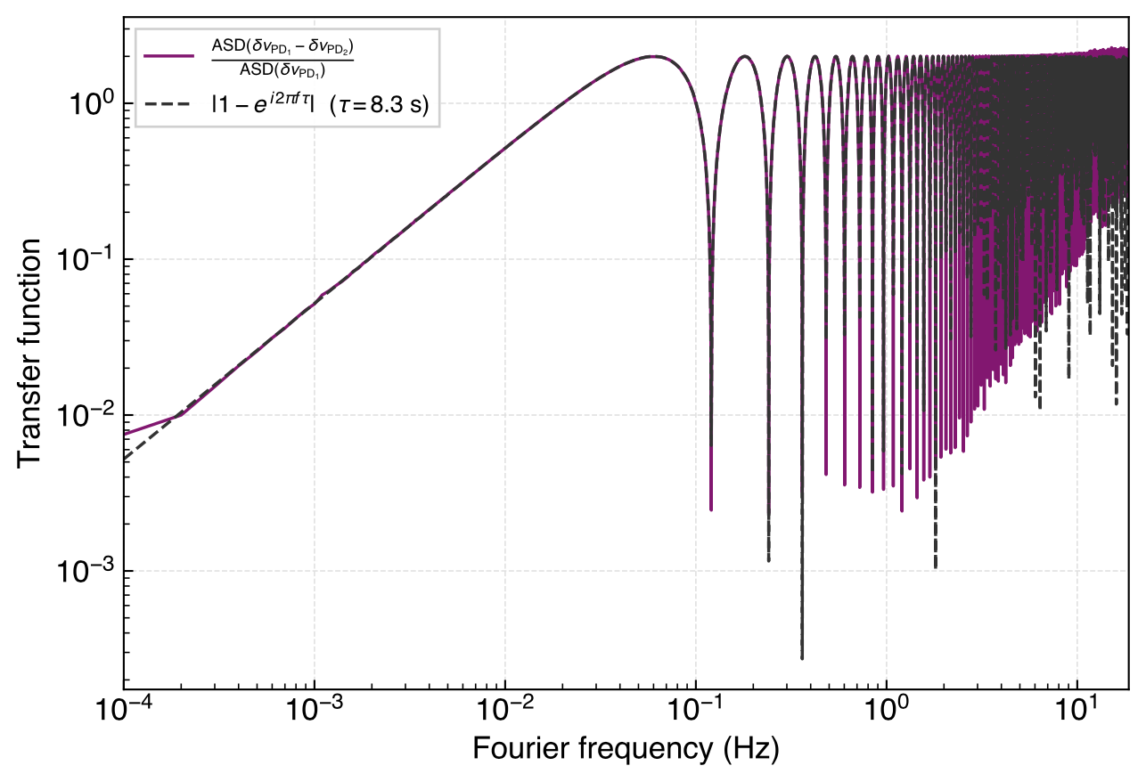
Recovering the Transfer Function
TDI AND LASER FREQUENCY NOISE: STATUS
We can recover a LISA-like one-way laser noise transfer function.
Recovered one-way laser-noise transfer function
STUDENT SEMINAR · TAC MEETING
27 August 2026 · 20 / 42
Notes:
We can recover a LISA-like one-way laser-noise transfer function.

Slide 21
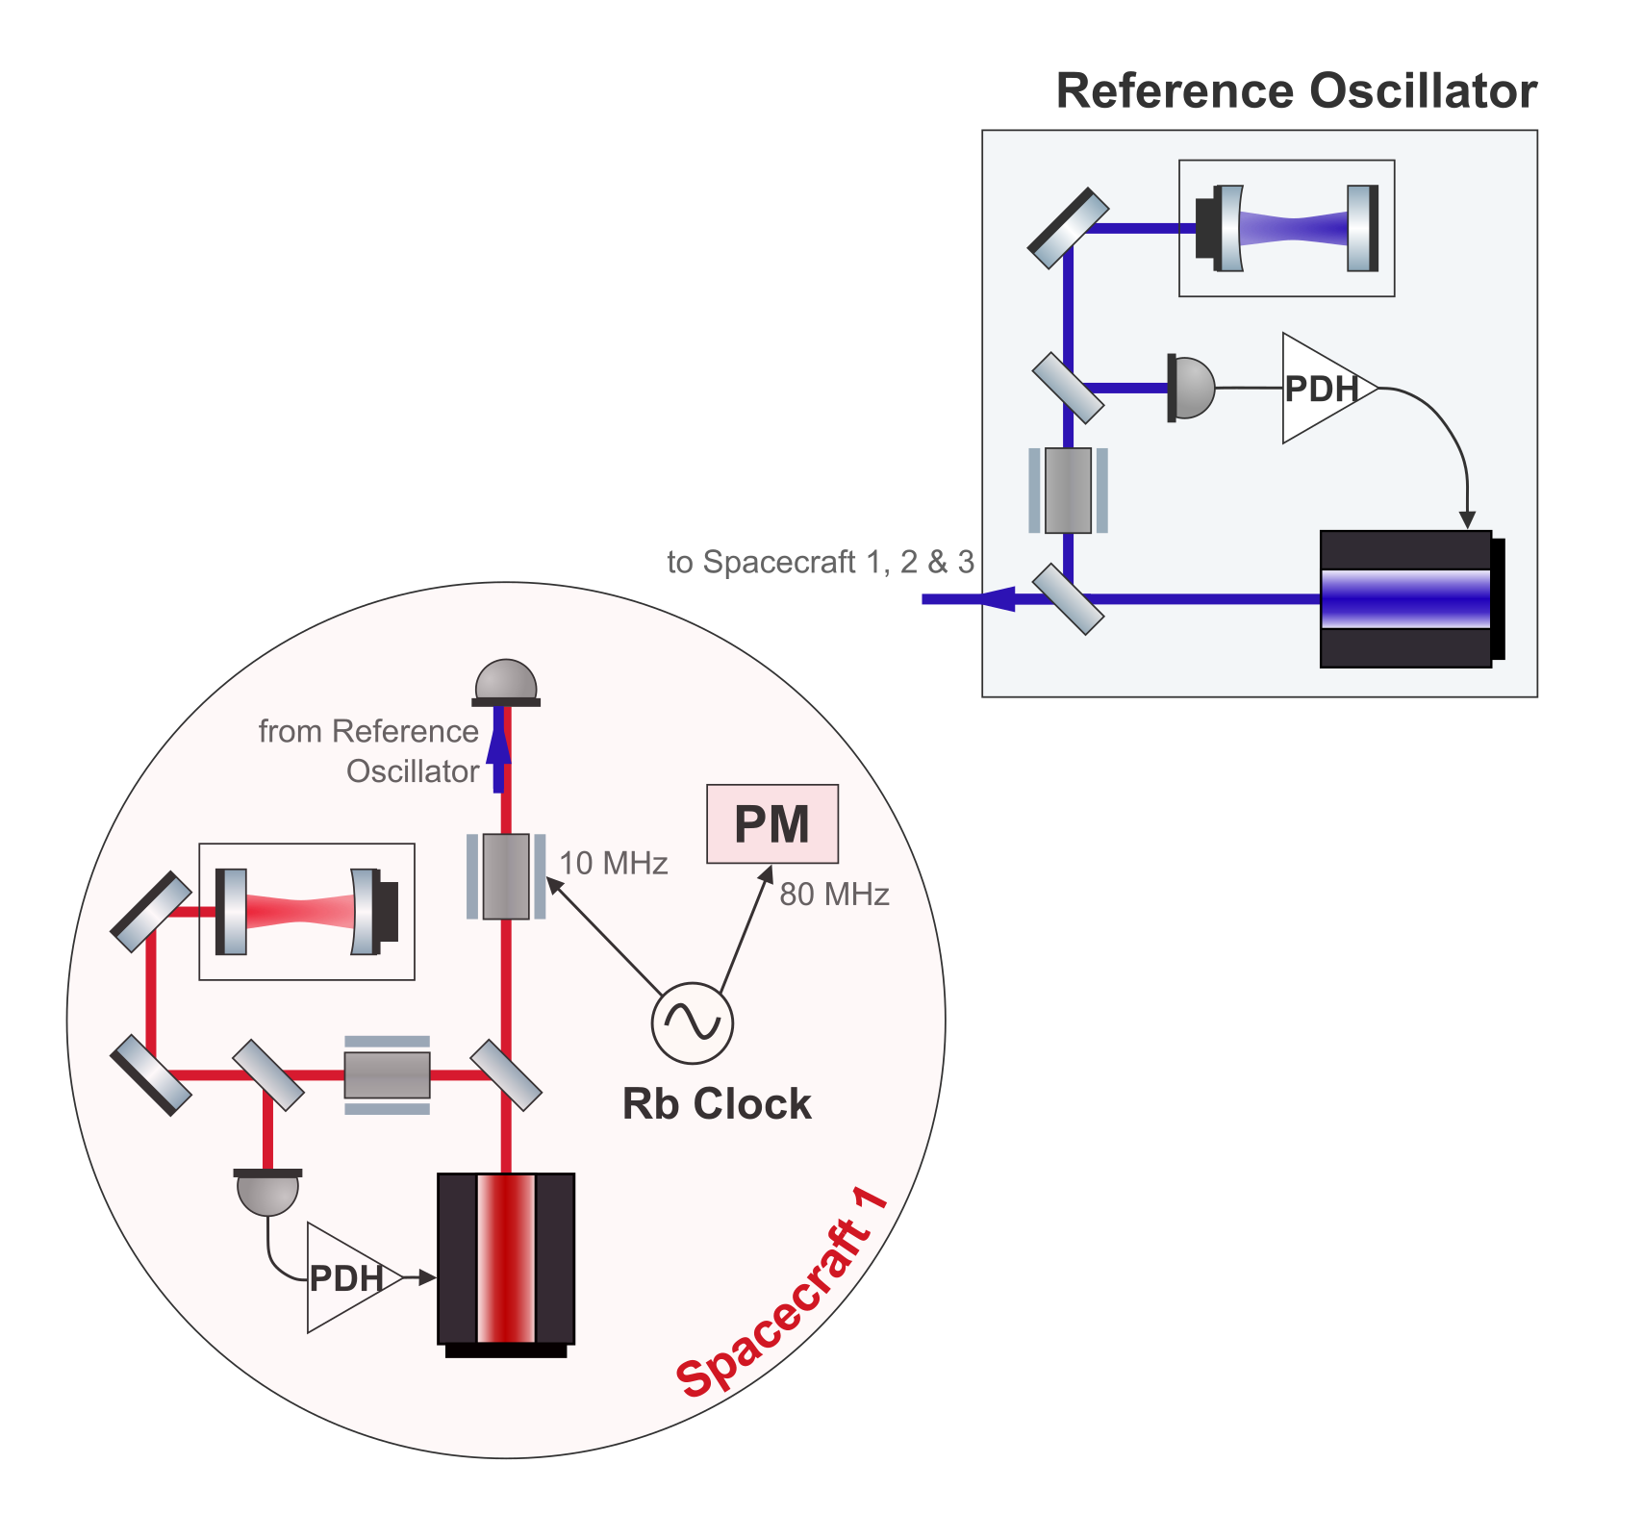
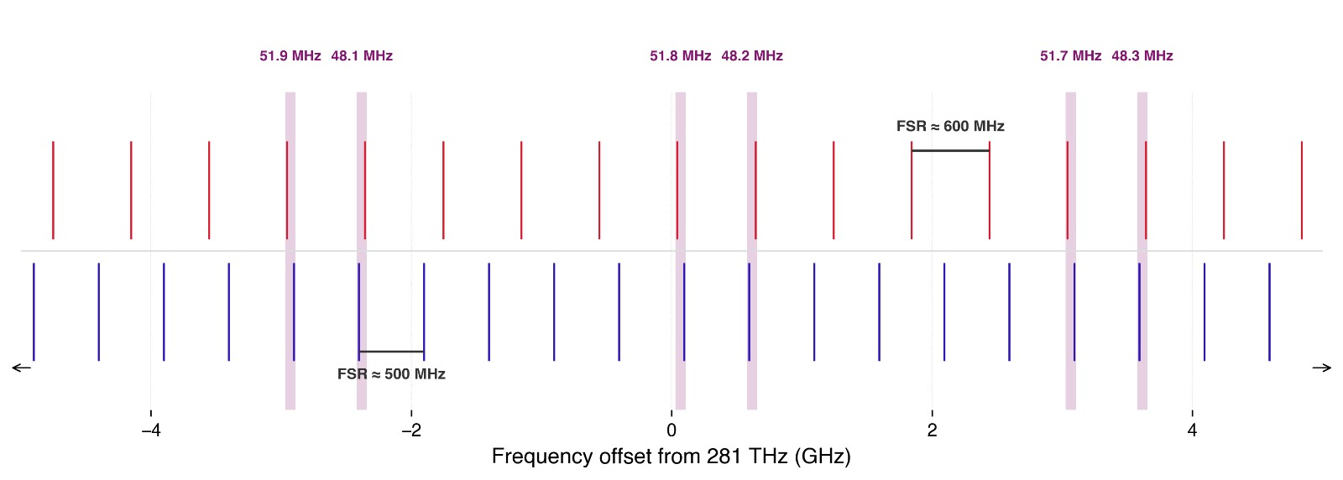
Cavity Locking
TDI AND LASER FREQUENCY NOISE: STATUS
Primary spacecraft laser should be cavity locked
Two lasers will be locked to 25 and 30 cm cavities
Beat note needs to be below 60 MHz
Cavity drift will limit measurement length
Illustrative cavity resonances
STUDENT SEMINAR · TAC MEETING
27 August 2026 · 21 / 42
Notes:
This will likely limit the measurement time.
How long should a measurement run for?
The reason I’m bringing this up is that this limits our measurement time

Slide 22
Context
Overview of the LISA Measurement System
Testbed Concept
TDI and Laser Frequency Noise: Status
Clock Noise: Status
Next Steps
Conclusions
STUDENT SEMINAR · TAC MEETING
27 August 2026 · 22 / 42
Notes:
Do I have a defined topic
And do I understand that topic, and the physics
The TAC decides if that’s a good topic for a thesis
is it worth a degree
is it realistic
For ambitious goals, what could be a minimum reasonable level
TAC2 –status and results, are there changes, what about publications
TAC3 – so what is the realistic goal now

Slide 23
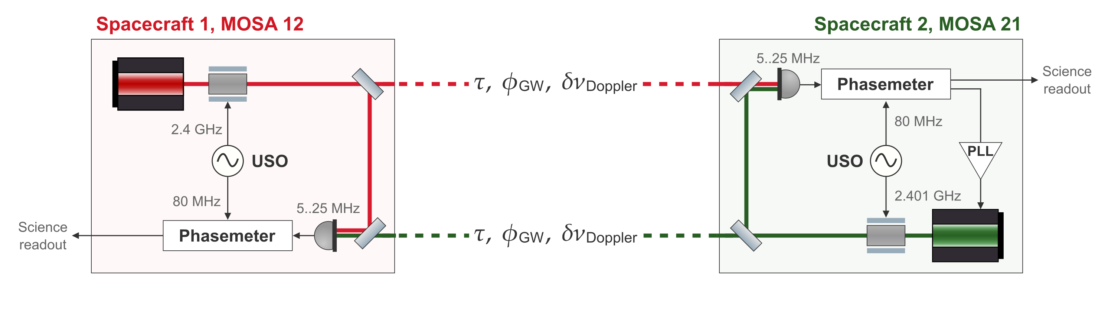
Clock Noise Transfer in LISA
CLOCK NOISE: STATUS
STUDENT SEMINAR · TAC MEETING
27 August 2026 · 23 / 42
Notes:
This has to very nicely nail down the problem. Probbaly add more stuff to this slide that I can point at
Add the spectrum picture?

Slide 24
Clock Noise Transfer Fidelity
CLOCK NOISE: STATUS
For LISA, the clock noise correction is assumed to be limited by the fidelity of the clock tones.
Any unwanted timing jitters on the modulating tone need to be kept low.
STUDENT SEMINAR · TAC MEETING
27 August 2026 · 24 / 42
Notes:
N_12 should couple with nu1

Slide 25
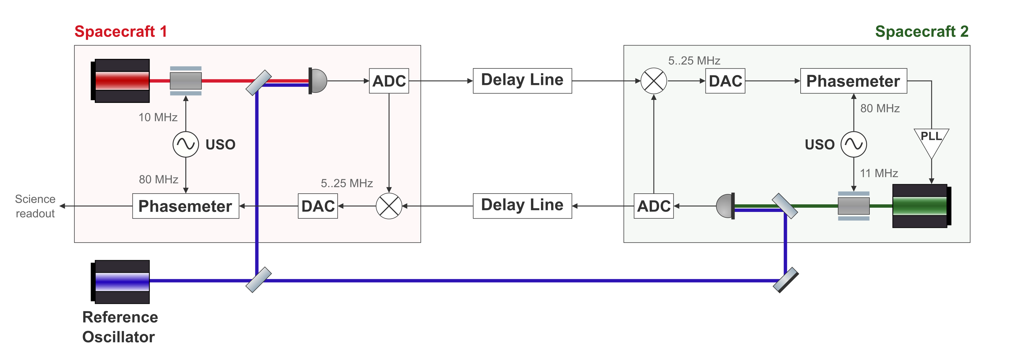
Clock Noise Transfer in the Lab
CLOCK NOISE: STATUS
LISA arm
In-flight link
Testbed arm
Benchtop analogue
STUDENT SEMINAR · TAC MEETING
27 August 2026 · 25 / 42
Notes:
what is the fdm critical thing in the testbed

Slide 26
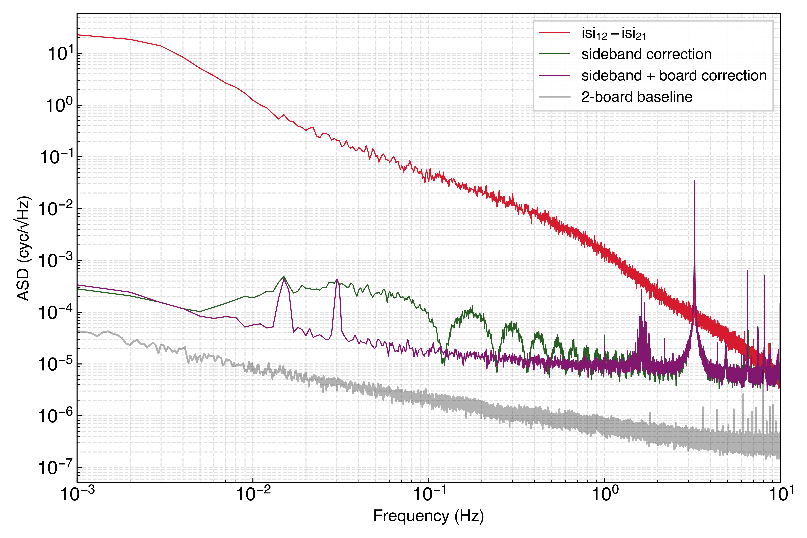
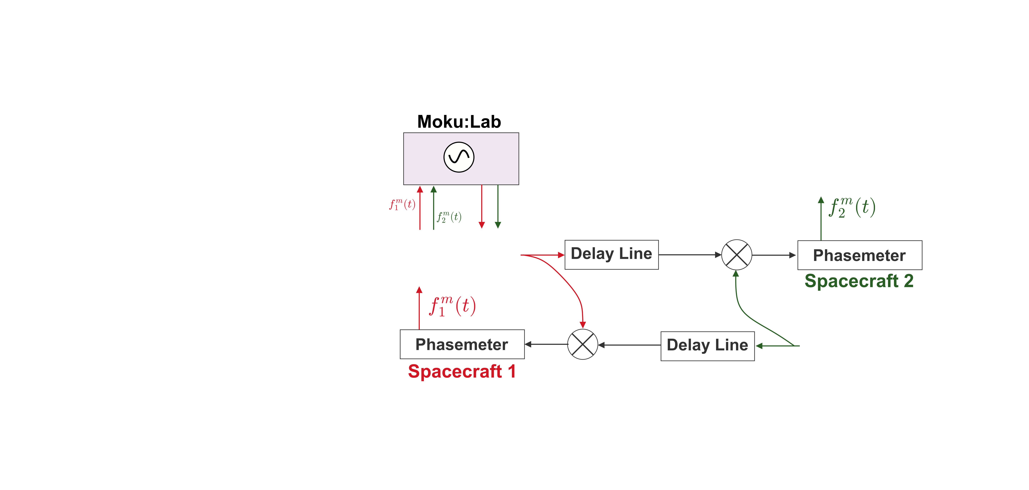
Preliminary Clock Noise Removal – Two Phasemeters
CLOCK NOISE: STATUS
Common carrier noise – this is not a test of TDI
Separate sideband modulations
Modulation done by Moku:Lab
STUDENT SEMINAR · TAC MEETING
27 August 2026 · 26 / 42
Notes:
Teka the noise floor from here? Also does this match 2 baseline noise floor?
How was that applied here? What EXACTLY can we learn from this? Like if it was baseline limited, where would the green line be instead
How can I tell if its from timing or phase? – repeat with a higher frequency? But like unneccesary to characterize here bc we move to optics anyways
We should be seeing the PM1 noise lobes basically why is the noise level so high? Repeat with other modulating frequencies

Slide 27
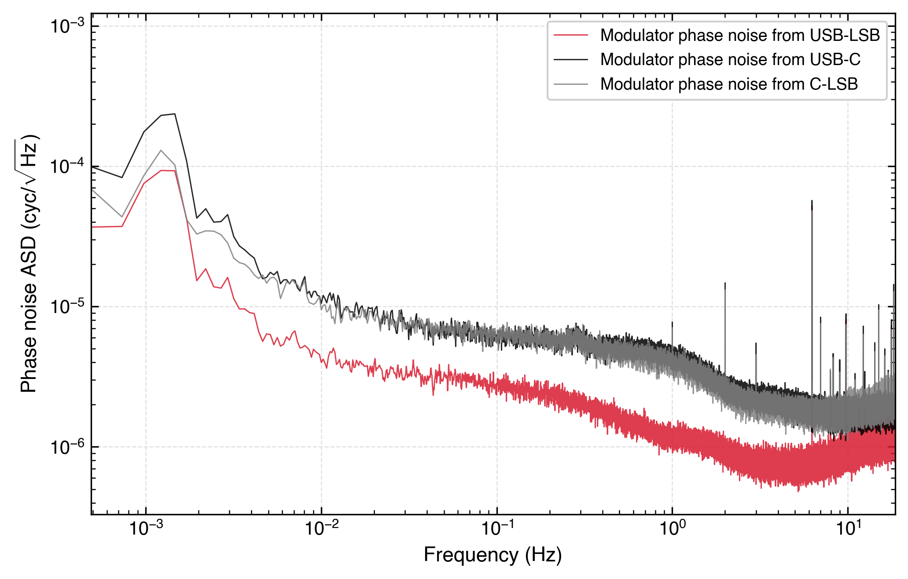
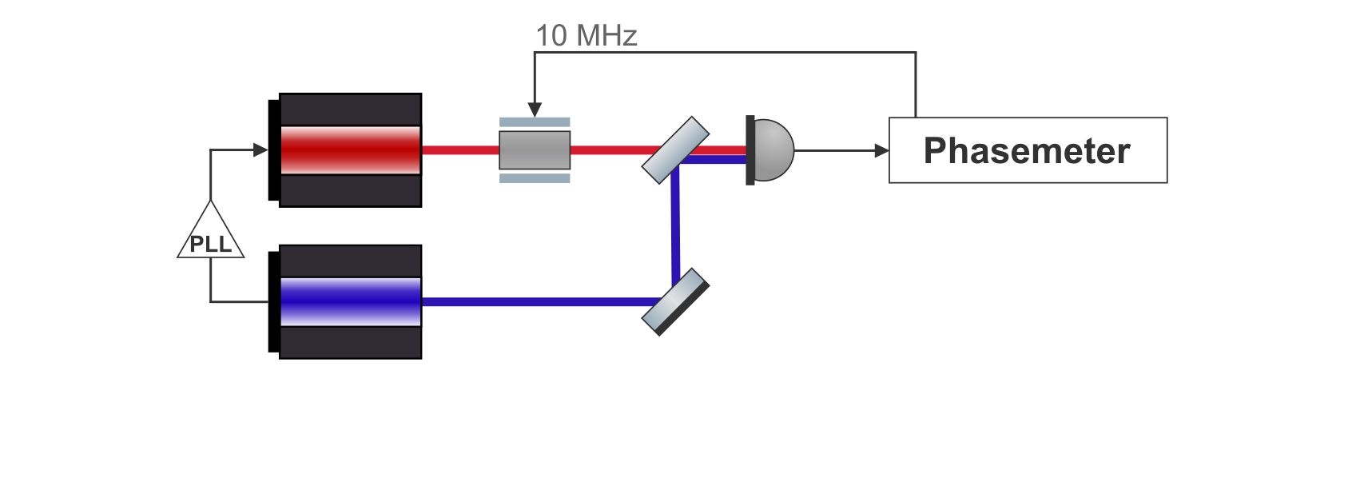
Clock Tone Transfer Limitation in miniLISA
CLOCK NOISE: STATUS
Upper limit on modulation noise of our EOMs.
Should be repeated with different modulating frequencies.
We should be able to figure out the underlying differential timing jitters between the phasemeter clock and the modulating signal it puts out
STUDENT SEMINAR · TAC MEETING
27 August 2026 · 27 / 42
Notes:
Remove the requirement lines? This iis in line with other’s measurements
This is the similar thing in optics. Is this from timing jitters or direct phase noise?

Slide 28
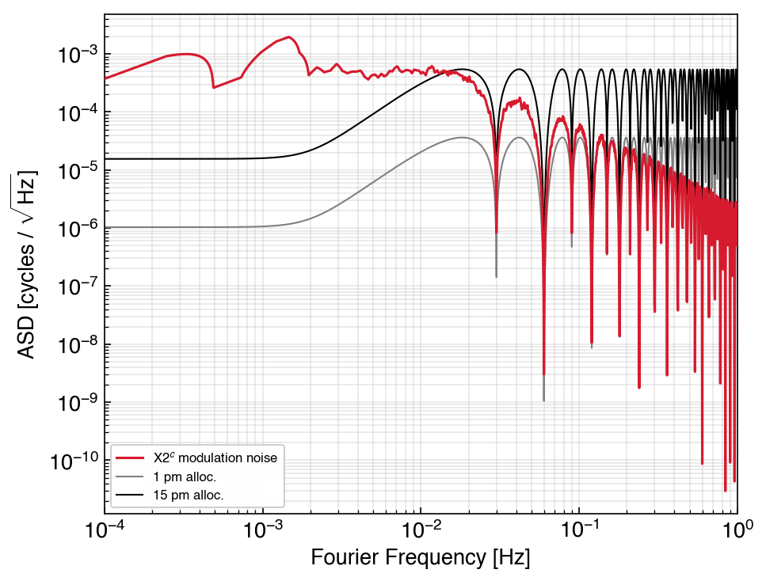
Clock Tone Transfer Limitation in miniLISA
CLOCK NOISE: STATUS
We can look at what this modulation noise would look like after TDI 2 and clock noise removal algorithms.
STUDENT SEMINAR · TAC MEETING
27 August 2026 · 28 / 42

Slide 29
GHz Sidebands
CLOCK NOISE: STATUS
Assuming that the measured modulation noise doesn’t scale with the modulating frequency, the solution is to increase the modulating frequency – which is why LISA uses 2.4 GHz sidebands for clock tone transfer.
STUDENT SEMINAR · TAC MEETING
27 August 2026 · 29 / 42
Notes:
Some solutions that we first came up with? Do I need to list them?
Modulating the ref laser is one bucket of solutions the other bucket is to relax the Nyquist limit. BUT WE DEF NEED TO INCREASE THE modulation, just the question is how do we get it into the delay lines.

Slide 30
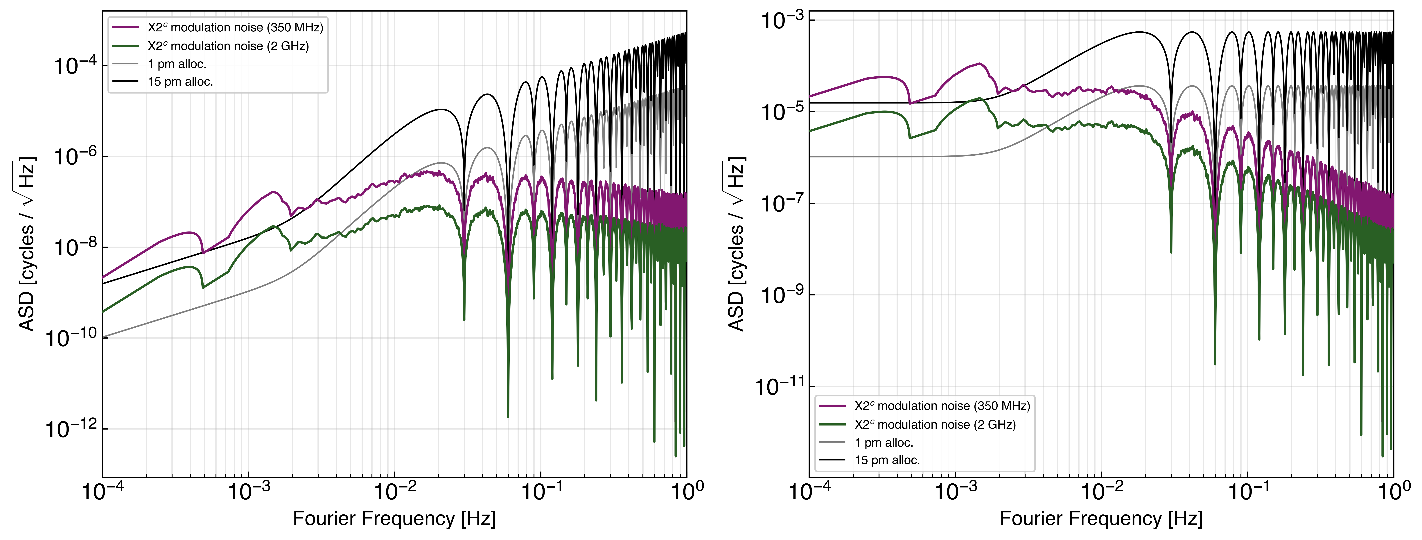
GHz Sidebands
CLOCK NOISE: STATUS
Assuming that the measured modulation noise doesn’t scale with the modulating frequency, the solution is to increase the modulating frequency – which is why LISA uses 2.4 GHz sidebands for clock tone transfer.
How high should be go?
STUDENT SEMINAR · TAC MEETING
27 August 2026 · 30 / 42

Slide 31
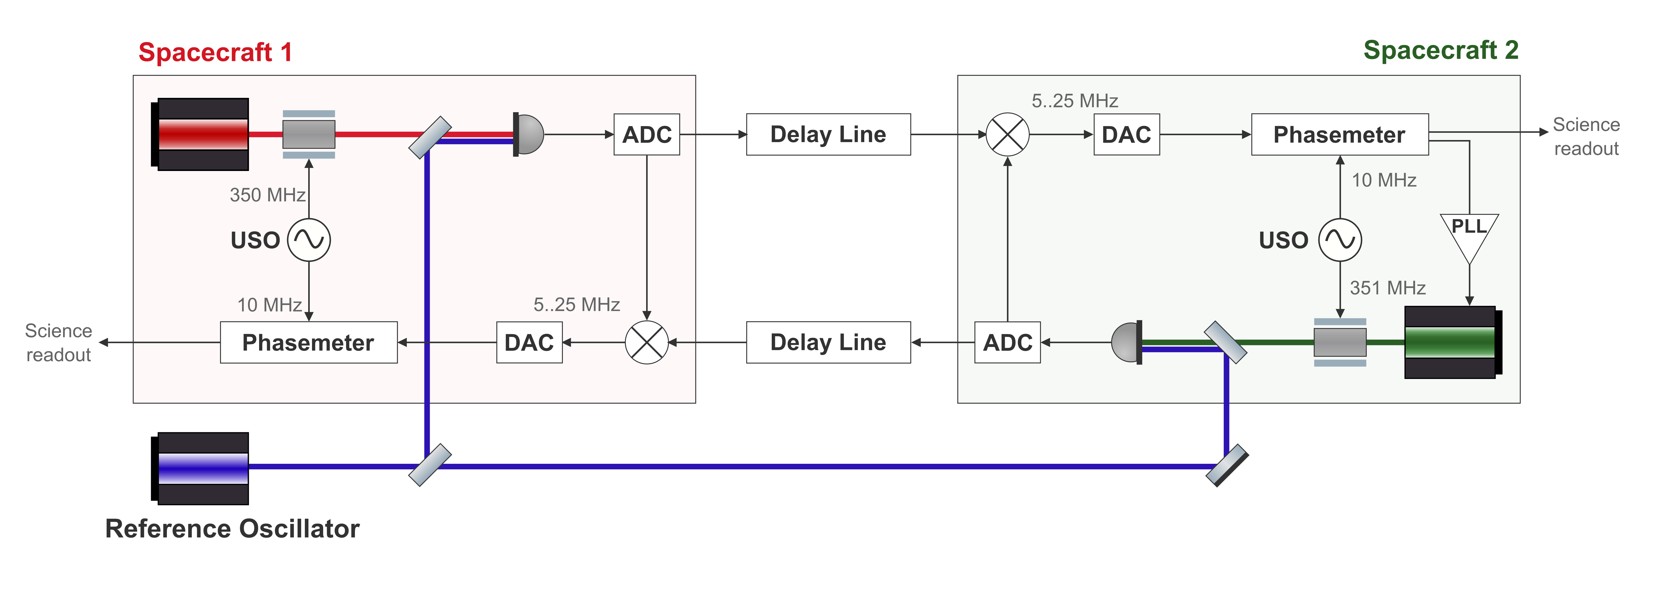
Increasing the Sideband Frequency
CLOCK NOISE: STATUS
First step is to ensure that the differential timing noise on the sidebands is still highly correlated with the phasemeter sampling clock.
STUDENT SEMINAR · TAC MEETING
27 August 2026 · 31 / 42
Notes:
Modulating the ref laser is one bucket of solutions the other bucket is to relax the Nyquist limit. BUT WE DEF NEED TO INCREASE THE modulation, just the question is how do we get it into the delay lines.

Slide 32
Increasing the Sideband Frequency
CLOCK NOISE: STATUS
To increase the sideband frequency, we have two avenues.
To increase the bandwidth of the ADCs
STUDENT SEMINAR · TAC MEETING
27 August 2026 · 32 / 42

Slide 33
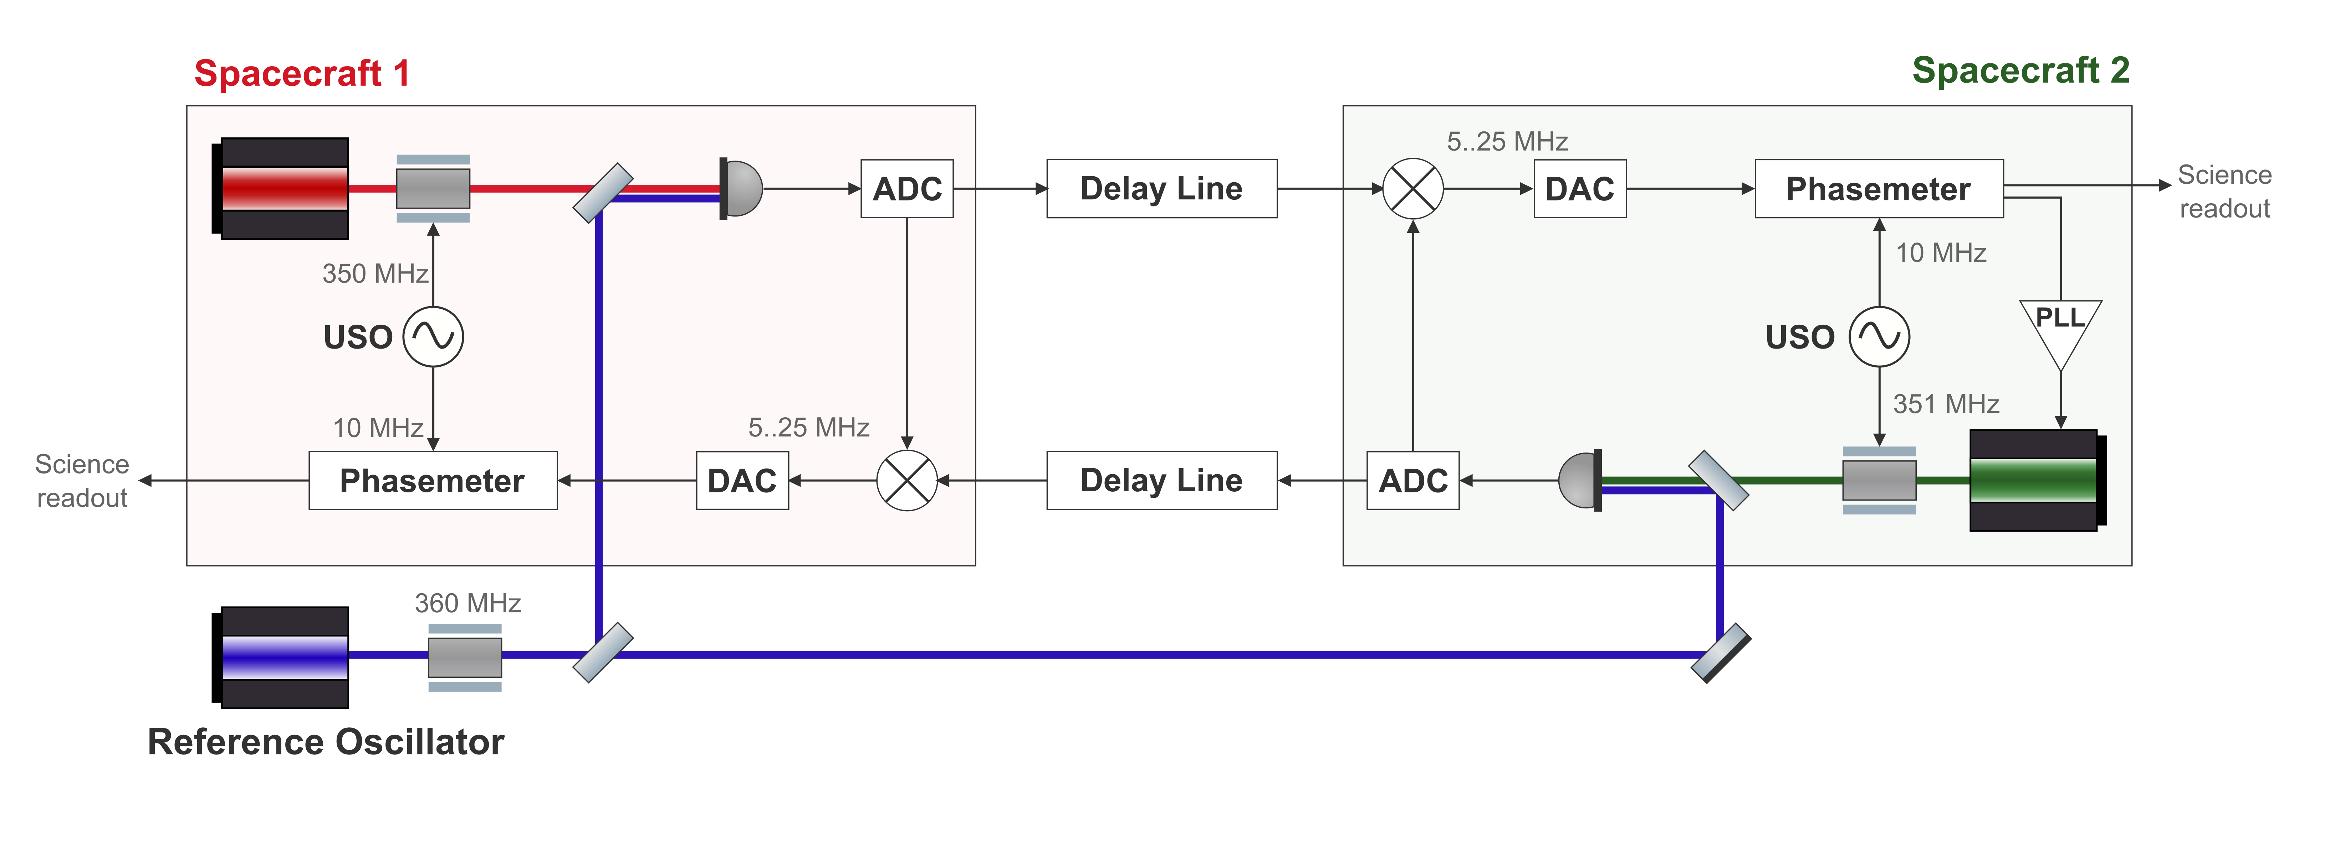
Increasing the Sideband Frequency
CLOCK NOISE: STATUS
To increase the sideband frequency, we have two avenues.
To increase the bandwidth of the ADCs
To also modulate the reference laser
STUDENT SEMINAR · TAC MEETING
27 August 2026 · 33 / 42

Slide 34
Increasing the Sideband Frequency
CLOCK NOISE: STATUS
To increase the sideband frequency, we have two avenues.
To increase the bandwidth of the ADCs
To also modulate the reference laser
STUDENT SEMINAR · TAC MEETING
27 August 2026 · 34 / 42
Notes:
Modulate the reference laser to get

Slide 35
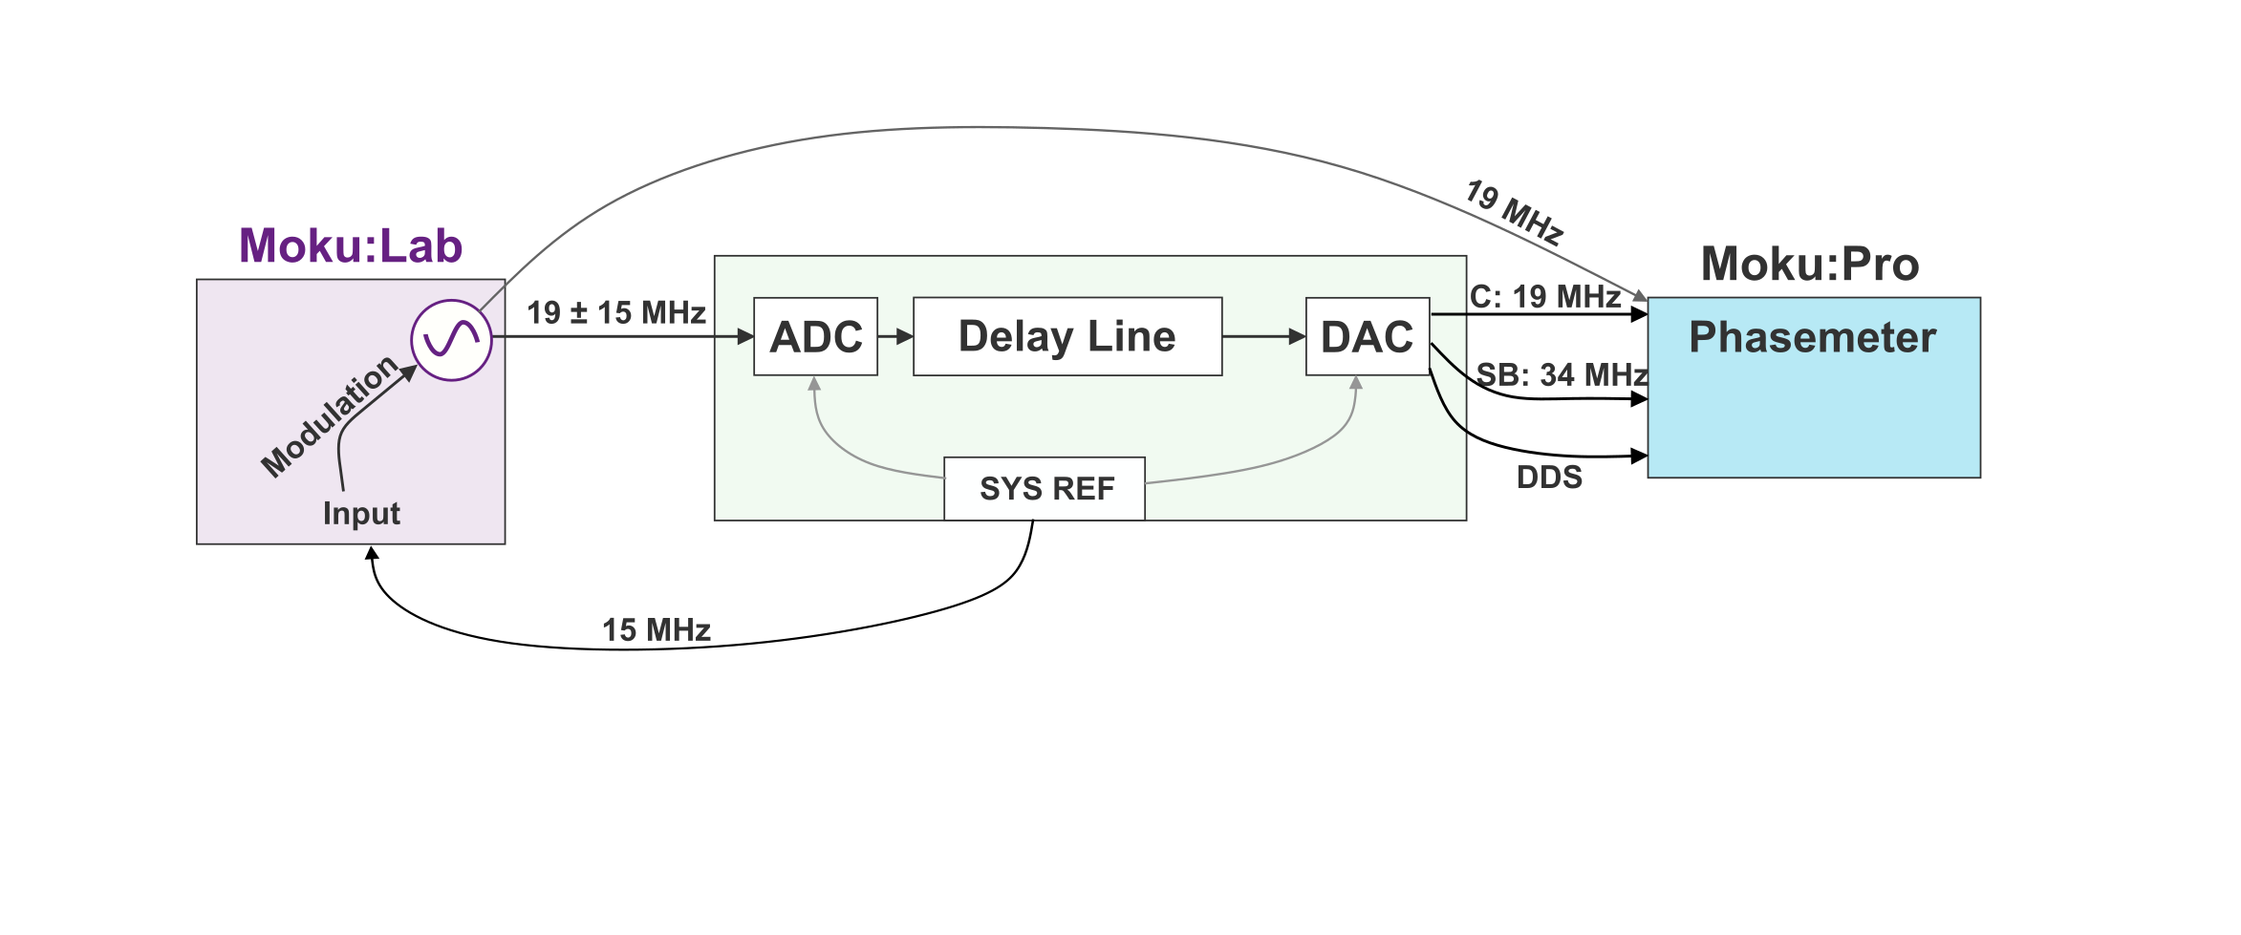
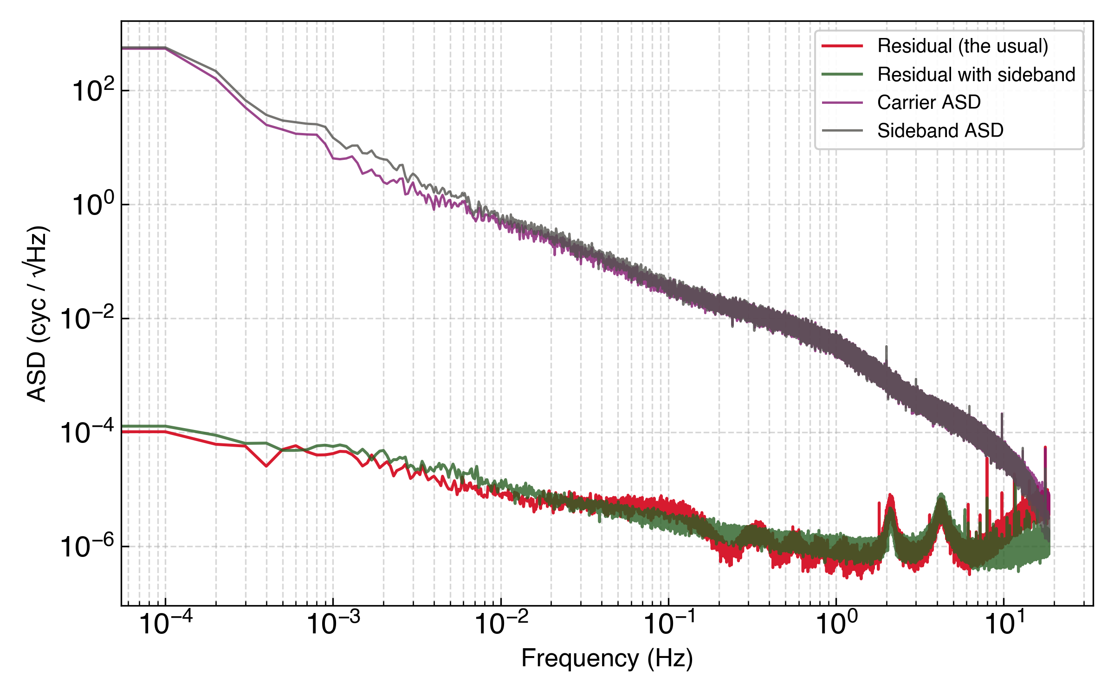
Using the Delay Line Board Clock as a Modulation Source
CLOCK NOISE: STATUS
Preliminary test for using the delay line board clock as a modulation source.
STUDENT SEMINAR · TAC MEETING
27 August 2026 · 35 / 42
Notes:
How do I nicely illustrate this solution? Why isn’t the modulation noise limiting here
If the green line is on the red line, then that means that the modulation frequency * modulation noise < baseline phase noise
This might not be the case for GHz or higher frequencies in general. Though we can just repeat the measurement with a higher frequency.
BUT THIS SHOULDN’T BE THE PHASEMETER CLOCK

Slide 36
Context
Overview of the LISA Measurement System
Testbed Concept
TDI and Laser Frequency Noise: Status
Clock Noise: Status
Next Steps
Conclusions
STUDENT SEMINAR · TAC MEETING
27 August 2026 · 36 / 42

Slide 37
Pinpoint the Multi-board Noise Floor
NEXT STEPS
Is the multi-board TDI combination limited by delay errors?
STUDENT SEMINAR · TAC MEETING
27 August 2026 · 37 / 42

Slide 38
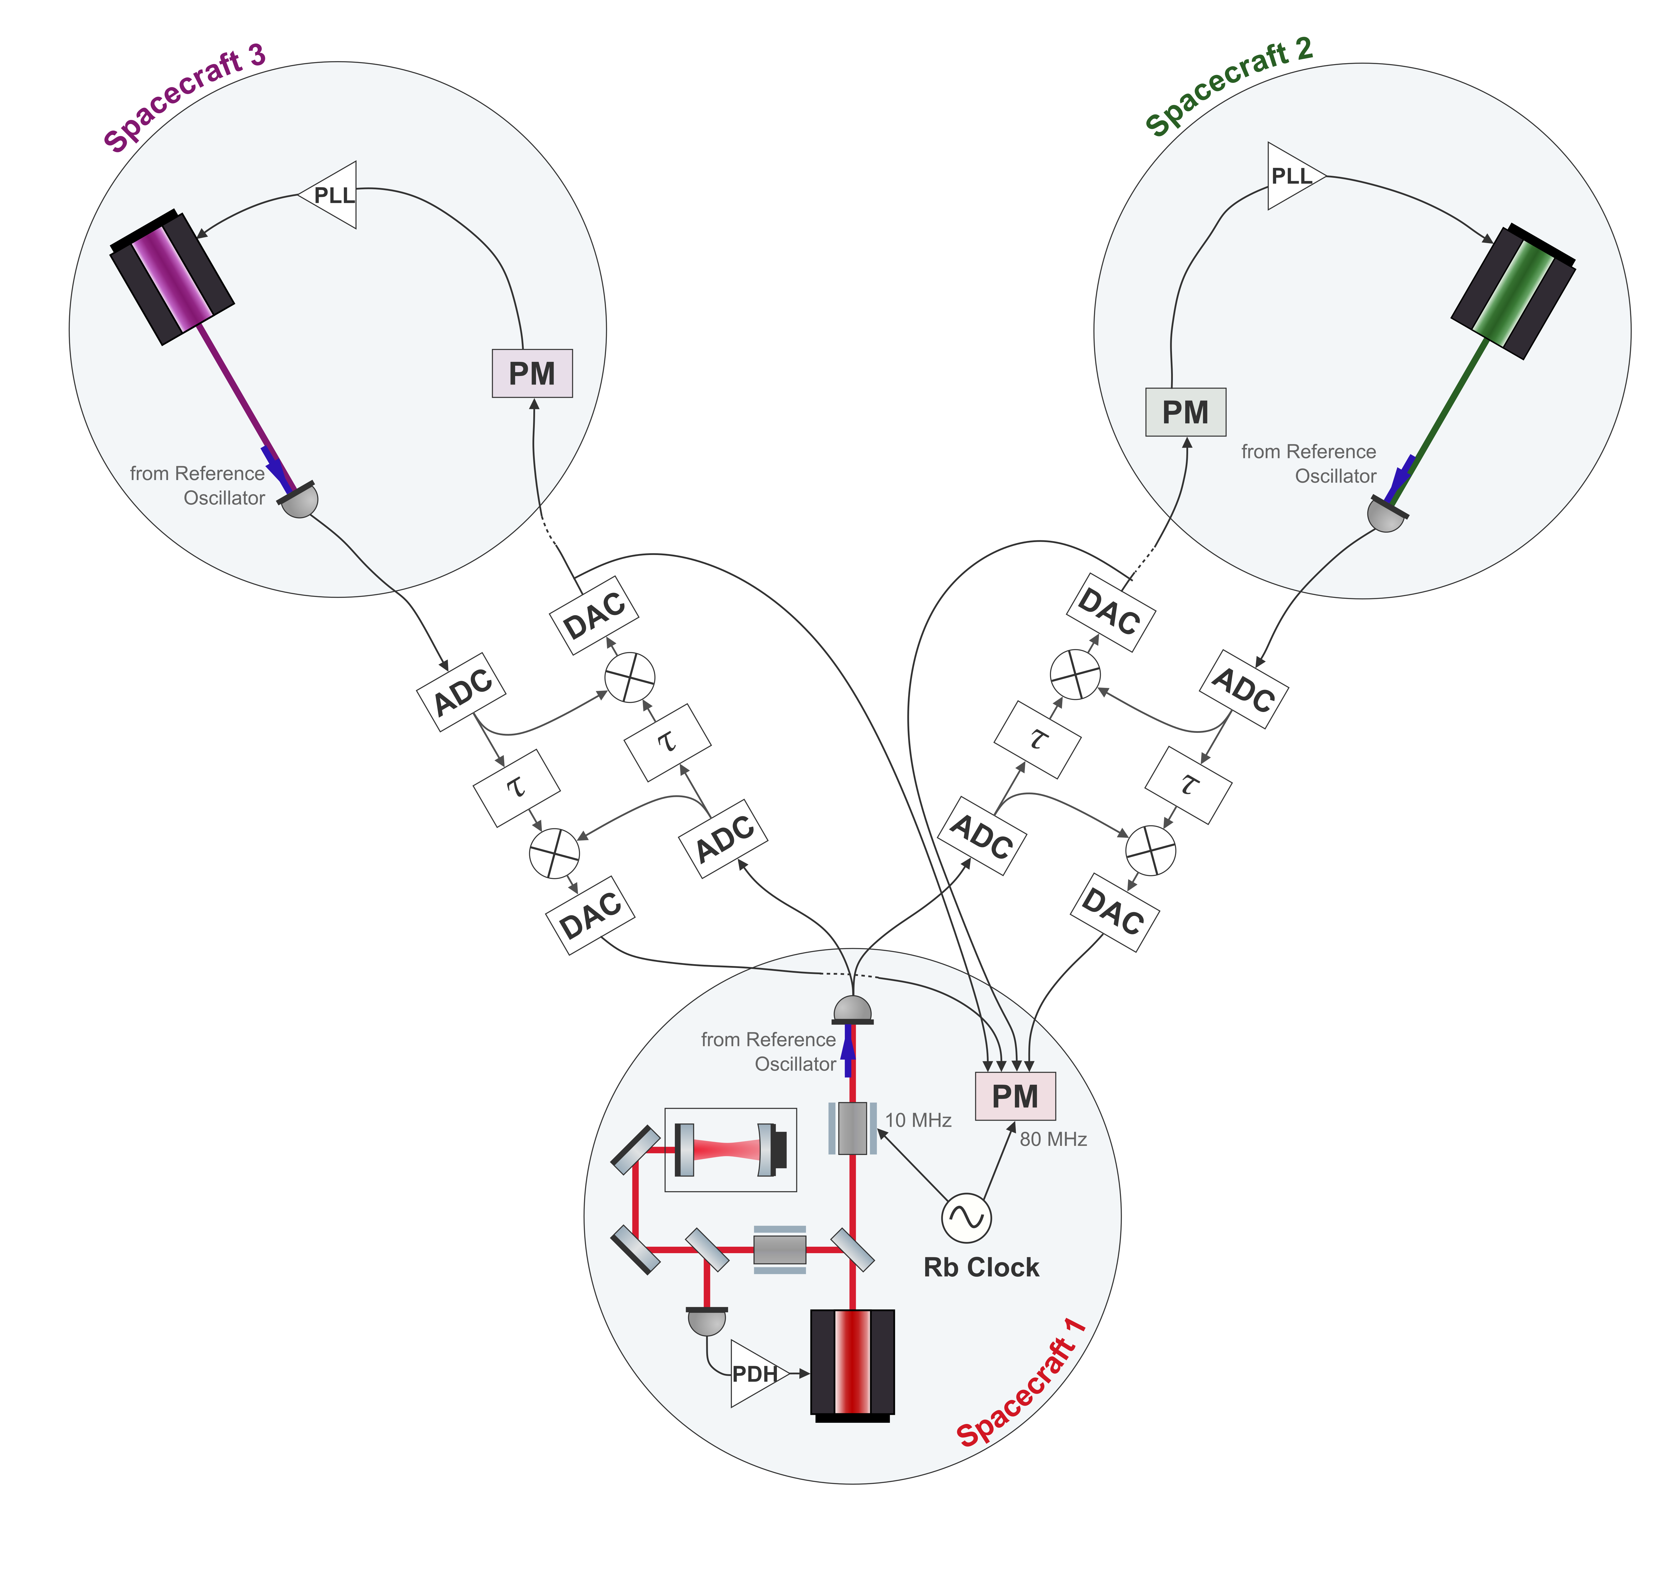
Towards the Full Setup
NEXT STEPS
TDI-1 with real lasers
TDI-2 with real lasers and independent phasemeters
TDI with three arms
Recovery of an injected signal
STUDENT SEMINAR · TAC MEETING
27 August 2026 · 38 / 42

Slide 39
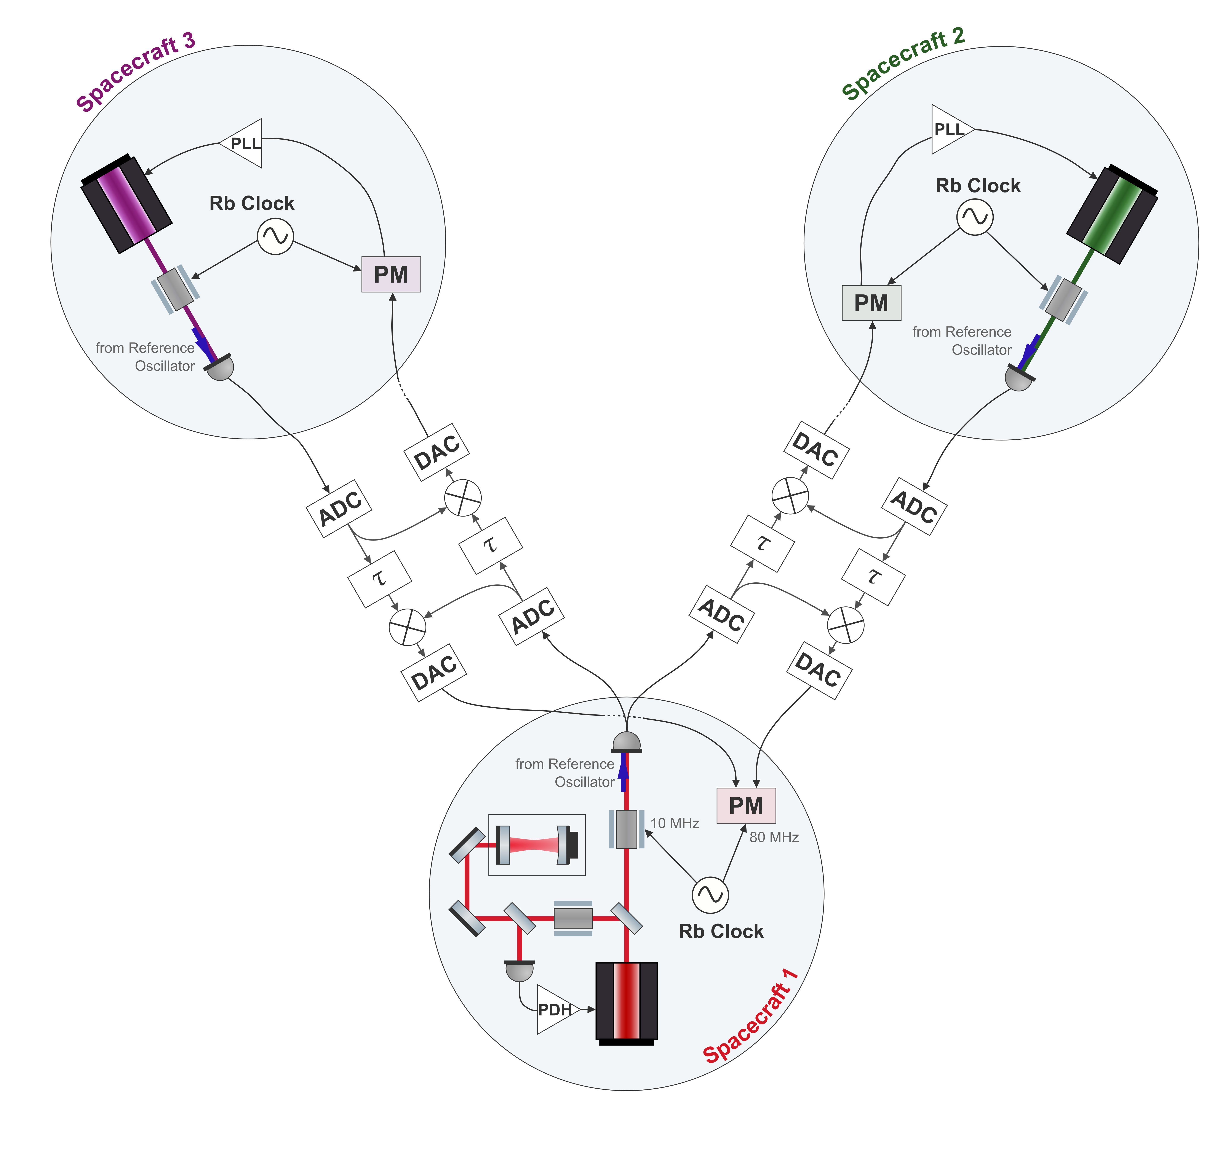
Towards the Full Setup
NEXT STEPS
TDI-1 with real lasers
TDI-2 with real lasers and independent phasemeters
TDI with three arms
Recovery of an injected signal
STUDENT SEMINAR · TAC MEETING
27 August 2026 · 39 / 42

Slide 40
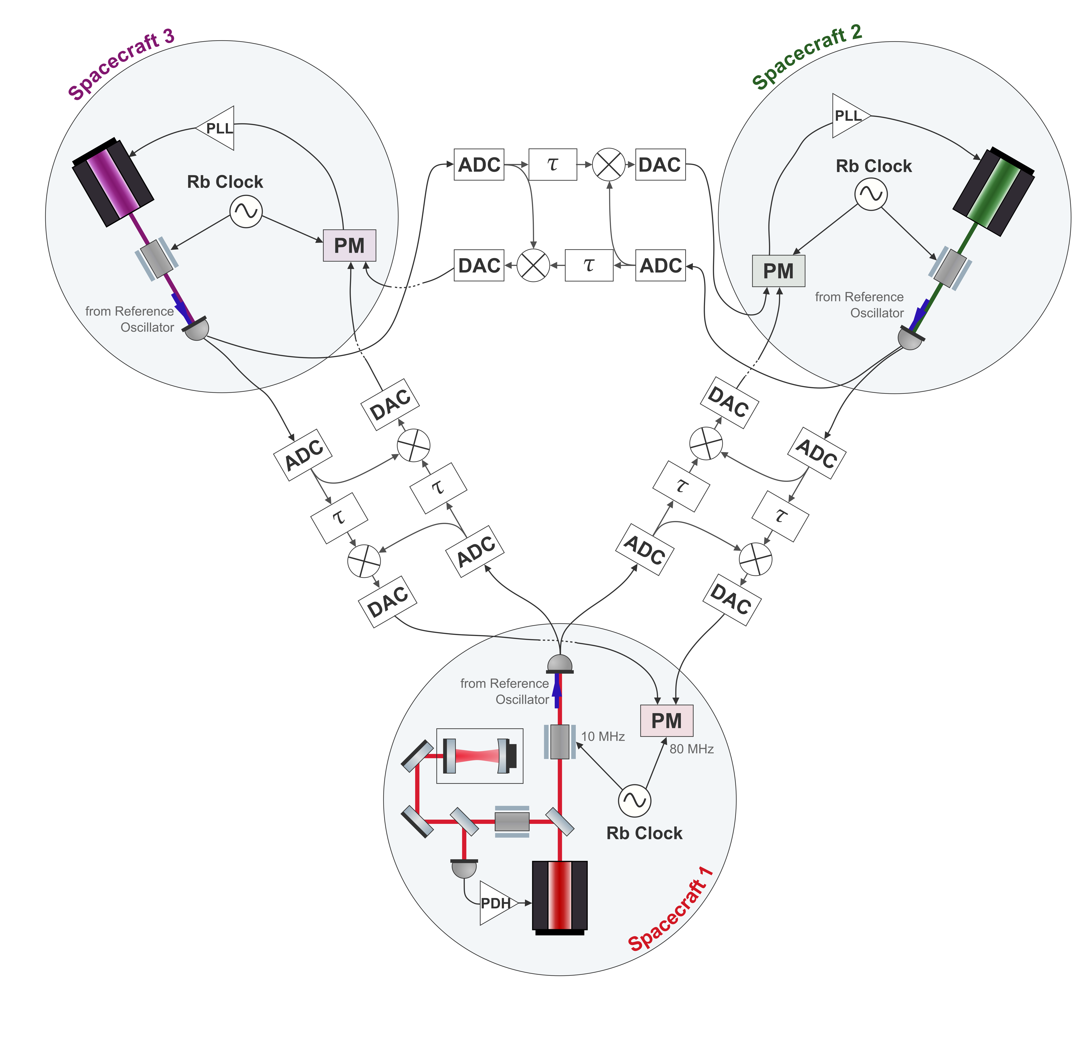
Towards the Full Setup
NEXT STEPS
TDI-1 with real lasers
TDI-2 with real lasers and independent phasemeters
TDI with three arms
Recovery of an injected signal
STUDENT SEMINAR · TAC MEETING
27 August 2026 · 40 / 42

Slide 41
Extensions
NEXT STEPS
TDI without clock synchronization — demonstrated in Hexagon, but without real delays
PRN ranging — requires delay-board modification
STUDENT SEMINAR · TAC MEETING
27 August 2026 · 41 / 42
Notes:
Theres a paper and id like to test we get good results
The delay line is designed for mHz noise to be preserved exactly. But ranging happened at kHz. So we need to make sure that that is presered properly as well.

Slide 42
Conclusions
An integrated optical testbed for validating LISA's TDI and clock-noise post-processing
Status: TDI-2 with signal recovery shown electronically
Next: pinpoint the multi-board floor, inject laser noise and clock noise
Goal: full three-arm TDI with clock noise removal at LISA performance
Extensions: TDI without clock synchronization; PRN ranging
STUDENT SEMINAR · TAC MEETING
27 August 2026 · 42 / 42
Notes:
To wrap up — what we're building is an integrated optical testbed for validating LISA's post-processing, both TDI and clock-noise removal, on real hardware.
Where we stand: TDI-2 with signal recovery is demonstrated on the electronic testbed, and the optics now lock through the delay line, so the two sides are starting to come together.
The immediate next steps are to pin down what's limiting the multi-board floor, and then to bring in real laser and clock noise instead of injected signals.
The goal that follows from that is the full three-arm measurement — TDI with clock-noise removal, aiming for LISA-level performance. That's the core of what this work is building toward.
And beyond that, there are some nice additions if time allows — testing TDI without the clock-synchronization algorithm, and adding PRN ranging, though that one needs real modification to the delay board

Slide 43
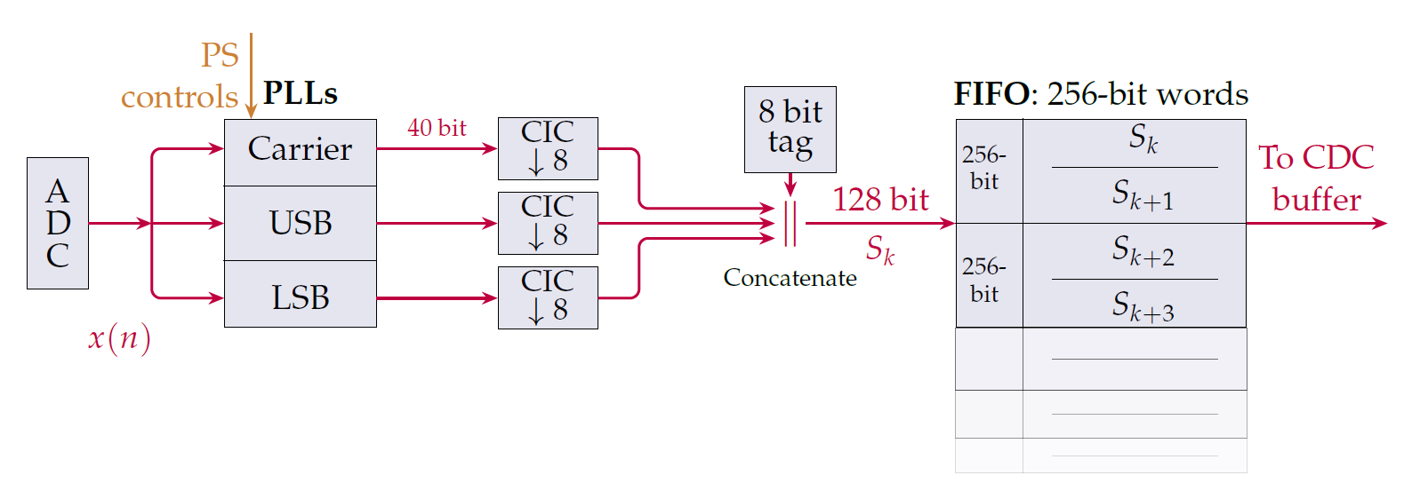
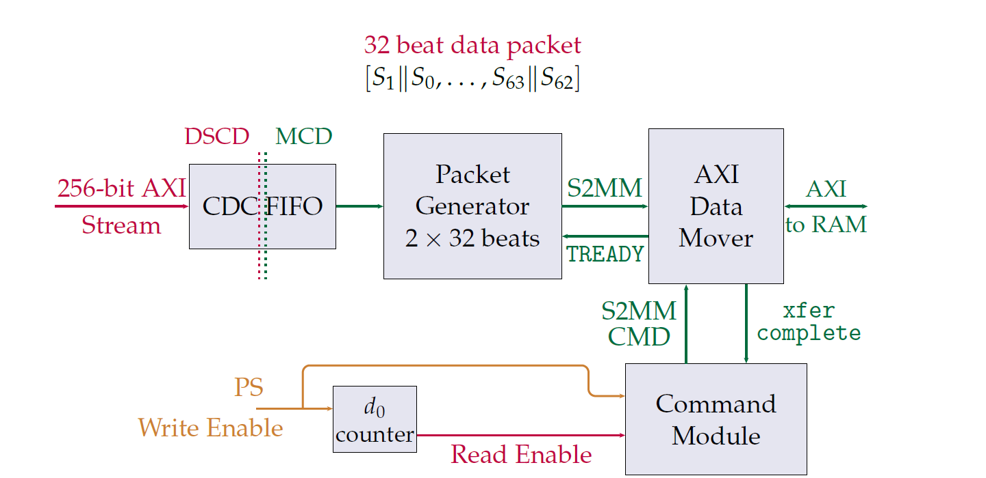
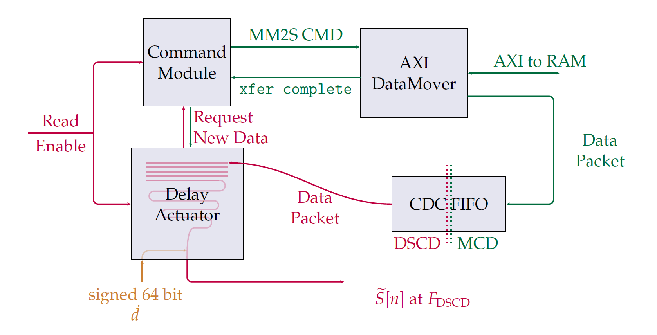
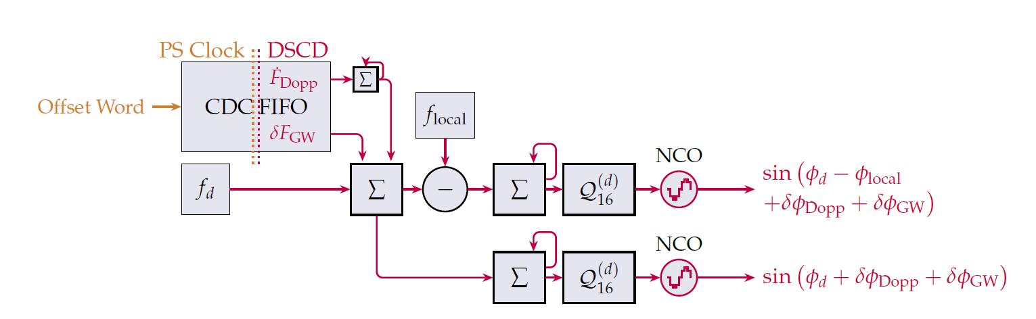
Extra: Internals of the Delay Line
WHAT HAPPENS IN THE FPGA?
Credit: R. Ferguson
STUDENT SEMINAR · TAC MEETING
27 August 2026 · 43 / 42
Notes:
Actually do like a whole board diagram, and as u go though it, mention places where clock noise can couple

Slide 44
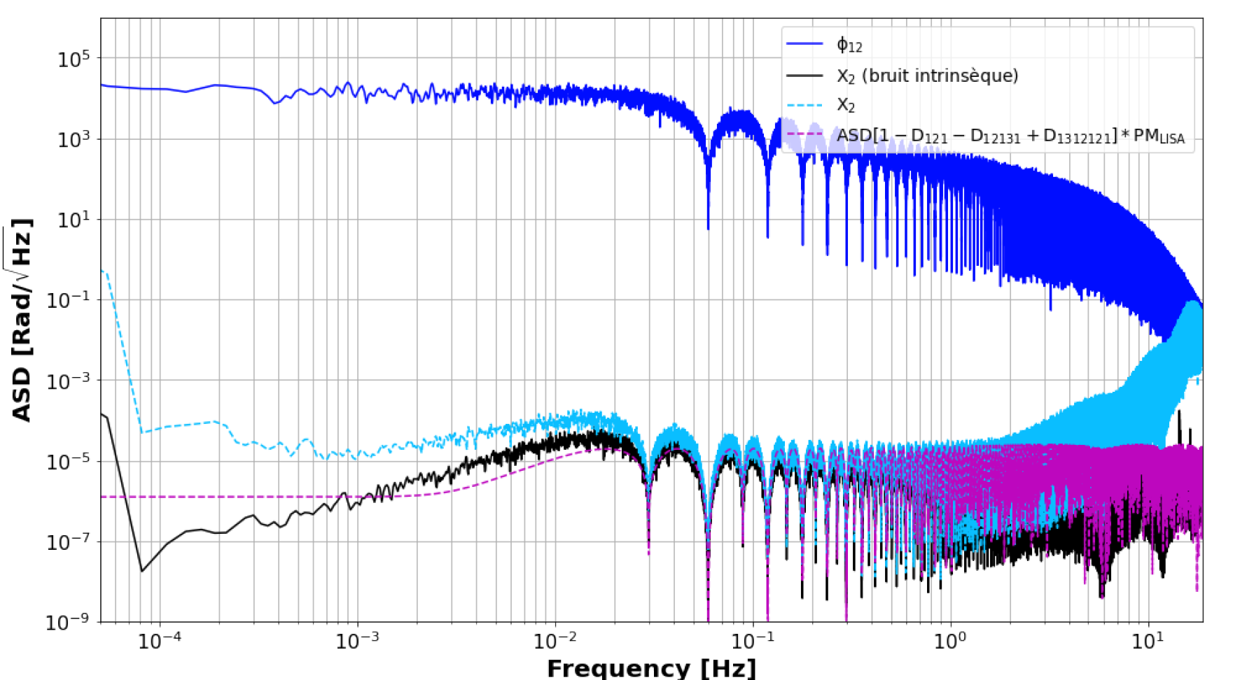
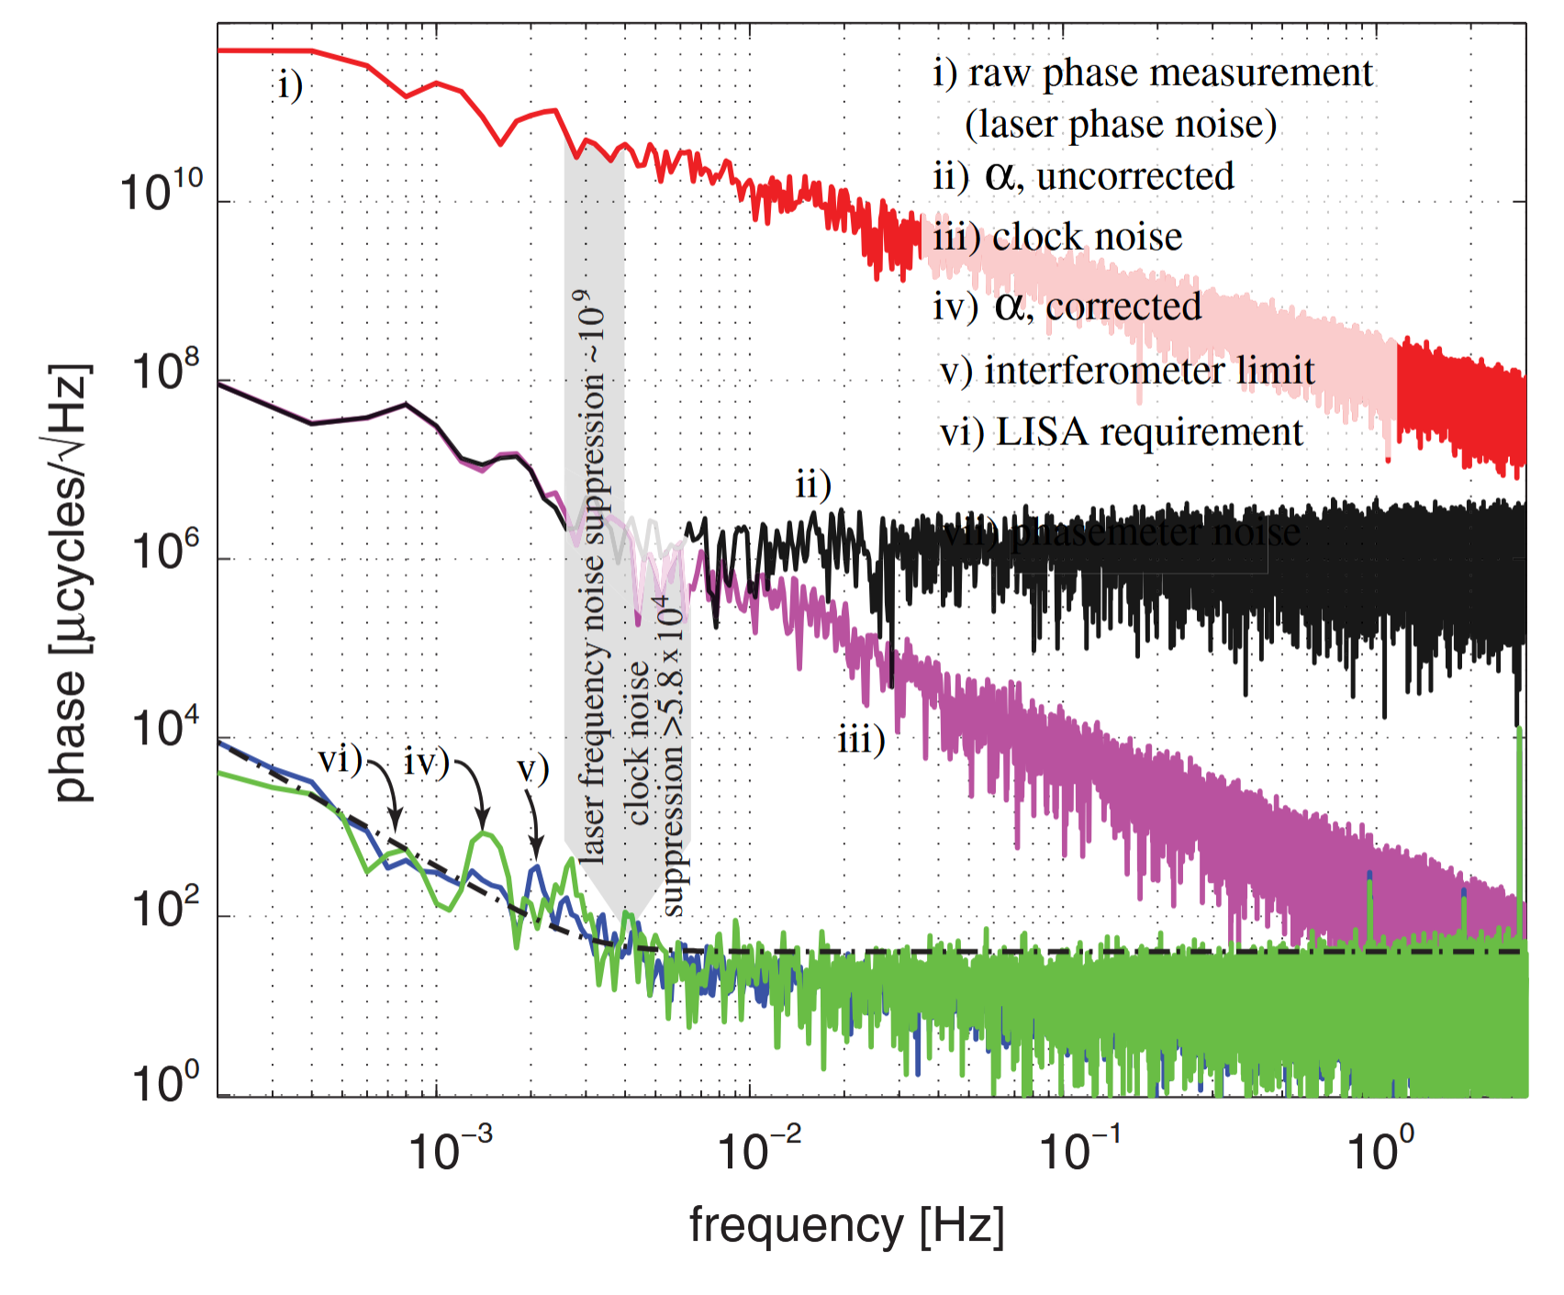
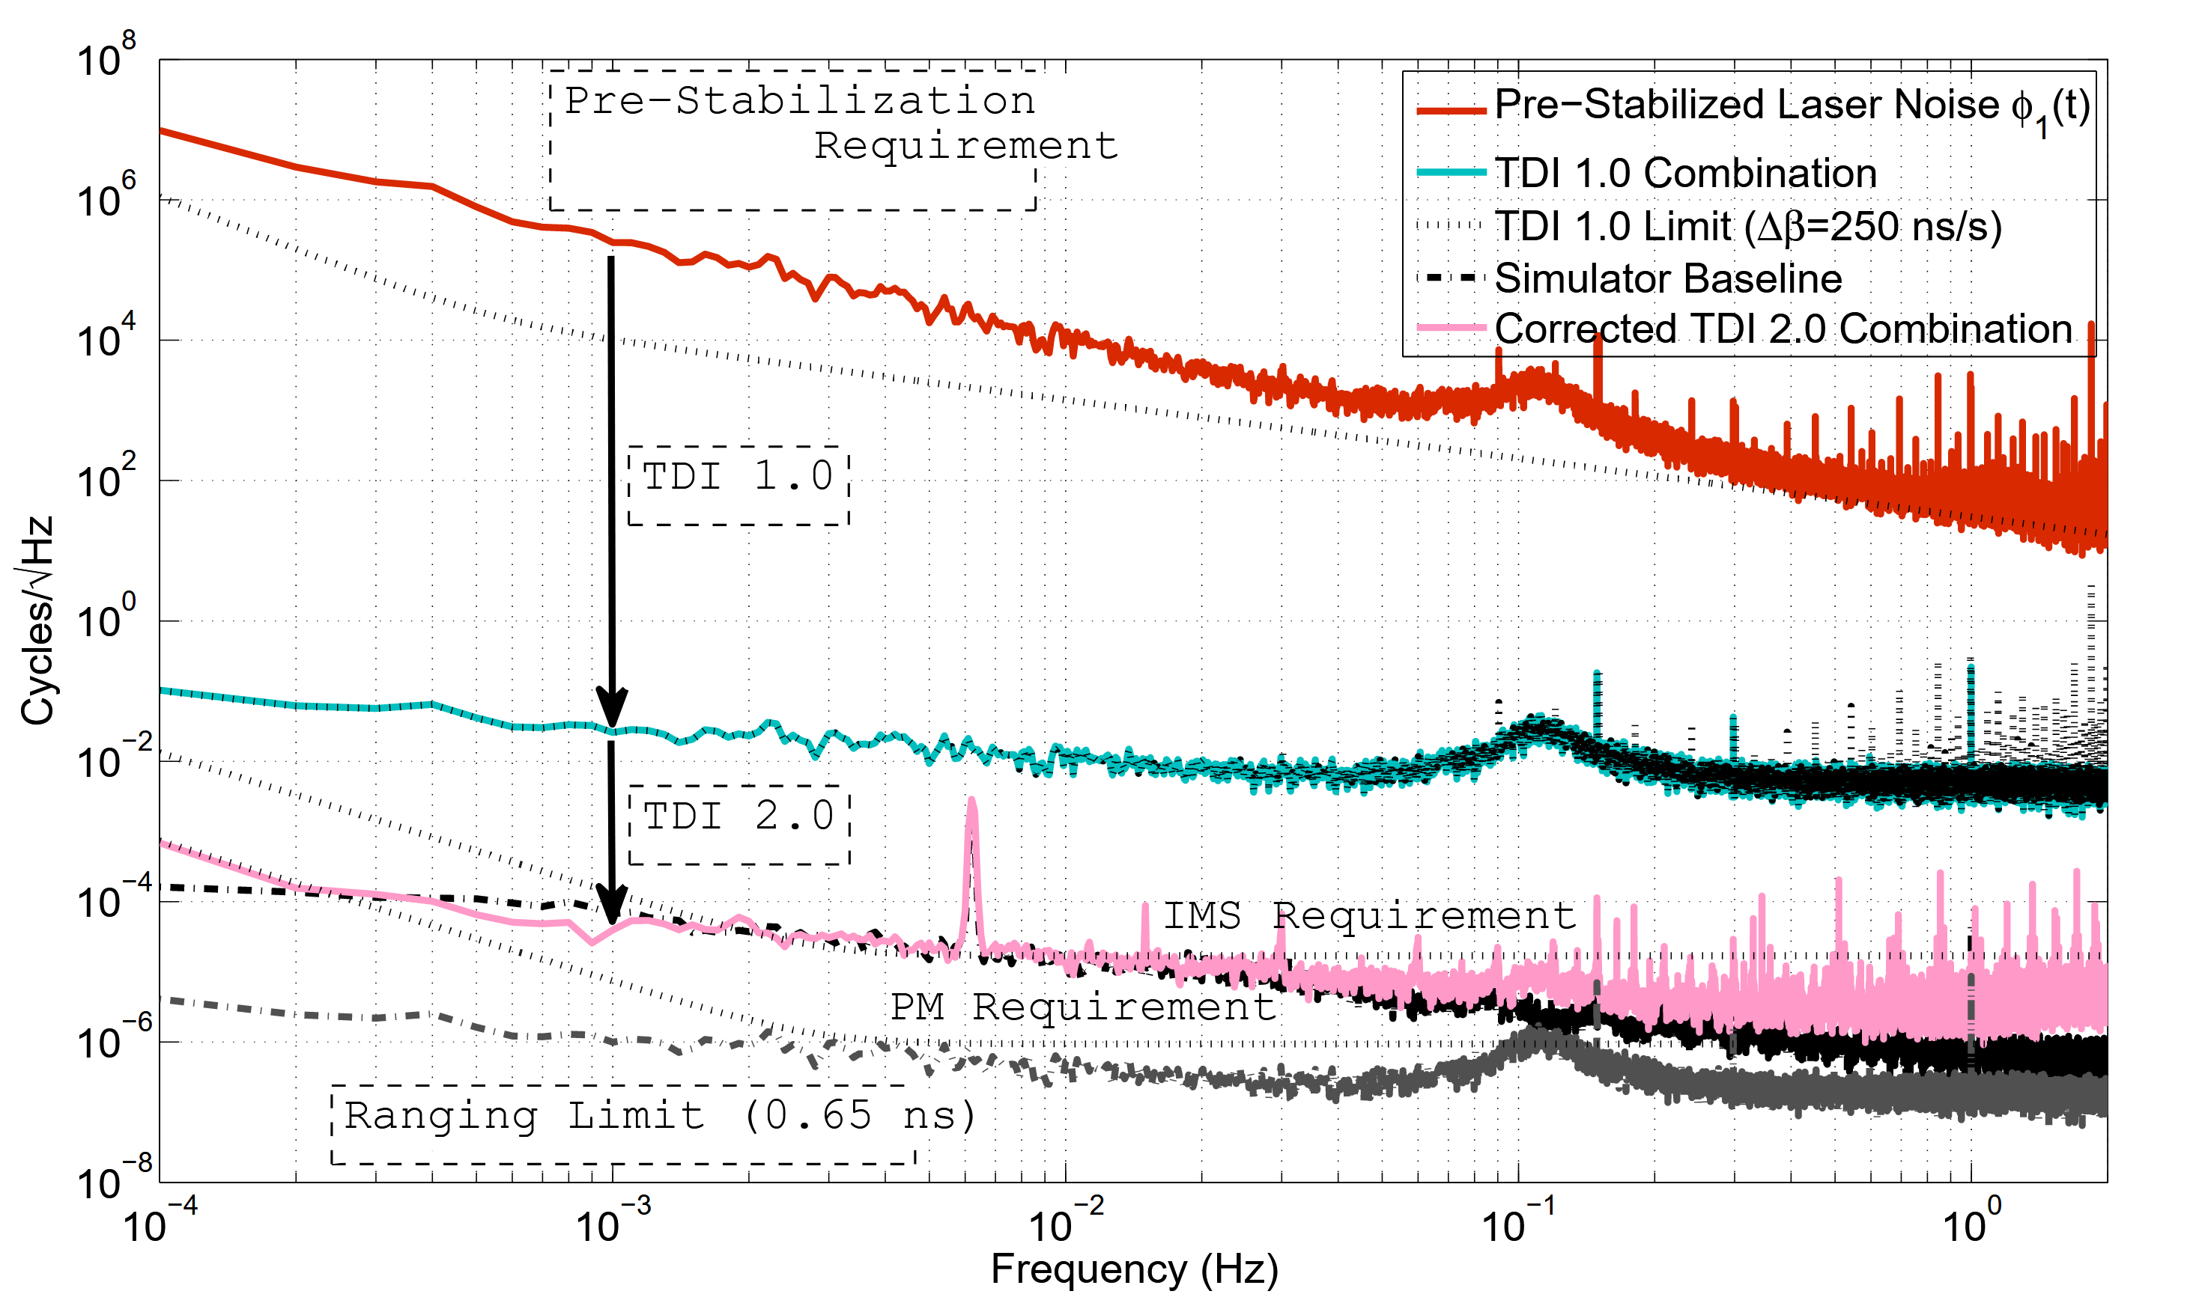
Extra: Results from Other Testbeds
HEXAGON IS MISSING
Vidal, 2023: Validation expérimentale des performances interférométriques de LISA, APC
Mitryk, 2012: Laser Noise Mitigation through Time Delay Interferometry for Space-based Gravitational Wave Interferometers Using the UF Laser Interferometer
De Vine et al., 2010: Experimental Demonstration of Time-Delay Interferometry for LISA, JPL
STUDENT SEMINAR · TAC MEETING
27 August 2026 · 44 / 42

Slide 45
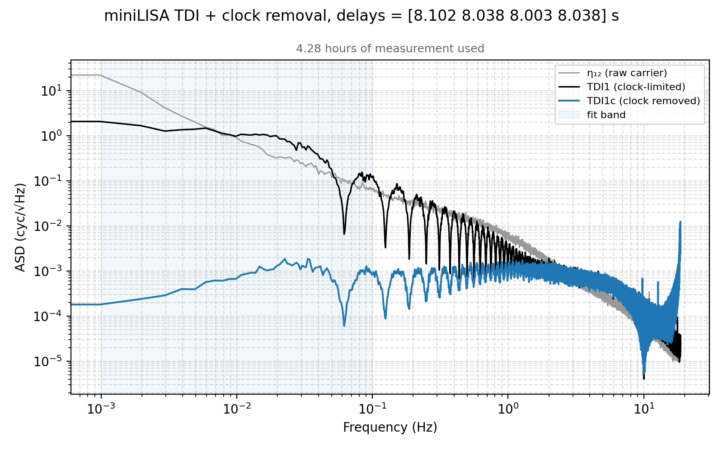
Extra: Preliminary Clock Noise Removal
THERE IS SOMETHING WRONG HERE
Multi board clock noise removal
Clock noise removal done via algorithm from Hartwig & Bayle
STUDENT SEMINAR · TAC MEETING
27 August 2026 · 45 / 42

Slide 46
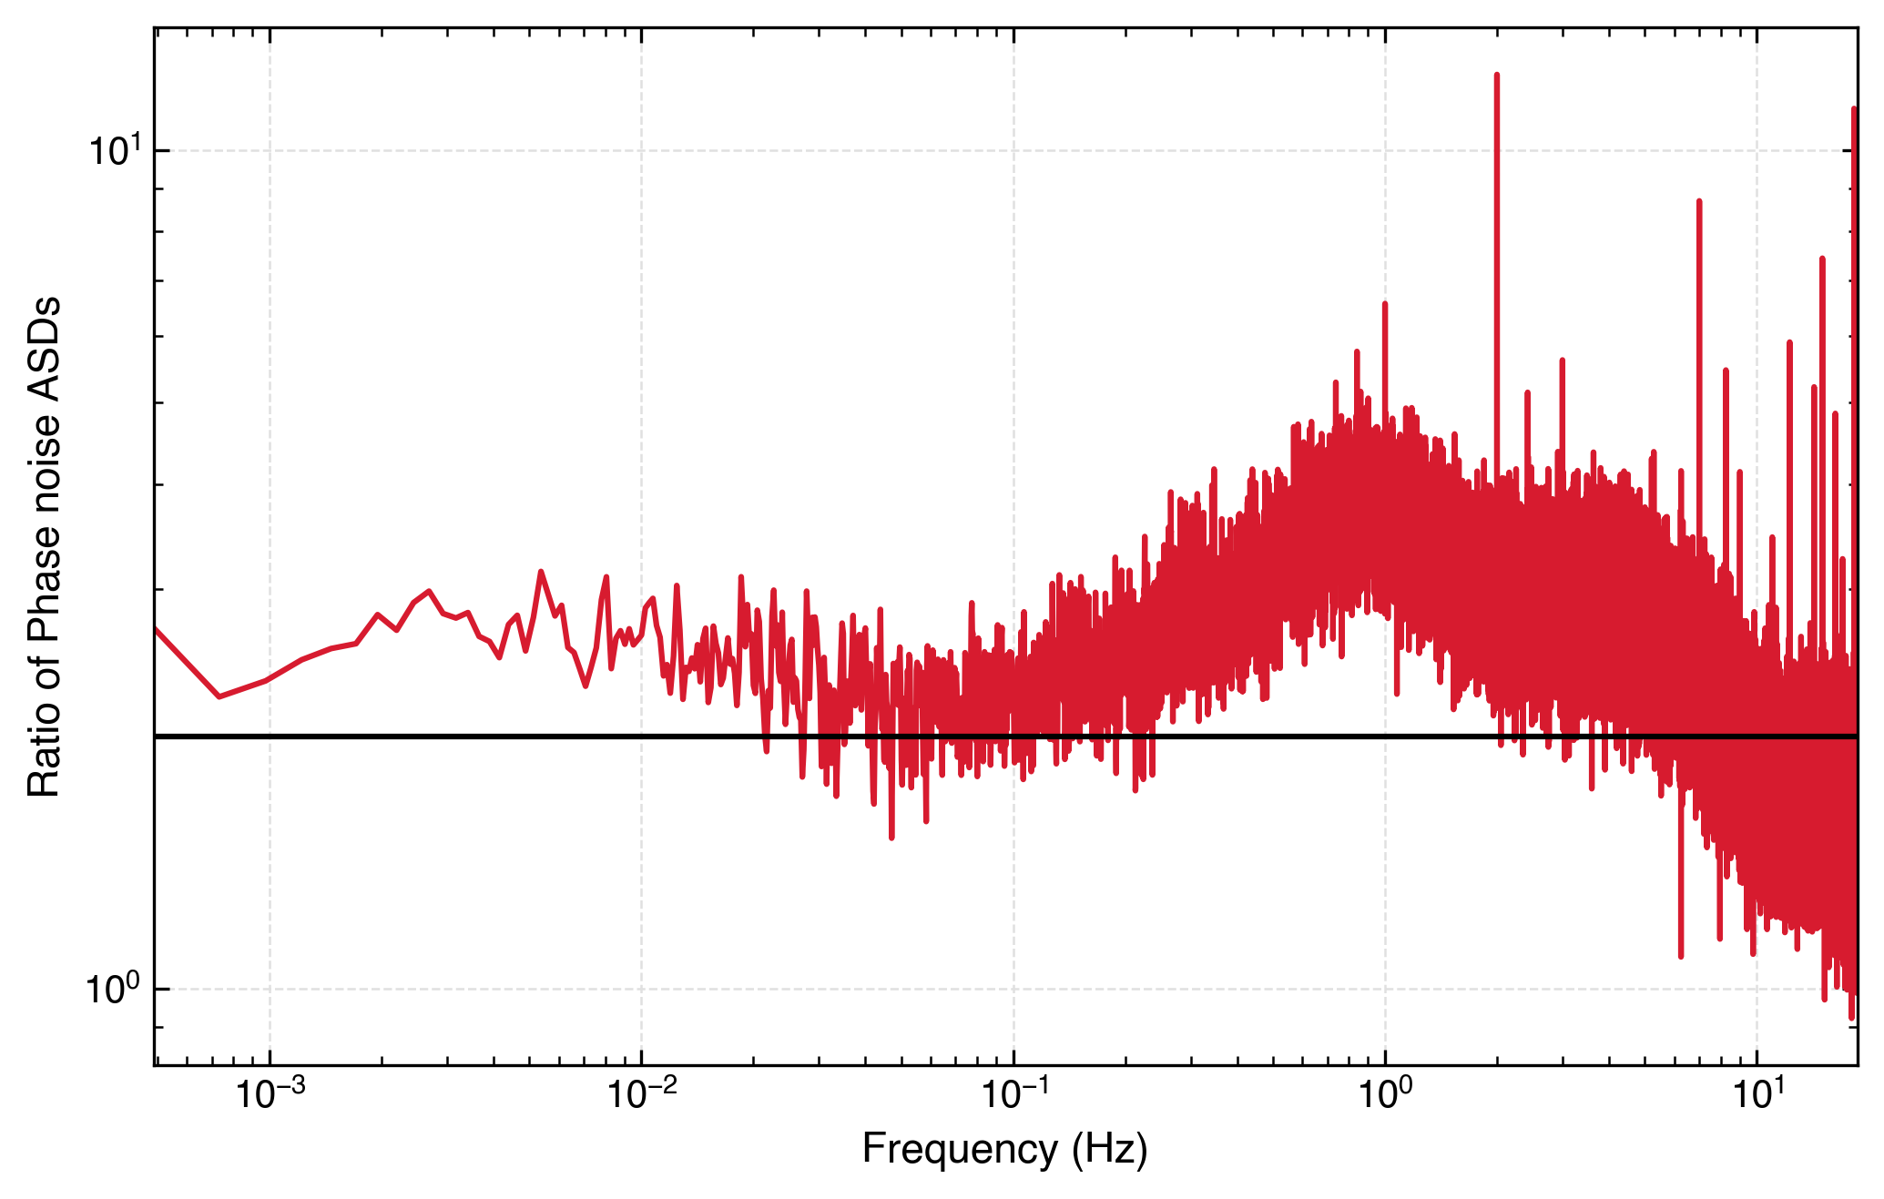
Extra: Modulation Noise Measurement
WHY ARE THE LINES NOT OVERLAPPING?
If the measurement was dominated by modulation noise, the USB-LSB would overlap with the other two lines.
Relative amplitude noise was equal in all three readouts.
STUDENT SEMINAR · TAC MEETING
27 August 2026 · 46 / 42
Notes:
Because the USB-LSB line is lower than the other two, the measurement likely isn’t modulation noise limited, and by that I mean that

