Slide 1


THESIS ADVISORY COMMITEE MEETING· 27 AUGUST 2026
Testbed for Validating Second-Generation TDI and Clock-Noise Correction for LISA
Karin Kruuse
Max Planck Institute for Gravitational Physics (AEI) · Leibniz Universität Hannover
STUDENT SEMINAR · TAC MEETING
27 August 2026 · 01 / 39
Notes:
Do I have a defined topic
And do I understand that topic, and the physics
The TAC decides if that’s a good topic for a thesis
is it worth a degree
is it realistic
For ambitious goals, what could be a minimum reasonable level
TAC2 –status and results, are there changes, what about publications
TAC3 – so what is the realistic goal now

Slide 2
Outline of the Talk
Context
Overview of the LISA Measurement System
Testbed Concept
TDI and Laser Frequency Noise: Status
Clock Noise: Status
Next Steps
Conclusion
STUDENT SEMINAR · TAC MEETING
27 August 2026 · 02 / 39

Slide 3
Context
Overview of the LISA Measurement System
Testbed Concept
TDI and Laser Frequency Noise: Status
Clock Noise: Status
Next Steps
Conclusion
STUDENT SEMINAR · TAC MEETING
27 August 2026 · 03 / 39
Notes:
I'll keep the context short, since you all know LISA well. I just want to establish two things before I get to my work: what makes LISA's measurement hard, and why the fix for it lives in post-processing — because that post-processing is exactly what my thesis is built to test.

Slide 4
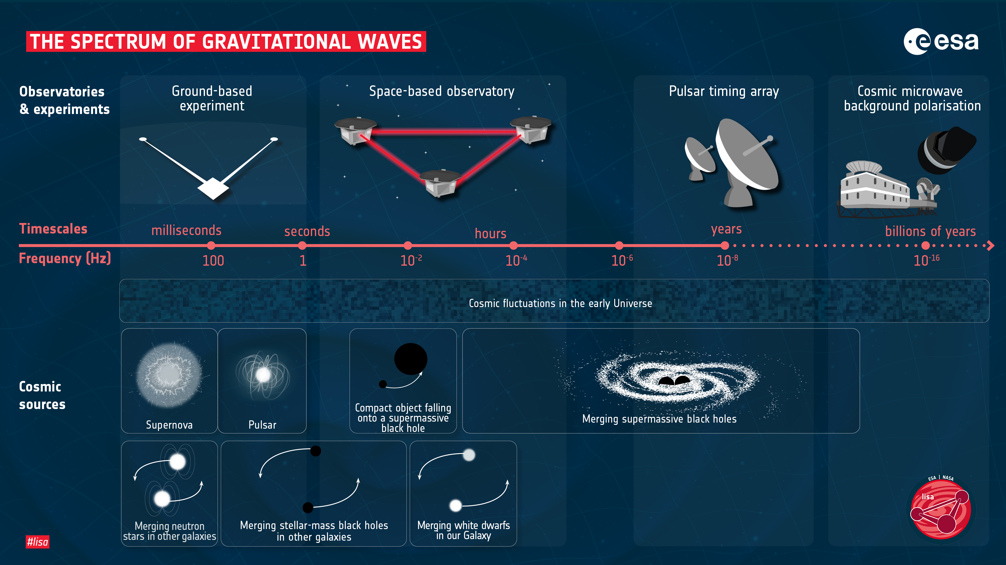
STUDENT SEMINAR · TAC MEETING
27 August 2026 · 04 / 39
Notes:
For LISA we want to put a gravitational-wave detector in space for two reasons: there's no seismic noise or Newtonian noise, and the arms can be made long enough — millions of kilometres — to be sensitive in the millihertz band. That's the regime LISA targets, and it's inaccessible from the ground

Slide 5
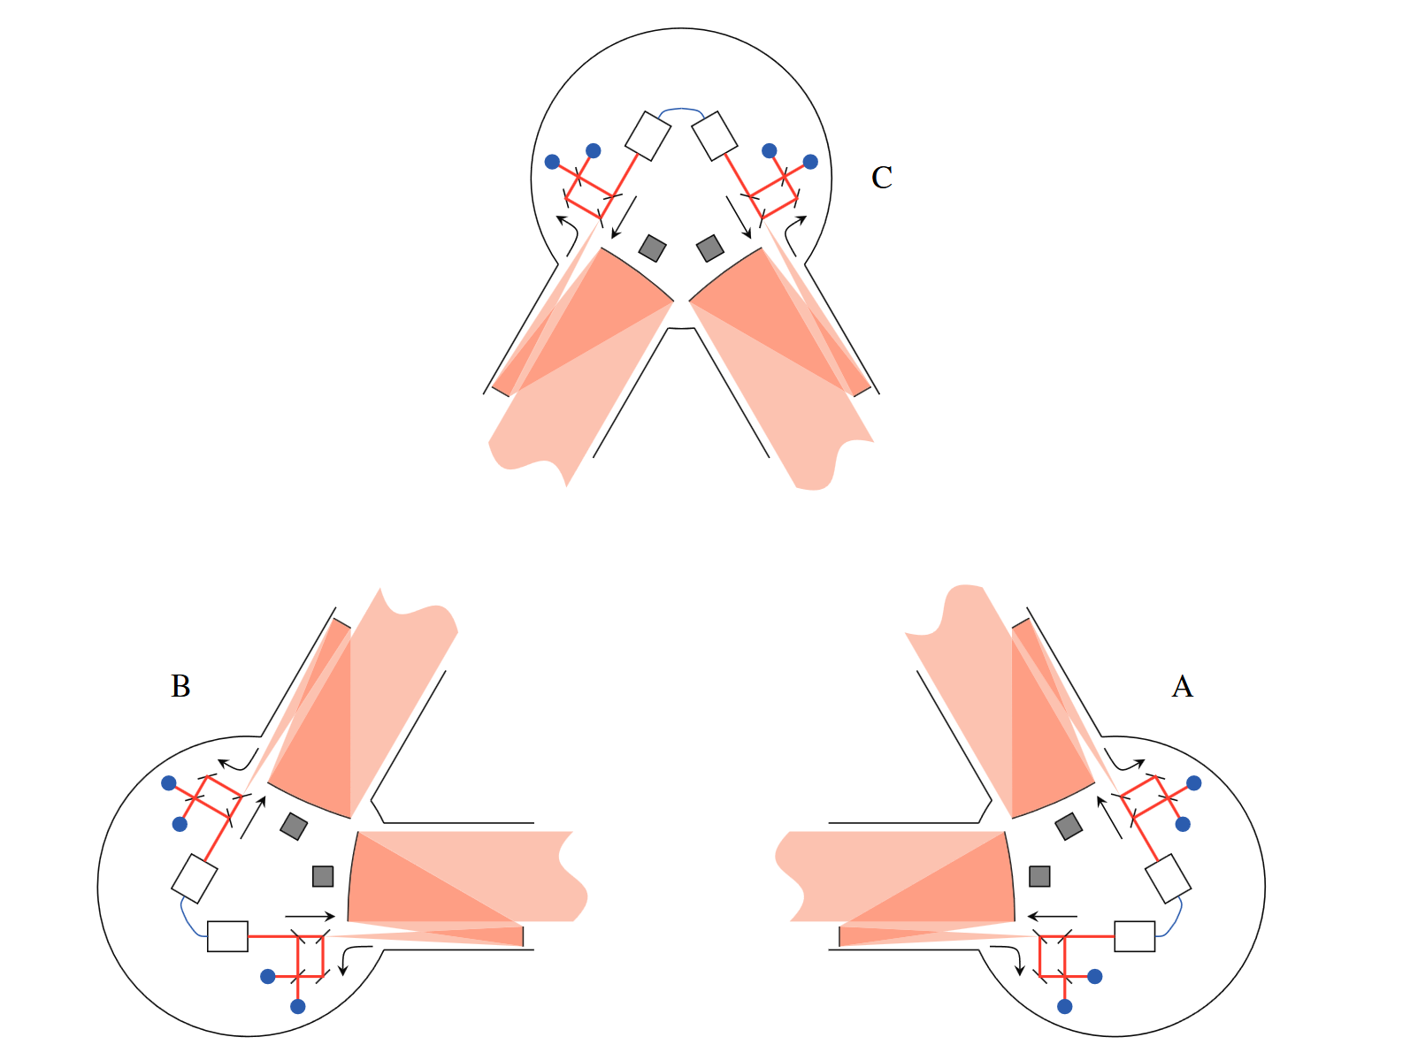
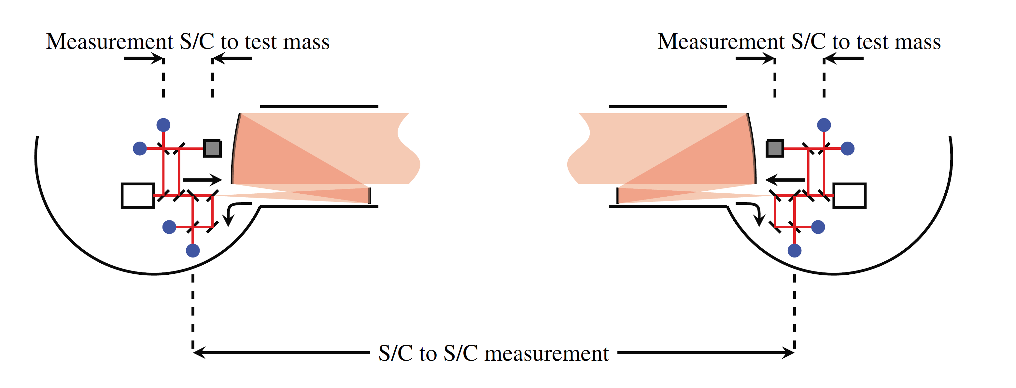
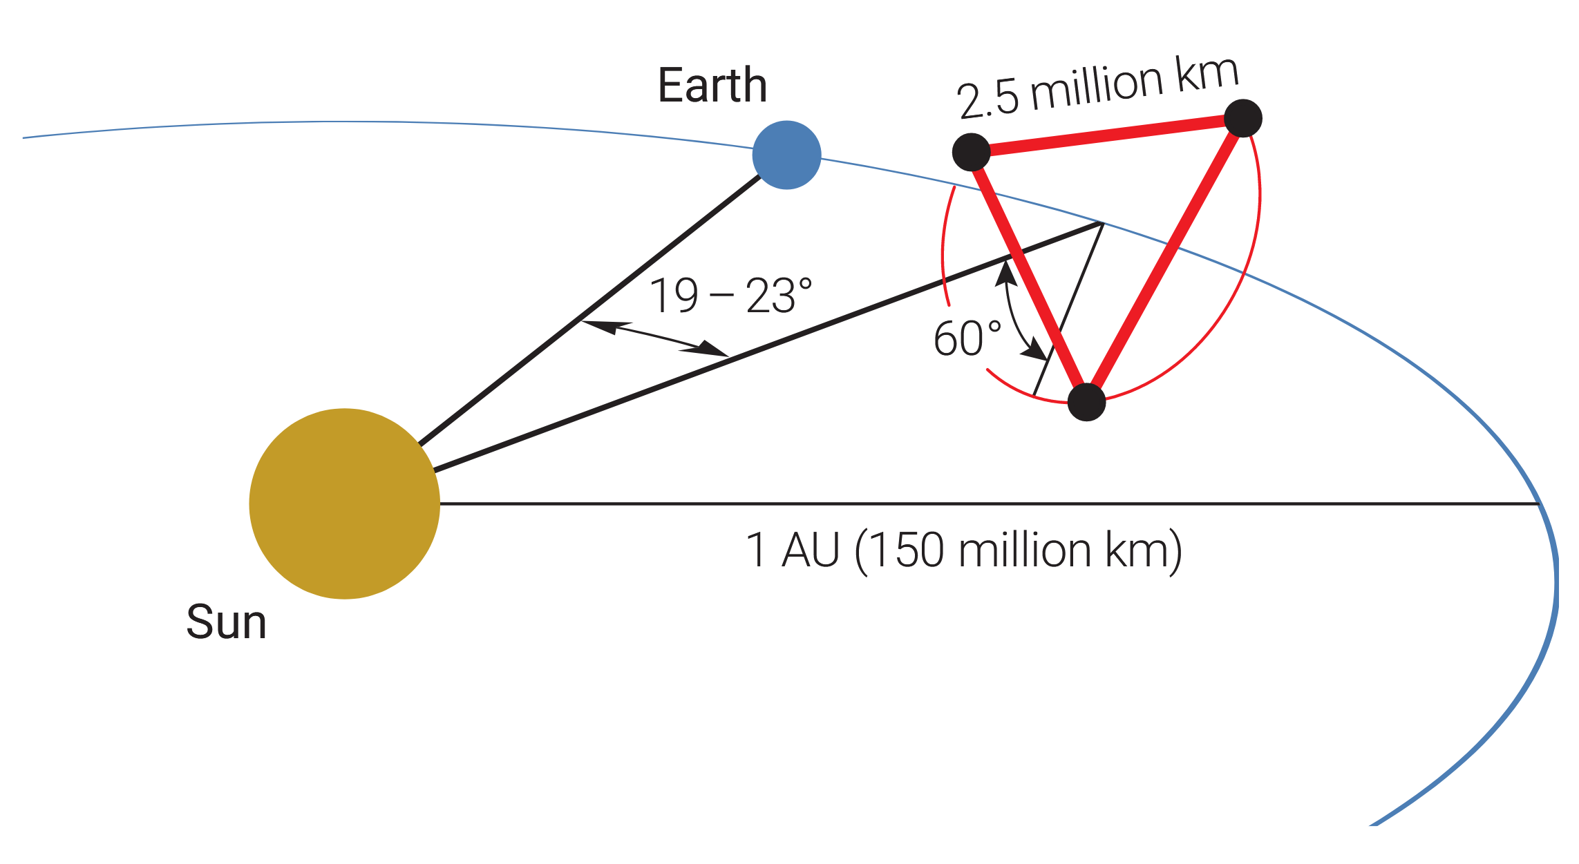
LISA Constellation
CONTEXT
Jennrich, 2010
STUDENT SEMINAR · TAC MEETING
Amaro-Seoane et al., 2017
27 August 2026 · 05 / 39
Notes:
And those long arms are the constellation itself: LISA is three spacecraft, 2.5 million kilometres apart.
To measure the distance change along one arm — between the two opposing test masses — LISA actually splits it between three separate interferometers. We call this split interferometry: one arm, several interferometers.
The interferometer we care about for this experiment is the spacecraft-to-spacecraft interferometer — the long-arm link — that’s what Time delay interferometry is most concerned with.

Slide 6

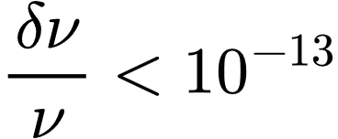
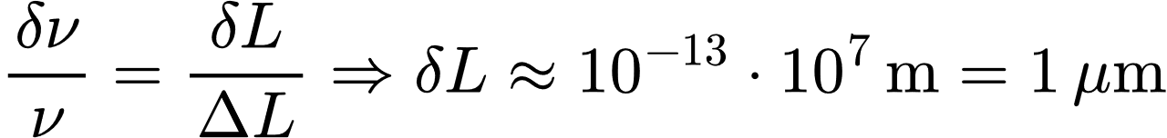
Laser Frequency Noise
CONTEXT
As per LISA laser frequency noise requirements
Hence for the corresponding arm length uncertainty we get
But to be sensitive enough to detect GWs, the needed relative arm length uncertainty gives us
Jennrich, 2010
STUDENT SEMINAR · TAC MEETING
27 August 2026 · 06 / 39
Notes:
Delta L is first the arm length differneces
and then its taken to be the ranging error
basically we see that for the given amount of laser noise that we will have, the difference between the arm lengths should be 1 m. And we put a pin in that.

Slide 7
Context
Overview of the LISA Measurement System
Testbed Concept
TDI and Laser Noise: Status
Clock Noise: Status
Next Steps
Conclusion
STUDENT SEMINAR · TAC MEETING
27 August 2026 · 07 / 39

Slide 8
LISA Science Interferometer
OVERVIEW OF THE LISA MEASUREMENT SYSTEM
Demodulated phase readout on spacecraft 1 inter-spacecraft interferometer facing spacecraft 2
STUDENT SEMINAR · TAC MEETING
27 August 2026 · 08 / 39
Notes:
Let's zoom into a single link — two lasers, one on each spacecraft. Each beam is measured locally and, after the arm delay, at the far spacecraft, where it beats against the local laser on the photodiode — we get a heterodyne measurement.
The green spacecraft is PLL-locked to keep that beat note in the phasemeter band, 5 to 25 MHz, as the Doppler shifts it around. We get a similar beatnote here on the red spacecraft as well.
From the photodiode, the signal goes into the phasemeter: it's sampled by an ADC — driven by the onboard ultra-stable oscillator, the USO — and then IQ-demodulated to give the phase fluctuations.
We label this readout isi₁₂: the inter-spacecraft interferometer on spacecraft 1, facing spacecraft 2.
Two noise terms in this readout matter for the rest of the talk. The first is the laser frequency noise, p — the red laser is cavity-locked, which prestabilises it to the requirement level I showed earlier, but it still sits orders of magnitude above the signal. The second is the clock noise, q — the USO's timing jitter gets imprinted when the ADC samples, so the phase error scales with the beatnote frequency, and it's referenced to each satellite's own proper time.
And it's this coupling — how p and q enter the readout — that TDI and the clock-noise removal are built on. So that exact coupling is what we replicate in the lab — and the open question is whether anything else couples in that the current models miss.

Slide 9
TDI and Laser Frequency Noise
OVERVIEW OF THE LISA MEASUREMENT SYSTEM
STUDENT SEMINAR · TAC MEETING
27 August 2026 · 09 / 39
Notes:
So how does LISA get rid of the laser frequency noise? The central idea is to synthesize an equal-arm interferometer in post-processing. You do this by time-shifting the recorded data streams by the light-travel delays and combining them, we build a combination where the laser noise cancels, just as it would in a real equal-arm interferometer.
And we only need to synthesize arms with a length difference of about 1 m, that’s the number from a couple of slides ago.
The way we do it is by synthesizing round trips: we combine the readouts so the light effectively goes out and back along both arms. Because both synthesized paths accumulate the same total delay, the laser phase lines up at the start and end and subtracts away. The particular round-trip combination that gives a virtual Michelson at one vertex is the one we call X.
Now, if you know the light-travel delays with infinite accuracy, then in theory you can subtract out all of the laser frequency noise between the lasers. But we of course do no know the delays with such accuracies. But what is “guaranteed” by requirements, is the knowledge to about 3 ns – again this is the same 1 m from a separate ranging measurement, which I will not get into here.
Finally, first- versus second-generation. First-gen assumes static arms — one fixed delay each. But the constellation flexes, so the arm changes during the light's round trip, the two paths no longer match exactly, and first-gen leaves a residual — that's the flexing curve on the next slide. Second-gen nests the delays, effectively traversing the paths in both orders, so the combination stays matched even while the arm moves. That's what the testbed has to reproduce, and it's why the title says second-generation.

Slide 10
Expected Laser Noise Reduction
OVERVIEW OF THE LISA MEASUREMENT SYSTEM
TDI needs to suppress laser frequency noise by about 8 orders of magnitude to bring it below other, limiting noises.
For LISA, 2nd generation TDI combinations should be able to achieve this.
STUDENT SEMINAR · TAC MEETING
27 August 2026 · 10 / 39
Notes:
Red at the top: pre-stabilised laser noise, 30 Hz per root-Hz — the problem. Now watch the residuals. Gray is first-gen TDI with a 1-metre ranging error but static arms — it's fine, well below the floor. If we don’t assume static arms, TDI 1 is looking not so hot anymore. Gray dotted is the same first-gen, but now with realistic arm flexing — it jumps up and rides right along the requirement. So it's flexing, not ranging, that breaks first-gen. Green is second-gen with the same 1-metre ranging: the flexing sensitivity is gone, we're back down here, now limited only by ranging. That's the whole case for second-generation TDI, in one figure. And purple — the single-link secondary noise floor from acceleration and readout noise — is what we're ultimately trying to measure down to. That's our benchmark: most of I show later gets compared to this line.
Make lines more consistent with other plots colorwise. Make the lines thicker.

Slide 11
Context
Overview of the LISA Measurement System
Testbed Concept
TDI and Laser Frequency Noise: Status
Clock Noise: Status
Next Steps
Conclusion
STUDENT SEMINAR · TAC MEETING
27 August 2026 · 11 / 39

Slide 12
Testbed One Arm Link
TESTBED CONCEPT
STUDENT SEMINAR · TAC MEETING
27 August 2026 · 12 / 39
Notes:
Blah blah about the digital delay line.
ADC after the PDs

Slide 13
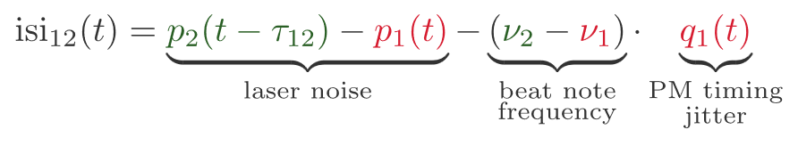
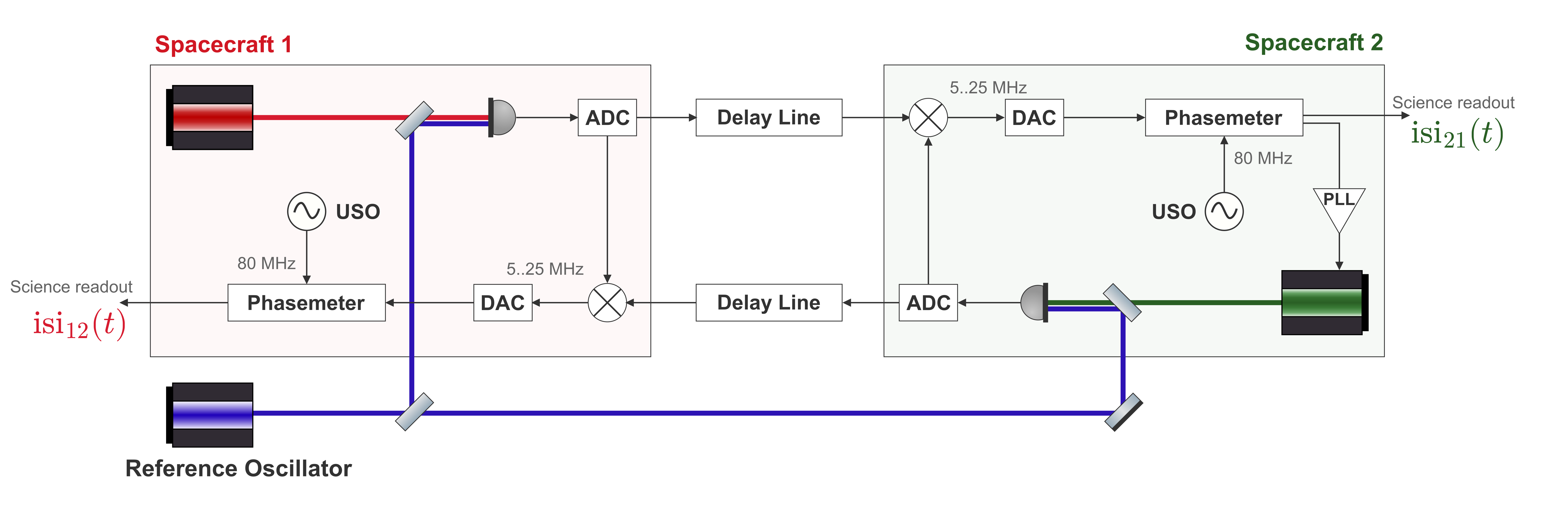
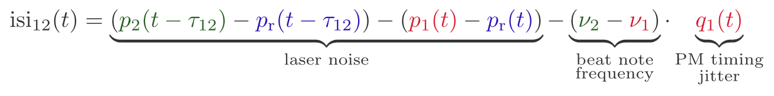
Comparison of the Readouts
TESTBED CONCEPT
LISA arm
In-flight link
Testbed arm
Benchtop analogue
STUDENT SEMINAR · TAC MEETING
27 August 2026 · 13 / 39
Notes:
Laser noise still actually has TDI structure

Slide 14
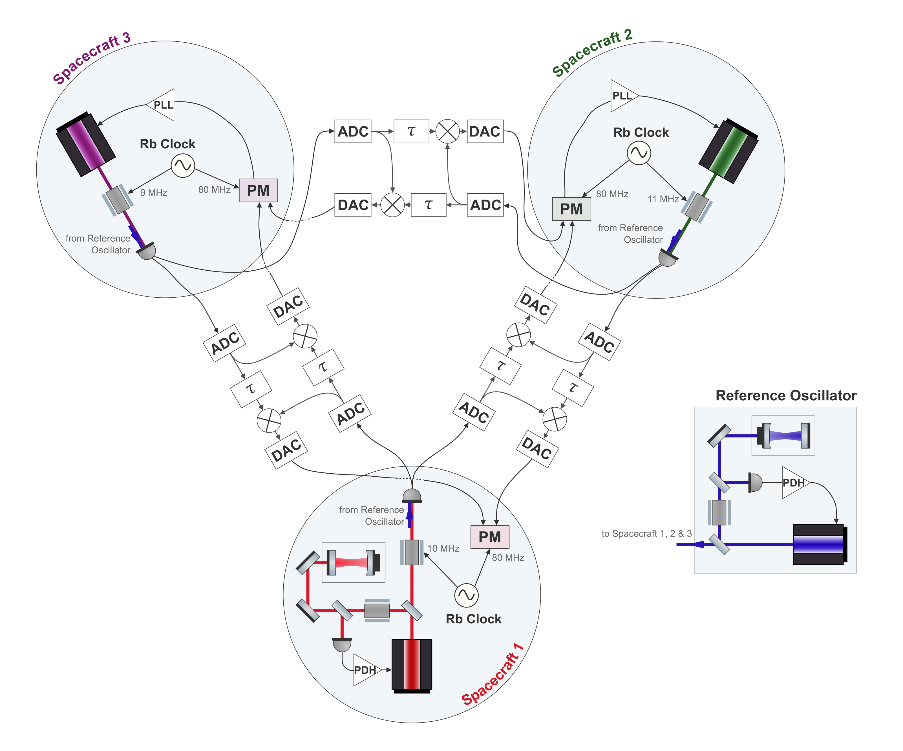
The Full Setup
TESTBED CONCEPT
One laser per spacecraft
An independent source on each satellite
Cavity-locked primary laser
Provides LISA-like laser frequency noise
Independent clocks
Allows to demonstrate clock noise removal
Six separate delay lines
Two per inter-spacecraft link
STUDENT SEMINAR · TAC MEETING
27 August 2026 · 14 / 39
Notes:
Add boxes around the delay lines
This is the ultimate goal. To test TDI and also clock noise removal with a setup like this and go for LISA like performance. The delay line also allows for injecting GW signals, so would be nice to recover those from laser noise and clock noise.
Paper in the works

Slide 15
Context
Overview of the LISA Measurement System
Testbed Concept
TDI and Laser Frequency Noise: Status
Clock Noise: Status
Next Steps
Conclusion
STUDENT SEMINAR · TAC MEETING
27 August 2026 · 15 / 39

Slide 16
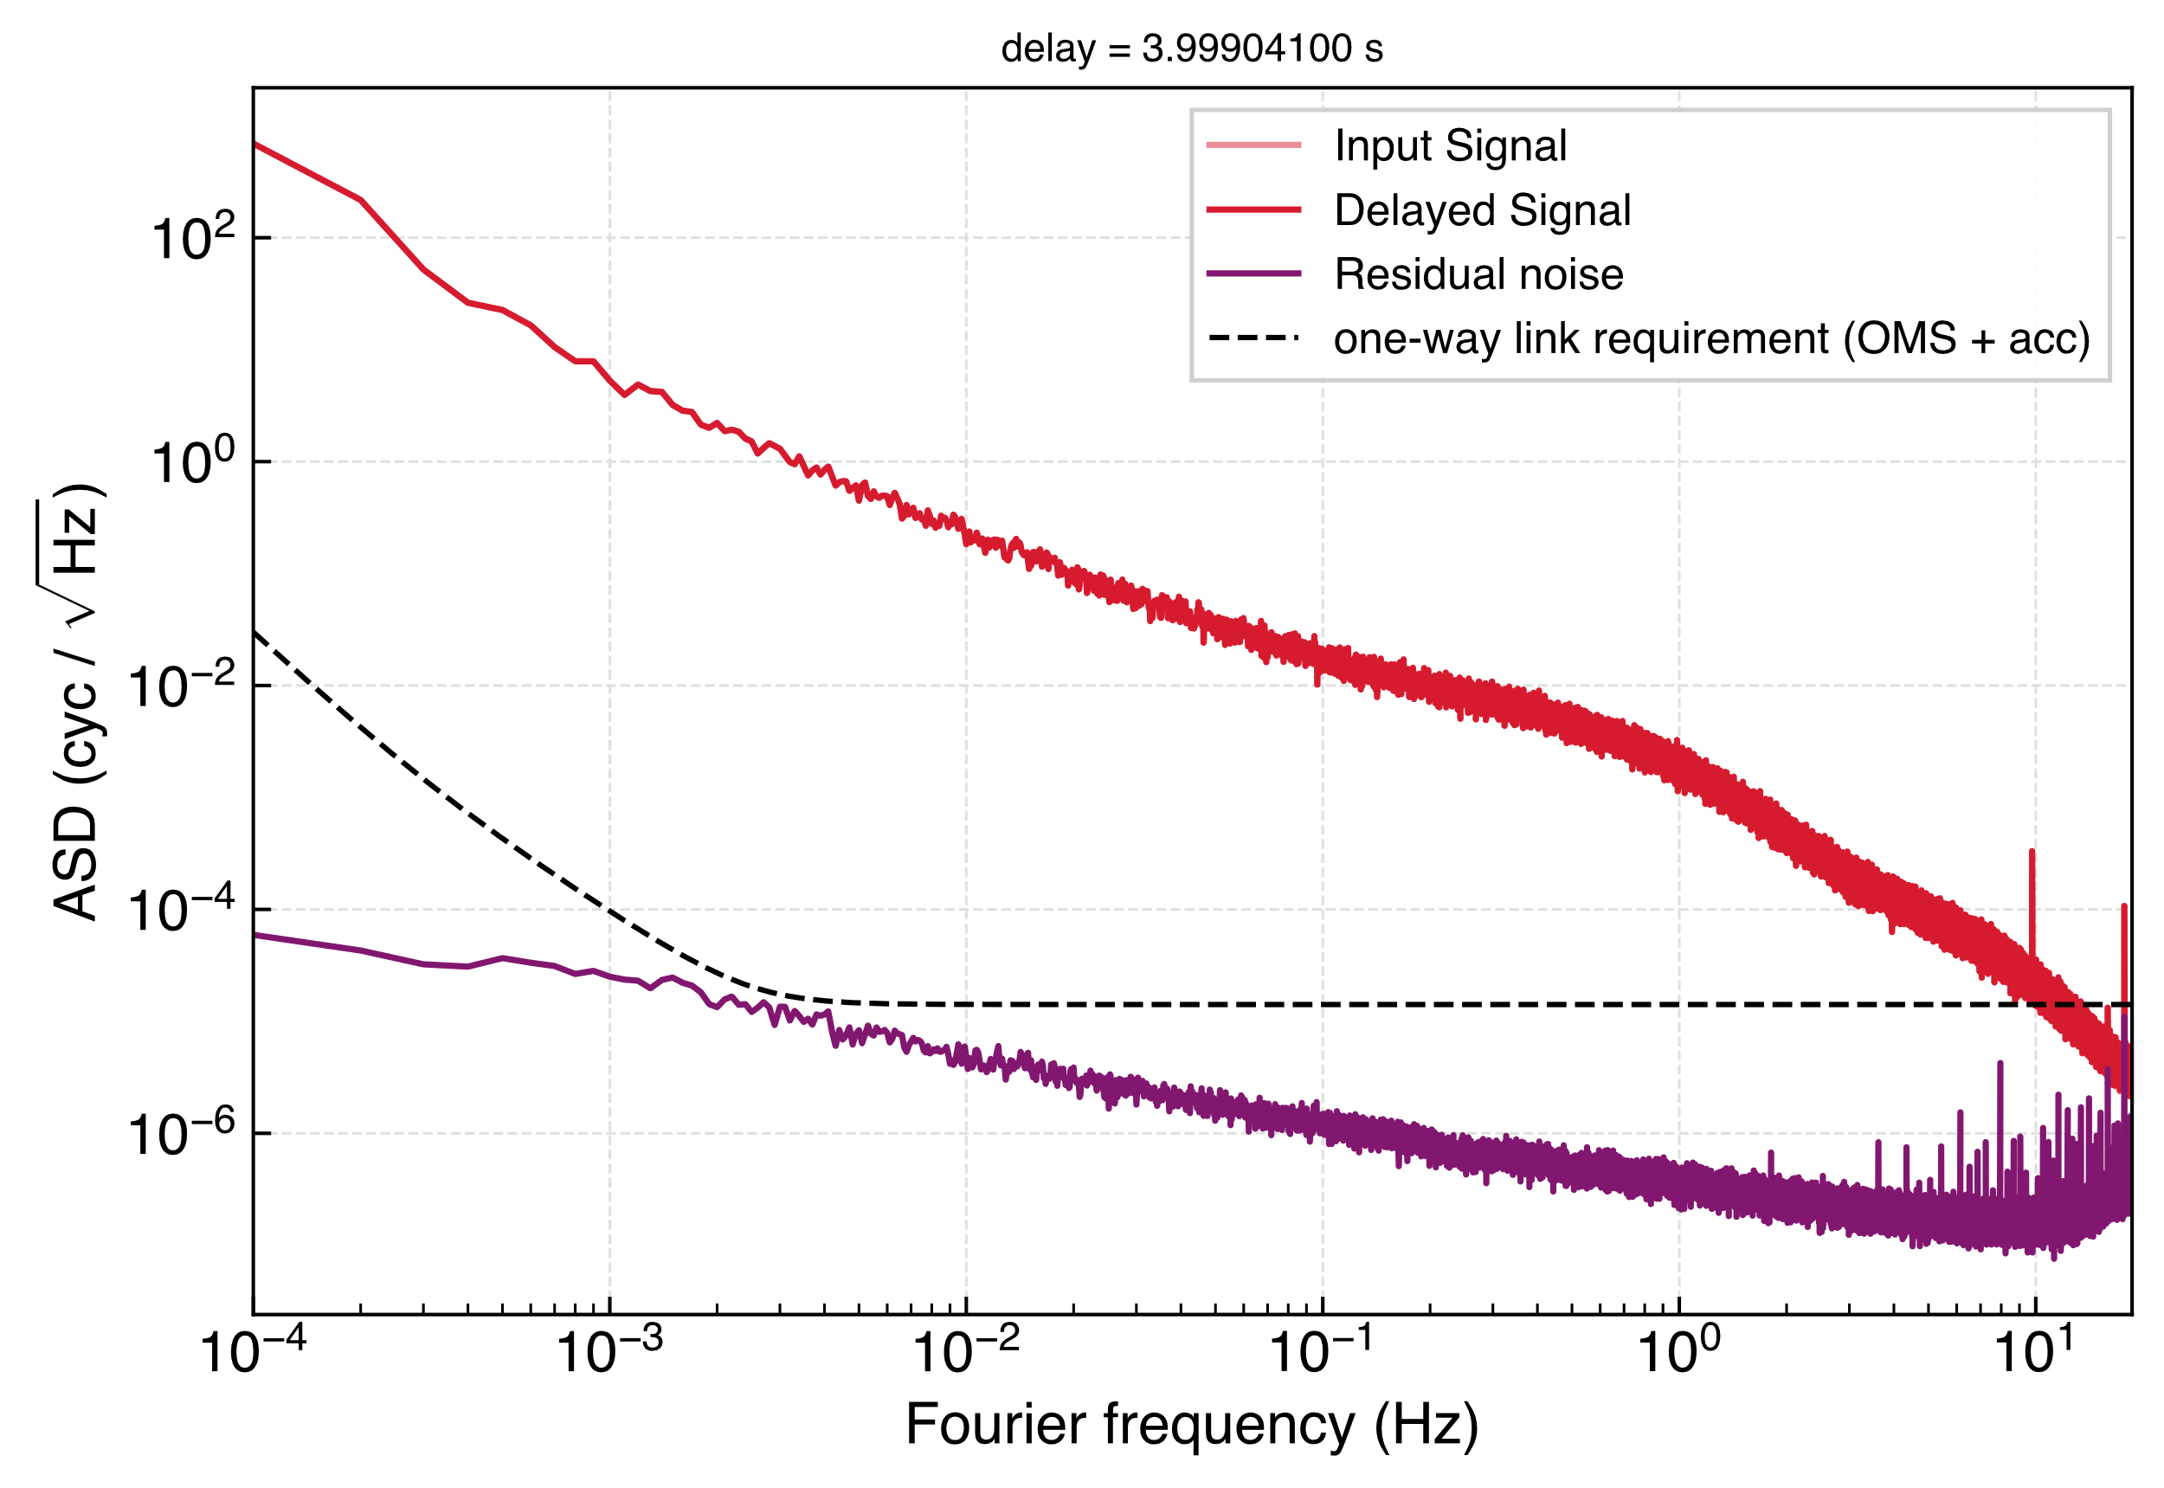
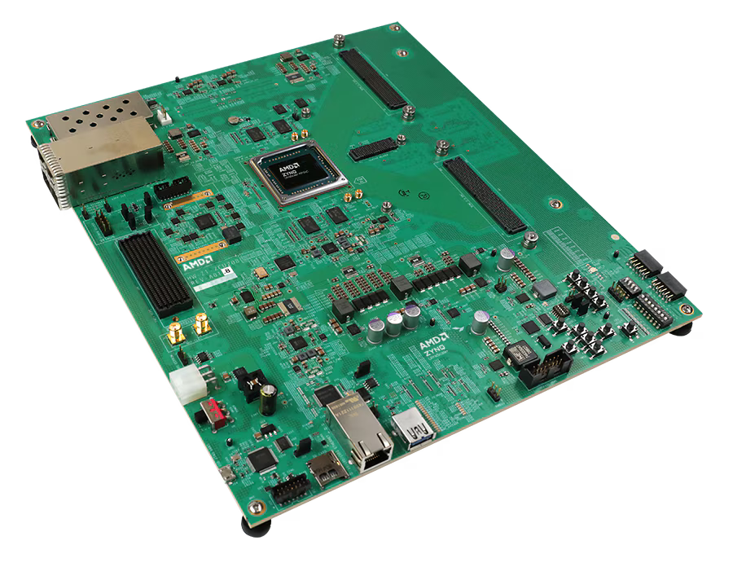
The Delay Line
TDI AND LASER FREQUENCY NOISE: STATUS
Digitally delays MHz signals and mixes the LISA-like beat notes.
Applies Doppler shifts
Injects the GW signal
AMD Zynq™ UltraScale+™ RFSoC ZCU208 Evaluation Kit
STUDENT SEMINAR · TAC MEETING
27 August 2026 · 16 / 39

Slide 17
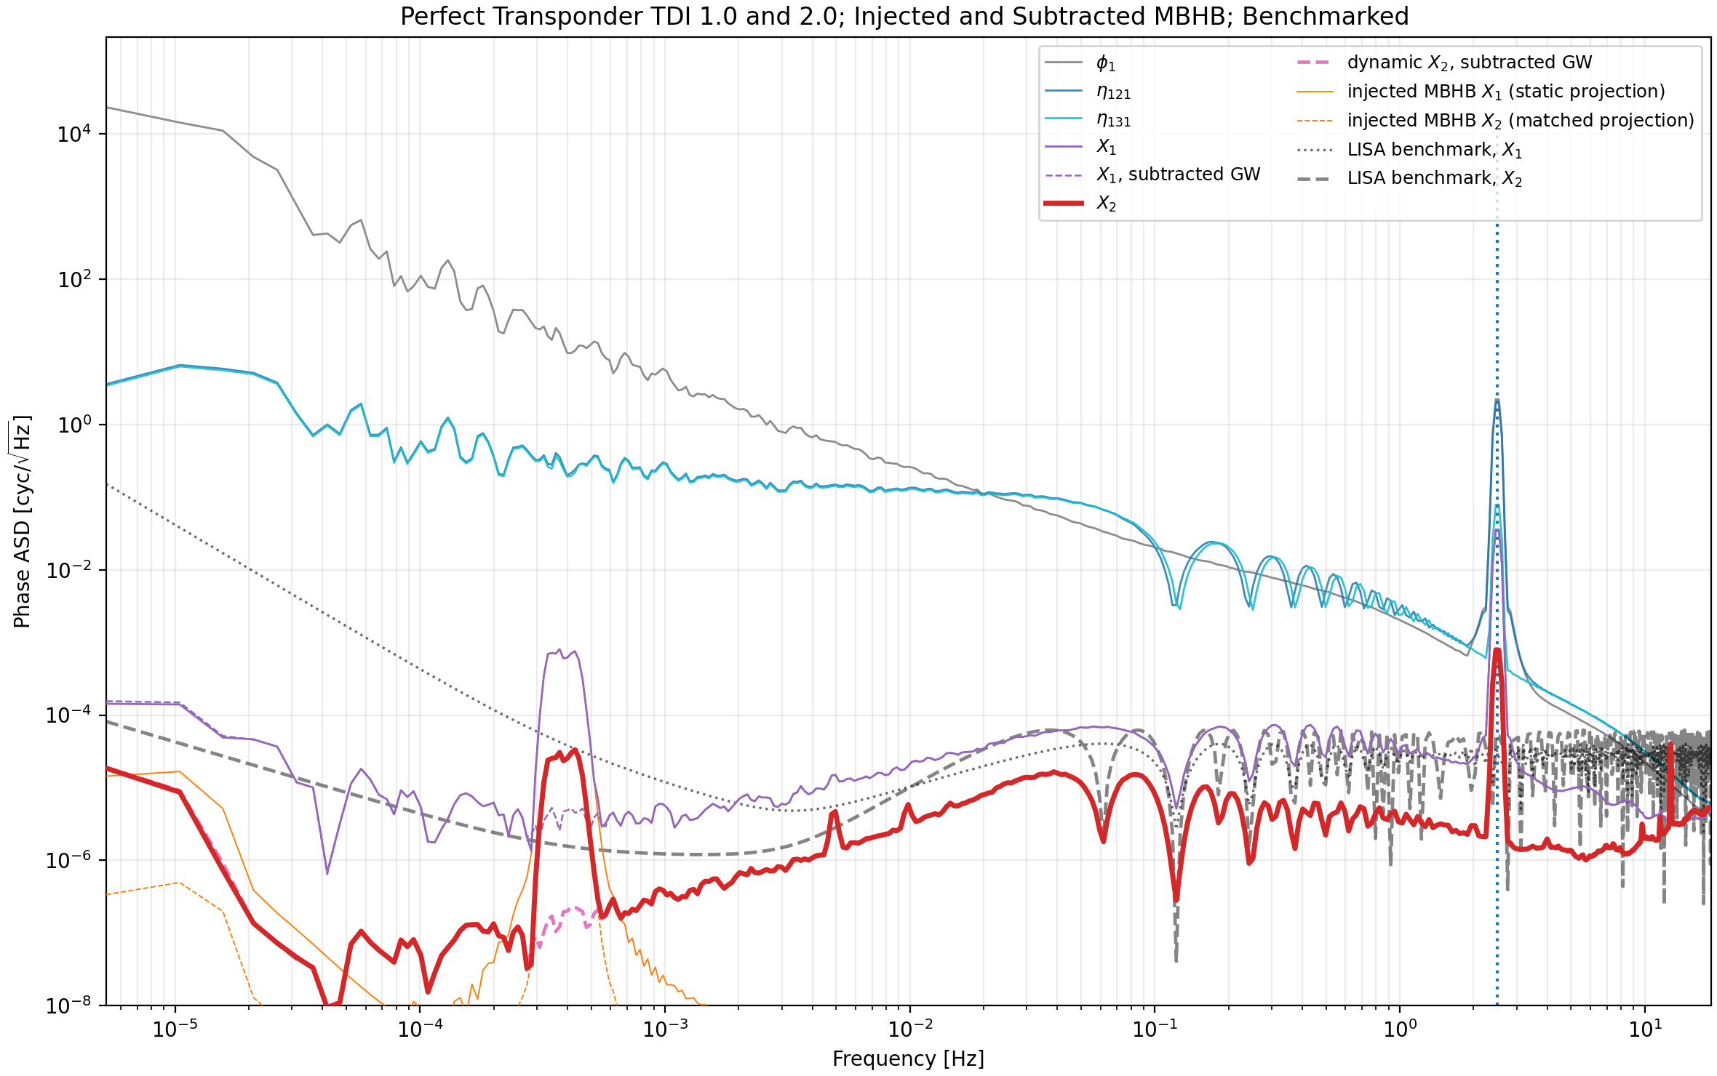
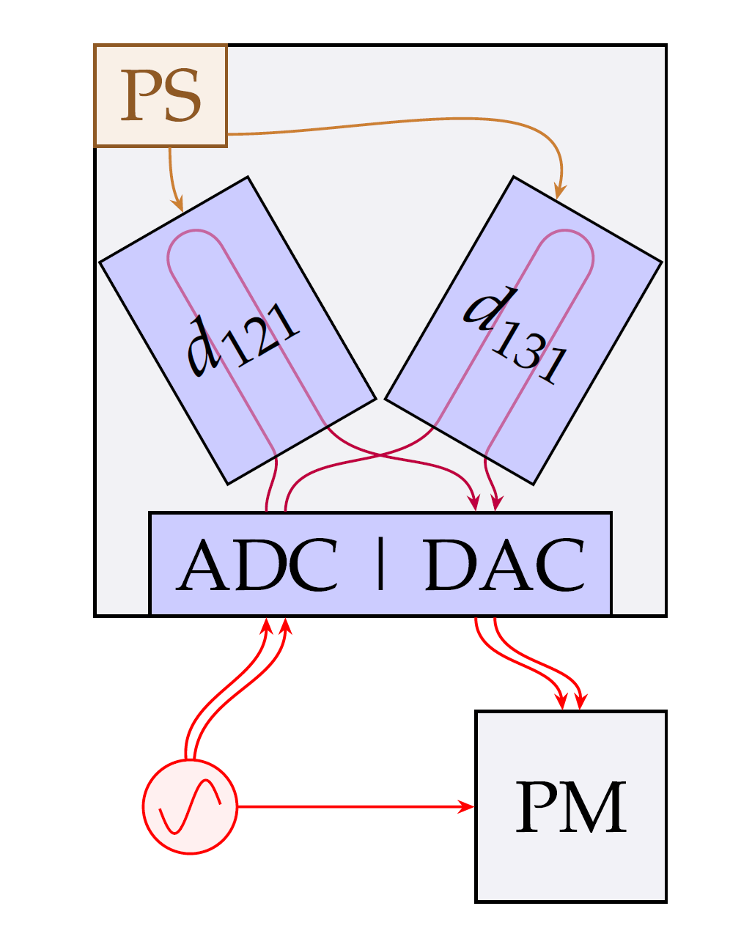
Demonstration of TDI 2 with Signal Injection
TDI AND LASER FREQUENCY NOISE: STATUS
Credit: R. Ferguson
STUDENT SEMINAR · TAC MEETING
27 August 2026 · 17 / 39
Notes:
The TDI 2 measurement
The injected noise level is low, so the level of noise removed might be better with more noise
Calculate the order of magnitude of noise removed

Slide 18
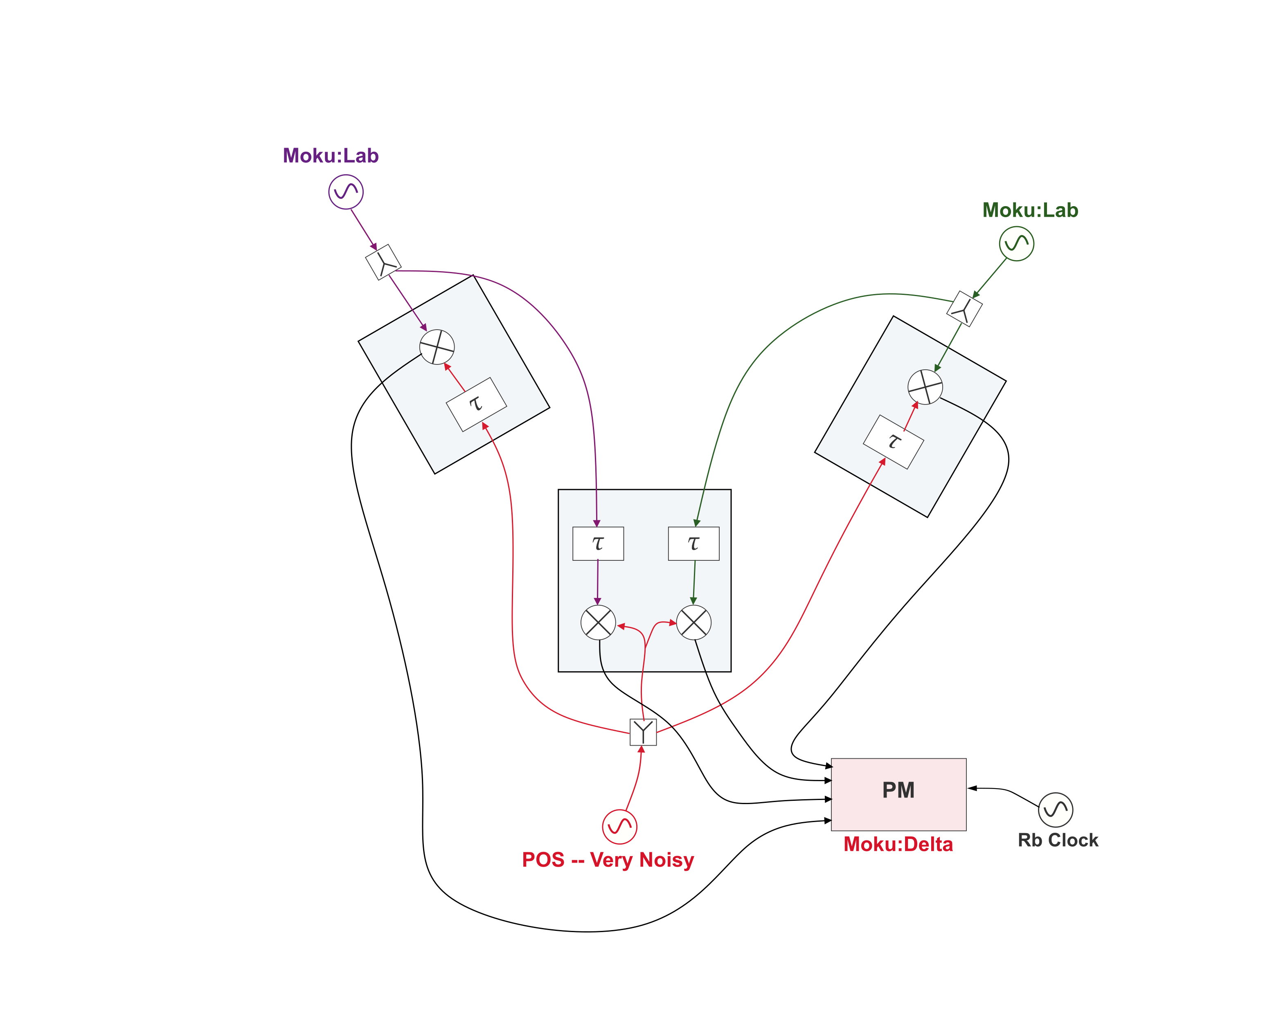
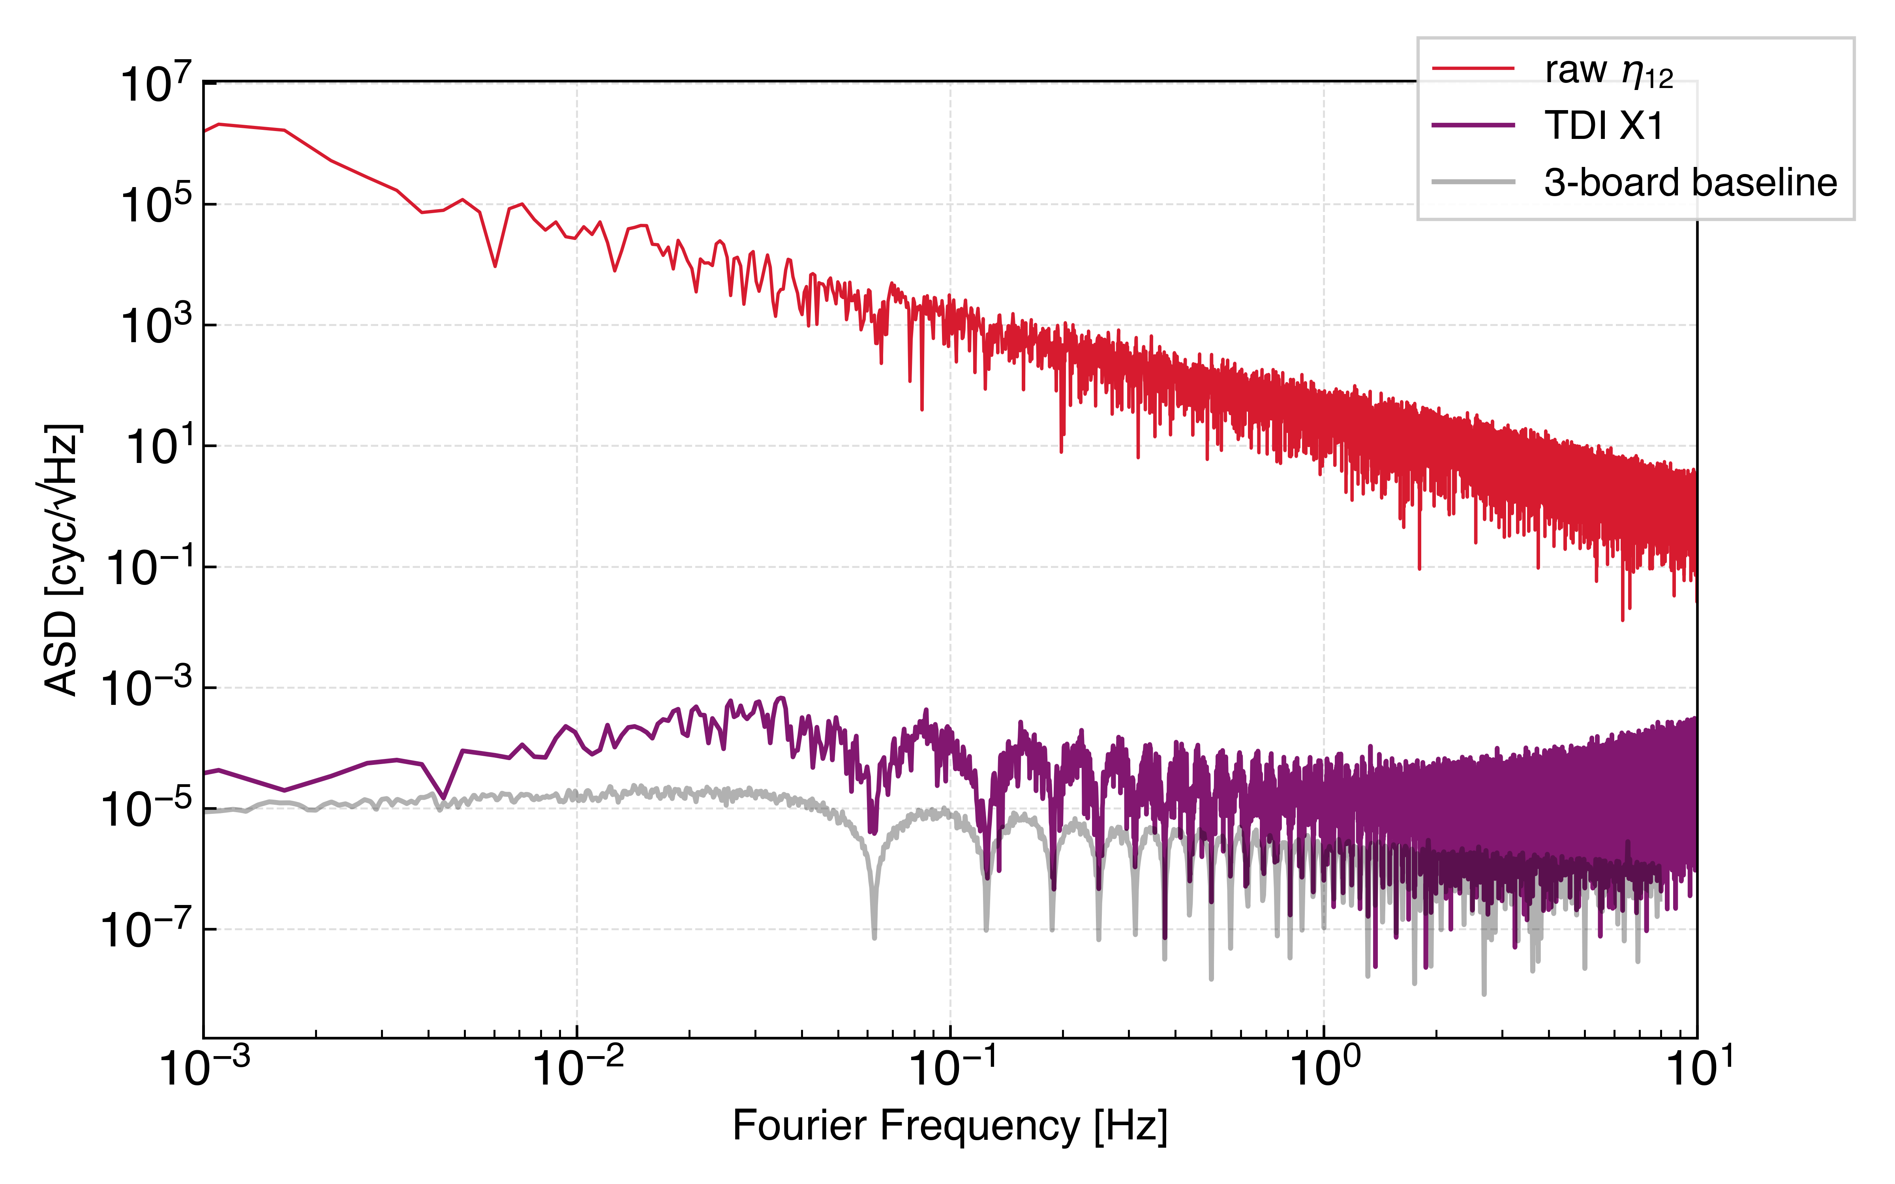
TDI Michelson X with a Multi-board Setup
TDI AND LASER FREQUENCY NOISE: STATUS
Latest results with higher injected noise levels and three delay line boards
Injected noise is reduced by 7 to 8 orders of magnitude
Is the floor due to ranging error?
STUDENT SEMINAR · TAC MEETING
27 August 2026 · 18 / 39

Slide 19
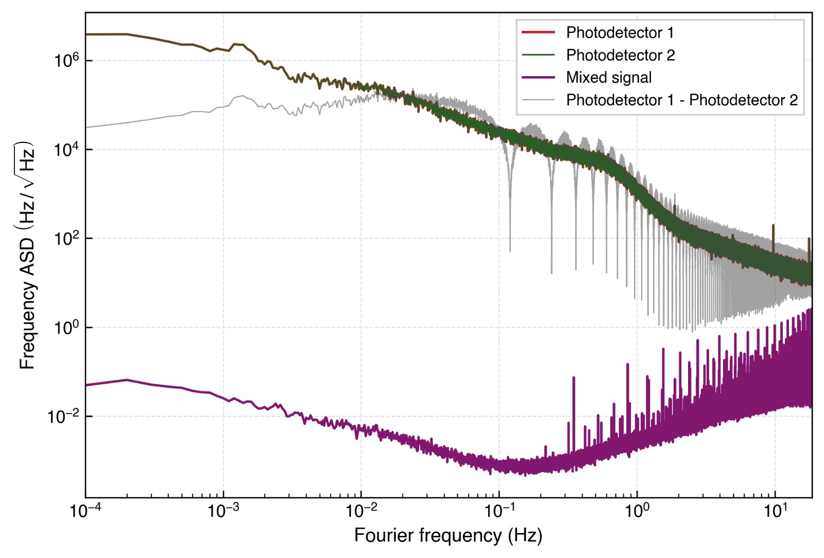
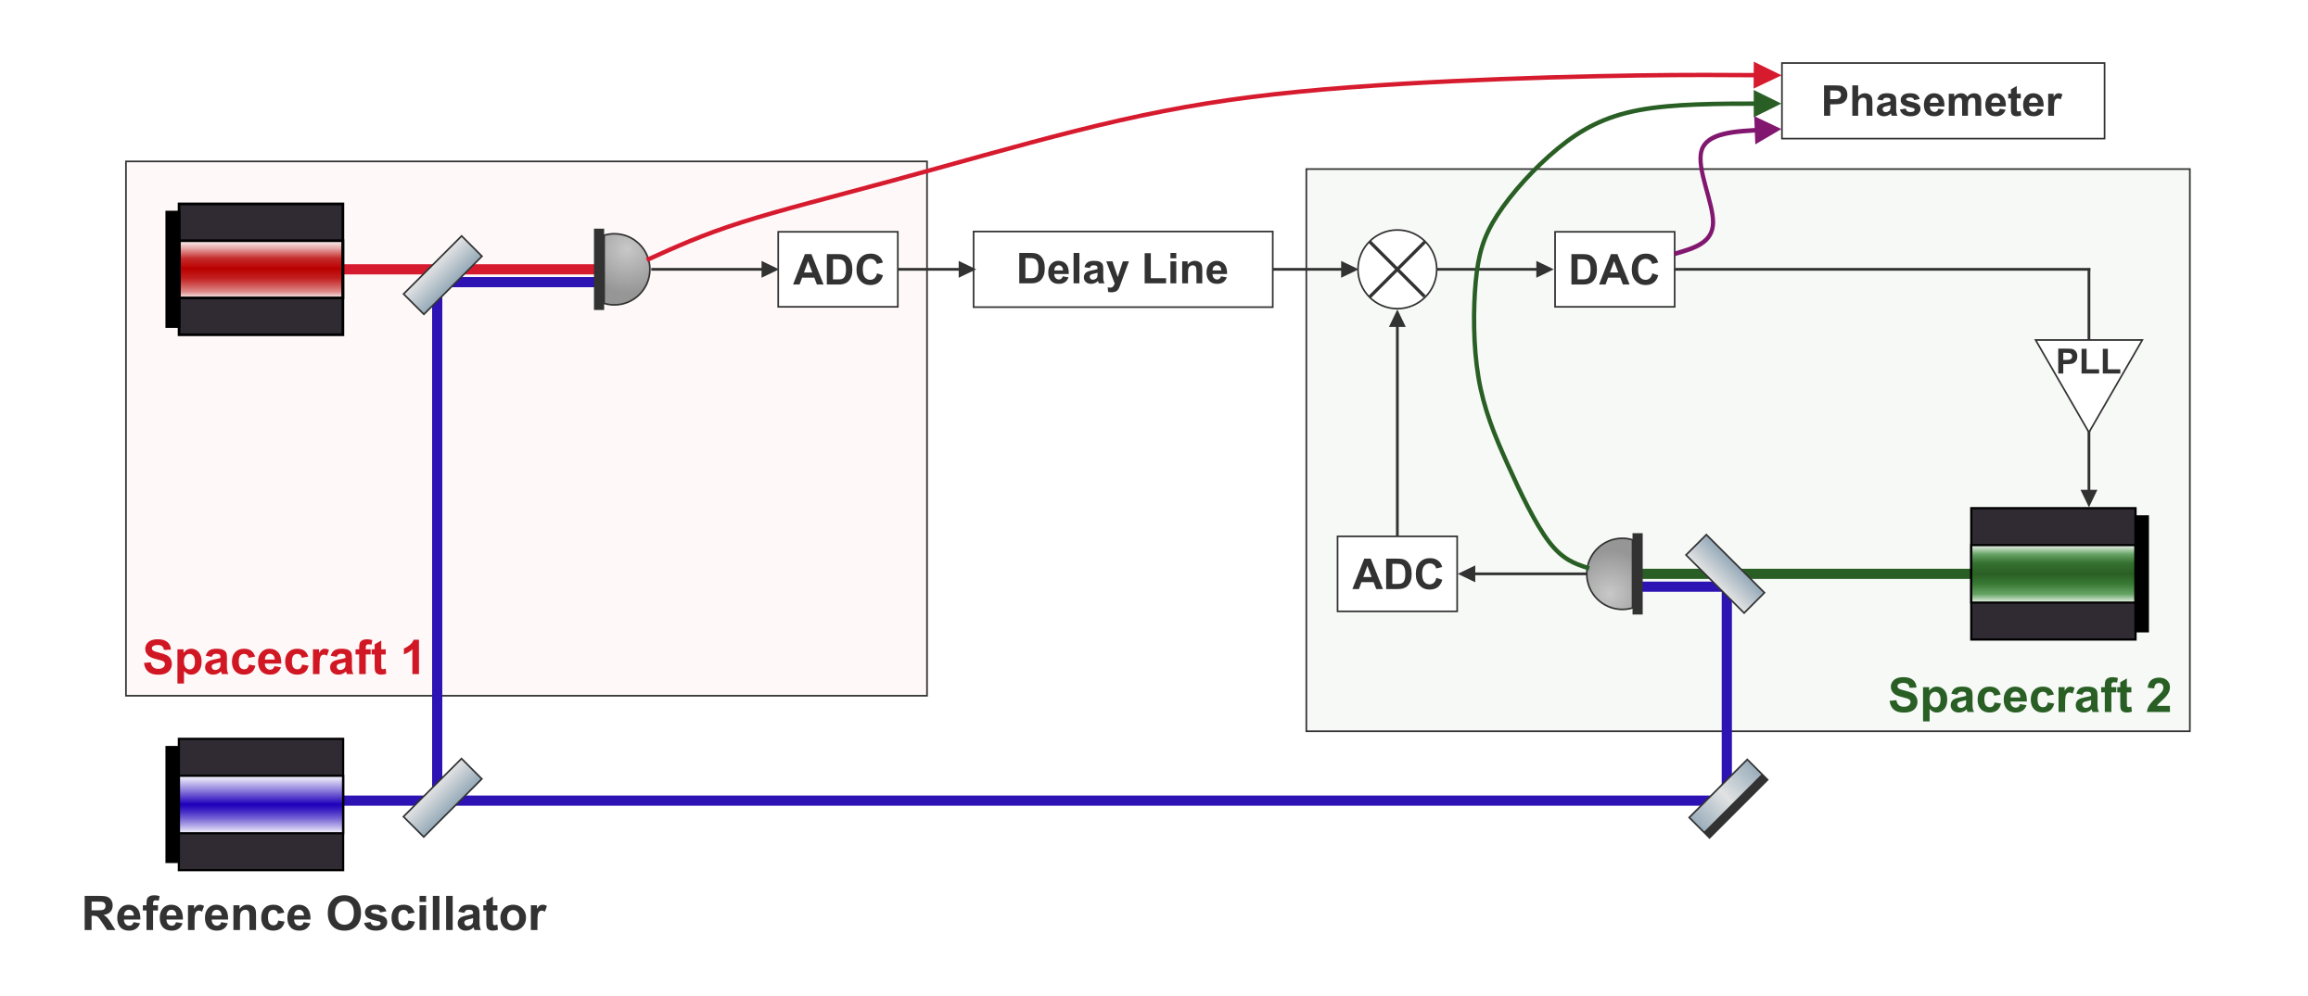


Injecting Laser Noise: PLL lock of far spacecraft
TDI AND LASER FREQUENCY NOISE: STATUS
Free-running photodetector noise vs. mixed output
STUDENT SEMINAR · TAC MEETING
27 August 2026 · 19 / 39
Notes:
Why don’t the peaks come to 0?
Photodetector readings are dominated by free-running laser frequency noise.

Slide 20
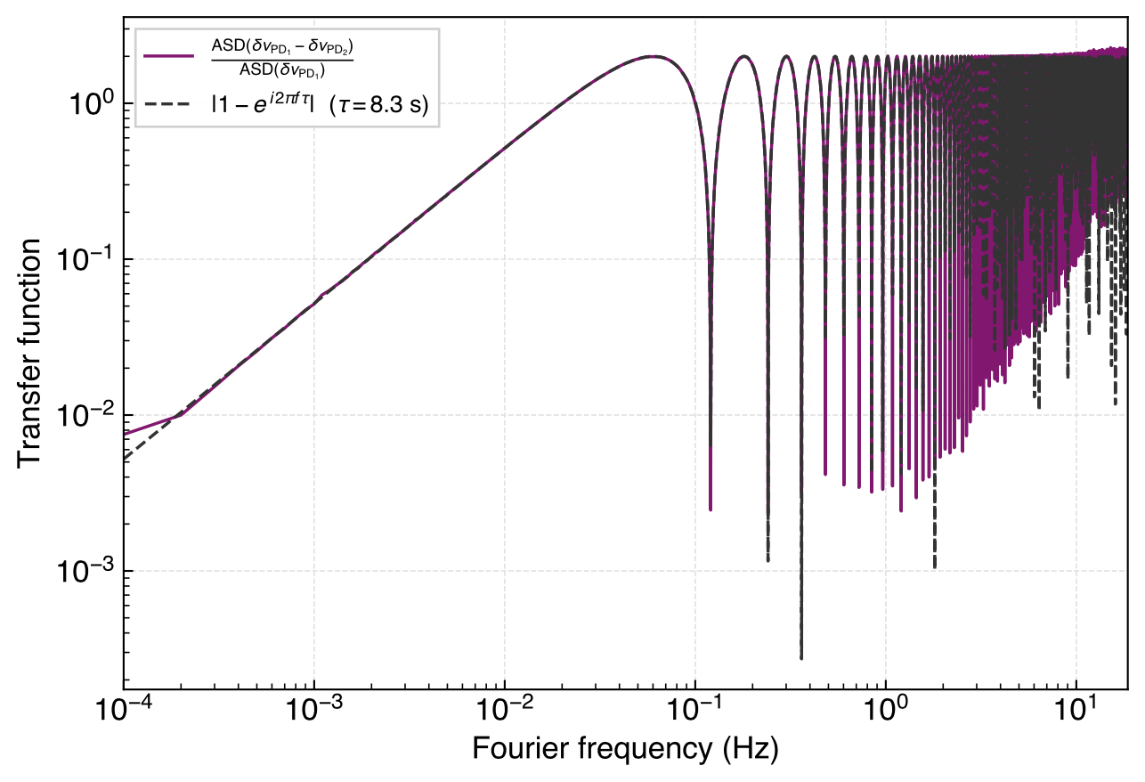
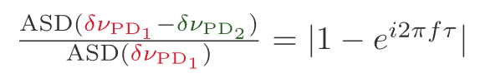
Recovering the Transfer function
TDI AND LASER FREQUENCY NOISE: STATUS
We can recover a LISA-like one-way laser-noise transfer function.
Recovered one-way laser-noise transfer function
STUDENT SEMINAR · TAC MEETING
27 August 2026 · 20 / 39

Slide 21
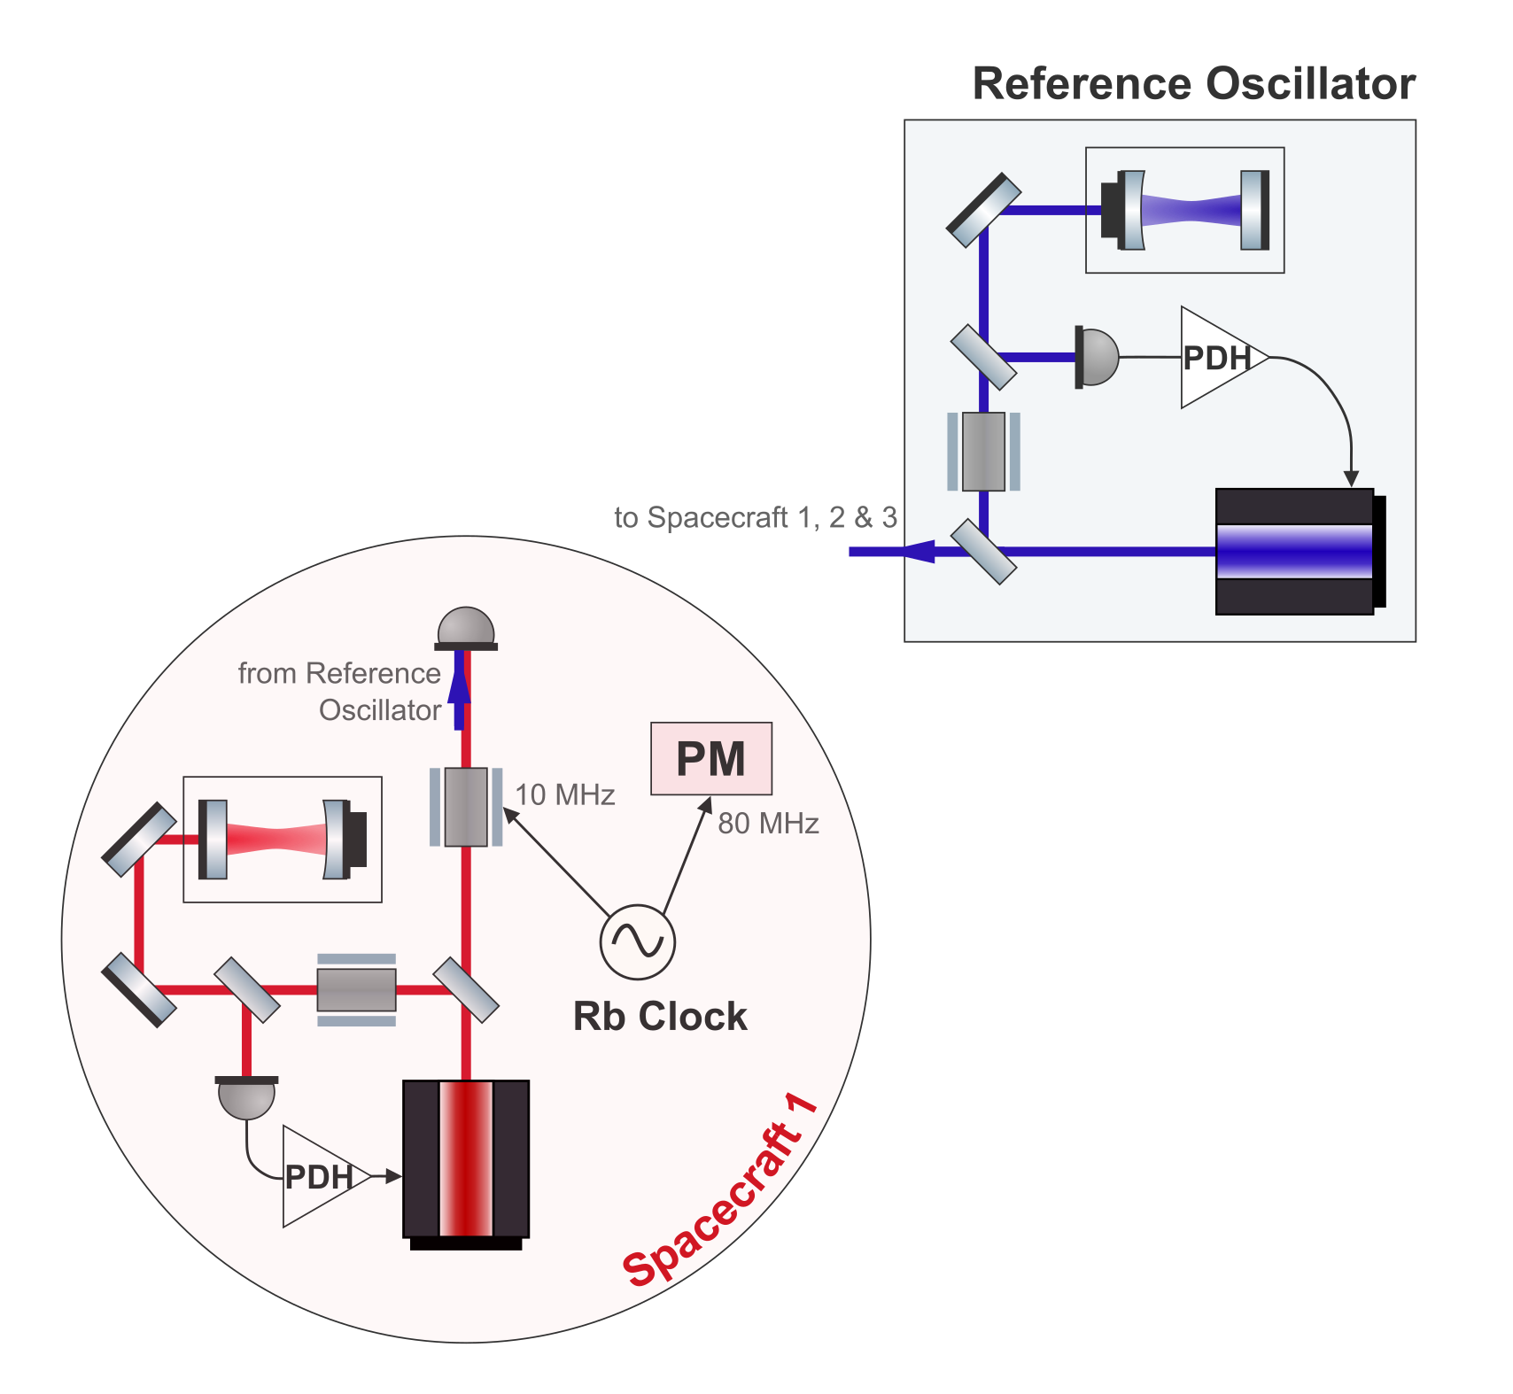
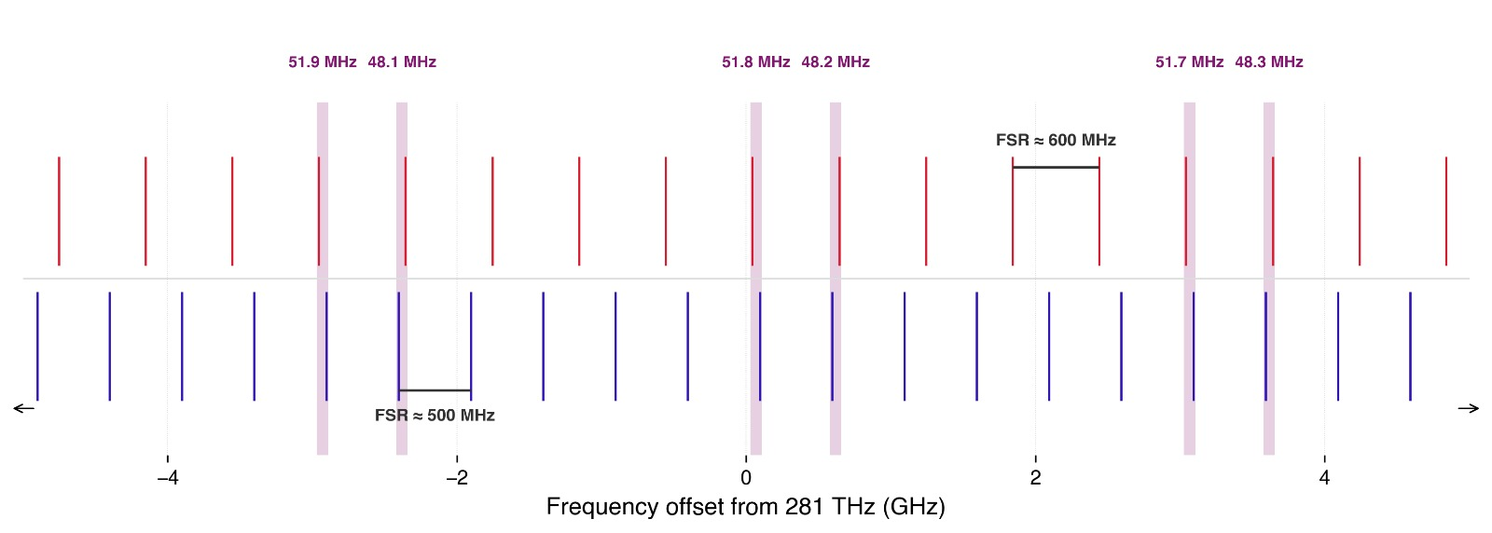
Cavity locking two lasers
TDI AND LASER FREQUENCY NOISE: STATUS
Primary spacecraft laser should be cavity locked
Two lasers will be locked to 25 and 30 cm cavities
Beat note needs to be below 60 MHz
Cavity drift will limit measurement length
Illustrative cavity resonances
STUDENT SEMINAR · TAC MEETING
27 August 2026 · 21 / 39
Notes:
This will likely limit the measurement time.
How long should a measurement run for?

Slide 22
Context
Overview of the LISA Measurement System
Testbed Concept
TDI and Laser Frequency Noise: Status
Clock Noise: Status
Next Steps
Conclusion
STUDENT SEMINAR · TAC MEETING
27 August 2026 · 22 / 39
Notes:
Do I have a defined topic
And do I understand that topic, and the physics
The TAC decides if that’s a good topic for a thesis
is it worth a degree
is it realistic
For ambitious goals, what could be a minimum reasonable level
TAC2 –status and results, are there changes, what about publications
TAC3 – so what is the realistic goal now

Slide 23
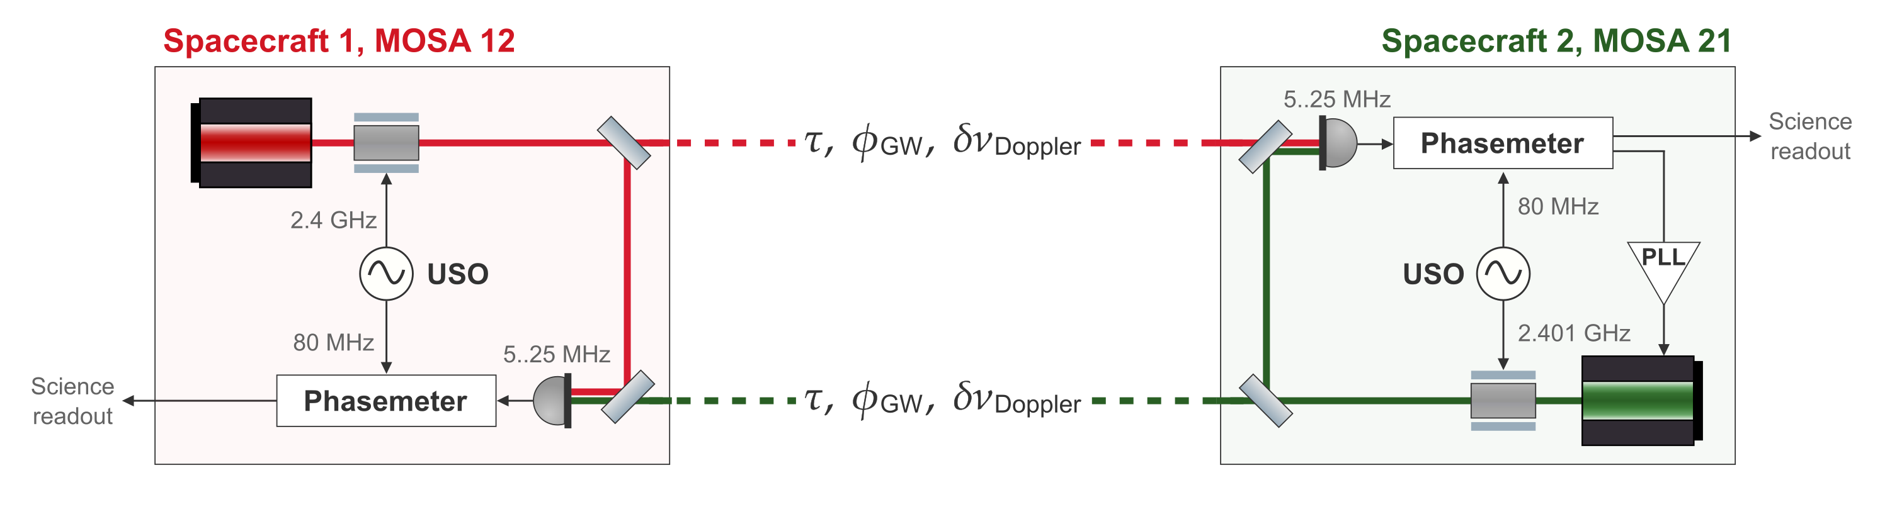
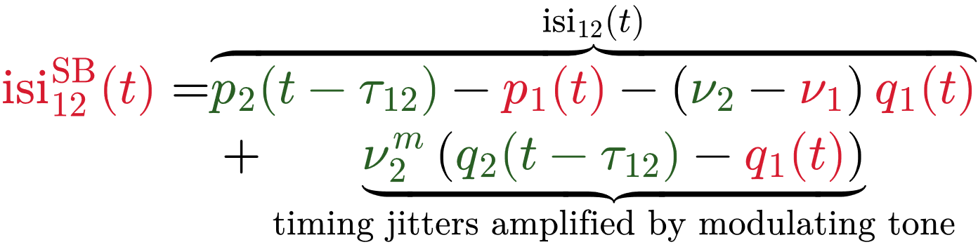
Clock Noise Transfer in LISA
CLOCK NOISE: STATUS
STUDENT SEMINAR · TAC MEETING
27 August 2026 · 23 / 39
Notes:
This has to very nicely nail down the problem. Probbaly add more stuff to this slide that I can point at
Add the spectrum picture?

Slide 24
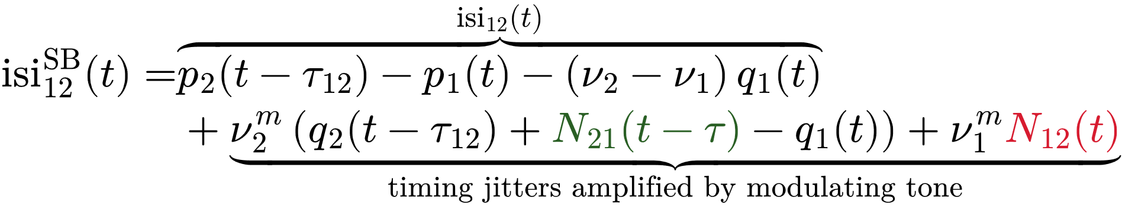
Clock Noise Transfer Fidelity
CLOCK NOISE: STATUS
For LISA, the clock noise correction is assumed to be limited by the fidelity of the clock tones.
Any unwanted timing jitter on the modulating tone need to be kept low.
STUDENT SEMINAR · TAC MEETING
27 August 2026 · 25 / 39
Notes:
N_12 should couple with nu1

Slide 25
The clock jitter removal algo and how its based on the same TDI algo
CLOCK NOISE: STATUS
Vallisneri’s algorithm to synthesize a closed loop from the r variables than should behave very similarly to TDI, actually.
TBD
STUDENT SEMINAR · TAC MEETING
27 August 2026 · 24 / 39
Notes:
Write out the r variable “extraction”. And highlight it w.r.t “modulation noise”. Maybe show plot from HB paper.

Slide 26
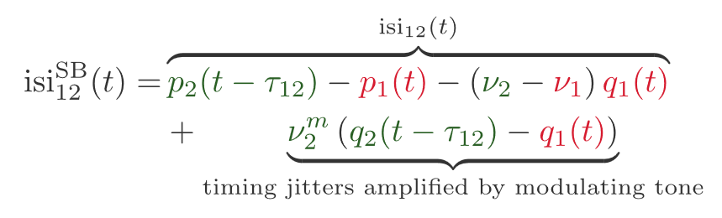
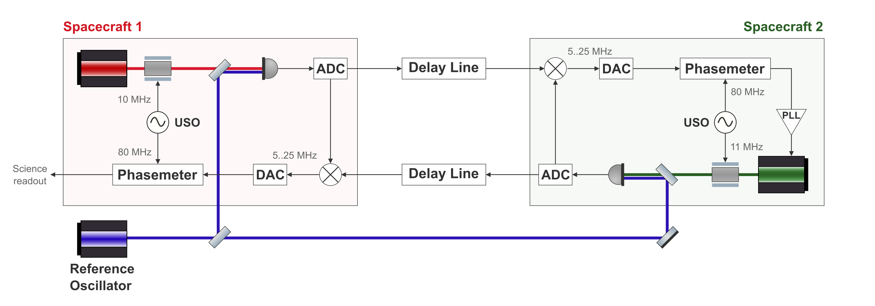
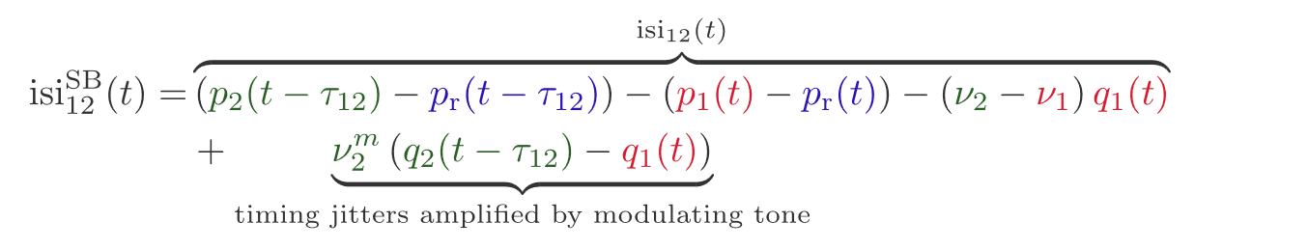
Clock Noise transfer in the lab
CLOCK NOISE: STATUS
LISA arm
In-flight link
Testbed arm
Benchtop analogue
STUDENT SEMINAR · TAC MEETING
27 August 2026 · 26 / 39
Notes:
what is the fdm critical thing in the testbed

Slide 27
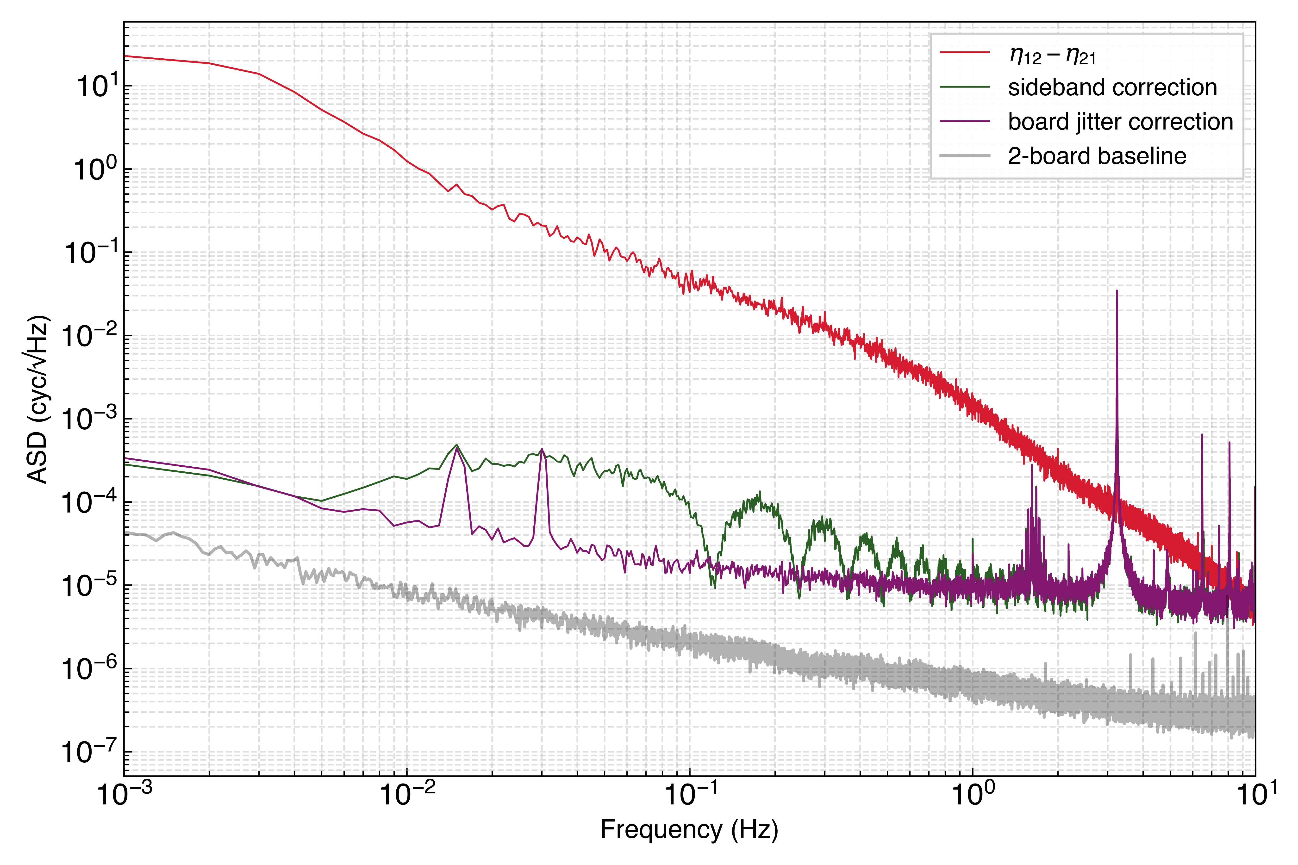
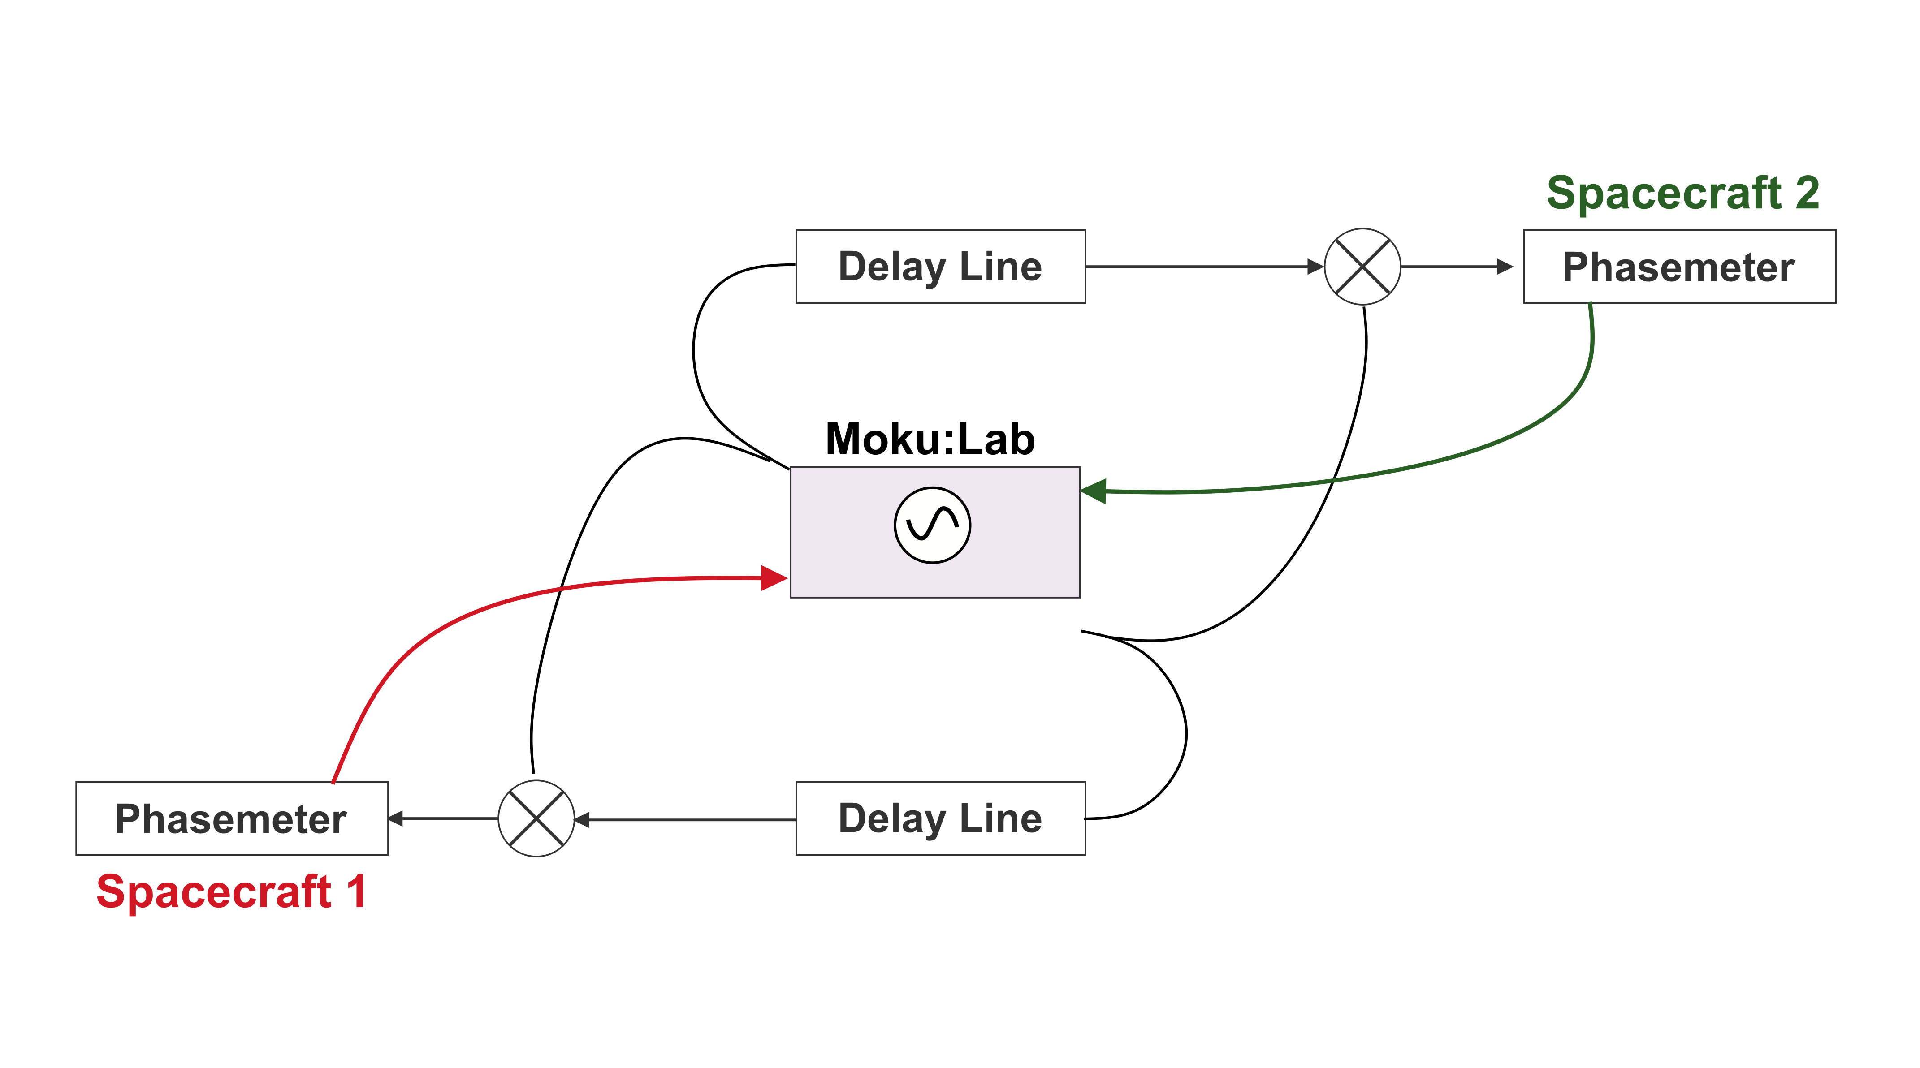
Preliminary Clock Noise Removal – Two Phasemeters
CLOCK NOISE: STATUS
Common carrier noise – this is not a test of TDI
Separate sideband modulations
Modulation done by Moku:Lab
STUDENT SEMINAR · TAC MEETING
27 August 2026 · 27 / 39
Notes:
Teka the noise floor from here? Also does this match 2 baseline noise floor?
How was that applied here? What EXACTLY can we learn from this? Like if it was baseline limited, where would the green line be instead

Slide 28
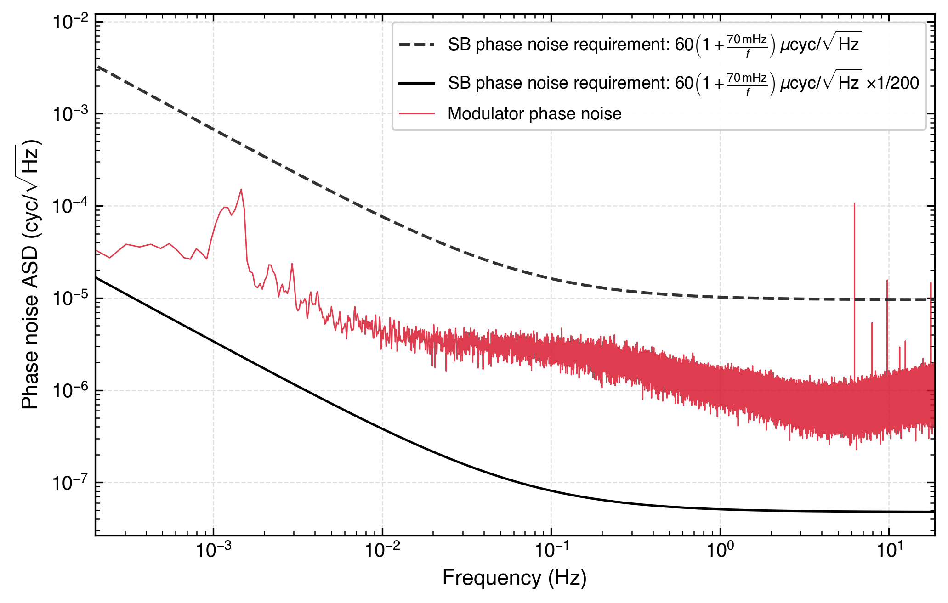
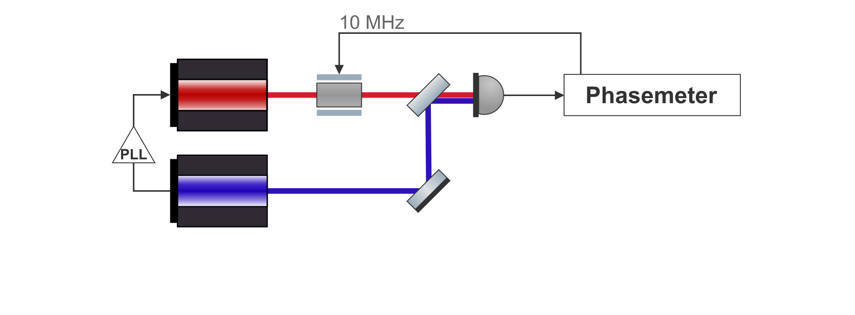
Clock Tone Transfer Limitation in miniLISA
CLOCK NOISE: STATUS
With optics, we will face the same modulation noise issue.
Modulator phase noise against the requirement
STUDENT SEMINAR · TAC MEETING
27 August 2026 · 28 / 39
Notes:
Remove the requirement lines?

Slide 29
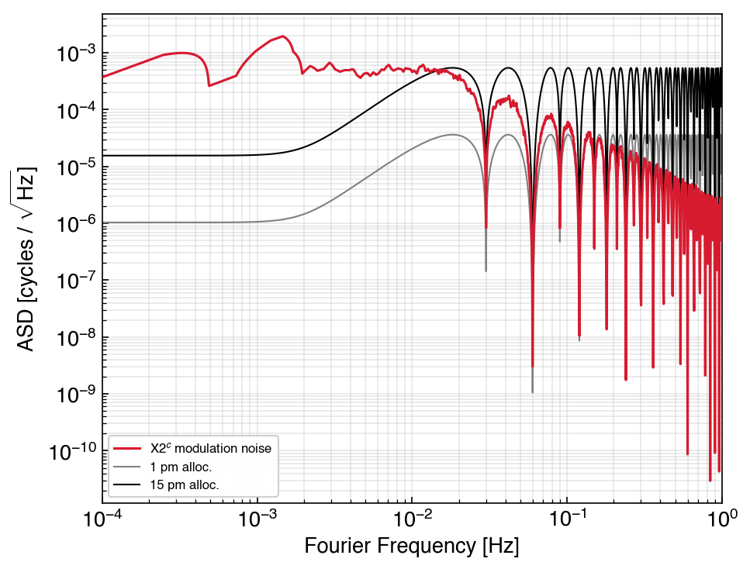
Clock Tone Transfer Limitation in miniLISA
CLOCK NOISE: STATUS
We can look at what this modulation noise would look like after TDI 2 and clock noise removal algorithms.
STUDENT SEMINAR · TAC MEETING
27 August 2026 · 29 / 39

Slide 30
GHz Sidebands
CLOCK NOISE: STATUS
Assuming that the modulation noise doesn’t scale with the modulating frequency, the solution is to increase the modulating frequency – which is why LISA uses 2.4 GHz sidebands for clock tone transfer.
STUDENT SEMINAR · TAC MEETING
27 August 2026 · 30 / 39
Notes:
Some solutions that we first came up with? Do I need to list them?
Modulating the ref laser is one bucket of solutions the other bucket is to relax the Nyquist limit. BUT WE DEF NEED TO INCREASE THE modulation, just the question is how do we get it into the delay lines.

Slide 31
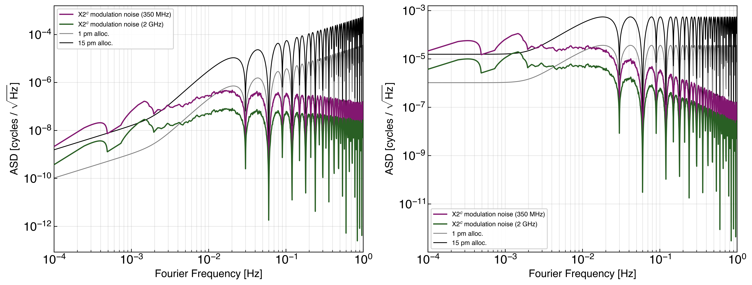
GHz Sidebands
CLOCK NOISE: STATUS
Assuming that the modulation noise doesn’t scale with the modulating frequency, the solution is to increase the modulating frequency – which is why LISA uses 2.4 GHz sidebands for clock tone transfer.
How high should be go?
STUDENT SEMINAR · TAC MEETING
27 August 2026 · 31 / 39

Slide 32
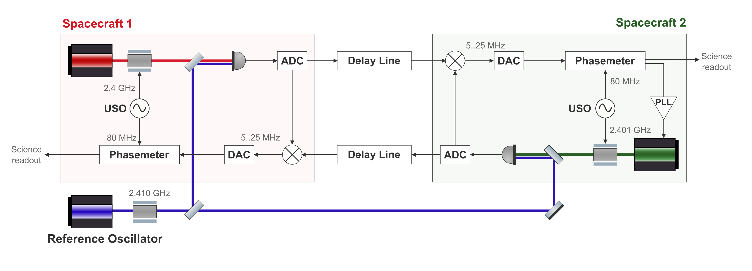
GHz Sidebands
CLOCK NOISE: STATUS
To increase the sideband frequency, we have two avenues.
STUDENT SEMINAR · TAC MEETING
27 August 2026 · 32 / 39
Notes:
Modulating the ref laser is one bucket of solutions the other bucket is to relax the Nyquist limit. BUT WE DEF NEED TO INCREASE THE modulation, just the question is how do we get it into the delay lines.

Slide 33
GHz Sidebands
CLOCK NOISE: STATUS
To increase the sideband frequency, we have two avenues.
To increase the bandwidth of the ADCs
STUDENT SEMINAR · TAC MEETING
27 August 2026 · 33 / 39

Slide 34
GHz Sidebands
CLOCK NOISE: STATUS
To increase the sideband frequency, we have two avenues.
To increase the bandwidth of the ADCs
To also modulate the reference laser
STUDENT SEMINAR · TAC MEETING
27 August 2026 · 34 / 39

Slide 35
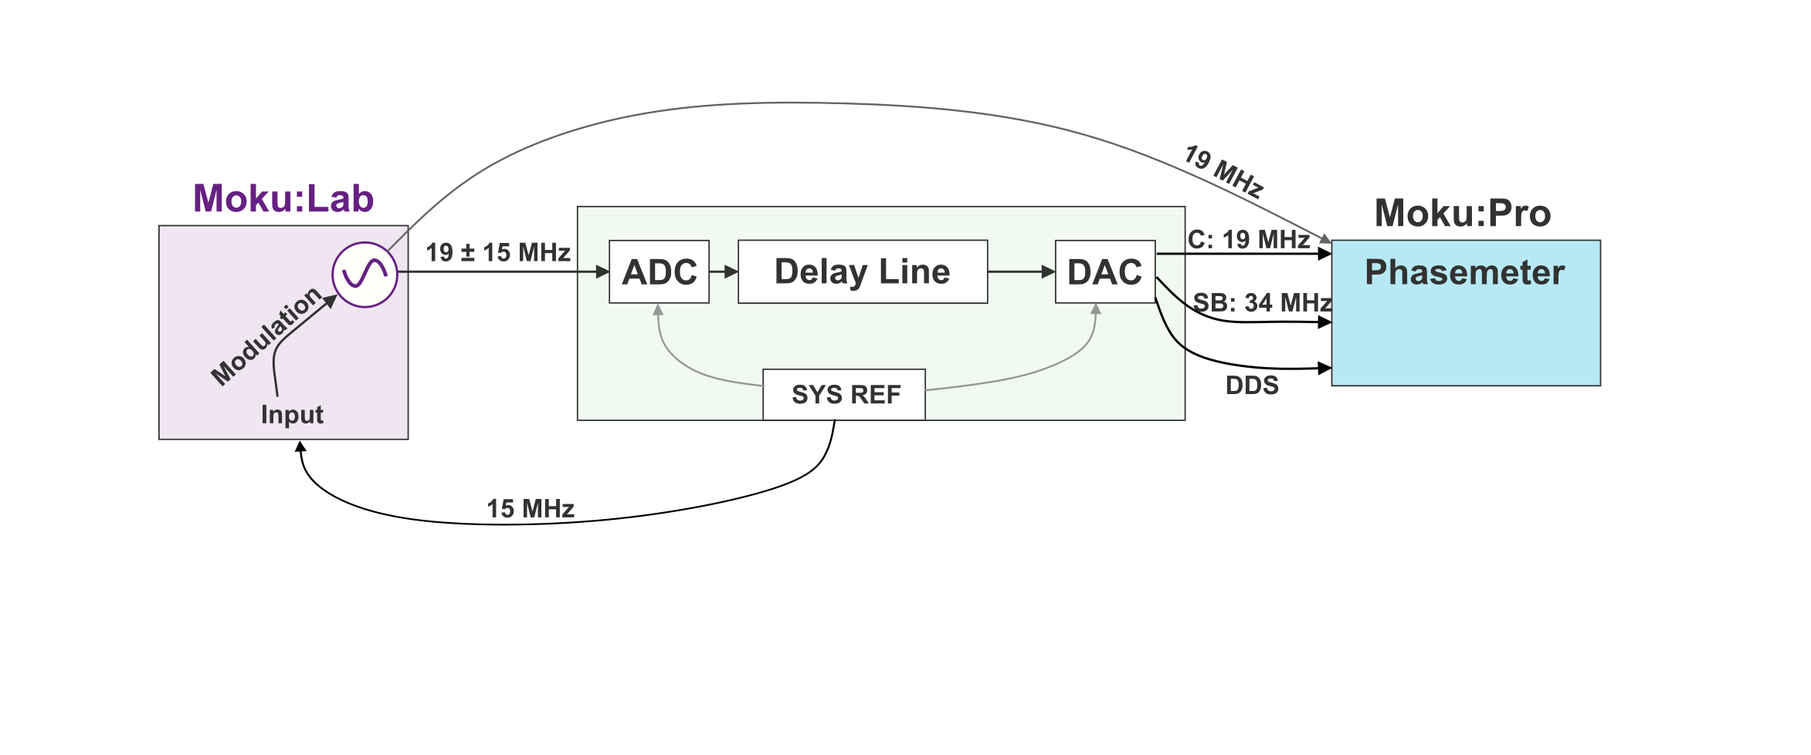
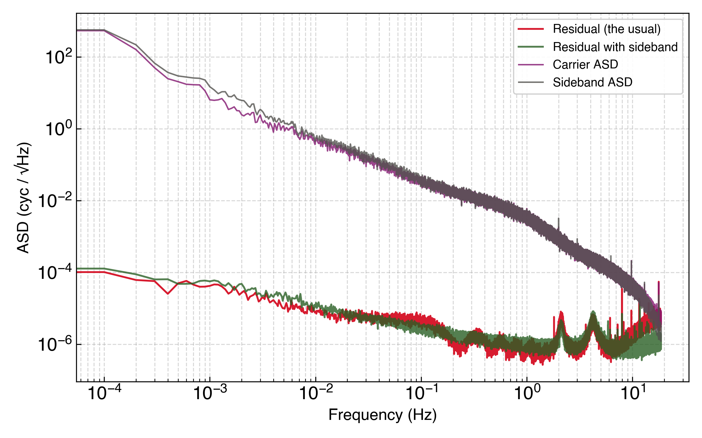
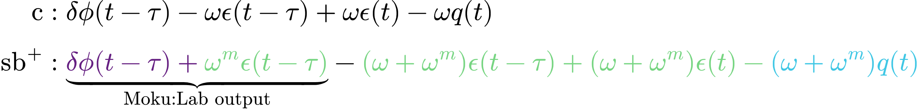
No Noise Modulation of the Reference Laser (Bad Title)
CLOCK NOISE: STATUS
For the reference laser we can exploit the same cancellation as the LISA phasemeter-local sideband does.
STUDENT SEMINAR · TAC MEETING
27 August 2026 · 35 / 39
Notes:
How do I nicely illustrate this solution? Why isn’t the modulation noise limiting here

Slide 36
Context
Overview of the LISA Measurement System
Testbed Concept
TDI and Laser Frequency Noise: Status
Clock Noise: Status
Next Steps
Conclusion
STUDENT SEMINAR · TAC MEETING
27 August 2026 · 36 / 39

Slide 37
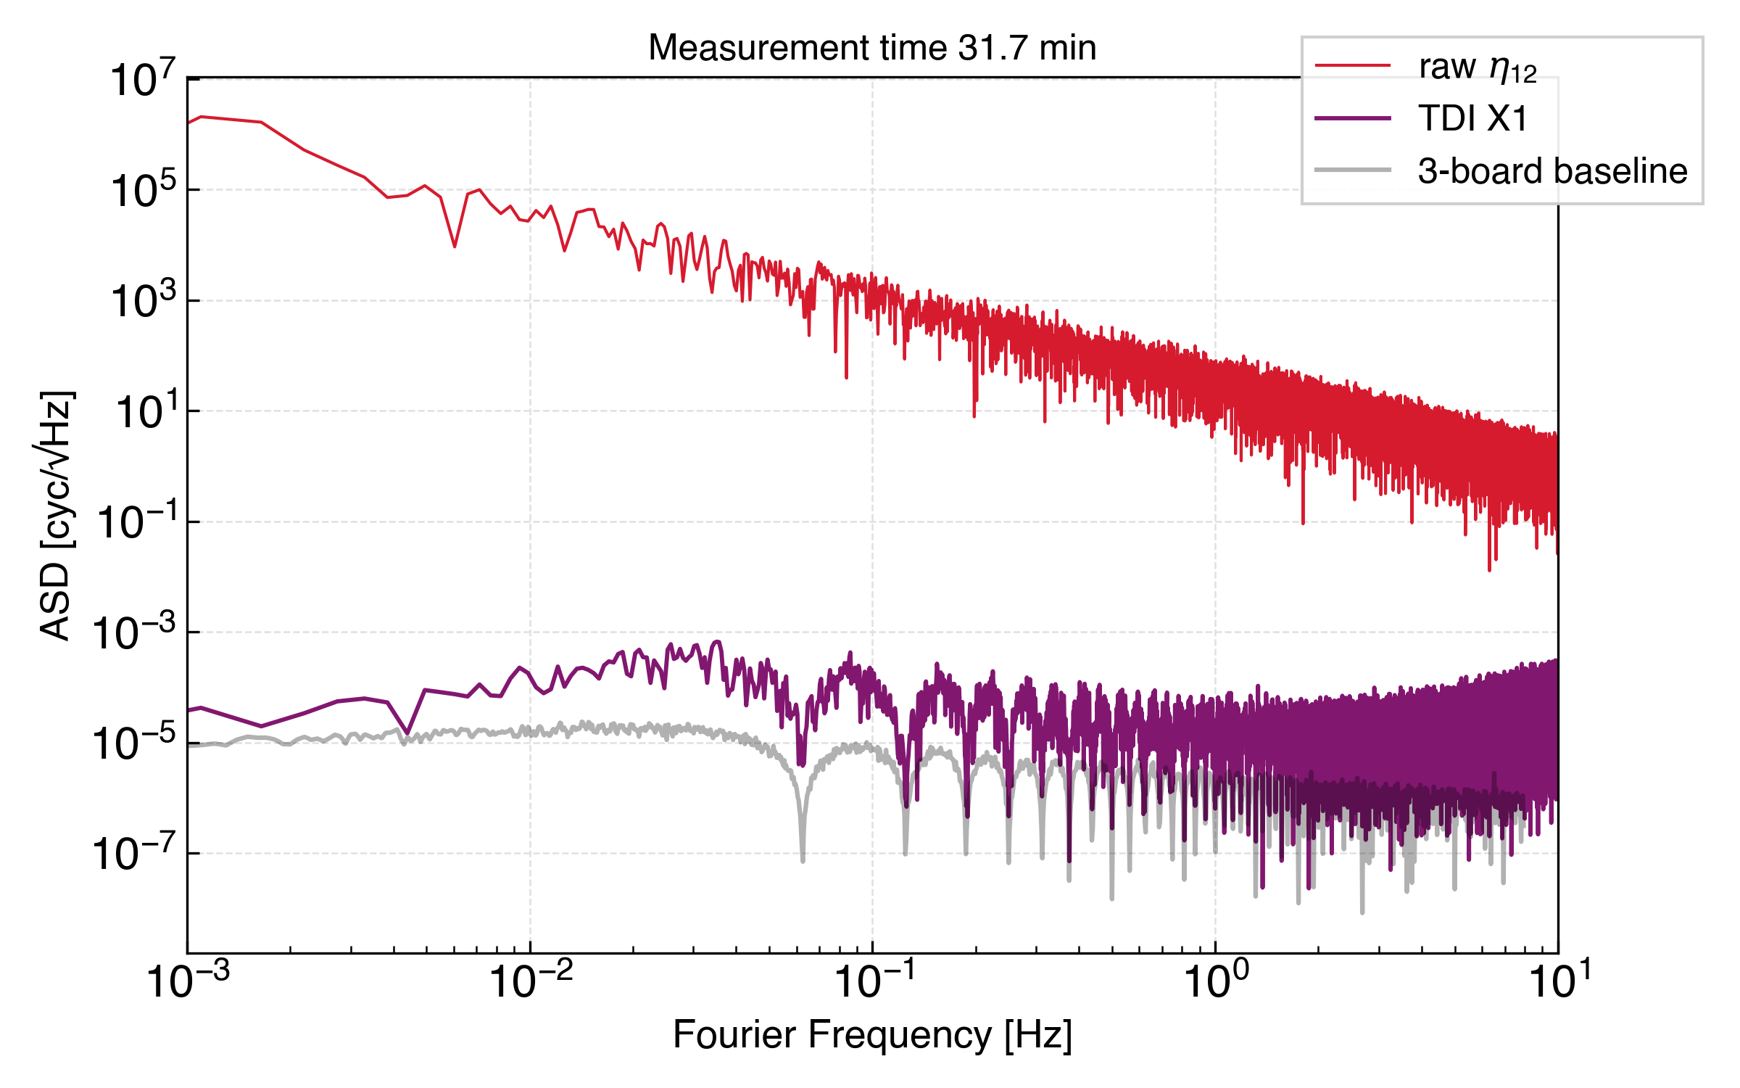
Step 1
NEXT STEPS
Figure out multi-board measurements
1) what is the limiting issue
2) how do we fix it
STUDENT SEMINAR · TAC MEETING
27 August 2026 · 37 / 39

Slide 38
Step 2
NEXT STEPS
Inject laser noise.
Inject clock noise
And make a Michelson combination.
STUDENT SEMINAR · TAC MEETING
27 August 2026 · 38 / 39

Slide 39
Step 3
NEXT STEPS
Ranging Limited – PRN ranging
STUDENT SEMINAR · TAC MEETING
27 August 2026 · 38 / 39

Slide 40
Conclusions
TBD
STUDENT SEMINAR · TAC MEETING
27 August 2026 · 39 / 39
Notes:
Fix this pleas?

Slide 41
Internals of the Delay Line
TDI AND LASER FREQUENCY NOISE: STATUS
TBD
STUDENT SEMINAR · TAC MEETING
27 August 2026 · 40 / 39
Notes:
Actually do like a whole board diagram, and as u go though it, mention places where clock noise can couple

Slide 42
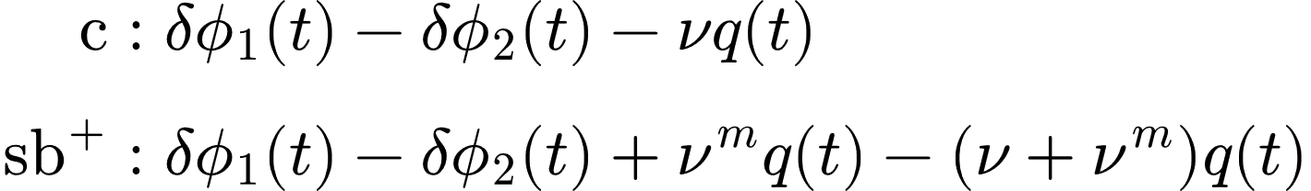
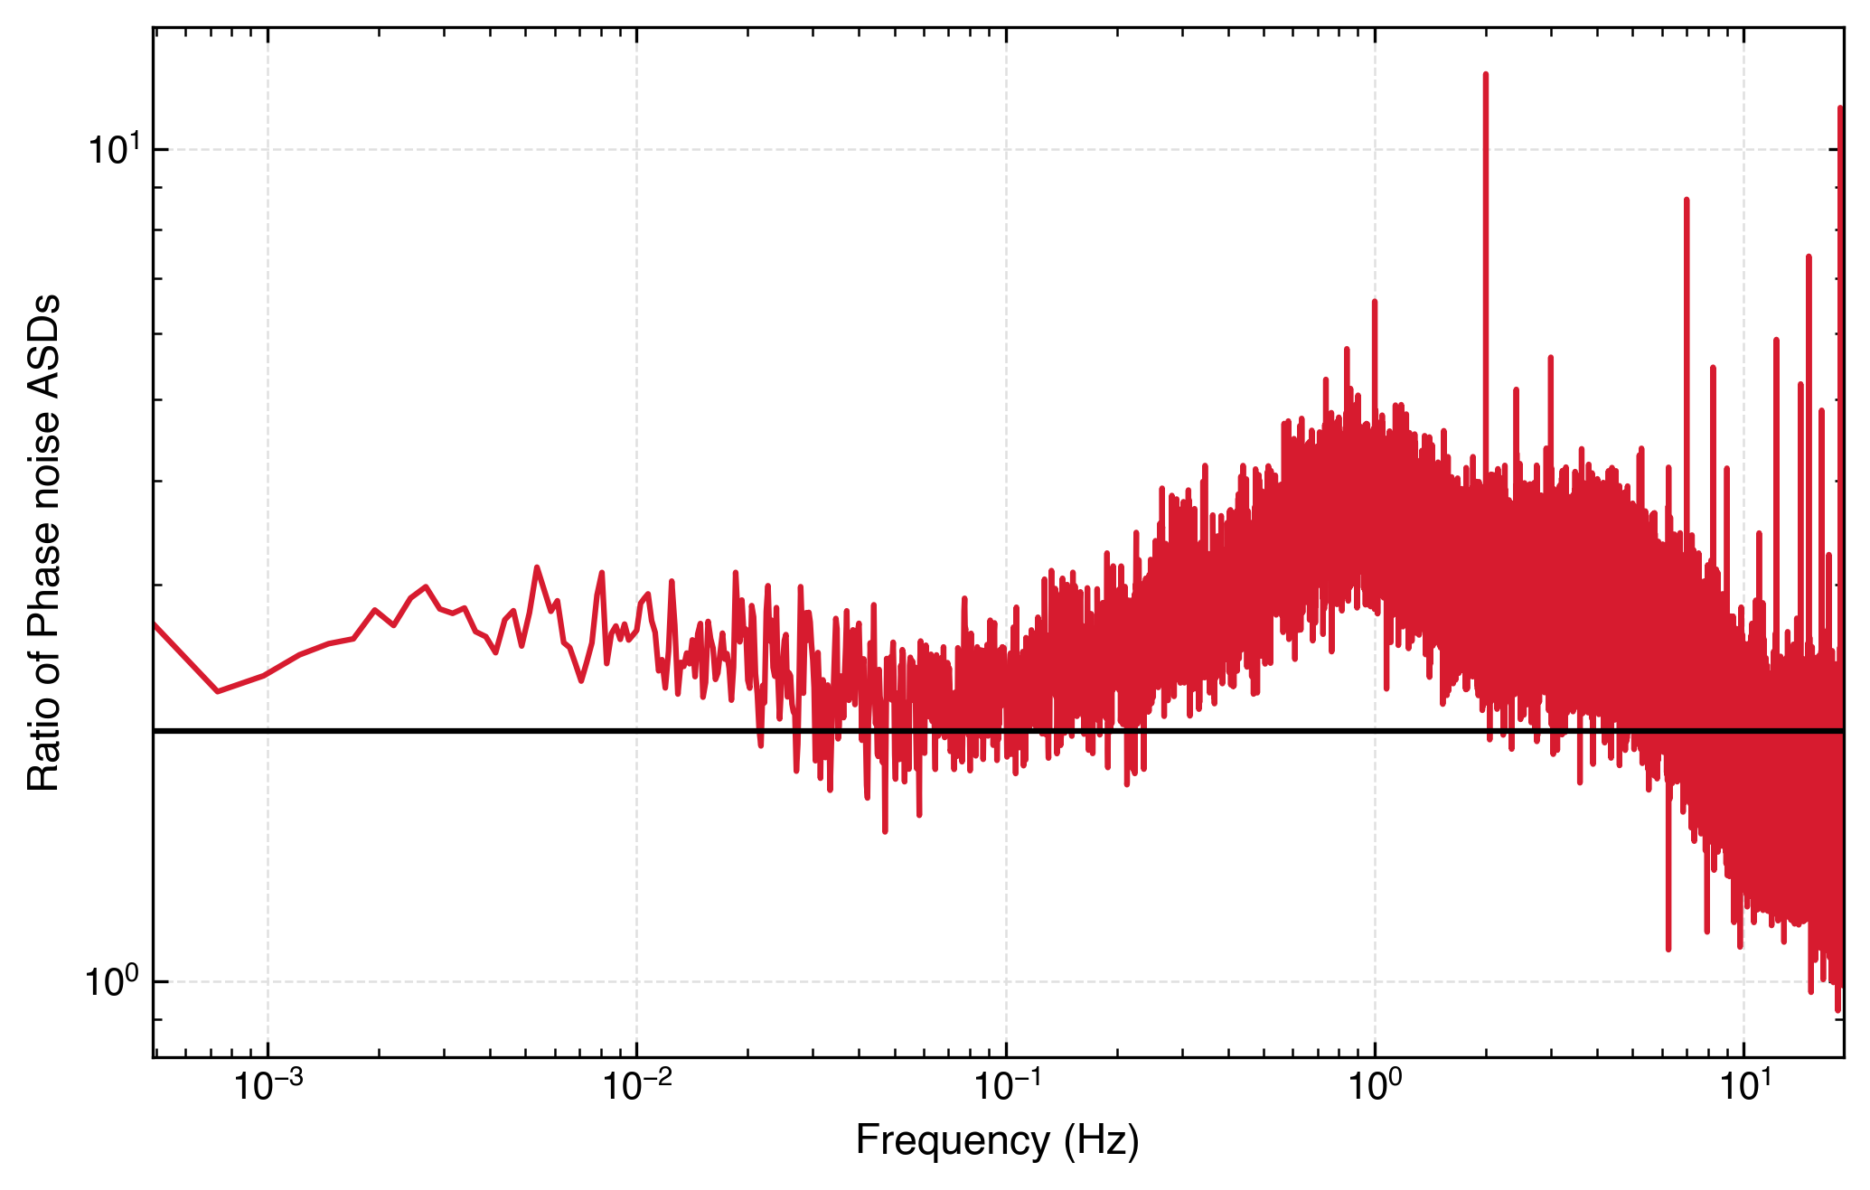
Modulation Noise Measurement
CLOCK NOISE: STATUS
If the measurement was dominated by the antisymmetric modulation noise, the USB-LSB would overlap with the other two lines.
STUDENT SEMINAR · TAC MEETING
27 August 2026 · 28 / 39
Notes:
Remove the requirement lines?

Slide 43
Extra: Preliminary Clock Noise Removal
CLOCK NOISE CORRECTION IN MINILISA
Multi board clock noise removal
Clock noise removal done via algorithm from Hartwig & Bayle
STUDENT SEMINAR · TAC MEETING
27 August 2026 · 41 / 39

Slide 44
Extra: Results from Other Testbeds
EXTRA
Vidal, 2023: Validation expérimentale des performances interférométriques de LISA, APC
Mitryk, 2012: Laser Noise Mitigation through Time Delay Interferometry for Space-based Gravitational Wave Interferometers Using the UF Laser Interferometer
De Vine et al., 2010: Experimental Demonstration of Time-Delay Interferometry for LISA, JPL
STUDENT SEMINAR · TAC MEETING
27 August 2026 · 42 / 39

