Slide 1
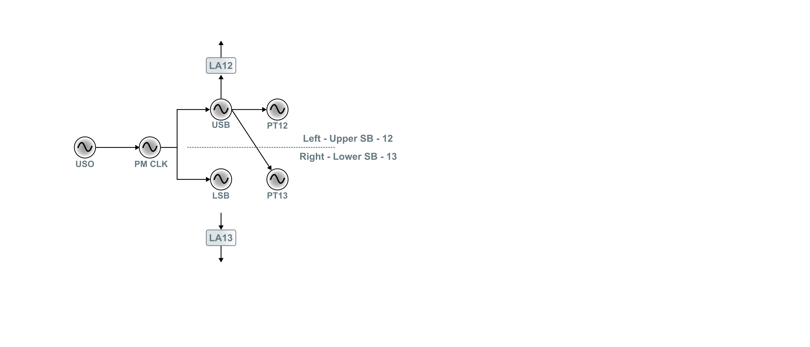
Phase Measurement System Clocks
USO – Ultra Stable Oscillator
PM CLK – Phasemeter system clock
USB – Upper Sideband
LSB – Lower Sideband
PT – Pilot Tone
LA – Laser Assembly

Slide 2
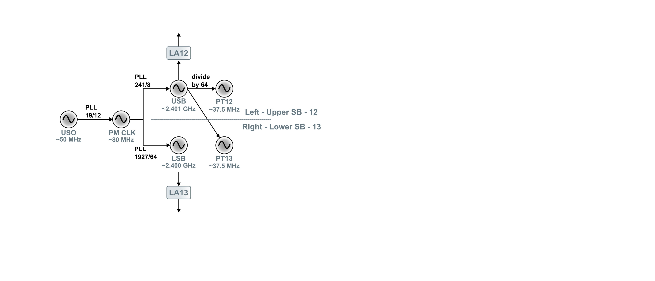
The Frequencies
USO – Ultra Stable Oscillator
PM CLK – Phasemeter system clock
USB – Upper Sideband
LSB – Lower Sideband
PT – Pilot Tone
LA – Laser Assembly

Slide 3
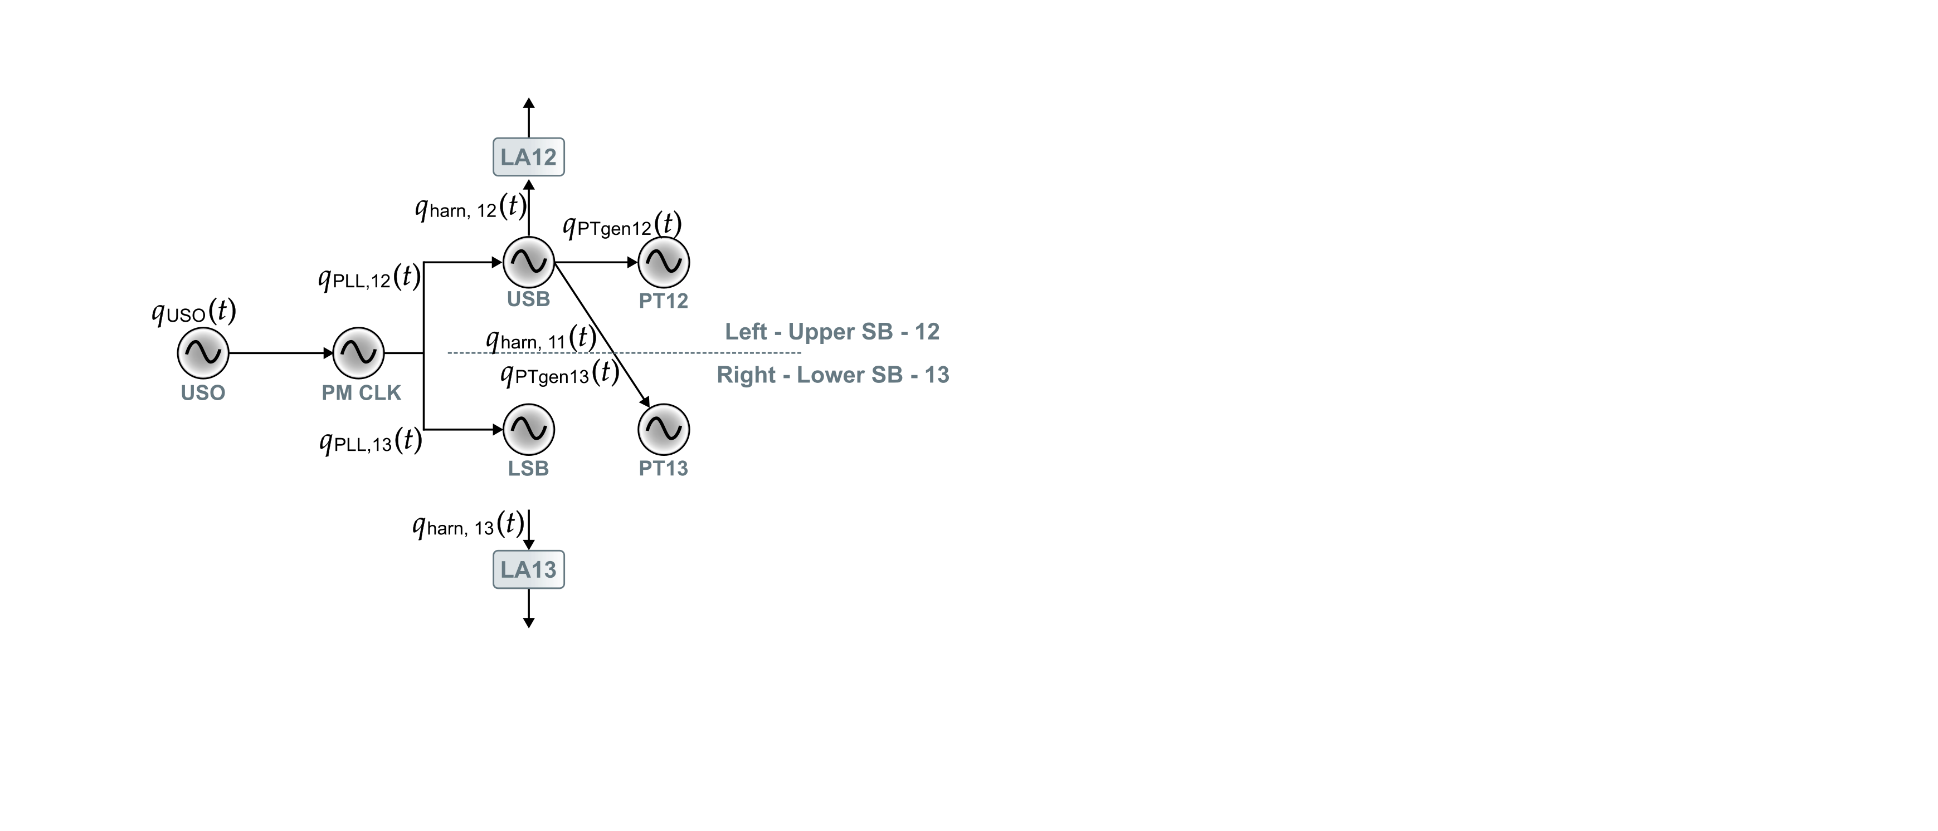
Noise terms

Slide 4
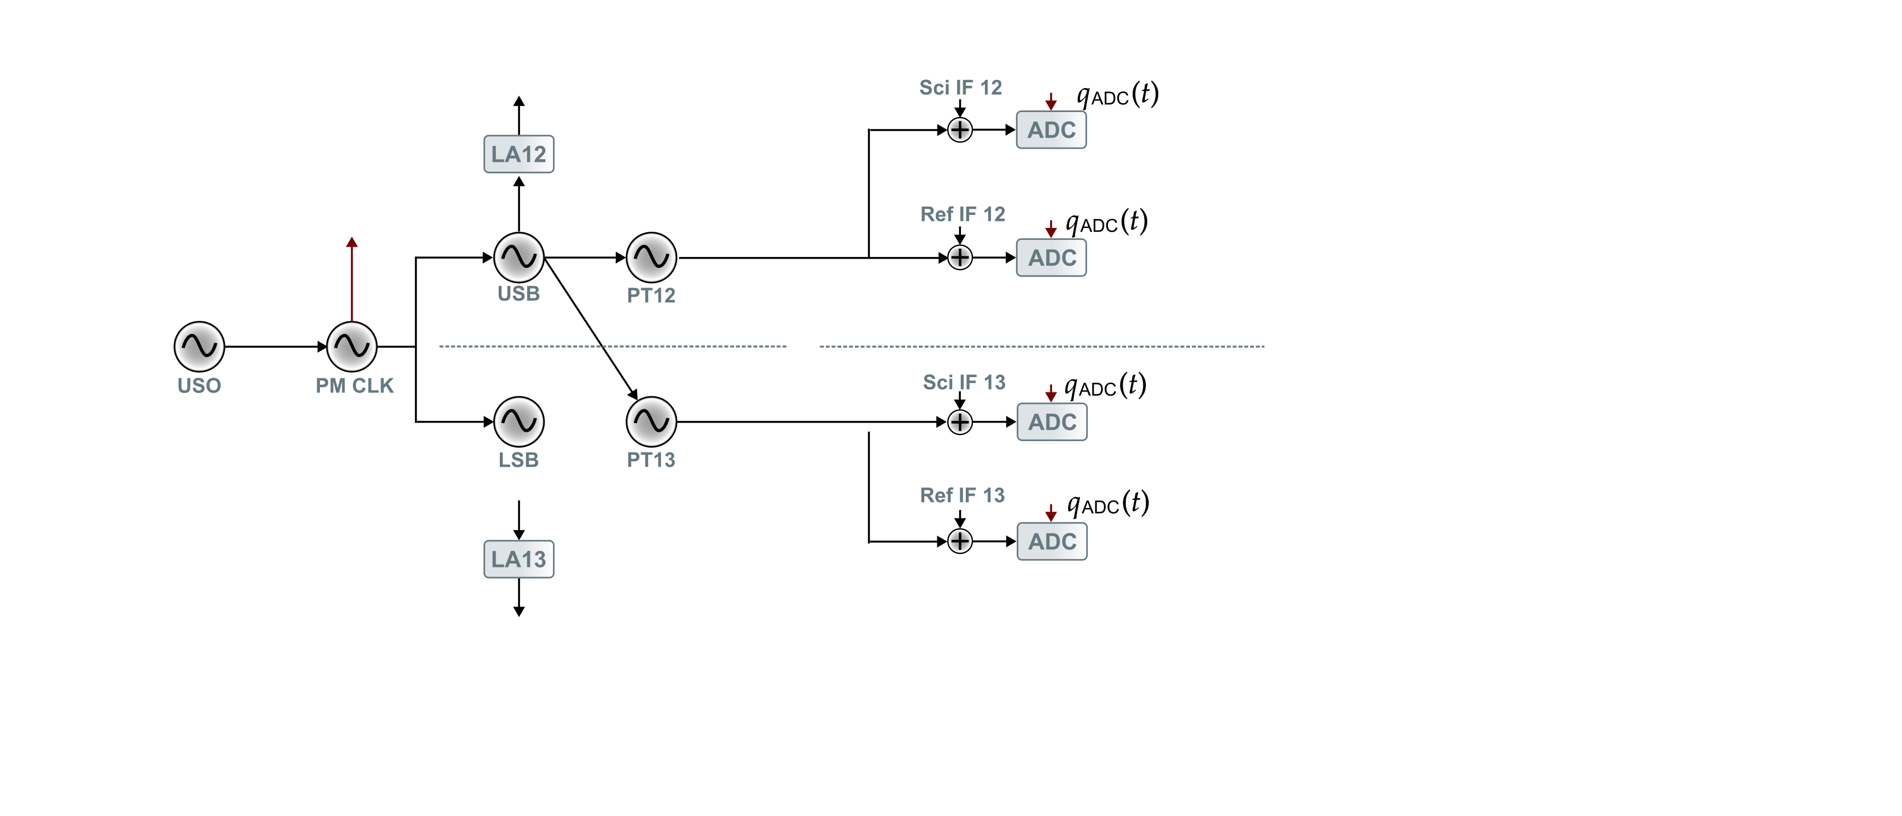
Signal Sampling
USO – Ultra Stable Oscillator
PM CLK – Phasemeter system clock
USB – Upper Sideband
LSB – Lower Sideband
PT – Pilot Tone
LA – Laser Assembly

Slide 5
PT as the Reference Signal
USO – Ultra Stable Oscillator
PM CLK – Phasemeter system clock
USB – Upper Sideband
LSB – Lower Sideband
PT – Pilot Tone
LA – Laser Assembly
The additional ADC noise is removed using the PT.
But the right-side PT is noisier than the left hand one (due to the harness term?).
This is remedied by a reference interferometer SB-SB beatnote.
After the PT correction, the heterodyne signals are almost exactly given in reference to the PT.

Slide 6
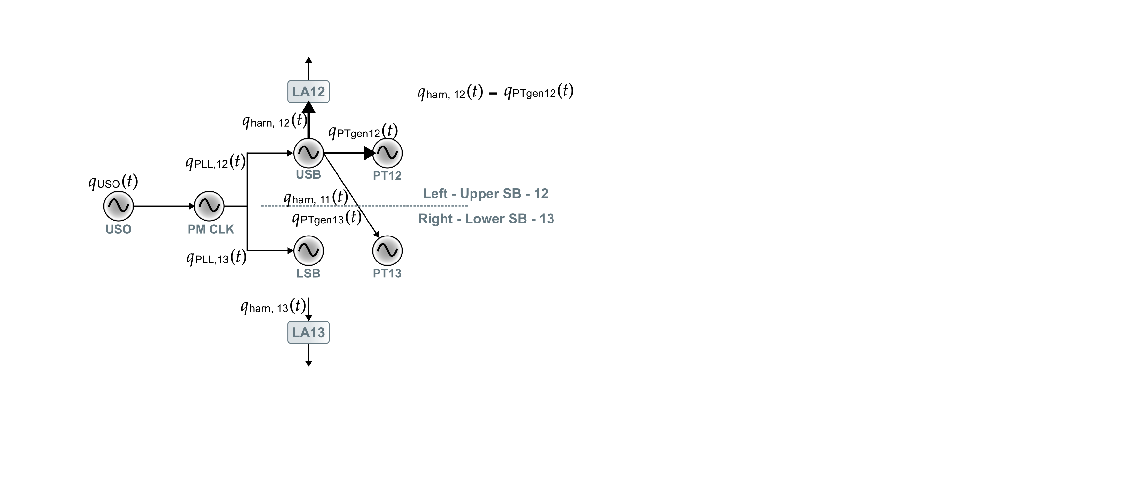
Most Stringent Differential

Slide 7
Take-away for miniLISA
Currently, we only have one laser, one EOM per spacecraft.
So it makes sense to generate only one PT per spacecraft.
Which would mean that the inclusion of the reference interferometer for this purpose would be unnecessary.

