Slide 1


THESIS ADVISORY COMMITEE MEETING· 27 AUGUST 2026
Testbed for Validating Second-Generation TDI and Clock-Noise Correction for LISA
Karin Kruuse
Max Planck Institute for Gravitational Physics (AEI) · Leibniz Universität Hannover
TAC MEETING
27 August 2026 · 01 / 43

Slide 2
Outline of the Talk
Context
Overview of the LISA IDS
Testbed Concept
TDI and laser noise: status
clock noise: status
Next Steps
Conclusion
TAC MEETING
27 August 2026 · 02 / 43
Notes:
Do I have a defined topic
And do I understand that topic, and the physics
The TAC decides if that’s a good topic for a thesis
is it worth a degree
is it realistic
For ambitious goals, what could be a minimum reasonable level
TAC2 –status and results, are there changes, what about publications
TAC3 – so what is the realistic goal now

Slide 3
Context
Overview of the LISA IDS
Testbed Concept
TDI and laser noise: status
clock noise: status
Next Steps
Conclusion
TAC MEETING
27 August 2026 · 03 / 43
Notes:
Do I have a defined topic
And do I understand that topic, and the physics
The TAC decides if that’s a good topic for a thesis
is it worth a degree
is it realistic
For ambitious goals, what could be a minimum reasonable level
TAC2 –status and results, are there changes, what about publications
TAC3 – so what is the realistic goal now

Slide 4
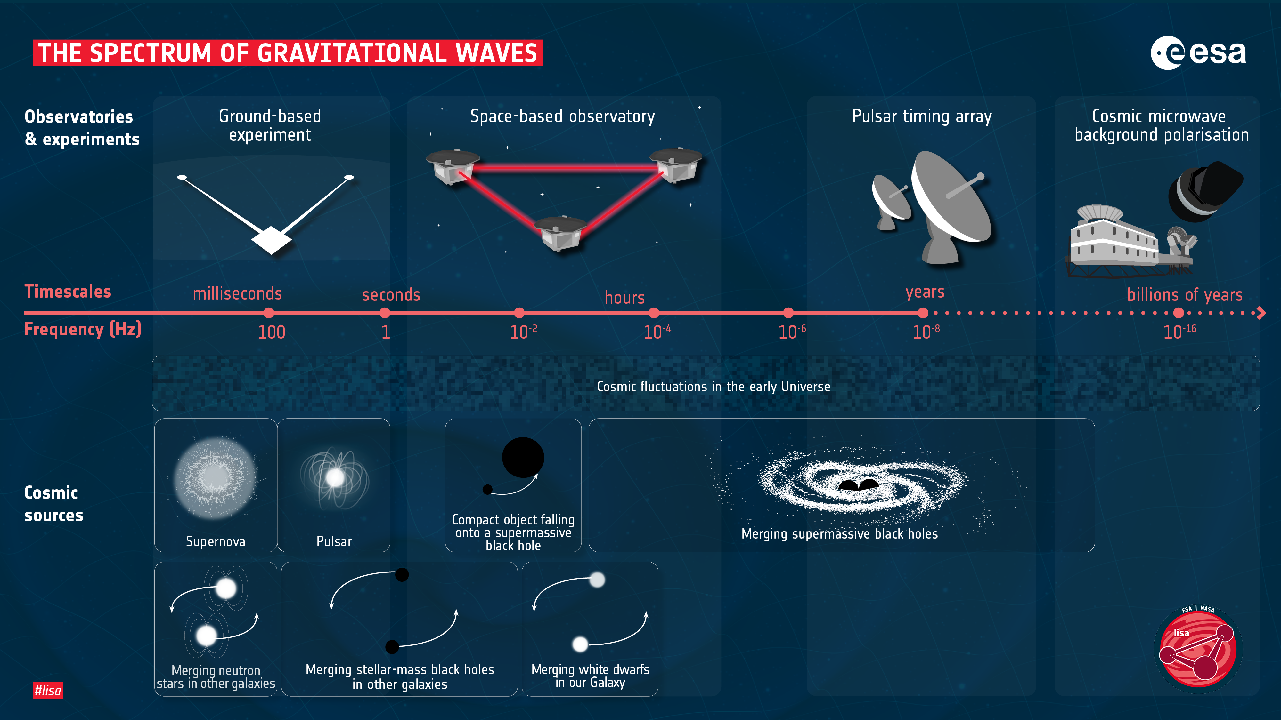
Notes:
Which part of the spectrum are we looking at and why?

Slide 5
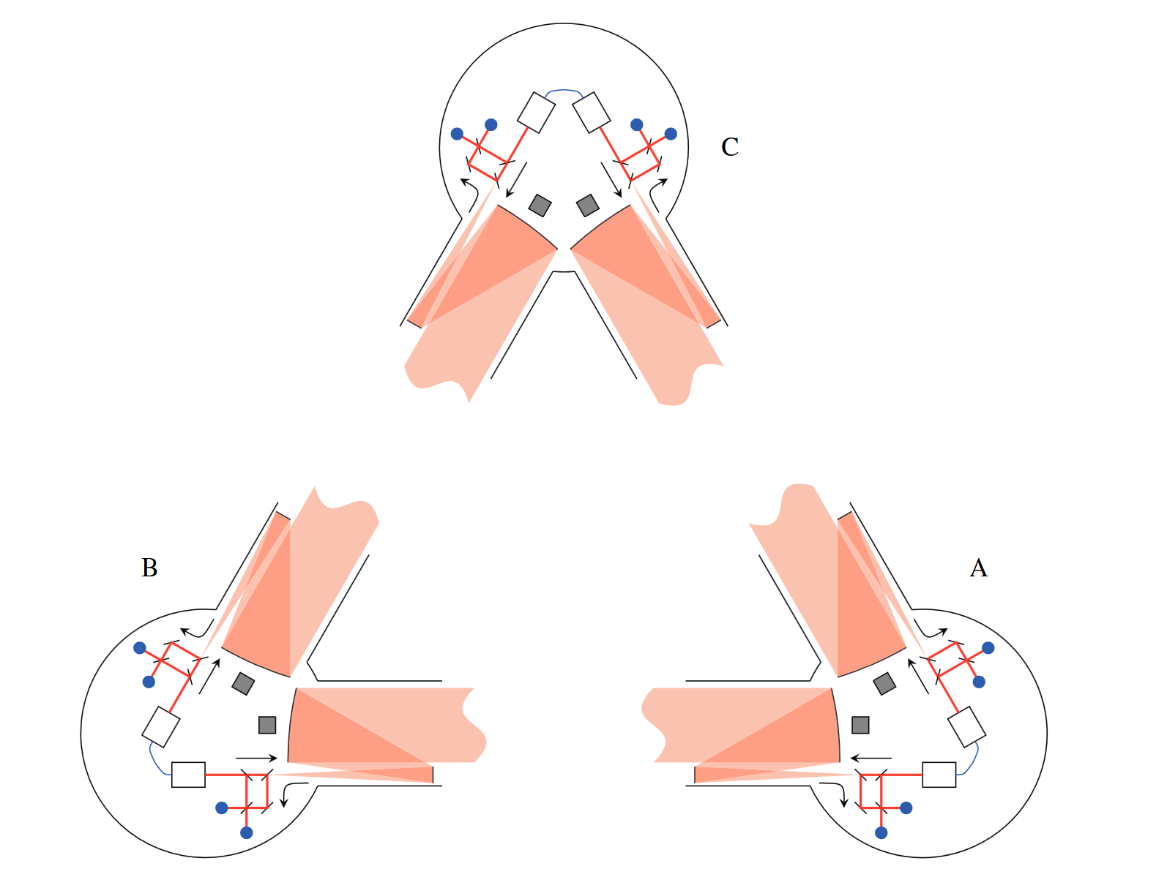
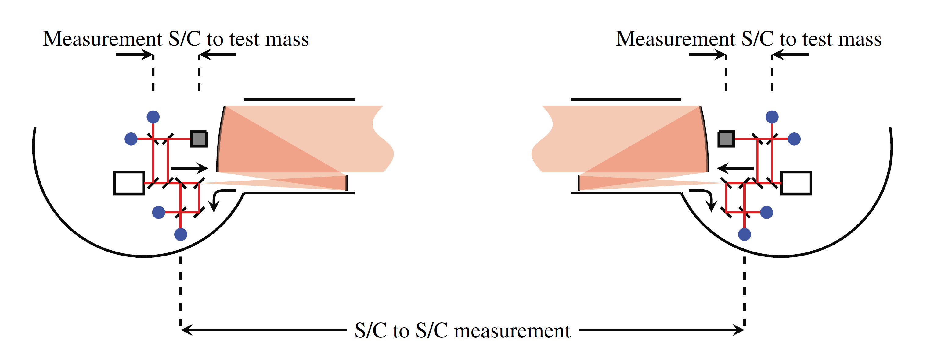
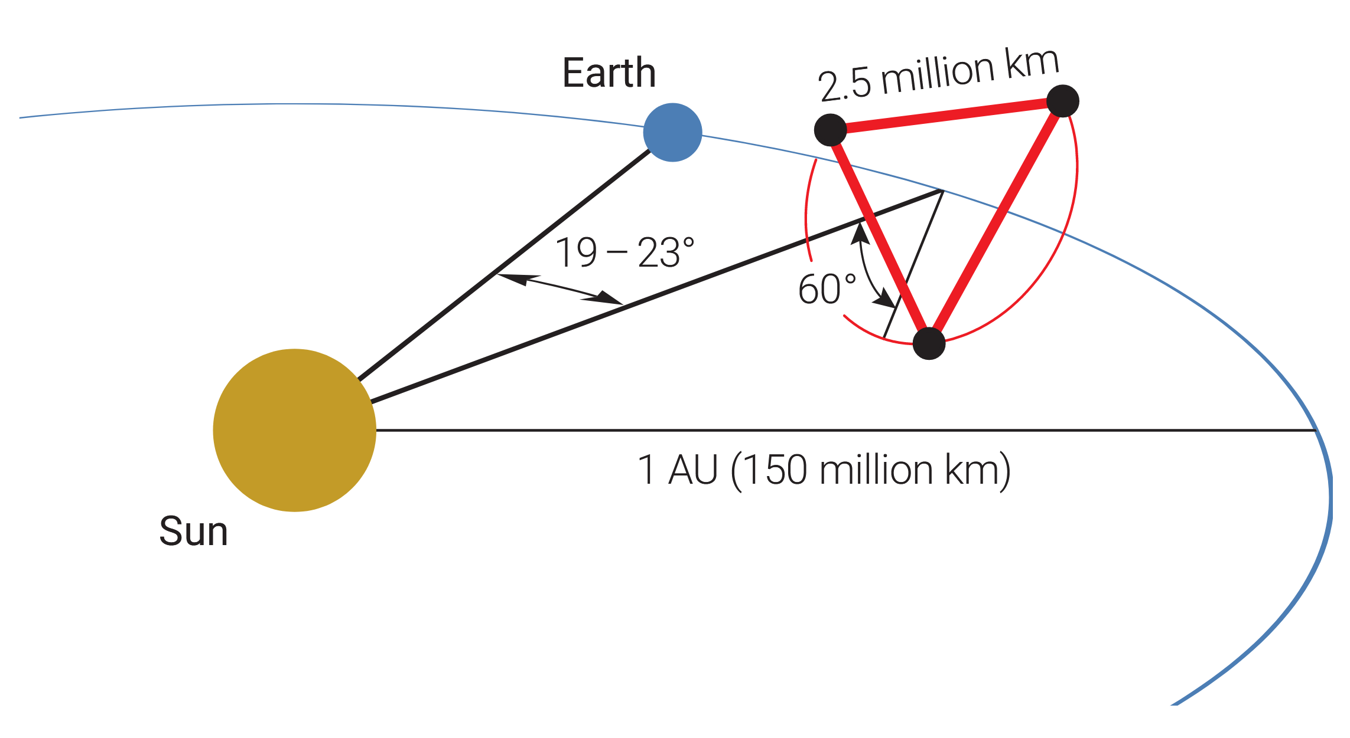
LISA Constellation
CONTEXT
Amaro-Seoane et al., 2017
TAC MEETING
27 August 2026 · 05 / 43
Notes:
So what do we do with three satellites?

Slide 6
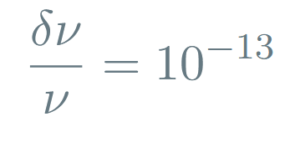
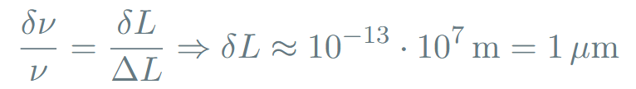

TDI Motivation
CONTEXT
As per LISA requirements
Unequal arm lengths and laser frequency noise
Hence for the arm length uncertainty we get
But to be sensitive enough to detect GWs, we need
Jennrich, 2010
TAC MEETING
27 August 2026 · 06 / 43

Slide 7
Context
Overview of the LISA IDS
Testbed Concept
TDI and laser noise: status
clock noise: status
Next Steps
Conclusion
TAC MEETING
27 August 2026 · 07 / 43

Slide 8
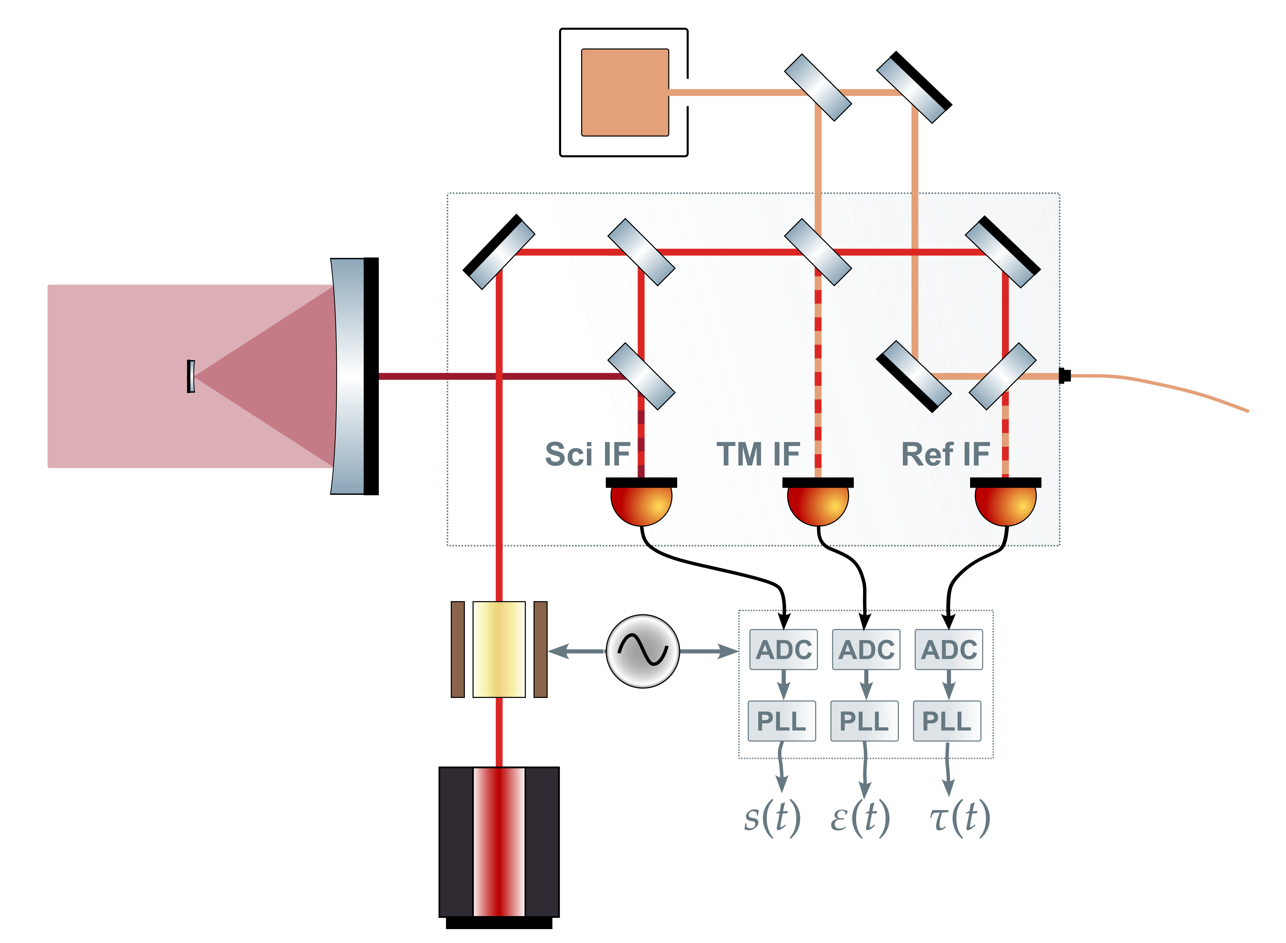
LISA Interferometers overview
OVERVIEW OF THE LISA IDS
TAC MEETING
27 August 2026 · 08 / 43

Slide 9
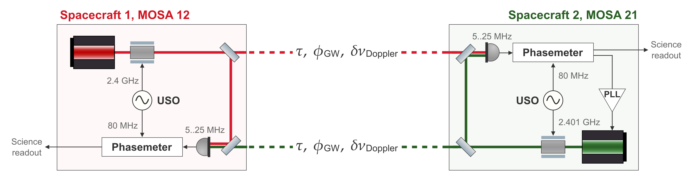
LISA Science Interferometer
OVERVIEW OF THE LISA IDS
This is in phase units. Signal has been demodulated
TAC MEETING
27 August 2026 · 09 / 43
Notes:
Remove the modulator
Discuss every frequency – what its for, how is it derived
The PD ones, the PLL is there to keep the beatnote in band
The red laser in this case would be cavity locked
Put the noise terms on the graph maybe? And like meka them appear as u talk
Add clarification that the isi12 is the red readout
USO – Ultra Stable Oscillator

Slide 10
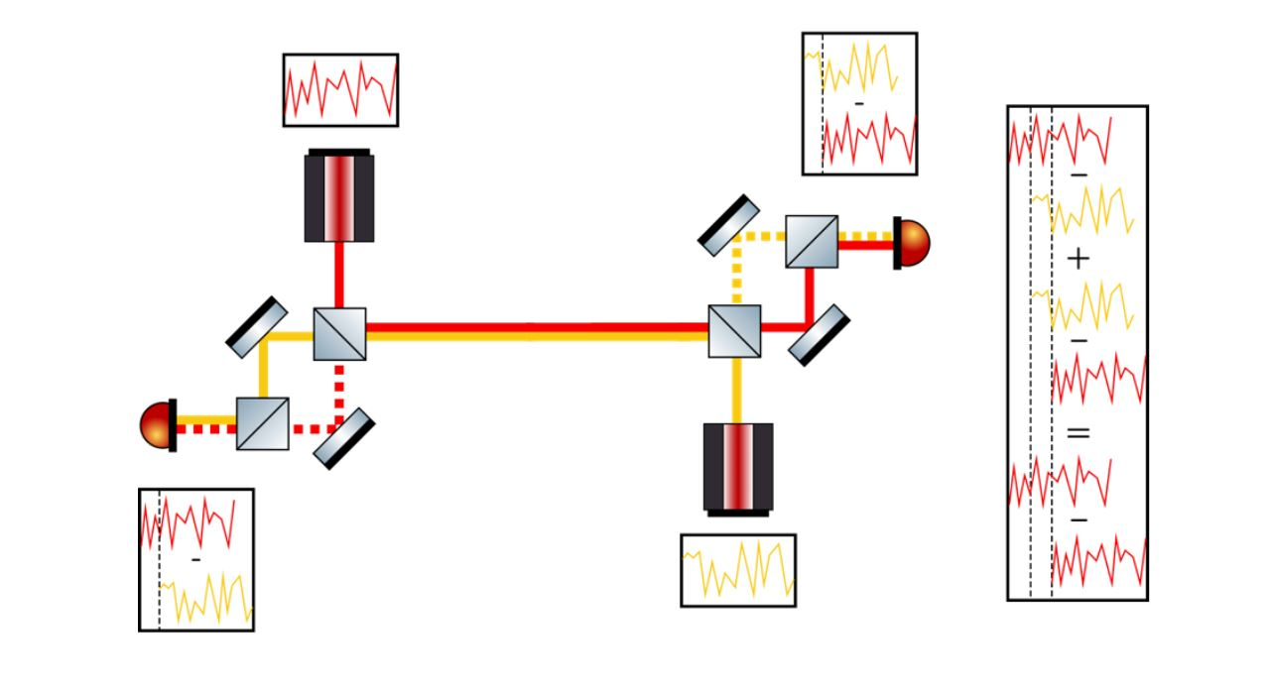
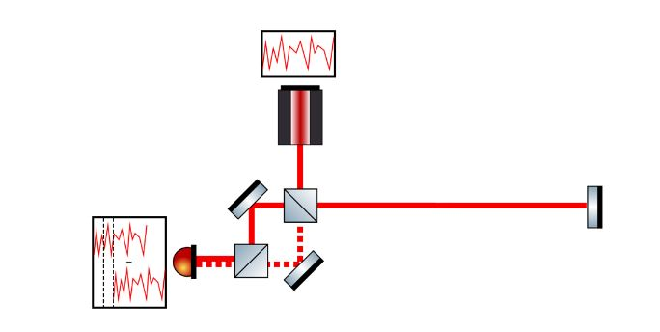
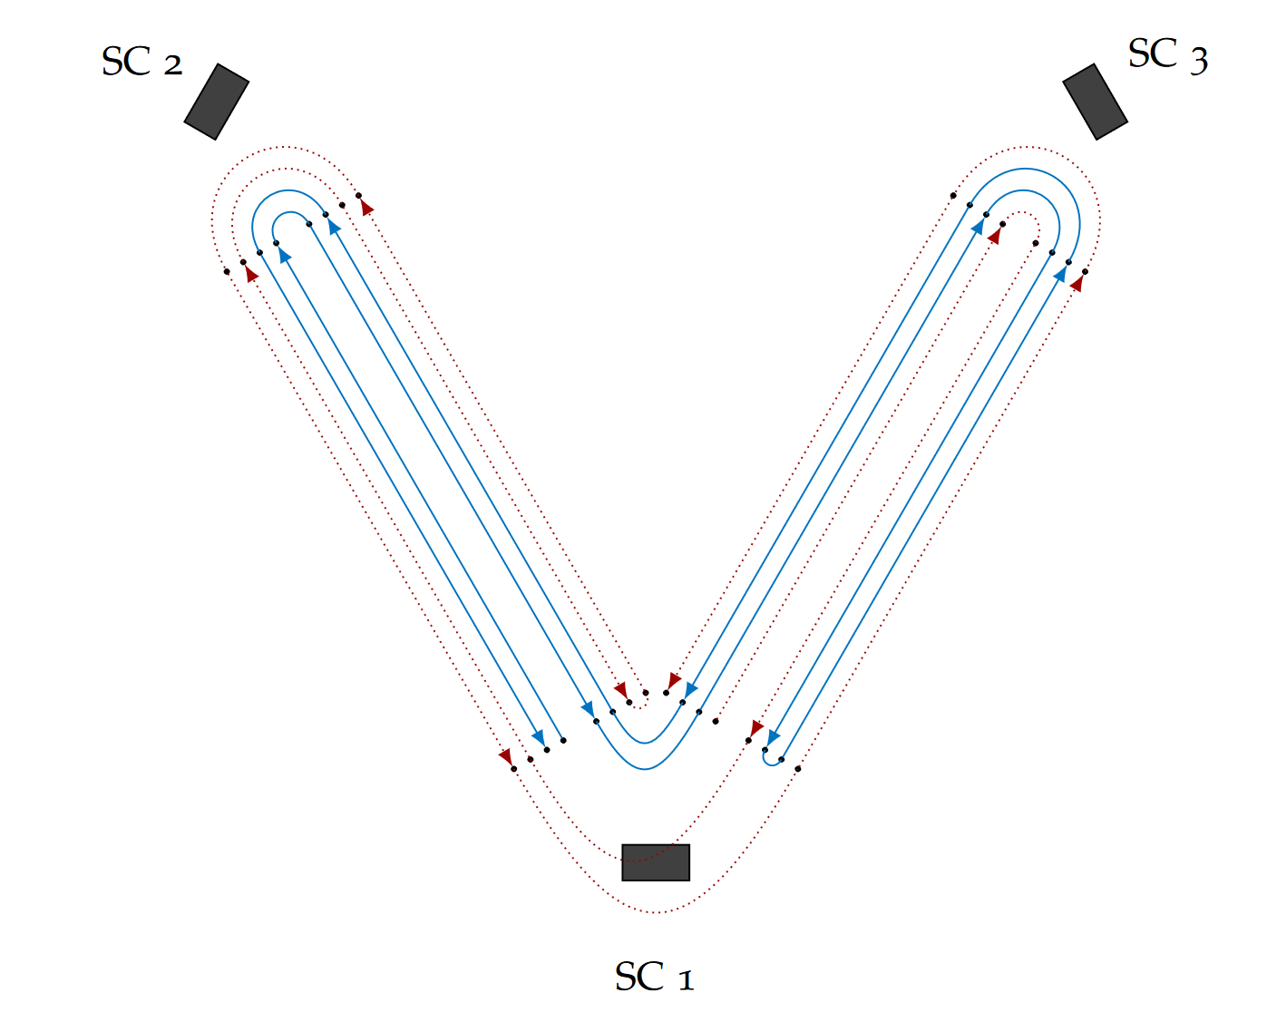
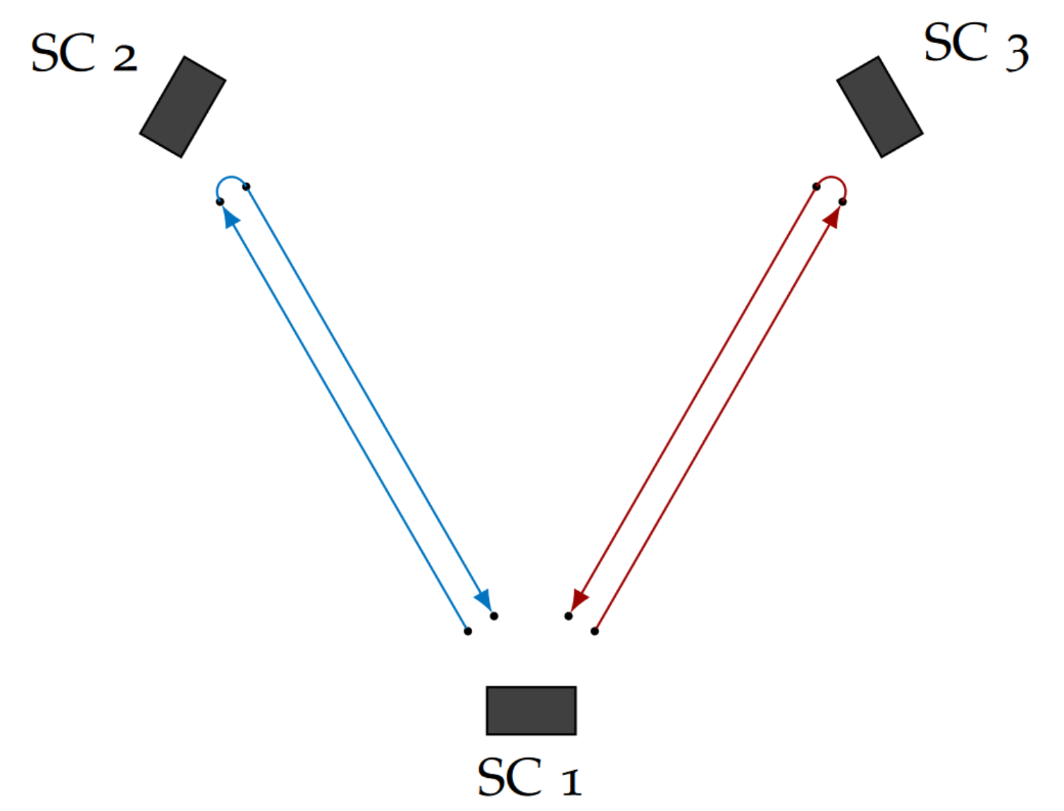
TDI and ranging
OVERVIEW OF THE LISA IDS
TAC MEETING
27 August 2026 · 10 / 43
Notes:
TDI mechanism — virtual equal arms Why 2nd-gen specifically (arms move during ~8 s light-travel) · ranging → residual laser noise ∝ δτ
Mention Vallisneris algorithm?

Slide 11
LISA benchmarks and requirements
OVERVIEW OF THE LISA IDS
TAC MEETING
27 August 2026 · 11 / 43
Notes:
LISA requirements — the yardstick — top-level readout allocation (cyc/√Hz); note laser / clock / modulation sub-allocations will return per thread

Slide 12
Context
Overview of the LISA IDS
Testbed Concept
TDI and laser noise: status
clock noise: status
Next Steps
Conclusion
TAC MEETING
27 August 2026 · 12 / 43
Notes:
Do I have a defined topic
And do I understand that topic, and the physics
The TAC decides if that’s a good topic for a thesis
is it worth a degree
is it realistic
For ambitious goals, what could be a minimum reasonable level
TAC2 –status and results, are there changes, what about publications
TAC3 – so what is the realistic goal now

Slide 13
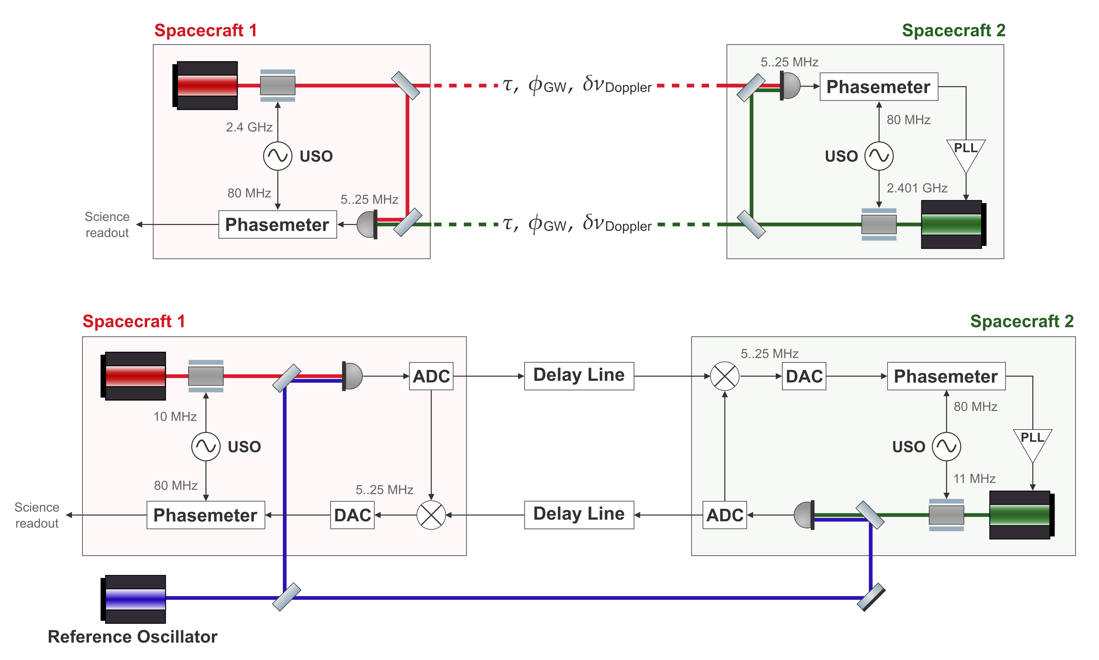
How to got the same coupling
TESTBED CONCEPT
LISA arm
In-flight inter-satellite link
Testbed arm
Benchtop analogue
TAC MEETING
27 August 2026 · 13 / 43

Slide 14
Testbed
TESTBED CONCEPT
LISA arm
In-flight inter-satellite link
Write out the terms
Testbed arm
Benchtop analogue
TAC MEETING
27 August 2026 · 14 / 43

Slide 15
TESTBED CONCEPT
LISA arm
In-flight inter-satellite link
Write out the terms
Testbed arm
Benchtop analogue
TAC MEETING
27 August 2026 · 15 / 43

Slide 16
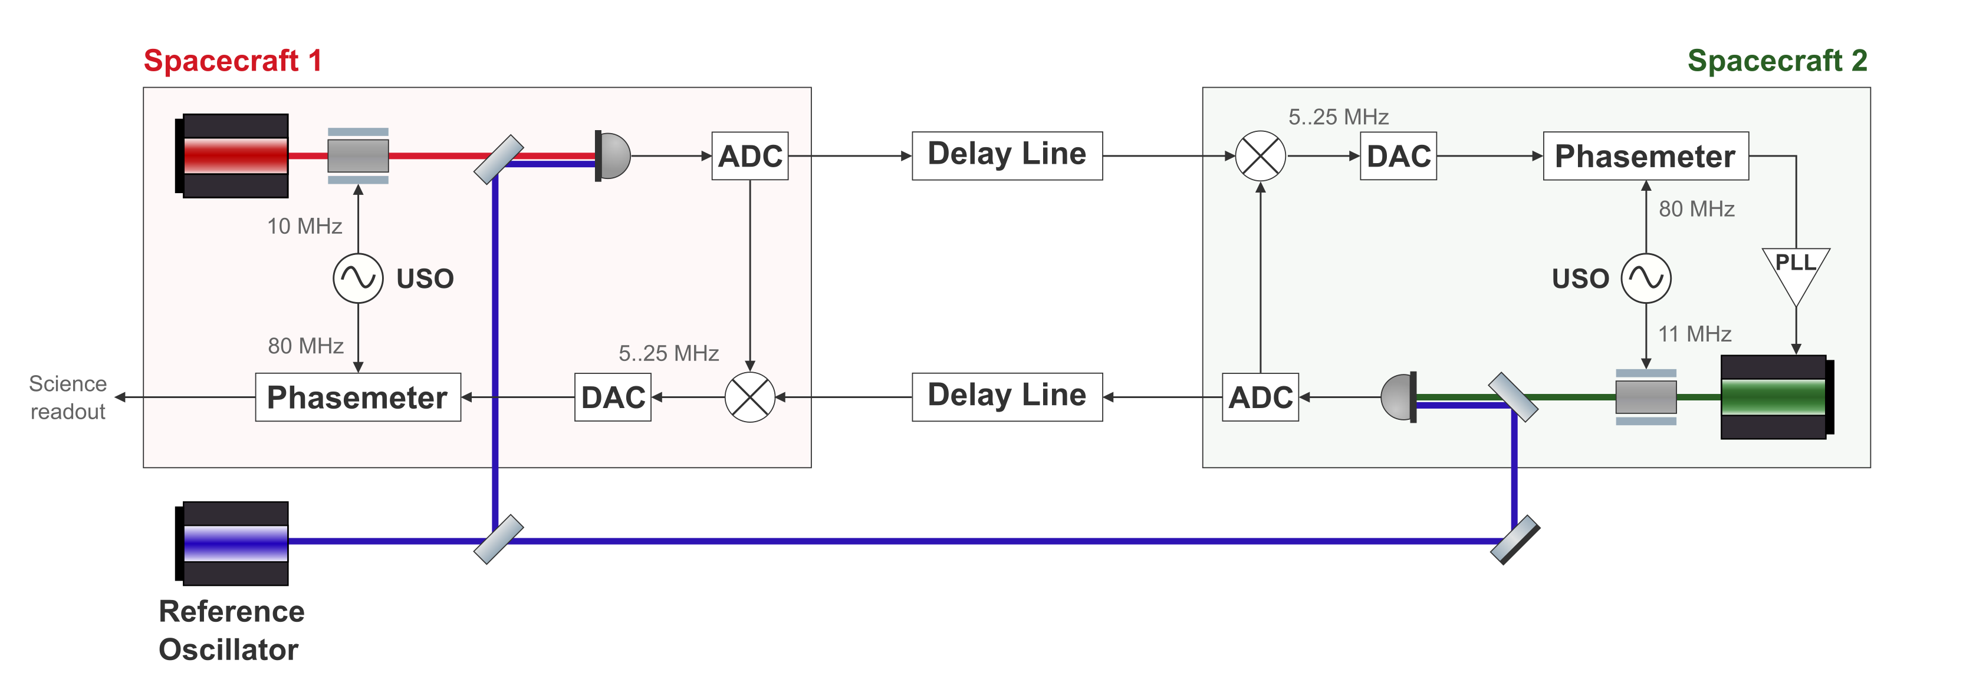
TESTBED CONCEPT
LISA arm
In-flight link
Testbed arm
Benchtop analogue
TAC MEETING
27 August 2026 · 16 / 43

Slide 17
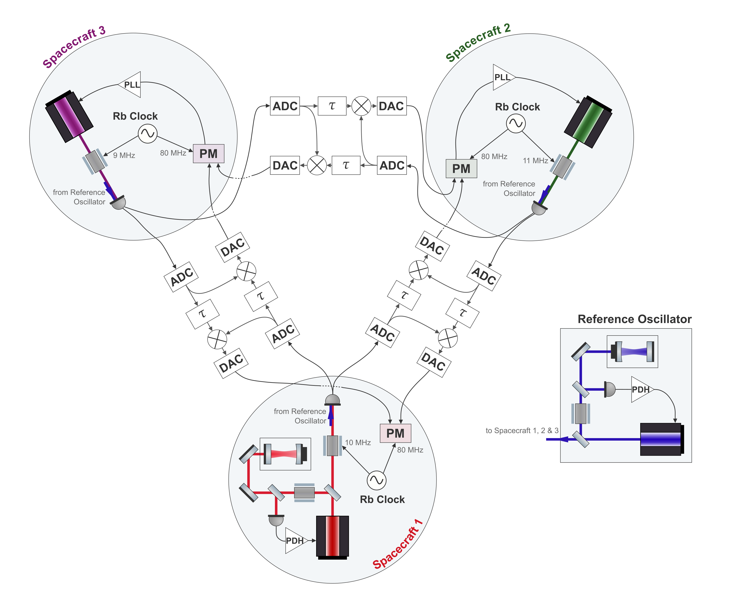
The Full Setup
TESTBED CONCEPT
One laser per spacecraft
An independent source on each satellite
Cavity-locked primary laser
Provides LISA-like laser frequency noise
Independent clocks
Allows to demonstrate clock noise removal
Six separate delay lines
Two per inter-spacecraft link
TAC MEETING
27 August 2026 · 17 / 43
Notes:
This is the goal
The delay status should be included in the presentation
Standing questions there – ex the last measurement, where ever it is
the interpolation/delay implementation
what are the next steps
But how do we properly inject the laser noise and clock noise understanding the Delay line coding is important
The X combination – next goal, is there anything unexplained happening

Slide 18
Context
Overview of the LISA IDS
Testbed Concept
TDI and laser noise: status
clock noise: status
Next Steps
Conclusion
TAC MEETING
27 August 2026 · 18 / 43
Notes:
Do I have a defined topic
And do I understand that topic, and the physics
The TAC decides if that’s a good topic for a thesis
is it worth a degree
is it realistic
For ambitious goals, what could be a minimum reasonable level
TAC2 –status and results, are there changes, what about publications
TAC3 – so what is the realistic goal now

Slide 19
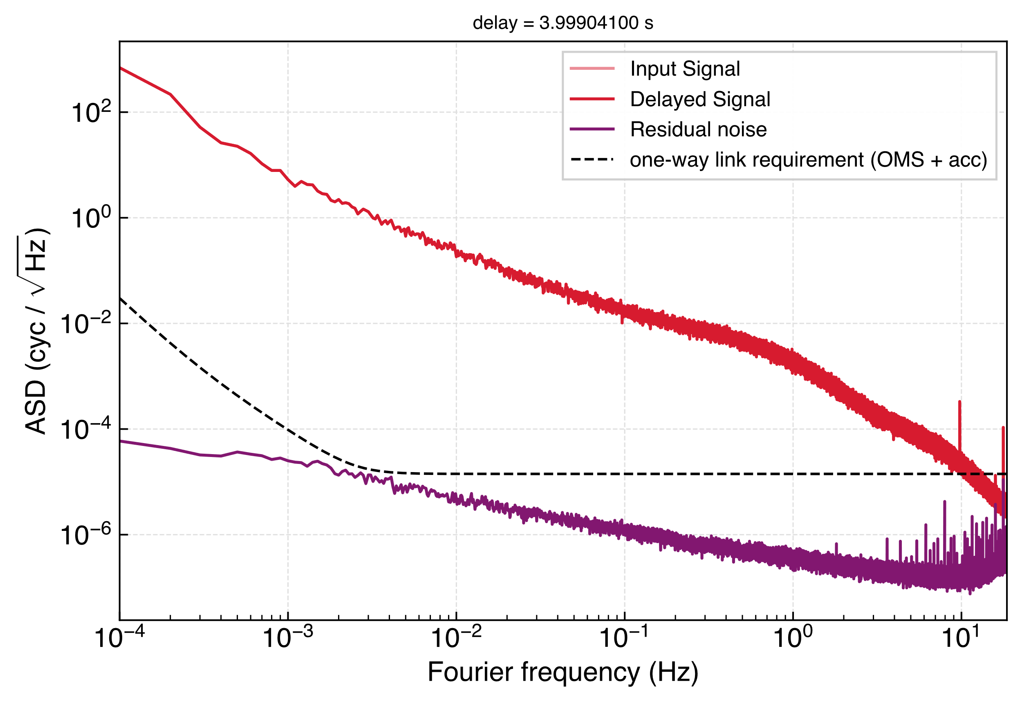
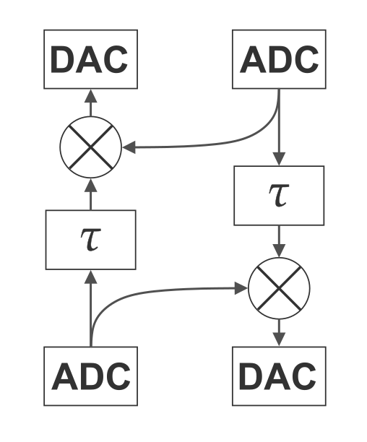
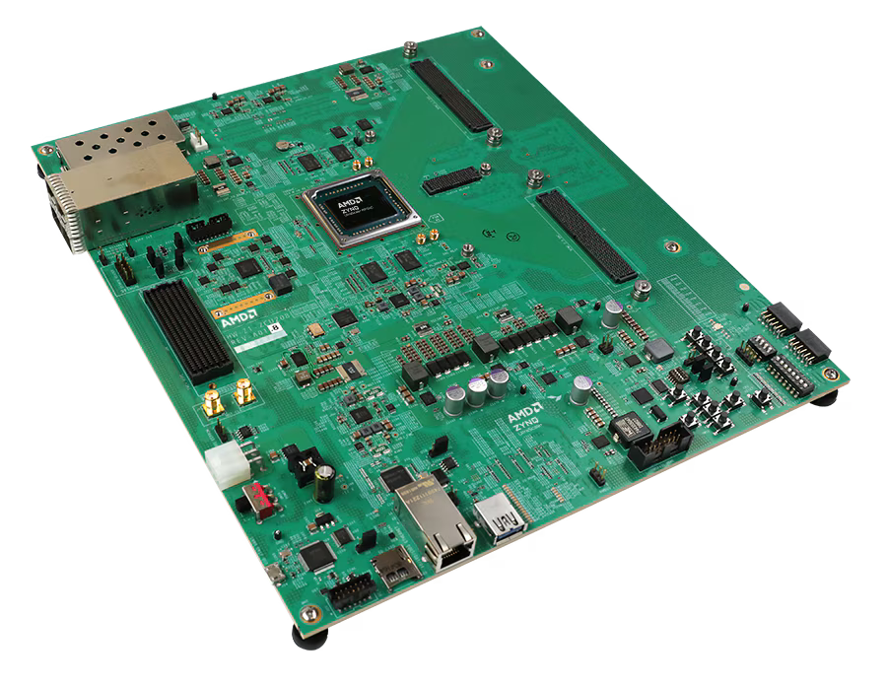
The Delay Line
TDI IN MINILISA STATUS
Time-varying delays
Doppler shifts for both carrier and sidebands
Gravitational-wave injection
AMD Zynq™ UltraScale+™ RFSoC ZCU208 Evaluation Kit
Intrinsic noise floor of one board (purple)
TAC MEETING
27 August 2026 · 19 / 43

Slide 20
The Delay Line – How is the delay implemented
TDI IN MINILISA STATUS
TAC MEETING
27 August 2026 · 19 / 43

Slide 21
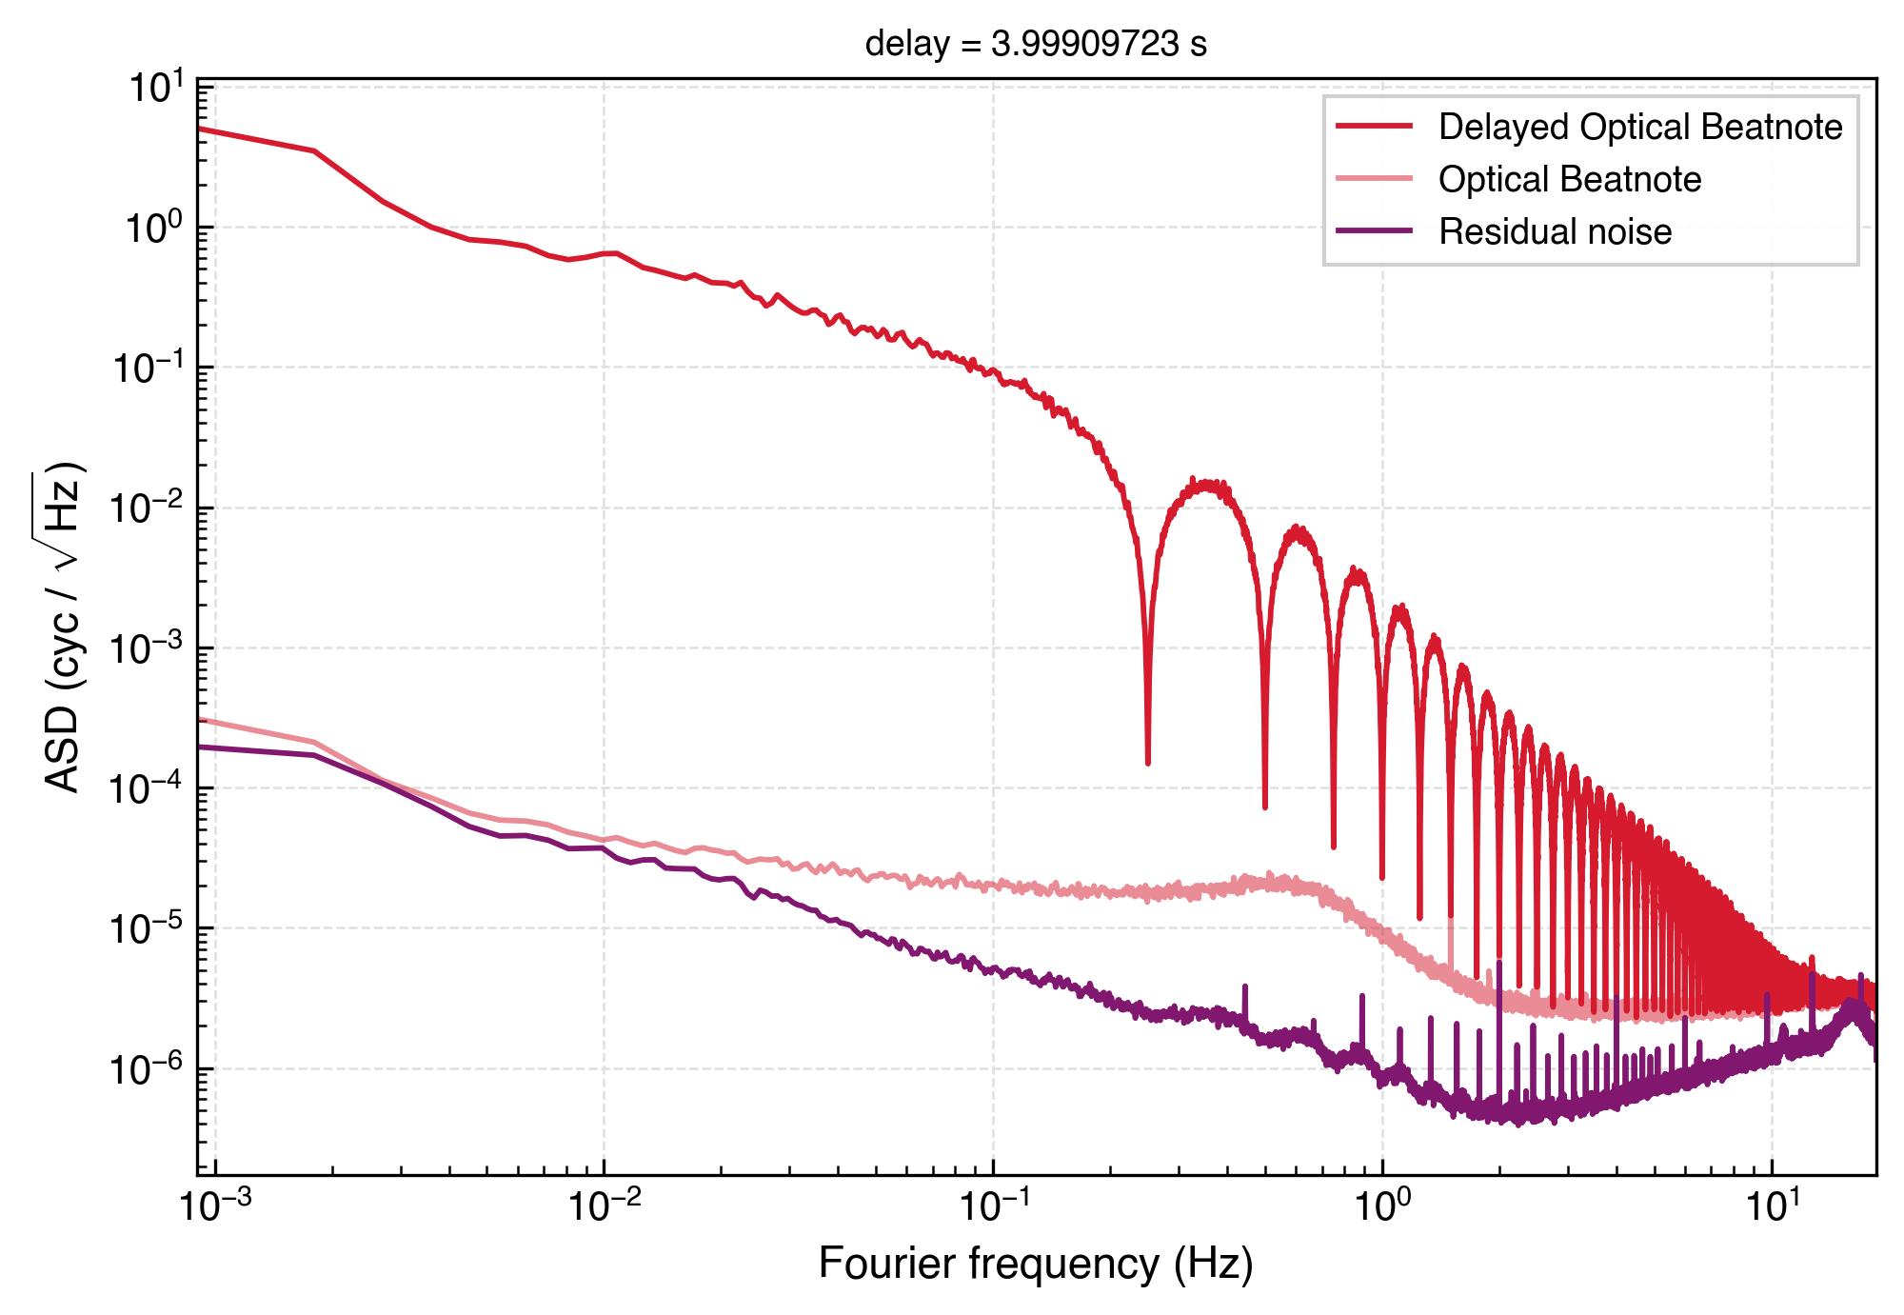
Clock Noise of the boards
TDI IN MINILISA STATUS
Clock noise of the electronics couples into the measurement via (at least) three mechanisms
Direct phase noise at the ADC/DACs
Delay/ranging error
Changing frequency at input and output
TAC MEETING
27 August 2026 · 20 / 43

Slide 22
TDI 2, one board
TDI IN MINILISA STATUS
Results of a one-board TDI2 and signal injection. Works. I didn’t help at all w this measurement
Credit: R. Ferguson et al. (2026)
TAC MEETING
27 August 2026 · 21 / 43
Notes:
The TDI 2 measurement

Slide 23
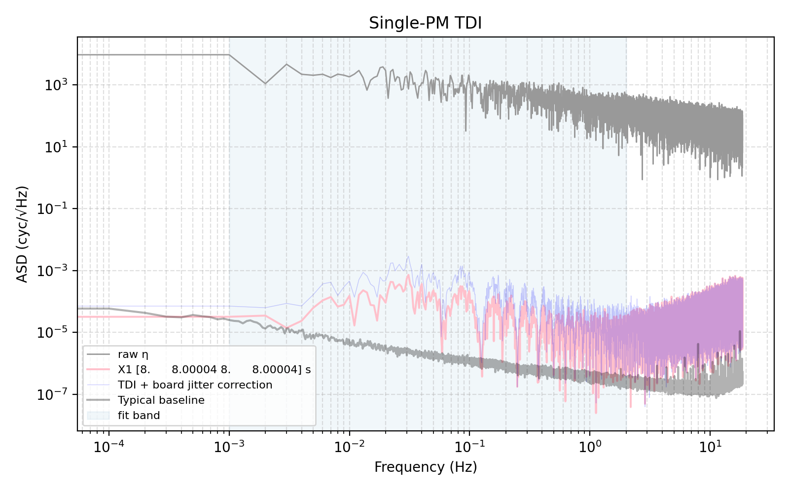
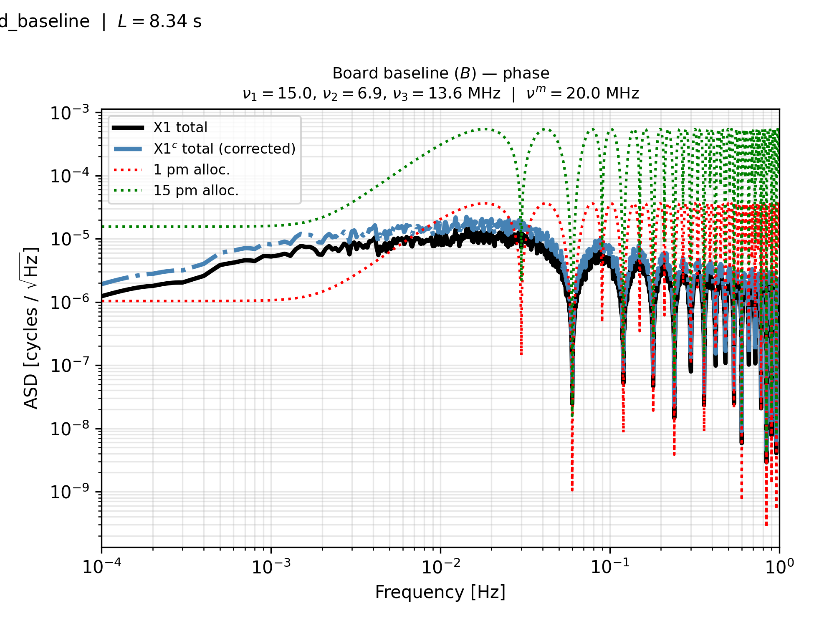
TDI Michelson X with 3 boards
TDI IN MINILISA STATUS
This is a measurement I was very closely involved in. Noise floor is unexplained as just the base line doesn’t quite come here.
For comparison, we also plot the baseline and its TDI 1 transferfunction ASD – which doesn’t go over 10-5.
This is actually a big issue, but not with TDI
TAC MEETING
27 August 2026 · 22 / 43

Slide 24
Injecting Laser Noise
TDI IN MINILISA STATUS
Why do over all
Why use cavities?
This will be covered again later in the Next steps (?)
TAC MEETING
27 August 2026 · 23 / 43

Slide 25
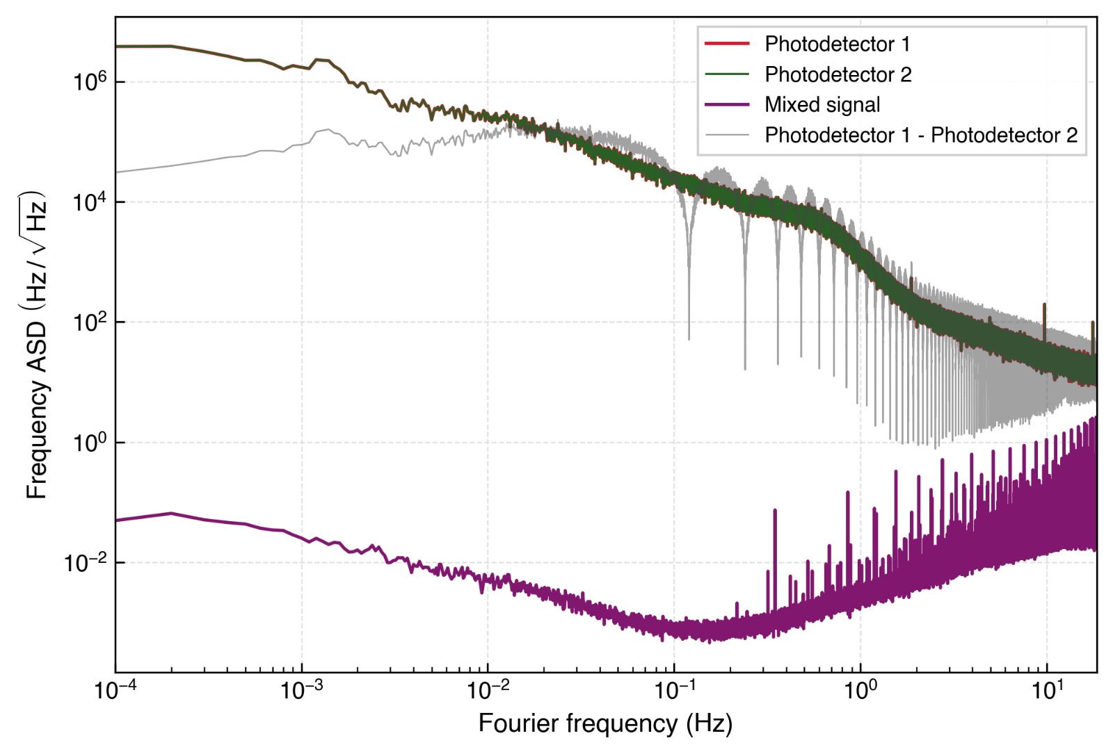
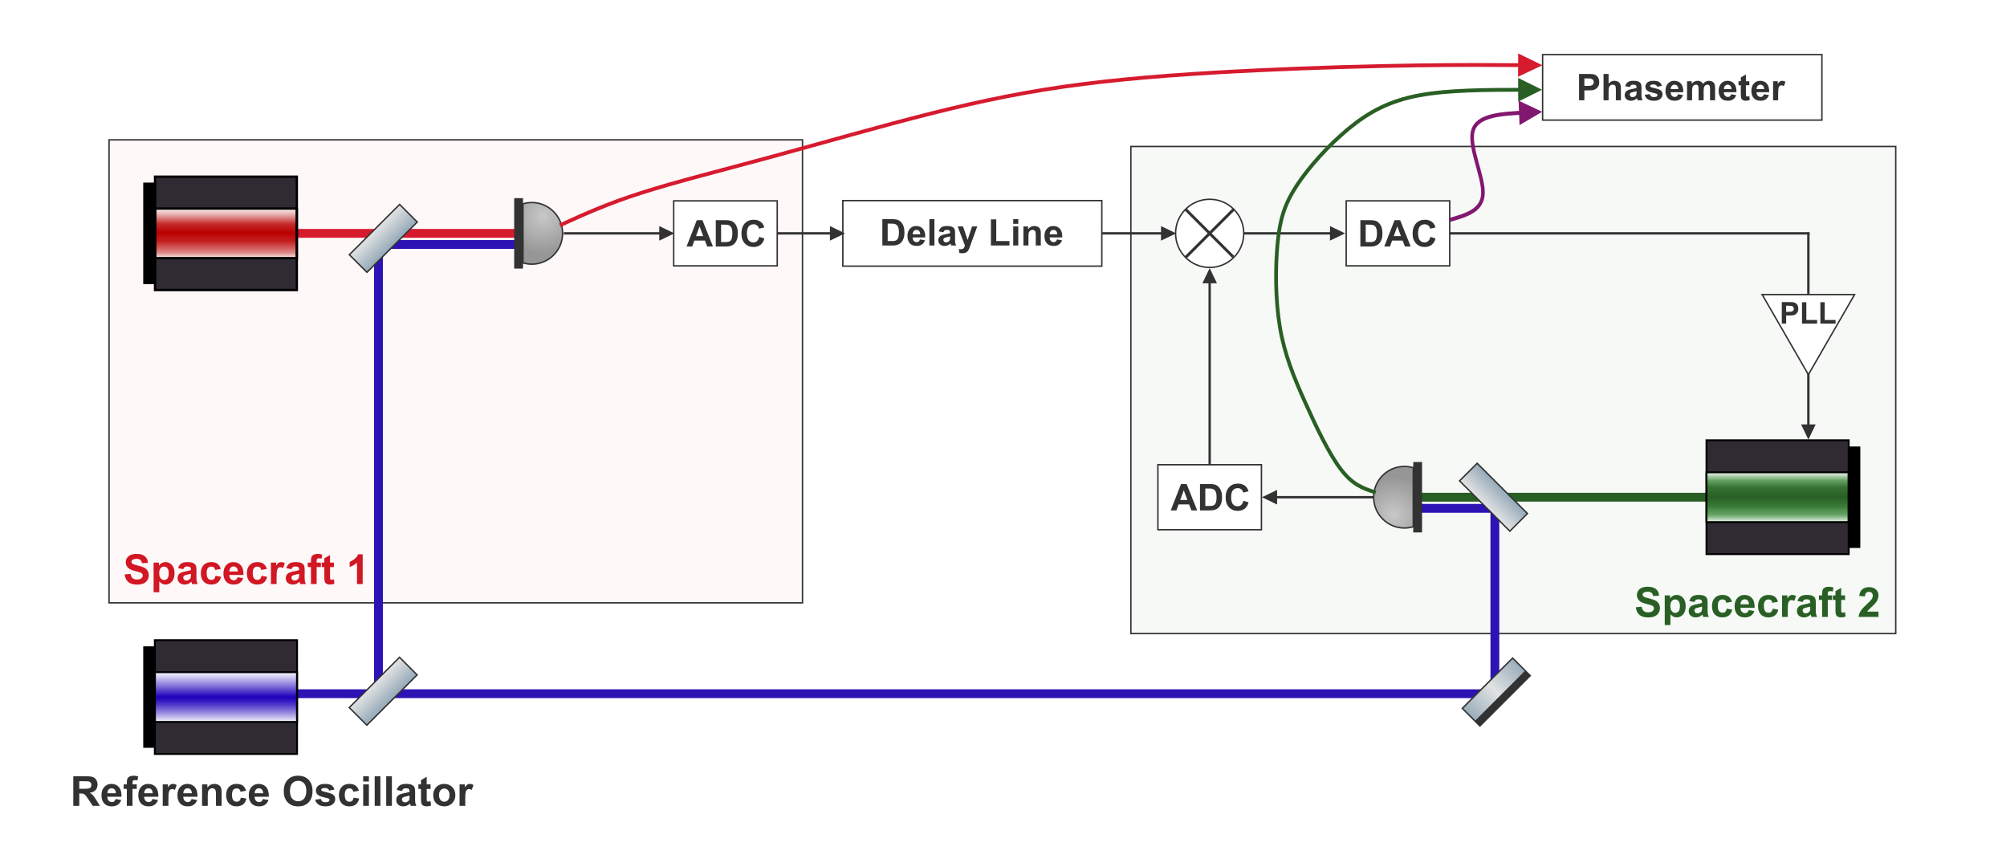
PLL lock of far spacecraft
TDI IN MINILISA STATUS
Photodetector readings are dominated by free-running laser frequency noise.
Everything seems to work as expected
Free-running photodetector noise vs. mixed output
TAC MEETING
27 August 2026 · 24 / 43
Notes:
Why don’t the peaks come to 0?

Slide 26
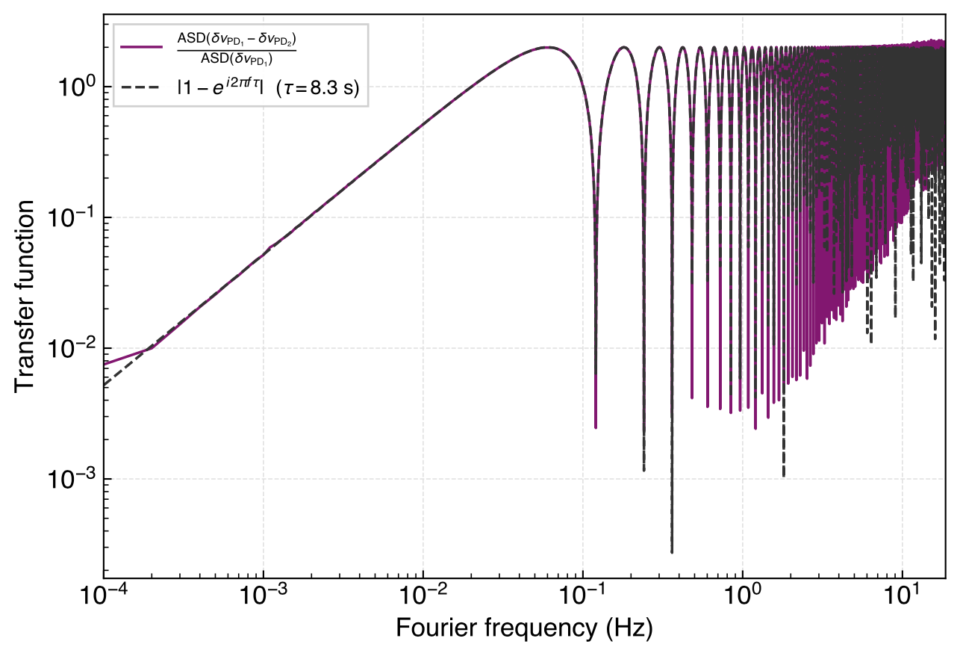
Recovering the Transferfunction
TDI IN MINILISA STATUS
We can recover a LISA-like one-way laser-noise transfer function.
Recovered one-way laser-noise transfer function
TAC MEETING
27 August 2026 · 25 / 43

Slide 27
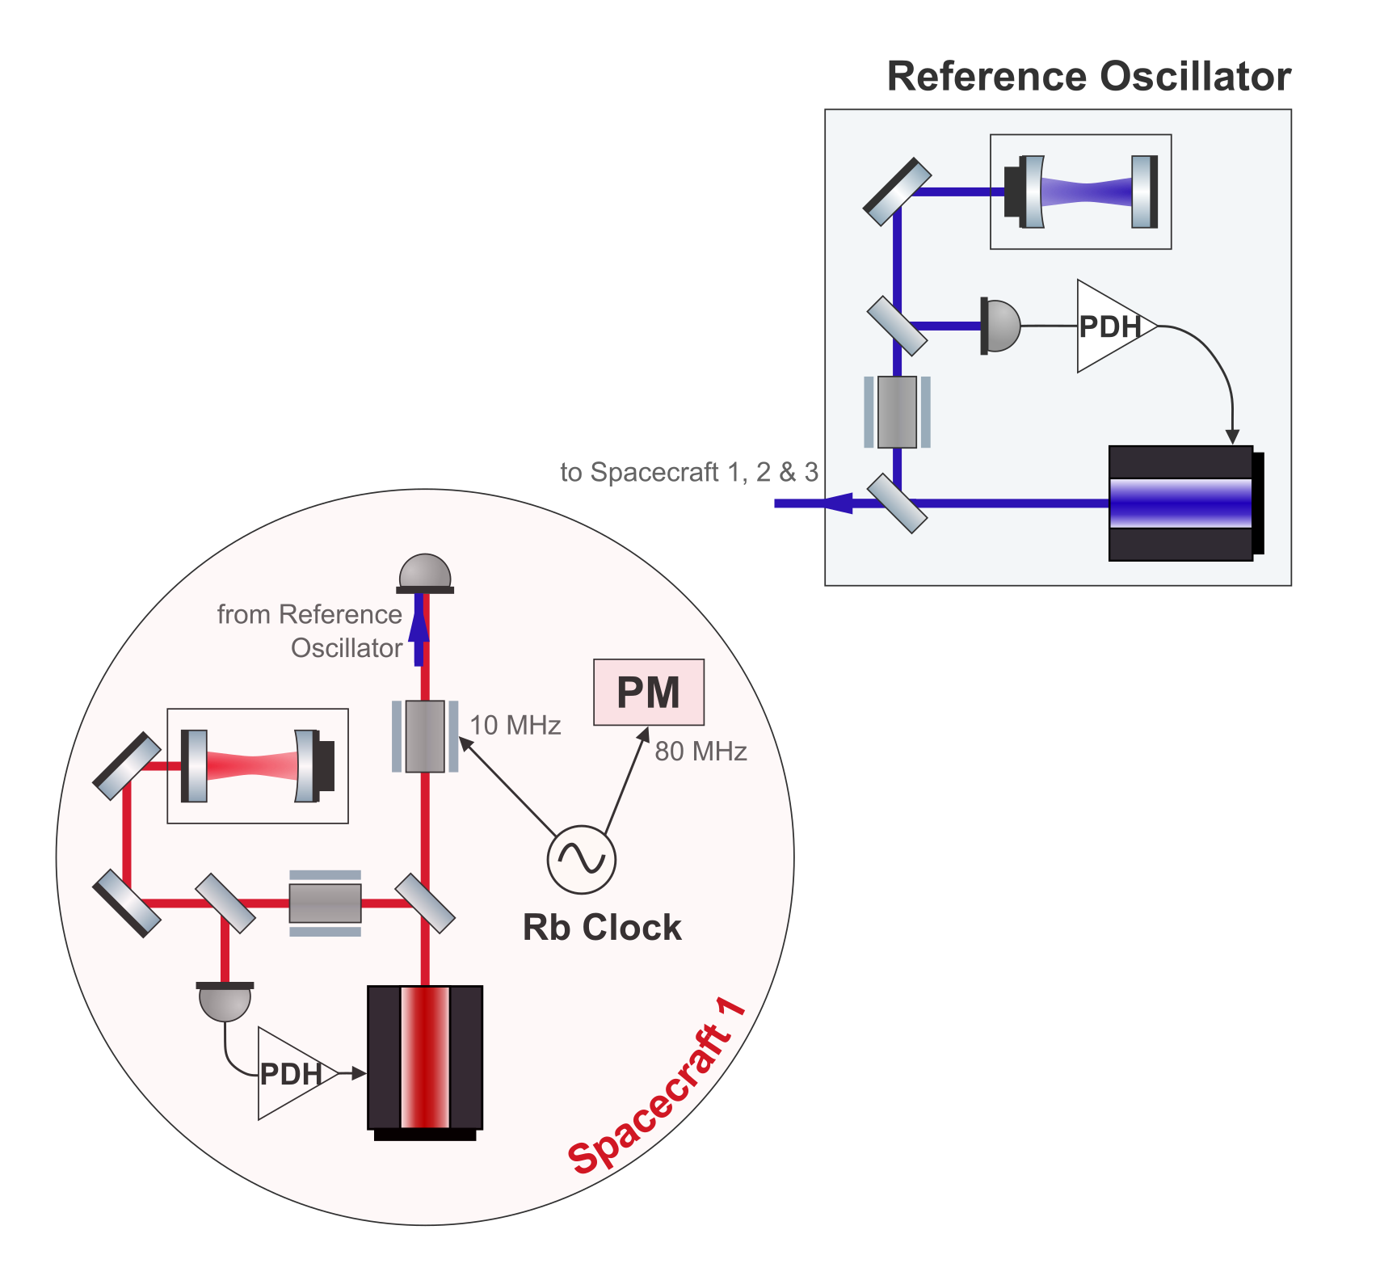
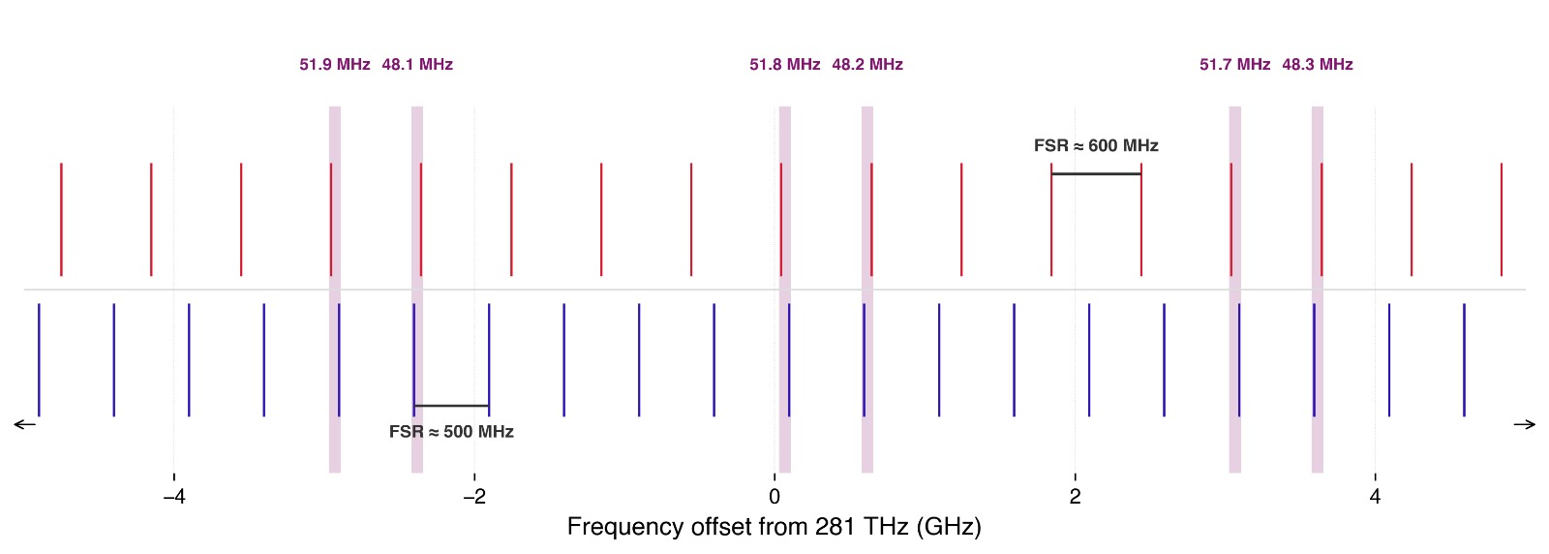
Cavity locking two lasers
TDI IN MINILISA STATUS
Primary laser should be cavity locked
Two lasers will be locked to 25 and 30 cm cavities
Two separate PDH locks
Beatnote needs to be below 60 MHz
Illustrative cavity resonances
This is one reason to increase the data rate
And decimate more
TAC MEETING
27 August 2026 · 26 / 43

Slide 28
Context
Overview of the LISA IDS
Testbed Concept
TDI and laser noise: status
clock noise: status
Next Steps
Conclusion
TAC MEETING
27 August 2026 · 27 / 43
Notes:
Do I have a defined topic
And do I understand that topic, and the physics
The TAC decides if that’s a good topic for a thesis
is it worth a degree
is it realistic
For ambitious goals, what could be a minimum reasonable level
TAC2 –status and results, are there changes, what about publications
TAC3 – so what is the realistic goal now

Slide 29
Clock Noise transfer in LISA
CLOCK NOISE CORRECTION IN MINILISA
LISA arm
In-flight link
TAC MEETING
27 August 2026 · 28 / 43

Slide 30
FDM
CLOCK NOISE CORRECTION IN MINILISA
This slide will highlight the critical part of the fidelity of the clock noise transfer
Like why it’s a limiting factor
TAC MEETING
27 August 2026 · 29 / 43

Slide 31
Clock Noise transfer in the lab
CLOCK NOISE CORRECTION IN MINILISA
LISA arm
In-flight link
Testbed arm
Benchtop analogue
TAC MEETING
27 August 2026 · 30 / 43
Notes:
WHAT IS THE FDM CRITICAL THING IN THE TESTBED

Slide 32
The clock jitter removal algo and how its based on the same TDI algo
CLOCK NOISE CORRECTION IN MINILISA
Vallisneri’s algorithm to synthesize a closed loop from the r variables than should behave very similarly to TDI, actually.
TAC MEETING
27 August 2026 · 31 / 43

Slide 33
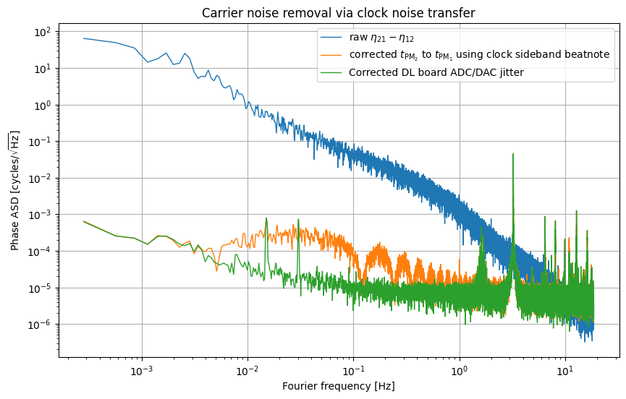
Preliminary Clock Noise Removal
CLOCK NOISE CORRECTION IN MINILISA
Again a multi board measurement where I was closely involved in.
This is likely limited by modulation noise – the same critical thing we want to build better with the optics – but I have to check this.
A nice result though.
TAC MEETING
27 August 2026 · 32 / 43
Notes:
Teka the noise floor from here? Also does this match 2 baseline noise floor?

Slide 34
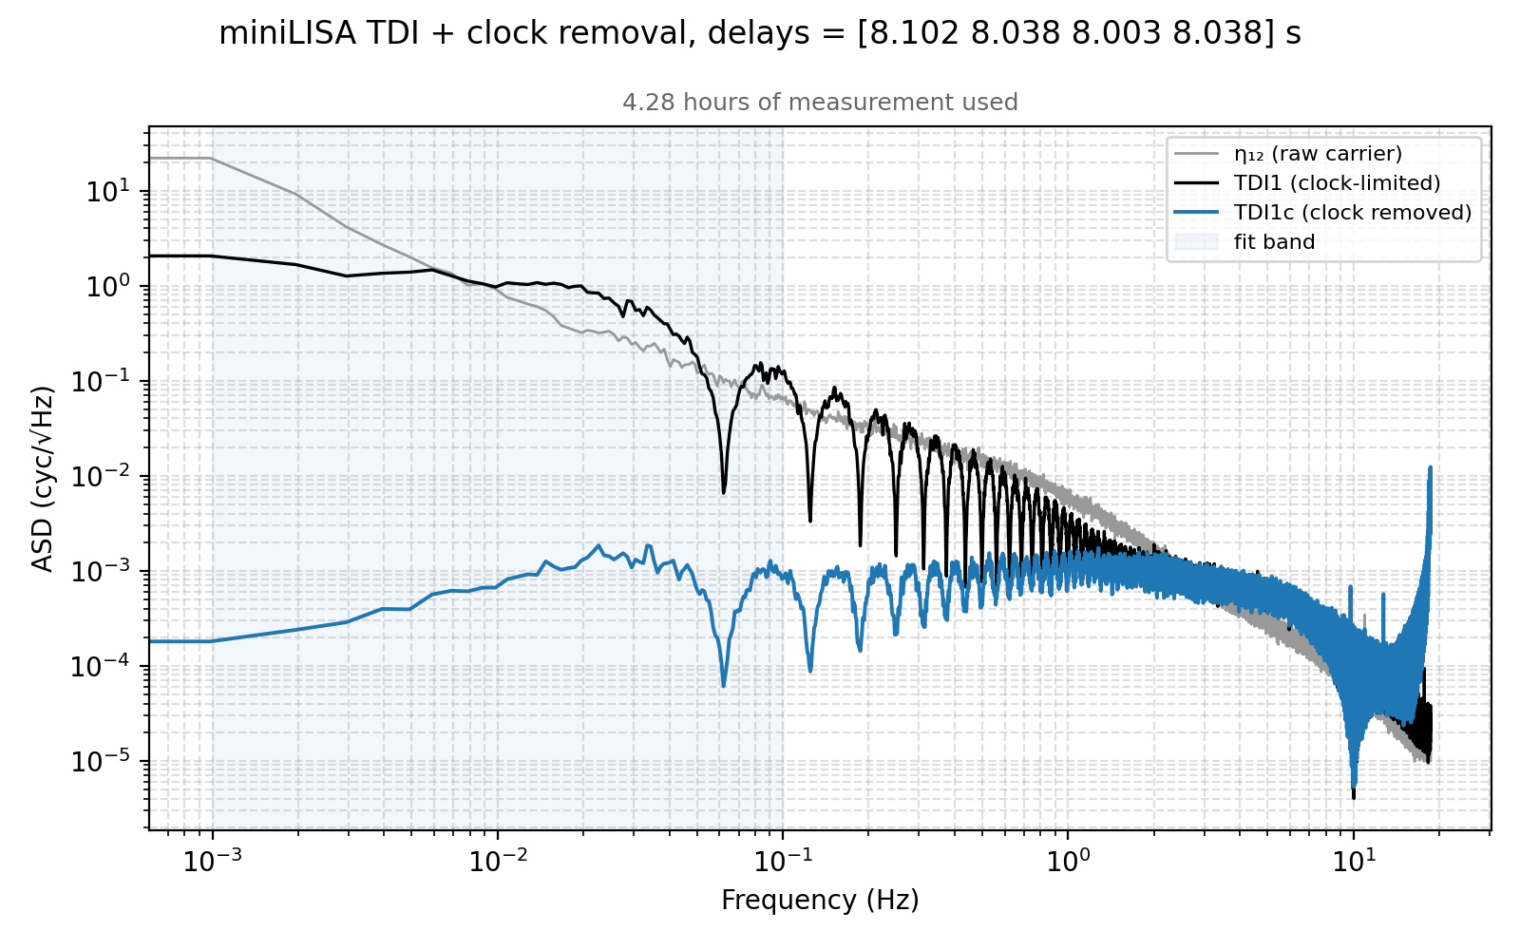
Preliminary Clock Noise Removal
CLOCK NOISE CORRECTION IN MINILISA
Multi board clock noise removal.
Clock noise removal done with Vallisneri’s algorithm.
PM was not following the Rb, so that’s likely a limiting noise here. Should repeat the measurement for this slide
TAC MEETING
27 August 2026 · 33 / 43

Slide 35
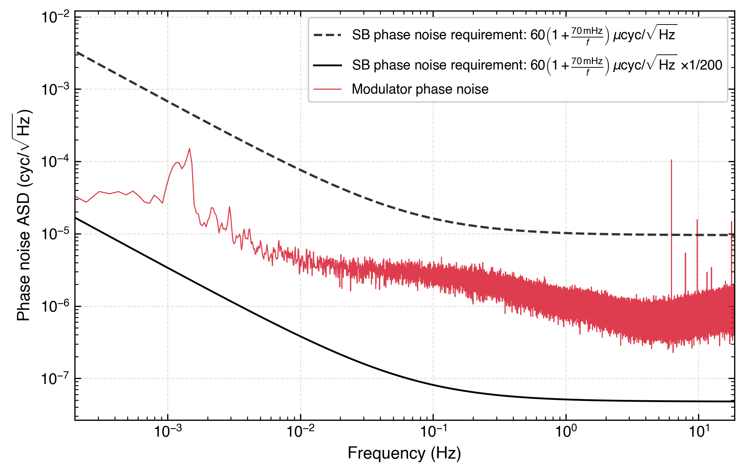
Clock Tone Transfer Limitation
CLOCK NOISE CORRECTION IN MINILISA
MHz SB seems to not be enough to combat phase noise
Here we take LISA modulation phase noise requirement and adjust it to a 10 MHz modulation for reference
For LISA-like performance we need to solve this
Modulator phase noise against the requirement
TAC MEETING
27 August 2026 · 34 / 43
Notes:
The power starts to matter as well, at least for LISA

Slide 36
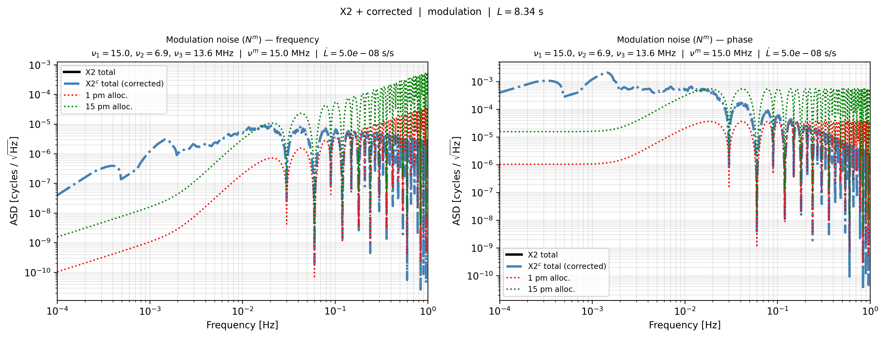
Clock Tone Transfer Limitation
CLOCK NOISE CORRECTION IN MINILISA
Here we take the measured noise ans assume that its frequency independent. Then multiply with a transferfunction assuming 15 MHz modulation. We are over the 15 pm allocation
TAC MEETING
27 August 2026 · 35 / 43

Slide 37
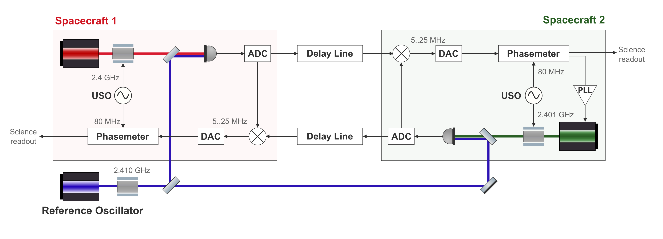
GHz Sidebands in the lab
CLOCK NOISE CORRECTION IN MINILISA
Some ideas. One is my favorite.
POTENTIAL SOLUTIONS UNDER INVESTIGATION
Driving the PM from the sidebands
Derive the clock phase directly from the RF sidebands.
Reference measurement
A dedicated channel to track the modulation tone.
ADC mixing
Down-mix the GHz tone inside the ADC.
Aliasing
Controlled aliasing of a MHz signal.
GHz modulation measurement scheme
TAC MEETING
27 August 2026 · 36 / 43

Slide 38
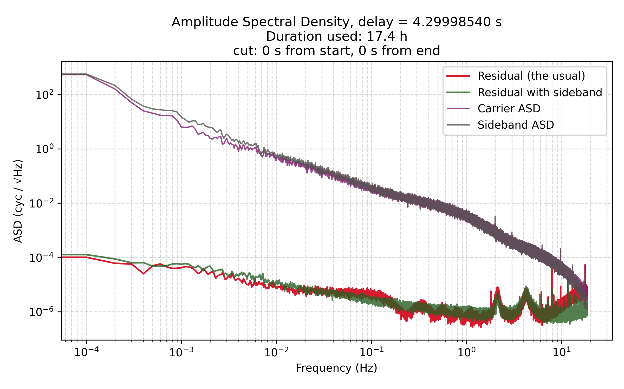
GHz Modulation – the same noise cancellation like modulation vs ADC
CLOCK NOISE CORRECTION IN MINILISA
Here’s my favourite idea of taking the DL sampling clock and using that for the reference modulator. Then the noises cancel out at the ADC and we don’t see that noise further down the line.
TAC MEETING
27 August 2026 · 37 / 43

Slide 39
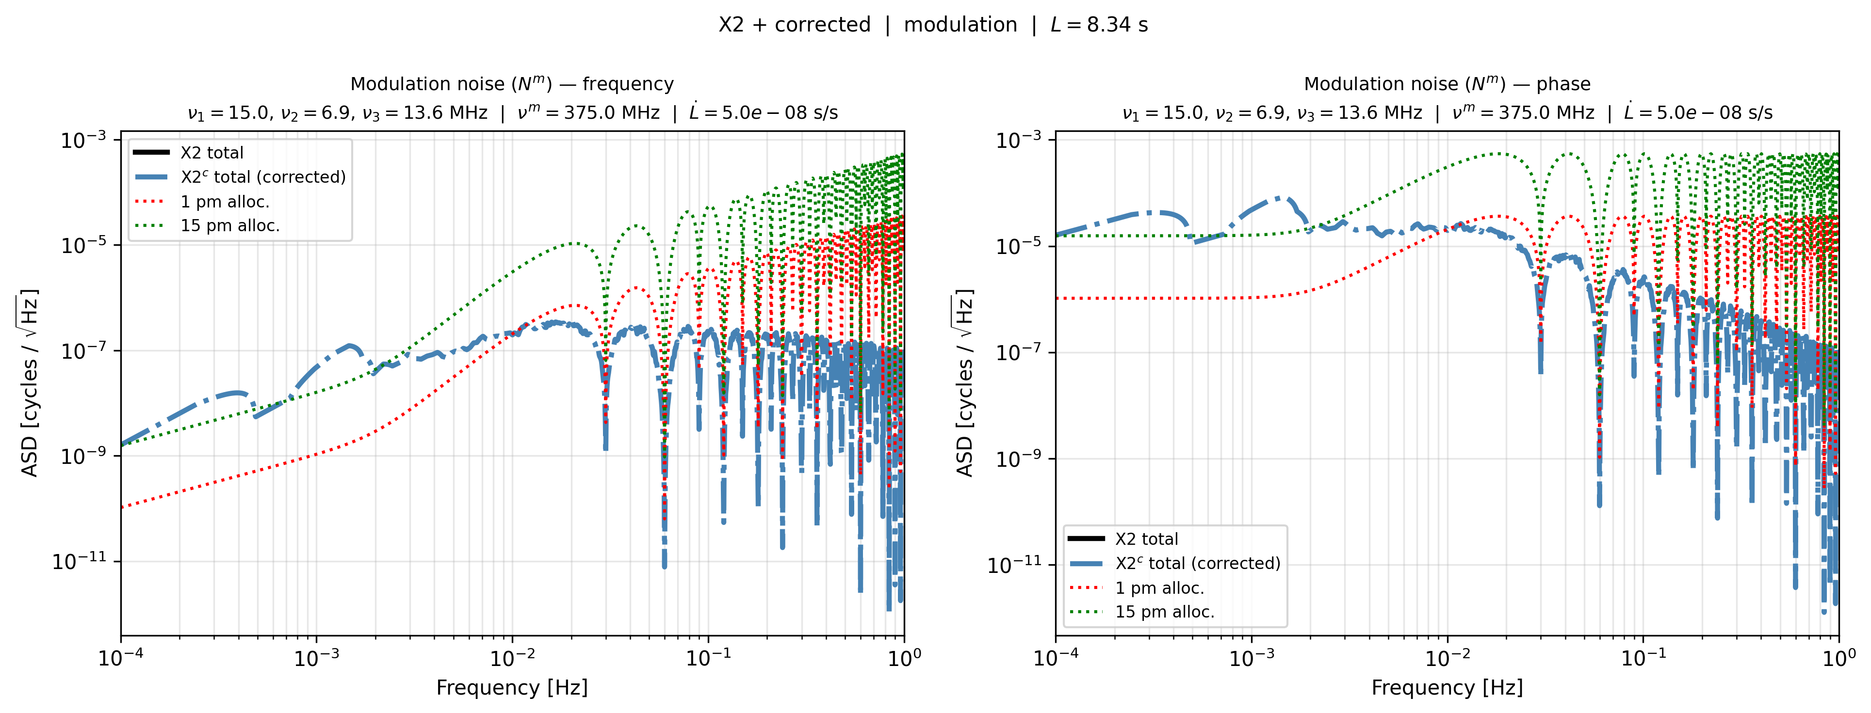
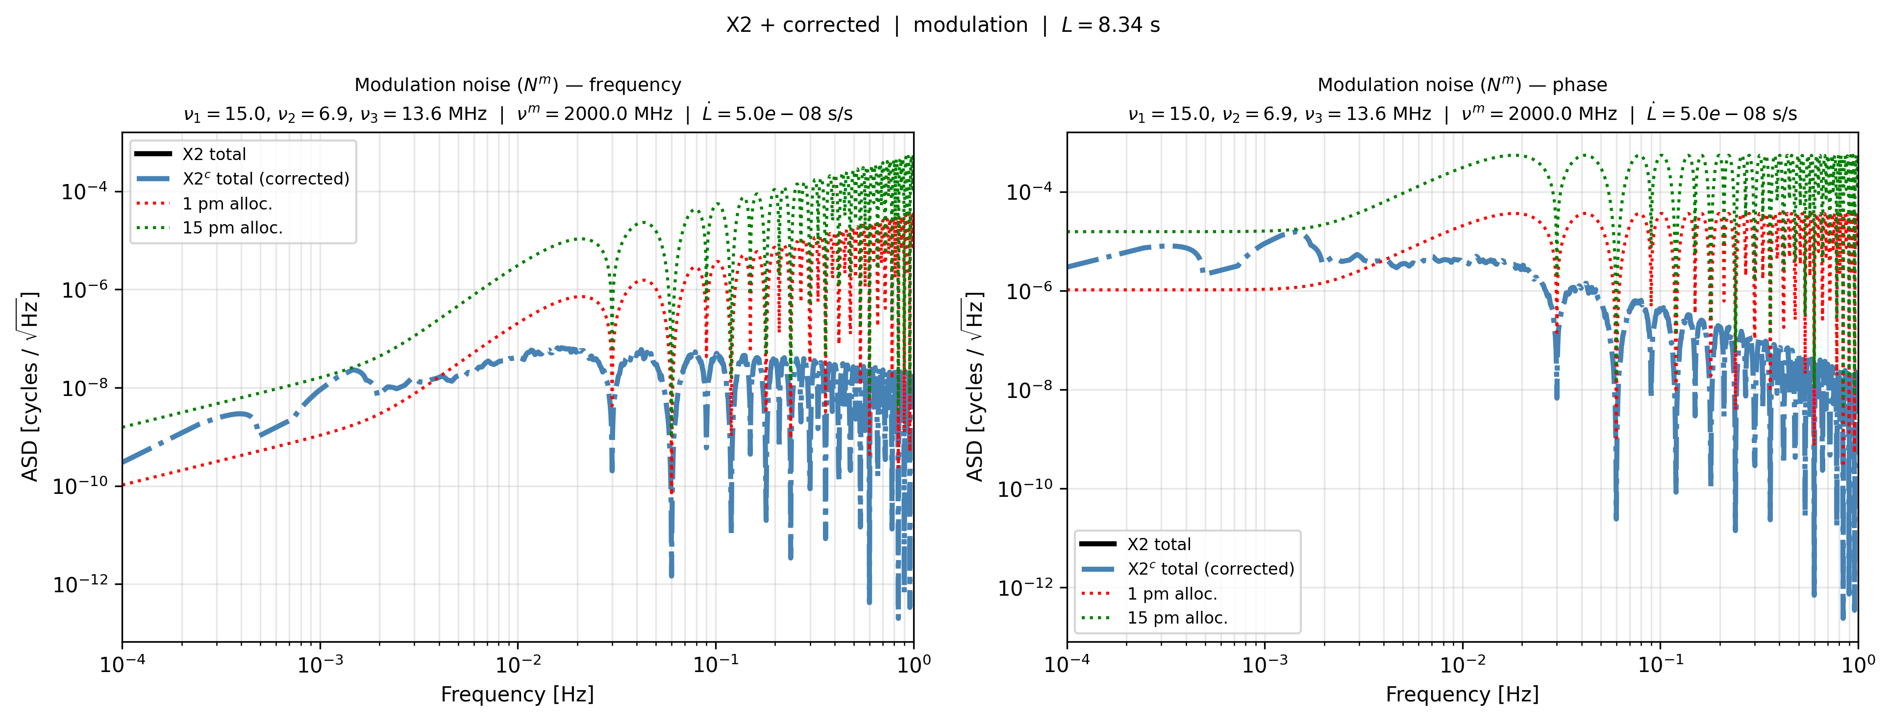
GHz Modulation – the same noise cancellation like modulation vs ADC
CLOCK NOISE CORRECTION IN MINILISA
What frequencies to use?
Is 300 enough?
TAC MEETING
27 August 2026 · 37 / 43

Slide 40
Context
Overview of the LISA IDS
Testbed Concept
TDI and laser noise: status
clock noise: status
Next Steps
Conclusion
TAC MEETING
27 August 2026 · 38 / 43

Slide 41
Step 1
NEXT STEPS
Figure out multiboard measurements
1) what is the limiting issue
2) there is a sync option, would it help?
TAC MEETING
27 August 2026 · 39 / 43

Slide 42
Step 2
NEXT STEPS
Inject laser noise.
Inject clock noise
TAC MEETING
27 August 2026 · 40 / 43

Slide 43
Step 3
NEXT STEPS
Optical clock-noise removal + the GHz decision. Integrate the cavities for LISA-like laser noise, run clock removal on optical data, and settle whether GHz is actually required. This is where the thesis Target lives.
TAC MEETING
27 August 2026 · 41 / 43

Slide 44
Conclusions
TAC MEETING
27 August 2026 · 42 / 43
Notes:
Fix this pleas?

Slide 45
Results from other testbeds
EXTRA
TAC MEETING
27 August 2026 · 43 / 43

