Slide 1
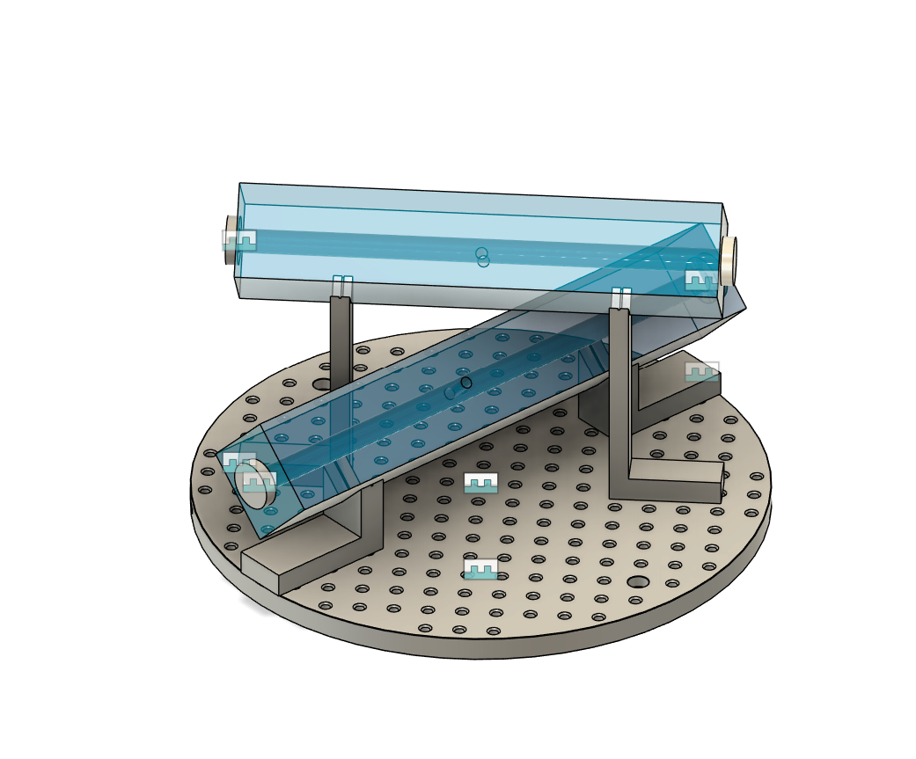
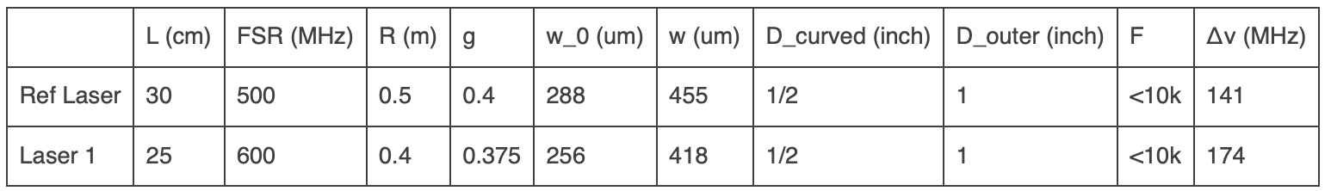
Cavities
Two more points from Layertec:
“You should as well avoid mounting which would apply sheer or rotational forces.”
“we do CRD on the mirrors before contacting on the cavity (due to the geometry we cannot measure the whole cavity). The geometrical dimensions are verified during the production as well.”

Slide 2
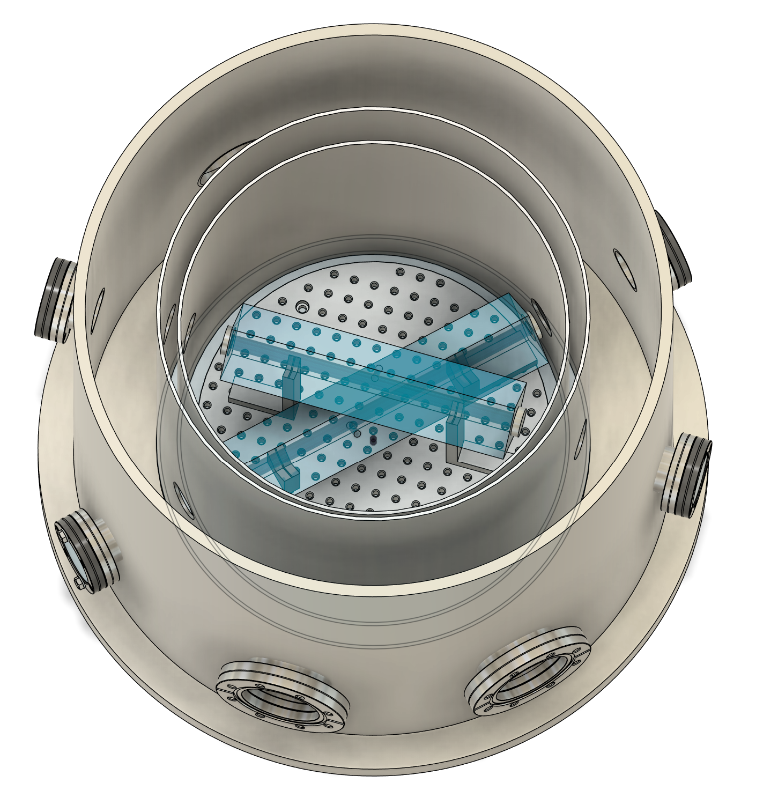
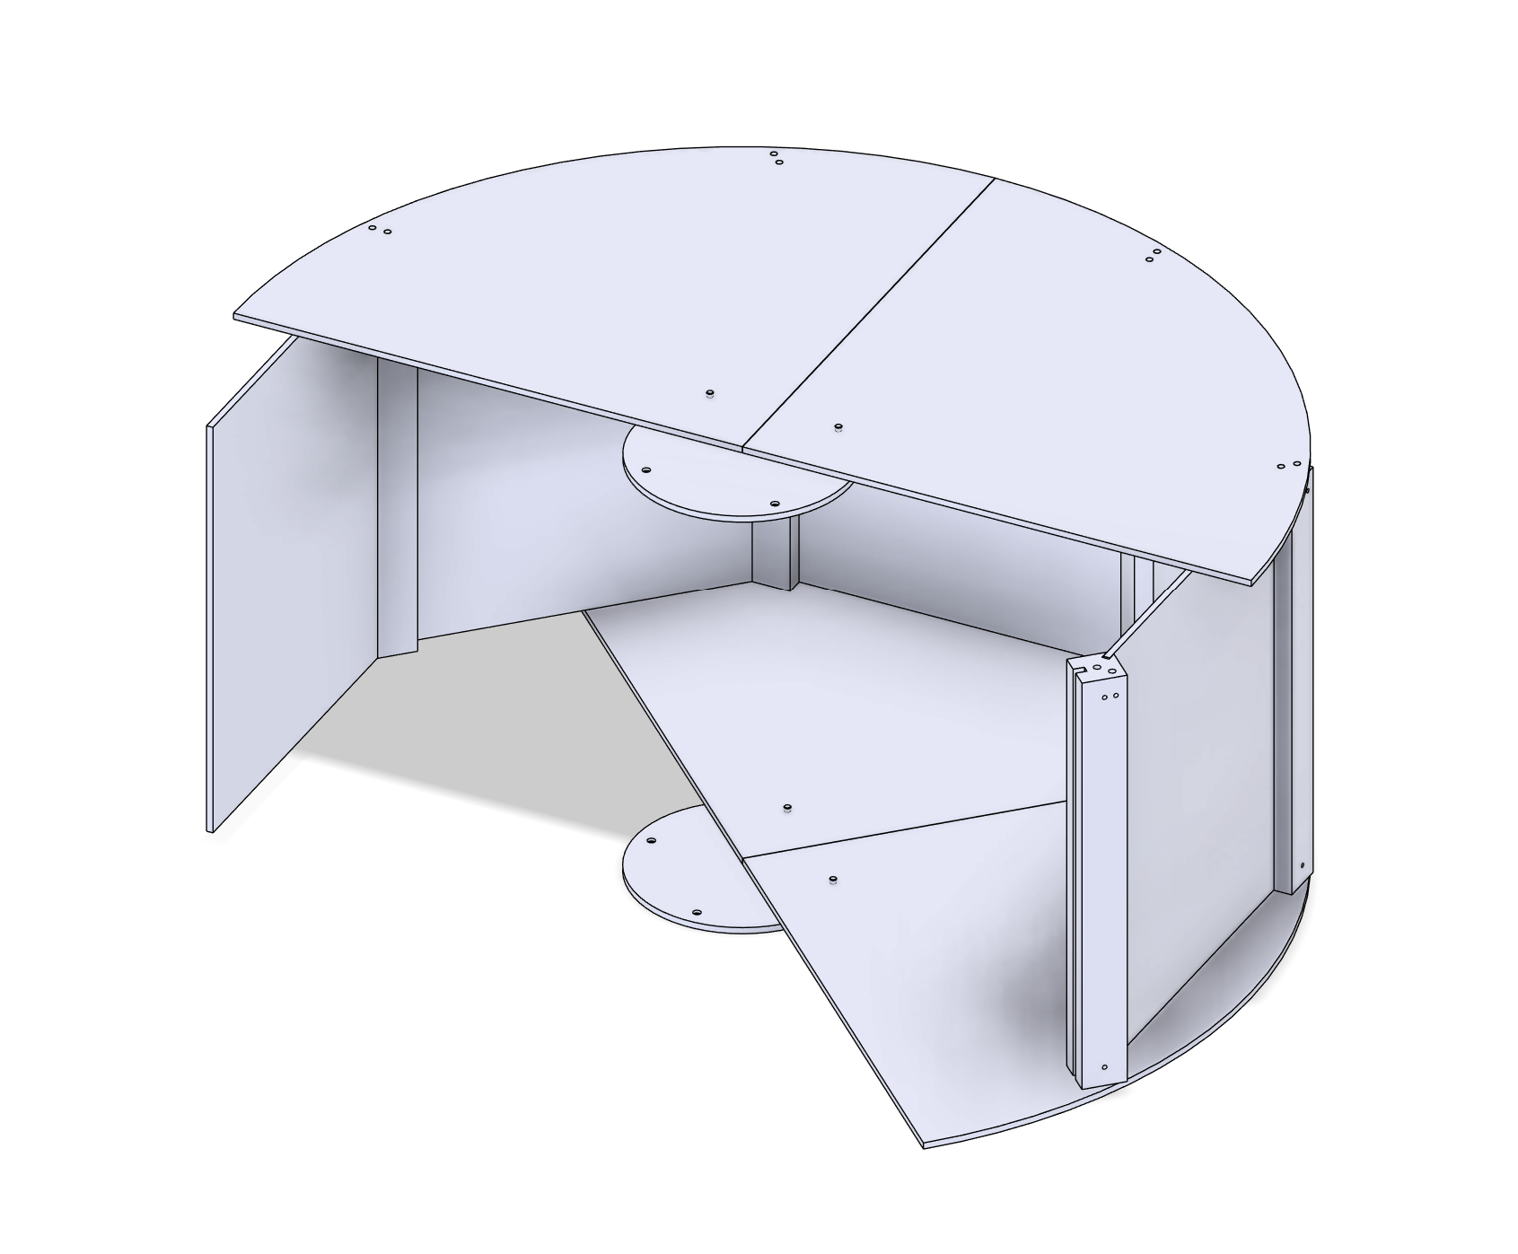
Vacuum and Thermal
Philip designed a shield that can be assembled inside the vacuum tank.
Pfeiffer responded, should get a quote maybe next week
I’ve been reading about pumps.

Slide 3
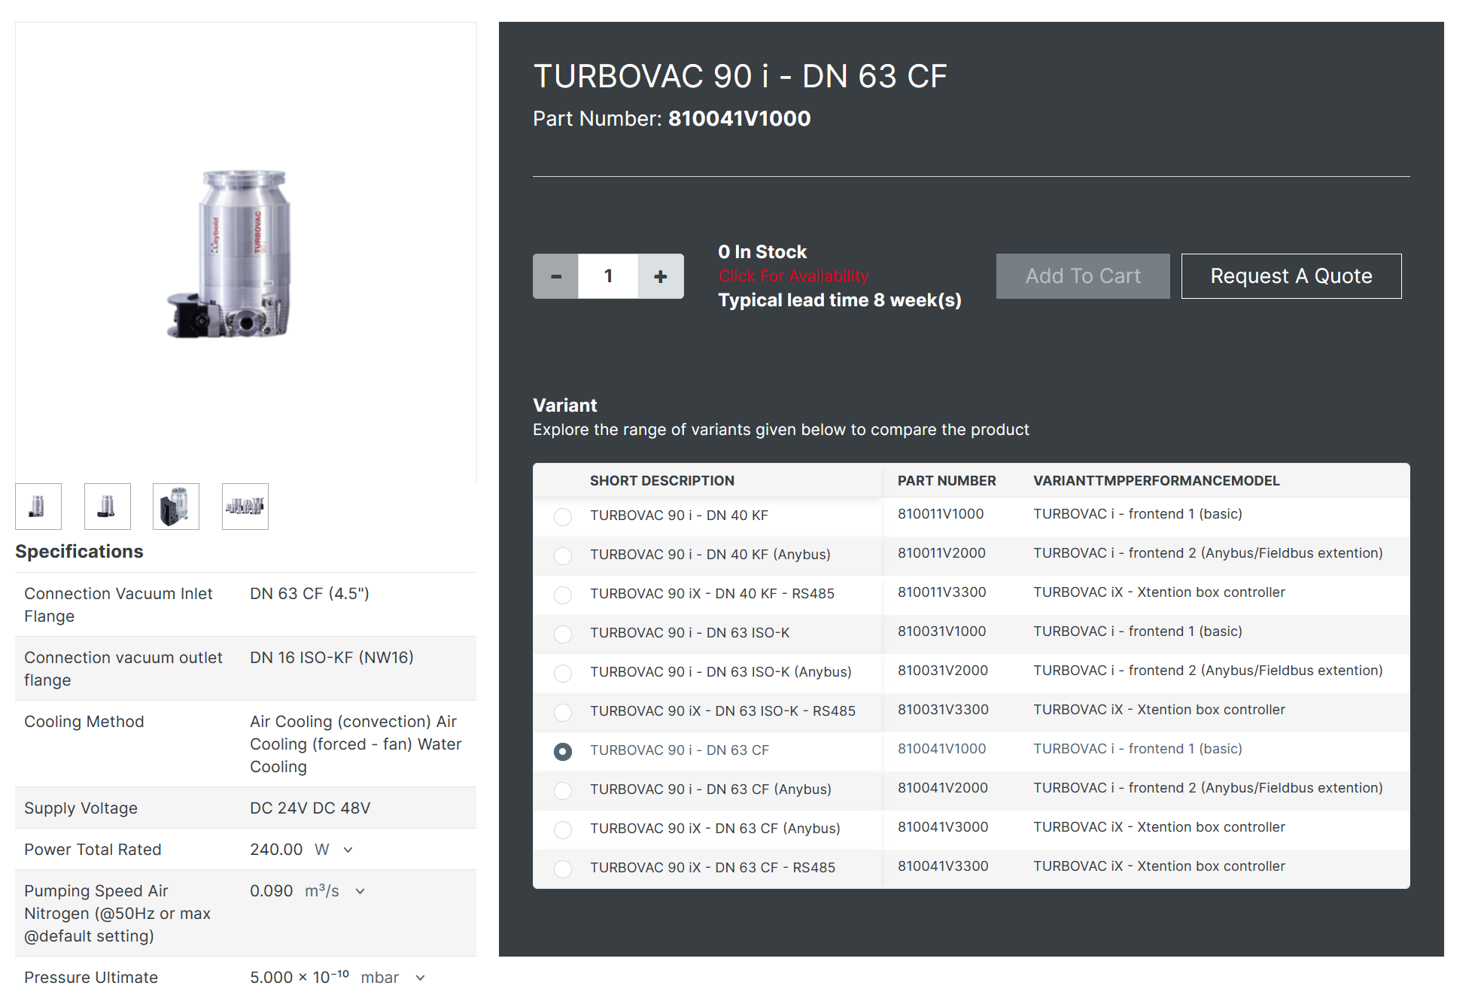
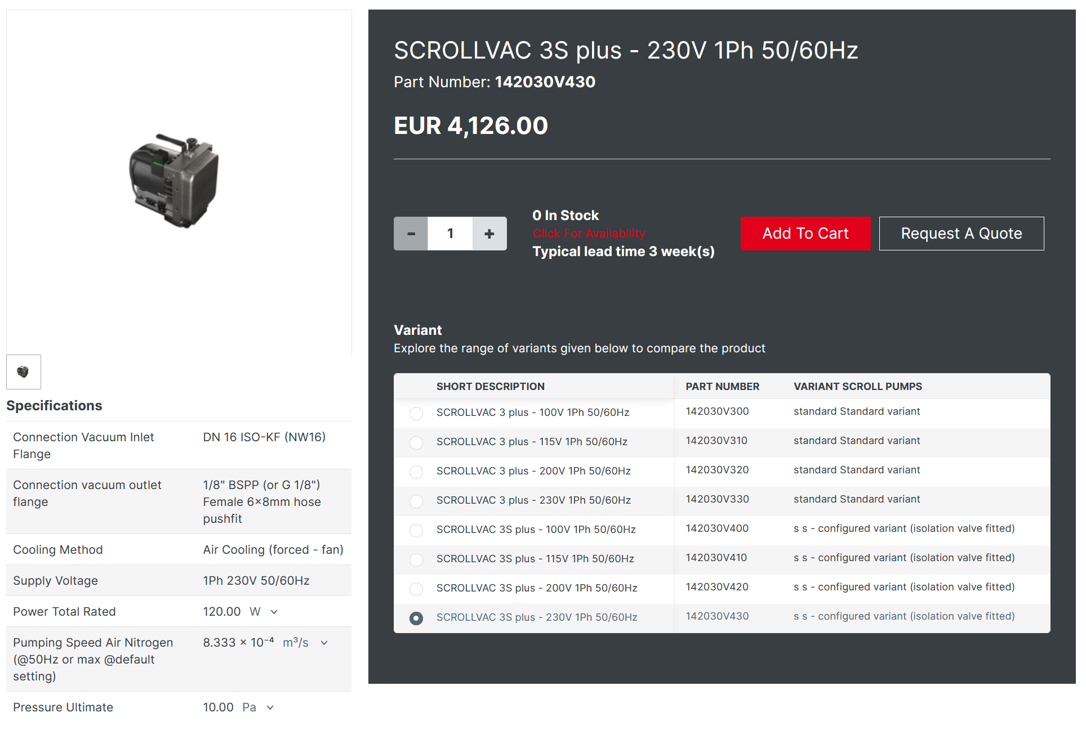
Pumps – Available on SAP
Turbomolecular Pump
Scroll Pump

Slide 4
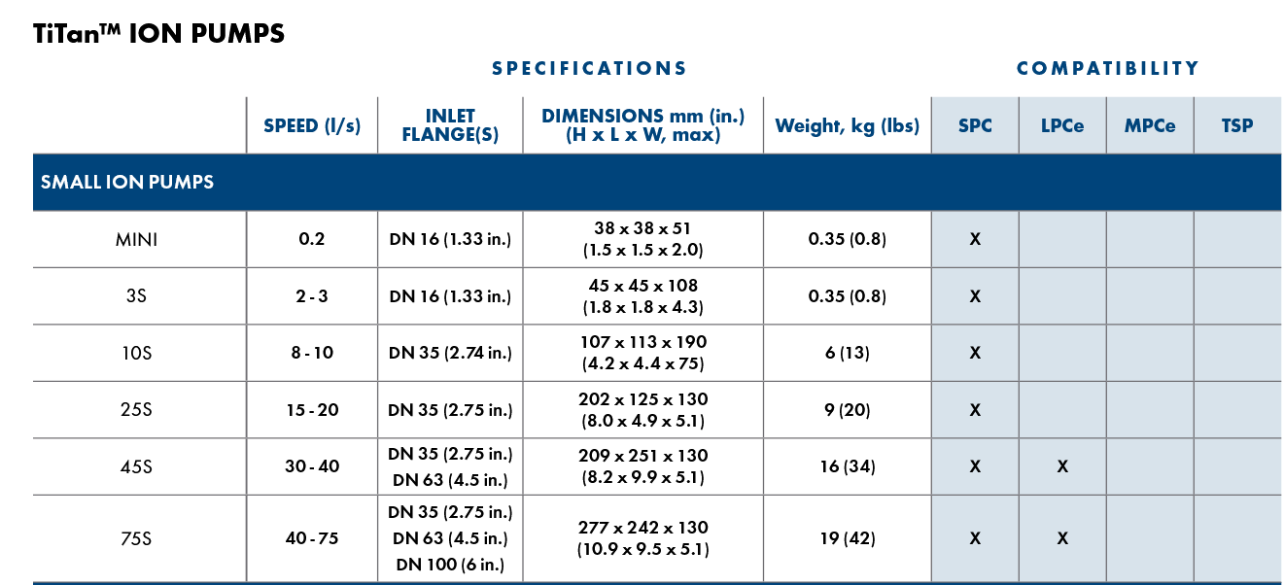
Ion Pump
Not that many options on the market I believe.

