Slide 1
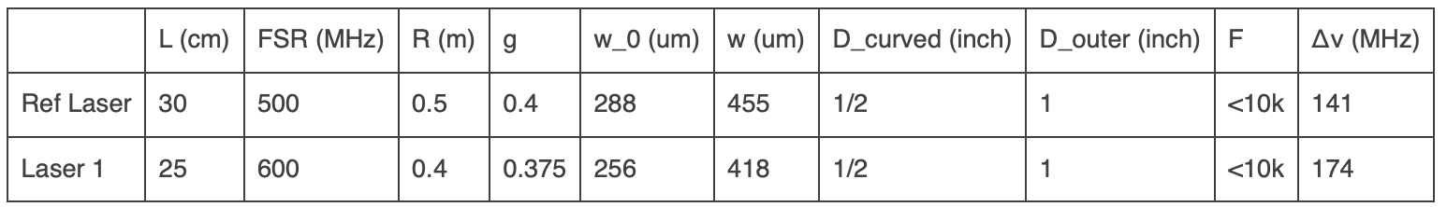
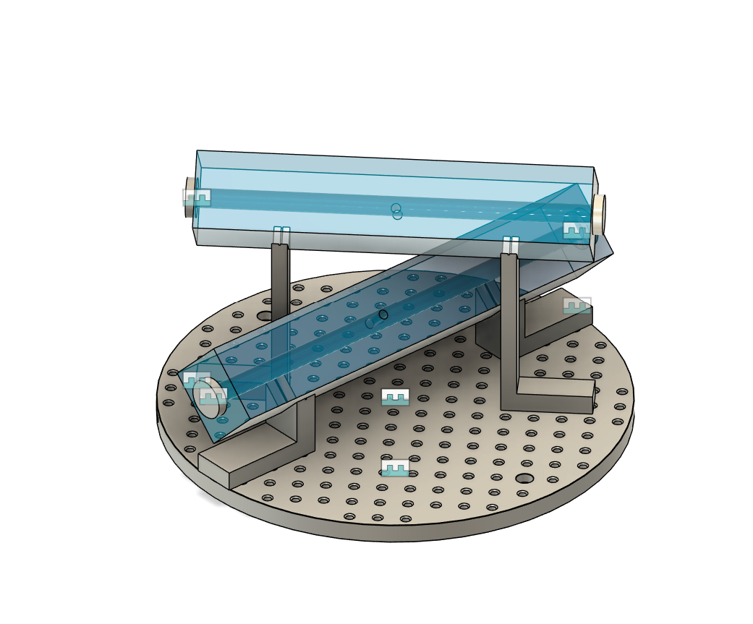
Cavities
Parallelism //<5’ guaranteed – geometrically this should be approximately equivalent to a beam shift of about 3 to 4 spot sizes
I am unsure about the higher order mode coupling

Slide 2
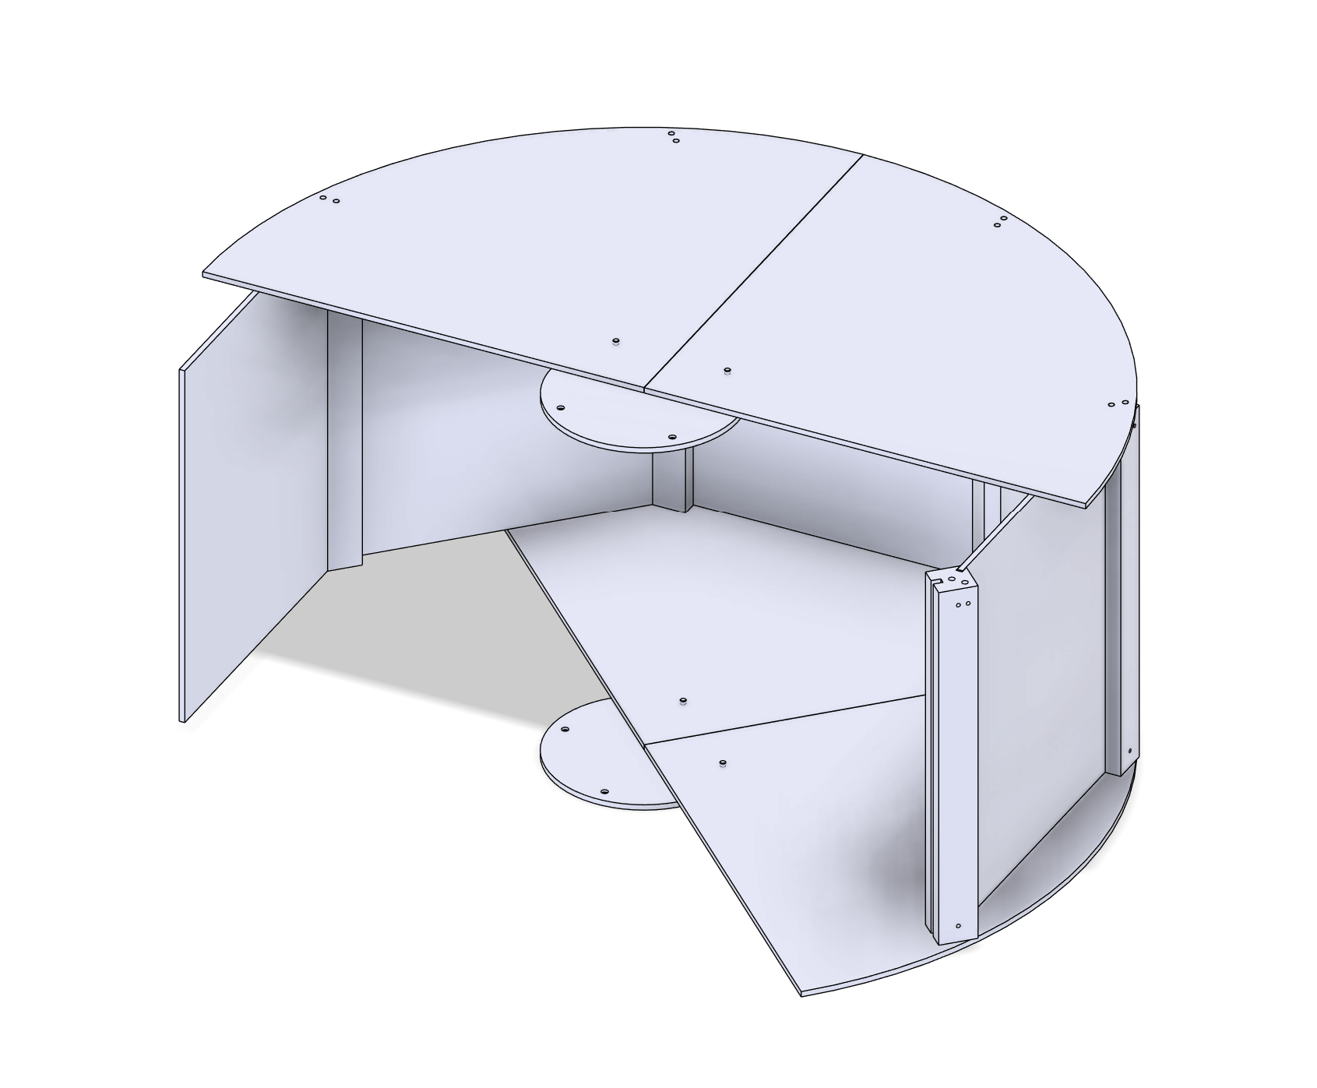
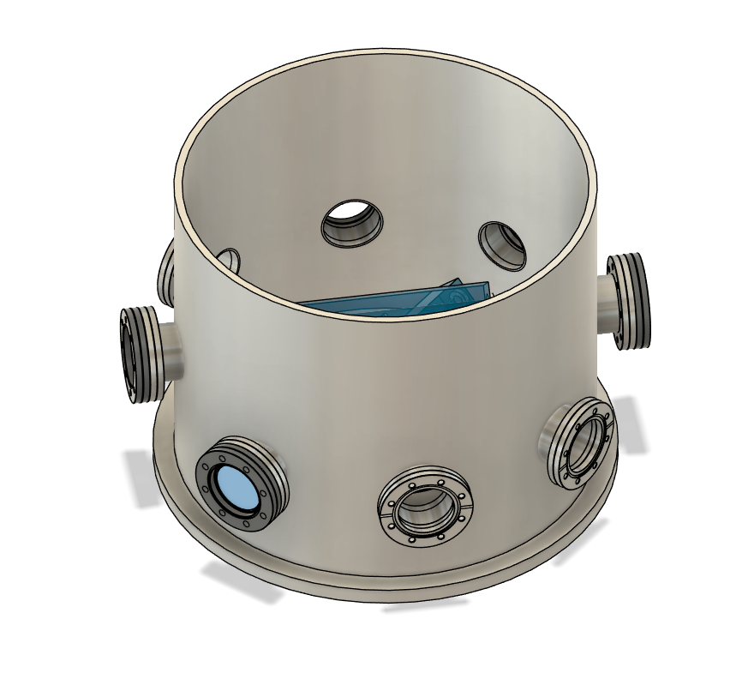
Vacuum and Thermal
Philip designed a shield that can be assembled inside the vacuum tank.
Ceramic spheres as spacers between shields.
Possibility of adding pins for fixing them more in place.
Pfeiffer hasn’t gotten back to me yet (with their quote)
For pumps
Leybold – turbo and scroll pump setup
But would a diaphragm pump be cleaner?

