Slide 1
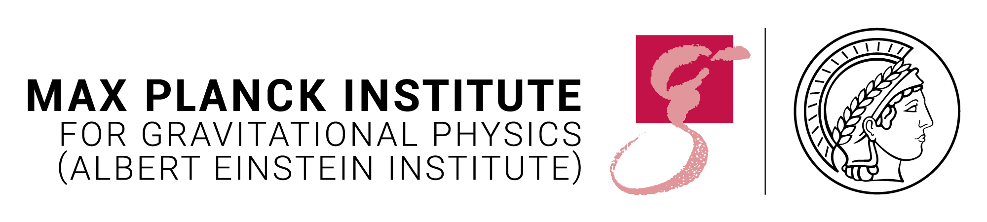

16TH INTERNATIONAL LISA SYMPOSIUM · 23 JUNE 2026
Testbed for Validating Second-Generation TDI and Clock-Noise Correction for LISA
Karin Kruuse, Reid Ferguson, Sourath Ghosh, Patrick Krieger, Daniele Vetrugno, Guido Mueller
Max Planck Institute for Gravitational Physics (AEI) · Leibniz Universität Hannover
01 / 16
Notes:
Status report on the testbed for validating second-generation TDI and clock-noise correction for LISA.

Slide 2
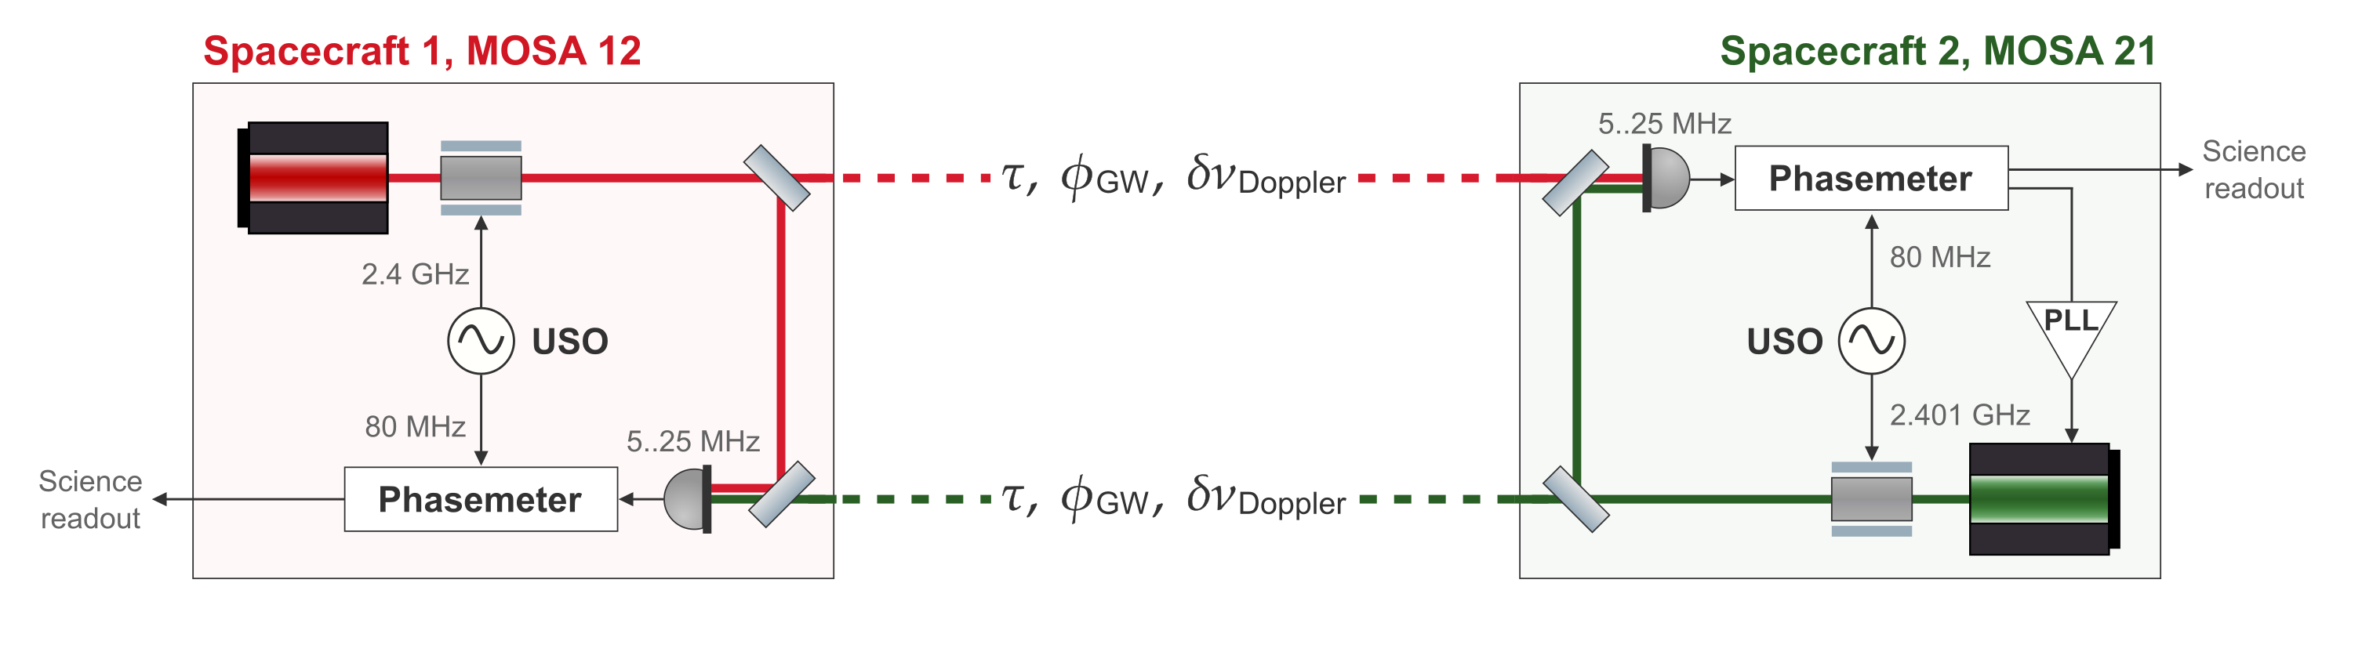

THE LISA MEASUREMENT
LISA Science Interferometer
The two primary noises in the raw data are laser frequency noise and clock timing jitter.
16th International LISA Symposium
23 June 2026 · 02 / 16
Notes:
I'm going to jump right into the technical stuff. So we're looking at the LISA inter-satellite interferometer. The raw phase meter data is dominated by two noise sources: laser frequency noise... and clock noise.
I've written down how these enter the phase readout — the laser noise comes from both lasers forming the link, and the clock noise of the local spacecraft couples in via the beat note frequency. These are the two couplings we need to replicate and then remove.
Now — why do this in hardware? [pause] Because simulations only simulate what you think to simulate. LISA has extremely detailed noise models — but a hardware testbed lets you check that those models actually match reality. That the noise couples in the way you think it does, with the structure you assumed, at the level you predicted. [pause] There is no substitute for seeing it in real data.

Slide 3
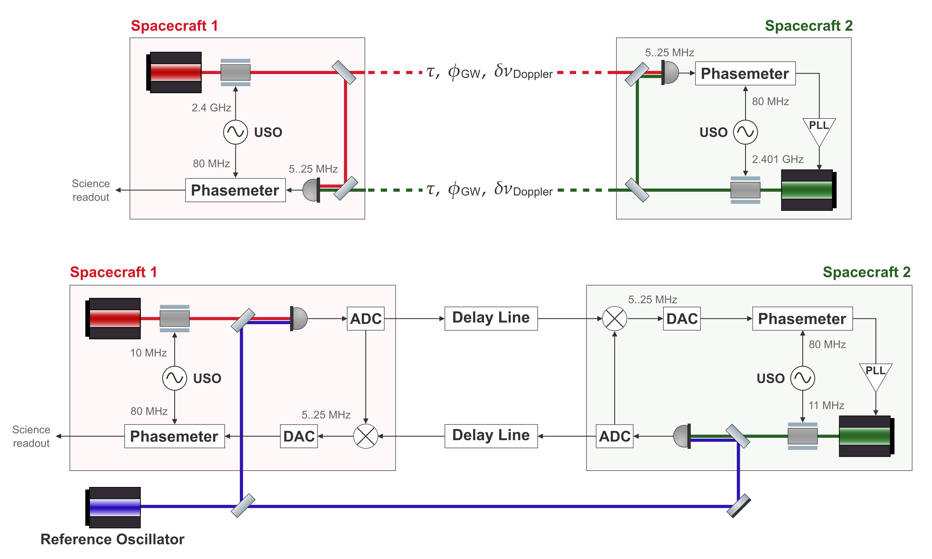
TESTBED CONCEPT
Replicating the LISA Arm in the Lab
LISA arm
In-flight inter-satellite link
Testbed arm
Benchtop analogue
16th International LISA Symposium
23 June 2026 · 03 / 16
Notes:
So here's our plan for how to replicate the LISA readouts in the lab. The top diagram is the actual LISA arm — light travelling between two spacecraft, picked up by a phasemeter. The bottom is our benchtop analogue.
At the centre of the testbed is the electronic delay line — my colleague gave a great talk on that a couple of hours ago, so I won't go into the details here. [pause] What I want to focus on instead is how we go from a purely electronic implementation to one that also includes real optics.

Slide 4
TESTBED CONCEPT
Replicating the LISA Arm in the Lab
LISA arm
In-flight inter-satellite link
Carrier from 281 THz to ~50 MHz
Testbed arm
Benchtop analogue
16th International LISA Symposium
23 June 2026 · 04 / 16
Notes:
So, we start with a laser field — and for an infrared laser that's sitting at about 281 terahertz.
To get it into our electronics [point], we heterodyne it with a reference laser field to produce a beat note in a measurable range.
This is effectively a frequency downconversion — and crucially, it preserves the phase noise around the beat note.
Which is exactly the same thing that happens in LISA — that's why the laser phase noise appears in the phasemeter readout in the first place. But this is not yet a LISA-like beat note, its just in intermediate frequency that can be passed thouogh the delay line electronics.

Slide 5
TESTBED CONCEPT
Replicating the LISA Arm in the Lab
LISA arm
In-flight inter-satellite link
Inter-satellite interferometers
Testbed arm
Benchtop analogue
16th International LISA Symposium
23 June 2026 · 05 / 16
Notes:
The LISA-like beat note is then synthesised in the electronics by a mixer. So these mixers here [point] are where a LISA-like photodetector reading is produced — this is the point in the signal chain that corresponds to the photodetector on the far spacecraft in LISA. This signal is then passed to the phasemeter, which behaves more or less like LISA.

Slide 6
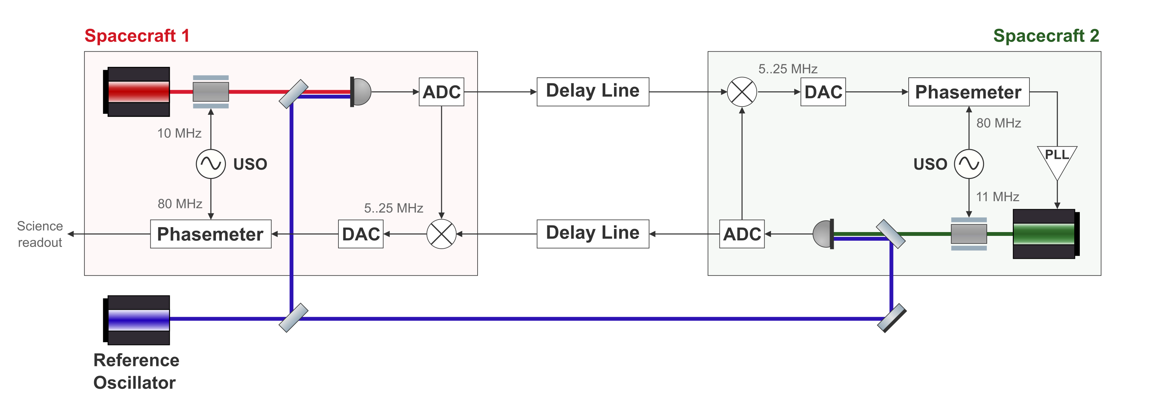

TESTBED CONCEPT
Matching the Interferometric Signal Model
LISA arm
In-flight link
Testbed arm
Benchtop analogue
16th International LISA Symposium
23 June 2026 · 06 / 16
Notes:
So following the LISA model, this is how we write down the noise couplings in our testbed measurement.
The clock noise couples in exactly like in LISA. For the laser noise — the differential between the reference oscillator phase and the spacecraft laser phase is essentially a proxy for the spacecraft laser noise terms.
So each photodetector reading carries a LISA-like laser noise contribution from one laser. [pause] From the perspective of TDI, these should all cancel perfectly — just as they would in LISA.

Slide 7
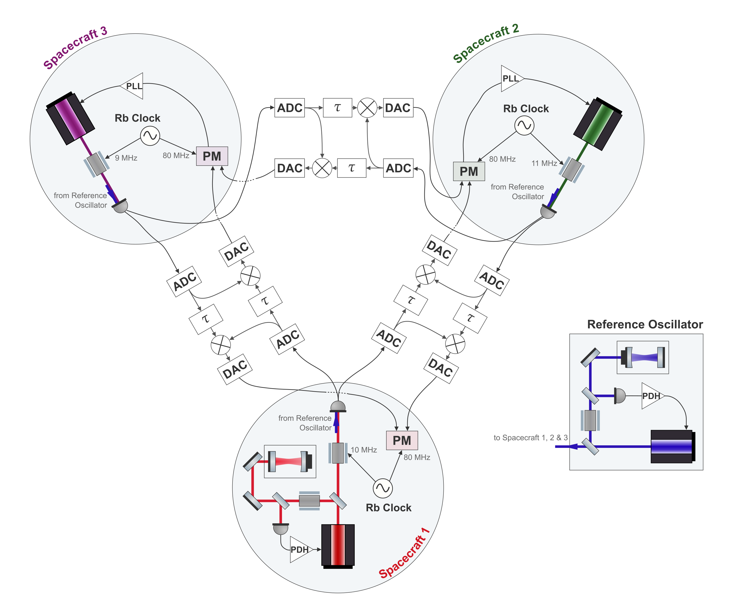
TESTBED CONCEPT
Full Testbed
One laser per spacecraft
An independent source on each satellite
Cavity-locked primary laser
Provides LISA-like laser frequency noise
Independent clocks
Allows to demonstrate clock noise removal
Six separate delay lines
Two per inter-spacecraft link
16th International LISA Symposium
23 June 2026 · 07 / 16
Notes:
So this is the full plan — take three such arms and build up a LISA-like constellation of three spacecraft. [pause]
Each spacecraft is represented by one laser, and the primary laser on Spacecraft 1 is locked to an optical cavity, which gives us realistic LISA-like laser frequency noise. The other two spacecraft have their lasers phase-locked to the incoming beam, just as in LISA.
We also have the fourth laser as the reference we use to heterodyne the other laser fields with. This laser will also be cavity locked.
Each spacecraft also has its own independent clock — this is what allows us to actually demonstrate clock noise removal, because the clocks are genuinely not synchronised.
And then connecting everything together we have six separate delay lines — two per inter-spacecraft link, one for each direction.

Slide 8
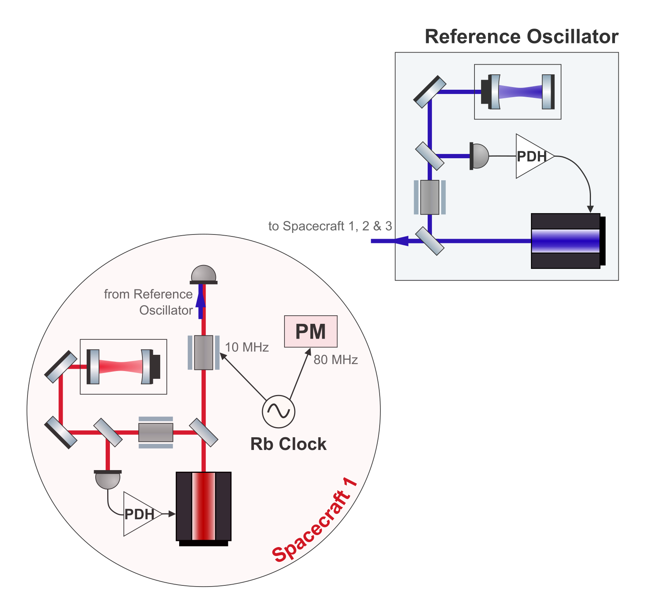
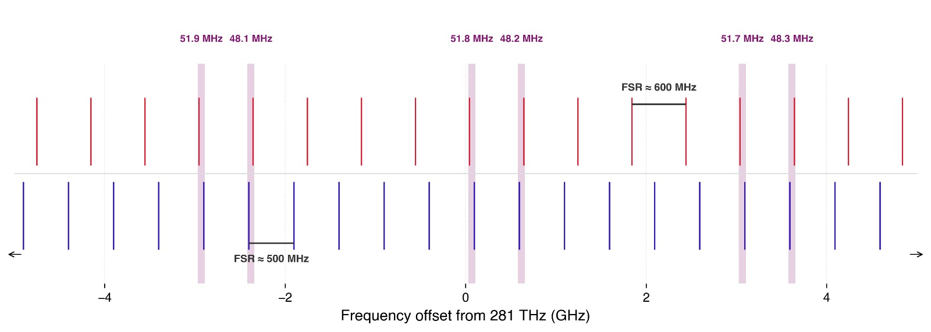
HARDWARE
Cavity Locking Two Lasers
For LISA-like laser noise, the primary laser should be cavity-locked.
Two lasers locked to separate cavities — 25 cm and 30 cm
Two separate Pound–Drever–Hall (PDH) locks
Beat note needs to be below 60 MHz
Illustrative cavity resonances
16th International LISA Symposium
23 June 2026 · 08 / 16
Notes:
I want to talk a bit about the cavity locking. We will have two lasers locked to separate cavities, and the interesting thing is that they need to produce a beat note below 60 MHz — that's the limit of our electronics. [pause]
The question is: can we always find a pair of resonances, one from each cavity, that happen to fall within 60 MHz of each other?
To do this, we use two custom ULE cavities with slightly different lengths of 25 and 30 centimetres, giving free spectral ranges of around 500 and 600 MHz.
[point at plot] Here I've plotted an illustrative example of the resonances of both cavities across a section of the laser tuning range. Now, if the ratio of the cavity lengths were exactly a rational number, the resonance pairs would always land at the same fixed set of beat note values. But in practice, small manufacturing imperfections mean the ratio is never exactly rational, and this causes the resonance pairs to slowly shift relative to each other as you scan across frequency. [pause] So you end up cycling through a wide range of beat note values, and we expect to always be able to find a pair within 60 MHz somewhere in the tuning range.

Slide 9
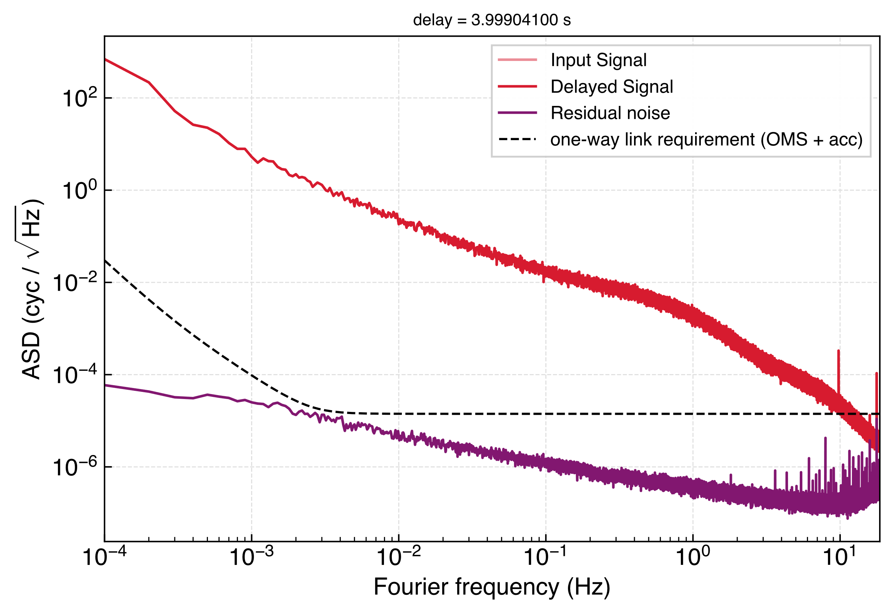
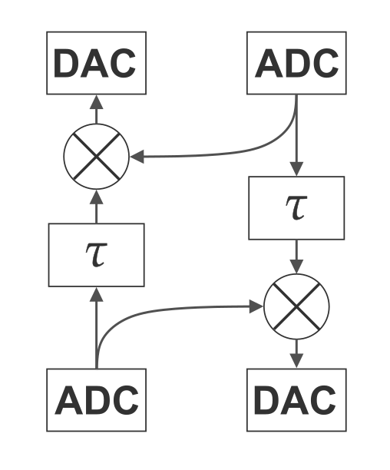
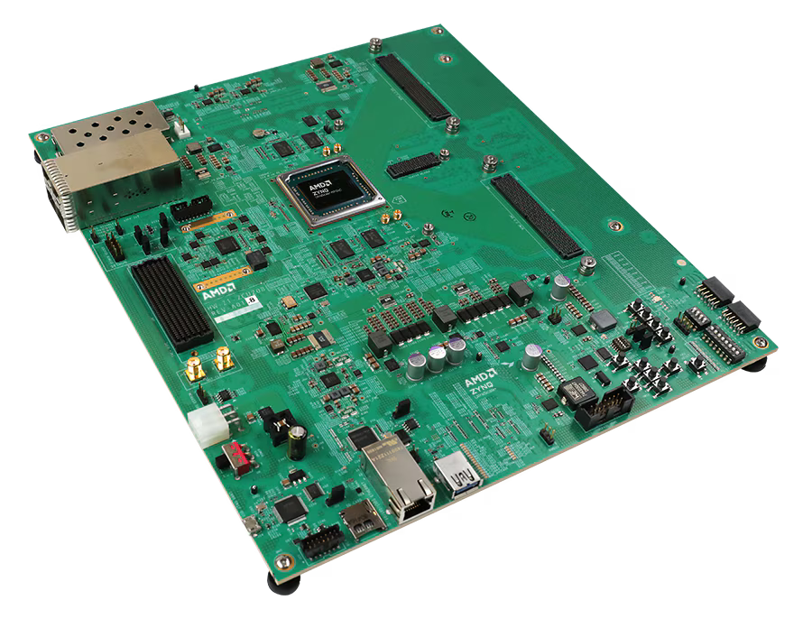
HARDWARE
Delay Line
Time-varying delays
Doppler shifts for both carrier and sidebands
Gravitational-wave injection
AMD Zynq™ UltraScale+™ RFSoC ZCU208 Evaluation Kit
Intrinsic noise floor of one board (purple)
16th International LISA Symposium
23 June 2026 · 09 / 16
Notes:
So for the delay lines, we use these FPGA evaluation boards. Each board includes the FPGA chip itself, the ADCs and DACs, and also a regular processing unit — essentially a tiny computer. One of these boards can handle two delay lines. Before running a measurement, the processing unit calculates the time-varying delays and Doppler shifts based on real LISA orbits, and also the gravitational wave strain signals to be injected— which is a feature I haven't mentioned so far. Then during a measurement, the FPGA handles the signal processing — controlling the delay, injecting the GW signal, and the mixing. [pause]
On the right we have a measurement of the intrinsic noise floor of one delay line. To measure this, we delayed a signal in hardware, bypassing the mixing step, and then applied the same delay in post-processing to the original signal. The difference between the two gives us the hardware noise. We also dis a pilot tone correction step here — so in a perfect case this purple line would be zero — and it sits nicely below the one-way link noise requirement across the band. So the delay line technically allows for LISA-like performance.

Slide 10
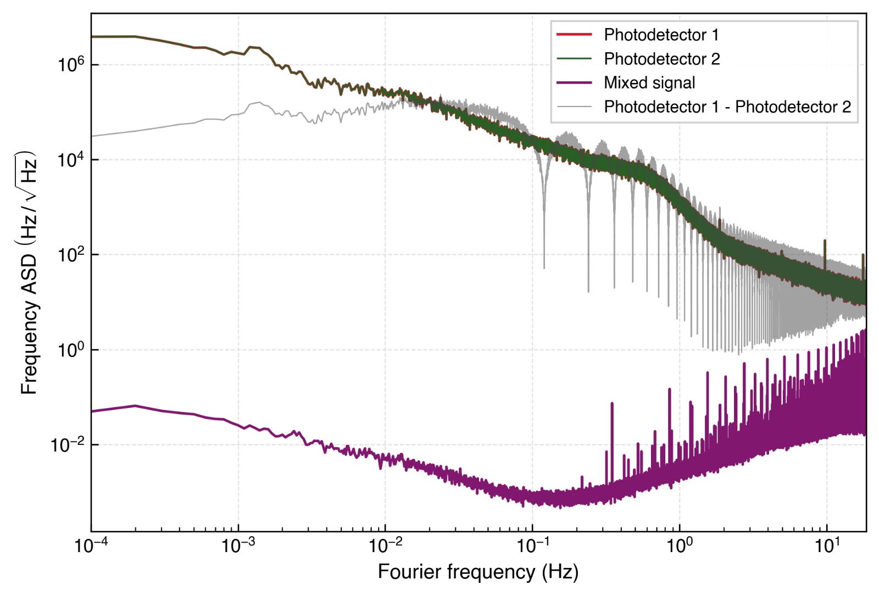
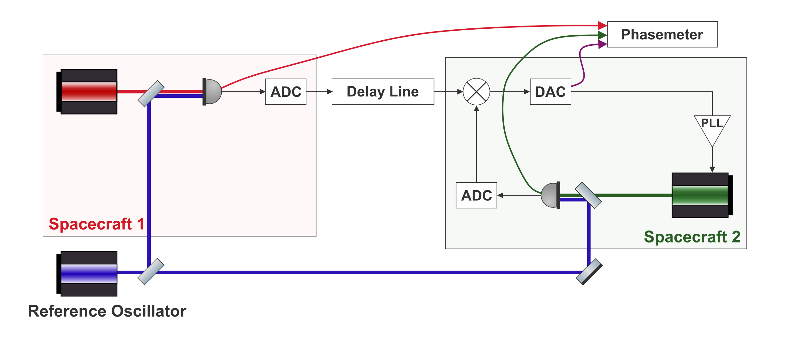


LASER NOISE RESULTS
PLL Lock of Far Spacecraft
Photodetector readings are dominated by free-running laser frequency noise.
The mixed output is orders of magnitude lower.
Free-running photodetector noise vs. mixed output
16th International LISA Symposium
23 June 2026 · 10 / 16
Notes:
We have started integrating the optics with the delay line. One demonstration we did is locking a laser to an incoming laser field as received through the delay line — which is exactly what LISA does via the phase-locked loop on the far spacecraft.
The red and green lines are the raw photodetector readings from the two spacecraft — so essentially the laser phase noise. The grey line is their calculated difference, and you can see the characteristic dips at frequencies corresponding to the inverse of the delay.
The purple line is the mixed signal. And you see that this drops by many orders of magnitude. This tells us that the PLL is working, the laser is successfully following the delay line signal, and the signal chain from the optics through the delay line and back out is functioning as intended.

Slide 11
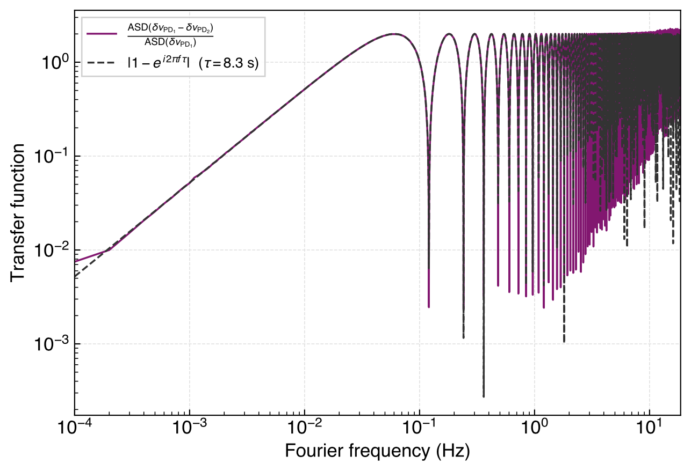

LASER NOISE RESULTS
Recovering the Transfer Function
We can recover a LISA-like one-way laser-noise transfer function.
Recovered one-way laser-noise transfer function
16th International LISA Symposium
23 June 2026 · 11 / 16
Notes:
This is another way to illustrate the same result — we can recover the modelled one-way laser noise transfer function directly from our measurements. We plot the ratio derived from our photodetector data against the analytical model, and the agreement is excellent. At higher frequencies we see some excess noise, which seems to originate from the mixing on the delay line board.

Slide 12

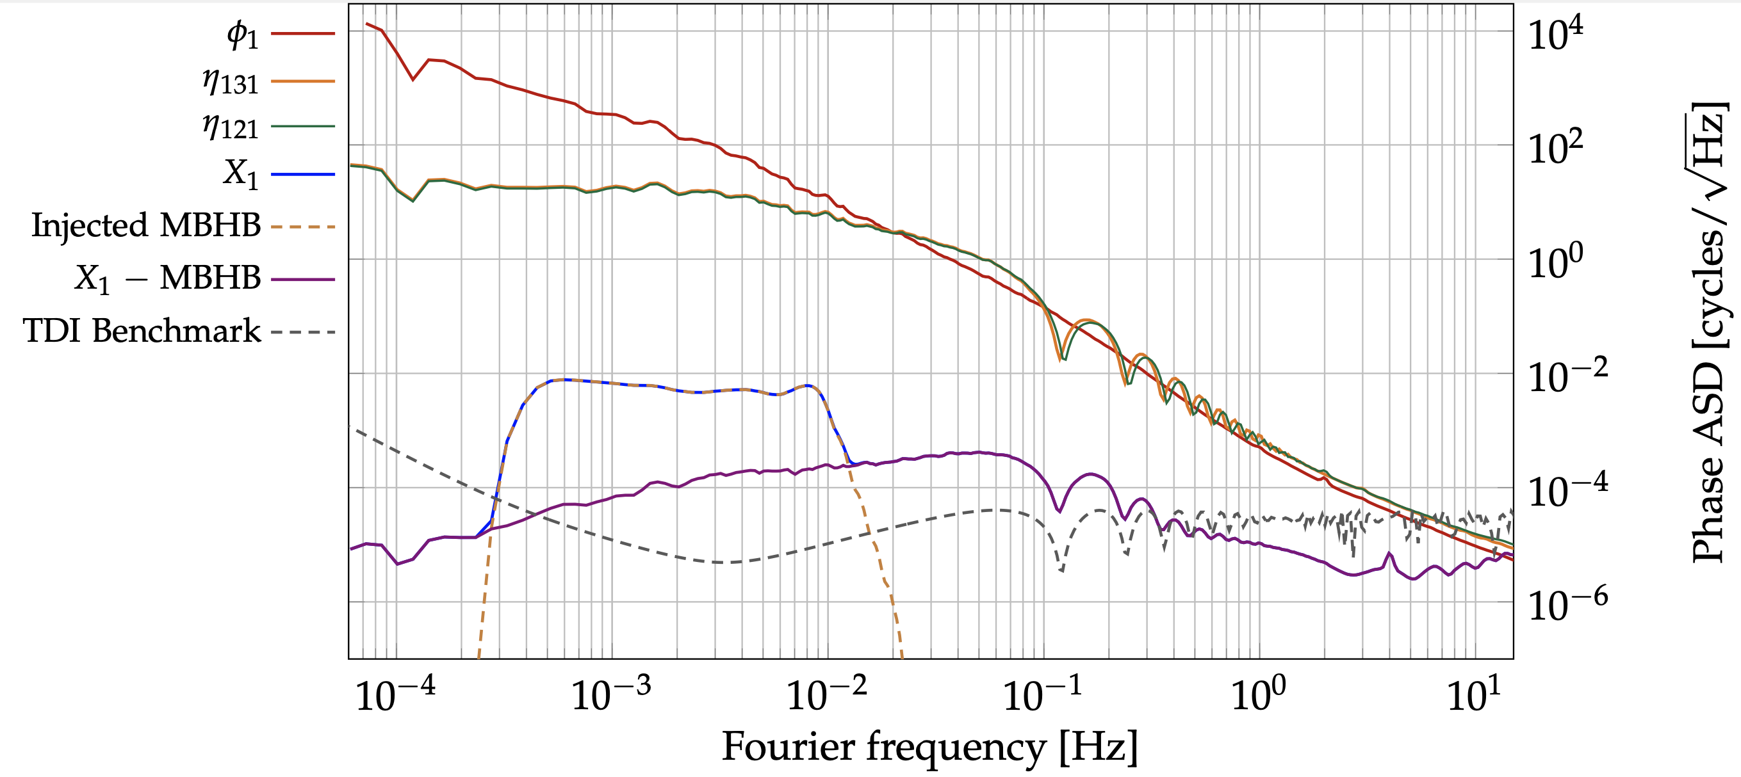
LASER NOISE RESULTS
Tests of TDI so Far
Fully electronic testbed can already demonstrate noise suppression with TDI
Static TDI has been demonstrated — the next step is to add the clock noise correction.
Credit: R. Ferguson et al. (2026)
16th International LISA Symposium
23 June 2026 · 12 / 16
Notes:
So this is where we currently stand with TDI — my colleague has demonstrated static two-arm perfect transponder Michelson X TDI using the purely electronic testbed, so no optics were used for this measurement. But effectively the MHz inputs can now be switched out for ones generated by the lasers. A gravitational wave signal was injected and successfully recovered, and the residual noise floor is shown by the light blue and purple lines. [pause]
Laser noise suppression with TDI is working. The next step is to add the independent clocks and demonstrate clock noise removal on top of that

Slide 13
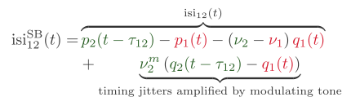
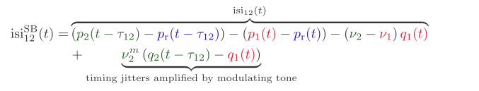
CLOCK-TONE TRANSFER
Sidebands in the Lab
LISA arm
In-flight link
Testbed arm
Benchtop analogue
16th International LISA Symposium
23 June 2026 · 13 / 16
Notes:
Now I'll get into our plans for the clock noise correction. The way LISA removes clock noise is by modulating each spacecrafts timing jitters onto the laser as a sideband, transmitting it to the far spacecraft, and measuring the differential there. [pause]
If you look at the sideband phase readout here — in addition to the usual laser noise and clock noise terms, which is in common mode with the carrier, there is now an extra term where the differential clock noise between the two spacecraft is amplified by the modulating frequency.
As a first approach, we can simply add modulators to the testbed laser fields and get the same coupling in the readout. In principle this already lets us play with clock noise removal. The catch is that, in such a configuration, we are limited to MHz modulation — if we tried to use a GHz sideband here, it would fall outside the ADC measurement range.

Slide 14
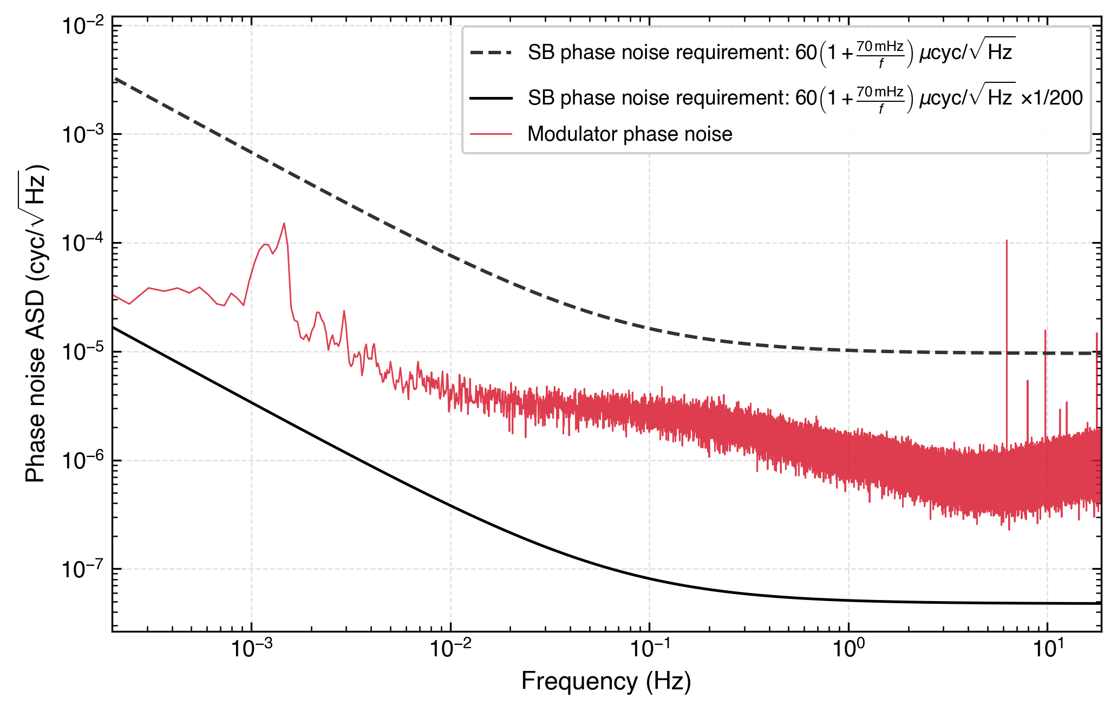
CLOCK-TONE TRANSFER
Clock Tone Transfer Limitation
Modulator noise remains too loud if MHz modulation is used.
The RF sideband phase-noise requirement should be adjusted for the modulating frequency used.
This limitation needs a solution before the clock noise removal can be done with LISA-like performance.
Modulator phase noise against the requirement
16th International LISA Symposium
23 June 2026 · 14 / 16
Notes:
So here is the problem with MHz modulation. The LISA sideband phase noise requirement is set assuming a GHz modulating tone. If we scale that requirement down to match our MHz modulation frequency — which in our case means tightening it by a factor of about 200 — we get the solid black line shown here. And our measured modulator phase noise, the red line, sits well above it. [pause]
So while the MHz approach gets the right terms in the readout, it doesn't get us to LISA-like performance. The modulator itself is simply too noisy at this scaled requirement as well. This means we most likely need to move to a GHz modulation scheme as well.

Slide 15
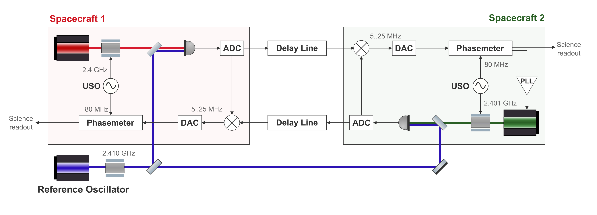
CLOCK-TONE TRANSFER
GHz Modulation
POTENTIAL SOLUTIONS UNDER INVESTIGATION
Driving the PM from the sidebands
Derive the clock phase directly from the RF sidebands.
Reference measurement
A dedicated channel to track the modulation tone.
ADC mixing
Down-mix the GHz tone inside the ADC.
Aliasing
Controlled aliasing of a MHz signal.
GHz modulation measurement scheme
16th International LISA Symposium
23 June 2026 · 15 / 16
Notes:
So we have a list of ideas that we need to properly investigate. The first two on the list assume modulating the reference laser at GHz frequencies giving a MHz sideband-sideband beatnote on the photodetector. But the thing is — since the driving signal will also carry timing jitter, that jitter gets amplified by the high modulation frequency just like the clock noise does. So you need a way to compare it against the spacecraft USOs to remove it in post-processing. One option is to simply measure it with a dedicated reference channel. Or — and this is an interesting idea — you use that same signal to drive the phasemeters directly, so it becomes part of the measurement rather than a noise source you need to subtract. [pause]
We are also looking at extending the ADC range itself through firmware changes, which would allow us to measure higher frequency sidebands. However this would still require mixing to downconvert the signal, so we face a similar noise problem as before.
And finally, we are looking at the possibility of using aliased sideband measurements as a way to access higher modulation frequencies within the existing ADC range.

Slide 16
SUMMARY
Conclusions & Next Steps
DEMONSTRATED
IN PROGRESS
✓
Delay line — working, below requirement
Assembling the optical layout and cavities
✓
PLL lock demonstrated with free-running lasers
GHz sideband chain — under investigation
✓
Gravitational wave recovery with TDI
Delay-board clock-noise removal
Full TDI and clock-noise removal
Thank you for listening!
16 / 16
Notes:
So to summarise. We have a working delay line that sits below the LISA requirement, we have demonstrated PLL lock with the optics integrated, and we have demonstrated gravitational wave recovery using TDI [pause]
Looking ahead, we are currently assembling the full optical layout with the cavity locked lasers. On the clock noise side, we have some performance limitations to work out. Once that is resolved, the path forward is clock noise removal on the delay boards, and ultimately a full end-to-end demonstration of second-generation TDI and clock noise correction in hardware. [pause]
Thank you for listening

