Slide 1
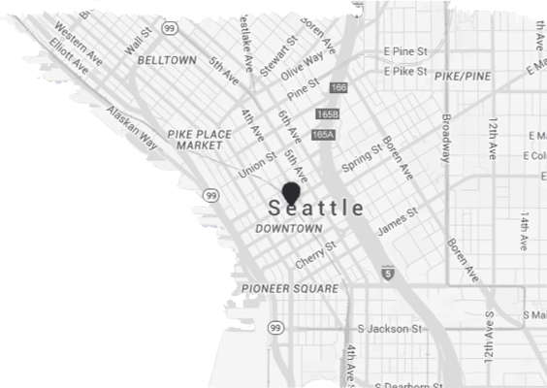
Exploratory Data Analysis
Seattle / King County Housing dataset
Karin Riklin
Neuefische Data science and AI bootcamp, May 2026

Slide 2

Meet Erin Robinsson
Philanthropist
Invest in poor neighborhoods,
buying & selling,
costs back + little profit,
socially responsible
2

Slide 3
Property requirements
Looking for cheaper properties in good condition to avoid additional renovation investment
Underpriceds Properties at a good condition
Focusing on locations with growth potential
Projected Revenue upon Sale (Year 10)
Targeting lower-to-middle-income areas for stable rental income and social impact
Low-income population
3

Slide 4
Average Price Gain by Neighborhood (2015-2025)
High-need areas saw the largest % gains — driven by low 2015 base prices, not rising wealth.
Poverty
Low income
Mid class
High class
Wealthy
4

Slide 5
1st Hypothesis
More than 50% of the houses in low-income zones have lower sale price per square meter, than the medians price of the whole dataset.
Low-income population
Projected Revenue upon Sale (Year 10)
Underpriceds Properties at a good condition
5

Slide 6
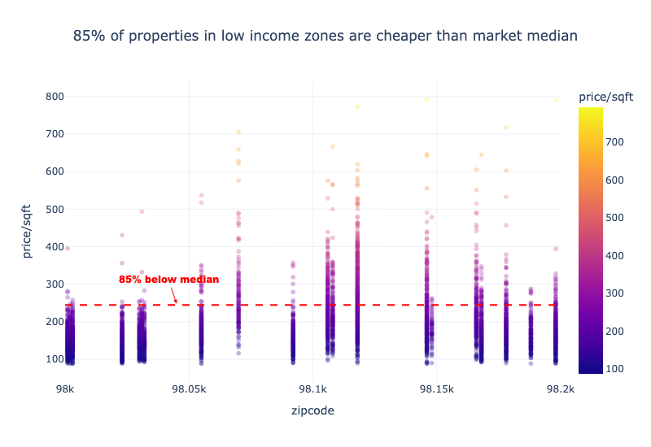
1st Hypothesis
More than 50% of the houses in low-income zones have lower sale price per square meter, than the medians price of the whole dataset.
6

Slide 7
2nd Hypothesis
More than 60% of waterfront houses in low-income zone have lower grade rating, than the dataset average.
Low-income population
Projected Revenue upon Sale (Year 10)
Underpriceds Properties at a good condition
7

Slide 8
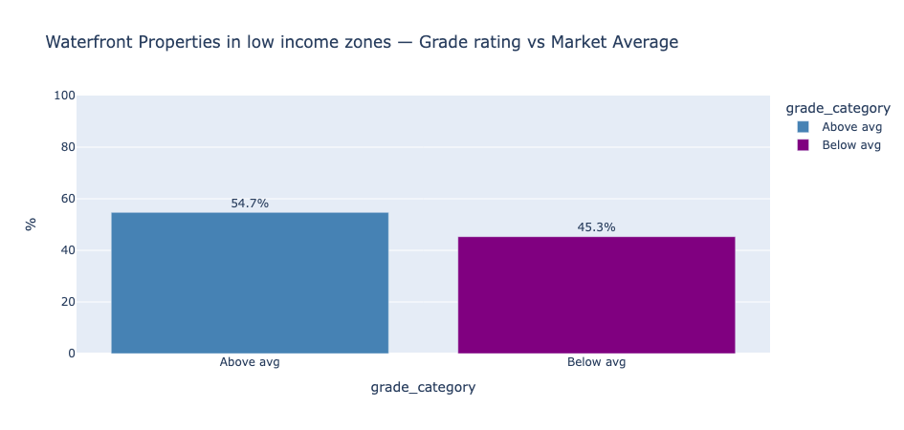
2nd Hypotheses
More than 60% of waterfront houses in low-income zone have lower have lower grade rating, than the dataset average.
8

Slide 9
3rd Hypothesis
Lower income zones yield the highest concentration of properties with condition rating 4+ and price (per square meter), lower than dataset median.
Low-income population
Underpriceds Properties at a good condition
9

Slide 10
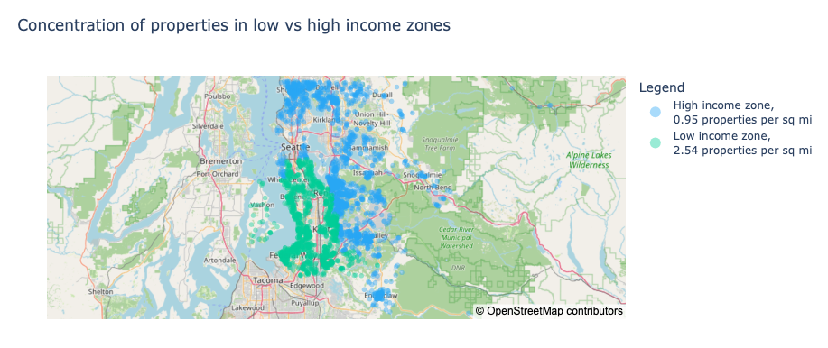
3rd Hypotheses
Lower income zones yield the highest concentration of properties with condition rating 4+ and price (per square meter), lower than dataset median.
10

Slide 11
Thank you
Questions?

Slide 12
Sources:
1. Seattle open data base:
https://data-seattlecitygis.opendata.arcgis.com/datasets/SeattleCityGIS::poverty-and-employment-status-seattle-neighborhoods/explore?filters=eyJGQU1JTElFU19QT1ZFUlRZX0RFVEVSTUlORUQiOlsyMTAsOTcxMDRdLCJGQU1JTElFU19CRUxPV19QT1ZFUlRZIjpbMCwzMDE1XX0%3D
2. Housing prices 1996- present
https://files.zillowstatic.com/research/public_csvs/zhvi/Zip_zhvi_uc_sfrcondo_tier_0.33_0.67_sm_sa_month.csv

