Slide 1
CMPS 470/570 FINAL PROJECT bonus models
TEAM: Kari!

Slide 2
DESCRIPTION OF THE PROJECT
Big Idea: How likely is it that a Kickstarter project will succeed?
Goal: Build a model to predict whether a project will succeed.
Bonus: KNN and SVM for classification
Kickstarter is a crowdfunding platform that allows people to pledge money to projects to help fund them.

Slide 3
DESCRIPTION OF DATA
Data source: https://www.kaggle.com/kemical/kickstarter-projects/data
Attributes:
main category | backers | usd goal
int (1-15) (art, comics, crafts, dance, design, fashion, film & video, food, fames, journalism, music, photography, publishing, technology, theater) | Int | int

Slide 4
DESCRIPTION OF DATA
Number of samples:
For kfold and threefold: 5,000
For leave one out: 1,000
Preprocessing
Used just main_category, backers and usd_goal features
Changed main_category from string values to an int (e.g. “Art” = 1, Comics = 2, etc.)

Slide 5
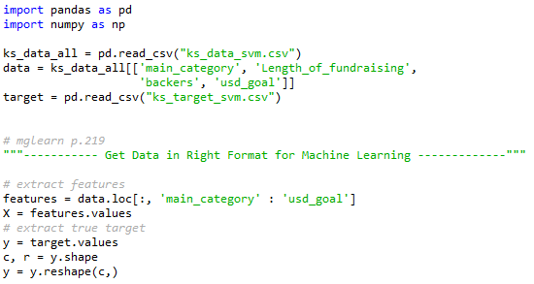
Importing Data

Slide 6
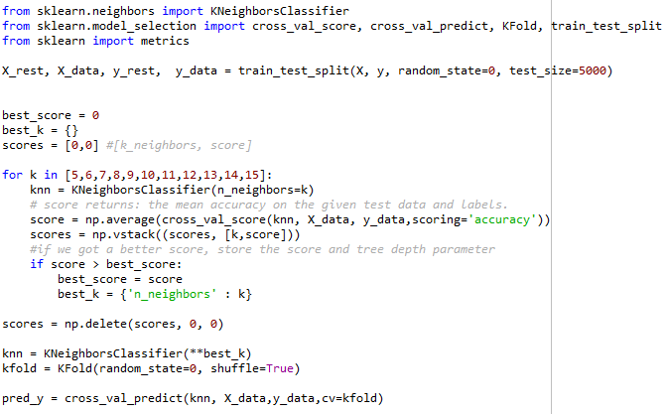
Parameter Tuning - KFOLD

Slide 7
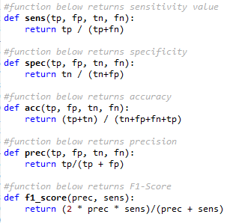
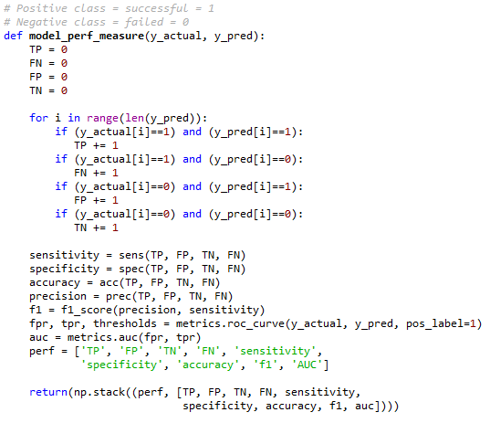
Calculating performance

Slide 8
MODEL PERFORMANCE
 | knn_kfold | svm_kfold | knn_threefold | svm_threefold | knn_loo | svm_loo
Sensitivity
Specificity
Accuracy
F1 Score
AUC
Best Depth

Slide 9
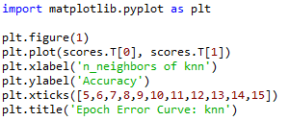
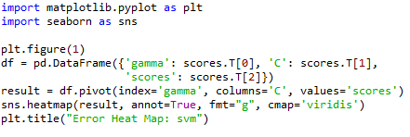
Epoch-error curve
Notes:
dt_kfold

Slide 10
Epoch Error curve graphs: dt_kfold, dt_threefold, rfdt_kfold & rfdt_threefold

Slide 11
Epoch Error curve graphs: dt_loo & rfdt_loo

Slide 12
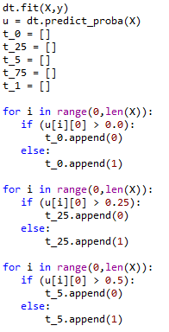
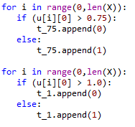
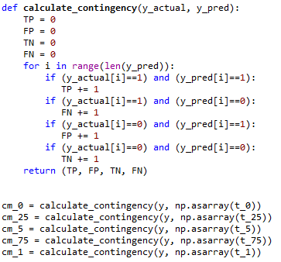
Threshold mechanism

Slide 13
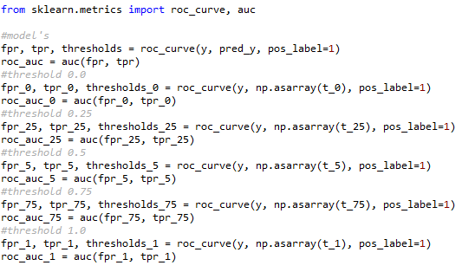
Getting fpr, tpr, auc

Slide 14
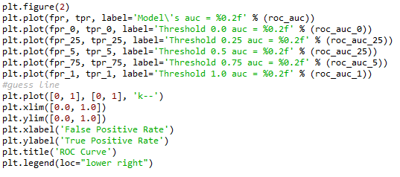
Plotting roc_auc curve

Slide 15
ROC_auc curves: kfold & threefold

Slide 16
Roc_auc curves: loo

Slide 17
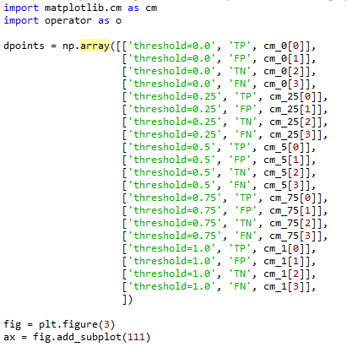
Plotting Bar chart of contingency values
Notes:
http://emptypipes.org/2013/11/09/matplotlib-multicategory-barchart/

Slide 18
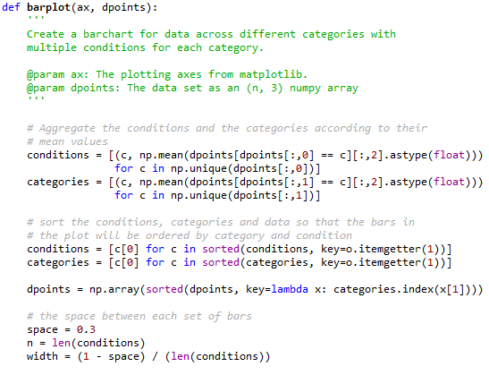
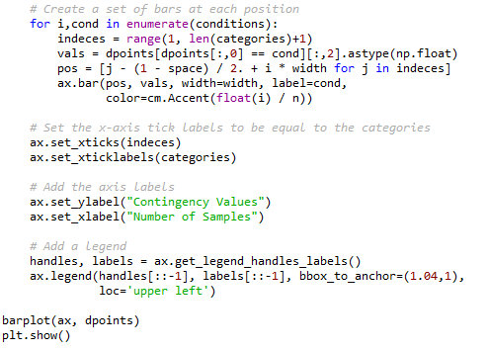
Bar graph, cont.

Slide 19
Bar charts threshold changes: kfold &threefold

Slide 20
Bar charts threshold changes: loo

Slide 21
contingency values
 | knn_kfold | svm_kfold | knn_threefold | svm_threefold | knn_loo | svm_loo
TP
FP
TN
FN
TOTAL

