Slide 1

GRACE
conclude
analysis
team
work
features
concern
Join hands for humanity

Slide 2

analysis
WASTE MANAGEMENT
concern
conclude
work
team
features
Excess cooked food.
Clothes
E-waste.

Slide 3



Hostel
Social Events
Society
Per day: 60-100kg
Annually:300to
400 tonnes.
Per day: 30-50 kg
Annually:100 to
180 tonnes.
Per day:15-30 kg
Annually:50 to 100
Tonnes.
conclude
team
work
features
concern
2014
2016
2018
41.8 million metric tonnes.
44.7 million metric tonnes
49.8 million metric tonnes.

Slide 4






Excess Cooked Food
Pick Up
There are tremendous amount of food wasted all around.
We reach out at your place and at your time
E-Waste
Feed Hungry People
analysis
conclude
team
work
Don’t know how to deal with it. We are here for you!
The NGO inturn deliver it to the poor people
feature
concern
Old Clothes
Mutual Benifits
You don’t need it. We know people who shiver in cold.
Rewards for the donar and food for the acceptors

Slide 5
HOSTELS
RESTURANTS
EVENTS
NEEDY
PEOPLE
EXCESS FOOD
NGOs
GRACE
conclude
work
analysis
team
features
concern
DONATER
ACCEPTOR

Slide 6
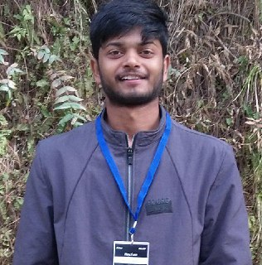
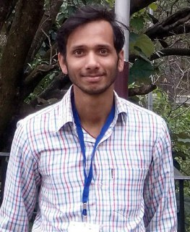
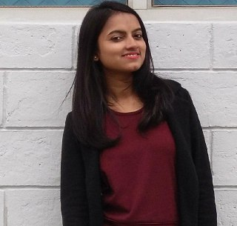
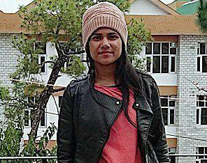
01
02
03
04
conclude
team
analysis
work
features
concern
Anmol Gupta
Shubham Srivastava
Shipli Singh
Karishma Kesari
Full Stack Developer
Frontend Developer
Content Manager
Backend Developer
Frontend Developer
Content Manager

Slide 7
TECH STACK
HTML5
Node JS
Bootstrap4
MongoDB
CSS3
conclude
analysis
team
work
features
concern
Java Script
React JS
Zulip (Chat API )

