Slide 1
mySql finance analytics

Slide 2
Problem statement
➢ AtliQ Hardwares, a leading hardware company specializing in PCs, printers, mice, and computers with a global reach.
➢ The expanding size of Excel files has led to performance problems, resulting in unresponsiveness and inefficiency. AtliQ Hardware has launched a project to tackle this issue by assembling a team of data analysts. They will utilize MySQL as their database management system to extract meaningful insights from the data. These insights will empower the company to enhance decision-making and optimize operations, ultimately boosting overall performance

Slide 3
Project overview
➢ This project is designed to analyze and extract valuable insights from the provided database. The database contains information about sales, products, customers, and regions for Atliq Hardware. I aim to address specific questions related to sales reports, market analysis, customer behavior, and supply chain forecasting.

Slide 4
Business Model
Customer Platforms
customers
Croma
Brick and Mortar
E-Commerce
Best Buy
Croma
BestBuy
Amazon
Flipkart
Staples
Flipkart

Slide 5
Customers channels:-
Retailer
Direct
Distibutor
Croma
Amazon
AtliQ
e-store
AtliQ
exclusive
NEPTUNE

Slide 6
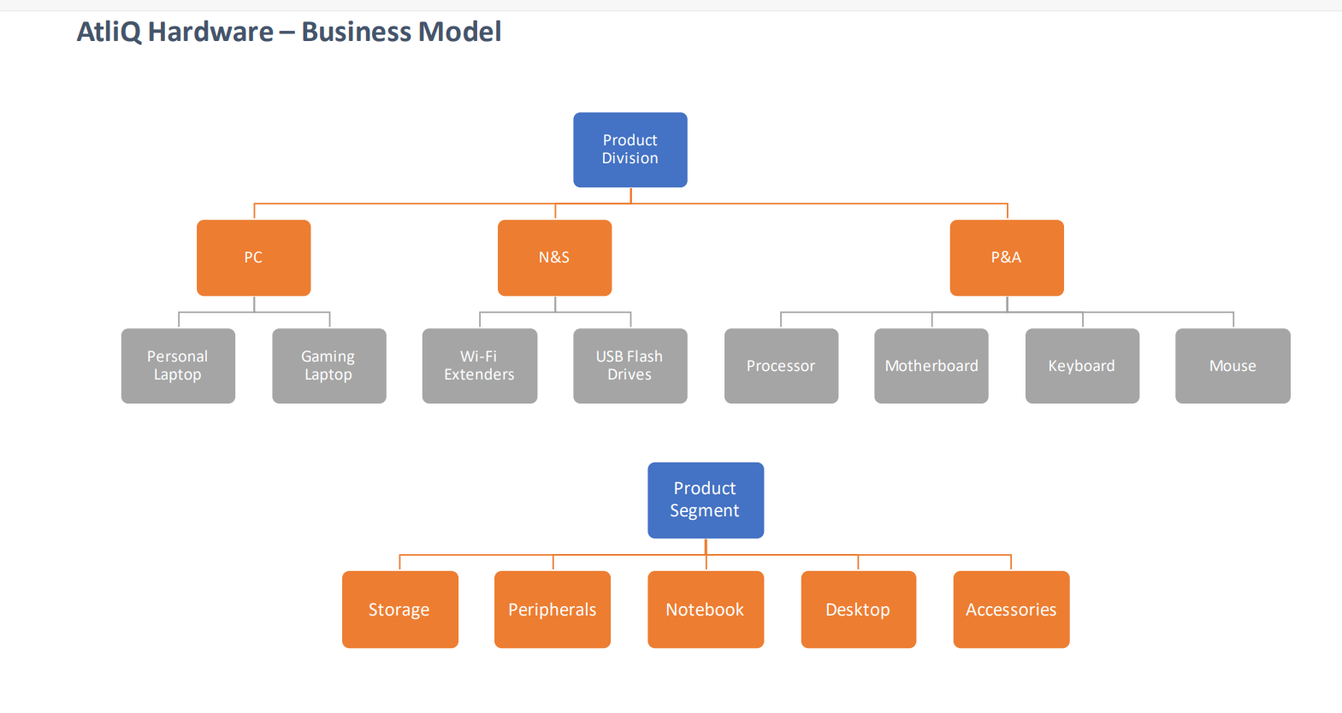

Slide 7
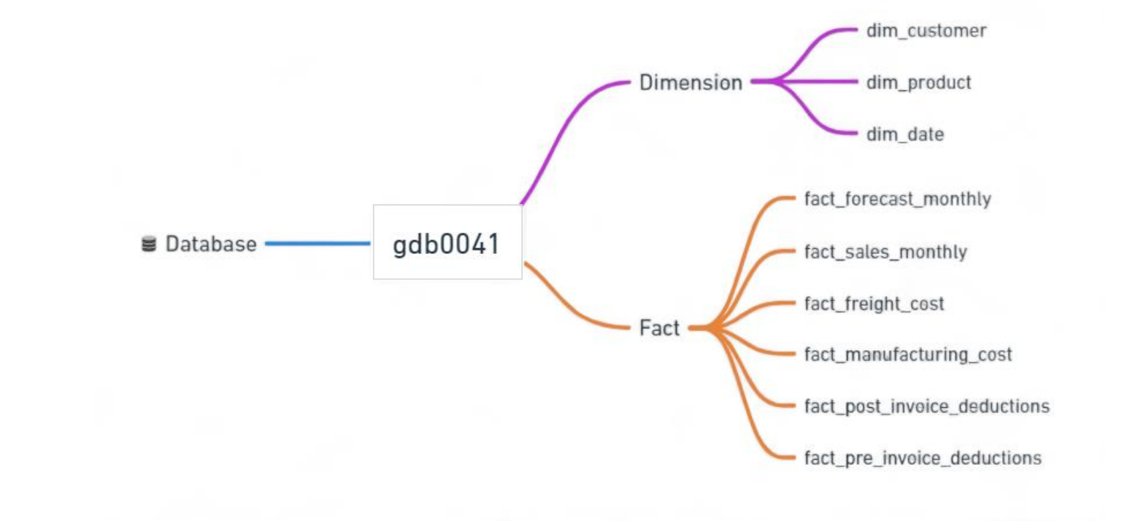
Data set:-

Slide 8
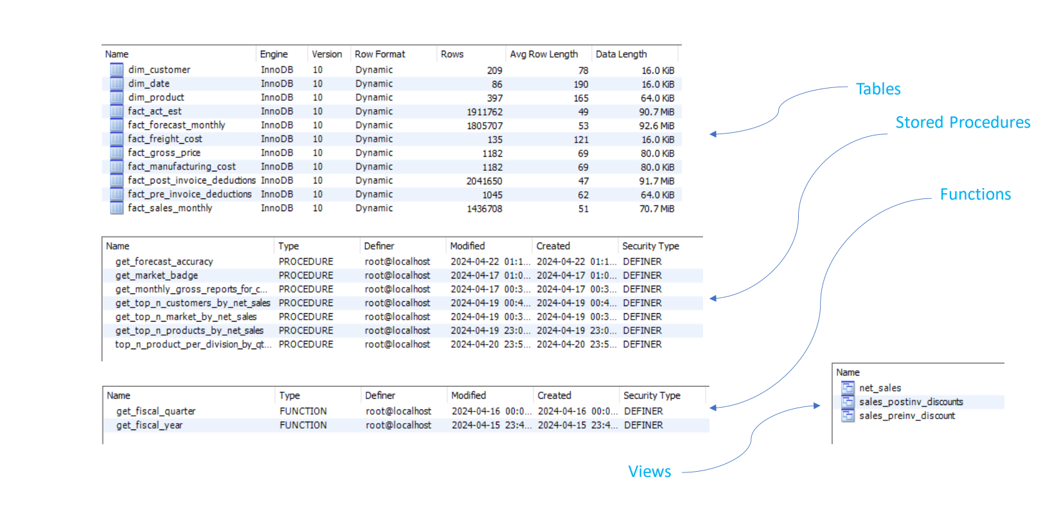
DATABASE OVERVIEW:-

Slide 9
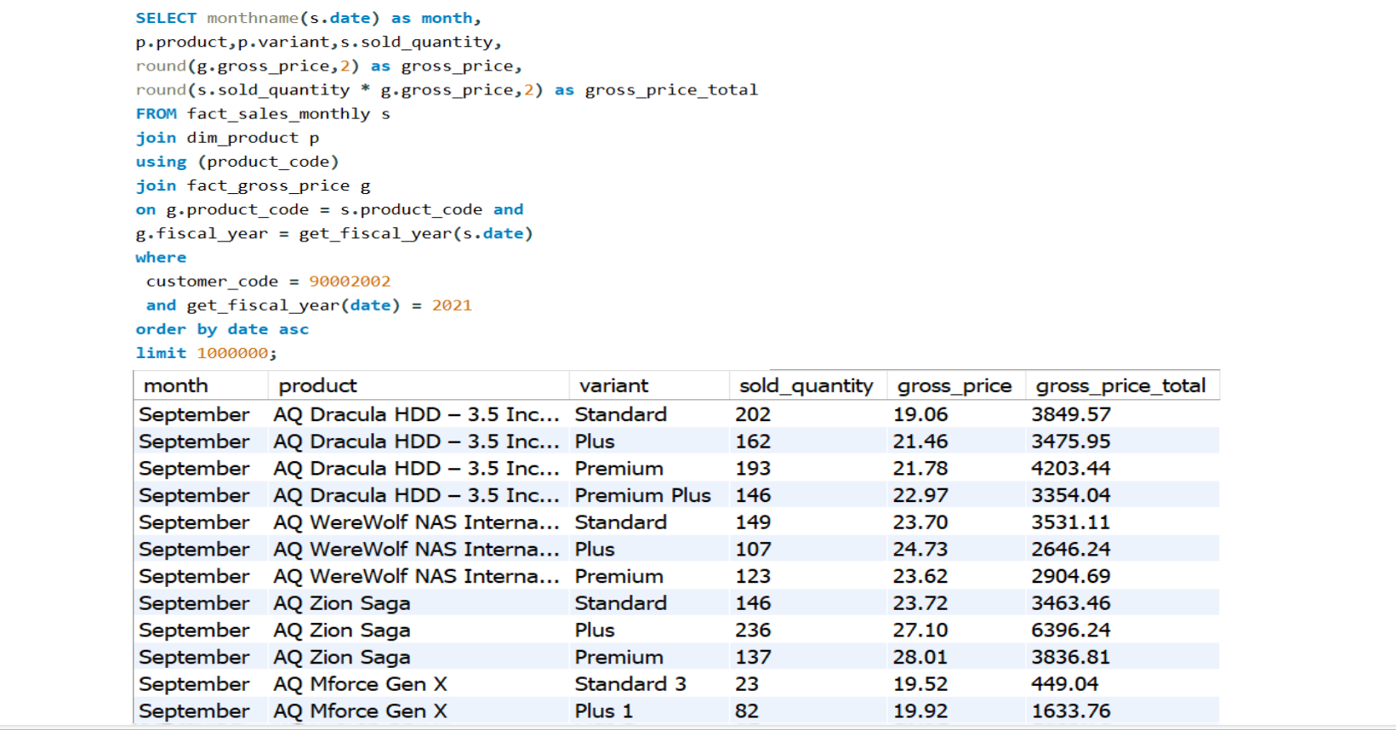
Croma India Product wise sales report for fiscal year-2021

Slide 10
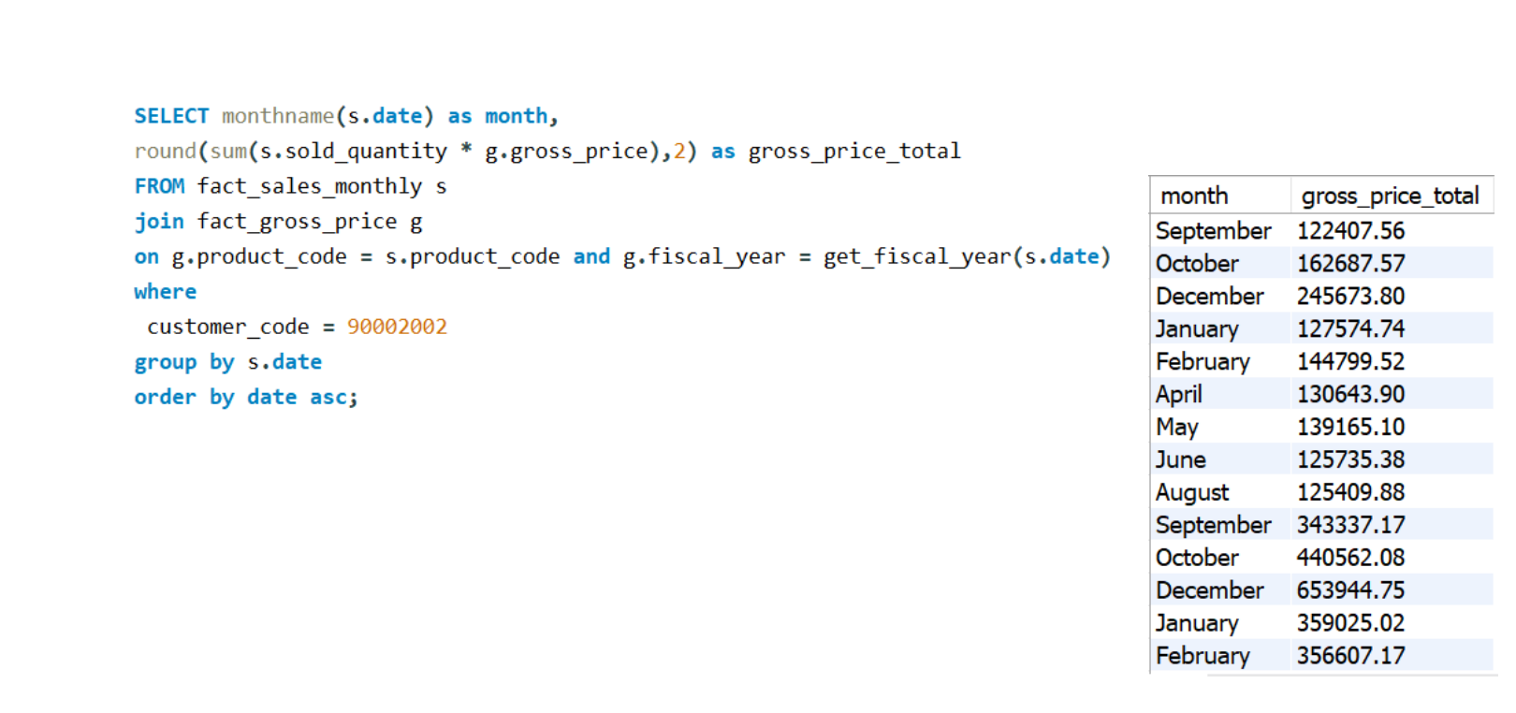
GROSS MONTHLY TOTAL SALES FOR CROMA

Slide 11
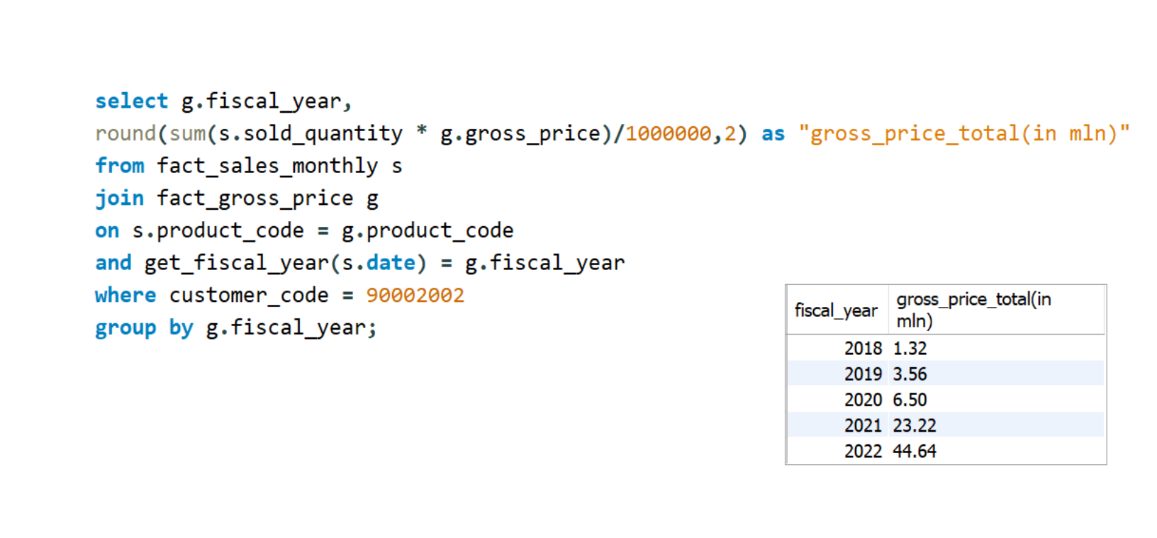
YEARLY GROSS SALES REPORT FOR CROMA

Slide 12
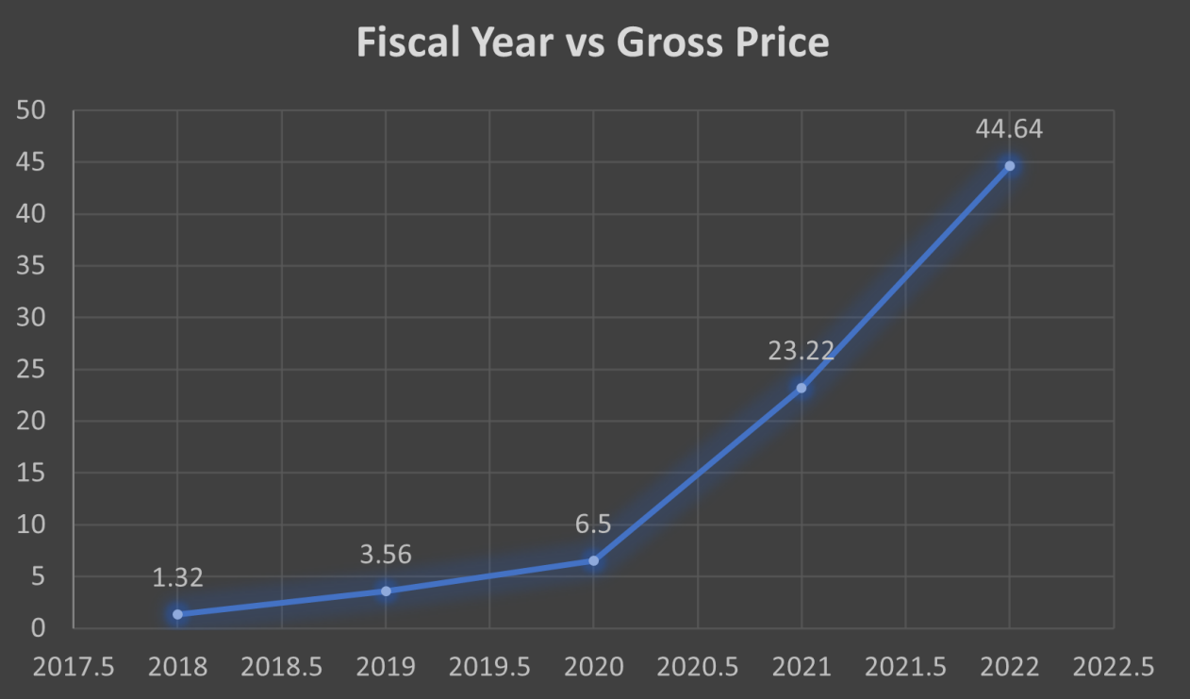
YEARLY GROSS SALES REPOTY FOR CROMA INDIA

Slide 13
Thank You

