Slide 1

BOT OR NOT Classifying twitter accounts as human or automated agents
Guided by: Mr. Sandeep Raghuwanshi
Submitted by : Karishma Chhugani

Slide 2

MOTIVATION
Twitter is one of the most popular social media platforms, it has been plagued by many bots during recent years.
Bots can control the sentiment of an issue and can create a biased opinion about any situation.
For example during the election of 2016 a huge number of bots started a bad campaign against a Presidential candidate. Bots were known to flood about 24% of daily tweets with their negative ideas.
This has motivated the software community to deal with this issue seriously.

Slide 3
APPLICATION DOMAIN
Politics: There is a group of political Twitter accounts, commonly referred to as political propaganda bots, that are different. These are accounts who identify themselves as real humans and whose tweets are politically polarizing. They often retweet content instead of actually creating their own.
Detecting bots posting adult content: These bots post URLs contained in their tweet and the tweets redirect to variety of spam websites.

Slide 4
SYSTEM ARCHITECTURE
Data Gathering Using Rest APIs and Web Scraping
Feature Extraction and Data Analysis
Training Dataset
Classification Algorithm
Cross Validation and Result

Slide 5
DATA RETRIEVAL
In order to create any classifier we need good variety of Twitter users and Twitter Bots.
There are many websites like botwiki.org which not only has a list of bots but also classifies them based on their tweets.
Users have been selected from our friends and known celebrities to have good mix of training data.
The Data of these users is collected using Twitter’s RestAPI.

Slide 6
CLEANING DATA
Once the tweets has been collected it needs to be cleaned because tweets contain a lot of non textual data which cannot be used for training of the Algorithms.
We used nltk and regex packages to remove stop words , emoticons and hashtags .
To create a fine sparse matrix we have to stemmed the words.

Slide 7
FEATURE EXTRACTION
Once data has been cleaned we need to extract relevant features.
Following features are used for classification of Bots on Twitter:
Verified account
Lexical diversity
Friends count
Followers count
Listed count
URL count
Tweet frequency
Account reputation
Source
Entropy

Slide 8
DATA ANALYSIS
Friends VS Followers Count
It was found that BOT follows a large no. of accounts and no one follow them back.
Verified Accounts
Bots never verify their accounts whereas some of human accounts were verified.

Slide 9
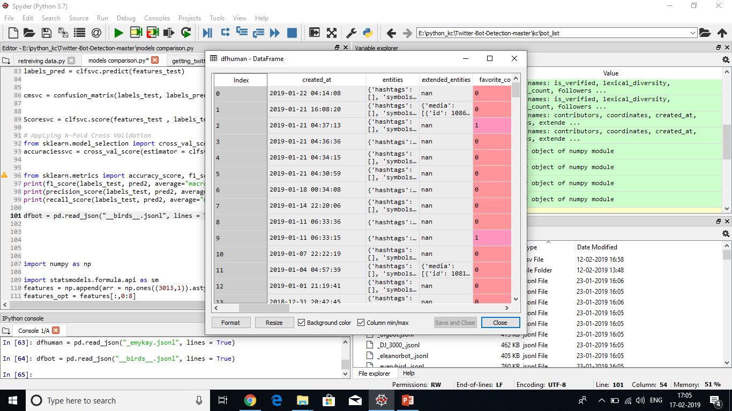
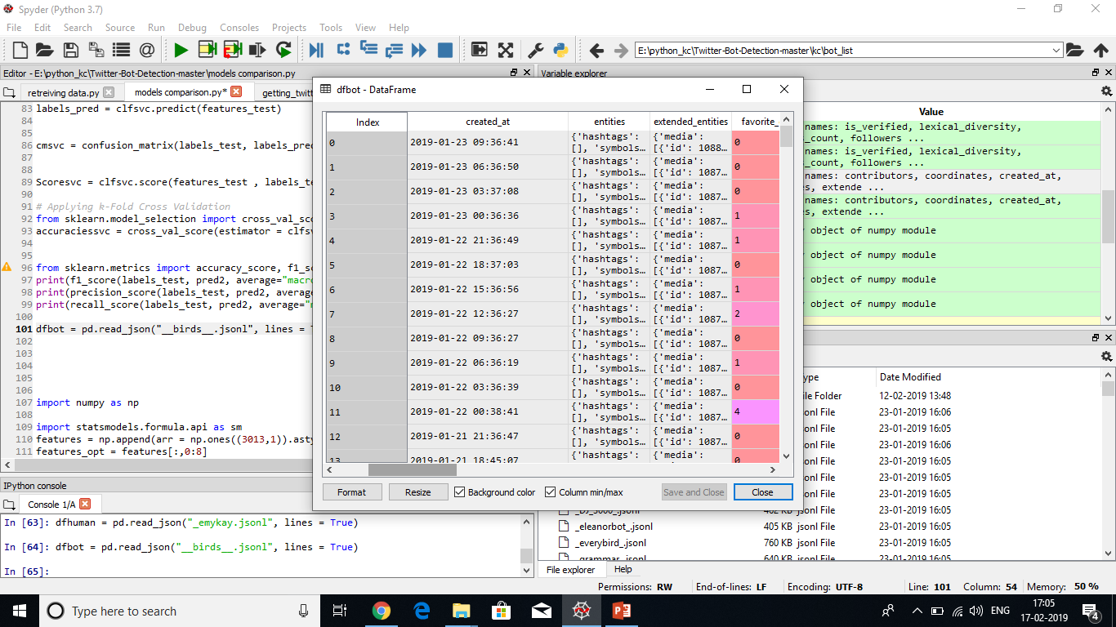
DATA ANALYSIS
Entropy or Tweet Timing
It was found that BOTs post tweets on regular interval of times whereas humans are random in nature their tweet timings are also random.

Slide 10
DATA ANALYSIS
Source or Tweeting Device:
It was found that BOTs post tweets using APIs or the websites which make these bots whereas humans post tweets using Twitter web or android app.
BOT Tweeting device | Human Tweeting Device
Cheapbotsdonequick 40% | Twitter Android app 40%
API 22% | Twitter Web 30%
TwitRobot 20% | Twitter mobile 10%
Tinysubversions , Unahormiga 5% | Tweets using facebook, Instagram 9%
Many other sources | Other Sources

Slide 11
DATA ANALYSIS
URL Count
In our measurement, we find out that, most bots tend to include URLs in tweets to redirect visitors to external webpages. For example, spam bots are created to spread unsolicited commercial information. Their topics are similar to those in e-mail spam, including online marketing and affiliate programs, working at home, selling fake luxury brands or pharmaceutical products.

Slide 12
DATA ANALYSIS
Lexical diversity
Since social robots automate messages, they have a limited and crystalline vocabulary in comparison to organic accounts. So after some time their new word introduction rate decrease whereas humans use random words whatever occur in their minds. Tweets of Bots are also similar as their previous tweets.

Slide 13
CLASSIFIERS USED
K-Nearest Neighbor
Support Vector Machine
Random Forest
Decision Tree
Logistic Regression

Slide 14
TRAINING & CROSS VALIDATION
After choosing the appropriate algorithms we went on to train and ran a 10-Fold cross validation and took the mean of the results for the following constrains:
 | K-Nearest Neighbor | Random Forest | Decision Tree | Support Vector Machine | Logistic Regression
accuracy | 0.8849 | 0.9435 | 0.9279 | 0.5630 | 0.7599
precision | 0.8823 | 0.9464 | 0.9219 | 0.2815 | 0.8227
recall | 0.8862 | 0.9486 | 0.9232 | 0.5 | 0.7868
f1 score | 0.8837 | 0.9474 | 0.9225 | 0.3602 | 0.7567

Slide 15
MODEL EVALUATION AND RESULT
Playing around with different features and parameters of random forest using sklearn provided different results every time and gave us an opportunity to learn more about the dataset and tune parameters for max results and accuracy.
Text data in spite cleaning, tokenizing and stemming did not provide any boost to the classifier.
As no public dataset was available, We have to scrape bot accounts from various websites which make these bots so dataset is not big enough.

Slide 16
FUTURE WORK
Gather a large amount of data and apply it on a big dataset.
Finding probability of an account to be a bot rather than classifying it.
Making a frontend and deploy it so that one can easily use it to check if an account is a bot or not.

Slide 17
REFERENCES
https://botometer.iuni.iu.edu/#!/
“Detecting Automation of Twitter Accounts: Are You a Human, Bot, or Cyborg?” Zi Chu, Steven Gianvecchio, Haining Wang, Senior Member, IEEE, and Sushil Jajodia, Senior Member, IEEE
https://github.com/mkearney/tweetbotornot

Slide 18


THANKYOU

