Slide 1
JobMatchHire
Explainable Resume Evaluation
Candidate Portal - contextual evidence, scoring and private PDF guidance
NAME : A.KARISHMA
REG NO:23MIC0057

Slide 2
PROBLEM STATEMENT
Limitations of basic resume-to-job matching
KEYWORD-ONLY MATCHING
LIMITED EXPLANATIONS
NO ACTIONABLE GUIDANCE
A listed skill does not necessarily show how it was applied in a project or role.
Candidates may see a score without clear supporting passages or requirement-level feedback.
Candidates often receive little direction about missing evidence or how to develop a genuine skill gap.
PROPOSED SOLUTION
ECCE analyses contextual resume evidence, calculates scores with deterministic rules, generates explanations, and produces a private PDF report with clearly labelled hypothetical improvements and learning guidance.

Slide 3
NOVELTY & USP
ECCE: Explainable Contextual Competency Engine with Automated Counterfactual Gap Remediation
CONTEXTUAL EVIDENCE
DETERMINISTIC SCORE
COUNTERFACTUAL GUIDANCE
Connect skills to actions, project descriptions and stated outcomes in the resume.
Python applies explicit scoring rules; the LLM assists with interpretation, not arbitrary score generation.
Simulate possible score changes and suggest legitimate learning steps for genuine gaps.
USP
One individual evaluation workflow that links score explanations to resume evidence and generates private, downloadable candidate guidance—without exposing other candidates' evaluations.
Research novelty must be established by testing ECCE against the existing keyword-based baseline and relevant prior work.

Slide 4
FEATURES
Candidate Portal and ECCE capabilities
JOB SELECTION
RESUME UPLOAD
CONTEXT ANALYSIS
Fetch available jobs from recruiter portal
PDF, DOCX and TXT; file picker and drag-and-drop.
Identify skill claims and supporting passages.
EVIDENCE LABELS
PRIVATE PDF REPORT
RE-EVALUATION
Evidence Found, Evidence Not Found, Potential Inconsistency.
Individual downloadable evaluation report.
Upload updated resume and create a new version.

Slide 5
INPUTS & OUTPUTS
From resume submission to a private report
INPUT
OUTPUT
• Selected job ID
• Resume file (PDF, DOCX or TXT)
• Optional candidate name
• Optional candidate ID for re-evaluation
Action: Candidate clicks Submit.
• Overall score and score breakdown
• Skill evidence and source passages
• Missing evidence and review flags
• Experience match status
• Hypothetical score simulation
• Private learning recommendations
• Downloadable PDF report

Slide 6
SCORING & PDF REPORT
LLM-assisted interpretation with reproducible numerical scoring
Score = 0.50 × Required Skills + 0.25 × Experience + 0.15 × Preferred Skills + 0.10 × Similarity
PDF REPORT SECTIONS
Job and evaluation details
Overall and component scores
Skill evidence and supporting excerpts
Missing evidence and potential inconsistencies
Counterfactual simulations
Learning recommendations and next steps

Slide 7
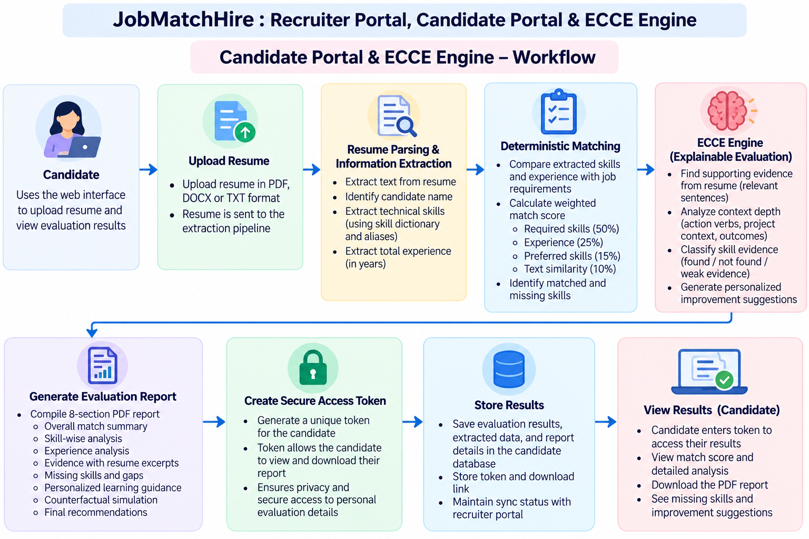
WORKFLOW

Slide 8
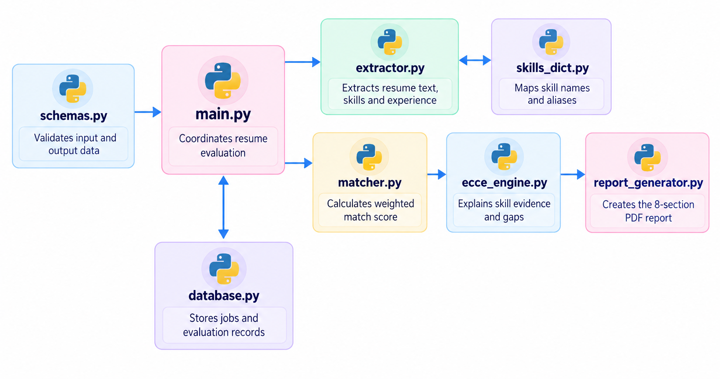

Slide 9
APIS, DATABASE & CONCLUSION
Method | Endpoint | Purpose
GET | /health | Service/database status
POST | /jobs | Receive job synchronisation
GET | /jobs | List available jobs
GET | /jobs/{job_id} | Get job criteria
POST | /analyze-resume | Evaluate uploaded resume
GET | /candidates/{id}/report?token=… | Download private PDF
GET | /candidates/{id}/status?token=… | Check evaluation status
GET | /candidates | Blocked to protect privacy
Table: received_jobs
Stores synced job criteria: job_id, job_title, required/preferred skills, experience and education.
Table: candidate_evaluations
Stores candidate/job IDs, score breakdown, evidence, token, resume version, report path, ECCE data and timestamps.
Conclusion: ECCE aims to make resume matching more explainable and actionable while protecting each candidate's private guidance.

