Slide 1


Slide 2

Our
Group
Members
Ms. Unnathi Pujari
Ms. Shivani Gavhane
Ms. Karishma Rahangdale
Ms. Sanchita Tejas Kolambe
Mr. Shubham Satpute
Mr. C Chandan
Mr. Rajat Kumar Maharana

Slide 3
Overview
The Olist Store Analysis project focuses on dissecting and understanding the operational dynamics and performance metrics of Olist, an e-commerce platform in Brazil. Through comprehensive data analysis, this project aims to uncover insights into various facets of Olist's operations, including sales trends, customer behavior, product performance, and market segmentation. By examining historical transactional data, demographic information, and customer feedback, the project seeks to identify patterns, correlations, and opportunities for optimization. Through advanced statistical methods and data visualization techniques, the project aims to deliver actionable insights to enhance decision-making processes, improve customer satisfaction, and drive business growth for Olist. Ultimately, this analysis serves as a strategic tool for Olist to refine its strategies, streamline operations, and capitalize on emerging market opportunities in the dynamic landscape of e-commerce.

Slide 4
Index
Weekend Vs Weekday Payment statistics
Number of orders with Review score 5 and payment type as credit card
Average number of day taken for delivery for Pet Shop
Average price and payment value from customers of Sao Paulo City
Relationship between shipping days and Review score
Top 10 and Bottom 10 Products
Average Price and freight value for sellers from various states
Excel Dashboard
Power BI Dashboard
Tableau Dashboard
Challenges faced
Overcoming Challenges

Slide 5
Weekend Vs weekday Payment Statistics
Observation :
This analysed the buying behaviour of customers.
77% revenue was generated on weekdays while weekends accounted for 23%
Conclusion :
Helped identify which day has highest sales.
Suggestion :
Offer special promotions, discounts, or limited-time offers specifically targeted for weekends to increase purchases.

Slide 6
Number of orders with Review score 5 and payment type as credit card
Observations :
Identifies customer satisfaction levels and payment preferences.
43,523 customers with review score 5 preferred credit card for payment.
Conclusion :
Helped in identifying satisfied customers, to encourage them to make repeated purchases.
A Substantial number of satisfied customers prefer credit card as their payment method
Suggestion :
Offer Exclusive Credit Card Benefits and ensure customer satisfaction.

Slide 7
Average number of day taken for delivery for Pet Shop
Observation:
This KPI analyzes the average number of days taken for delivery of order to Pet Shop
Our analysis revealed an average delivery time of 11 days.
Conclusion:
Quick delivery can improve customer satisfaction
Suggestion:
Olist can improve their delivery procedure and ensure lesser delivery time.

Slide 8
Average price and payment value from customers of Sao Paulo City
Observation:
Average price and payment values in Sao Paulo reveals higher spending patterns
Average price and payment were 108 and 153 respectively
Conclusion:
Helped in understanding consumer spending patterns in this city.
Useful for identifying high value customers.
Helped in identifying target audience.
Suggestion:
Olist should conduct high marketing campaigns in various areas.

Slide 9
Relationship between shipping days and Review score
Observation :
It revealed how delivery time influenced customer satisfaction
Average number of days taken for delivery for review score 1,2,3,4 and 5 are 21, 17, 14, 12 and 13 respectively.
Products with 1 or 2-star reviews generally have longer average shipping days
Conclusion :
More number of days for delivery lesser the review score.
Olist can use this information to optimize their logistics and improve their delivery time
Suggestion :
Need to improve delivery process to enhance customer experience and boost review scores.

Slide 10
Top 10 and Bottom 10 Products
Observation:
Identified the best and worst performing products
The total price for top 10 products range from 5,92,720 to 6,32,249
The total price for bottom 10 products range from 283 to 1814
Conclusion:
Helped the store to find out areas of improvement
Identifying them helps in assessing inventory performance and potential areas for improvement
Suggestion:
They can make necessary improvements in worst performing products to encourage their sales

Slide 11
Average Price and freight value for sellers from various states
Observation:
Average freight and price values for different states are correlated.
The states with higher freight value also should higher price value.
Conclusion:
Offers valuable insights into regional trends and shipping costs.
Help sellers identify regions which need additional support or adjustments to shipping policies.
This helps in influencing pricing strategies and logistics decision.
Suggestion:
Embrace Automation and proper risk management.

Slide 12
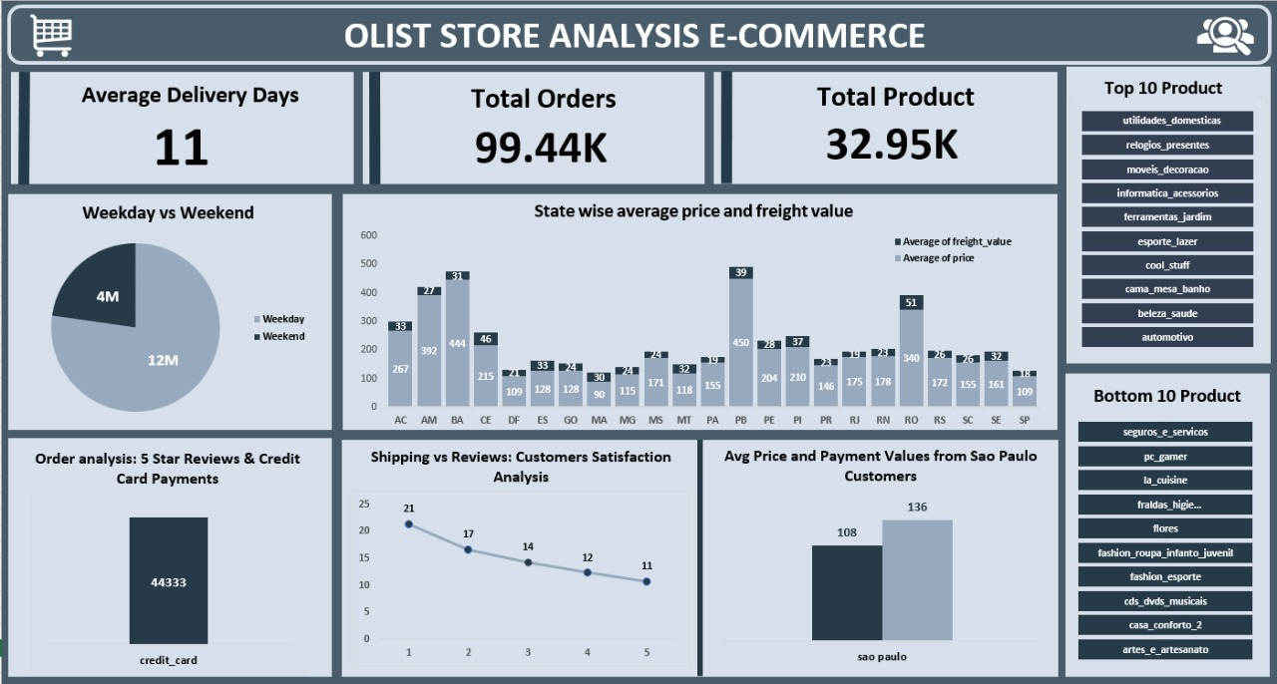
Excel Dashboard

Slide 13
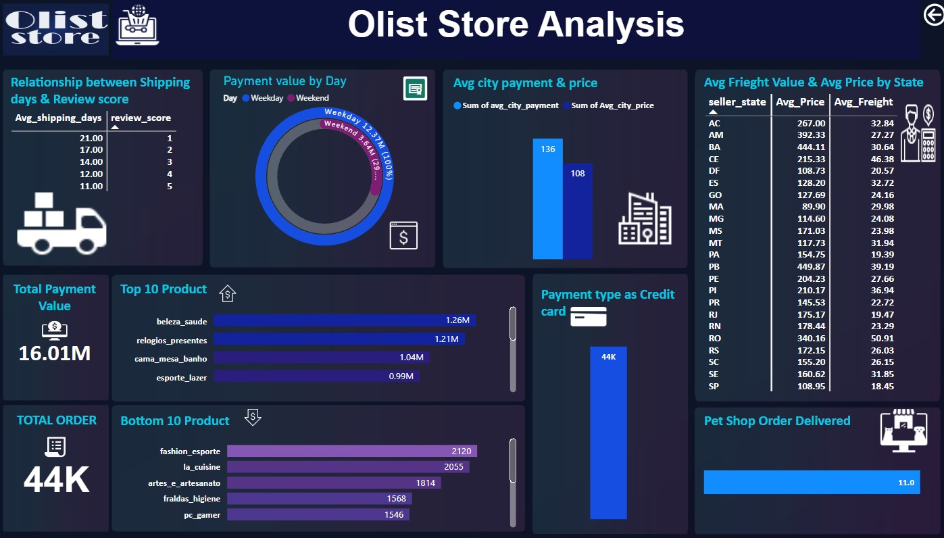
Power BI Dashboard

Slide 14
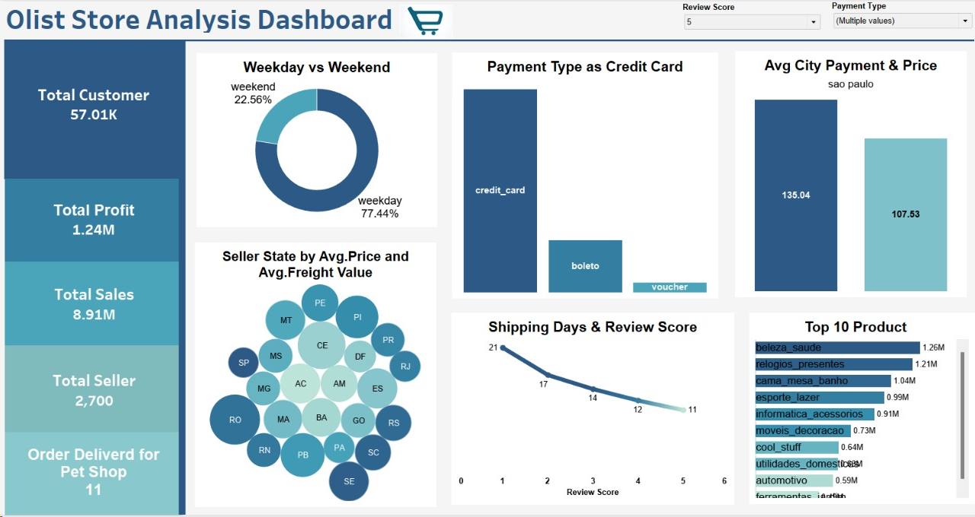
Tableau Dashboard

Slide 15
Challenges Faced
Data was divided into different datasets. Integrating these disparate data sources was complex.
The large volume of datasets made it difficult to merge and handle them.
The sheer volume of information was leading to cluttered designs, making it difficult to interpret the data.
Different KPIs require different visualization formats (e.g., line charts, bar graphs, heatmaps). Selecting the most effective type was tricky
Striking the right balance between detailed information and an overview was difficult.

Slide 16
How we tackled these challenges?
Used power query to integrate the data which made this easy.
Infile method was used to load data into SQL which made loading of large datasets easy.
Considered the priorities and minimized overcomplicated aesthetics.
Thoroughly understood the type of data required to visualize through KPI.
Assessed the relevance of information , removed unwanted or less valuable ones.

Slide 17
Thank You

