Slide 1


SMART INDIA HACKATHON 2025
Problem Statement ID – 25028
Problem Statement Title- Smart
Classroom & Timetable Scheduler
Theme- Smart Education
PS Category- Software
Team ID-
Team Name MindSync

Slide 2
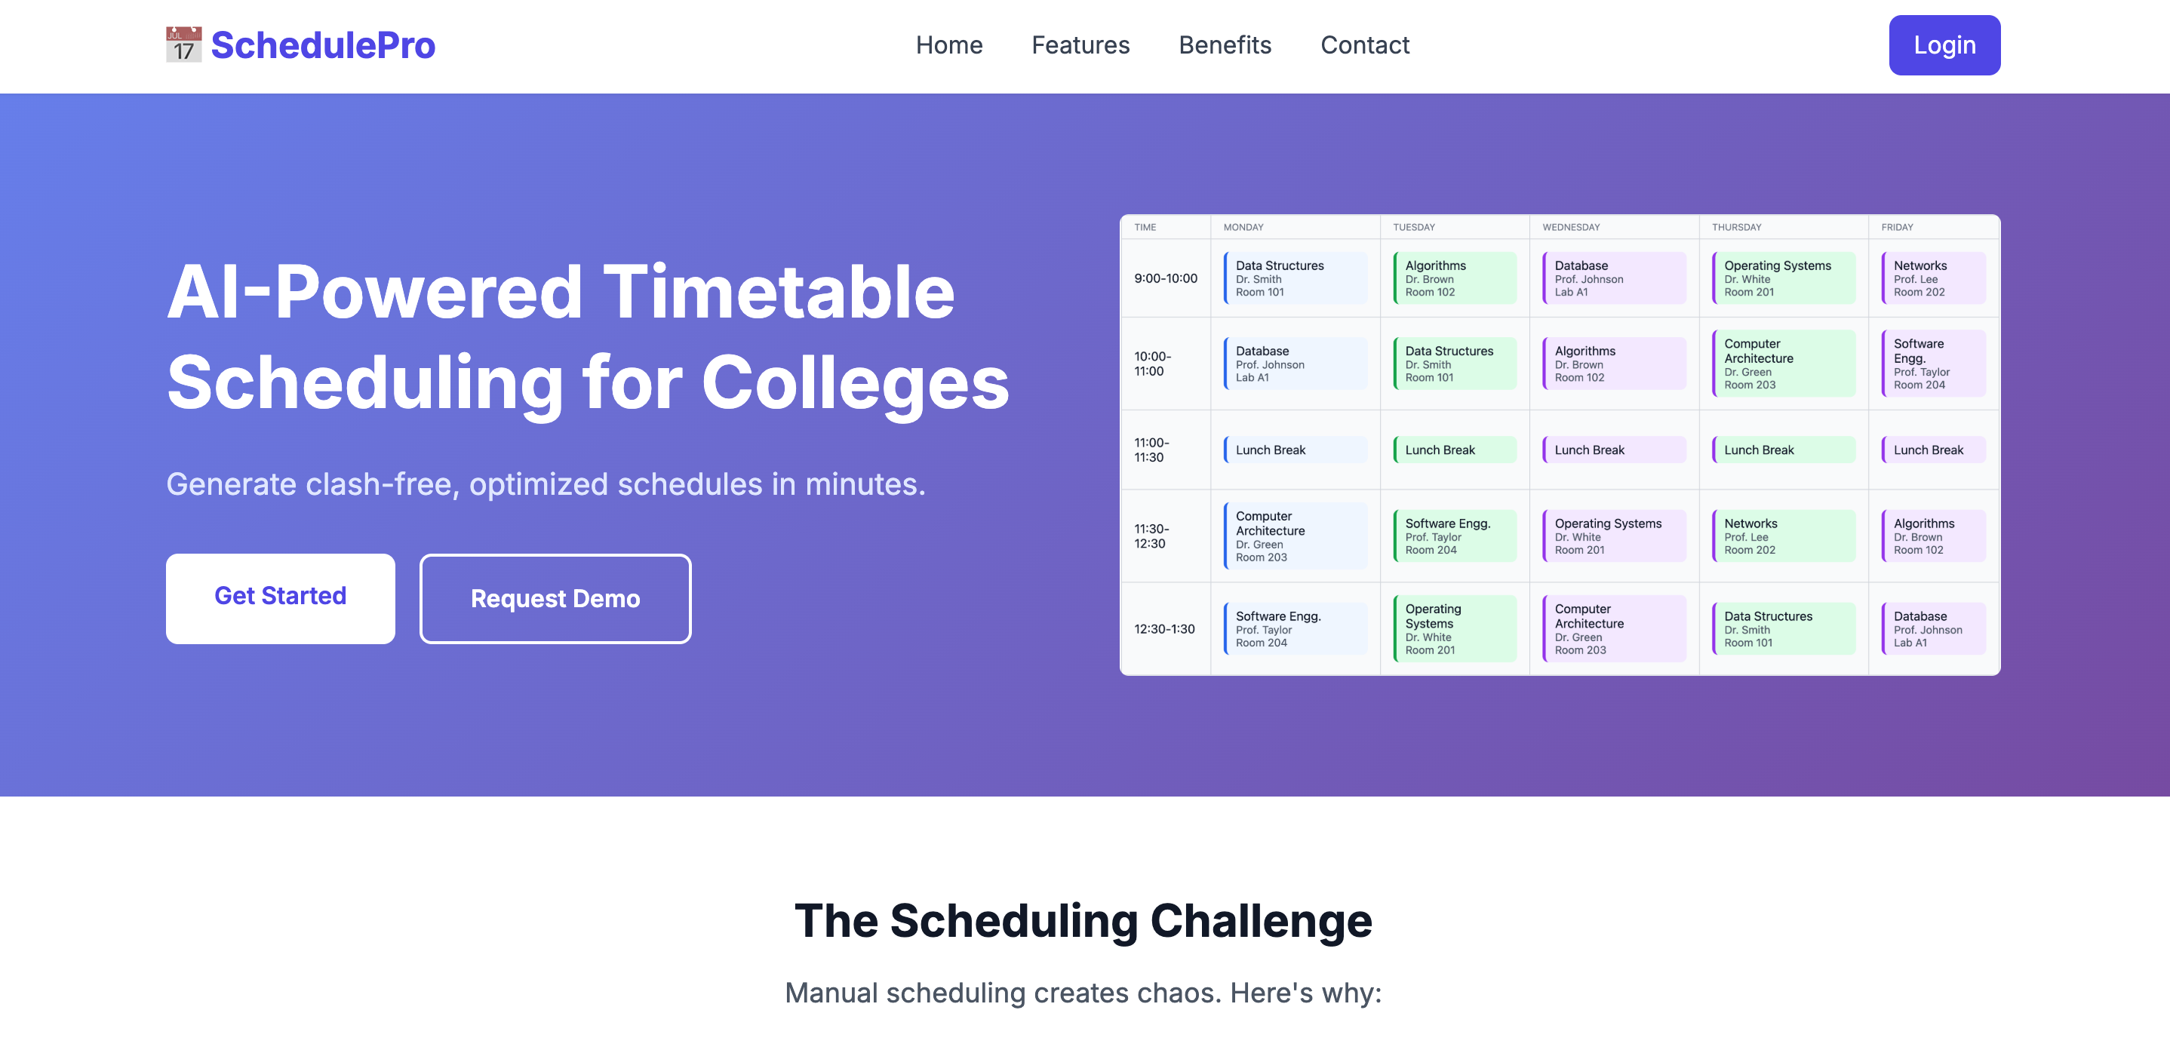
Schedular Pro
MindSync
Proposed Solution
The system ensures conflict-free scheduling, proper resource allocation (teachers, rooms, slots), and balanced workload.
A secure, adaptable, and user-friendly scheduling platform with role-based access, conflict prevention, notifications, and integration with external calendars.
It also includes intelligent rearrangement suggestions and provides easy export to PDF and Excel.
Homepage
Addressing The Problem
Timetable scheduling is still largely manual and time intensive without optimization, universities faces scheduling delays, faculty overload and frequent timetable clashes.To solve this problem we have introduced:-
AI based timetable generator :- Provide flexible and optimized timetable.It gives rearrangement and suggestion at real time.
Our system will handle multiple department. Automatically avoids conflicts for faculty, classrooms and student batches.
Prototype : https://karishma9142.github.io/SIH2k25/
Uniqueness
Notifies teachers and student about upcoming classes and any changes like shifted, cancellation or substitution.
Arranges tough on intensive subject thoughtfully to keep students focused and balanced.
Teachers can add on update today’s topic directly in the timetable.
Convert student feedback after each lecture to spot difficulties and arrange extra sessions if needed.
Teacher can add Zoom/Google Meet links for online lectures.
@SIH Idea submission- Template

Slide 3

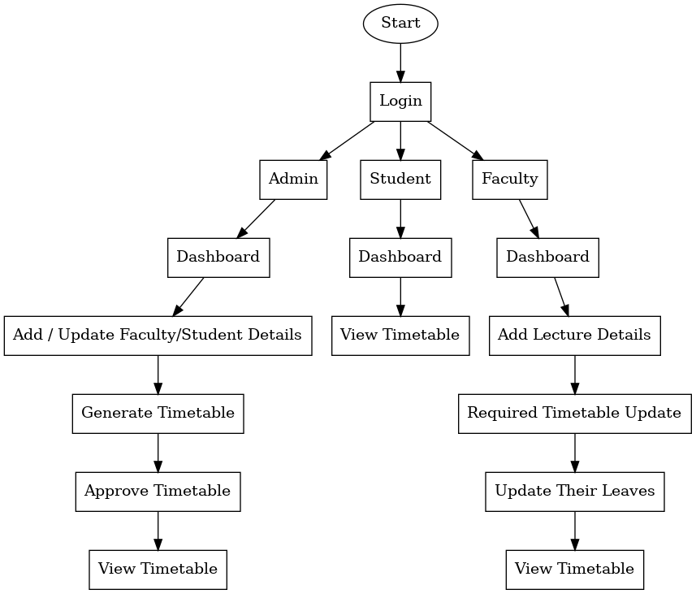

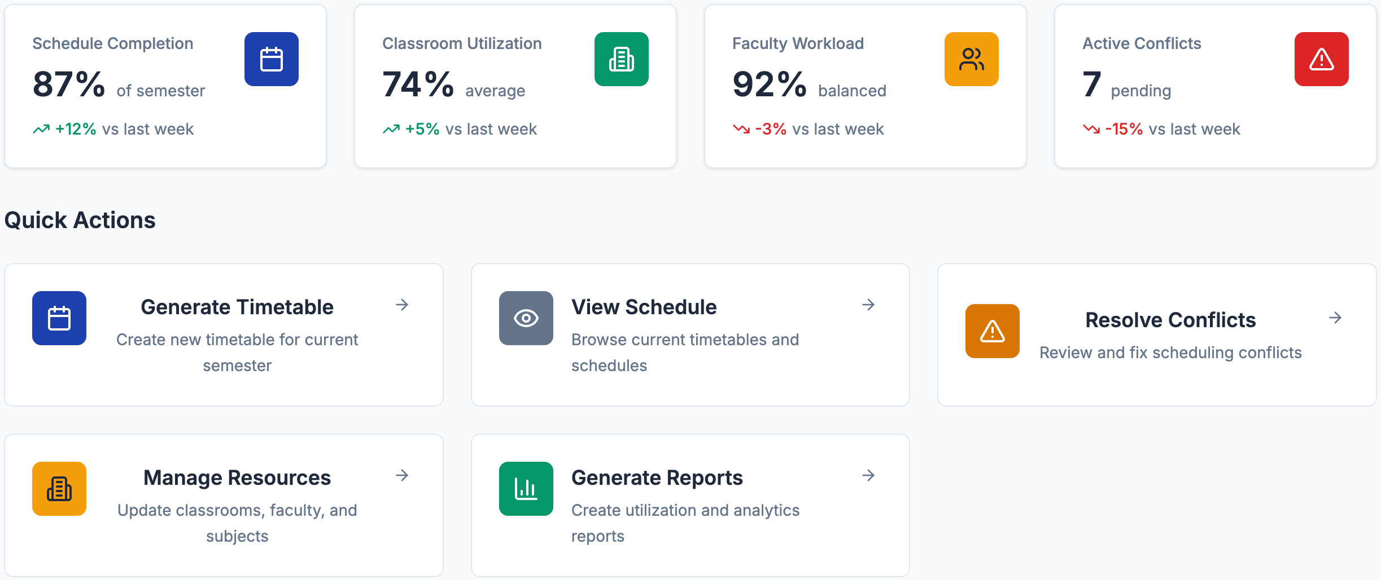

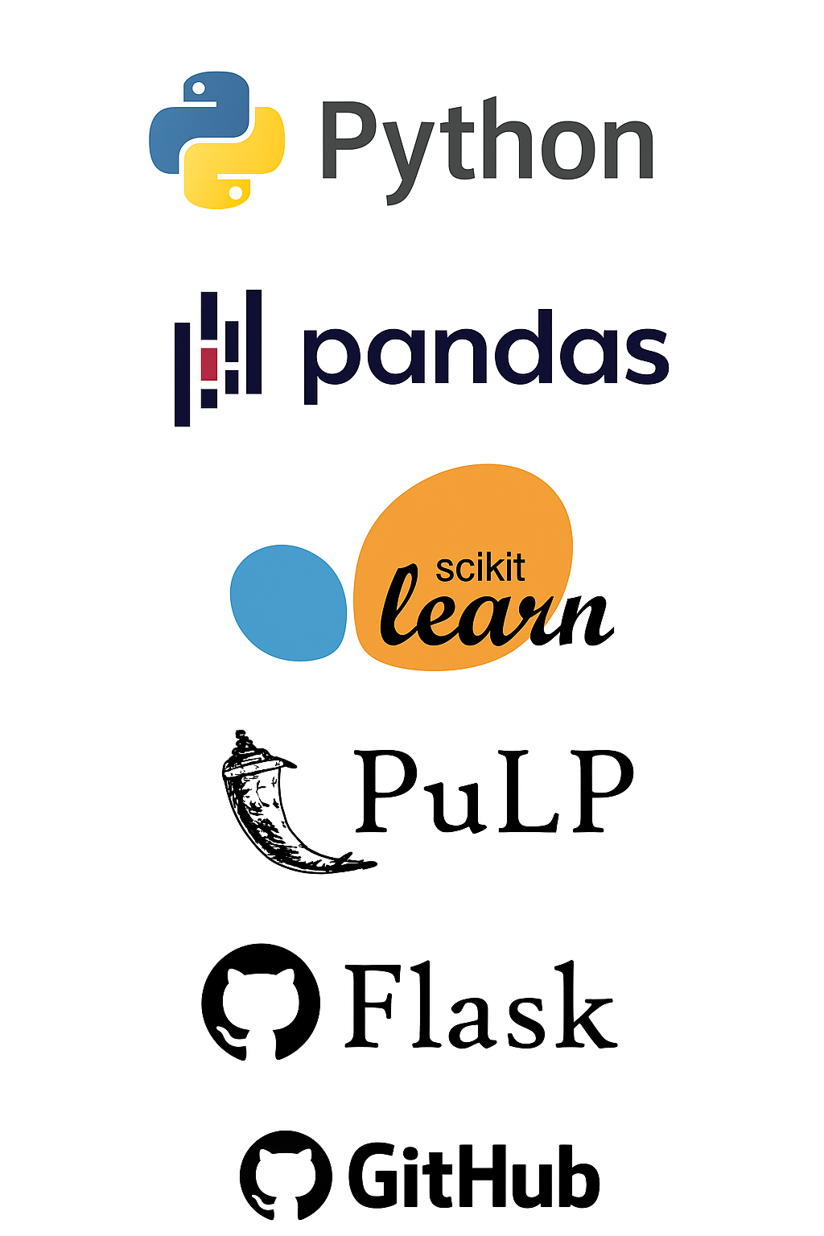

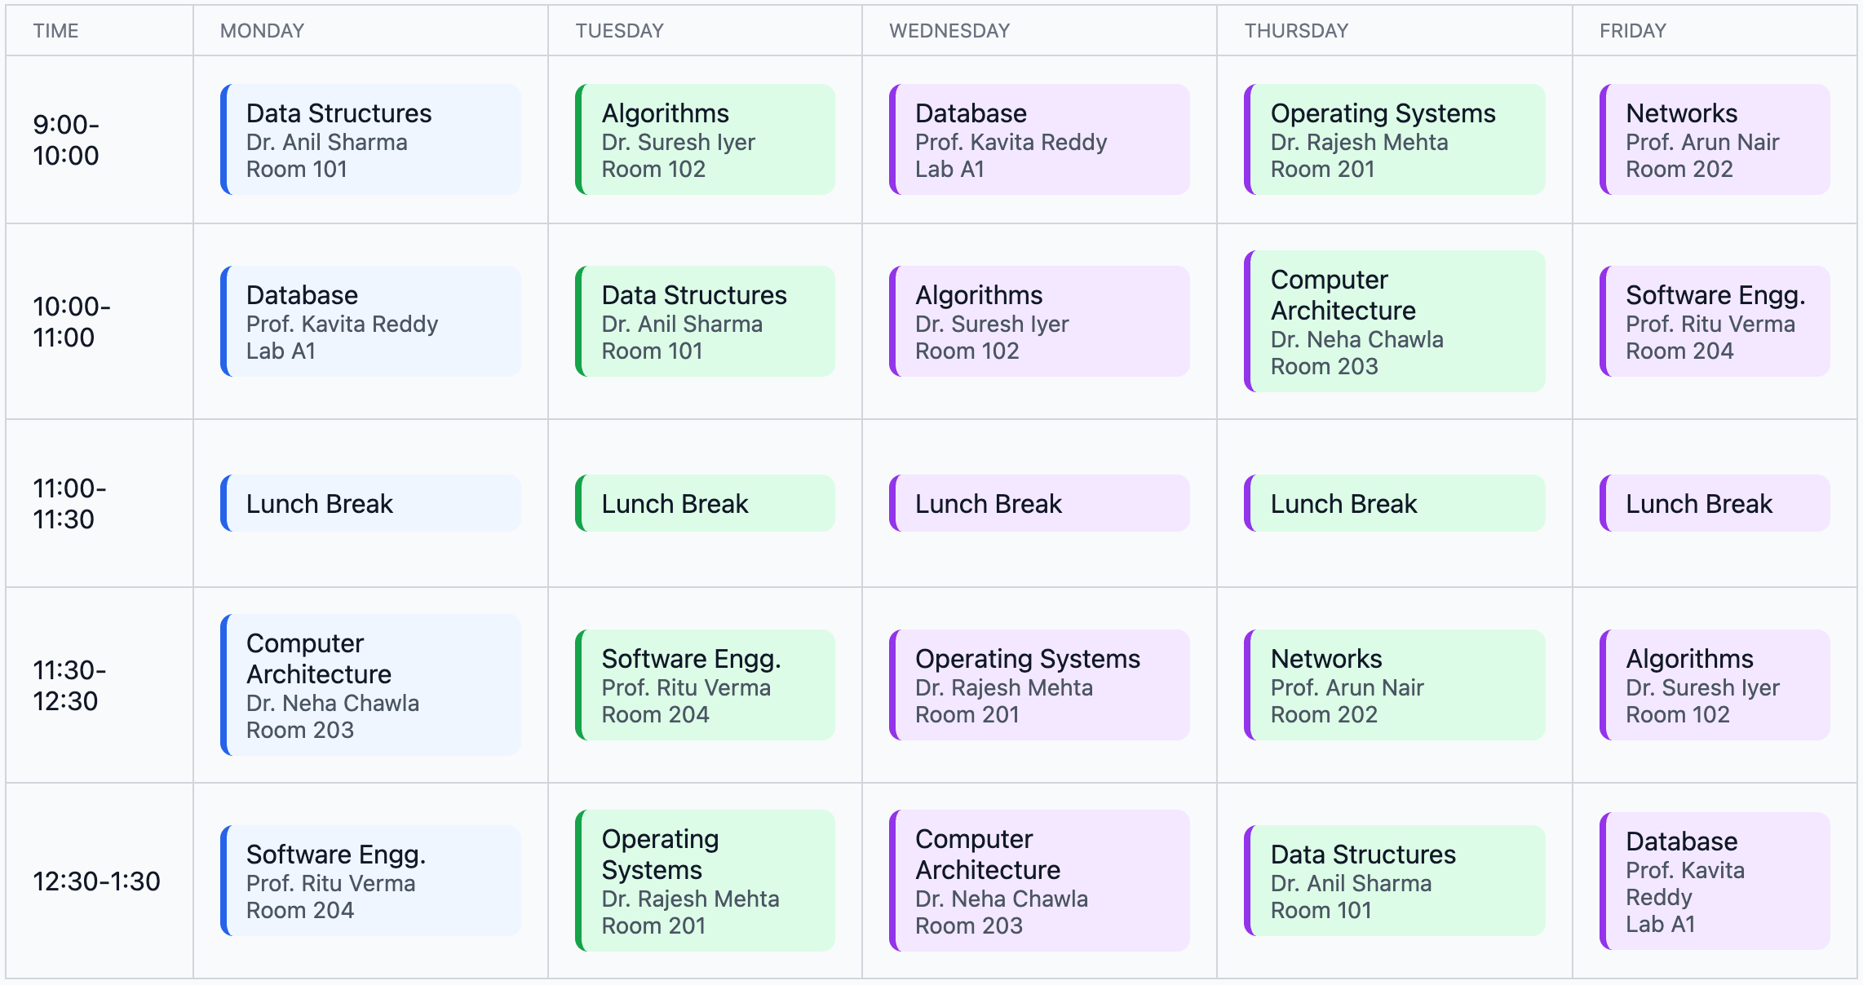


TECHNICAL APPROACH (Flow Chart)
MindSync
Technology Stack :
Dashboard
FlowChart
Figma
TimeTable
@SIH Idea submission- Template

Slide 4
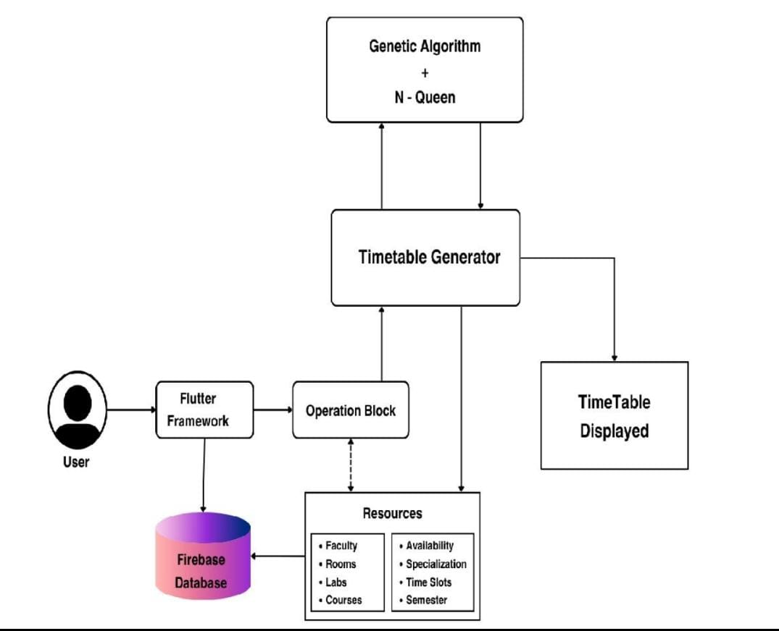
FEASIBILITY AND VIABILITY
MindSync
Feasibility:
Can be built using free/open tools
Supports AI algorithms(Genetic + N-Queen)which are already well documented.
User-friendly interface-> teachers/admins/student can quickly adopt it.
Viability:
Colleges and schools are shifting to digital automation -> high demands.
Can be extended into a paid SaaS(Software as a service) product for multiple institutes.
Training required is minimal , since we provide a demo video.
Challenge:
Some staff find it difficult to use it.
Solution:
Keep the system simple and provide a demo video.
@SIH Idea submission- Template

Slide 5
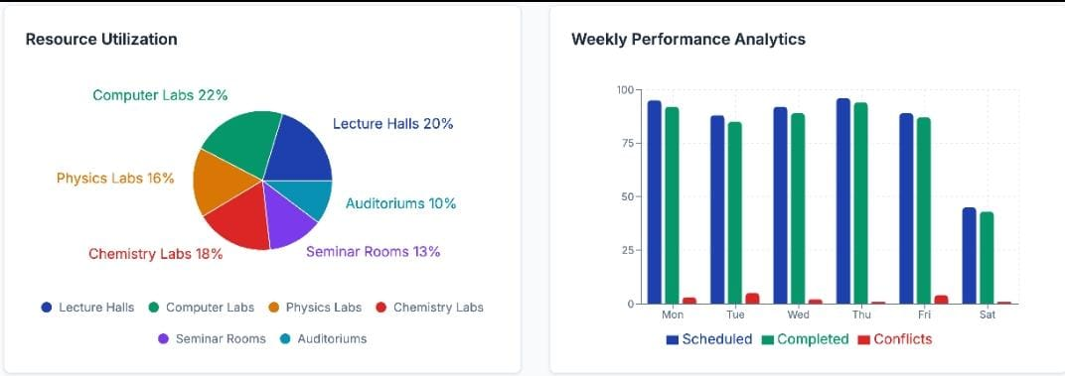
IMPACT AND BENEFITS
MindSync
Potential Impact:
On Education System – Encourages digital transformation in colleges/universities by introducing AI-based automation.
On Institutions – Saves administrative time, reduces dependency on manual staff, and ensures fair resource usage (classrooms , labs , teachers).
On Environment – Reduces paper usage since all timetables are digital-> eco-friendly solution.
Benefits:
Social:
Promotes discipline and time management skills.
Ensures fair distribution of workload for teachers and students.
Saves time that can be used for social and extracurricular activities.
Economical:
Optimizes use of facilities (classrooms, labs), avoiding under-utilization.
Less wasted time and optimized resources directly translate to lower operating expenses.
Environmental:
Digital scheduling reduces paper usage, saving trees and decreasing paper waste.
@SIH Idea submission- Template

Slide 6
RESEARCH AND REFERENCES
MindSync
https://www.ijarsct.co.in/Paper17285.pdf?utm_source
https://ijarcce.com/wp-content/uploads/2025/05/IJARCCE.2025.14540.pdf?utm_source
https://www.iosrjournals.org/iosr-jce/papers/Vol27-issue1/Ser-1/H2701014755.pdf?utm_source
@SIH Idea submission- Template

