Slide 1
Q3 Infrastructure Review
Internal Engineering Update

Slide 2
Highlights
Migrated 60% of services to the new cluster
Reduced p95 latency by 18%
3 incidents resolved within SLA

Slide 3
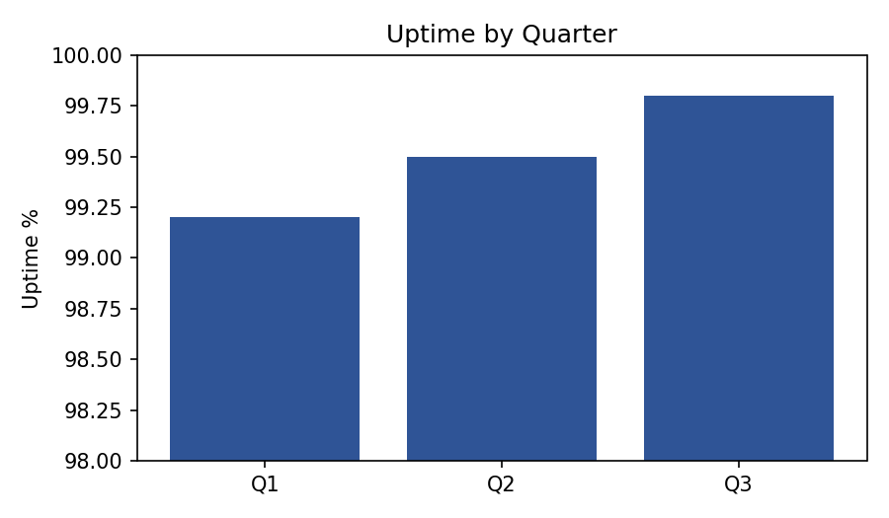
Uptime by Quarter
Uptime trended upward across all three measured quarters

Slide 4
Next Steps
Complete migration by Q4
Run load test in staging
Publish updated runbook

