Slide 1
Hash table
Ankush Gupta
Karishma Chauhan
Chenjia Guo

Slide 2
Why we need it?
Large data set
Time complexity

Slide 3
Basic Concept
Hash table is a data structure that has multiple buckets
Each bucket has few numbers of key value pairs
Bucket indexes are computed using a hash function

Slide 4
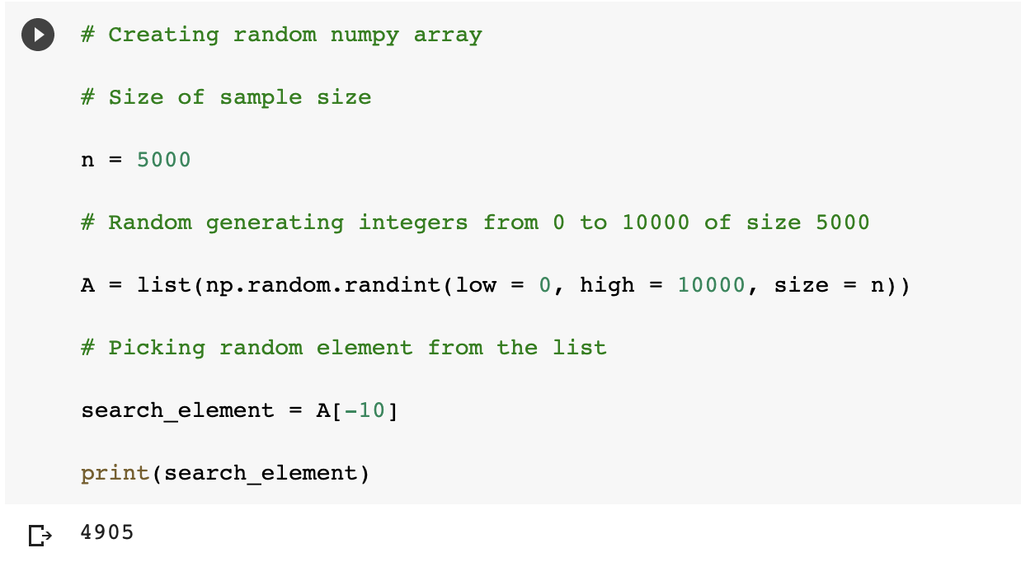
Example1: Search through random NumPy array

Slide 5
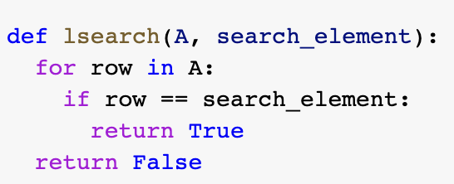
With Linear Search, we go through the whole list step by step…
1348 | 3423 | 1245 | 5672 | 8712 | 88 | … | 4905 | … | 7612

Slide 6
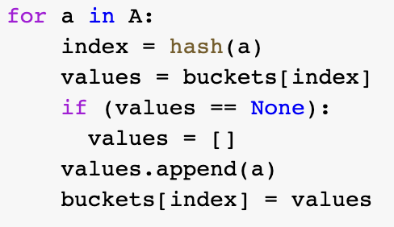
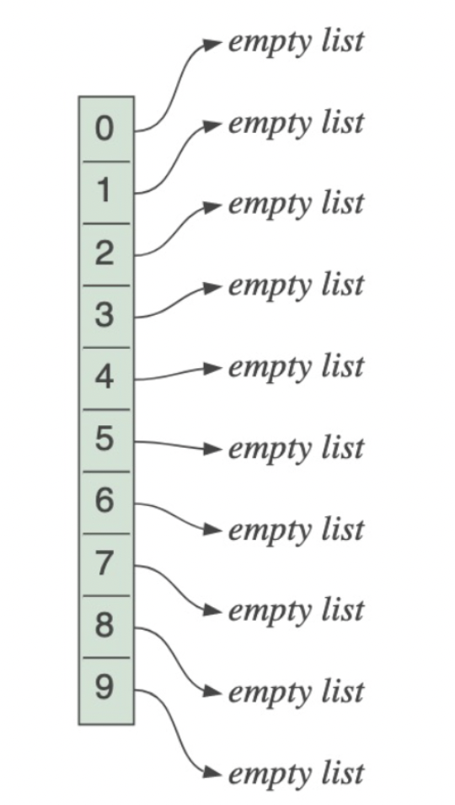
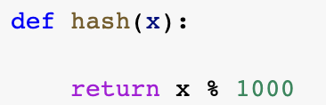
With Hash Table…
Build table with empty buckets
Choose a hash function
Insert values to the corresponding bucket

Slide 7
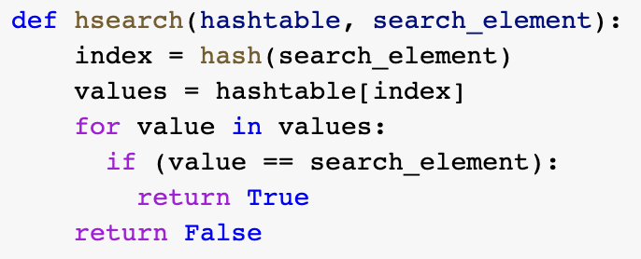
Search through a hash table
Calculate bucket index for the wanted element
Go straight to the bucket
Check if the element is there

Slide 8
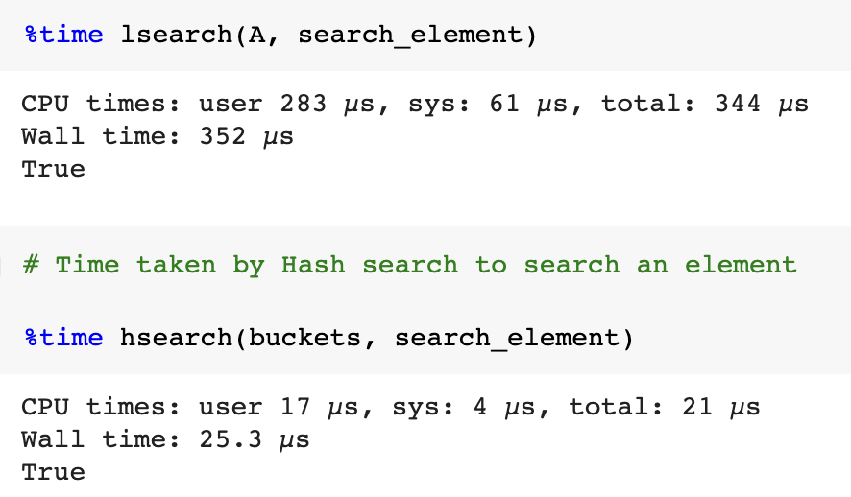
Linear Search and Hash Table Search

Slide 9
Time Complexity
Different approaches take different time to do the same job

Slide 10
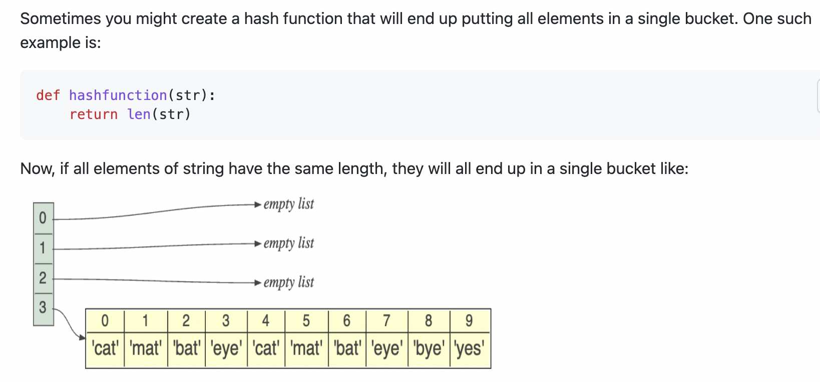
Number of buckets matters!

Slide 11
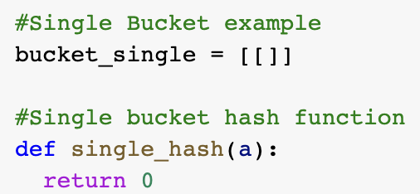
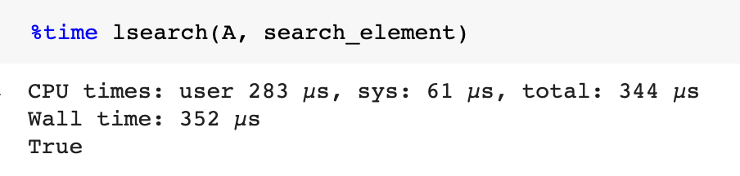
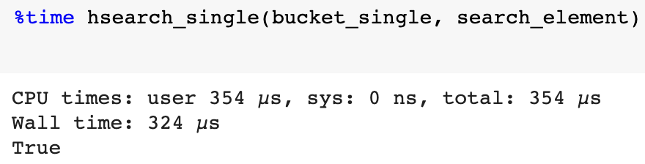
Hash table with a single bucket behaves the same as the linear approach
Time for linear search
Time for single bucket search

Slide 12
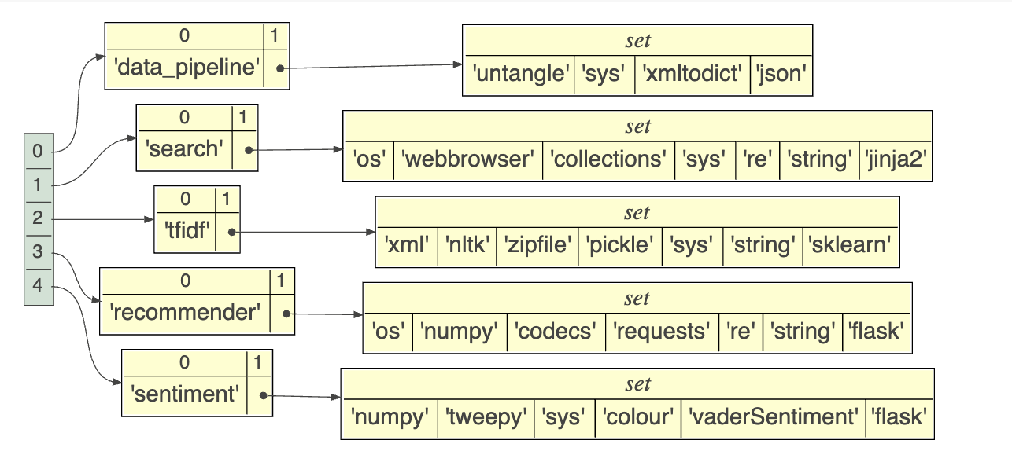
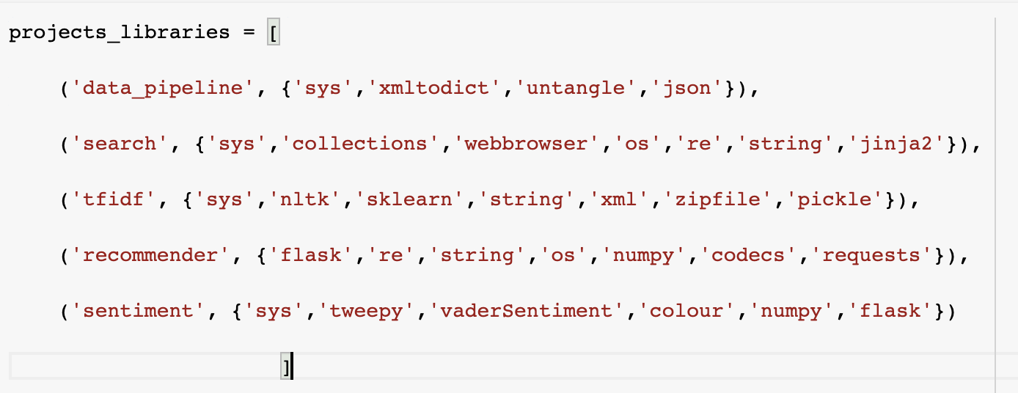
Example 2: Mapping Projects with Libraries used
Creating key value pairs
Visualizing the dataset using objviz

Slide 13
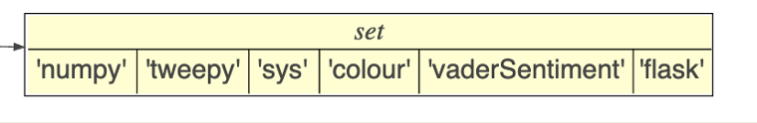
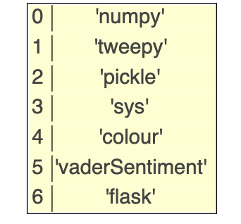
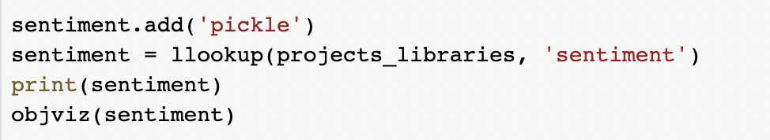
Modifying the values of set for a project
Sentiment
Suppose we require additional library for testing the output of project
Code
Modified Set

Slide 14
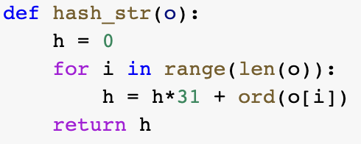
Chose a new hash function for strings using Unicode values
Converting characters of strings to ordinal values using “ord function”

Slide 15
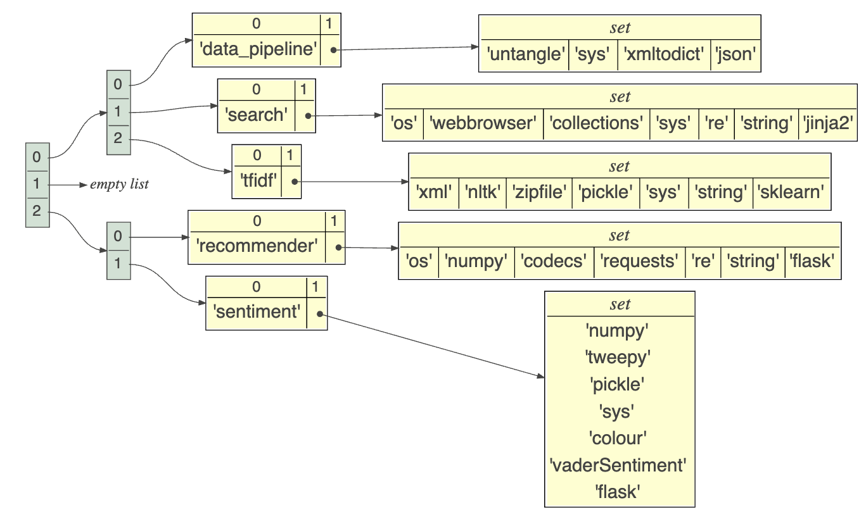
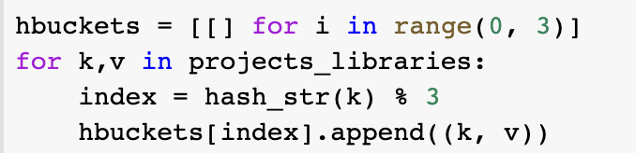
Insert values to the buckets
Creating empty buckets
Inserting the key value pair using hash function

Slide 16
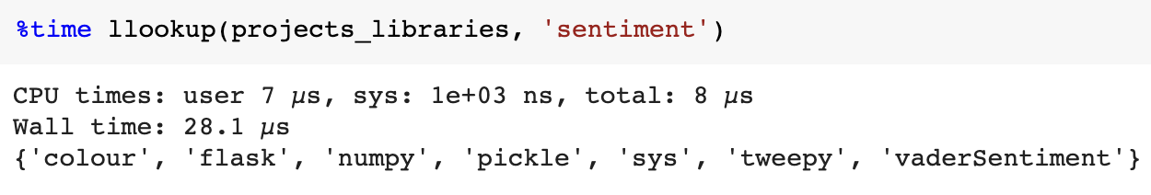
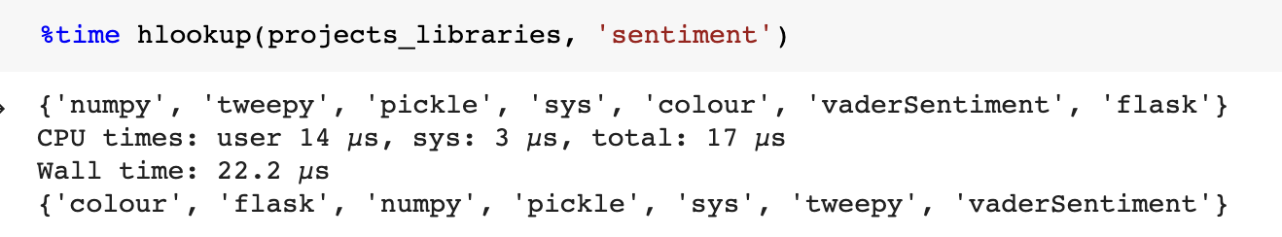
Comparing the execution time!

Slide 17
Conclusion
We trade off computation complexity for time
Linear Search
More Time
Less Complexity
Hash Table
More Complexity
Large Dataset
Less Time
Linear Search
Less Time
For Small Dataset
Hash Table
More Time
More complexity
Less Complexity

Slide 18

Q&A

Slide 19

Thanks!

