Slide 1

KONKAN GYANPEETH COLLEGE OF ENGINEERING ,Karjat
Department of information Technology
“Data Transfer Using Virtual Printer"
Project group members Roll NO
Karishma Ghadge 14
Sayali Jadhav 24
Chaitali Shevale 47
Harshali Thale 53
UNDER THE GUIDANCE OF
Prof. Mahesh Zemse

Slide 2
CONTENT
Abstract
Introduction
Literature survey
Problem Statement
Proposed System
Objective
Purpose
System Requirement
Screenshot of Implementation
Future scope
Reference
Conclusion

Slide 3
Abstract
The project aims is to share Securely encrypted file over cloud server using virtual printer driver And We can access that data/file anywhere
User will be able to prints a document through the virtual printer from any application.
The virtual printer intercepts the print job and saves each printed page as EMF file.
The virtual printer converts EMF files to Image output formats.
Data has been extracted from Image file into text or other human readable file format.
Data/files are available to access from aywhere.

Slide 4
Introduction
In our project that is in Data Transfer Using Virtual Printer Driver we are going to implement application for to share Securely encrypted file over cloud server using virtual printer driver And We can access that data/file anywhere

Slide 5
Literature survey
Sr NO | Name of Paper | Description | Working
1 | Control of distributed computerusing virtual printer(2007) | Author :Fumihiko Iwata, Nagano-ken (JP); Masashi Asakawa, Nagano-ken (JP); Akihiro Sato, Nagano-ken (JP); Akira Mochida, Nagano-ken (JP); Koki Togashi, Nagano-ken (JP) | The application program converts print data into data Suitable for the virtual printer based on the performance information and transmits the converted print data to the virtual printer driver

Slide 6
Problem Statement
1 ) Time consumption
2) user interface

Slide 7
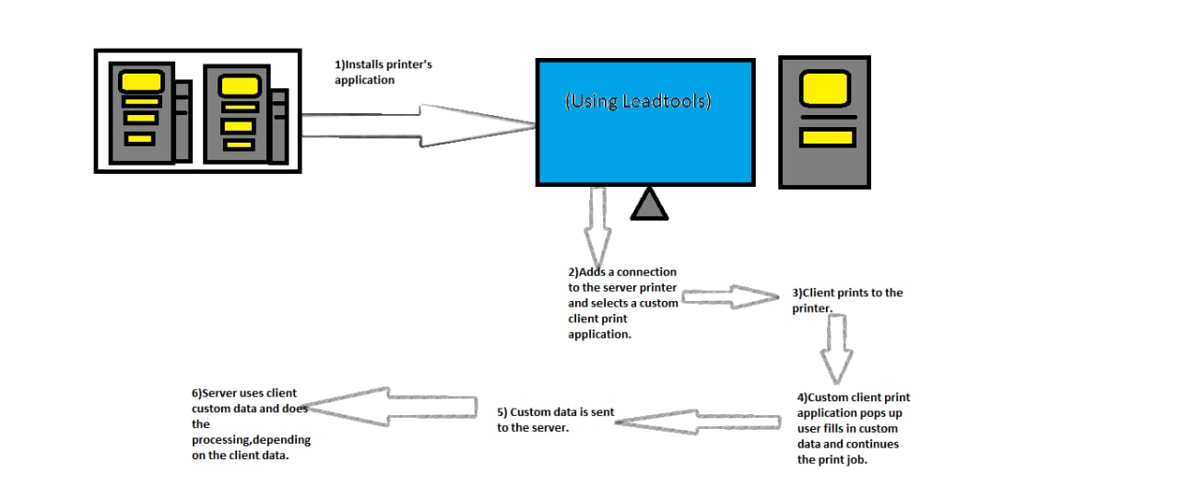
Proposed System

Slide 8
Objective
In computing a virtual printer is a simulated device whose user interface and API resemble that of a printer driver, but which is not connected with a physical computer printer.
Data will be extracted from Image file into the text or other human readable file format.
Virtual printers are frequently used as modules in a multi-purpose editor to convert the documents into a desired format.
With the help of virtual printers drivers data has been transferred securely from source to destination.

Slide 9
Purpose
Virtual printer work with print drivers that are coded to send their output to other applications rather than to a physical device.
The virtual printer can help save resources because it makes it possible to carry out tasks that would formerly have involved actual printing without wasting paper and ink And EMF file.

Slide 10
System Requirement
Various Hardware prerequisites for the project are as follows:
Intel processor of AMD dual core.
2 GB RAM.
500 GB Hard disk.
Various software prerequisites are as follows:
Windows XP,7,8,10.
Visual Studio 17.
SQL server 14.
Lead tools.
Programming languages called C# and ASP.Net.

Slide 11
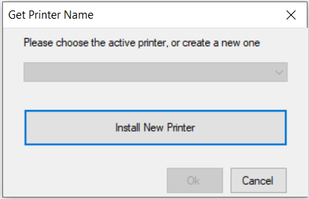
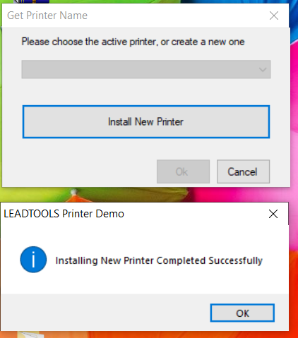
Screenshot of Implementation

Slide 12
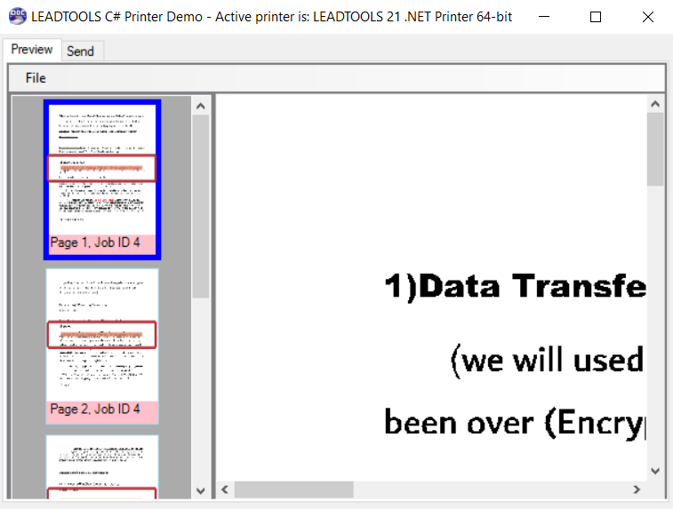
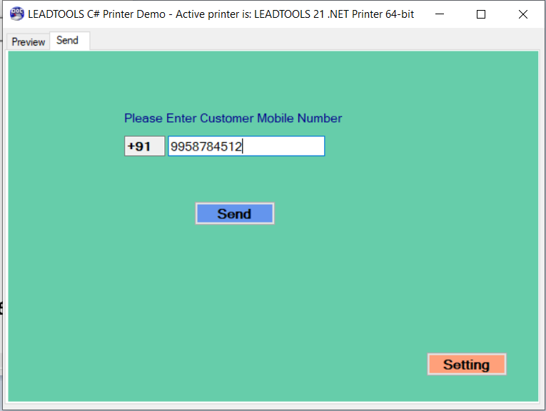
Screenshot of Implementation

Slide 13
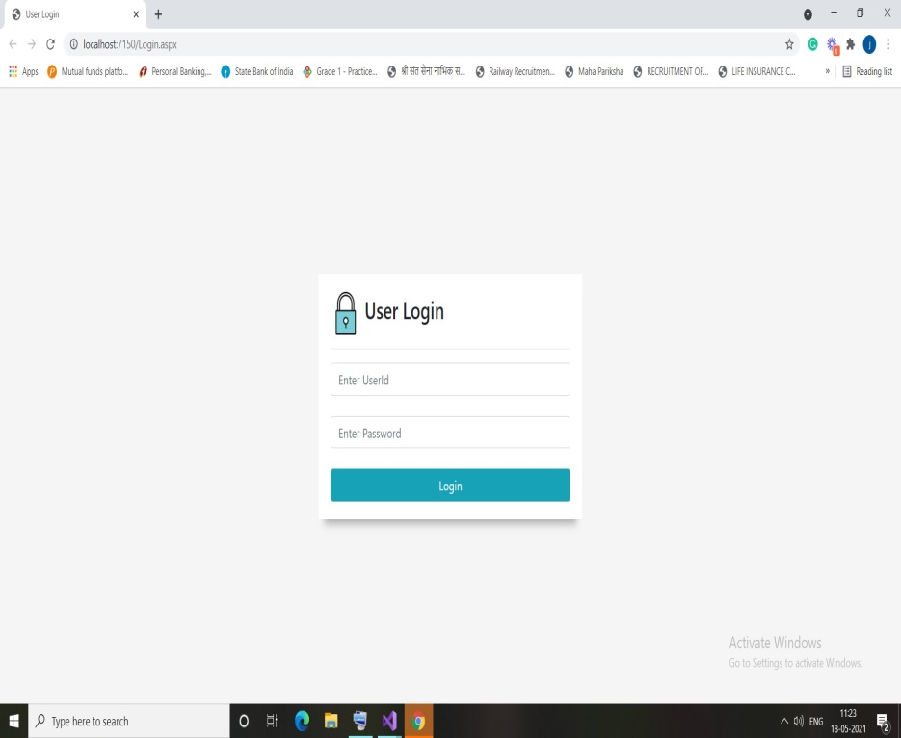
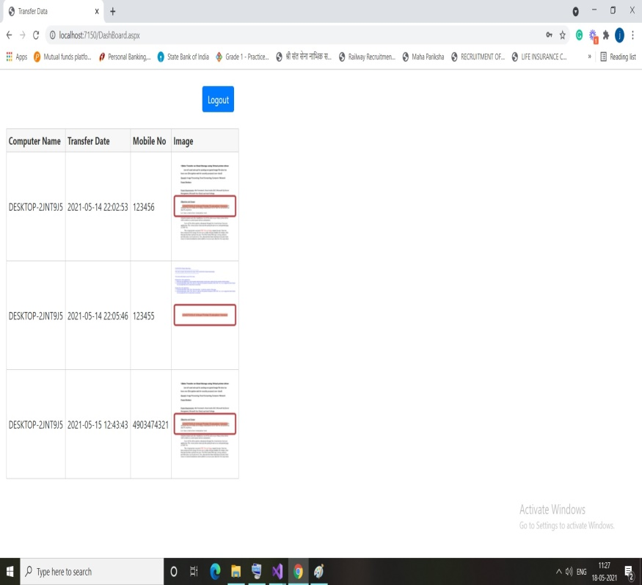
Screenshot of Implementation

Slide 14
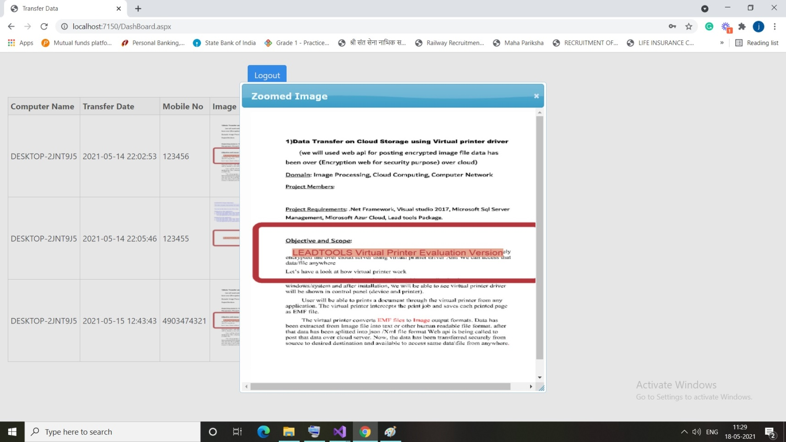
Screenshot of Implementation

Slide 15
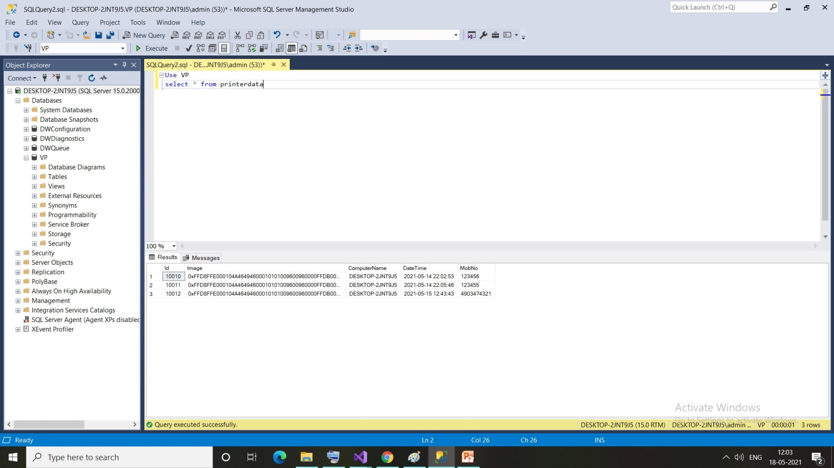
Screenshot of Implementation

Slide 16
Future Scope
Sending documents to a fax server
Allowing user to control certain aspects of printing not supported natively , such as printing multiple pages per sheet without border , print letterhead, watermarks etc.
Previewing a printed document before printing it, to save ink and paper. This functionality is also built into many GUI applications.
This technology is also being used to allow printing from devices such as smart phone.

Slide 17
Reference
Umang Rupareliya, Henali Shaha, Pragnya Kulkarni, Nirmala Baloorkar (2019). Sen- tence Completion using NLP Techniques. ISSN:2321-9653
Christopher Meek, Christopher J.C. Burgs, Aniur Yessenalina, Qiang Liu, Geoffrey Zweig, John C. Platt(2012). Computational Approaches to Sentence Completion.
Heewong Park, Sukhyun Cho, Jonghun Park(2018). Word RNN as a Baseline for Sentence Completion. IEEE
N-gram language modeling titorial Dustin Hillard and Sarah Petersen Lecture notes courtesy of Prof. Mari Ostendorf

Slide 18
Conclusion
The project is to objective of virtual printer is to share securely encrypted file over server using virtual printer driver and we can access that data or file from anywhere.

Slide 19
THANK YOU

