Slide 1
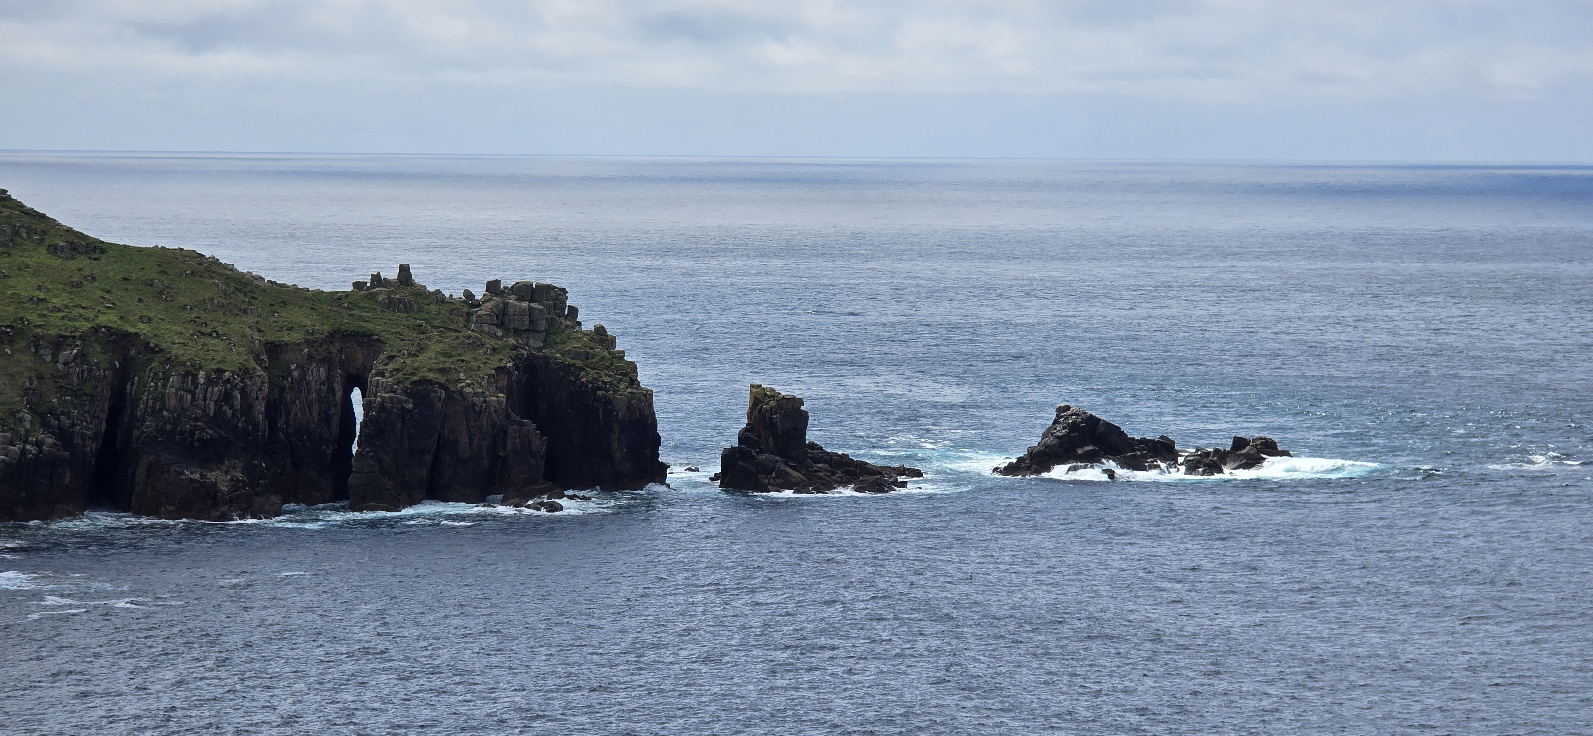
CORNWALL , UNITED KINGDOM
Cornwall, located on the southwestern tip of England, is known for its stunning coastline, picturesque fishing villages, and rich Celtic heritage. With its rugged cliffs, golden beaches, and turquoise waters, it’s a favourite escape for nature lovers and surfers alike.

