Slide 1
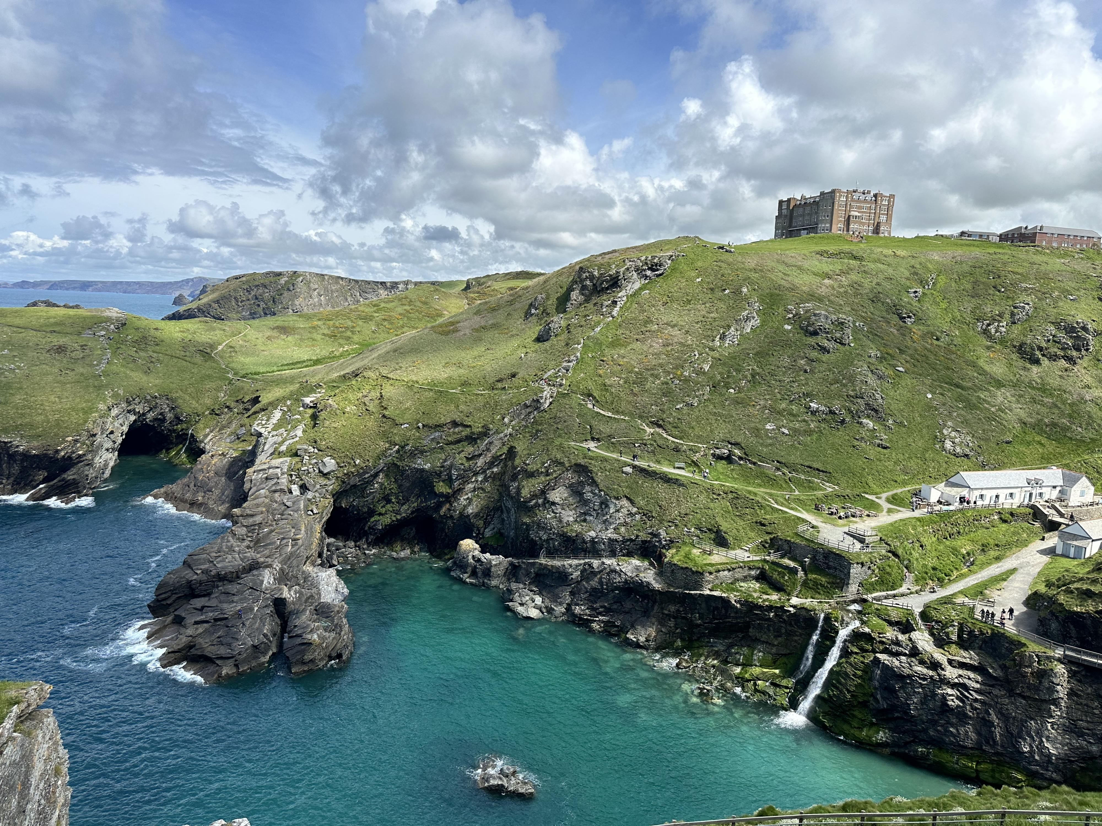
TINTAGEL CASTLE
This breathtaking bronze sculpture stands dramatically on the cliff edge, overlooking the wild Atlantic.
It’s semi-transparent in places—more like a spirit or echo of the legendary king than a solid form.
The statue ties into Tintagel’s rich mythological connection to King Arthur, said to be born there according to legend
“Gallos” means "power" in Cornish. Installed in 2016

