Slide 1
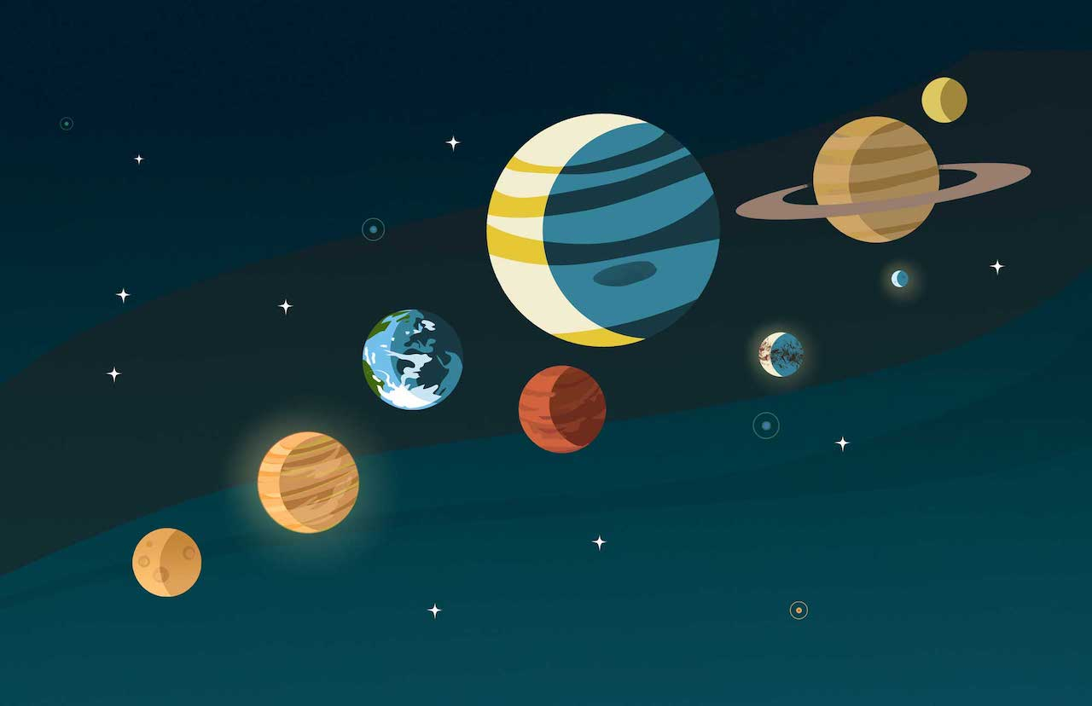
Measuring Mass, Radius, and Density of GJ 436 b
Illustration: NASA/JPL-Caltech/Lizbeth B. De La Torre
Group 2:
Jacob Borison, Leandra Hogrefe, Andrew Miller, Karish Seebaluck

Slide 2

Motivations: Meet GJ 436b!
Orbits a red dwarf with M = 0.41 M_{Sun}
Discovered in 2004 (Butler et al. 2004)
Was the first Neptune-mass planet candidate discovered
How can we determine the mass and radius of this planet?

Slide 3
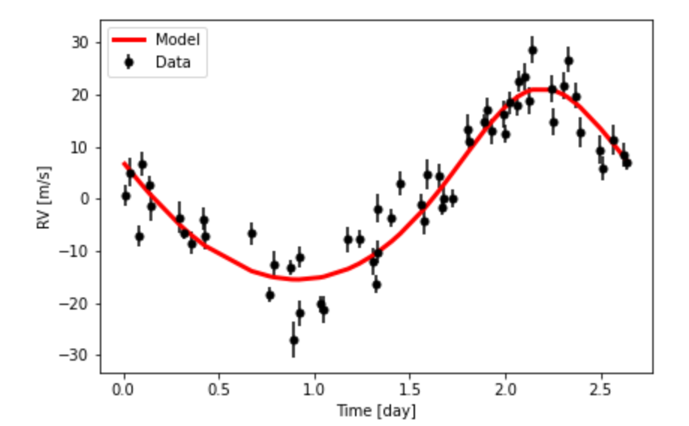
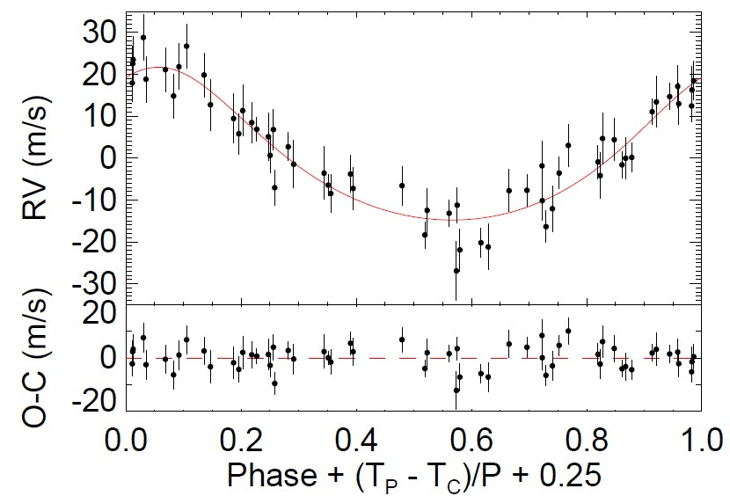
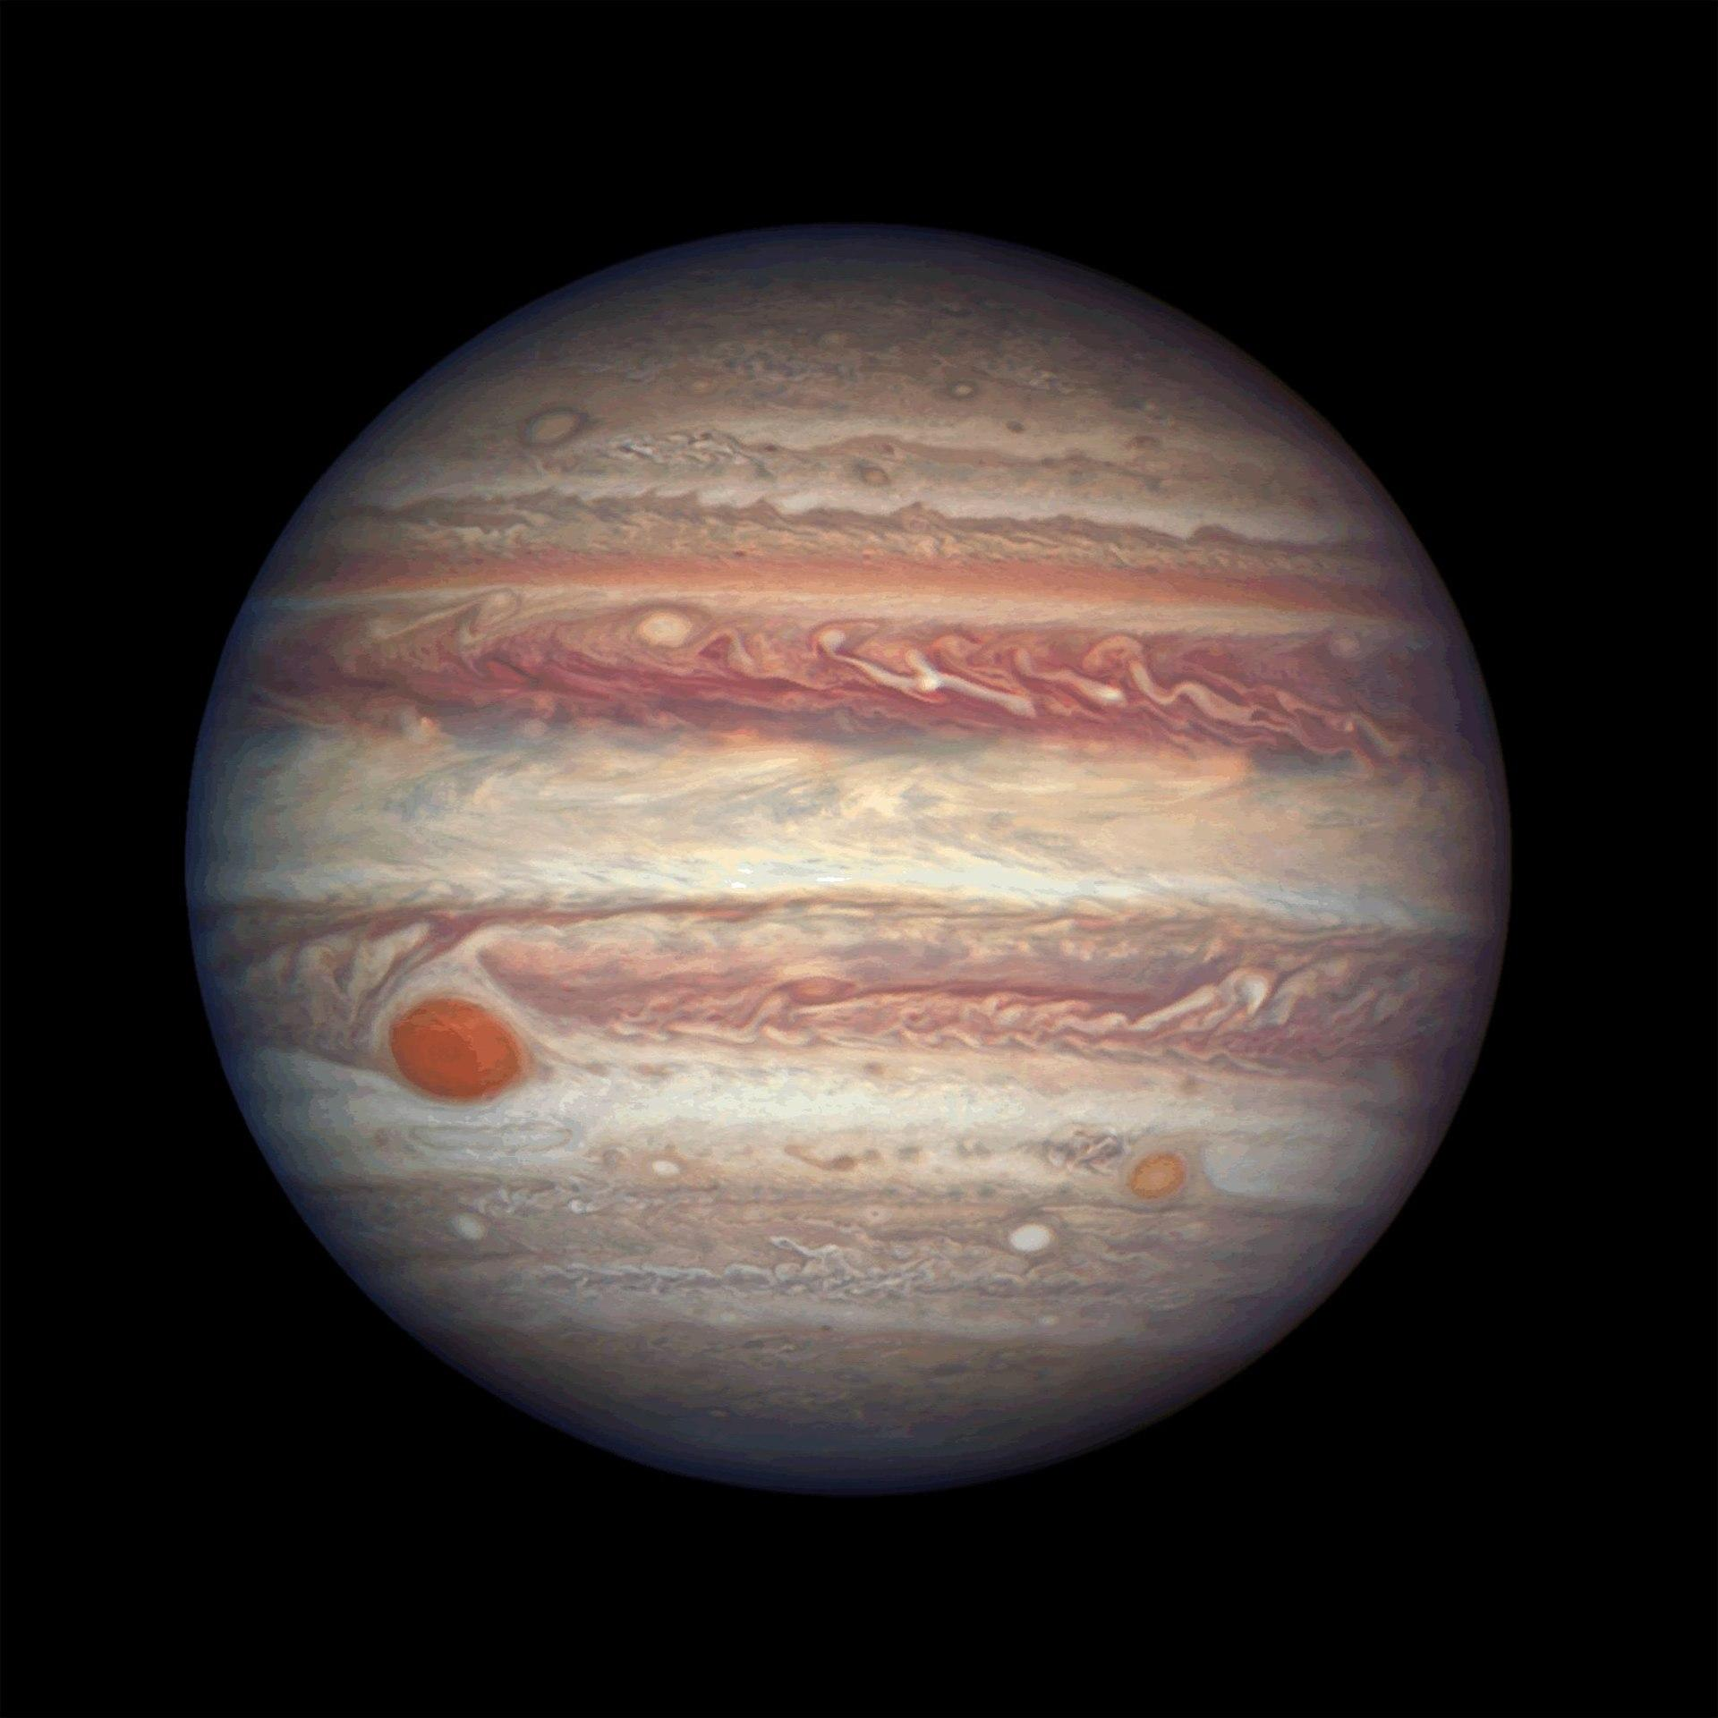
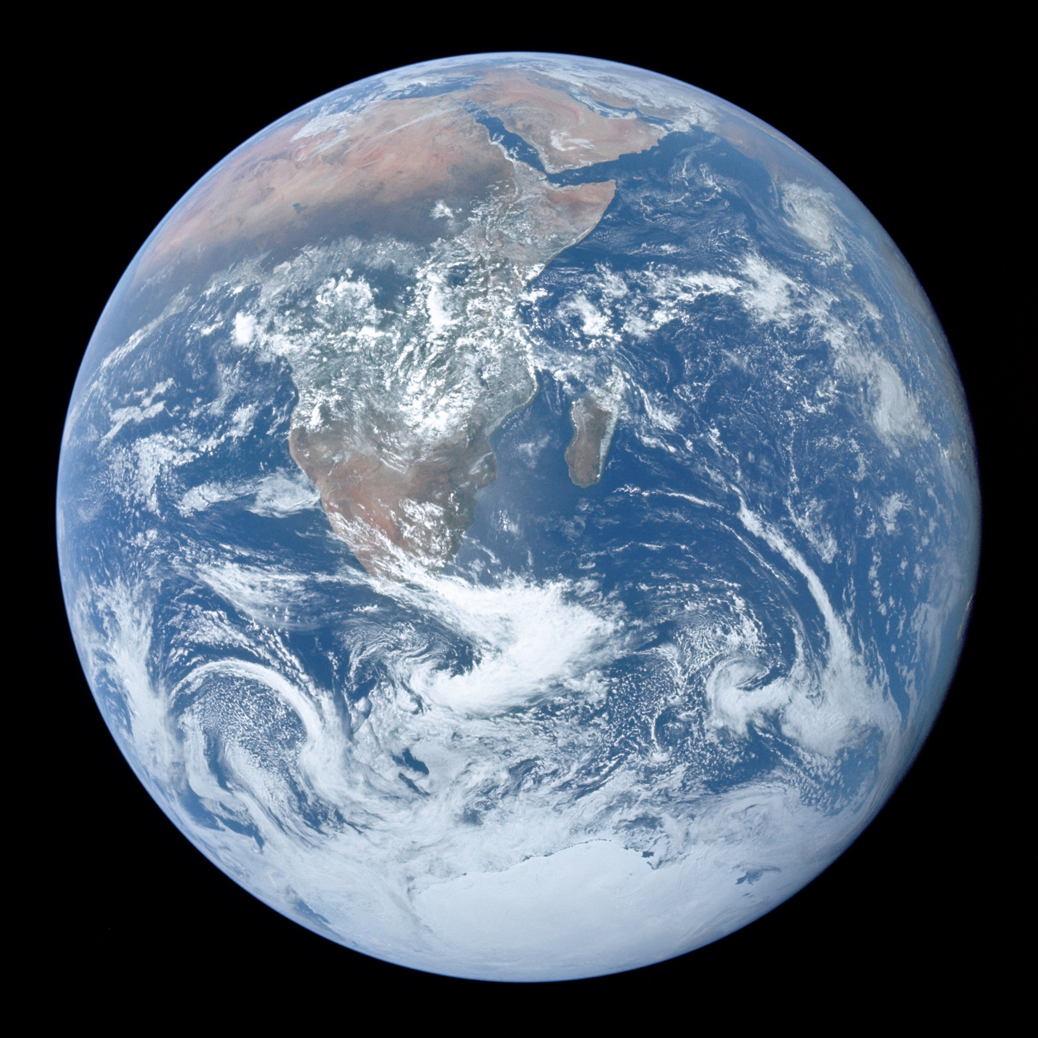
Methods: Measuring Planet Mass with RV
22.52 +/- 3.33 M_{Ꚛ}
1 M_{Ꚛ}
Solar system data from https://nssdc.gsfc.nasa.gov
318 M_{Ꚛ}

Slide 4
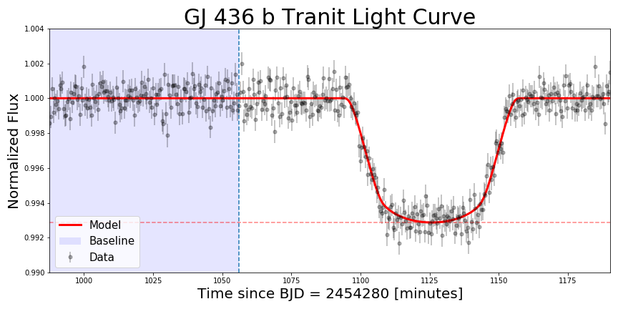
Methods: Measuring Planet Radius with Transits
R = 24,979 ± 71km
3.9 R_{Ꚛ}
1 R_{Ꚛ}
11 R_{Ꚛ}

Slide 5
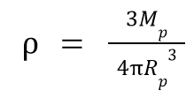
Methods: Measuring Planet Density
Fractional Uncertainty:
(Mass U/Mass) + 3(Radius U/Radius)
2061 +/- 479 kg/m³
1326 kg/m³
5513 kg/m³

Slide 6
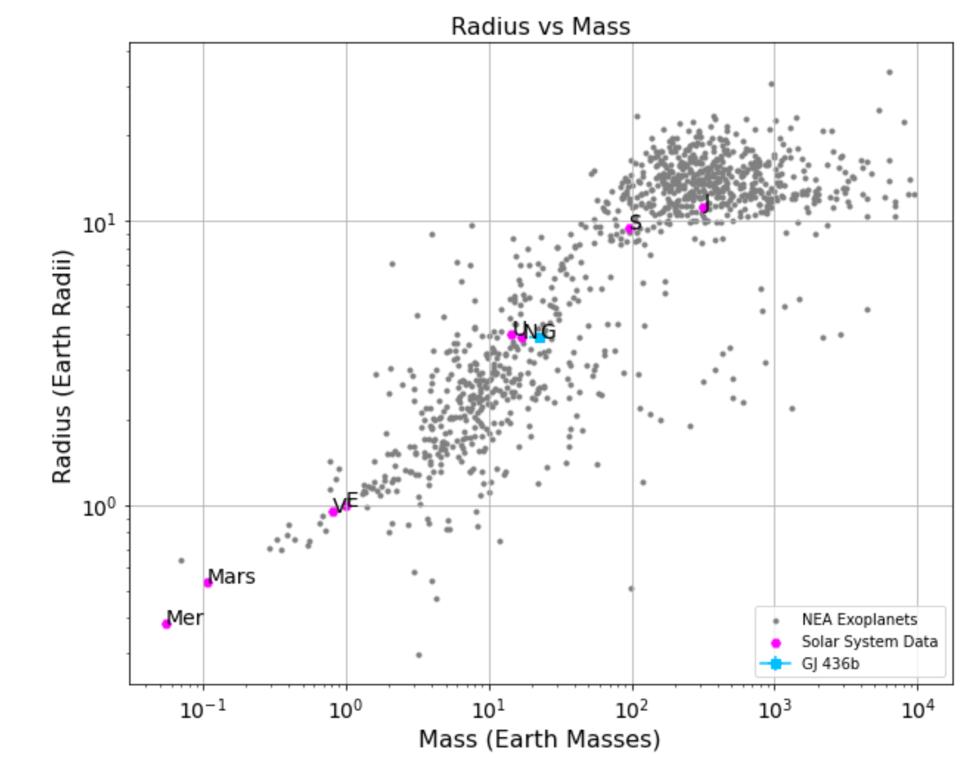
Results: How does GJ 436b compare to other planets?

Slide 7
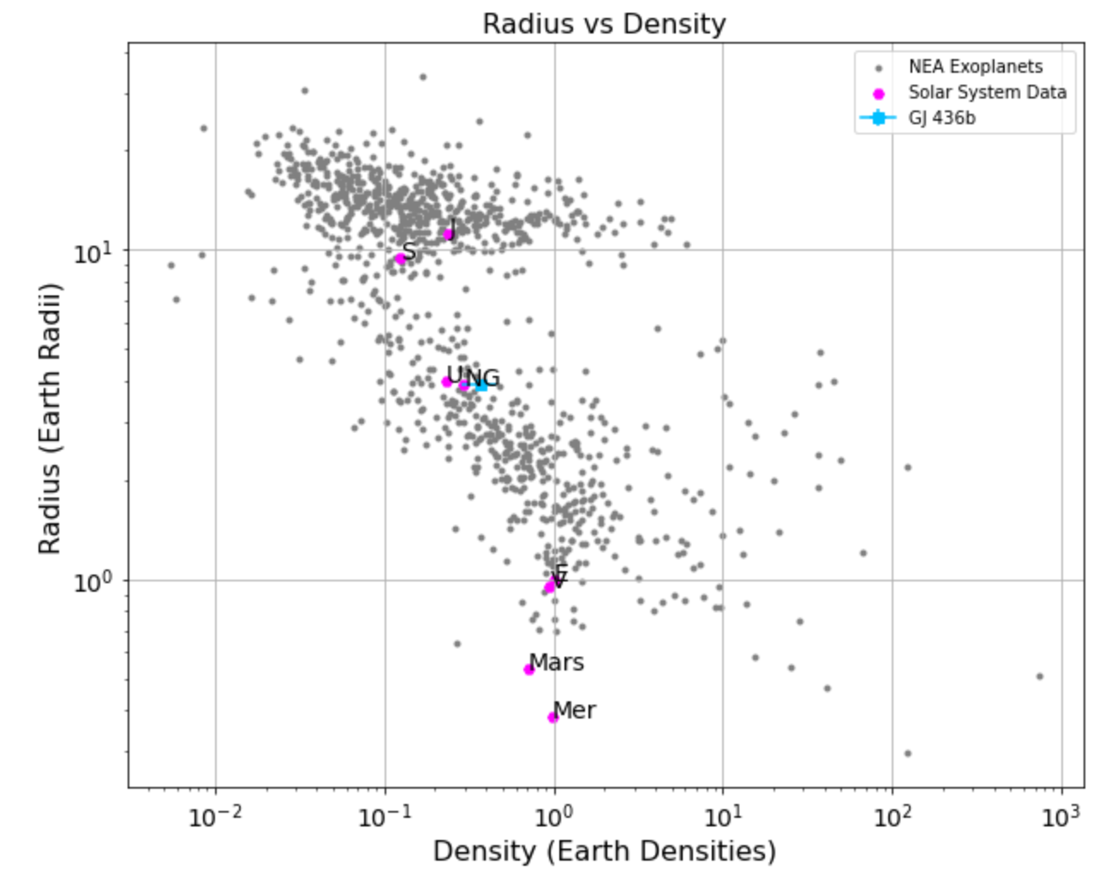
Results: How does GJ 436b compare to other planets?

Slide 8
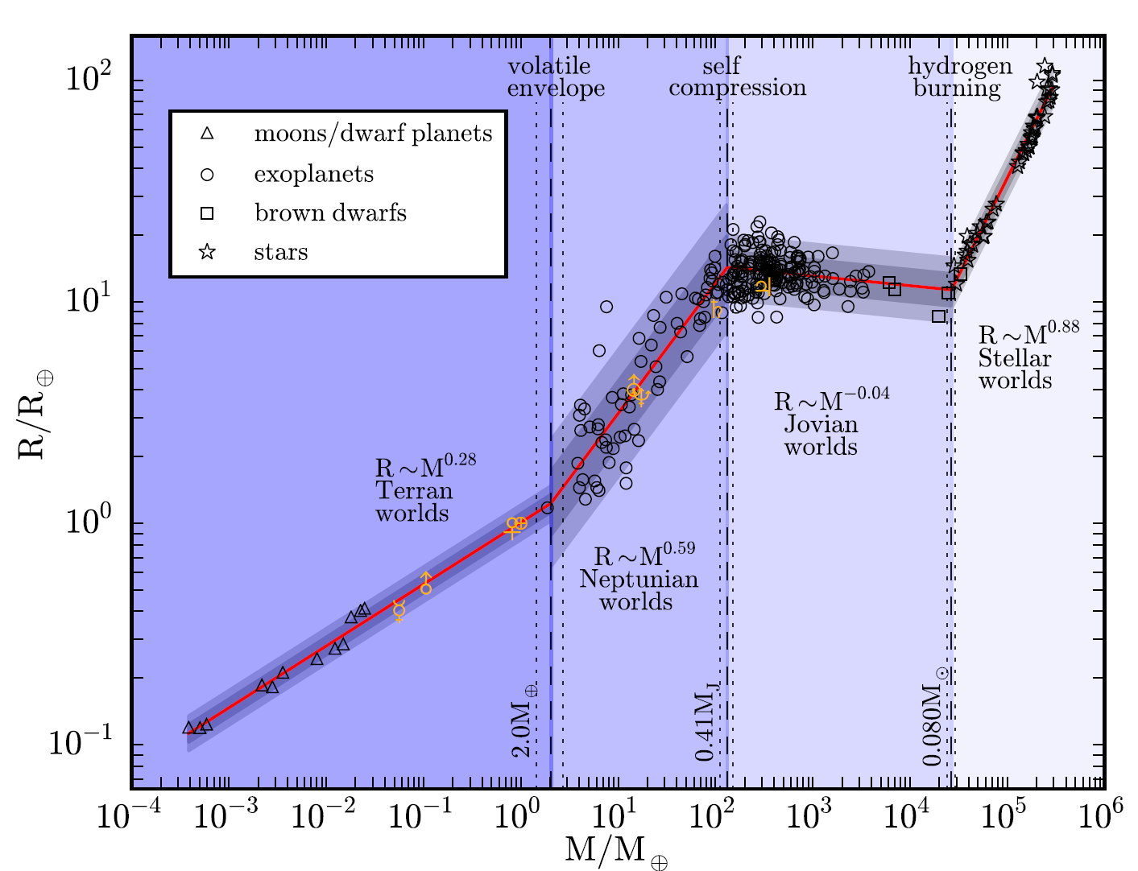
Comparing with Chen & Kipping 2016
22.52^(0.59)=6.2 Earth Radii
“Probabilistic Forecasting of the Masses and Radii of Other Worlds,” Chen & Kipping 2016

Slide 9
Conclusions
Constrained GJ 436b’s mass and radius.
Compare our measurements with other similar exoplanets
Exoplanets detected via both the transit and radial velocity methods are incredibly important

