Slide 1
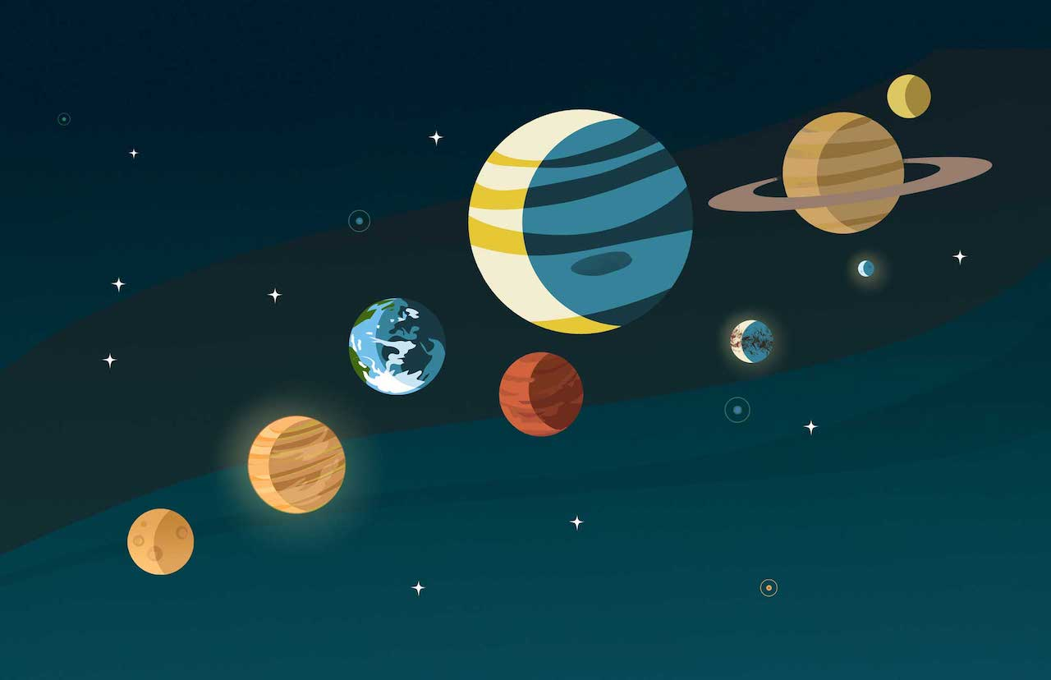
Measuring Planet Mass, Radius, and Density
Illustration: NASA/JPL-Caltech/Lizbeth B. De La Torre
Group 2:
Jacob Borison, Leandra Hogrefe, Andrew Miller, Karish Seebaluck

Slide 2

Motivations: Meet GJ 436b!
Orbits a red dwarf with M = 0.41 M_{Sun}
Discovered in 2004 (Butler et al. 2004)
Was the first planet discovered in its mass category
How can we determine the mass and radius of this planet?

Slide 3
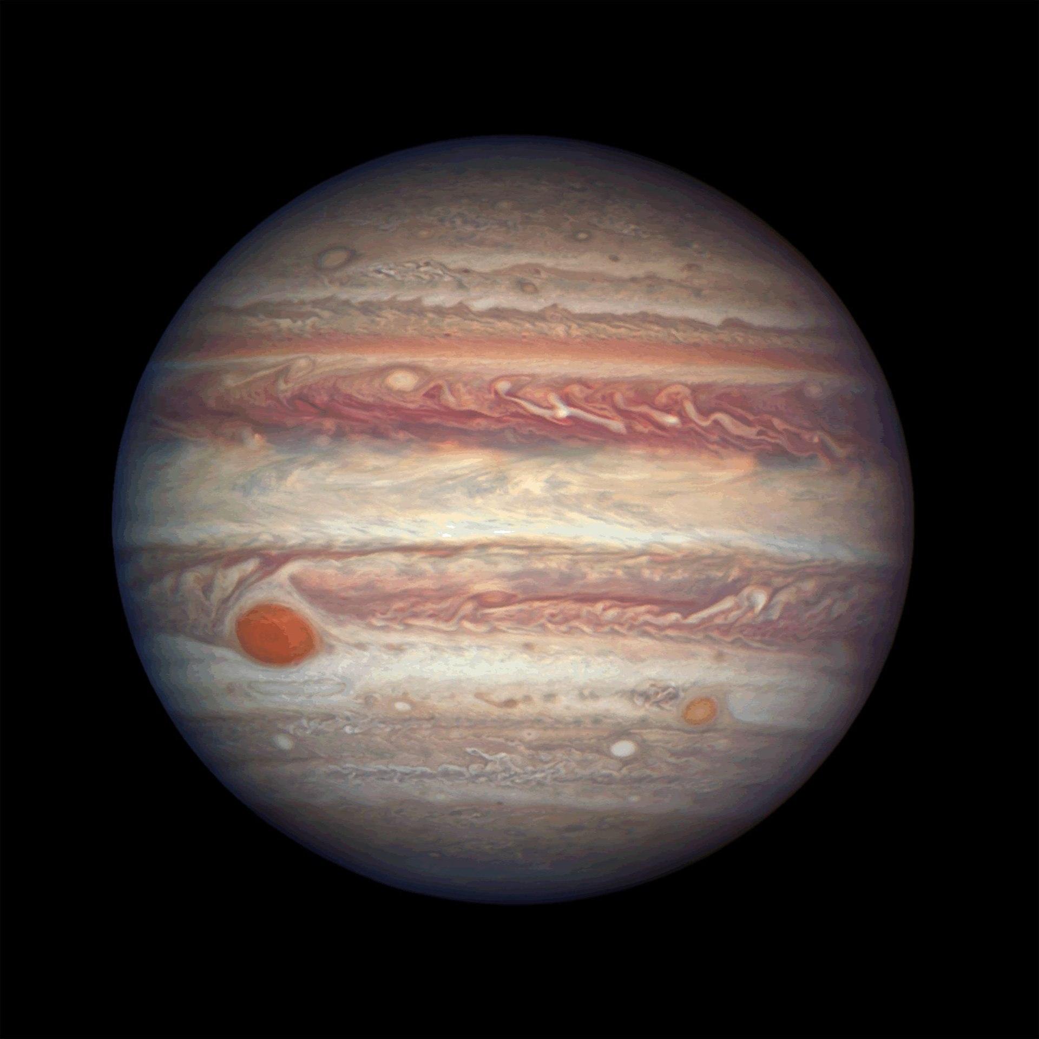
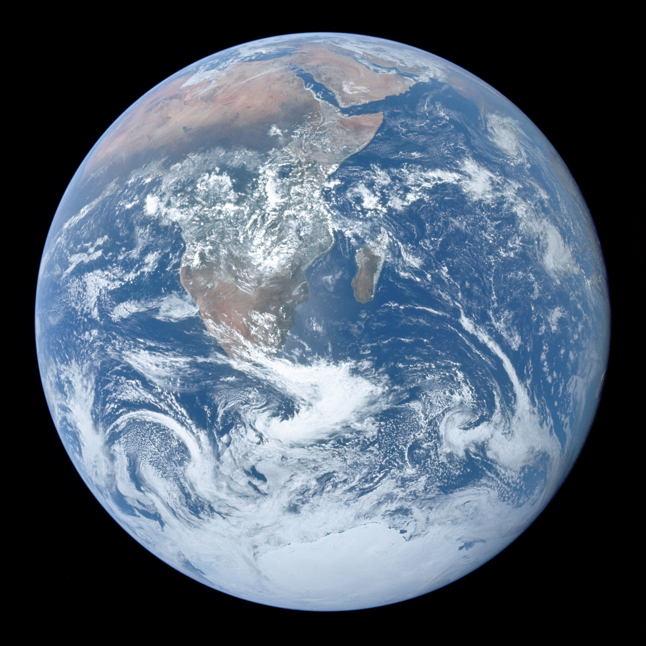
Methods: Measuring Planet Mass
Radial velocity
1 M_{Ꚛ}
Solar system data from https://nssdc.gsfc.nasa.gov
318 M_{Ꚛ}

Slide 4
Methods: Measuring Planet Radius
Transit Method
1 R_{Ꚛ}
11 R_{Ꚛ}

Slide 5
Methods: Measuring Planet Density
Density = Mass/Volume
1326 kg/m³
5513 kg/m³

Slide 6
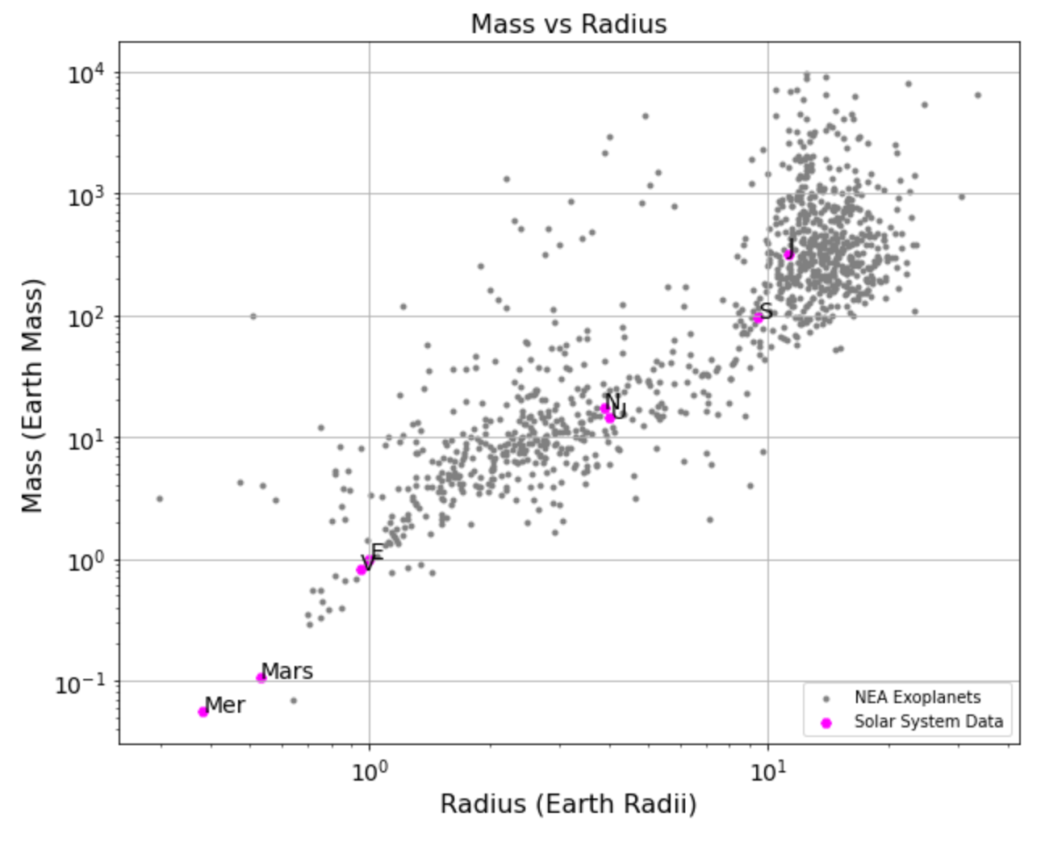
Results: How does GJ 436b compare to other planets?
←Placeholder plot (mass v radius)
Need data for GJ436b

Slide 7
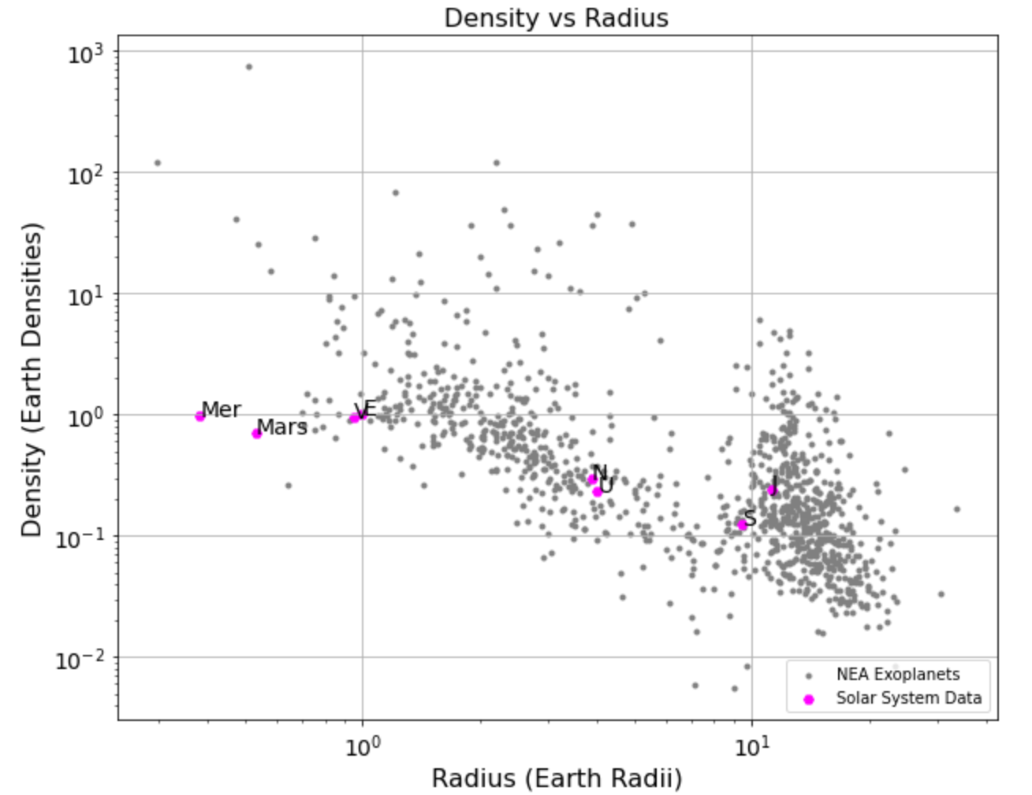
Results: How does GJ 436b compare to other planets?
←Placeholder plot (density v radius)
Need data for GJ436b

Slide 8
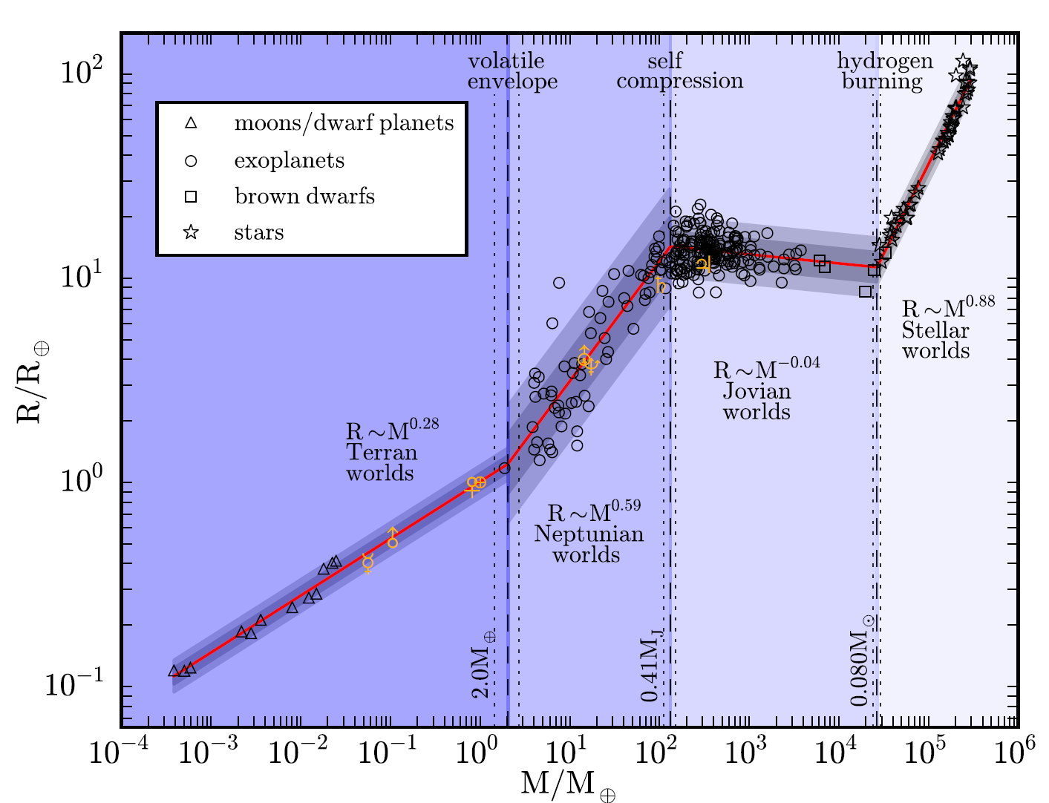
Comparing with Chen & Kipping 2016
Talk here about how our mass/radius relation compares with this plot
“Probabilistic Forecasting of the Masses and Radii of Other Worlds,” Chen & Kipping 2016

Slide 9
Conclusions

