Slide 1
Case Study
Using the cohort of patients who were diagnosed with Stage IV adenocarcinoma NSCLC, we will:
Process data into a analysis-ready matrix of events.
Summarize genomic alteration frequencies and analyze diﬀerences between males and females.
nsclc_cohort <- create_analytic_cohort(
data_synapse =
nsclc_synapse_data$NSCLC_v2.0,
stage_dx = c("Stage IV"),
histology = "Adenocarcinoma",
regimen_drugs =
c("Carboplatin, Pemetrexed Disodium",
"Cisplatin, Pemetrexed Disodium",
"Bevacizumab, Carboplatin, Pemetrexed 10
11
12
13
14
15 )
Characteristic
N = 241¹
naaccr_sex_code
Female
145 (60%)
Male
96 (40%)
1
n (%)
Disodium",
"Bevacizumab, Cisplatin, Pemetrexed Disodium"), regimen_type = "Exact",
regimen_order = 1,
regimen_order_type = "within cancer", return_summary = TRUE
1

Slide 2
Overview of Genomic Data
We will be processing and analyzing data on:
Mutations
1 mutations <- nsclc_synapse_data$NSCLC_v2.0$mutations_extended
Discrete Copy Number Alterations
1 cna <- nsclc_synapse_data$NSCLC_v2.0$cna
Fusions
1 fusions <- nsclc_synapse_data$NSCLC_v2.0$fusions
AACRA Data Guide: https://www.aacr.org/wp-content/uploads/2020/02/20200127_GENIE_Data_Guide_7.pdf
3

Slide 3
Processing Data
5

Slide 4

Issues When Processing Multi-Institutional Genomic Data
6

Slide 5
Issues When Processing Multi-Institutional Genomic Data
1. Multiple Samples Per Patient
6

Slide 6
Issues When Processing Multi-Institutional Genomic Data
1. Multiple Samples Per Patient
We often need to select a single sample per patient for analyses
6

Slide 7
Issues When Processing Multi-Institutional Genomic Data
Multiple Samples Per Patient
We often need to select a single sample per patient for analyses
Cohort Inclusion
6

Slide 8
Issues When Processing Multi-Institutional Genomic Data
Multiple Samples Per Patient
We often need to select a single sample per patient for analyses
Cohort Inclusion
Samples with no alterations may be dropped when pulling data
6

Slide 9
Issues When Processing Multi-Institutional Genomic Data
Multiple Samples Per Patient
We often need to select a single sample per patient for analyses
Cohort Inclusion
Samples with no alterations may be dropped when pulling data
Data Formats & Gene Standards Often Inconsistent
6

Slide 10
Issues When Processing Multi-Institutional Genomic Data
Multiple Samples Per Patient
We often need to select a single sample per patient for analyses
Cohort Inclusion
Samples with no alterations may be dropped when pulling data
Data Formats & Gene Standards Often Inconsistent
Column names, data formats and gene names may diﬀer between studies or even within studies
6

Slide 11
Issues When Processing Multi-Institutional Genomic Data
Multiple Samples Per Patient
We often need to select a single sample per patient for analyses
Cohort Inclusion
Samples with no alterations may be dropped when pulling data
Data Formats & Gene Standards Often Inconsistent
Column names, data formats and gene names may diﬀer between studies or even within studies
Multi-Institutional Studies Use Several Gene Panels
6

Slide 12
Issues When Processing Multi-Institutional Genomic Data
Multiple Samples Per Patient
We often need to select a single sample per patient for analyses
Cohort Inclusion
Samples with no alterations may be dropped when pulling data
Data Formats & Gene Standards Often Inconsistent
Column names, data formats and gene names may diﬀer between studies or even within studies
Multi-Institutional Studies Use Several Gene Panels
Samples may be sequenced using diﬀerent panels, therefore the non-overlapping genes have to be annotated as missing
6

Slide 13
Select One Sample Per Patient
1. Multiple Samples Per Patient
We often need to select a single sample per patient for analyses
7

Slide 14
Select One Sample Per Patient
1. Multiple Samples Per Patient
We often need to select a single sample per patient for analyses
Patients can have many NGS reports
7

Slide 15
Select One Sample Per Patient
1. Multiple Samples Per Patient
We often need to select a single sample per patient for analyses
Patients can have many NGS reports
We can use select_unique_ngs() to select 1 sample per patient
7

Slide 16
Select One Sample Per Patient
1. Multiple Samples Per Patient
We often need to select a single sample per patient for analyses
Patients can have many NGS reports
We can use select_unique_ngs() to select 1 sample per patient
This function prioritizes characteristics of interest and breath of genes sequenced
7

Slide 17
Select One Sample Per Patient
1. Multiple Samples Per Patient
We often need to select a single sample per patient for analyses
Patients can have many NGS reports
We can use select_unique_ngs() to select 1 sample per patient
This function prioritizes characteristics of interest and breath of genes sequenced If patients only have one report, it will be returned regardless of criteria
7

Slide 18

| Select One Sample Per Patient
1. Multiple Samples Per Patient
We often need to select a single sample per patient for analyses
1 nrow(nsclc_cohort$cohort_ngs)
[1] 262
1 nsclc_samp <- select_unique_ngs( 2
3
4
5
6 )
7
8 nrow(nsclc_samp)
data_cohort = oncotree_code sample_type =
nsclc_cohort$cohort_ngs,
= "LUAD",
"Metastasis",
min_max_time = "max"
[1] 241
8

Slide 19
Format Data in Analysis-ready Matrix
sample_id | CREBBP | GLI2 | KRAS | MAP3K1 | PIK3C2B | PBRM1
GENIE-DFCI-004022-1313 | 0 | 0 | 0 | 0 | 0 | NA
GENIE-DFCI-000013-8840 | 0 | 0 | 1 | 0 | 0 | 0
GENIE-DFCI-000136-6004 | 0 | 0 | 1 | 0 | 0 | 0
GENIE-DFCI-000215-8010 | 0 | 0 | 0 | 0 | 0 | 0
GENIE-DFCI-000381-9526 | 0 | 0 | 0 | 0 | 0 | 0
9

Slide 20
Format Data in Analysis-ready Matrix
Next we want to get our genomic data in an analysis-friendly format.
sample_id | CREBBP | GLI2 | KRAS | MAP3K1 | PIK3C2B | PBRM1
GENIE-DFCI-004022-1313 | 0 | 0 | 0 | 0 | 0 | NA
GENIE-DFCI-000013-8840 | 0 | 0 | 1 | 0 | 0 | 0
GENIE-DFCI-000136-6004 | 0 | 0 | 1 | 0 | 0 | 0
GENIE-DFCI-000215-8010 | 0 | 0 | 0 | 0 | 0 | 0
GENIE-DFCI-000381-9526 | 0 | 0 | 0 | 0 | 0 | 0
9

Slide 21
Format Data in Analysis-ready Matrix
Next we want to get our genomic data in an analysis-friendly format.
create_gene_binary() from {gnomeR} will give us a data frame of n
patients x p alterations.
sample_id | CREBBP | GLI2 | KRAS | MAP3K1 | PIK3C2B | PBRM1
GENIE-DFCI-004022-1313 | 0 | 0 | 0 | 0 | 0 | NA
GENIE-DFCI-000013-8840 | 0 | 0 | 1 | 0 | 0 | 0
GENIE-DFCI-000136-6004 | 0 | 0 | 1 | 0 | 0 | 0
GENIE-DFCI-000215-8010 | 0 | 0 | 0 | 0 | 0 | 0
GENIE-DFCI-000381-9526 | 0 | 0 | 0 | 0 | 0 | 0
9

Slide 22
Format Data in Analysis-ready Matrix
Next we want to get our genomic data in an analysis-friendly format.
create_gene_binary() from {gnomeR} will give us a data frame of n
patients x p alterations.
Alteration columns are denoted by the gene name if mutation (e.g. TP53) or gene name + .Amp, .fus, .Del (TP53.Del) for other alterations types.
sample_id | CREBBP | GLI2 | KRAS | MAP3K1 | PIK3C2B | PBRM1
GENIE-DFCI-004022-1313 | 0 | 0 | 0 | 0 | 0 | NA
GENIE-DFCI-000013-8840 | 0 | 0 | 1 | 0 | 0 | 0
GENIE-DFCI-000136-6004 | 0 | 0 | 1 | 0 | 0 | 0
GENIE-DFCI-000215-8010 | 0 | 0 | 0 | 0 | 0 | 0
GENIE-DFCI-000381-9526 | 0 | 0 | 0 | 0 | 0 | 0
9

Slide 23
Format Data in Analysis-ready Matrix
Next we want to get our genomic data in an analysis-friendly format.
create_gene_binary() from {gnomeR} will give us a data frame of n
patients x p alterations.
Alteration columns are denoted by the gene name if mutation (e.g. TP53) or gene name + .Amp, .fus, .Del (TP53.Del) for other alterations types.
Each cell will have 0 if no alteration, 1 if altered, or NA if that gene was not tested in that patient.
sample_id | CREBBP | GLI2 | KRAS | MAP3K1 | PIK3C2B | PBRM1
GENIE-DFCI-004022-1313 | 0 | 0 | 0 | 0 | 0 | NA
GENIE-DFCI-000013-8840 | 0 | 0 | 1 | 0 | 0 | 0
GENIE-DFCI-000136-6004 | 0 | 0 | 1 | 0 | 0 | 0
GENIE-DFCI-000215-8010 | 0 | 0 | 0 | 0 | 0 | 0
GENIE-DFCI-000381-9526 | 0 | 0 | 0 | 0 | 0 | 0
9

Slide 24
Get Data in Standardized Format
2. Data Formats & Gene Standards Often Inconsistent
Column names, data formats and gene names may diﬀer between studies or even within studies!
{gnomeR} functions are designed to work with standard alteration data formats used in common platforms like cBioPortal.
GENIE CNA and fusion data is slightly diﬀerent than this standard, therefore we need to reformat it using:
gnomeR::reformat_fusions() gnomeR::pivot_cna_longer()
Documentation on data formats: https://docs.cbioportal.org/file-formats/
10

Slide 25
Get Data in Standardized Format
Format fusions to follow the cBioPortal standard:
Before: After:
1 fusions 1 reformat_fusion(fusions)
Hugo_Symbol Tumor_Sample_Barcode Fusion sample_id site_1_hugo_symbol site_2_hugo_symbol fusion
TP53
GENIE-MSK-P-0004827-T01- GENIE-MSK- IM5
TP53-intragenic ALK-
P-0003446- T01-IM5 | ALK | EML4 _{EML4}
GENIE-MSK-
P-0003863- | FLT4 | NA FLT4
T01-IM5
GENIE-MSK-
P-0004103- | BRAF | SND1 _{SND1}
T01-IM5
GENIE-MSK-
P-0004336- | CD74 | ROS1 _{ROS1}
T01-IM5
GENIE-MSK-
P-0004827- | TP53 | NA TP53
T01-IM5
GENIE-MSK-
P-0004827- | USP34 | XPO1 _{XPO1}
T01-IM5
XPO1 | GENIE-MSK-P-0004827-T01- IM5 | XPO1-USP34 fusion
USP34 | GENIE-MSK-P-0004827-T01- IM5 | XPO1-USP34 fusion
BRAF-
CD74-
USP34-
11

Slide 26
Get Data in Standardized Format
Format CNA to follow the cBioPortal standard:
Before: After:
1 cna[1:5, 1:3] 1 gnomeR::pivot_cna_longer(cna)
Hugo_Symbol GENIE.DFCI.003908.234520 GENIE.DFCI.002183.6917 hugo_symbol sample_id alteration
ABCB11 0 0
ABL1 0 0
GENIE-DFCI-003908- 234520
APC
gain
ABL2 NA NA
ACTB NA NA
ARID1B
GENIE-DFCI-003908- 234520
loss
BCL2
GENIE-DFCI-003908- 234520
loss
ACTG1 NA NA
BCL6
GENIE-DFCI-002183-6917
gain
CARD11
GENIE-DFCI-002183-6917
gain
Documentation on data formats: https://docs.cbioportal.org/file-formats/
12

Slide 27

| Get Data in Standardized Format
mutations <- nsclc_synapse_data$NSCLC_v2.0$mutations_extended
cna <- nsclc_synapse_data$NSCLC_v2.0$cna
fusions <- nsclc_synapse_data$NSCLC_v2.0$fusions
1 reformat_fusions <- gnomeR::reformat_fusion(fusions) 2
3 nrow(reformat_fusions)
[1] 538
1 reformat_cna <- gnomeR::pivot_cna_longer(cna) 2
3 nrow(reformat_cna)
[1] 38163

Slide 28
Format Data in Analysis-ready Matrix
Basic code:
gnomeR::create_gene_binary(
mutation = mutations,
cna = reformat_cna,
fusion = reformat_fusions)
14

Slide 29
Format Data in Analysis-ready Matrix
Data is now in standardized format and can be processed using {gnomeR}
create_gene_binary()
Basic code:
gnomeR::create_gene_binary(
mutation = mutations,
cna = reformat_cna,
fusion = reformat_fusions)
14

Slide 30
Format Data in Analysis-ready Matrix
Data is now in standardized format and can be processed using {gnomeR}
create_gene_binary()
We will add additional arguments to create_gene_binary() to help address remaining data processing issues
Basic code:
gnomeR::create_gene_binary(
mutation = mutations,
cna = reformat_cna,
fusion = reformat_fusions)
14

Slide 31
Cohort Inclusion
2. Cohort Inclusion
Samples with no alterations may be dropped when pulling raw genomic data
gnomeR::create_gene_binary(
mutation = mutations,
cna = reformat_cna,
fusion = reformat_fusions
samples = nsclc_samp$cpt_genie_sample_id)
The samples argument will ensure all study IDs have a row in resulting analysis data, even if they are not present in genomic files

Slide 32
Not All Patients Tested on Same Panel
4. Multi-Institutional Studies Use Several Gene Panels
Samples may be sequenced using diﬀerent panels therefore the non overlapping genes have to be annotated as missing
gnomeR::create_gene_binary(
mutation = mutations,
cna = reformat_cna,
fusion = reformat_fusions,
samples = nsclc_samp$cpt_genie_sample_id,
specify_panel = nsclc_panels)
The specify_panels argument can insert NAs when we know that gene was not tested for a specific set of patients.

Slide 33
Not All Patients Tested on Same Panel
To use specify_panels, we first need to create a data frame indicating which patient IDs were sequenced on which panels.
nsclc_panels <- data.frame(
sample_id = nsclc_samp$cpt_genie_sample_id,
panel_id = nsclc_samp$cpt_seq_assay_id) %>%
mutate(panel_id = ifelse(!is.na(panel_id),
panel_id, "no"))
6
7 nsclc_panels %>% head()
sample_id panel_id
GENIE-DFCI-000013-8840 DFCI-ONCOPANEL-2 GENIE-DFCI-000136-6004 DFCI-ONCOPANEL-2 GENIE-DFCI-000215-8010 DFCI-ONCOPANEL-2 GENIE-DFCI-000381-9526 DFCI-ONCOPANEL-2 GENIE-DFCI-000410-10003 DFCI-ONCOPANEL-2 GENIE-DFCI-000583-11175 DFCI-ONCOPANEL-2

Slide 34
Not All Patients Tested on Same Panel
Without Panel Annotation With Panel Annotation
binmat1 <- gnomeR::create_gene_binary(
mutation = mutations,
cna = reformat_cna,
fusion = reformat_fusions,
samples = nsclc_samp$cpt_genie_sample_id,
specify_panel = "no")
binmat2 <- gnomeR::create_gene_binary(
mutation = mutations,
cna = reformat_cna,
fusion = reformat_fusions,
samples = nsclc_samp$cpt_genie_sample_id,
specify_panel = nsclc_panels)
sample_id | panel_id | GLI2 | KRAS | PIK3C2B | PBRM1 |  | sample_id | panel_id | GLI2 | KRAS | PIK3C2B | PBRM1
GENIE-DFCI- DFCI- ₀ ₀ ₀ ₀ GENIE-DFCI- DFCI- ₀ |  |  |  |  |  |  |  |  |  | 0 | 0 | NA
GENIE-DFCI- DFCI- ₀ ₁ ₀ ₀ GENIE-DFCI- DFCI- ₀ |  |  |  |  |  |  |  |  |  | 1 | 0 | 0
GENIE-MSK-P- MSK- ₀ ₁ ₀ ₀ GENIE-MSK-P- MSK- _{NA} |  |  |  |  |  |  |  |  |  | 1 | NA | 0
GENIE-MSK-P- MSK- ₀ ₀ ₀ ₀ GENIE-MSK-P- MSK- _{NA} |  |  |  |  |  |  |  |  |  | 0 | NA | 0
004022-1313
ONCOPANEL-1
004022-1313
ONCOPANEL-1
000013-8840
ONCOPANEL-2
000013-8840
ONCOPANEL-2
0002725-T01-IM3
IMPACT341
0002725-T01-IM3
IMPACT341
0017722-T02-IM6
IMPACT468
0017722-T02-IM6
IMPACT468

Slide 35
Ensure Gene Names Are Consistent Across Studies
2. Data Formats & Gene Standards Often Inconsistent
Column names, data formats and gene names may diﬀer between studies or even within studies.
no_recode <- gnomeR::create_gene_binary(
samples = nsclc_samp$cpt_genie_sample_id,
mutation = mutations,
cna = reformat_cna,
fusion = reformat_fusions,
specify_panel = nsclc_panels,
recode_aliases = "no")
recode <- gnomeR::create_gene_binary(
samples = nsclc_samp$cpt_genie_sample_id,
mutation = mutations,
cna = reformat_cna,
fusion = reformat_fusions,
specify_panel = nsclc_panels,
recode_aliases = "impact")
1 setdiff(names(no_recode), names(recode)) %>% head()
[1] “MRE11A” “RFWD2” “H3F3A” “FAM46C” “HIST1H3D” “WHSC1L1”

Slide 36
| Process Data: Final Dataset
Let’s run create_gene_binary() with the samples, specify_panel and
recode_aliases arguments.
First we create nsclc_panels:
nsclc_panels <- data.frame(
sample_id = nsclc_samp$cpt_genie_sample_id,
panel_id = nsclc_samp$cpt_seq_assay_id) %>%
mutate(panel_id = ifelse(!is.na(panel_id),
panel_id, "no"))
Then run create_gene_binary():
gene_binary <- gnomeR::create_gene_binary(
mutation = mutations,
cna = reformat_cna,
fusion = reformat_fusions,
samples = nsclc_samp$cpt_genie_sample_id,
specify_panel = nsclc_panels,
recode_aliases = "impact")

Slide 37
Analyzing Data

Slide 38
Issues When Analyzing Multi-Institutional Genomic Data
23

Slide 39
Issues When Analyzing Multi-Institutional Genomic Data
1. Multiple Testing and False Positives
23

Slide 40
Issues When Analyzing Multi-Institutional Genomic Data
1. Multiple Testing and False Positives
Many hypothesis tests done simultaneously can lead to high rate of false positive findings.
23

Slide 41
Issues When Analyzing Multi-Institutional Genomic Data
1. Multiple Testing and False Positives
Many hypothesis tests done simultaneously can lead to high rate of false positive findings. Very low prevalence genes are often not very informative.
23

Slide 42
Issues When Analyzing Multi-Institutional Genomic Data
1. Multiple Testing and False Positives
Many hypothesis tests done simultaneously can lead to high rate of false positive findings. Very low prevalence genes are often not very informative.
Choose a threshold (e.g. 1% or 5 %) a prior to limit number of hypothesis tests and consider reporting a q- value (adjusted for multiple testing).
23

Slide 43
Issues When Analyzing Multi-Institutional Genomic Data
Multiple Testing and False Positives
Many hypothesis tests done simultaneously can lead to high rate of false positive findings. Very low prevalence genes are often not very informative.
Choose a threshold (e.g. 1% or 5 %) a prior to limit number of hypothesis tests and consider reporting a q- value (adjusted for multiple testing).
Limited Power To Detect Clinical Associations When Sparse Alterations
23

Slide 44
Issues When Analyzing Multi-Institutional Genomic Data
Multiple Testing and False Positives
Many hypothesis tests done simultaneously can lead to high rate of false positive findings. Very low prevalence genes are often not very informative.
Choose a threshold (e.g. 1% or 5 %) a prior to limit number of hypothesis tests and consider reporting a q- value (adjusted for multiple testing).
Limited Power To Detect Clinical Associations When Sparse Alterations
If biologically meaningful, you may want to summarize on alteration, gene or pathway Level
23

Slide 45
Case Study
We will use the processed binary data frame data (gene_binary) to summarize genomic alterations overall in the cohort, and by sex.
First, we need to join clinical data on sex to genomic data

Slide 46
| Add Clinical Variable To Data
# get patient IDs and sample IDs
patient_index <- nsclc_cohort$cohort_ngs %>%
select(record_id, cpt_genie_sample_id) 4
# Join sex data to patient ID index
select_clinical <- nsclc_cohort$cohort_pt_char %>%
select(record_id, naaccr_sex_code) %>%
left_join(patient_index) 9
# Join all to gene binary data
gene_binary <- gene_binary %>%
left_join(select_clinical,
by = c("sample_id"= "cpt_genie_sample_id
select(-record_id) 15
gene_binary <- gene_binary %>%
select(sample_id, naaccr_sex_code, everything()) 18
gene_binary %>%
select(naaccr_sex_code) %>%
tbl_summary()
Characteristic N = 241¹
naaccr_sex_code
Female 145 (60%)
Male 96 (40%)
¹ n (%)

Slide 47
Subset By a Prevalence Threshold
1. Multiple Testing and False Positives
Use subset_by_frequency(t) to subset genes above a given threshold t indicates a prevalence threshold between 0 (t = 0) and 100% (t = 1) other_vars retains the clinical variable of interest in the resulting data set

Slide 48
| Subset By 40% Threshold
1 ncol(gene_binary)
[1] 1403
nscl_subset <- gene_binary %>%
subset_by_frequency(t = .4, other_vars = naaccr_sex_code) 3
4 ncol(nscl_subset)
[1] 6

Slide 49
Subset by a Panel
Use subset_by_panel() to subset genes in a given targeted panel.
1 ncol(gene_binary)
[1] 1403
nscl_subset_panel <- gene_binary %>%
subset_by_panel(panel_id = 'IMPACT300', other_vars = naaccr_sex_code) 3
4 ncol(nscl_subset_panel)
[1] 220

Slide 50
Summarize Alterations with tbl_genomic()
tbl_genomic() is a wrapper function for gtsummary::tbl_summary()
specifically designed for presenting genomic data
You can use any {gtsummary} function on top of tbl_genomic() to customize the table (e.g. bold_labels())

Slide 51
| Summarize Alterations with tbl_genomic
Create a simple tbl_genomic object, then bold the labels.
nscl_subset %>%
select(-naaccr_sex_code) %>%
tbl_genomic() %>%
bold_labels()
Characteristic | N = 241¹
TP53 | 124 (51%)
GBA.Amp | 17 (46%)
Unknown | 204
KRAS | 98 (41%)
JAZF1.Amp | 15 (41%)
Unknown | 204
¹ n (%)

Slide 52
Summarize Genes with tbl_genomic()
You may want to analyze on the gene level instead of the alteration level. Use summarize_by_gene() first, then pass to tbl_genomic():
Note: summarize_by_gene() should come before passing to subset_by_frequency()
tbl_gene <- gene_binary %>%
select(-naaccr_sex_code) %>%
summarize_by_gene() %>%
subset_by_frequency(t = .4) %>%
tbl_genomic() 6
7 tbl_gene
Characteristic
N = 241¹
TP53
135 (56%)
GBA
17 (46%)
Unknown
204
PTK2B | 17 (46%)
Unknown | 204
KRAS | 107 (44%)
WRN | 38 (41%)
Unknown | 149
JAZF1 | 15 (41%)
Unknown | 204
¹ n (%)

Slide 53
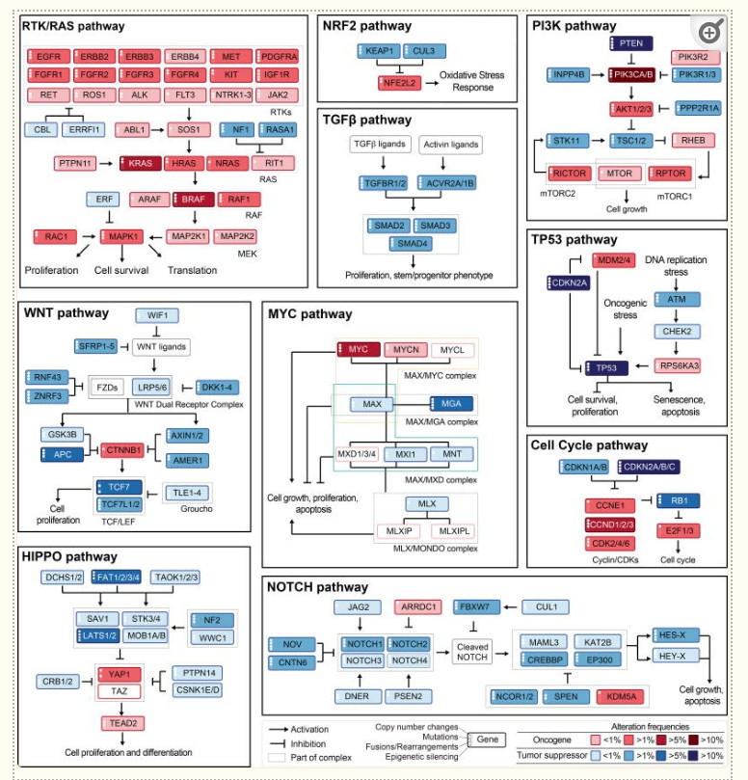
Summarize Oncogenic Pathways
2. Limited Power To Detect Clinical Associations When Sparse Alterations
If biologically meaningful, you may want to summarize on Alteration, Gene or Pathway Level
Often we want to analyze alterations on the pathway level.

Slide 54
Summarize Oncogenic Pathways
2. Limited Power To Detect Clinical Associations When Sparse Alterations
If biologically meaningful, you may want to summarize on Alteration, Gene or Pathway Level
{gnomeR} oﬀers several default pathways that can be added with
add_pathways()
paths <- gnomeR::pathways %>% names()
paths
[1] “RTK/RAS” “Nrf2” “PI3K” “TGFB” “p53”
[6] “Wnt” “Myc” “Cell cycle” “Hippo” “Notch”

Slide 55
Summarize Oncogenic Pathways
You can also add a custom pathway:
path_df <- gene_binary %>%
add_pathways(custom_pathways = c("SPOP.mut", "FOXA1.mut")) 3
path_df %>% select("pathway_custom") %>%
tbl_summary()
Characteristic N = 241¹ pathway_custom 2 (0.8%)
¹ n (%)
Note: You must specify .mut, .Amp, .Del for alterations custom_pathways

Slide 56
| Summarize Alteration Pathways
path_df <- gene_binary %>%
select(-naaccr_sex_code) %>%
add_pathways() 4
path_df %>%
select(contains("pathway")) %>%
tbl_summary() %>%
bold_labels()
35

Slide 57
| Summarize Alteration Pathways
path_df <- gene_binary %>%
select(-naaccr_sex_code) %>%
add_pathways() 4
path_df %>%
select(contains("pathway")) %>%
tbl_summary() %>%
bold_labels()
Characteristic | N = 241¹
pathway_RTK/RAS 217 (90%)
pathway_Nrf2 | 48 (20%)
pathway_PI3K | 114 (47%)
pathway_TGFB | 34 (14%)
pathway_p53 | 181 (75%)
pathway_Wnt | 51 (21%)
pathway_Myc | 70 (29%)
pathway_Cell cycle 90 (37%)
pathway_Hippo | 31 (13%)
pathway_Notch | 72 (30%)
¹ n (%)
35

Slide 58
Comparing Alteration Frequencies Across Clinical Data
We can easily compare frequencies by sex using the by argument:
tbl_gene <- gene_binary %>%
subset_by_frequency( 3 t = .4,
other_vars = naaccr_sex_code) %>%
tbl_genomic(by = naaccr_sex_code) %>%
bold_labels() 7
8 tbl_gene
36

Slide 59
Comparing Alteration Frequencies Across Clinical Data
We can easily compare frequencies by sex using the by argument:
tbl_gene <- gene_binary %>%
subset_by_frequency( 3 t = .4,
4 other_vars = naaccr_sex_code) %>%
Characteristic Overall, N = 241¹ TP53 124 (51%)
GBA.Amp 17 (46%)
Female, N = 145¹
Male, N = 96¹
72 (50%)
52 (54%)
8 (36%)
9 (60%)
5 | tbl_genomic(by | = | naaccr_sex_code) | %>%
6 | bold_labels() |  |  |  | Unknown | 204 | 123 | 81
7 8 tbl_gene ^{KRAS} |  |  |  |  |  | 98 (41%) | 66 (46%) | 32 (33%)
JAZF1.Amp |  |  |  |  |  | 15 (41%) | 9 (41%) | 6 (40%)
Unknown
204
123
81
¹ n (%)
36

Slide 60
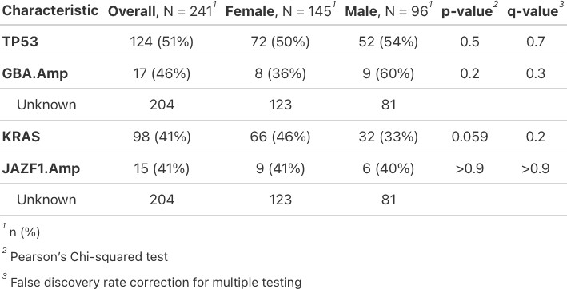
Comparing Alteration Frequencies Across Clinical Data
1. Multiple Testing and False Positives
gene_binary %>%
subset_by_frequency( 3 t = .4,
other_vars = naaccr_sex_code) %>%
tbl_genomic(
by = naaccr_sex_code) %>%
bold_labels() %>% 8 add_p() %>%
9 add_q()
37

Slide 61
| Comparing Alteration Frequencies Across Clinical Data
tbl_gene <- gene_binary %>%
subset_by_frequency( 3 t = .4,
other_vars = naaccr_sex_code) %>%
tbl_genomic(by = naaccr_sex_code) %>%
bold_labels() %>% 7 add_p() %>%
8 add_q()
9
10 tbl_gene

Slide 63
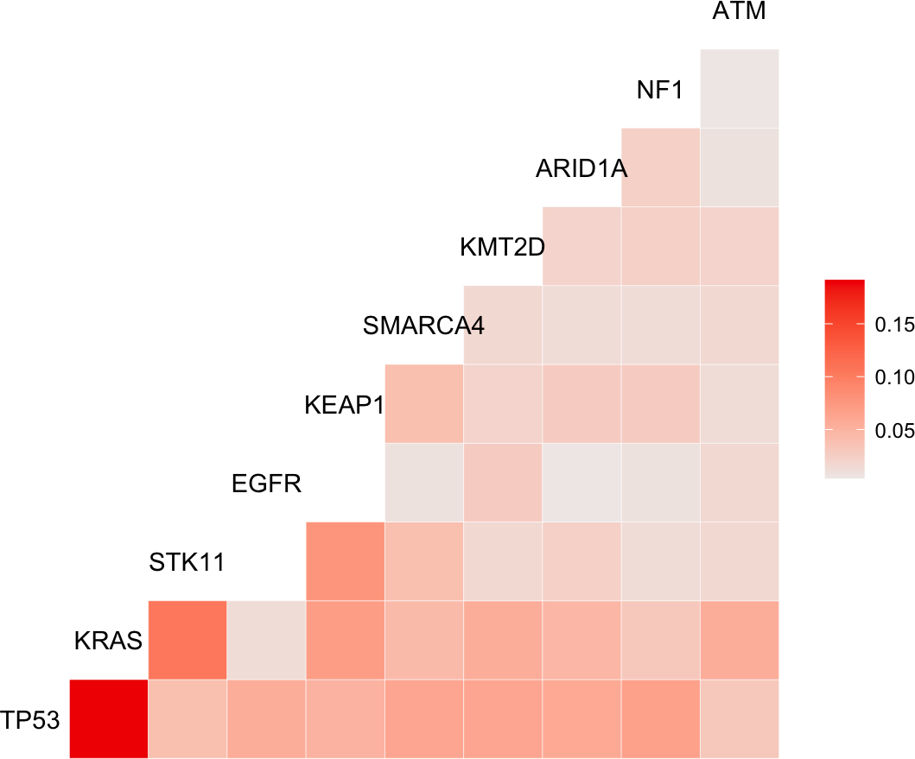
Visualize Data
1 gnomeR::ggcomut(nsclc_cohort$cohort_mutations_extended)

Slide 64
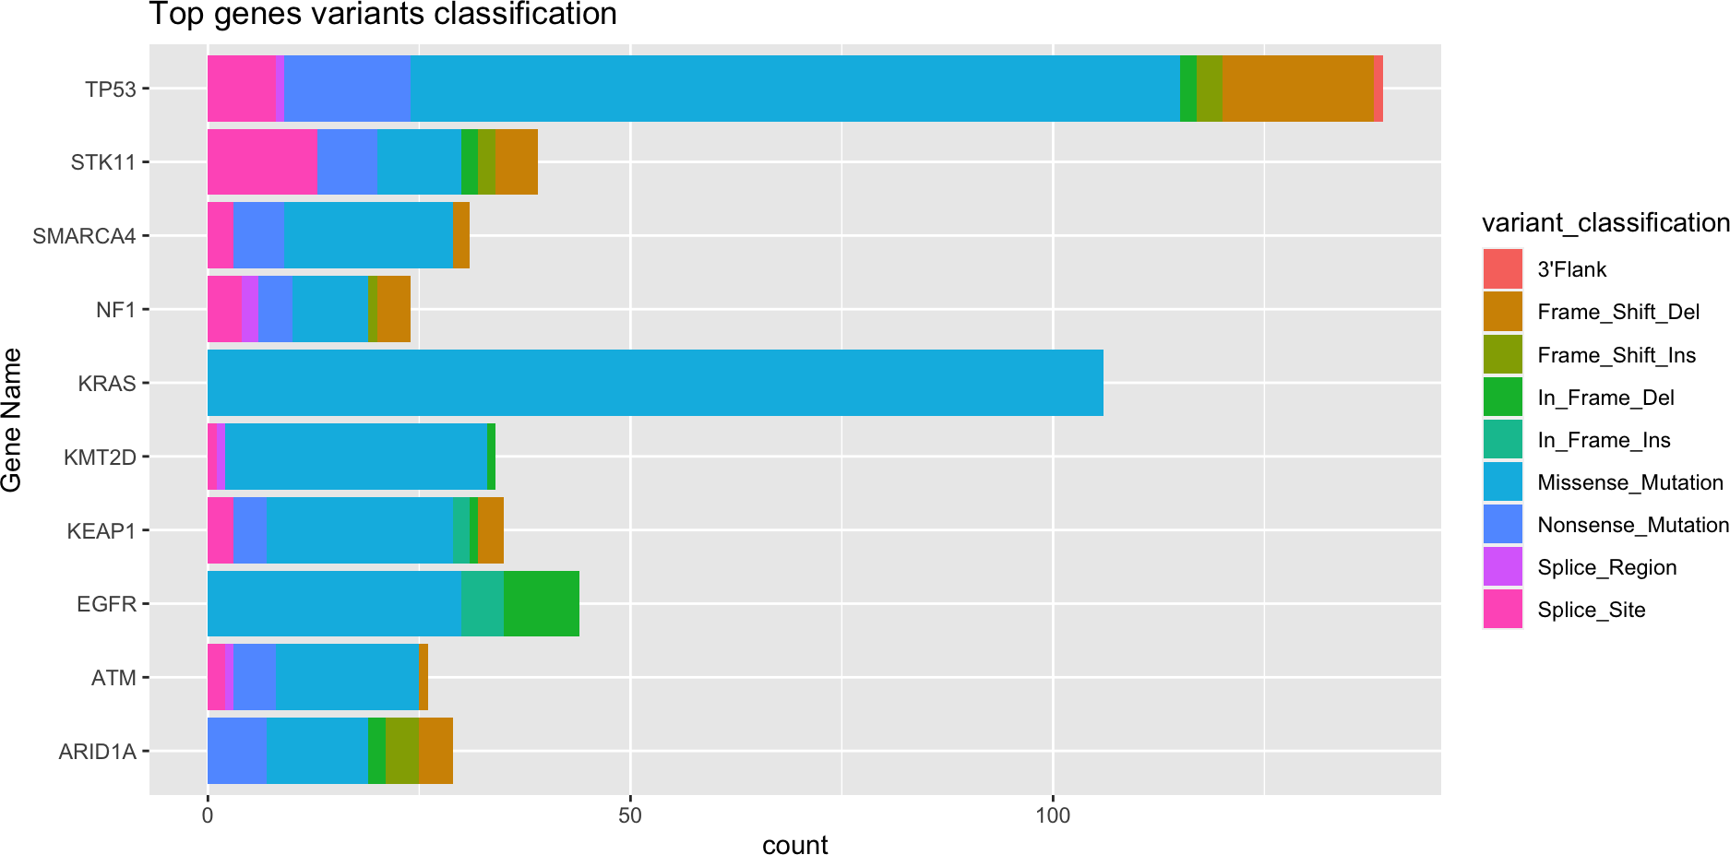
Visualize Data
1 gnomeR::ggtopgenes(nsclc_cohort$cohort_mutations_extended)

Slide 65
Additional Items & Next Steps
Additional visualizations and color palettes useful for genomic data are available in {gnomeR} package
Some data may require additional data checks. See {gnomeR vignette} for helpful tips on data QA.
It may be appropriate to oncoKB annotate your data and only analyze oncogenic mutations (see oncoKB.org for more information)
Some projects may utilize CNA Segmentation data. See {gnomeR documentation} for more information on available tools.

Slide 66
Thank You!

