Slide 1
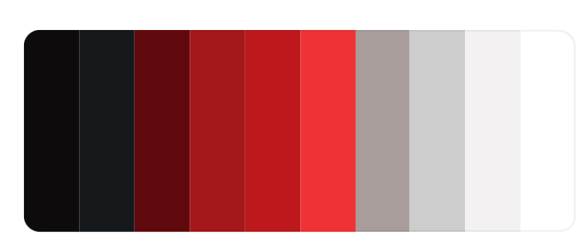
Markowitz model for portfolio optimization (hvað á það að heita?)
FJAX2
T-620-ENGX
Joseph T. Foley & Heiðar Ingvi Eyjólfsson
14. Mars 2022
Andri Hrafn Þorvaldsson, Aron Páll Símonarson, Hlynur Karl Viðarsson & Róbert Vilhjálmur Ásgeirsson

Slide 2
Efnisyfirlit

Slide 3







Harry Markowitz
Input Data
Portfolio
Optimization
Output Data
Our Product
Notes:
What is the project?
The product is a portfolio optimization model that uses the theories of Nobal Prize winner Harry Markowitz on Portfolio Selection to find the most efficeint portfolio of given securites. The user of the product can input the securites that he wants to construct the portfolio out of and the model will output the most efficient protfolios for different levels of risk. These efficient portfolios are called an efficeint frontier. The program will uses variance or standard deviation, returns and the correlation between the securites to calculate the efficient frontier.
Why is it called that?
As one can guess, the name of our product comes from the inventor of the theories, Harry Markowitz.

Slide 4


Efficient frontier? Why is is important?
Portfolio policy
Efficient frontier
Expected Returns
Risk (Standard Deviation)
Notes:
But what is the efficient frontier and why is it important? An efficient portfolio is a portfolio that has the highest possible return for a standard deviation. That means that no other portfolio has a better return with the same standard deviation. With an efficient frontier, which is the collection of all the efficient porfolios, an investor can choose the his best option of an portfolio for his risk appiatie, or in other words how much standard deviation he is willing to accept on his portfolio.
For investors who are risk averse, want to diversify their investments and want to maximixe their returns for a given risk level; The product is really functional. In the real world the number one problem that the product tries to solve is shaping a viable portfolio policy (fjárfestingastefna semi). That is a target of the mix of securites for a portfolio.
Hönnun:
Animatea efficient frontier á glæruna
Animatea

Slide 5


Target customer
Notes:
The target customers of the product are almost all asset management firms that are looking to construct or optimize their portolio of securities and want to actively update their portfolio policy.
That’s why we chose to work with our current stakeholder. The stakeholder is Akta Capital Management or Akta sjóðir in Icelandic. Akta is a leading independent fund management company here in Iceland. They offer a variety of investment solutions in Icelandic and foreign markets. Their objective is to deliver the best returns for clients return objectives and risk appetites.
Akta is looking for us to develop a Markowitz model that works with two of their domestic funds that contain both stocks and bonds.

Slide 6
Related technology/designs for comparison?
Related technology/ designs for comparison?

Slide 7
Metrics?
Metrics?

Slide 8


Two Stakeholder Interviews
Product Concepts
Notes:
Two possible stakeholders were contacted and interviewed for a short period. This was done to build a list of customer needs. The possible stakeholders were both persons that work in the asset management industry. One works for Arion bank and the other works in asset management at Landsbankinn.
The customer needs were then organized and translated into Functional Requirements.
But why is this important? It is so we can develop Product concepts. Concepts can be developed and based on the functional requirements. 4 initital concepts were developed and two of them were combined to be our main concept. The concepts were chosen using the matrix method that is detailed in the book Product Design and Development.

Slide 9



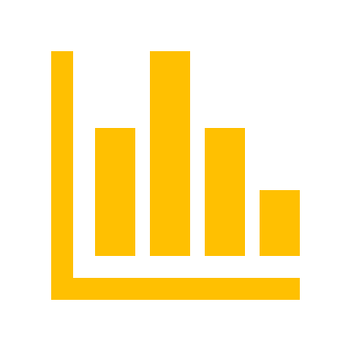

The Combined Final Concept
Outputs Data For Optimal Portfolios
Pulls Data From The Internet
Outputs Visuals Of The Results
Input Of Tickers
Notes:
The Combined final concept: The program uses tickers as an input for securities that are considered by the user to invest in. The program pulls the price series from the internet and outputs the data for the optimal portfolios that are on the efficient frontier and a visual graph that shows the different mean (of the returns) and standard deviation of differently weighted portfolios, and also shows the efficient frontier on that picture.
This is a concept fits with our customers needs because the program will be easy to use because the only input are the tickers and the program returns the most accessible and easily readable results that can be used further in portfolio policies for example.

Slide 10
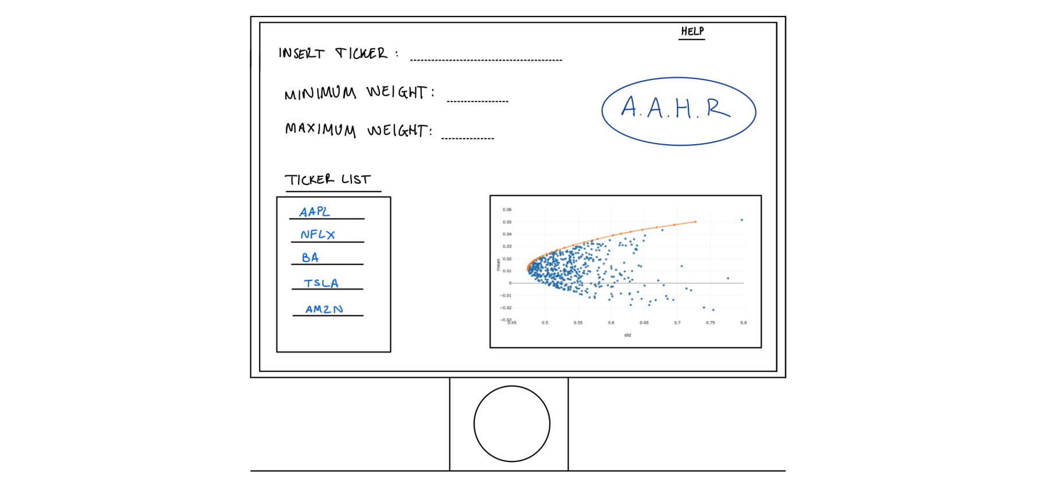




Concept Testing
Verbal Discription
Final Concept Shown To Potential Customers
Like The Product?
Insight Into Features And Requirements
Alternative Concepts
Sketch
Notes:
The final concept was shown to our real potential customers to test it. 5 customers were got a verbal description of the concept and were shown a sketch of how the product looks. The purpose of this concept testing was to receive answers to important questions regarding the project. The things that we liked to know were mainly if our potential customers like our project idea. If they do, we would liked to get their insight into features and requirements that they would like to see in our product and maybe we could modify our concept in the future to match their interests. The survey was useful to get a better understanding of which alternative concepts we should pursue.
Here is the sketch of what a potential interface to the program would look like.
SYNA MYND AF SKETCH
The results of the customer survey was that there are many potential customers for our product but we might have to improve the interface and workings of the product a little. Our survey told us that we should have more information about the stocks themselves and their prices, and more about our results. We could have a special page just about our results where we show the graph and more numerical results
Functional Requirements mapped to concepts that were tested ????????????

Slide 11
Concept testing results
Notes:
The results of the customer survey was that there are many potential customers for our product but we might have to improve the interface and workings of the product a little. Our survey told us that we should have more information about the stocks themselves and their prices, and more about our results. We could have a special page just about our results where we show the graph and more numerical results

Slide 12
Design details
Modules?
PS (Problem Solution) details?
Data/CAD/Sketches/Equations?
Notes:
Data scraping

Slide 13
Resources
Bill of Materials?
Notes:
Every project needs resources in the form of materials, time and knowledge amongst many others. Since our project is developing a software, the bill of materials isn´t as rich in content as if we were designing and developing a physical product. The main resources of the project is the time and knowledge of the team. The only physical resources needed is a basic computer that is able to run a simple application.

Slide 14
Resources
Estimated costs and demands?
Additional resources needed?
Notes:
*
*An additional resource to the computer mentioned in the bill of materials is of course electricity to run the computer.

Slide 15
Status
What have we done?
What is the current state?

Slide 16
Status
Is there any hard or interesting problems that need to be solved?

Slide 17
Tasks Remaining
What is left to be done?
Break down by time remaining in class
Use a Gantt chart to do that.

