Slide 1

AUTOBIOGRAPHICAL ESSAY NAVIGATING THE CODE OF LIFE: The Journey of Joseph Kariuki JOSEPH NJENGA KARIUKI C026-01-0696/2020 SUPERVISOR: MR. MICHAEL KAGIRI

Slide 2
Introduction
In this presentation, we'll explore my autobiography—a tale of a young man with a passion for computer science. Through my journey, we'll uncover my experiences, challenges, and the steadfast determination that has shaped who I am today.

Slide 3
Chapter 1: Journey of Dreams
Born in Dundori, Kenya, on a sunny day in April 2002
Began his education at Gladways Junior Academy at the tender age of four
Developed a love for learning and a thirst for knowledge
Faced the challenge of adapting to a new environment at Ciira Primary School
Achieved academic excellence through hard work and dedication
Scored an exceptional 383 out of 500 on the KCPE exam.

Slide 4
Chapter 2: Nurturing Flames of Curiosity
Gladways Junior Academy ignited Joseph's curiosity and love for learning
Teachers played a significant role in shaping his academic foundation
Faced the challenge of adapting to a new environment at Ciira Primary School
Achieved academic excellence through hard work and dedication
Achieved an exceptional score of 383 out of 500 on the KCPE exam
This chapter highlights the importance of my early education and the positive influence of his teachers.

Slide 5
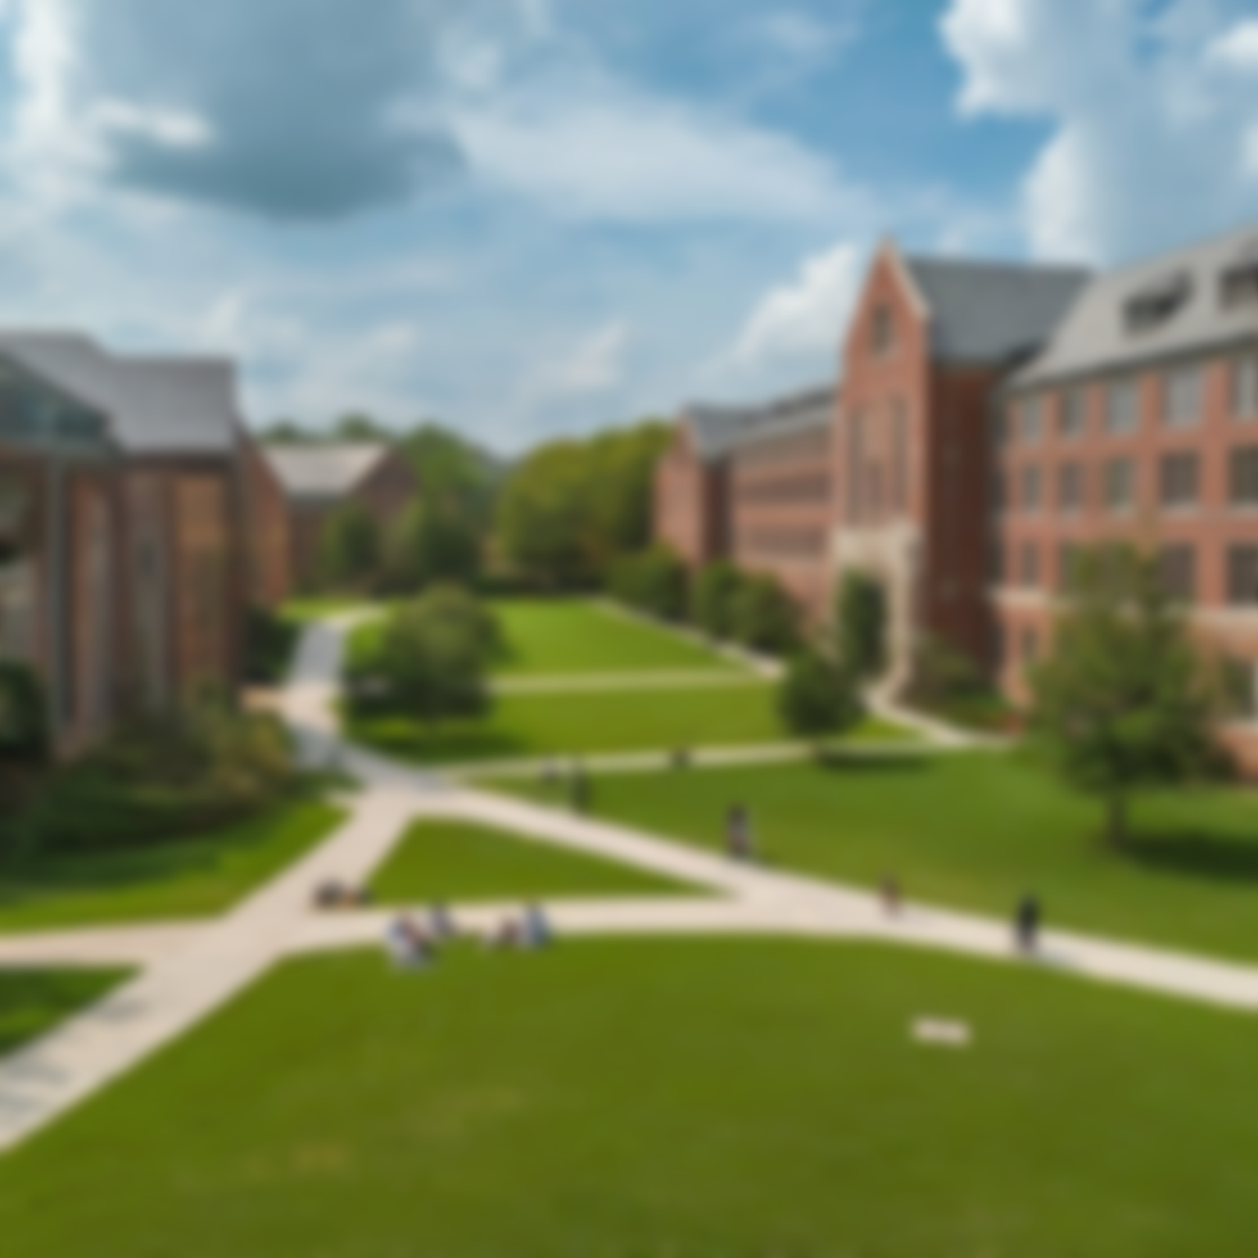
Chapter 3: Charting The Course
Gained admission to the prestigious Machakos School after his KCPE results
Encountered a new world of diverse subjects, extracurricular activities, and new friends
Faced the challenge of adapting to a rigorous academic schedule
Understood the power of dreams and their ability to motivate
Importance of family support in achieving his dreams
Balanced academics and personal growth to become a well-rounded individual

Slide 6
Chapter 4: Crossroads of Passion
Initially drawn towards Electrical and Electronics Engineering
Became intrigued by the world of aviation and its vast opportunities
Ultimately discovered his true passion for Computer Science
Immersed himself in the intricacies and possibilities of the field
Developed a passion for problem-solving and innovation through programming
Sought opportunities to further his understanding through competitions and projects

Slide 7
Chapter 5: Pursuing the Dream
Faced setbacks, doubts, and challenges along the way
Overcame obstacles with resilience and the support of his family
Achieved a remarkable KCSE score of A- in 2019
Enrolled at Dedan Kimathi University to pursue his dream career in computing
Faced the challenge of complex financial concepts and principle

Slide 8
Chapter 6: Building Bridges to Success
Actively participated in workshops, hackathons, and webinars to broaden knowledge in IT fields, programming, and specific programming concepts.
Networked with professionals and peers, forming valuable connections that opened doors to future opportunities.

Slide 9
Contd…
Recognized the ever-evolving nature of computing and relentlessly pursued knowledge.
Focused on core computing principles, algorithms, data structures, and emerging IT trends.
Hackathons and webinars offered practical insights beyond textbooks.
Subscribed to industry publications to stay informed about regulatory changes and best practices.

Slide 10
The end.
THANK YOU

