Slide 1
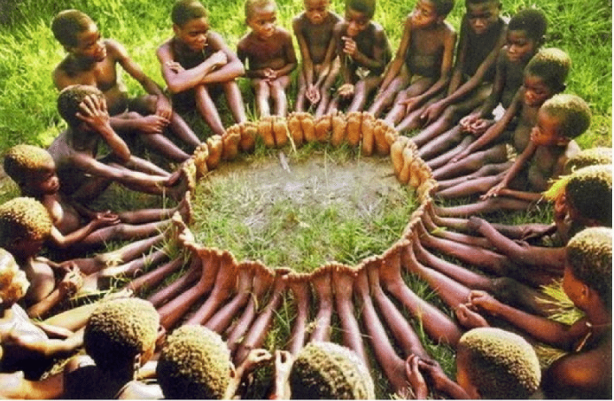
African culture and its importance in IT
JOSEPH NJENGA KARIUKI
C026-01-0696/2020

Slide 2

Introduction
As an individual born and raised in the heart of Africa, I've always felt a deep connection to the rich tapestry of traditions, values, and beliefs that define our continent's diverse cultures. From the vibrant rhythms of our music to the warmth of our hospitality, African culture permeates every aspect of daily life, shaping our identities and guiding our interactions with the world around us.

Slide 3

Body
One of the most profound aspects of African culture that has left an indelible mark on my life is the concept of Ubuntu. Rooted in the Bantu languages of Southern Africa, Ubuntu is a philosophy that emphasizes the interconnectedness of humanity and the importance of compassion, empathy, and community.

Slide 4
Growing up, I was immersed in the spirit of Ubuntu from an early age. Whether it was sharing a meal with neighbors, offering a helping hand to those in need, or simply greeting strangers with a warm smile, the principles of Ubuntu were woven into the fabric of everyday life.

Slide 5
One of my fondest memories of embracing Ubuntu occurred during a visit to my grandmother's village. As the sun dipped below the horizon, casting a warm glow over the landscape, the entire community would gather around a crackling fire to share stories, laughter, and wisdom passed down through generations. In those moments, I felt a deep sense of belonging and connection to something greater than myself – a sense of Ubuntu that transcended language, ethnicity, and background.

Slide 6
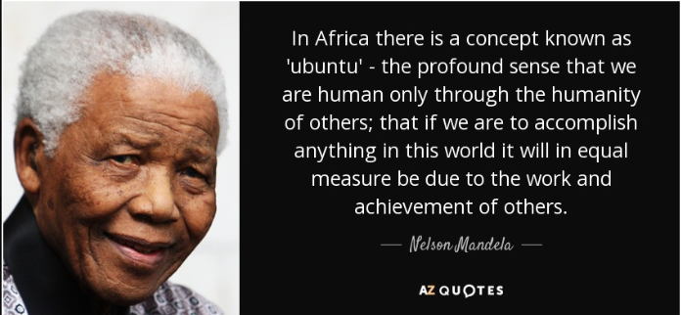
Nelson Mandela popularized Ubuntu

Slide 7
As I journeyed through life, Ubuntu became more than just a cultural tradition – it became a guiding principle that shaped my worldview and influenced my interactions with others. In a world that often emphasizes individualism and self-interest, Ubuntu serves as a powerful reminder of our shared humanity and the importance of compassion and empathy in building a more harmonious society.

Slide 8
Today, as I navigate the complexities of modern life, I strive to embody the spirit of Ubuntu in all that I do. Whether it's lending a listening ear to a friend in need, volunteering in my community, or advocating for social justice and equality, I believe that embracing Ubuntu is essential for creating a more inclusive, compassionate, and equitable world.

Slide 9
How Ubuntu is important to IT
Inclusive Design Principles: Emphasize inclusivity, accessibility, and user-centered design to ensure that technology serves the needs of all individuals, regardless of background or ability.
Community-Centered Development: Encourage collaboration, knowledge sharing, and collective decision-making to build technology solutions that reflect the diverse needs and perspectives of the community.

Slide 10
How Ubuntu is important to IT
Open Source Collaboration: Embrace the spirit of Ubuntu by promoting open source collaboration and sharing of knowledge within the IT community. Encourage developers to contribute to open source projects, share code, and collaborate with others to drive innovation and solve complex challenges collectively.
Digital Inclusion Initiatives: Develop initiatives focused on bridging the digital divide, providing access to technology resources, and delivering digital skills training to enable individuals to participate fully in the digital economy.

Slide 11
How Ubuntu is important to IT
Ethical Use of Technology: Apply the principles of Ubuntu to guide ethical decision-making in the use of technology. Prioritize values such as respect, empathy, and social responsibility in the development and deployment of IT solutions, ensuring that technology is used for the benefit of all members of society.
Building Trust and Relationships: Cultivate trust and build relationships within the IT community and beyond. Foster a culture of collaboration, transparency, and accountability, where individuals feel valued, respected, and supported in their endeavors to harness technology for positive change.

Slide 12
Conclusion
In conclusion, African culture, with its emphasis on Ubuntu, has profoundly shaped my identity and worldview. Through embracing the principles of interconnectedness, compassion, and community, I've discovered a deeper sense of purpose and belonging that transcends borders and boundaries. As I continue on my journey, I carry with me the wisdom of Ubuntu – a timeless reminder of the power of unity and solidarity in creating a brighter future for all.

Slide 13

THE END

