Slide 1
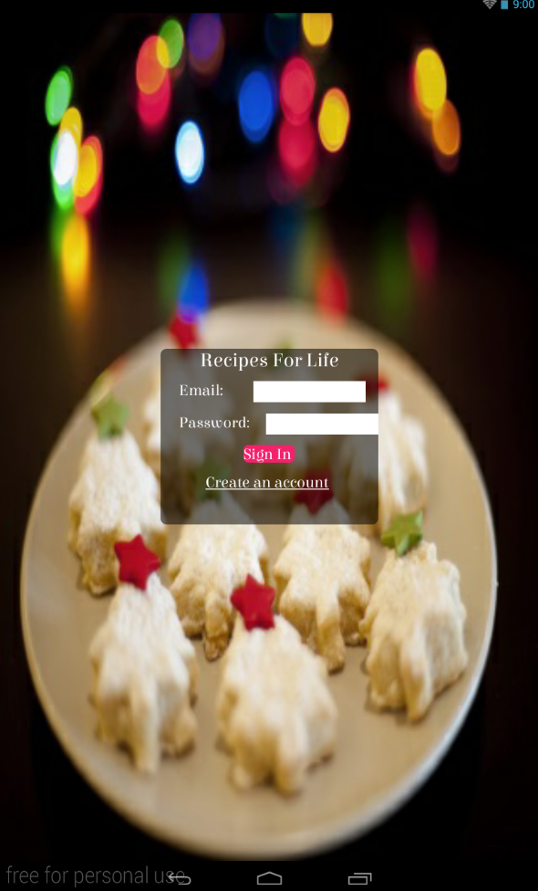
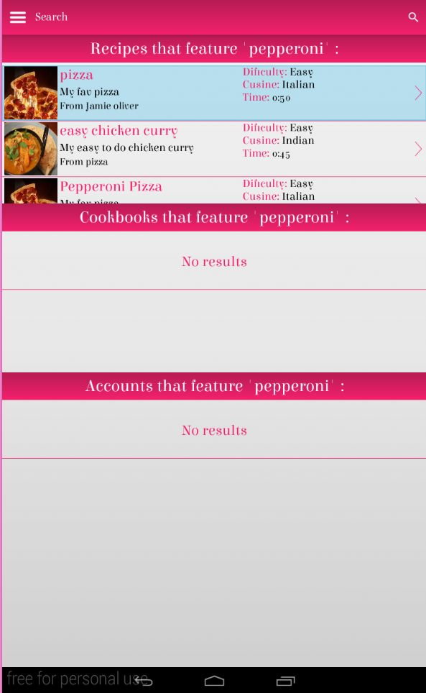
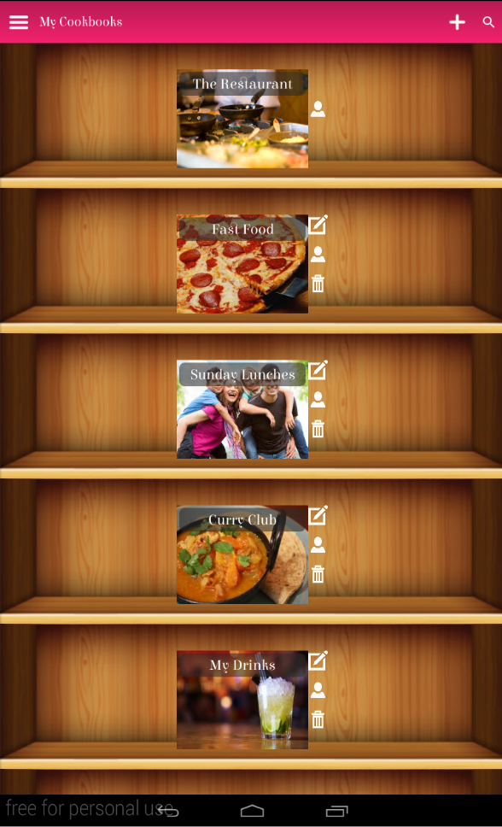
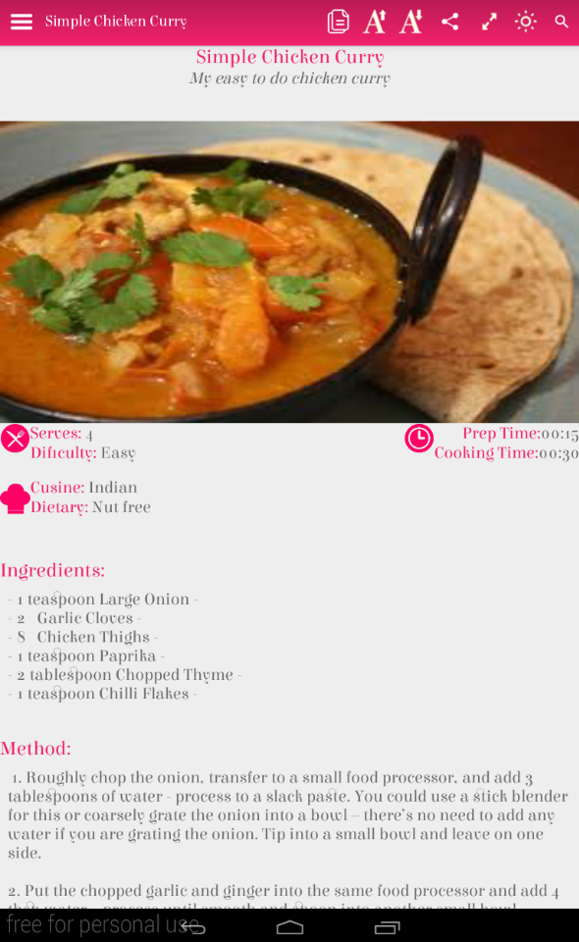
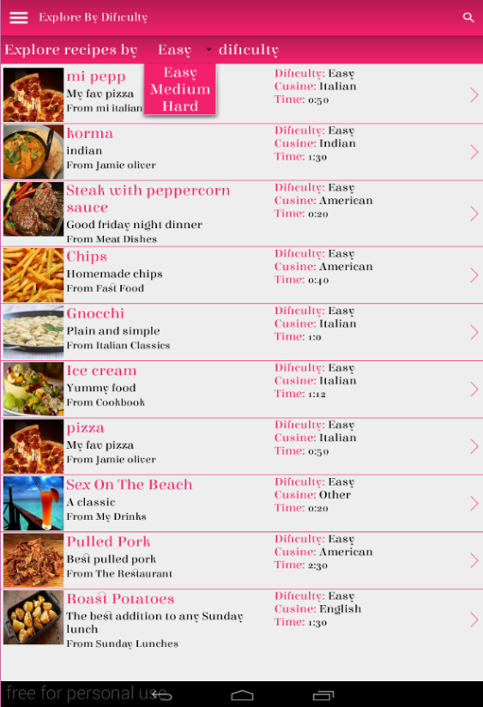



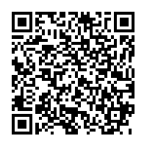
Recipes For Life
Bringing the tradition of cookbooks to the 21st century
By Kari McMahon
Supervised by Dr Keith Edwards
What Is Recipes For Life ?
Recipes For Life is an Android application that aims to bring the tradition of recipe books to the 21st century through collaborative recipe management.
Why Was It Developed ?
For generations collaborative cookbooks have been a way for individuals to express themselves and share experiences with others through the format of cooking.
But as society increasingly moves into a digital age the concept of collaborative cookbooks could soon be lost. Recipes For Life aims to be the solution which will help solve this problem.
How did users respond to the application?
Recipes For Life was evaluated against a popular recipe management application which has had over 50,000 downloads. The results from the evaluation were:
All 10 participants preferred Recipes For Life
The collaboration feature received very positive comments from participants
Recipes For Life received an A grade in usability in the SUS evaluation

