Slide 1

DATA STRUCTURES AND ALGORITHMS-3 · 25CS2103E · PROJECT BASED LEARNING
LogInsight Analyzer
Algorithm-Driven Log Analysis and Incident Investigation
TEAM
KARKALA SHIVA REDDY · 2520030105
PARIPALLI NAVADEEP · 2520030196
COURSE INSTRUCTOR
Dr. J Sirisha Devi
Professor, Department of Computer Science and Engineering
INSTITUTION
Koneru Lakshmaiah Education Foundation
2026-2027, Odd Semester
Department of Computer Science and Engineering · Koneru Lakshmaiah Education Foundation
1 / 16

Slide 2
THE PROBLEM
An outage is never explained by one log line
The evidence that matters is spread across services, interleaved and out of order.
HOW THE FAILURE ARRIVES
— A payment provider starts returning 502 responses. One ERROR line, one service, easy to miss.
— Within minutes the order service retries, the gateway returns 504, confirmations stop, checkouts fail.
— The signal is present from the first moment, diluted across ~14,000 records spanning 8 services.
— A developer scrolling a flat log view never finds it.
WHY PLAIN SEARCH IS NOT ENOUGH
— A naive substring scan is O(nm). Re-scanning 14k records on every keystroke is wasteful and, in the worst case, quadratic in the pattern.
— Worse: the engineer does not know the phrase. The message that matters is the one that actually occurred, not the one remembered.
— The corpus is homogeneous in format but heterogeneous in signal, so volume alone does not identify the failure.
14,000
log events
deterministic seeded corpus
8
services
observed in the demo estate
O(nm)
naive search
the cost to beat
LogInsight Analyzer · DATA STRUCTURES AND ALGORITHMS-3 · 25CS2103E
2 / 16

Slide 3
OBJECTIVES
What the project sets out to prove
Every objective is stated so it can be checked, and each is checked by a test or a measured run.
01
Make the algorithm visible
Each algorithm's contribution is observable in the interface, not hidden behind a search box.
02
Stay honest about provenance
Dataset replay, generated simulation and observed topology are labelled distinctly at every surface.
03
Stay linear where it matters
Exact substring search and multi-pattern labelling are O(n) so the cost does not grow with the corpus.
04
Keep the boundary visible
Of 42 catalogue algorithms, 36 are reachable through an endpoint and 13 are traceable; the interface reports which.
05
Prove it in a browser
Layout, contrast, keyboard access and runtime stability are asserted against the running application.
LogInsight Analyzer · DATA STRUCTURES AND ALGORITHMS-3 · 25CS2103E
3 / 16

Slide 4
POSITIONING
Conventional tooling vs LogInsight
The gap is not the absence of a search box; it is the absence of traceability and honesty.
Conventional tooling
LogInsight
· Grep or a plain log viewer over a flat file
· Substring scan repeated per query, O(nm)
· The operator must already know the phrase
· Any error volume is presented as a failure
· Topology drawn from hand-written config
· Nothing states whether the data is live or replayed
· Command center over a single loaded dataset
· KMP linear exact search, no backtracking
· Aho-Corasick labels every record in one pass
· Levenshtein ranks a suggestion when the phrase is wrong
· Topology derived from observed request trails
· Every surface labels its own provenance
The contribution is the last two rows
Traceability and provenance are what make an algorithmic tool usable during an incident: a number an operator cannot trace to its source cannot be acted on, and a graph whose provenance is unstated cannot be relied on. Both are enforced in the interface rather than only described in documentation.
LogInsight Analyzer · DATA STRUCTURES AND ALGORITHMS-3 · 25CS2103E
4 / 16

Slide 5
SYSTEM DESIGN
Three layers, one deterministic stream
Each layer owns one concern, and the boundary between them is enforced in code and in the interface.
PRESENTATION
SERVICES
DATA & ALGORITHMS
React 18 + TypeScript SPA
Command center, Scenario Lab, Incident Workbench, Algorithm Lab
REST + Server-Sent Events
one telemetry frame per tick, owned by a single provider
Seeded corpus generator
14,000 reproducible events across 8 services
Accessible 2D SVG topology
paired node and edge list for keyboard and screen-reader use
Incident detector
fixed 5-minute windows, baseline-relative threshold
com.loginsight.dsa
8 packages: string, dp, graph, flow, approximation, randomized, parallel, common
Lazy-loaded WebGL scene
Three.js in a separate bundle, downloaded only on demand
Lifecycle store
forward-only transitions, illegal moves rejected with HTTP 409
Hand-written structures
queue and stack underpinning the parallel algorithms
One Server-Sent Events stream is owned by the client provider, so the overview, the live monitor and the workbench can never display contradictory numbers for the same tick.
LogInsight Analyzer · DATA STRUCTURES AND ALGORITHMS-3 · 25CS2103E
5 / 16

Slide 6
IMPLEMENTATION
Technology stack
Versions are pinned in the build, so the figures quoted in the results are reproducible.
BACKEND
FRONTEND
DATA & 3D
Java 21
language
React 18
UI
Server-Sent Events
telemetry
Spring Boot 3.5
framework
TypeScript
types
Three.js
WebGL topology
Maven Wrapper
build
Vite 6
build
Playwright
18 browser workflows
JUnit + JaCoCo
test + coverage
Vitest
unit tests
npm audit
0 vulnerabilities
6
viewport widths
1440x900 down to 360x800
36
route declarations
1 layout, 34 paths, 1 catch-all
19
navigation entries
5 Workspace, 14 Advanced
LogInsight Analyzer · DATA STRUCTURES AND ALGORITHMS-3 · 25CS2103E
6 / 16

Slide 7
DATA STRUCTURES
The structures the algorithms are built from
Written for this project rather than borrowed, so their cost is explicit and testable.
Failure function (LPS)
Trie + failure links
Edit-distance table
int[]
nodes[]
D[i][j]
Longest proper prefix that is also a suffix of every pattern prefix. Built once, indexed on mismatch.
Aho-Corasick states. Goto edges completed so every character has a transition, plus dict-suffix output links.
Dynamic programming table; a rolling row reduces the distance-only case to the shorter axis.
O(m) space
O(states x alphabet)
O(min(n, m))
Dependency graph
Fixed windows
Hand-written queue & stack
outbound / inbound
buckets[]
CustomQueue / CustomStack
Adjacency sets for both directions, so reachability and degree share one structure.
Events bucketed by time span, error counts per bucket, then a linear merge over flagged windows.
Underpin the parallel algorithms, which then analyse work and span rather than wall-clock.
O(V + E)
O(n + W)
sequential below 1024
LogInsight Analyzer · DATA STRUCTURES AND ALGORITHMS-3 · 25CS2103E
7 / 16

Slide 8
ALGORITHMS
Five production algorithms, and where the catalogue stops
The first five run on every frame of the pipeline. The sixth is the study catalogue, kept visibly separate.
KMP
Aho-Corasick
Levenshtein / Damerau
O(n + m)
PRODUCTION
O(n)
PRODUCTION
O(nm)
PRODUCTION
Linear exact substring search; no backtracking.
Every error signature matched in one left-to-right pass.
Edit-distance DP ranks a 'did you mean' suggestion.
BFS over dependency graph
Fixed-window detection
Suffix array + Kasai LCP
O(V + E)
PRODUCTION
O(n + W)
PRODUCTION
O(n log n)
STUDY CATALOGUE
Blast radius reachable downstream of the failing service.
Bucketed, baseline-relative threshold, merged into one window.
Traceable phrase search over the corpus.
42
algorithms
across 6 modules
36
reachable
via a canonical or trace endpoint
13
traceable
with a step-by-step trace endpoint
LogInsight Analyzer · DATA STRUCTURES AND ALGORITHMS-3 · 25CS2103E
8 / 16

Slide 9
HOW IT WORKS
A frame is a pure function of scenario, seed and tick
The live surface is server-generated and deterministic, not recorded traffic.
1
2
3
4
5
6
Resolve scenario
Generate events
Label signatures
Evaluate detector
Compute blast radius
Emit the frame
CatalogueDefinition supplies severity, affected services and declared error signatures.
DeterministicRandom seeded by (scenario, seed, tick) yields the same events every time.
AhoCorasick matches the whole signature set in one left-to-right pass over each message.
Fixed-window counts; flag buckets at max(3, 3 x baseline) and merge adjacent ones.
BFS over outbound edges gives the services reachable downstream of the origin.
Metrics, events, signals, evidence, health, incidents and topology ship as one SSE payload.
7
scenarios
curated failure modes
5 min
window size
fixed buckets
max(3, 3x)
threshold
with an absolute floor of 3
8x
delivery speed
pacing only, never content
Raising delivery speed only paces frames. It never changes which events a tick contains, so a captured run is reproducible at any speed setting.
LogInsight Analyzer · DATA STRUCTURES AND ALGORITHMS-3 · 25CS2103E
9 / 16

Slide 10
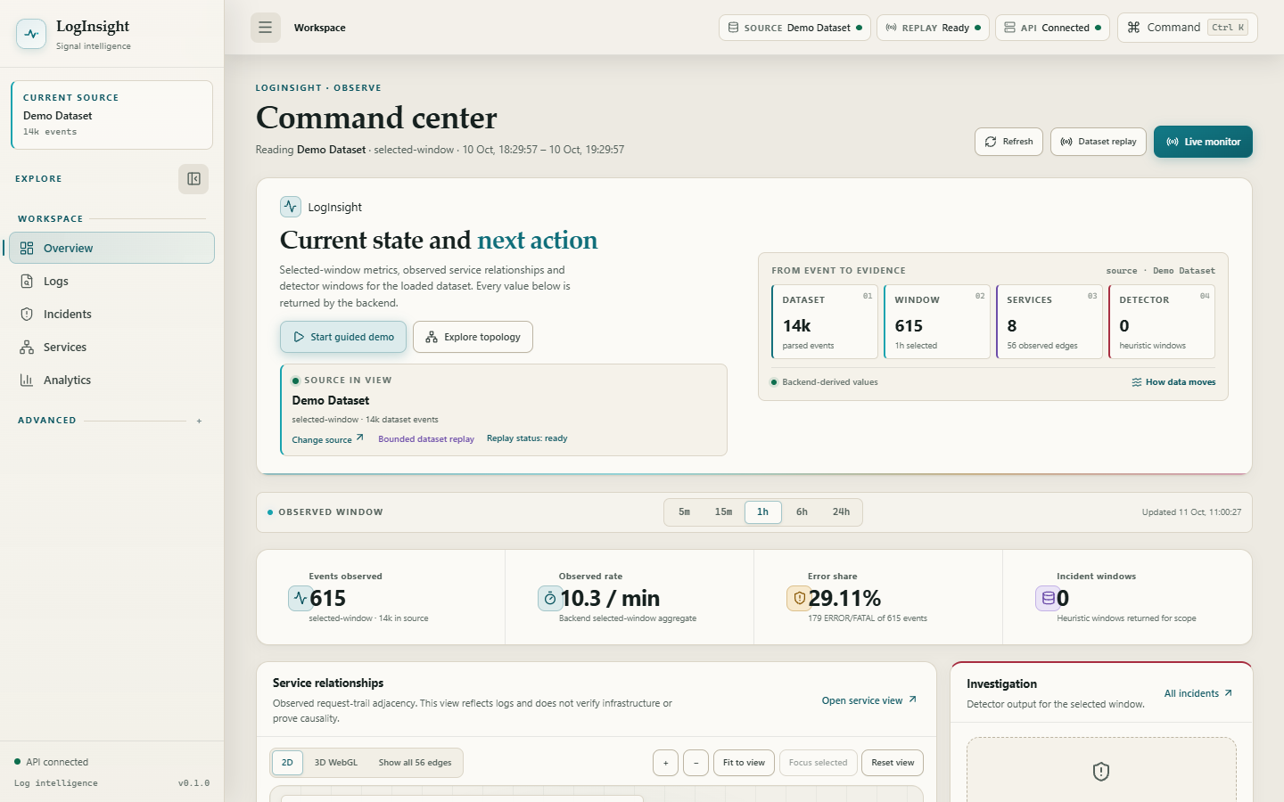
THE PRODUCT
Command center: state and next action above the fold
The selected-window signals are readable without scrolling, and the simulation is reported separately from the dataset.
Source in view
The active dataset, its event count and whether the current stream is replay or generated.
Backend-derived numbers
Dataset, window, services and detector windows are returned by the API, never invented client-side.
Compact hero
Dataset context, four headline figures and the primary actions all fit the first viewport at desktop width.
Overview command center with the demo dataset loaded.
LogInsight Analyzer · DATA STRUCTURES AND ALGORITHMS-3 · 25CS2103E
10 / 16

Slide 11
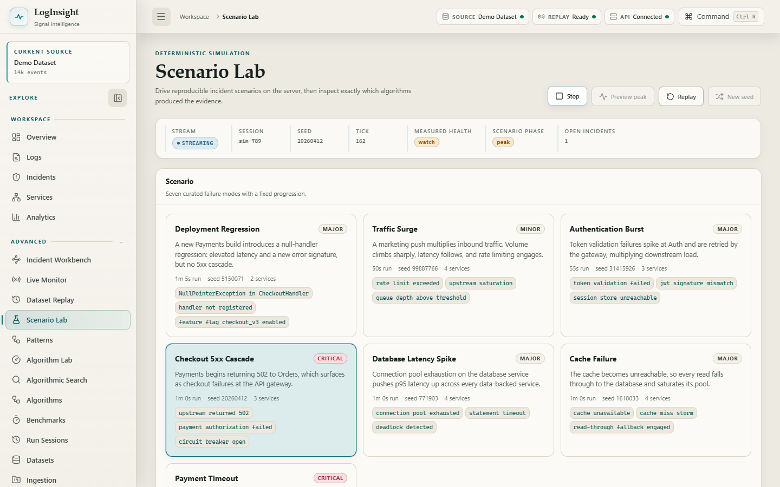
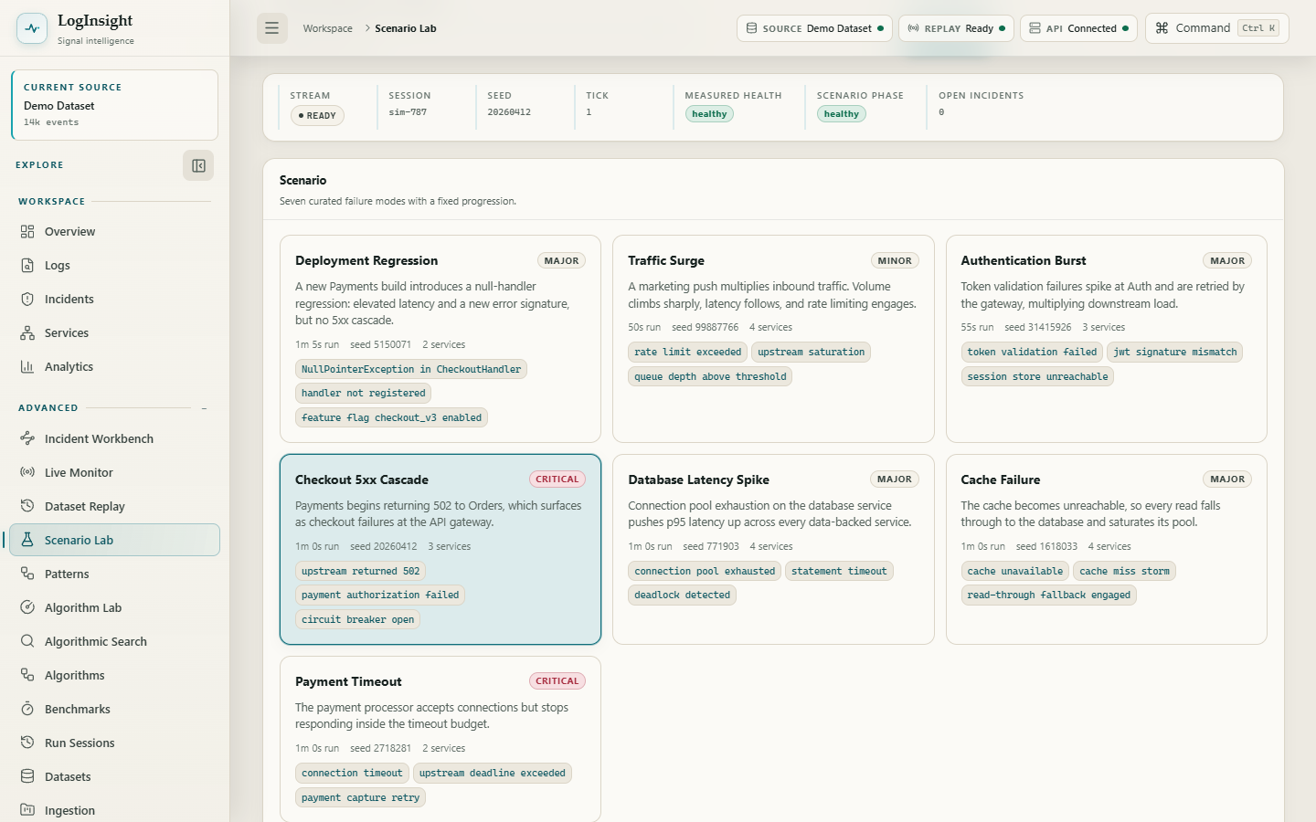
THE PRODUCT
Scenario Lab: a run you can reproduce
Seven declared failure modes; a frame is a pure function of scenario, seed and tick.
A run in progress: measured health elevated, phase at peak, one incident open.
The catalogue with Checkout 5xx Cascade selected before the run begins.
Deterministic by construction
The same scenario and seed replay identically, so a screenshot is evidence rather than decoration.
Signatures, not guesses
Aho-Corasick labels each generated message with the signature that caused it.
Explicit provenance
Generated traffic is labelled as generated on every surface, never as captured telemetry.
LogInsight Analyzer · DATA STRUCTURES AND ALGORITHMS-3 · 25CS2103E
11 / 16

Slide 12
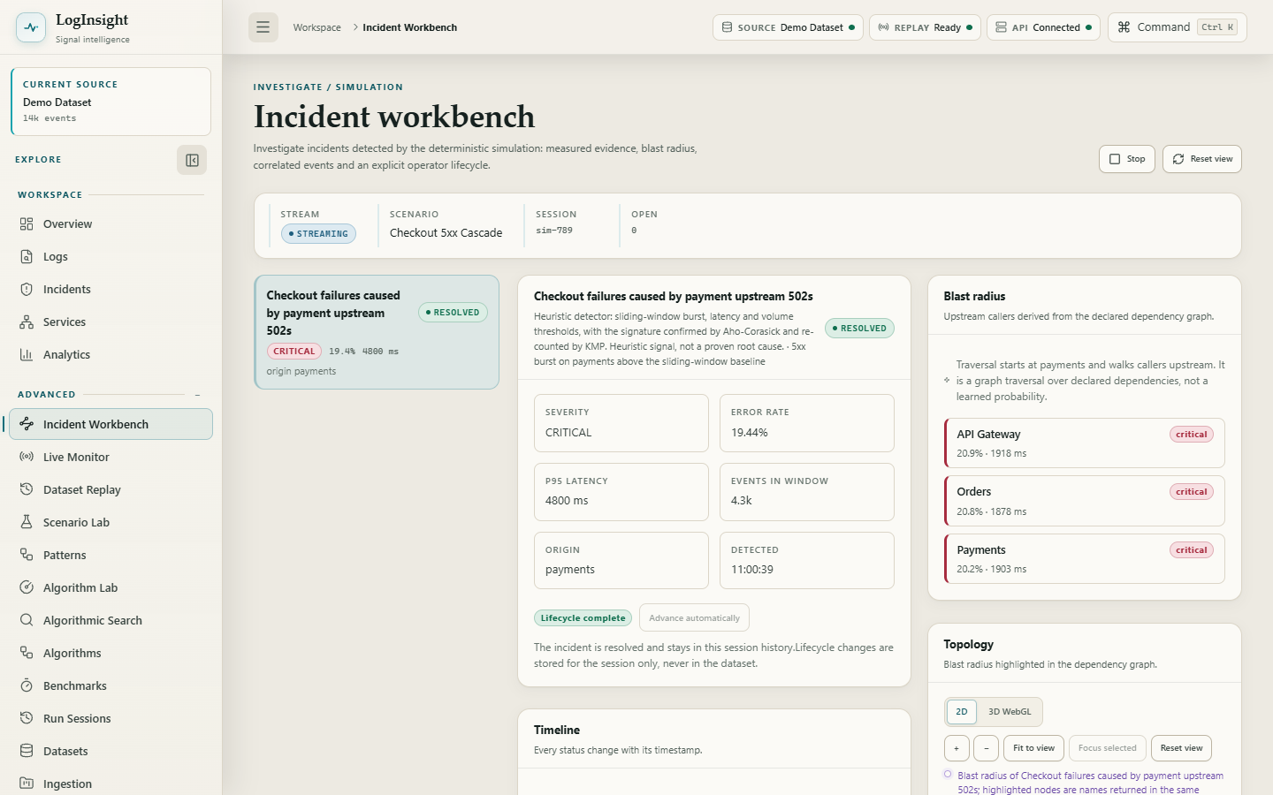
THE PRODUCT
Incident workbench: evidence, then conclusion
Three panes: incident navigator, selected incident, and health and topology context.
Measured evidence
Severity, error rate, p95 latency and window size are measured, not asserted.
Blast radius by traversal
Services reachable downstream over declared edges, labelled as traversal rather than confirmed root cause.
Forward-only lifecycle
An illegal transition is rejected with HTTP 409 instead of being silently accepted.
Incident workbench with a detected, resolved incident and its blast radius.
LogInsight Analyzer · DATA STRUCTURES AND ALGORITHMS-3 · 25CS2103E
12 / 16

Slide 13
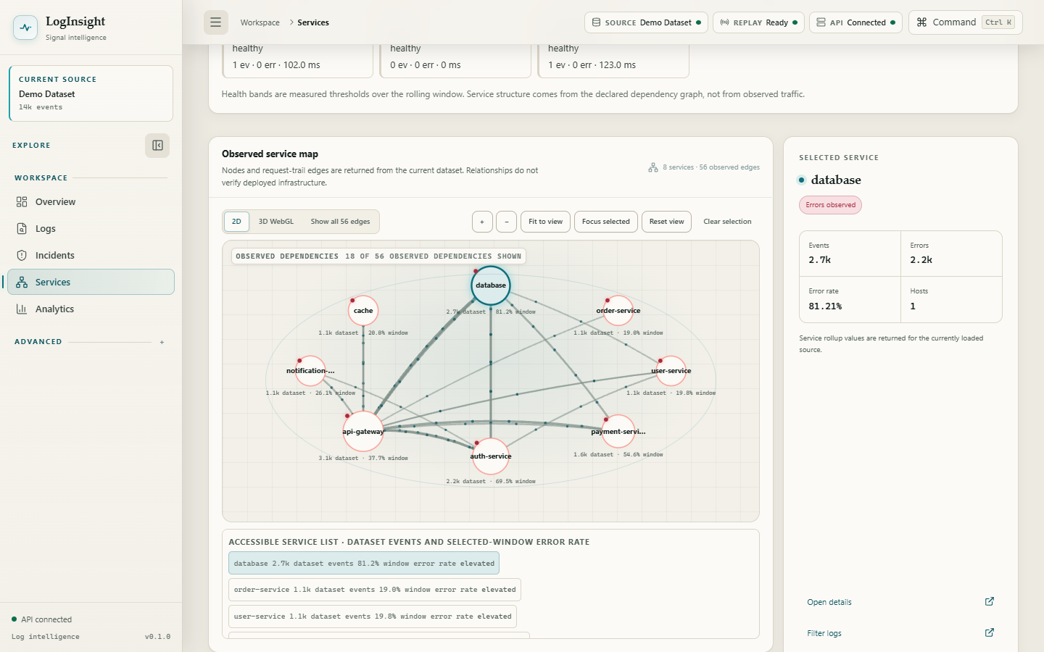
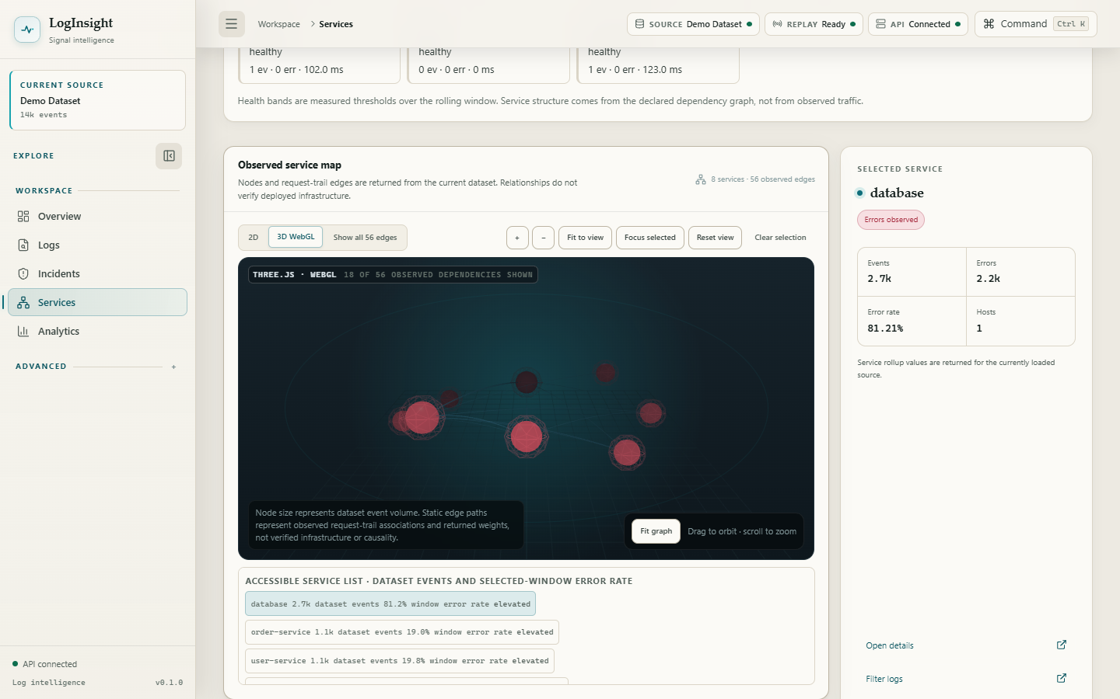
THE PRODUCT
One graph, two renderers
Both consume the same nodes and edges; the accessible map is always available.
Two-dimensional service topology as an accessible SVG map.
Three-dimensional topology rendered as a real WebGL scene.
Accessible by default
The 2D view keeps a paired node and edge list for keyboard and screen-reader users.
Lazy-loaded scene
Three.js ships in a separate bundle, downloaded only when 3D is selected.
Explicit lifecycle
Content-keyed effect, forceContextLoss on unmount, context restoration and pause when off-screen.
LogInsight Analyzer · DATA STRUCTURES AND ALGORITHMS-3 · 25CS2103E
13 / 16

Slide 14
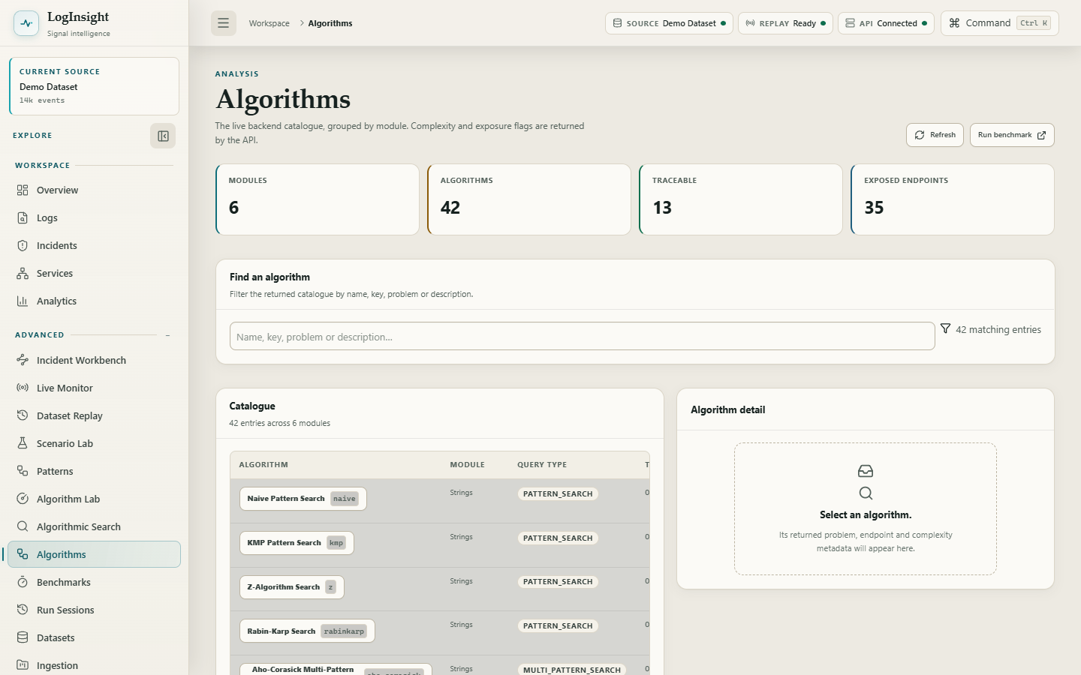
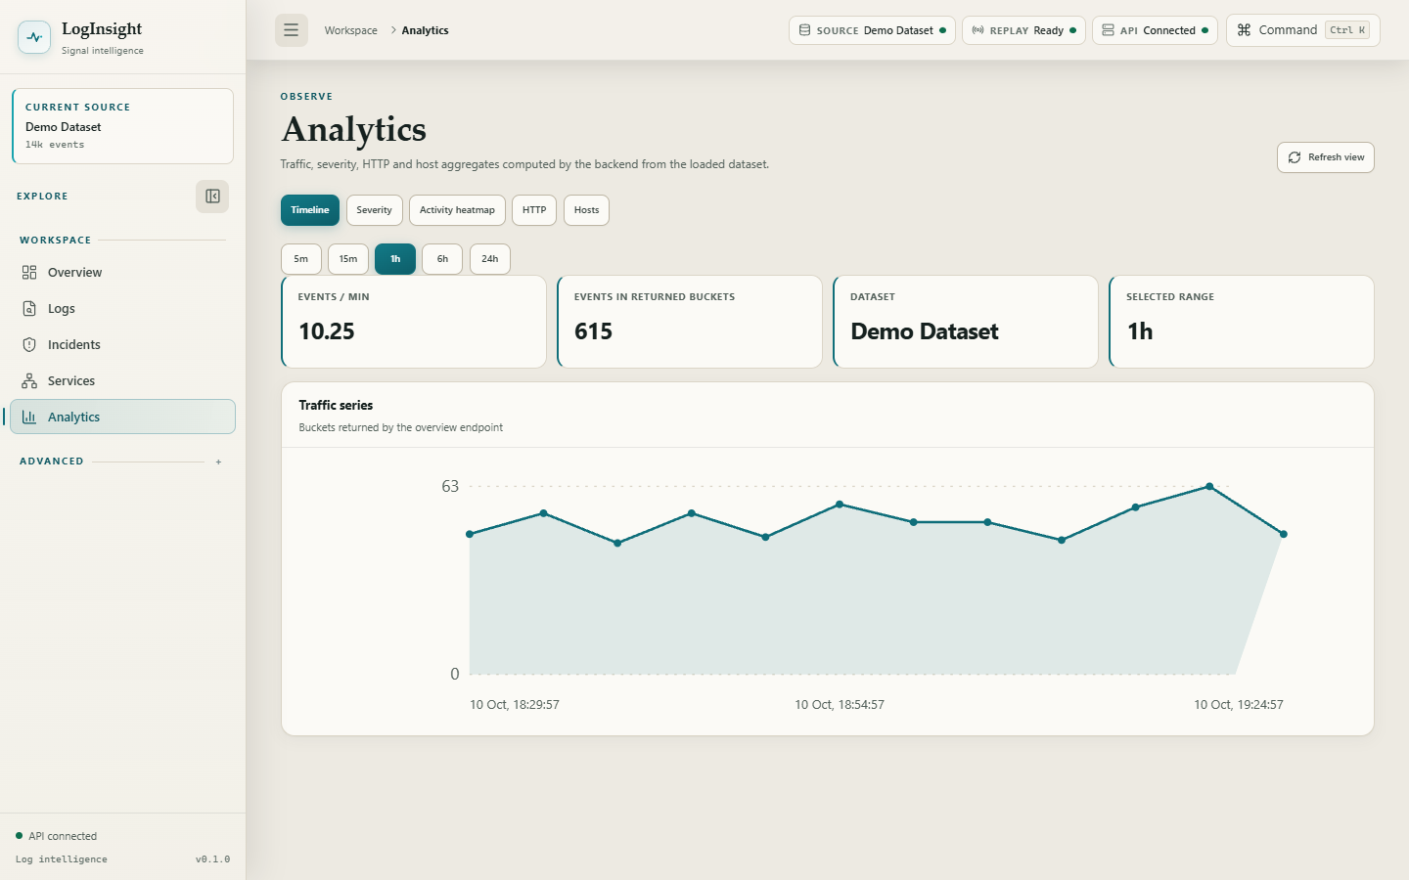
THE PRODUCT
Catalogue and analytics
The study catalogue stays visibly separate from the production pipeline.
Algorithm catalogue with time and space complexity and exposure flags.
Analytics computed by the backend from the loaded demo corpus.
42 algorithms
Across 6 modules, from naive search to parallel prefix scan.
36 reachable, 13 traceable
36 reachable through an endpoint across 35 dispatch keys; 13 traceable.
Backend-computed aggregates
Traffic, severity, HTTP and host rollups come from the API, not the browser.
LogInsight Analyzer · DATA STRUCTURES AND ALGORITHMS-3 · 25CS2103E
14 / 16

Slide 15
VERIFICATION
What was actually measured
Figures below are the output of the verification commands on this revision, not estimates.
BACKEND TESTS
910
mvnw -B verify — 0 failures, 0 errors, 0 skipped
FRONTEND UNIT TESTS
72
vitest run — 72 across 20 files, single aggregate run
BROWSER END-TO-END
18
Playwright — all routes, 2D/3D round trip, reduced motion
DEPENDENCY AUDIT
0
npm audit — no vulnerabilities
PRODUCTION BUILD
pass
tsc && vite build
Browser verification, run separately because unit tests do not exercise layout or interaction
Zero console errors
on every route of the application
Zero horizontal overflow
at 1440x900, 1280x800, 1024x768, 768x1024, 390x844 and 360x800
Contrast pass
zero failures against the required 4.5:1 for body text
Keyboard focus
a visible indicator on every element reached by tabbing
Runtime stability
repeated 2D/3D switching, stream restarts and route changes: no DOM growth, no duplicated renderer
Continuous integration runs the Maven verify goal, the frontend suite, the TypeScript compile and the production build on every push to the main branch.
LogInsight Analyzer · DATA STRUCTURES AND ALGORITHMS-3 · 25CS2103E
15 / 16

Slide 16
CONCLUSION
Limits, next steps and what the project shows
Stating the boundary of the work is part of the result.
LIMITATIONS
FUTURE WORK
— In-memory, single-current-dataset state. No database, no durable uploads, no restart persistence.
— No authentication or authorization. This is not a shared multi-user service.
— Dataset Replay is a bounded replay of the loaded dataset, not a live collector.
— Live Monitor is server-generated simulation from a scenario and seed, not captured telemetry.
— Topology edges are request-trail adjacency inferred from requestId co-occurrence, not verified infrastructure.
— Durable storage so a loaded dataset and its run history survive a restart.
— A collector path so the platform can observe a real system rather than a generated one.
— Authentication and per-operator incident assignment.
— Root-cause ranking that states a confidence score, once one can actually be computed.
What this project demonstrates
Classical string matching, dynamic programming, graph traversal and randomized algorithms are not a laboratory exercise here: each one runs on every frame of a live stream, each one has a complexity claim, and each claim is checked by 910 backend tests, 72 frontend tests and 18 browser workflows that run against the real application rather than a mock.
Thank you · Questions
LogInsight Analyzer · DATA STRUCTURES AND ALGORITHMS-3 · 25CS2103E
16 / 16

