Slide 1

DATA STRUCTURES AND ALGORITHMS-3 · 25CS2103E · PBL
LogInsight
Real-Time Log Intelligence and Incident Investigation using Classical Algorithms
KARKALA SHIVA REDDY
2520030105
PARIPALLI NAVADEEP
2520030196
Dr. J Sirisha Devi
Professor, Department of Computer Science and Engineering
Koneru Lakshmaiah Education Foundation · 2026-2027, Odd Semester

Slide 2
THE PROBLEM
One error line, spread across seven services
During an outage the evidence exists, but it is diluted, interleaved and queried faster than a human can read it.
THE SCENARIO
WHY NAIVE SEARCH FAILS
— A payment provider begins returning 502 responses.
— The order service retries; the gateway returns 504.
— Notifications stop; customers see failed checkouts.
— The first ERROR line appears immediately — but it is one record among ~14,000 across seven services.
— Scrolling a flat log view does not surface it.
— Substring search is O(nm): it rescans the corpus on every keystroke.
— Worst case it is quadratic in the pattern length.
— The engineer does not know the phrase to search for.
— The message that matters is the one that actually occurred, not the one remembered.
LogInsight · KLH_CSE_2026-27_DSA-3_S3_T17_Loginsight-Analyzer
1

Slide 3
THE SOLUTION
Classical algorithms, made visible
Each number on screen is traceable to the algorithm that produced it.
KMP
O(n + m)
Aho-Corasick
O(n)
Levenshtein
O(nm)
Linear exact substring search. No backtracking; failure function pulls the pattern state back instead of the text pointer.
All error signatures tested in one left-to-right pass — this is what labels each generated event with its cause.
Edit-distance DP table ranks a “did you mean” suggestion when the operator does not know the phrase.
BFS reachability
O(V + E)
Fixed-window
O(n + W)
Suffix array + LCP
O(n log n)
Blast radius: services reachable downstream of the failing one, by graph traversal.
Five-minute buckets, baseline-relative threshold, merged into one incident per failure.
Kasai LCP powers traceable phrase search over the corpus.
Every one of these runs in the product pipeline
A wider repertoire — bitmask TSP, Needleman-Wunsch, Dinic flow, vertex-cover kernelization, parallel prefix scan, Miller-Rabin — is exposed as runnable, traceable implementations in the Algorithm Lab.
LogInsight · KLH_CSE_2026-27_DSA-3_S3_T17_Loginsight-Analyzer
2

Slide 4
ARCHITECTURE
Three layers, one deterministic stream
State is server-owned so the overview and the monitor can never show contradictory numbers.
PRESENTATION
• Command center, Scenario Lab, Live Monitor, Incident Workbench
• 2D SVG topology + lazy-loaded Three.js scene
• One TelemetryProvider owns the SSE stream
React 18 · TypeScript · Vite
SERVICE
• Dataset lifecycle, incident detector, deterministic simulation
• 35 algorithm engines behind a query registry
• Forward-only incident lifecycle; illegal moves return 409
Java 21 · Spring Boot · REST + SSE
ALGORITHM
• String matching · dynamic programming · graph traversal
• Flow · approximation · parallel · randomized
• Each reports measured runtime and complexity
com.loginsight.dsa (pure Java)
DATA
• 14,000 seeded events, re-anchored to the current hour
• Simulation frames are pure functions of (scenario, seed, tick)
• In-memory: restart discards state — stated, not hidden
Deterministic in-memory corpus
LogInsight · KLH_CSE_2026-27_DSA-3_S3_T17_Loginsight-Analyzer
3

Slide 5
DSA CONTRIBUTION
The algorithm that labels every event
Aho-Corasick is what turns raw generated text into a named, evidenced failure signature.
SCAN(root, text):
state = root; hits = []
for c in text:
state = state.next[c]
for p in state.output:
hits.add(p)
return hits
PRODUCTION vs STUDY
In the product pipeline
KMP — default phrase search and dominant-signature location
Aho-Corasick — per-record signature labelling
Levenshtein — “did you mean” suggestion ranking
Suffix array + Kasai LCP — traceable phrase search
Reservoir sampling — bounded stream sample
Exposed for study only
Bitmask TSP, Needleman-Wunsch, Dinic flow, vertex-cover kernelization, parallel prefix scan, Miller-Rabin and more — runnable and traceable, deliberately not in the pipeline.
Why it matters here
The detector must test every candidate error signature against each incoming record. One search per signature multiplies the cost by the signature count; a single automaton pass is O(n) in the text length no matter how many patterns match.
LogInsight · KLH_CSE_2026-27_DSA-3_S3_T17_Loginsight-Analyzer
4

Slide 6
REAL-TIME BEHAVIOUR
Seven declared failure scenarios
A frame is a pure function of scenario, seed and tick. Speed changes delivery pacing only — never event content.
Checkout 5xx Cascade
Database Latency Spike
Authentication Burst
Cache Failure
Payments 502s to Orders; checkout fails.
Pool exhaustion lifts p95 everywhere.
Token failures spike; gateway retries.
Cache unreachable; reads hit the DB.
CRITICAL
MAJOR
MAJOR
MAJOR
Traffic Surge
Deployment Regression
Payment Timeout
DECLARED SEVERITY
Marketing push multiplies traffic.
New Payments build, null handler.
Processor stops responding in budget.
3 CRITICAL
4 MAJOR
1 MINOR
MINOR
MAJOR
CRITICAL
DETECTION
BLAST RADIUS
LIFECYCLE
DELIVERY
3× baseline
BFS
5 states
0.25–8×
five-minute windows, floor of 3
reachability, not causation
forward-only; 409 on illegal
pacing only
Health bands are fixed heuristic thresholds (healthy < 5%, watch < 10%, elevated ≥ 10% window error rate). Incidents carry no confidence score, because none is computed.
LogInsight · KLH_CSE_2026-27_DSA-3_S3_T17_Loginsight-Analyzer
5

Slide 7
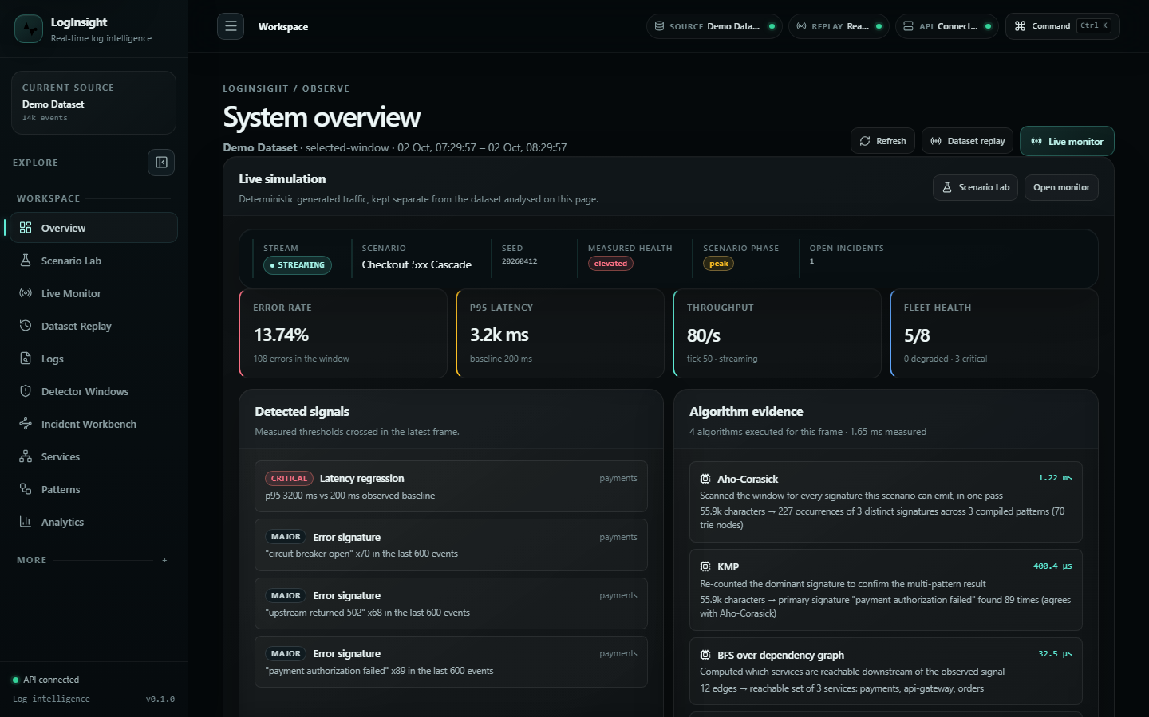
INTERFACE
Overview command center
Asymmetric by design: telemetry takes the wider column, the incident panel the narrower one.
LogInsight · KLH_CSE_2026-27_DSA-3_S3_T17_Loginsight-Analyzer
6

Slide 8
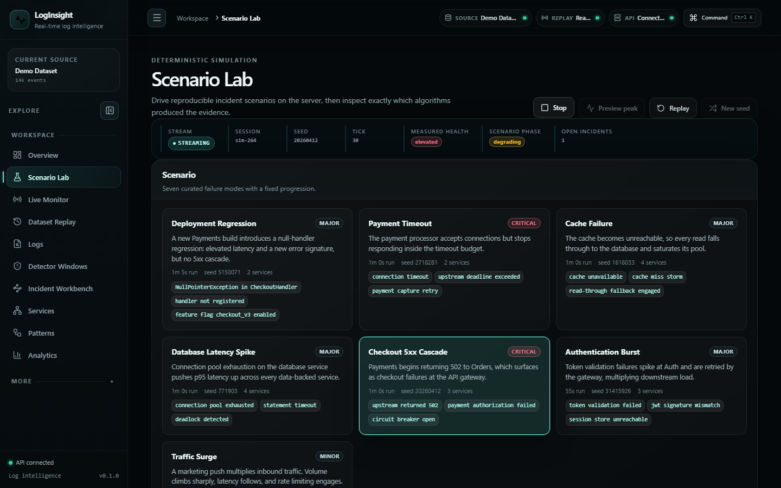
INTERFACE
Scenario Lab — a controlled failure lab
READING THE SURFACE
— Seven scenarios with declared severity and affected services.
— Server-Sent Events carry each frame.
— Evidence rows name the matcher that produced each signature.
— A single provider feeds overview, monitor and workbench.
Run in progress: phase, metrics, evidence and incident advance together.
LogInsight · KLH_CSE_2026-27_DSA-3_S3_T17_Loginsight-Analyzer
7

Slide 9
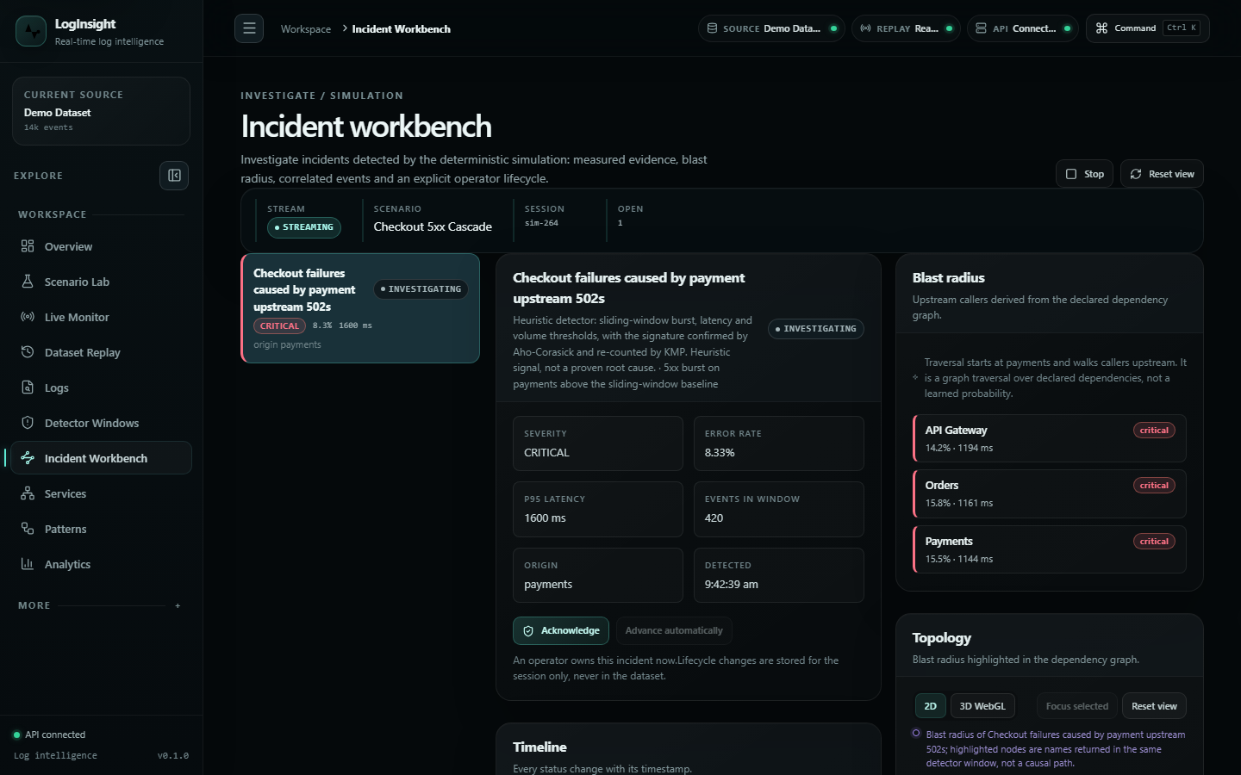
INTERFACE
Incident Workbench — a digital investigation desk
LIFECYCLE
DETECTED → INVESTIGATING → ACKNOWLEDGED → MITIGATED → RESOLVED
Forward transitions only. An attempt to move backwards, or to reopen a closed incident, is rejected with HTTP 409 instead of being silently accepted.
This was a real defect found during the audit: the endpoint returned 200 and ignored the illegal move, so a client could believe it had closed an incident that was still open.
Navigator · selected incident · context, at 220–280px / widest / 280px+.
LogInsight · KLH_CSE_2026-27_DSA-3_S3_T17_Loginsight-Analyzer
8

Slide 10
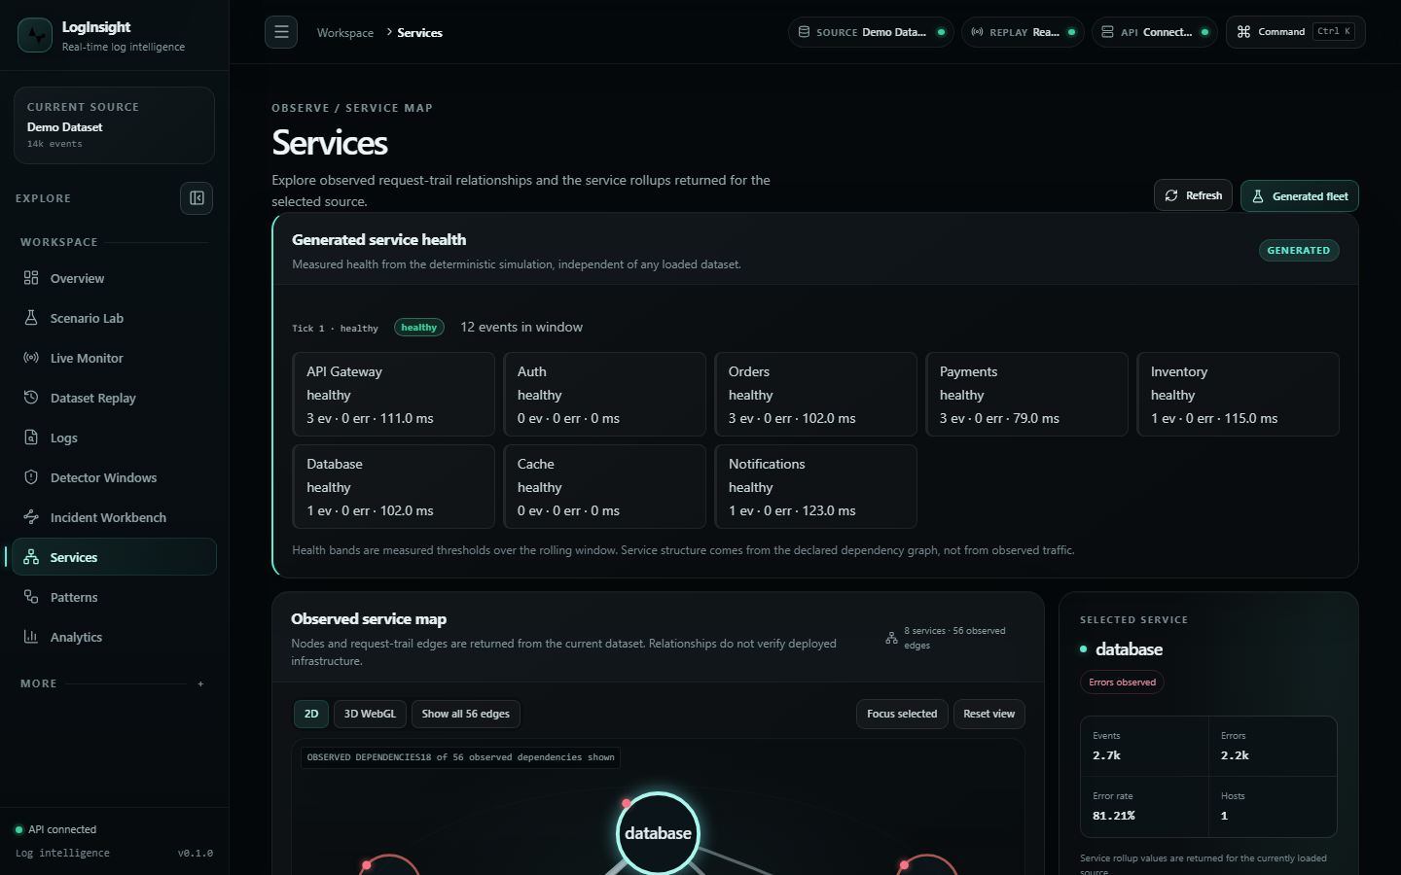
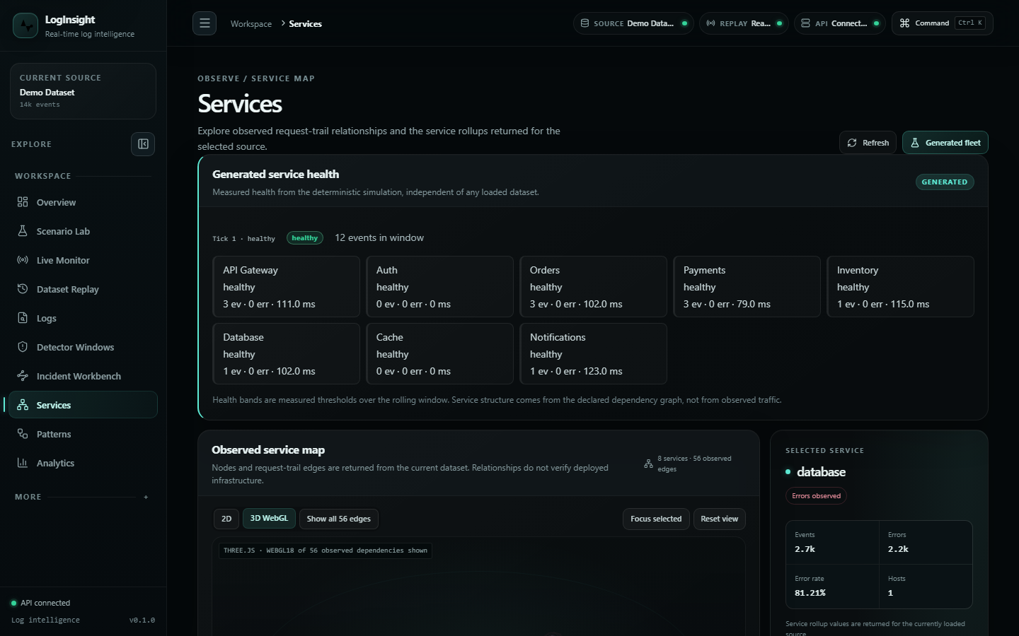
INTERFACE
Service topology — one graph, two renderers
2D — accessible SVG map with paired node/edge list.
3D — lazy-loaded WebGL scene (separate bundle).
Node size is measured event volume; node state is the measured health band — neither encodes importance or request rate. Surfaces state whether edges are OBSERVED request-trail adjacency or DECLARED scenario dependencies.
The camera does not auto-rotate or auto-zoom, the loop pauses off-screen or on a hidden tab, and every renderer, geometry, material, observer and listener is disposed on unmount.
LogInsight · KLH_CSE_2026-27_DSA-3_S3_T17_Loginsight-Analyzer
9

Slide 11
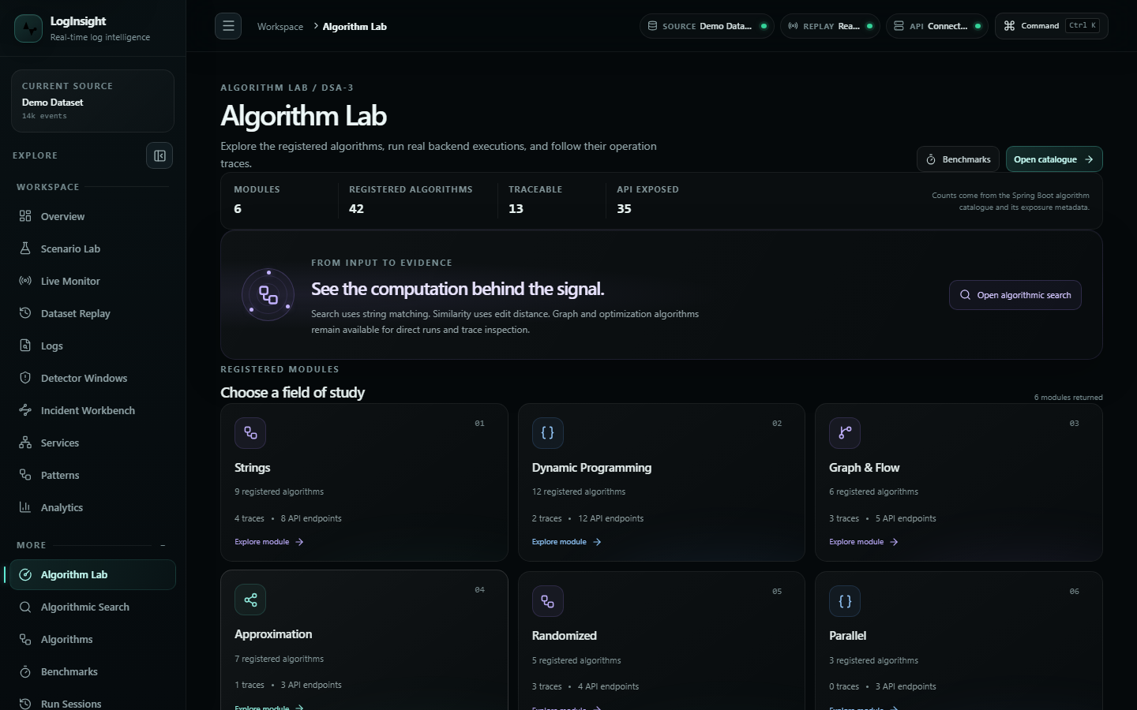
DSA CONTRIBUTION
Algorithm catalogue and traceable runs
Each technique reports module, query type, time and space complexity, and whether it is exposed or traceable.
LogInsight · KLH_CSE_2026-27_DSA-3_S3_T17_Loginsight-Analyzer
10

Slide 12
VERIFICATION
Claims that are measured, not asserted
Reproducible from the repository: CI runs the same three commands on every push to main.
BACKEND TESTS
FRONTEND TESTS
CONSOLE ERRORS
CONTRAST FAILURES
877
53
0
0
0 failures · 0 errors · 0 skipped
across 17 files
every route, every viewport
measured vs 4.5:1 requirement
STABILITY UNDER REPETITION
ACCESSIBILITY FLOOR
— 5× 2D↔3D switching: exactly one canvas, flat DOM and heap.
— 3× start/stop: event buffer bounded at 40 rows.
— 12 route changes: identical DOM, zero leaked canvases.
— No horizontal overflow at 5 viewports, 1440→390.
— Minimum 10px text (root is 14px, so 0.72rem = 10.08px).
— Minimum 24×24px targets; 32px on touch viewports.
— 2px focus ring on every keyboard stop.
— Colour never carries meaning alone.
LogInsight · KLH_CSE_2026-27_DSA-3_S3_T17_Loginsight-Analyzer
11

Slide 13
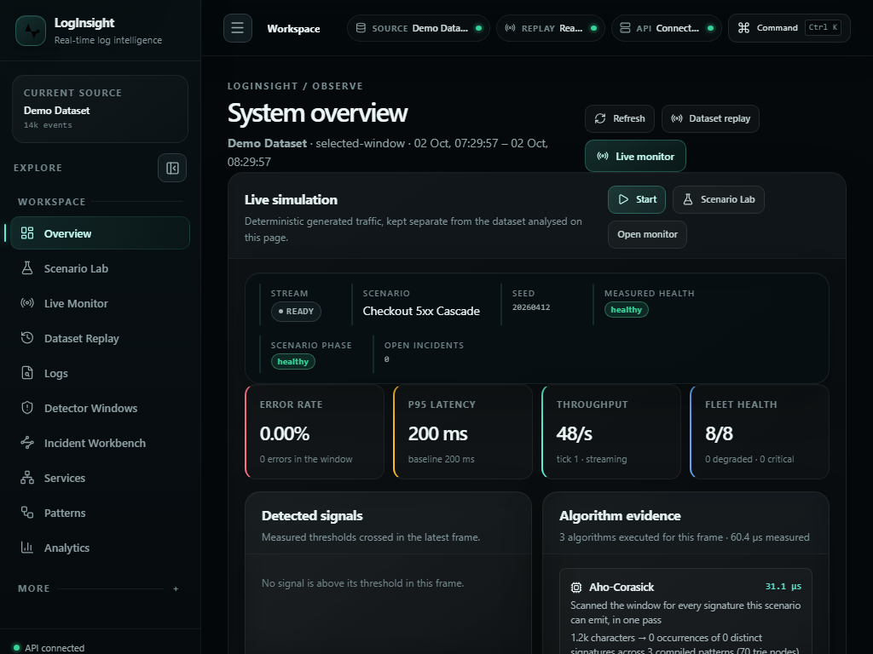
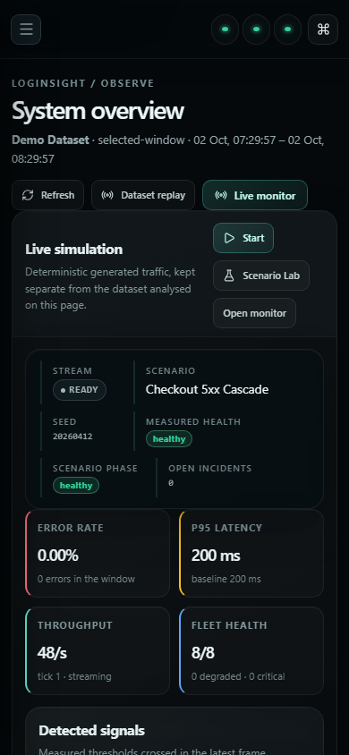
INTERFACE
Restructured, not scaled down
AT 390px
— Single column in priority order.
— Nav collapses to a drawer.
— Tables scroll inside their own box.
— Targets grow to 32px.
1024 × 768
390 × 844
LogInsight · KLH_CSE_2026-27_DSA-3_S3_T17_Loginsight-Analyzer
12

Slide 14
LIMITATIONS
Stated plainly
In-memory only
Generated traffic
Heuristics, not ML
Bounded history
— Single JVM; no durable storage.
— Restart discards the dataset and any running stream.
— Not a multi-node deployment.
— Simulation is deterministic and labelled generated.
— Not evidence about any real system.
— Fixed thresholds, no trained model.
— No confidence score, because none is computed.
— Blast radius is reachability, not root cause.
— Run history, buffers and trace steps are capped.
— Protects memory at the cost of depth.
— Compose validated for syntax only.
The project is academic software. Its shape is defensible for a single-node demonstration and is not presented as production scale.
LogInsight · KLH_CSE_2026-27_DSA-3_S3_T17_Loginsight-Analyzer
13

Slide 15
CONCLUSION
Classical algorithms, applied honestly
The DSA is load-bearing
KMP, Aho-Corasick, Levenshtein, BFS and fixed-window detection run in the product pipeline — not only in a demo folder.
Provenance is visible
Dataset replay and generated simulation are labelled apart; observed and declared edges are distinguished on every surface.
The numbers are reproducible
877 backend tests, 55 frontend tests, green CI, and a browser pass with zero console errors and zero contrast failures.
Repository:
github.com/karkalashivareddy/KLH_CSE_2026-27_DSA-3_S3_T17_Loginsight-Analyzer
LogInsight · KLH_CSE_2026-27_DSA-3_S3_T17_Loginsight-Analyzer
14

Slide 16
Thank you
Questions are welcome — particularly on the algorithm choices and the honesty constraints.
KARKALA SHIVA REDDY · 2520030105
PARIPALLI NAVADEEP · 2520030196
Dr. J Sirisha Devi · Professor, Department of Computer Science and Engineering
Koneru Lakshmaiah Education Foundation

