Slide 1
DBMS Chapter-3 Relational Model

Slide 2
Chapter Contents
Definitions and Terminology
Structure of Relational Databases
The Relational Algebra
Schema and Views
Data Dictionary

Slide 3
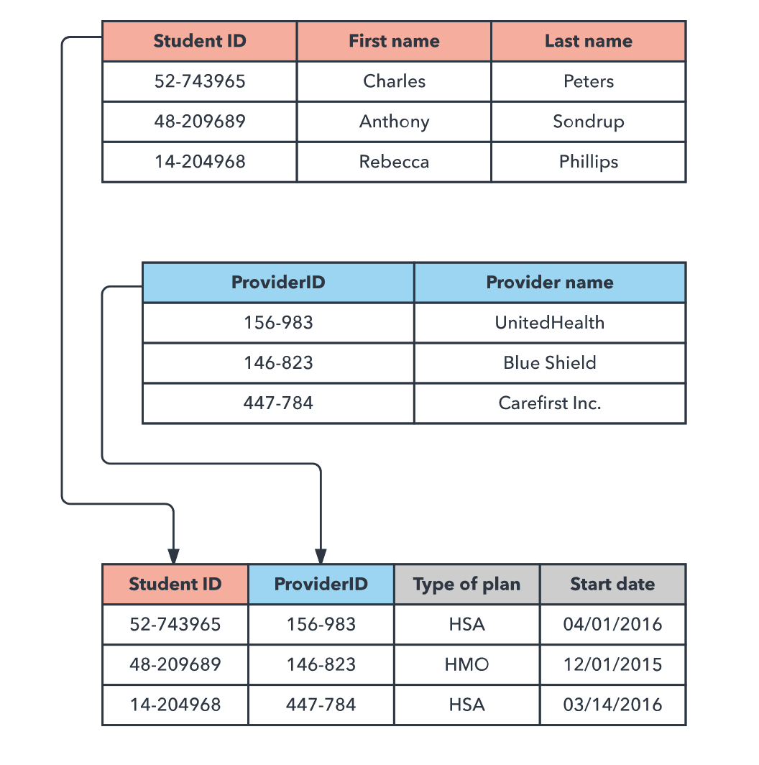
Relational Data Model

Slide 4
Relational Data Model
Relational Model is a simple model in which database is represented as a collection of Relation where each relation is represented by a two dimensional table.
Relational Model stores data in form of tables.
Primary data model used widely around the world for storage and processing.

Slide 5
Relational Data Model
Components
The set of relations and set of domains that defines the way data can be represented. (data structure)
Integrity rules that define the procedure to protect the data. (data integrity).
The operations that can be performed on data. (data manipulation).

Slide 6
Properties
Each relation (or table) in a database has a unique name.
Each row is unique, no two rows in a relation are identical.
Each attribute (or column) within a table has a unique name.

Slide 7
Tables and Tuple
Tables
Relations are saved in forms of tables.
The format stores the relation between entities.
A table has rows and columns.
Rows represents records
Columns represents attributes
Tuple
A single row of a table, which contains a single record for that relation is called tuple.

Slide 8
Attribute and Domains
Attribute
The name of each column in a table is used to interpret its meaning and is called an attribute.
Domain
A domain is a set of permissible values that can be given to an attribute.
Every attribute in a table has a specific domain.
Values to these attributes cannot be assigned outside their domains.
The domain can be defined by assigning a type or a format or a range to an attribute.

Slide 9
Relational Schema
A relational schema specifies the relation’s name, its attributes and the domain of the each attribute.
If R is the name of relation and A₁,A₂,….A_{n} is a list of attributes representing R then R(A₁,A₂,….A_{n}) is called a relational schema.
Each attribute in this relational schema takes a value from some specific domain called Domain (A_{i})
A₁, A₂, …, A_{n} are attributes
R = (A₁, A₂, …, A_{n} ) is a relation schem
E.g. Customer-schema = (customer-name, customer-street, customer-city)
r(R) is a relation on the relation schema R
E.g. customer (Customer-schema)

Slide 10
Relational Instance
A relation instances denoted as r is a collection of tuples for a given relational schema at a specific point of time.
A relation state r of the relation schema R(A₁,A₂,….A_{n}), also denoted by r(R) is a set of n-tuples.
r = {t₁,t₂,…….….t_{m}}where each n-tuple is an ordered list of n values.
t=<v₁,v₂,…….….v_{n}> where each v_{i} belongs to domain (A_{i}) or contains null values.
The current values (relation instance) of a relation are specified by a table
An element t of r is a tuple, represented by a row in a table

Slide 11
Relational Instance
attributes
(or columns)
customer-name
customer-street
customer-city
Jones
Smith
Curry
Lindsay
Main
North
North
Park
Harrison
Rye
Rye
Pittsfield
tuples
(or rows)
customer

Slide 12
Key Constraints
Primary Key
Column or a set of columns that uniquely identify a row in a table.
Must be unique and must have a value.
Key Constraint
Foreign Key
Column or set of columns which references the primary key or a unique key of another table.
Rows in two tables are linked by matching the values of the foreign key in one table with the values of the primary key in another.
Referential Integrity Constraints

Slide 13
Query Languages
Language in which user requests information from the database.
Get information from different tables.
Interact with database system

Slide 14
Relational Algebra
Procedural Language
Takes instances of relations as input and yields instances of relations as output.
Uses operators to perform queries.
Binary or unary operators
Relation tables are equivalent to sets.

Slide 15
Relational Algebra
Selection
Projection
Union
Difference
Product
Join
Rename
Intersection
Division

Slide 16
Selection(σ)
It selects tuples that satisfy the given predicate from a relation.
Notation: σ_{p}(r)
Defined as:
σ_{p}(r) = {t | t ∈ r and p(t)}
σ stands for selection predicate.
r stands for relation.
p is the prepositional logic formula which may use connectors like and, or, and not.
These terms could use relational operators like − =, ≠, ≥, < , >, ≤.

Slide 17
Selection (σ)
A | B | C | D | E
1 | A | 212 | Y | 2
2 | C | 45 | N | 84
3 | B | 8656 | N | 4
4 | D | 324 | N | 56
5 | C | 5656 | Y | 34
6 | A | 445 | N | 4
7 | B | 546 | Y | 55

Slide 18
Selection(σ)
σ_{subject = ”DBMS"}(Books)
Selects tuples from books where subject is ’DBMS'.
σsubject = ”DBMS" and price = "450"(Books)
Selects tuples from books where subject is ’DBMS' and 'price' is 450.
σsubject = ”DBMS" and price = "450" or year > "2010"(Books)
Selects tuples from books where subject is ’DBMS' and 'price' is 450 or those books published after 2010.

Slide 19
Projection (∏)
It projects column(s) that satisfy a given predicate.
The project operator retrieves subsets of columns from a relational table removing duplicate rows from the result.
Notation − ∏_{A1, A2, An} (r)
Where A1, A2 , An are attribute names of relation r.
Duplicate rows are automatically eliminated, as relation is a set.

Slide 20
Projection (∏)
A | B | C | D | E
1 | A | 212 | Y | 2
2 | C | 45 | N | 84
3 | B | 8656 | N | 4
4 | D | 324 | N | 56
5 | C | 5656 | Y | 34
6 | A | 445 | N | 4
7 | B | 546 | Y | 55

Slide 21
Projection (∏)
Π_{staffNo, fName, lName, salary}(Staff)
Produce a list of salaries for all staff, showing only the staffNo, fName, lName, and salary details.
∏_{subject, author} (Books)
Selects and projects columns named as subject and author from the relation Books.

Slide 22
Union (∪)
Performs binary union between two given relations.
For R ∪ S, The union of two relations R and S defines a relation that contains all the tuples of R, or S, or both R and S, duplicate tuples being eliminated.
R and S must have the same quantity of attributes.
Attribute domains must be compatible.
Duplicate tuples gets automatically eliminated.

Slide 23
Union (∪)
k | x | y
1 | A | 2
2 | B | 4
3 | C | 6
k | x | y
1 | A | 2
4 | D | 8
5 | E | 10
k | x | y
1 | A | 2
2 | B | 4
3 | C | 6
4 | D | 8
5 | E | 10
Table A
Table B
A Union B

Slide 24
Union (∪)
∏ _{author} (Books) ∪ ∏ _{author} (Articles)
Projects the names of the authors who have either written a book or an article or both.

Slide 25
Set Difference (−)
For R − S The Set difference operation defines a relation consisting of the tuples that are in relation R, but not in S.
R and S must be union-compatible.
Notation: R − S
Example: ∏ _{author} (Books) − ∏ _{author} (Articles)
Provides the name of authors who have written books but not articles.

Slide 26
Set Difference (−)
Table A
k | x | y
1 | A | 2
2 | B | 4
3 | C | 6
A MINUS B
k | x | y
2 | B | 4
3 | C | 6
Table B
B MINUS A
k | x | y
1 | A | 2
4 | D | 8
5 | E | 10
k | x | y
4 | D | 8
5 | E | 10

Slide 27
Cartesian Product (Χ)
Combines information of two different relations into one.
For R × S, the Cartesian product operation defines a relation that is the concatenation of every tuple of relation R with every tuple of relation S.
σ_{author = ’NCIT'}(Books Χ Articles)
Yields a relation, which shows all the books and articles written by tutorialspoint.

Slide 28
Cartesian Product (Χ)
ak | ax | ay | bk | bx | by
1 | A | 2 | 1 | A | 2
1 | A | 2 | 4 | D | 8
1 | A | 2 | 5 | E | 10
2 | B | 4 | 1 | A | 2
2 | B | 4 | 4 | D | 8
2 | B | 4 | 5 | E | 10
3 | C | 6 | 1 | A | 2
3 | C | 6 | 4 | D | 8
3 | C | 6 | 5 | E | 10
k | x | y
1 | A | 2
2 | B | 4
3 | C | 6
Table A
A TIMES B
k | x | y
1 | A | 2
4 | D | 8
5 | E | 10
Table B

Slide 29
Intersection (∩)
INTERSECTION of R and S
the intersection of R and S is a relation that includes all tuples that are both in R and S.
R ∩ S

Slide 30
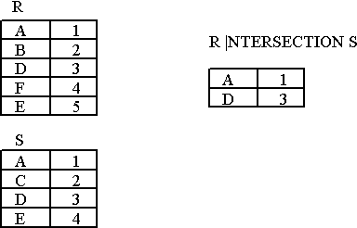
Intersection (∩)

Slide 31
Division
r ÷ s
Notation:
Let r and s be relations on schemas R and S respectively where
R = (A₁, …, A_{m} , B₁, …, B_{n} )
S = (B₁, …, B_{n})
The result of r ÷ s is a relation on schema
R – S = (A₁, …, A_{m})

Slide 32
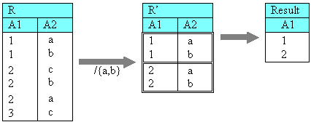
Division

Slide 33
Joins
Joins is a special form of cross product of two tables.
Binary operation that allows combining certain selections and a Cartesian Product into one operation.
The join operation:
Forms a Cartesian product of its two arguments.
Performs a selection forcing equality on those attributes
Finally removes duplicate attributes

Slide 34
Joins
Theta Join (θ)
Equi Join
Natural Join
Outer Joins

Slide 35
Theta Join (θ)
Theta join combines tuples from different relations provided they satisfy the theta condition.
The join condition is denoted by the symbol θ.
Notation: R1 ⋈_{θ} R2
R1 and R2 are relations having attributes (A1, A2, .., An) and (B1, B2,.. ,Bn) such that the attributes don’t have anything in common, that is R1 ∩ R2 = Φ.
Theta join can use all kinds of comparison operators.

Slide 36
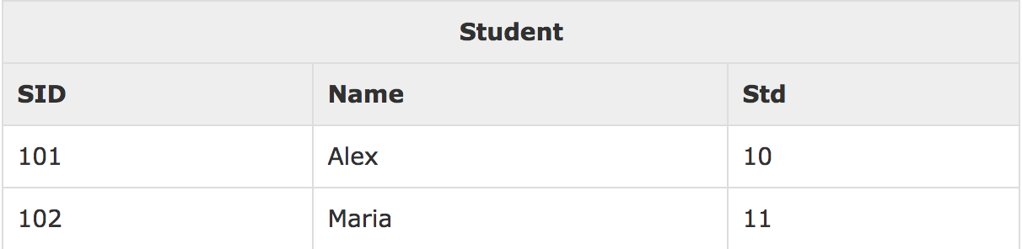
Theta Join (θ)

Slide 37
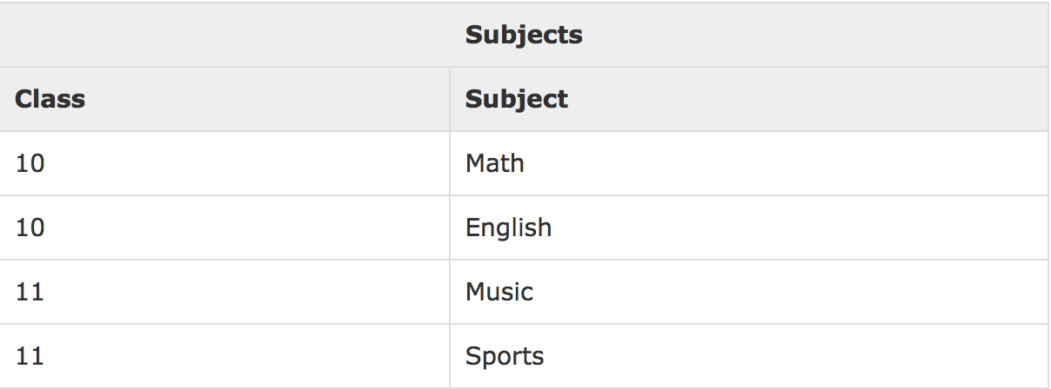
Theta Join (θ)

Slide 38
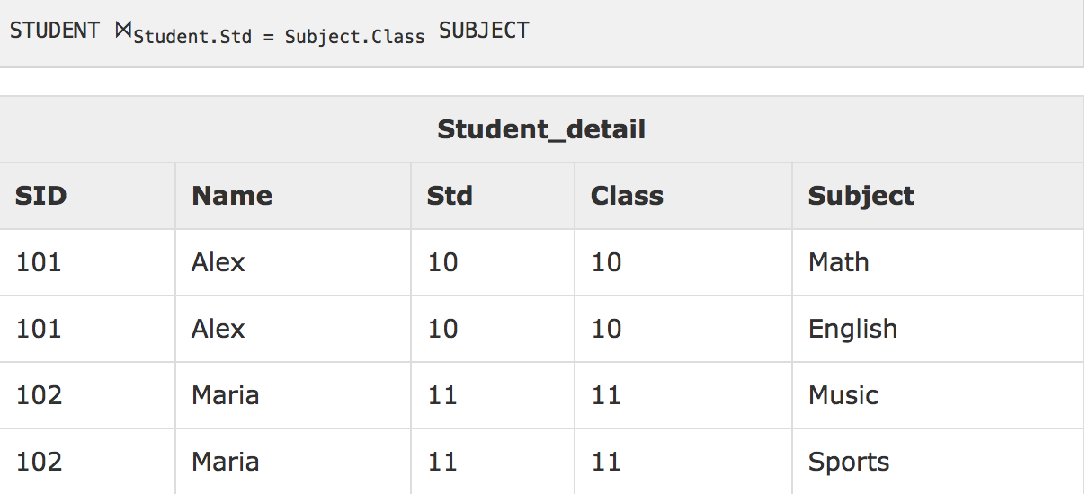
Theta Join (θ)

Slide 39
Equi-Join
When Theta join uses only equality comparison operator, it is said to be equijoin. The above example corresponds to equijoin.

Slide 40
Natural Join (⋈)
Does not use any comparison operator.
It does not concatenate the way a Cartesian Product does.
We can perform a natural join only if there is at least one common attribute that exists between two relations.
In addition, the attribute must have the same name and domain.
Natural join acts on those matching attributes where the values of attributes in both relations are same.

Slide 41
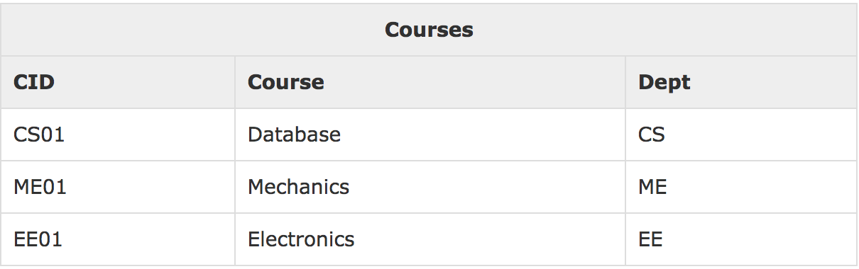
Natural Join (⋈)

Slide 42
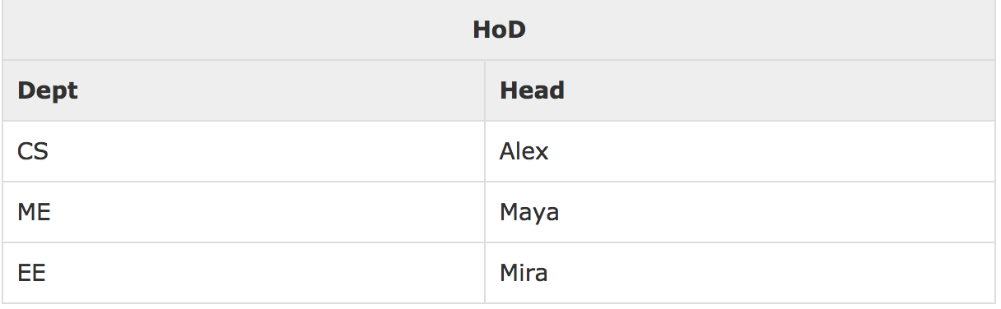
Natural Join (⋈)

Slide 43
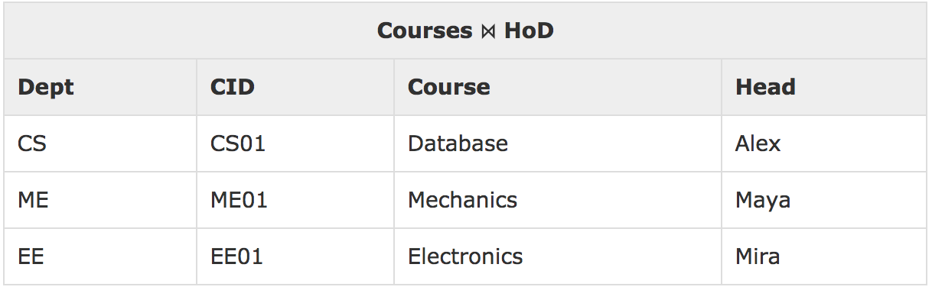
Natural Join (⋈)

Slide 44
Outer Joins
Theta Join, Equi Join and Natural Join are called inner joins.
An inner join only includes those tuples with matching attributes and the rest are discarded in the resulting operation.
We need to use outer joins to include all tuples from the participating relations in the resulting operation.
Left Outer Join, Right Outer Join, Full Outer Join.

Slide 45
Left Outer Join
All the tuples from the left relation, R, are included in the resulting operation.
If there are tuples in R without any matching tuple in the Right relation S, then the S-attributes of the resulting relation are made NULL.

Slide 46
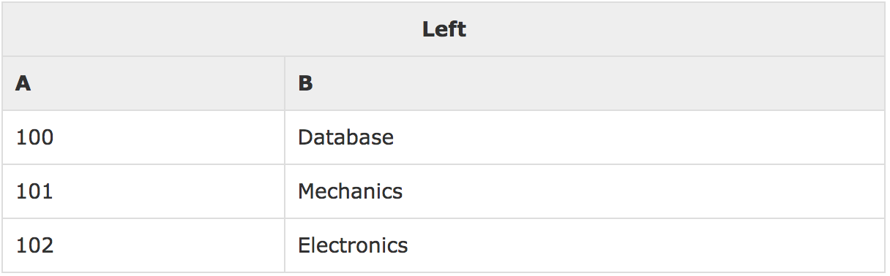
Left Outer Join
Courses

Slide 47
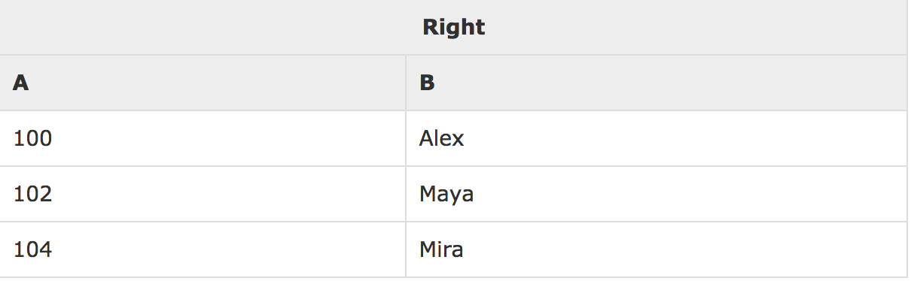
Left Outer Join
HoD

Slide 48
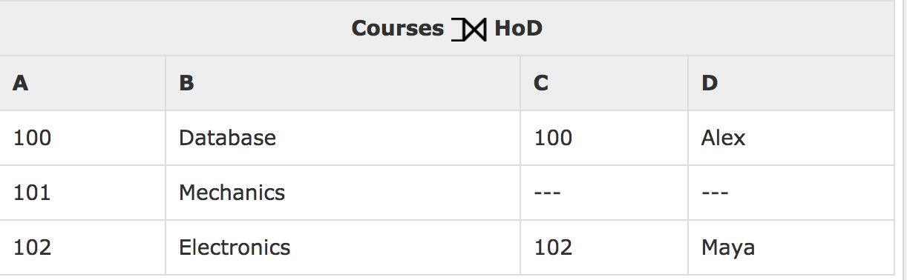
Left Outer Join

Slide 49
Right Outer Join
All the tuples from the Right relation S, are included in the resulting relation.
If there are tuples in S without any matching tuple in R, then the R-attributes of resulting relation are made NULL.

Slide 50
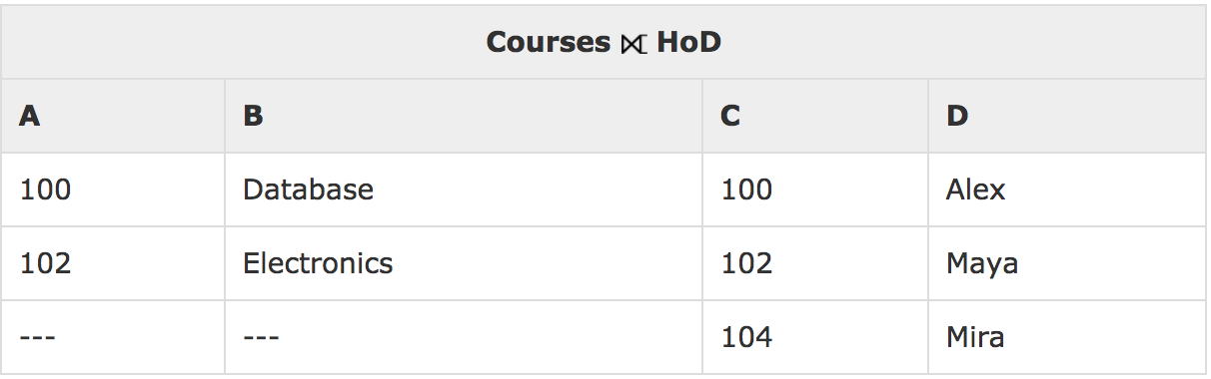
Right Outer Join

Slide 51
Full Outer Join
All the tuples from both participating relations are included in the resulting relation.
If there are no matching tuples for both relations, their respective unmatched attributes are NULL.

Slide 52
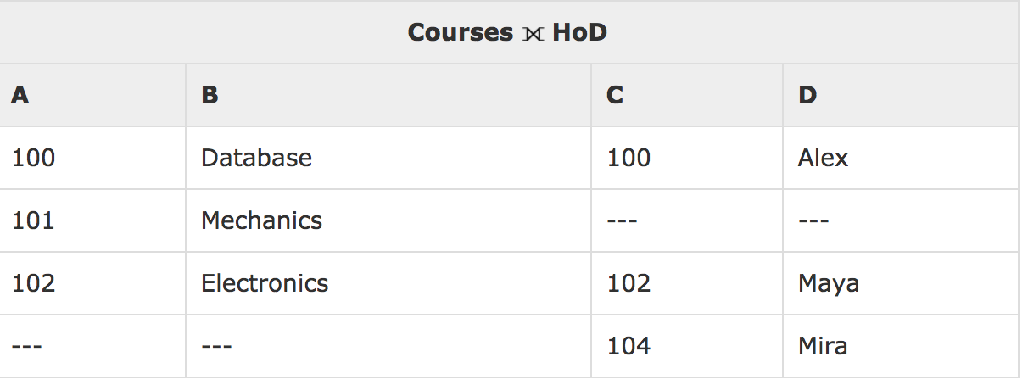
Full Outer Join

Slide 53
Rename (ρ)
The results of relational algebra are also relations but without any name.
The rename operation provides database designers to rename the output relation.
The rename-operation is denoted using small Greek letter rho (ρ).
It is written as:ρ_{x} (E)
Where the result of expression E is saved with name of x.

Slide 54
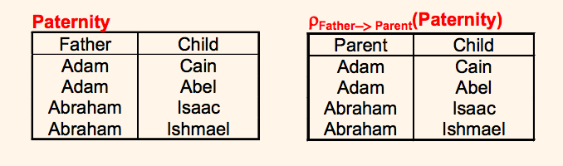
Rename (ρ)

Slide 55
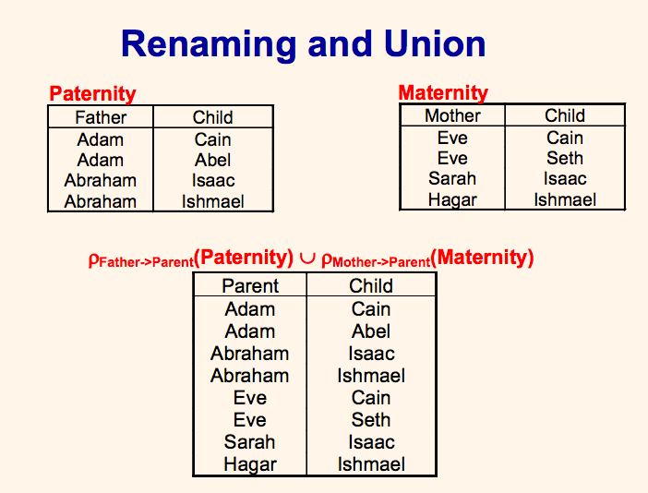
Rename (ρ)

Slide 56
Composition of Operations
Can build expressions using multiple operations
Example: σ_{A=C}(r x s)
A
B
C
D
E
σ_{A=C}(r x s)
α
α
α
α
β
β
β
β
1
1
1
1
2
2
2
2
α
β
β
γ α
β
β
γ
10
10
20
10
10
10
20
10
a
a
b
b
a
a
b
b
r x s
A
B
C
D
E
α
β
β
1
2
2
α
β
β
10
20
20
a
a
b

Slide 57
Aggregate Functions and Operations
Aggregate functions takes a collection of values and returns a single value as a result.
avg: average value
min: minimum value
max: maximum value
sum: sum of values
count: number of values

Slide 58
Aggregate Functions and Operations
Aggregate operation in relational algebra
_{G1, G2, …, Gn} g _{F1( A1), F2( A2),…, Fn( An)} (E)
E is any relational-algebra expression
G₁, G₂ …, G_{n} is a list of attributes on which to group (can be empty)
Each F_{i} is an aggregate function
Each A_{i} is an attribute name

Slide 59
Aggregate Functions: Example
Relation r:
A
B
C
g _{sum(c)} (r)
α
α
β
β
α
β
β
β
7
7
3
10
sum-C
27

Slide 60
Aggregate Functions: Example
Relation account grouped by branch-name:
branch-name
account-number
balance
Perryridge
Perryridge
Brighton
Brighton
Redwood
A-102
A-201
A-217
A-215
A-222
400
900
750
750
700
_{branch-name} g _{sum(balance)} (account)
branch-name
balance
Perryridge
Brighton
Redwood
1300
1500
700

Slide 61
Aggregate Functions: Example
Result of aggregation does not have a name
Can use rename operation to give it a name
For convenience, we permit renaming as part of aggregate operation
_{branch-name} g _{sum(balance) as sum-balance} (account)

Slide 62
Views
In some cases, it is not desirable for all users to see the entire logical model (i.e., all the actual relations stored in the database.)
Consider a person who needs to know a customer’s loan number but has no need to see the loan amount.
This person should see a relation described, in the relational algebra, by :
∏_{customer-name, loan-number} (borrower loan)
Any relation that is not of the conceptual model but is made visible to a user as a “virtual relation” is called a view.

Slide 63
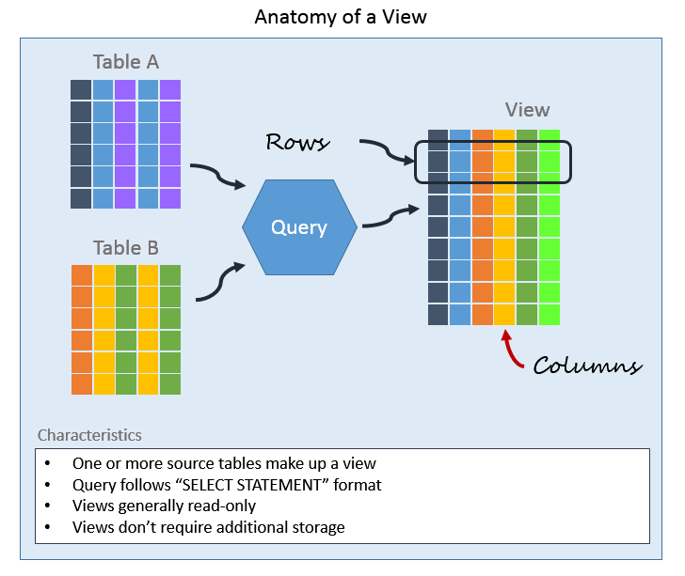
Views

Slide 64
Data Dictionary
Also called Data Definition Matrix
Is a file or set of files that contains a database’s metadata.
Contains records about other objects in the database, such as data ownership, data relationships to other objects, and other data.
Crucial component of any database system.
Mostly DBA’s interact with data dictionary.

Slide 65
Data Dictionary
Metadata in Data Dictionary includes the following.
Names of all tables in the database and their owners
Names of all indexes and the columns to which the tables in those indexes relate
Constraints defined on tables, including primary keys, foreign-key relationships to other tables, and not-null constraints

Slide 66
Key Elements of Data Dictionary
Provides information about each attribute, also referred to us as fields of a data model.
Organized in spreadsheet format.
Attribute Name:
A unique identifier, typically expressed in business language, that labels each attribute.

Slide 67
Key Elements of Data Dictionary
Optional/Required
Indicates whether information is required in an attribute before a record can be saved.
Attribute Type:
Defines what type of data is allowable in a field. Common types include text, numeric, date/time, enumerated list, look-ups, booleans, and unique identifiers.

Slide 68
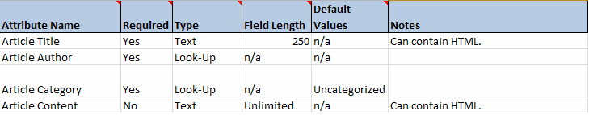
Data Dictionary

Slide 69
Relation Algebra: Examples

Slide 70
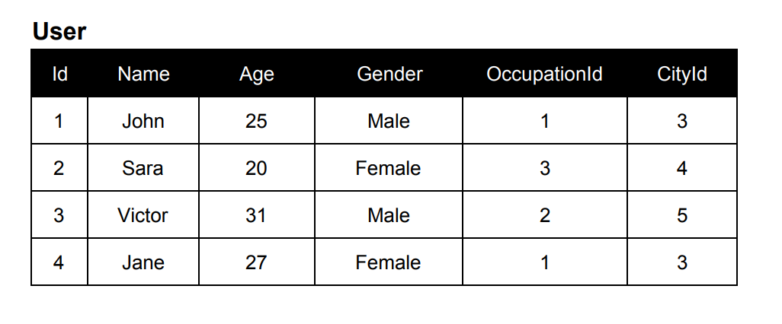
Example 1

Slide 71
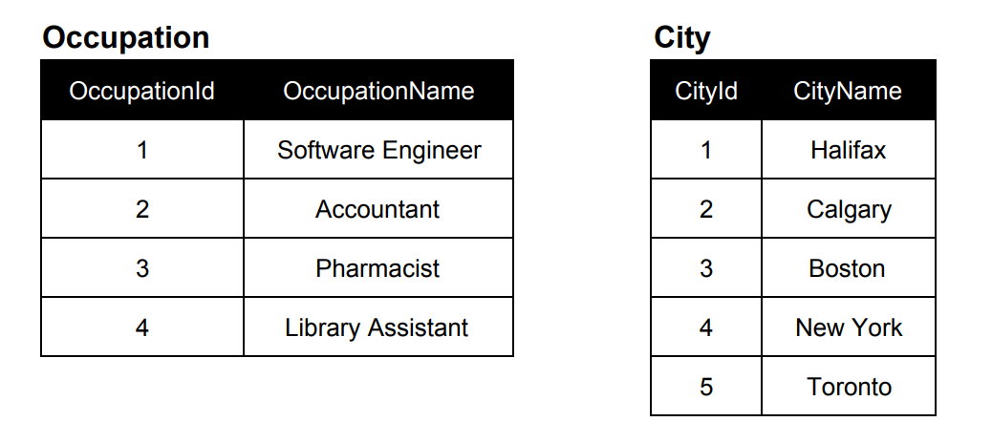
Example 1

Slide 72
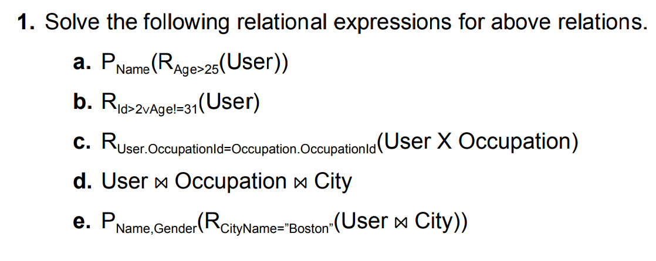
Example 1
P = ∏ (Projection), R = σ (Selection)

Slide 73
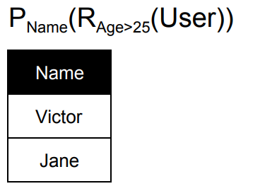
Example 1

Slide 74
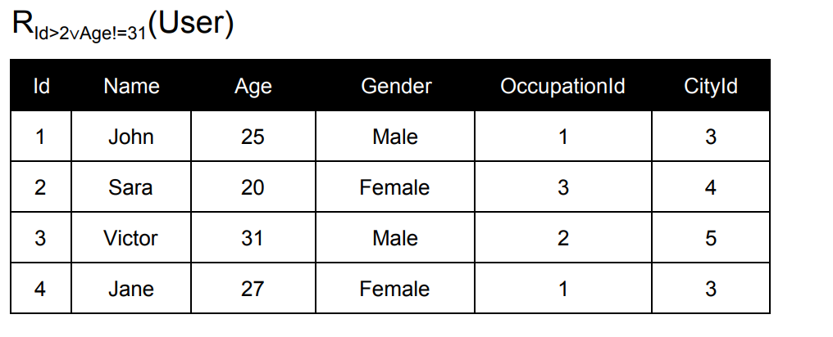
Example 1

Slide 75
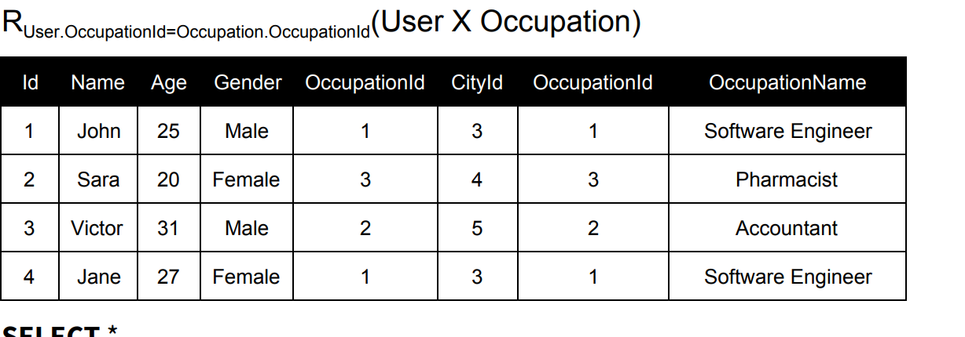
Example 1

Slide 76
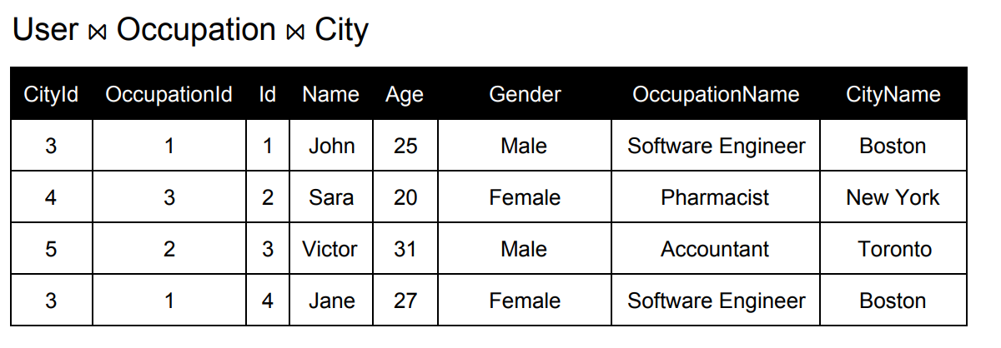
Example 1

Slide 77
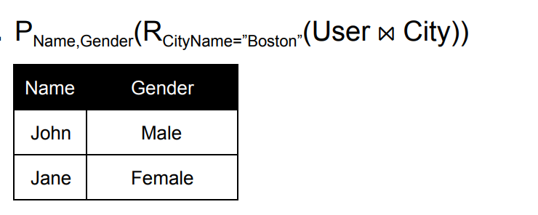
Example 1

Slide 78
Banking Example
branch (branch_name, branch_city, assets)
customer (customer_name, customer_street, customer_city)
account (account_number, branch_name, balance)
loan (loan_number, branch_name, amount)
depositor (customer_name, account_number)
borrower (customer_name, loan_number)

Slide 79
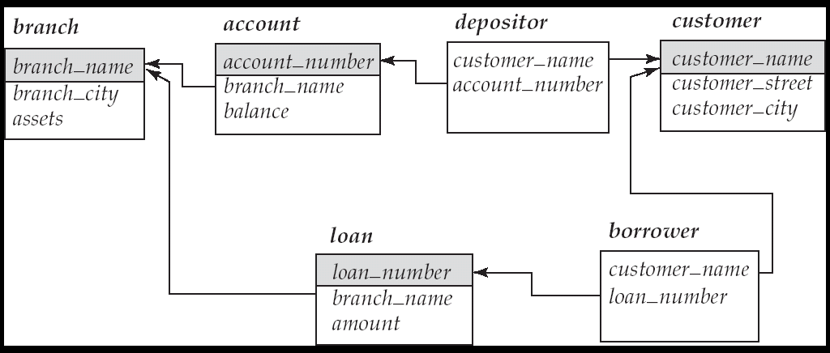
Banking Example - ERD

Slide 80
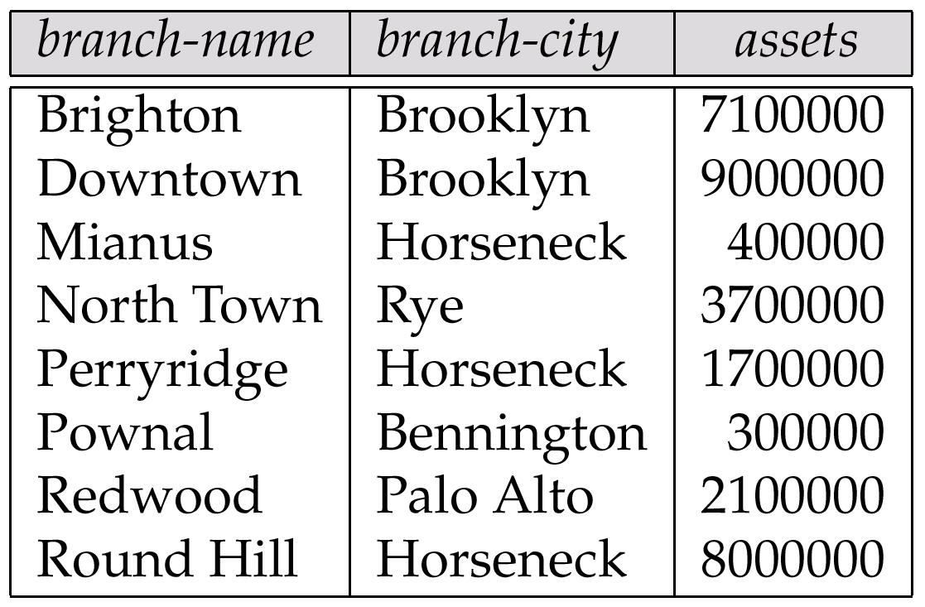
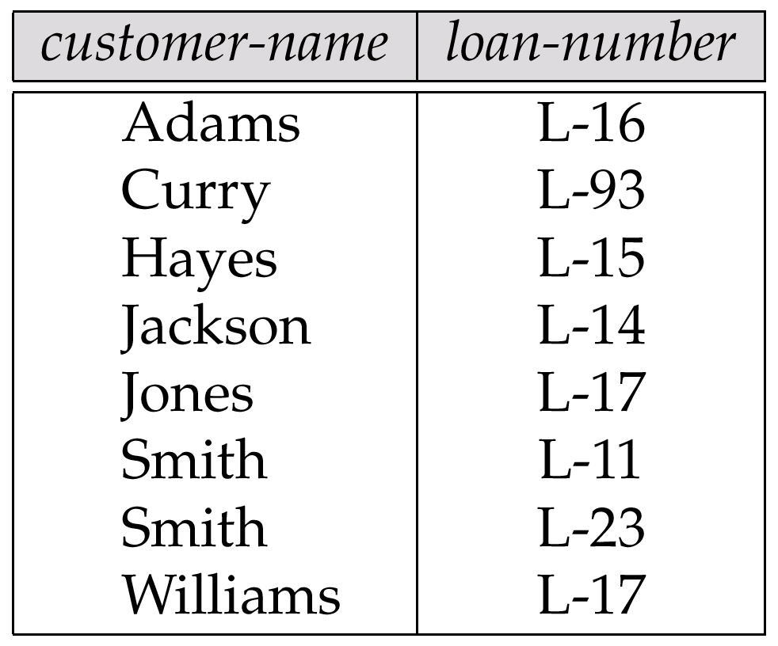
Banking Example
Relation: Branch
Relation: Borrower

Slide 81
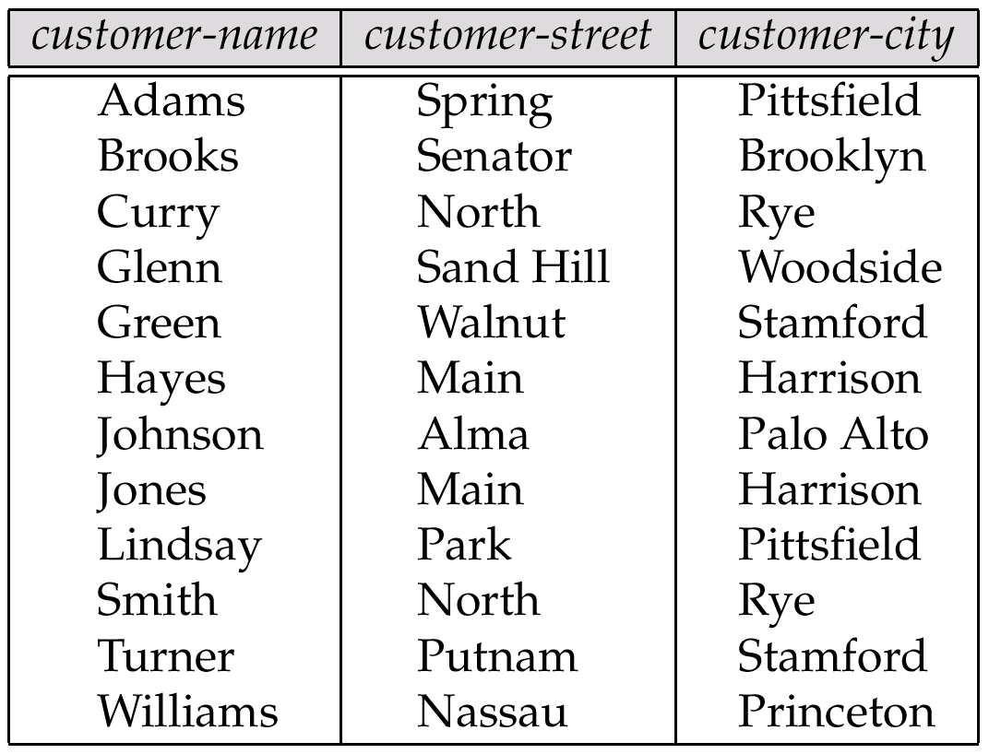
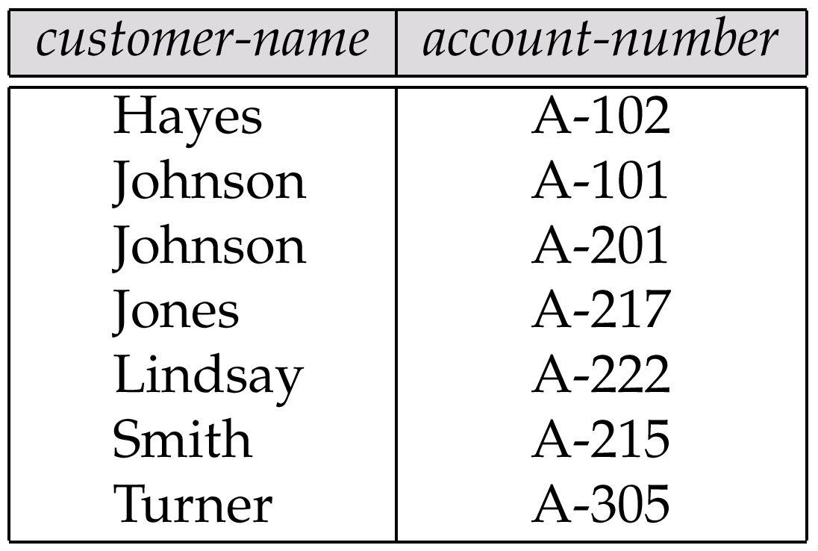
Banking Example
Relation: Customer
Relation: Depositor

Slide 82
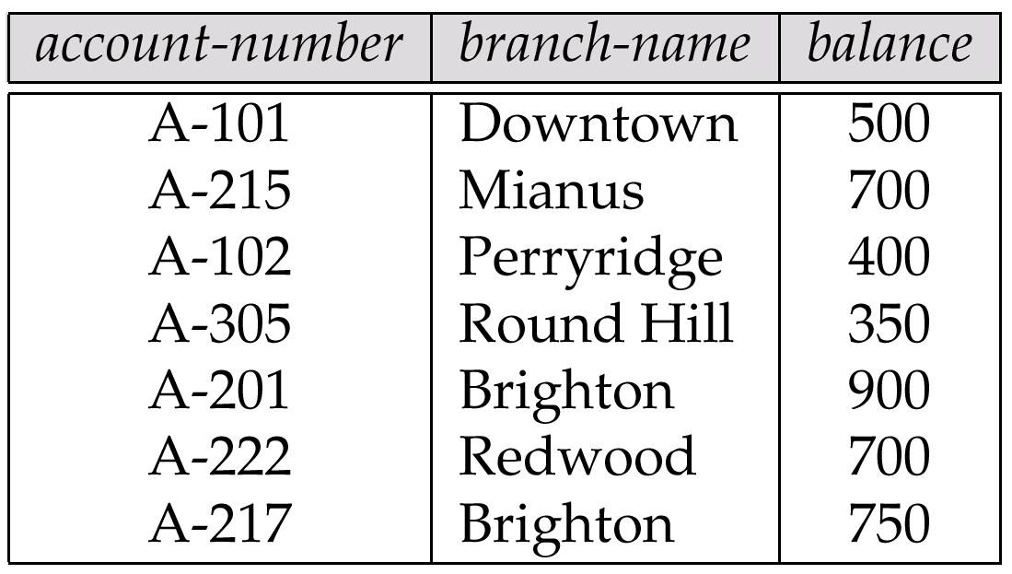
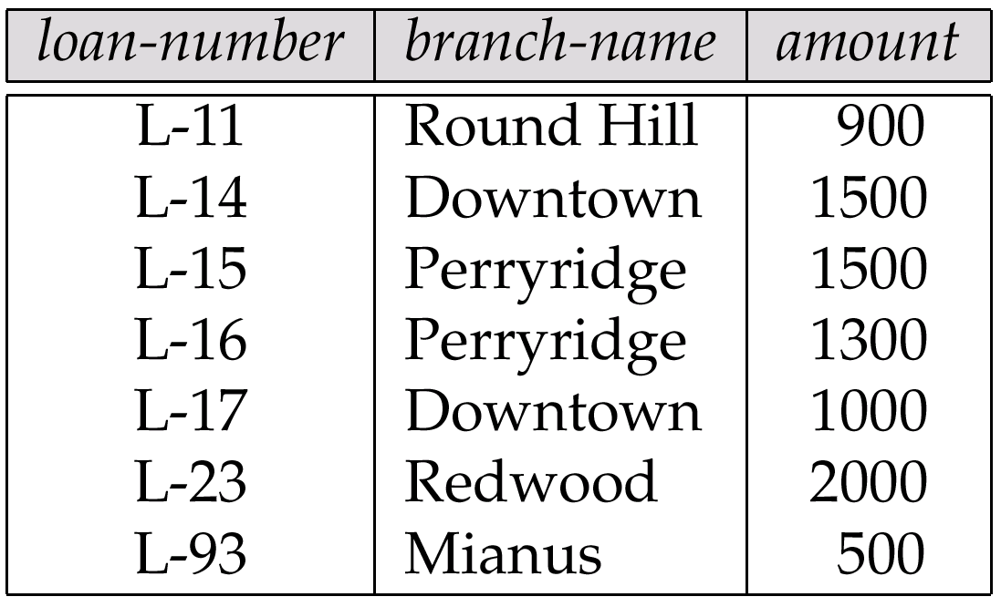
Banking Example
Relation: Account
Relation: Loan

Slide 83
Example Queries
Find all loans of over $1200
σ_{amount > 1200} (loan)
Find the loan number for each loan of an amount greater than $1200
∏_{loan-number} (σ_{amount} _{> 1200} (loan))

Slide 84
Example Queries
Find the names of all customers who have a loan, an account, or both, from the bank
Find the names of all customers who have a loan and an
account at bank.
∏_{customer-name} (borrower) ∪ ∏_{customer-name} (depositor)
∏_{customer-name} (borrower) ∩ ∏_{customer-name} (depositor)

Slide 85
Example Queries
Find the names of all customers who have a loan at the Perryridge branch.
∏_{customer-name} (σ_{branch-name=“Perryridge”}
(σborrower.loan-number = loan.loan-number(borrower x loan)))

Slide 86
Example Queries
Find the names of all customers who have a loan at the Perryridge branch but do not have an account at any branch of the bank.
∏_{customer-name} (σ_{branch-name = “Perryridge”}
(σborrower.loan-number = loan.loan-number(borrower x loan))) – ∏_{customer-name}(depositor)

Slide 87
Example Queries
Find the names of all customers who have a loan at the Perryridge branch.
Query 1 ∏_{customer-name}(σ_{branch-name = “Perryridge”} ( σborrower.loan-number = loan.loan-number(borrower x loan)))
− Query 2
∏_{customer-name}(σloan.loan-number = borrower.loan-number( (σ_{branch-name = “Perryridge”}(loan)) x borrower))

Slide 88
Example Queries
Find the largest account balance
Rename account relation as d
The query is:
∏_{balance}(account) - ∏_{account.balance}
(σ_{account.balance < d.balance} (account x ρ_{d} (account)))

Slide 89
Example Queries
Find all customers who have an account from at least the “Downtown” and the Uptown” branches.
Query 1
∏_{CN}(σ_{BN=“Downtown”}(depositor account)) ∩
∏_{CN}(σ_{BN=“Uptown”}(depositor account))
where CN denotes customer-name and BN denotes branch-name.
Query 2
∏_{customer-name, branch-name} (depositor account) ÷ ρ_{temp(branch-name)} ({(“Downtown”), (“Uptown”)})

Slide 90
Example Queries
Find all customers who have an account at all branches located in Brooklyn city.
∏_{customer-name, branch-name} (depositor account) ÷ ∏_{branch-name} (σ_{branch-city = “Brooklyn”} (branch))

Slide 91
End of Chapter Three Thank you ☺

