Slide 1
DBMS Chapter-5 Database Constraints and Relational Database Design

Slide 2
Chapter Contents
Introduction
Integrity Constraints
Referential Integrity
Assertions and Triggers
Functional Dependencies
Normalization and Normal Forms
Multivalued Dependencies
Decomposition of relations schemas

Slide 3
Introduction
Database Constraints are user-defined structures that let you restrict the behaviors of columns.
Rules enforced on the data column of the table.
Used to limit the type of data that can go into the table.
Maintain data integrity during an update/delete/insert into an table.

Slide 4
Integrity Constraints
Used to ensure accuracy and consistency of data in a relational database.
Data integrity is handled in a relational database through the concept of referential integrity.
Many types of integrity constraints play a role in referential integrity (RI).

Slide 5
Integrity Constraints
Primary Key Constraints
Unique Constraints
NOT NULL Constraints
Check Constraints
Foreign Key Constraints

Slide 6
Referential Integrity
Refers to the relationship between tables.
Set of constraints applied to foreign key which prevents entering row in child table for which you don’t have any corresponding row in parent table.
Prevents table from having incomplete or incorrect relationships.

Slide 7
Referential Integrity
Because each table in a database must have a primary key, this primary key can appear in other tables because of its relationship to data within those tables.
When a primary key of one table appears in another table, it is called a foreign key.
Foreign keys joins tables and establish dependencies between tables.

Slide 8
Referential Integrity
Foreign Keys join tables and establish dependencies between tables.
Tables can form a hierarchy of dependencies in such a way that if you can change or delete a row in one table, you destroy the meaning of rows in other tables.

Slide 9
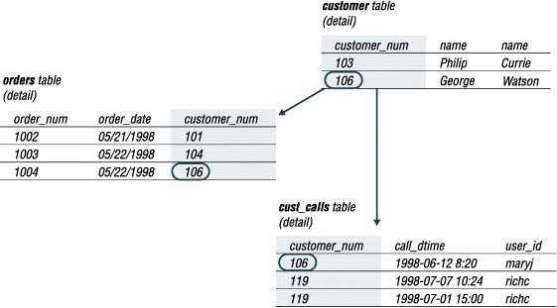
Referential Integrity

Slide 10
ON DELETE
NO ACTION
which is the default) prevents deleting a parent when there are children (would be nice arrangement for real life)
CASCADE
when a referenced parent table row is removed all the child are removed automatically)
SET NULL
action allows data that references the parent key to be deleted, but not updated. When referenced data in the parent key is deleted, all rows in the child table that depend on those parent key values have their foreign keys set to null.

Slide 11
PL/SQL Basics
Introduction
Control Statements
Stored Procedure
Function
Cursor
Exception
Trigger and Assertions

Slide 12
PL/SQL
Block structured language
Logical blocks that can contain any number of nested sub-blocks.
Procedural Language extension of SQL
Closely integrated with SQL but adds some programming constraints not available in SQL.

Slide 13
PL/SQL
Each block of PL/SQL program is consists of three sub parts.
Declarations
Executable Commands: Mandatory
Exception Handling
Every PL/SQL statement ends with a semicolon (;)

Slide 14
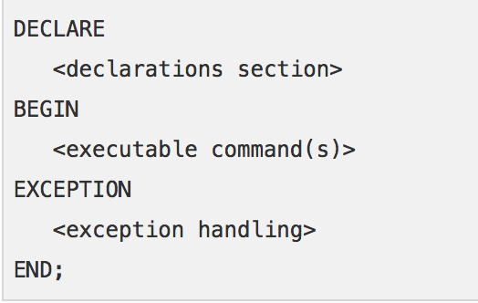
PL/SQL
PL/SQL blocks can be nested within other PL/SQL blocks using BEGIN and END.

Slide 15
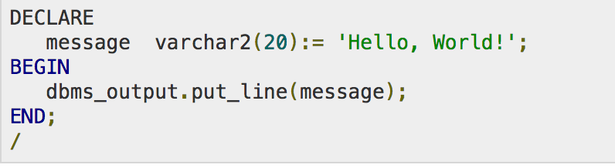
PL/SQL
The end; line signals the end of the PL/SQL block.
To run the code from the SQL command line, we may need to type / at the beginning of the first blank line after the last line of code.

Slide 16
PL/SQL Identifiers
PL/SQL identifiers are constants, variables, exceptions, procedures, cursors, and reserved words.
The identifiers consist of a letter optionally followed by more letters, numerals, dollar signs, underscores, and number signs and should not exceed 30 characters.
By default, identifiers are not case-sensitive.
We can use integer or INTEGER to represent a numeric value.
We cannot use a reserved keyword as an identifier.

Slide 17
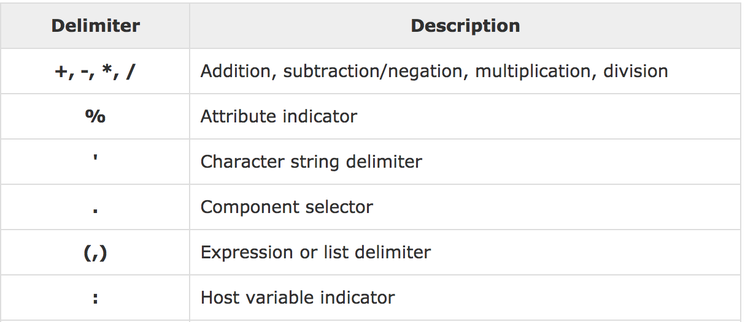
PL/SQL Delimiters
A delimiter is a symbol with a special meaning.

Slide 18
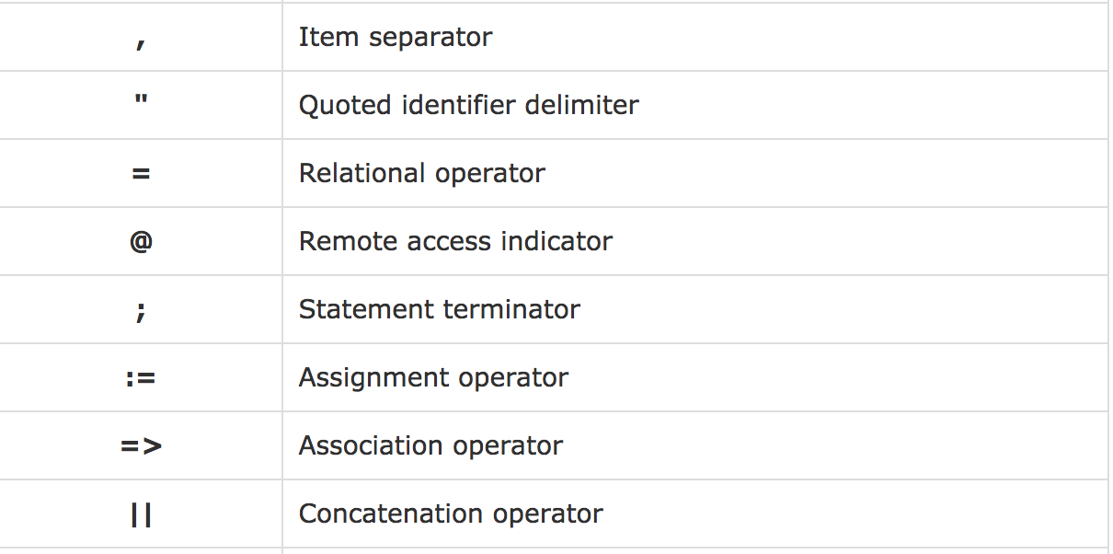
PL/SQL Delimiters

Slide 19
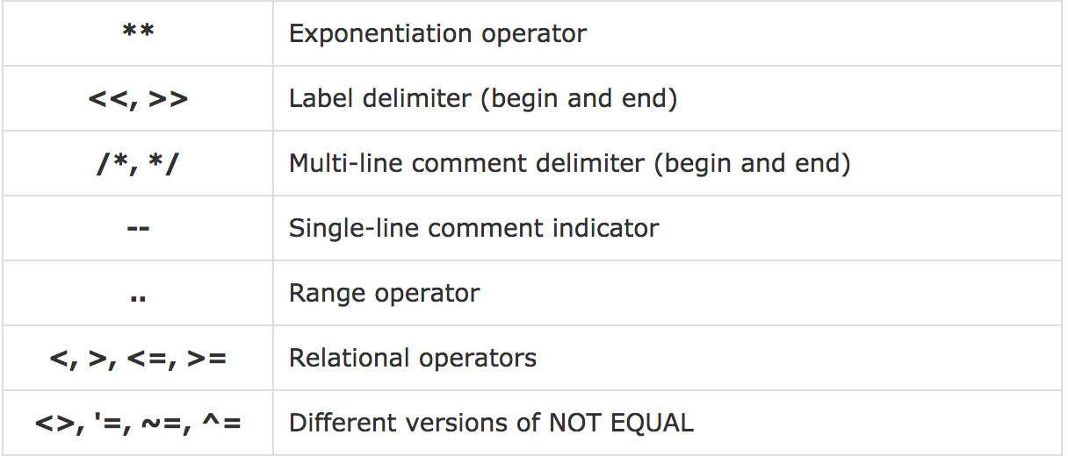
PL/SQL Delimiters

Slide 20
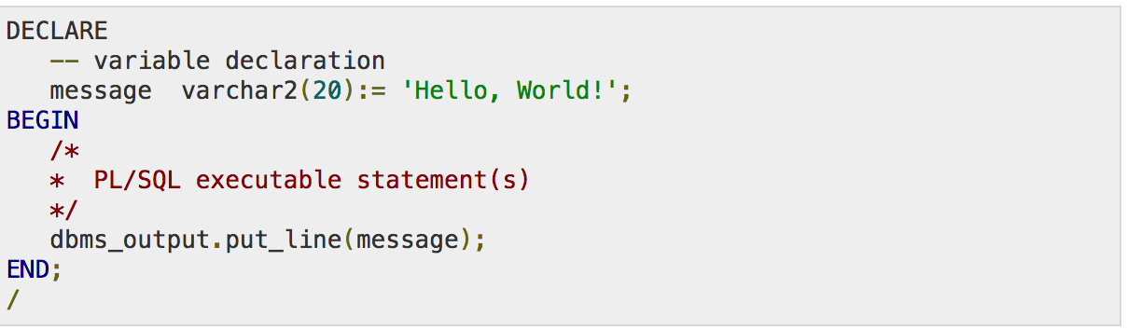
PL/SQL Comments

Slide 21
PL/SQL Program Units
A PL/SQL unit is one of the following.
PL/SQL block
Function
Package
Procedure
Trigger
Type

Slide 22
PL/SQL Data Types
Scalar
Numeric
INTEGER, FLOAT, DOUBLE etc..
Character
CHAR, VARCHAR etc….
Boolean
TRUE,FALSE
DateTime
YEAR, MONTH, HOUR
Large Object (LOB): BLOB.
Composite, Reference

Slide 23
PL/SQL Variables
PL/SQL variables must be declared in the declaration section or in a package or as a global variable.
When we declare a variable, PL/SQL allocates memory for the variable’s value and the storage location is identified by the variable name.

Slide 24
PL/SQL Variables
The syntax for declaring a variable is:
variable_name is a valid identifier.
datatype must be valid PL/SQL data type or any user defined data type.

Slide 25
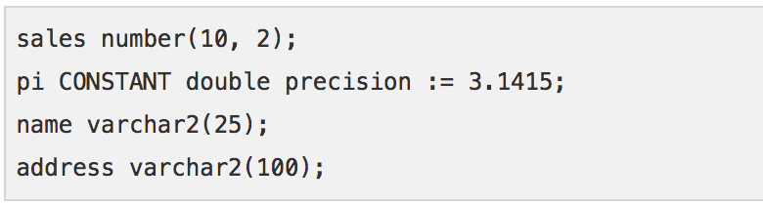
PL/SQL Variables
When we provide size, scale or precision limit with the data type, it is called a constrained declaration.
Constrained declarations require less memory than unconstrained declarations.

Slide 26
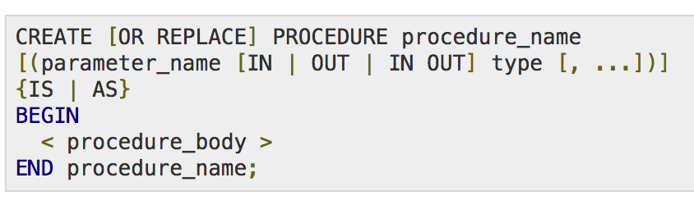
PL/SQL Procedure
A procedure is created with CREATE OR REPLACE PROCEDURE statement.

Slide 27
PL/SQL Procedure
procedure_name specifies the name of the procedure.
[OR REPLACE] option allows the modification of an existing procedure.
The optional parameter list contains name, mode and types of the parameters.
IN represents the value that will be passed from outside and OUT represents the parameter that will be used to return a value outside of the procedure.
procedure-body contains the executable part.
The AS keyword is used instead of the IS keyword for creating a standalone procedure.

Slide 28
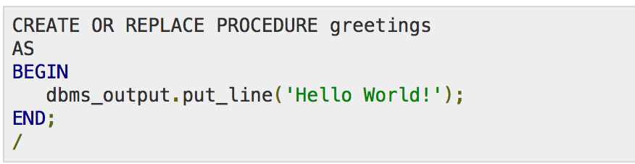


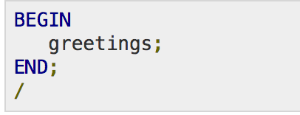
PL/SQL Procedure

Slide 29
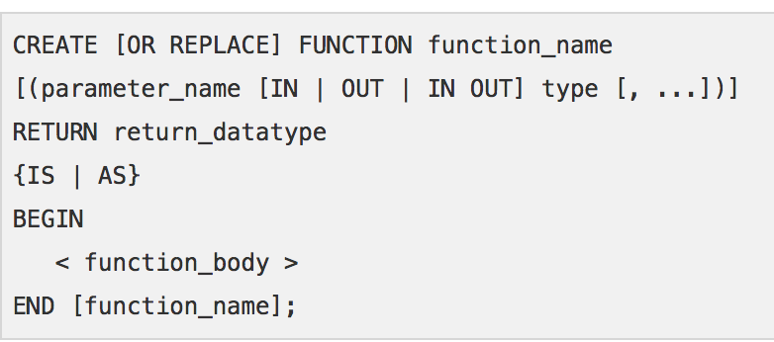
PL/SQL Function

Slide 30
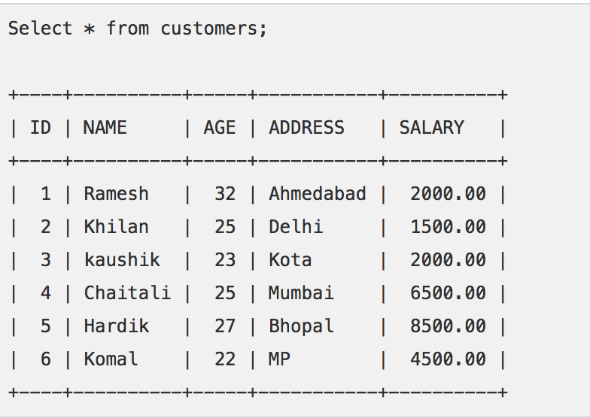
PL/SQL Function

Slide 31
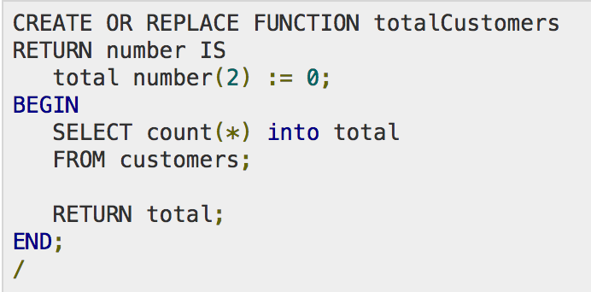
PL/SQL Function

Slide 32
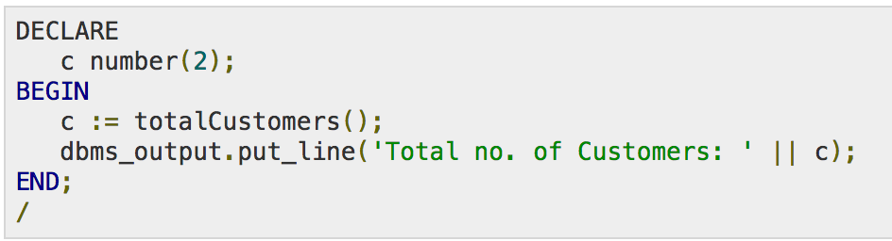
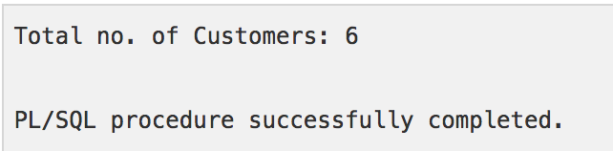
PL/SQL Function

Slide 33
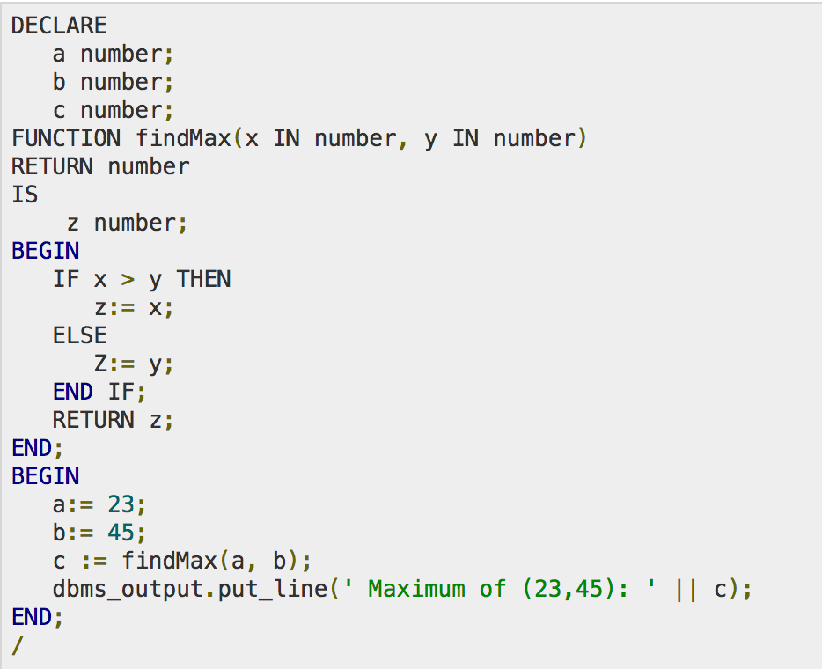
PL/SQL Function

Slide 34
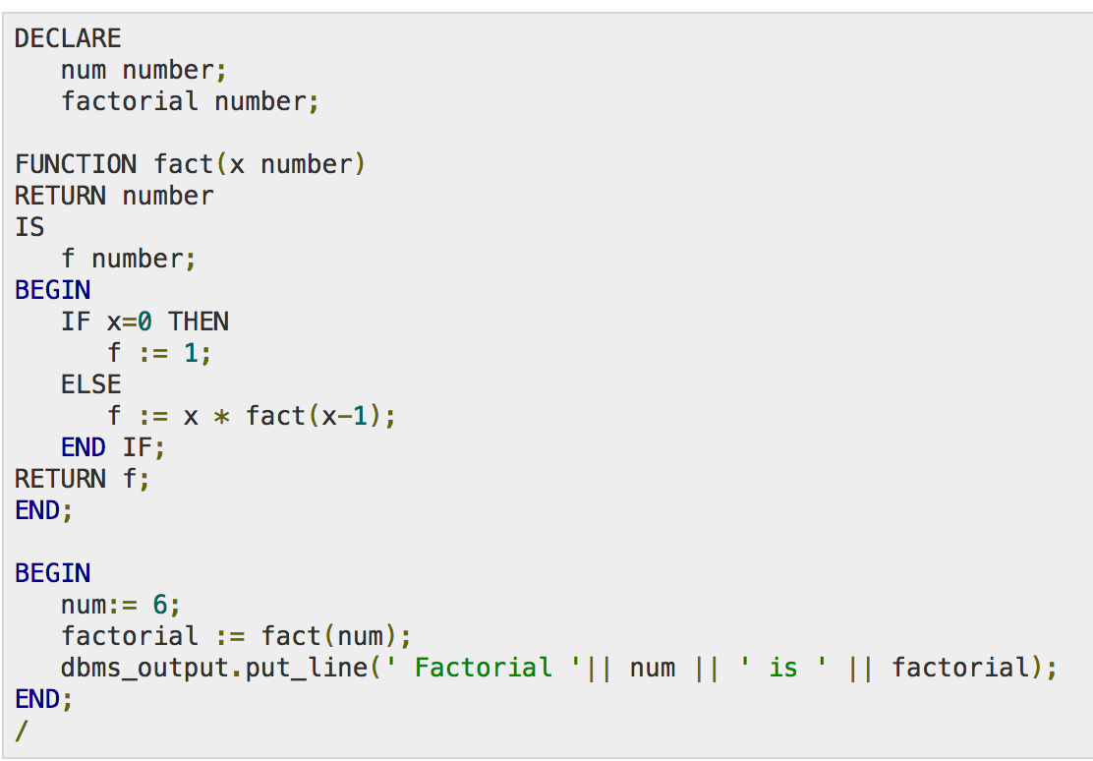
PL/SQL Function

Slide 35
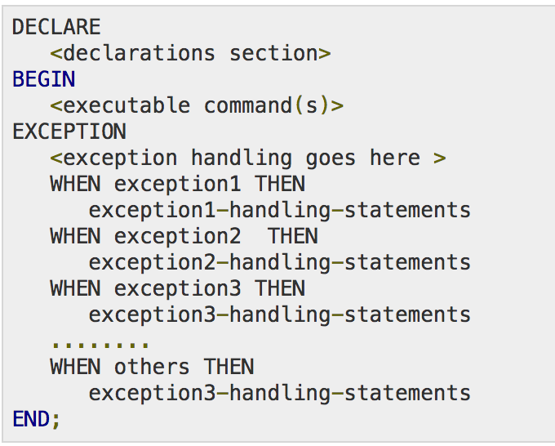
PL/SQL Exceptions

Slide 36
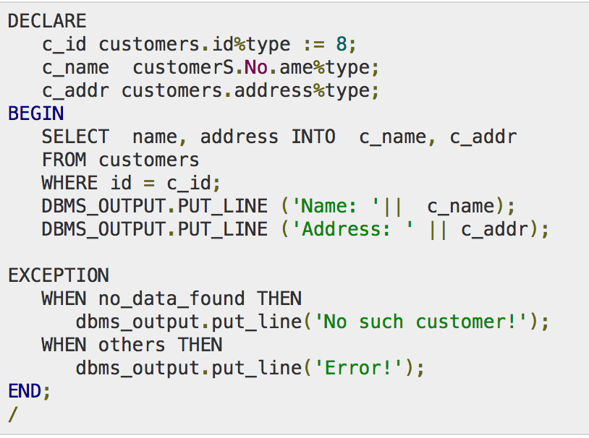
PL/SQL Exceptions

Slide 37
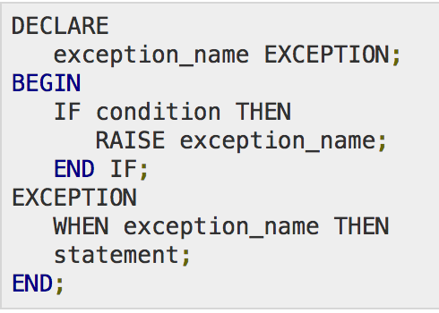
PL/SQL Exceptions

Slide 38
Triggers
How is age calculated?
S.No | Name | Date Of Birth | Age
1 | Ram | 1989/04/17
2 | Shyam | 1992/08/04
3 | Hari | 1992/08/09
4 | Madan | 1987/01/03
5 | Ramesh | 1990/12/10
6 | Sita | 1986/10/11

Slide 39
Triggers
A procedure that runs automatically when a certain event occurs in the DBMS.
Blocks of PL/SQL code, which are executed as a result of any insert/update/delete on the table.
It is always automatically executed.
Might perform single or a set of queries.
Always written as a PL/SQL code.

Slide 40
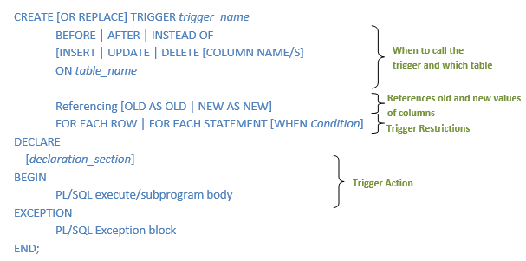
Triggers

Slide 41
Triggers
The procedure performs some actions
Check certain values.
Fill in some values.
Inserts/deletes/updates/records
Check that some constraints are satisfied.
Commit or rollback

Slide 42
Triggers
Three Components
Event
When this Event happens, the trigger is activated.
Condition (Optional)
If the condition is true, the triggers executes
Action
The actions performed by the Trigger.
Semantics: When the Event occurs and Condition is True, execute the Action

Slide 43
Triggers
Three event types
Insert
Update
Delete
Two Triggering times
Before the event
After the event
Two granularities
Execute for each row
Execute for each statement

Slide 44
Triggers: Event
Create Trigger <name>
Before|After Insert|Update|Delete ON <tablename>
….
That is the event
Create Trigger ABC
Before Insert On Students
….
Create Trigger XYZ
After Update On Students
….
This trigger is activated when an insert statement is issued, but before the new record is inserted
This trigger is activated when an update statement is issued and after the update is executed

Slide 45
Granularity of Event
A single SQL statement may update, delete, or insert many records at the same time
E.g., Update student set gpa = gpa x 0.8;
Does the trigger execute for each updated or deleted record, or once for the entire statement ?
We define such granularity
Create Trigger <name>
Before| After Insert| Update| Delete
For Each Row | For Each Statement
….
This is the event
This is the granularity

Slide 46
Granularity of Event
Create Trigger XYZ
After Update ON <tablename>
For each statement
….
Create Trigger XYZ
Before Delete ON <tablename>
For each row
….
This trigger is activated once (per UPDATE statement) after all records are updated
This trigger is activated before deleting each record

Slide 47
Triggers: Condition
This component is optional
Create Trigger <name>
Before| After Insert| Update| Delete On <tableName>
For Each Row | For Each Statement
When <condition>
…
That is the condition
If the employee salary > 150,000 then some actions will be taken
Create Trigger EmpSal
After Insert or Update On Employee
For Each Row
When (new.salary >150,000)
…

Slide 48
Triggers: Action
Action depends on what do you want to do?
Check certain values
Fill in some values
Inserts/deletes/updates other records
Check that some business constraints are satisfied
Commit (approve the transaction) or roll back (cancel the transaction)

Slide 49
Triggers: Referencing Values
In the action, you may want to reference:
The new values of inserted or updated records (:new)
The old values of deleted or updated records (:old)
Create Trigger EmpSal
After Insert or Update On Employee
For Each Row
When (new.salary >150,000)
Begin
if (:new.salary < 100,000) …
End;
Inside “When”, the “new” and “old” should not have “:”
Trigger body
Inside the trigger body, they should have “:”

Slide 50
Triggers: Referencing Values
Insert Event
Has only :new defined
Delete Event
Has only :old defined
Update Event
Has both :new and :old defined
Before Triggering (for insert/update)
Can update the values in :new
Changing :old values does not make sense
After Triggering
Should not change :new because the event is already done

Slide 51
Triggers: Example 1
If the employee salary increased by more than 10%, make sure the ‘rank’ field is not empty and its value has changed, otherwise reject the update
If the trigger exists, then drop it first
Create or Replace Trigger EmpSal
Before Update On Employee
For Each Row
Begin
IF (:new.salary > (:old.salary * 1.1)) Then
IF (:new.rank is null or :new.rank = :old.rank) Then
RAISE_APPLICATION_ERROR(-20004, 'rank field not correct');
End IF;
End IF;
End;
/
Compare the old and new salaries
Make sure to have the “/” to run the command

Slide 52
Triggers: Example 2
If the employee salary increased by more than 10%, then increment the rank field by 1.
In the case of Update event only, we can specify which columns
Create or Replace Trigger EmpSal
Before Update Of salary On Employee
For Each Row
Begin
IF (:new.salary > (:old.salary * 1.1)) Then
:new.rank := :old.rank + 1;
End IF;
End;
/
We changed the new value of rank field
The assignment operator has “:”

Slide 53
Triggers: Example 3
If the newly inserted record in employee has null hireDate field, fill it in with the current date
Create Trigger EmpDate
Before Insert On Employee
For Each Row
Declare
temp date;
Begin
Select sysdate into temp from dual;
IF (:new.hireDate is null) Then
:new.hireDate := temp;
End IF;
End;
/
Since we need to change values, then it should be “Before” event
Declare section to define variables
Oracle way to select the current date
Updating the new value of hireDate before inserting it

Slide 54
Triggers: Example 4
Keep the bonus attribute in Employee table always 3% of the salary attribute
Create Trigger EmpBonus
Before Insert Or Update On Employee
For Each Row
Begin
:new.bonus := :new.salary * 0.03;
End;
/
Indicate two events at the same time
The bonus value is always computed automatically

Slide 55
Triggers: Example 5
Store the count of employees having salary > 100,000 in table R
Indicate three events at the same time
Create Trigger EmpBonus
After Insert Or Update of salary Or Delete On Employee
For Each Statement
Begin
delete from R;
insert into R(cnt) Select count(*) from employee where salary > 100,000;
End;
/
Delete the existing record in R, and then insert the new count.

Slide 56
Assertions
An expression that should be always true
When created, the expression must be true
DBMS checks the assertion after any change that may violate the expression
Must return True or False

Slide 57
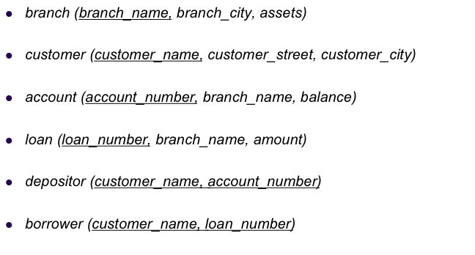
Assertions
Sum of loans taken by a customer does not exceed 100,000
Must return True or False (not a relation)
Create Assertion SumLoans Check
( 100,000 >= ALL
Select Sum(amount)
From borrower B , loan L
Where B.loan_number = L.loan_number
Group By customer_name );

Slide 58
Assertions
Number of accounts for each customer in a given branch is at most two
Create Assertion NumAccounts Check
( 2 >= ALL
Select count(*)
From account A , depositor D
Where A.account_number = D.account_number
Group By customer_name, branch_name );

Slide 59
Assertions
Customer city is always not null
Create Assertion CityCheck Check
( NOT EXISTS (
Select *
From customer
Where customer_city is null));

Slide 60
Triggers Vs. Assertions
Assertions do not modify the data, they only check certain conditions
Triggers are more powerful because the can check conditions and also modify the data
Assertions are not linked to specific tables in the database and not linked to specific events
Triggers are linked to specific tables and specific events

Slide 61
Triggers Vs. Assertions
All assertions can be implemented as triggers (one or more)
Not all triggers can be implemented as assertions
Oracle does not have assertions

Slide 62
Triggers Vs. Assertions
All new customers opening an account must have opening balance >= $100. However, once the account is opened their balance can fall below that amount.
Trigger Event: Before Insert
We need triggers, assertions cannot be used
Create Trigger OpeningBal
Before Insert On Customer
For Each Row
Begin
IF (:new.balance is null or :new.balance < 100) Then
RAISE_APPLICATION_ERROR(-20004, 'Balance should be >= $100');
End IF;
End;

Slide 63
Functional Dependencies
The attributes of a table is said to be dependent on each other when an attribute of a table uniquely identifies another attribute of the same table.
Suppose we have a student table with attributes: Stu_Id, Stu_Name, Stu_Age.
Here Stu_Id attribute uniquely identifies the Stu_Name attribute of student table because if we know the student id we can tell the student name associated with it.
This is known as functional dependency and can be written as Stu_Id->Stu_Name or in words we can say Stu_Name is functionally dependent on Stu_Id.

Slide 64
Functional Dependencies
Require that the value for a certain set of attributes determines uniquely the value for another set of attributes.
If there is a functional dependency between column A and column B in a given table, which may be written A —> B, then the value of column A determines the value of column B.
For example, in the employee table, the employeeID functionally determines the name

Slide 65
Functional Dependencies
Let R be a relation schema
α ⊆ R and β ⊆ R
The functional dependency
α → β holds on R if and only if for any legal relations r(R), whenever any two tuples t₁ and t₂ of r agree on the attributes α, they also agree on the attributes β. That is,
t₁[α] = t₂ [α] ⇒ t₁[β ] = t₂ [β ]

Slide 66
Functional Dependencies
Trivial Functional Dependency
Non Trivial Functional Dependency
Multivalued Dependency
Transitive Dependency

Slide 67
Trivial Functional Dependency
The dependency of an attribute on a set of attributes is known as trivial functional dependency if the set of attributes includes that attribute.
Symbolically: A ->B is trivial functional dependency if B is a subset of A.
The following dependencies are also trivial: A->A & B->B

Slide 68
Trivial Functional Dependency
Consider a table with two columns Student_id and Student_Name.
{Student_Id, Student_Name} -> Student_Id is a trivial functional dependency as Student_Id is a subset of {Student_Id, Student_Name}.
If we know the values of Student_Id and Student_Name then the value of Student_Id can be uniquely determined.
Also, Student_Id -> Student_Id & Student_Name -> Student_Name are trivial dependencies too.

Slide 69
Non-Trivial Functional Dependency
If a functional dependency X->Y holds true where Y is not a subset of X then this dependency is called non trivial Functional dependency.
An employee table with three attributes: emp_id,emp_name, emp_address.
The following functional dependencies are non-trivial:
emp_id -> emp_name (emp_name is not a subset of emp_id)
emp_id -> emp_address (emp_address is not a subset of emp_id)

Slide 70
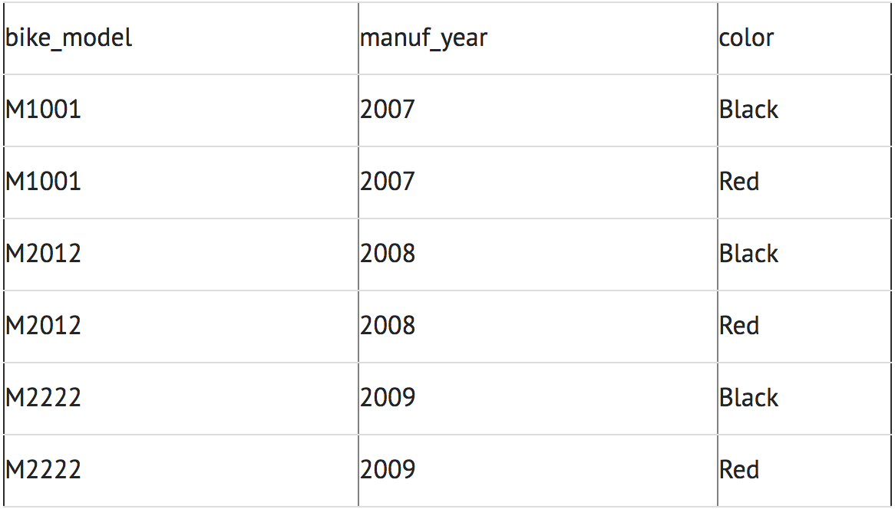
Multivalued Dependencies
Multivalued dependency occurs when there are more than one independent multivalued attributes in a table.

Slide 71
Multivalued Dependencies
Here columns manuf_year and color are independent of each other and dependent on bike_model.
In this case these two columns are said to be multivalued dependent on bike_model.
These dependencies can be represented like this:
bike_model ->> manuf_year
bike_model ->> color

Slide 72
Limitations of E-R Designs
E-R modeling provides a set of guidelines, but does not result in a unique database schema.
Nor does it provide a way of evaluating alternative schemas.
Normalization theory provides a mechanism for analyzing and refining the schema produced by an E-R design, or any other design.

Slide 73
Limitations of E-R Designs
Redundancy
Anomalies
Solution: Decomposition

Slide 74
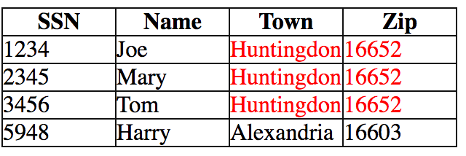
Redundancy
Dependencies between attributes within a relation cause redundancy
Ex. All addresses in the same town have the same zip code
There's clearly redundant information stored here.

Slide 75
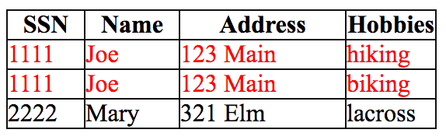
Redundancy and Other Problems
Set-valued or multi-valued attributes in the E-R diagram result in multiple rows in corresponding table
Example: Person (SSN, Name, Address, Hobbies)

Slide 76
Redundancy and Other Problems
A person entity with multiple hobbies yields multiple rows in table Person.
Hence, the association between Name and Address for the same person is stored redundantly.
SSN is key of entity set, but (SSN, Hobbies) is key of corresponding relation below.

Slide 77
Anomalies
An anomaly is an inconsistent, incomplete, or contradictory state of the database
Insertion anomaly
user is unable to insert a new record of data when it should be possible to do so because not all other information is available.
Deletion anomaly
when a record is deleted, other information that is tied to it is also deleted
Update anomaly
a record is updated, but other appearances of the same items are not updated

Slide 78
Insertion anomaly
To record one fact may require more information than is available.
Hobby value must be supplied for any inserted row since Hobby is part of key.

Slide 79
Update Anomaly
A change in Address must be made in several places.
Updating one fact may require updating multiple tuples.

Slide 80
Delete Anomaly
Deleting one fact may delete other information. Suppose a person gives up all hobbies.
Do we:
Set Hobby attribute to null?
No, since Hobby is part of key
Delete the entire row?
No, since we lose other information in the row

Slide 81
Decomposition
Decomposition is the process of breaking a relation into two or more relations to eliminate the redundancies and corresponding anomalies.
use two relations to store Person information.
Person1 (SSN, Name, Address)
Hobbies (SSN, Hobby)
The decomposition is more general: people with hobbies can now be described.
No update anomalies:
Name and address stored once
A hobby can be separately supplied or deleted

Slide 82
Normalization
Appropriate decomposition can solve problems.
Database Normalization is the process of efficiently organizing data in the database.
Two reasons:
Eliminating redundant data. For example: storing the same data in more than one table.
Ensuring Data dependencies make sense
Reduces amount of space of a database and ensures data is logically stored.

Slide 83
Normalizations
Consists of a series of guidelines that help us guide in creating a good database structure.
These guidelines are divided into forms.
Form is the format or the way database structure is laid out.
Aim of normal forms is to organize the database structure, so that it complies with the rules of the forms.

Slide 84
Normalizations
First Normal Form (1NF)
Second Normal Form (2NF)
Third Normal Form (3NF)
Boyce Code Normal Form (BCNF)

Slide 85
Normalization
0NF Relations
1NF Relations
2NF Relations
3NF Relations
Optimised Relations

Slide 86
Functional Dependencies Revision
Full/Partial Functional Dependency
Trivial Functional Dependency
Transient Functional Dependency

Slide 87
Functional Dependency
Relation between attributes in a table.
X->Y, X determines Y
What is the CGPA of A? Which A?
Name | Roll Number | CGPA
A | R1 | 3.6
B | R2 | 3.7
C | R3 | 2.6
A | R4 | 3.2
B | R5 | 3.5

Slide 88
Full Functional Dependency
X -> Y
Y is said to fully functional dependent if it cannot be determined by any of the subsets of X.
A,B,C -> D
B,C cannot determine D
A,C cannot determine D
D is fully functional dependent on A,B,C

Slide 89
Partial Functional Dependency
AC -> P
A -> D
D -> P
A attribute alone can determine P.
P is partially functional dependent on A,C.

Slide 90
Transitive Functional Dependency
Transitive relations
X -> Y and Y -> Z
X -> Z
Z is transitively functional dependent on X.

Slide 91
Trivial Functional Dependency
Reflexive rule
X is a subset of Y.
Then
Y -> X
X -> X
ABC -> BC

Slide 92
Why Normalize tables?
Save typing of repetitive data.
Increase flexibility to query, sort, summarize, and group data (Simpler to manipulate data!).
Avoid frequent restructuring of tables and other objects to accommodate new data.
Reduce disk space.

Slide 93
Steps of Normalization
Select the data source and convert into an un-normalized table (UNF or 0NF).
Transform the un-normalized data into first normal form (1NF)
Transfer data in 1NF to second normal form (2NF).
Transfer data in 2NF to third normal form (3NF).
Transfer data in 3NF to Boyce Code normal form (BCNF).

Slide 94
A Typical Spreadsheet File
Emp No | Employee Name | Time Card No | Time Card Date | Dept No | Dept Name
10 | Thomas Arquette | 106 | 11/02/2002 | 20 | Marketing
10 | Thomas Arquette | 106 | 11/02/2002 | 20 | Marketing
10 | Thomas Arquette | 106 | 11/02/2002 | 20 | Marketing
10 | Thomas Arquette | 115 | 11/09/2002 | 20 | Marketing
99 | Janice Smitty |  |  | 10 | Accounting
500 | Alan Cook | 107 | 11/02/2002 | 50 | Shipping
500 | Alan Cook | 107 | 11/02/2002 | 50 | Shipping
700 | Ernest Gold | 108 | 11/02/2002 | 50 | Shipping
700 | Ernest Gold | 116 | 11/09/2002 | 50 | Shipping
700 | Ernest Gold | 116 | 11/09/2002 | 50 | Shipping

Slide 95
Normalized Table
Table: Employees
Table: Departments
EmpNo | EmpFirstName | EmpLastName | DeptNo
10 | Thomas | Arquette | 20
500 | Alan | Cook | 50
700 | Ernest | Gold | 50
99 | Janice | Smitty | 10
DeptNo | DeptName
10 | Accounting
20 | Marketing
50 | Shipping
TimeCardNo | EmpNo | TimeCardDate
106 | 10 | 11/02/2002
107 | 500 | 11/02/2002
108 | 700 | 11/02/2002
115 | 10 | 11/09/2002
116 | 700 | 11/09/2002
Primary Key
Table: Time Card Data

Slide 96
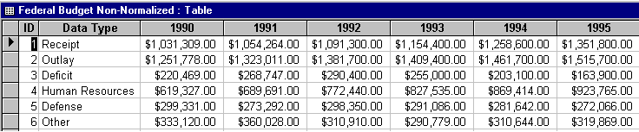
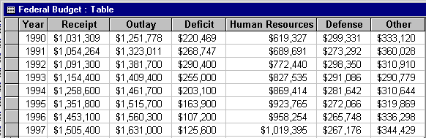
Another Example
Normalized Table

Slide 97
First Normal Form
Data must be in a database table.
The tables stores information in rows and columns where one or more columns, called the primary key, uniquely identify each row.
Each row contains atomic values, and there are no repeating groups of columns.
Each field contains the smallest meaningful value.
The table does not contain repeating groups of fields or repeating data within the same field.

Slide 98
First Normal Form
Define the data items required, because they become the columns in a table.
Place the related data items in a table.
Ensure that there are no repeating groups of data.
Ensure that there is a primary key.

Slide 99
Tables Violating First Normal Form
PART (Primary Key) | WAREHOUSE
P0010 | Warehouse A, Warehouse B, Warehouse C
P0020 | Warehouse B, Warehouse D
Really Bad Set-up!
Better, but still flawed!
PART (Primary Key) | WAREHOUSE A | WAREHOUSE B | WAREHOUSE C
P0010 | Yes | No | Yes
P0020 | No | Yes | Yes

Slide 100
Table Conforming to First Normal Form
PART (Primary Key) | WAREHOUSE (Primary Key) | QUANTITY
P0010 | Warehouse A | 400
P0010 | Warehouse B | 543
P0010 | Warehouse C | 329
P0020 | Warehouse B | 200
P0020 | Warehouse D | 278

Slide 101
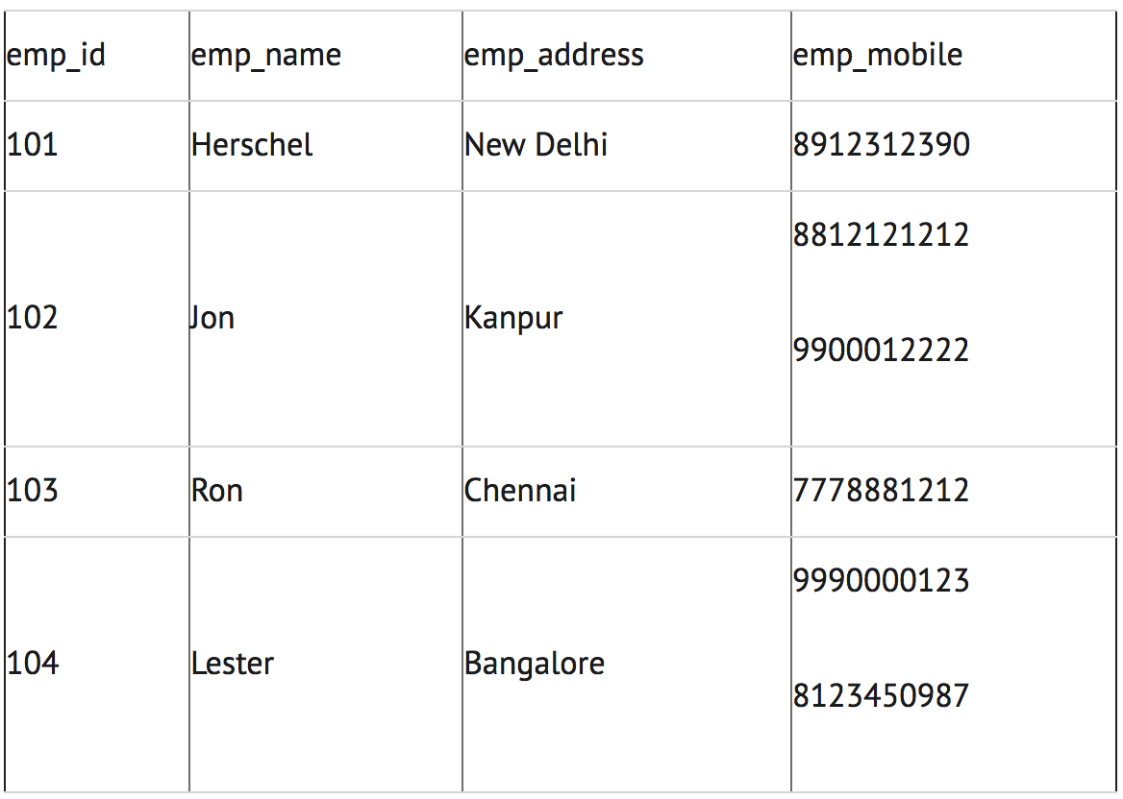
First Normal Form
Not Normalised

Slide 102
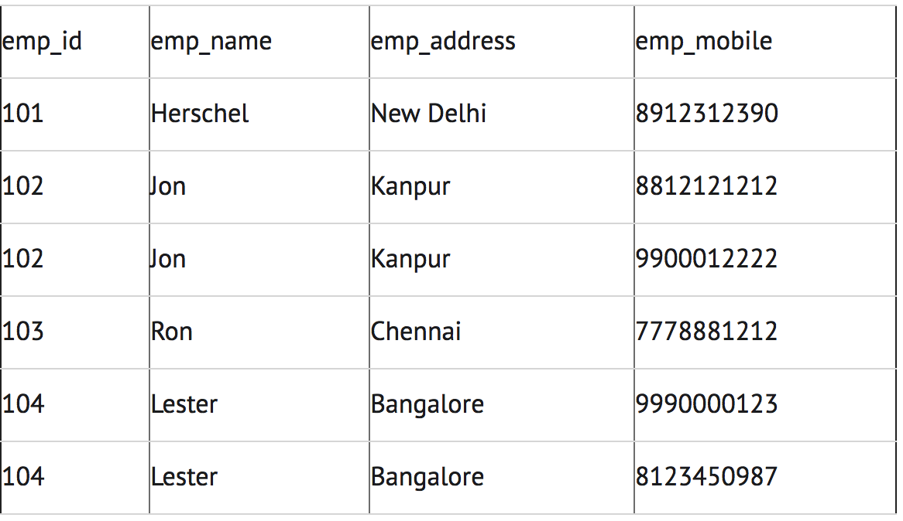
First Normal Form

Slide 103
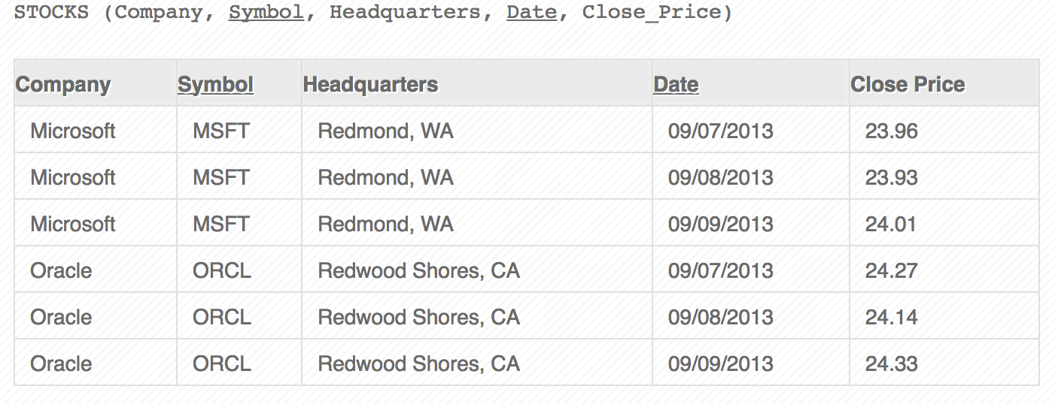
First Normal Form

Slide 104
Second Normal Form
A Candidate Key can be any column or a combination of columns that can qualify as unique key in database.
There can be multiple Candidate Keys in one table.
Each Candidate Key can qualify as Primary Key.
An attribute that is not part of any candidate key is known as non-prime attribute.

Slide 105
Second Normal Form
The table must be in first normal form.
All the non-key columns are dependent on the table’s primary key.
usually used in tables with a multiple-field primary key (composite key)
each non-key field relates to the entire primary key
any field that does not relate to the primary key is placed in a separate table

Slide 106
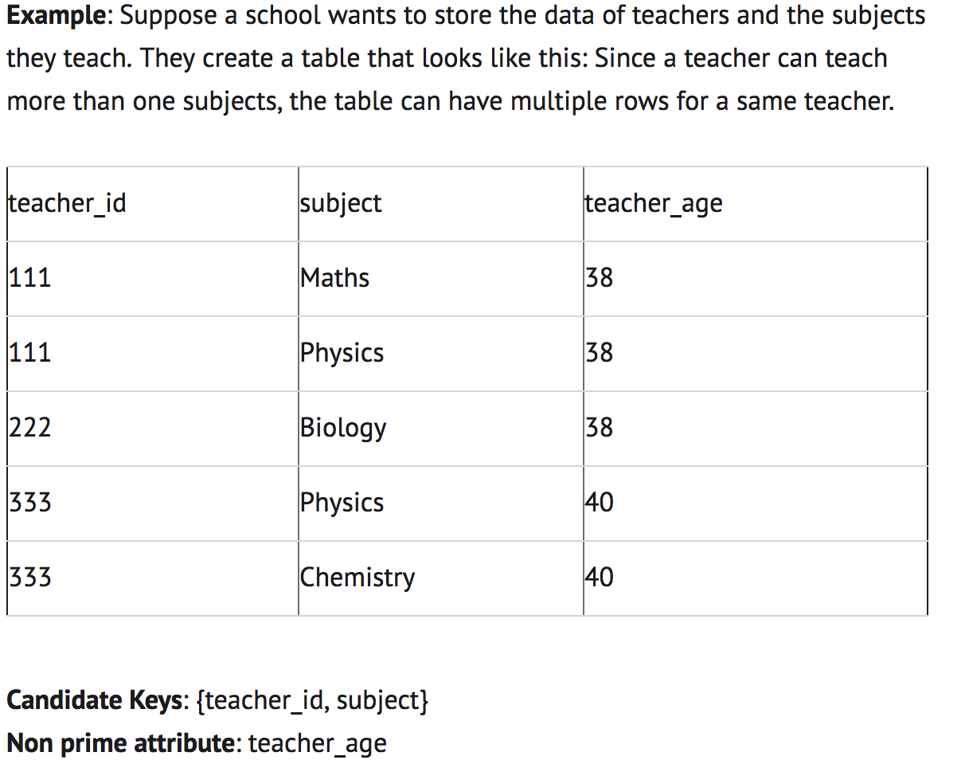
Second Normal Form

Slide 107
Second Normal Form
The table is in 1 NF because each attribute has atomic values.
However, it is not in 2NF because non prime attribute teacher_age is dependent on teacher_id alone which is a proper subset of candidate key.
This violates the rule for 2NF as the rule says “no non-prime attribute is dependent on the proper subset of any candidate key of the table”.

Slide 108
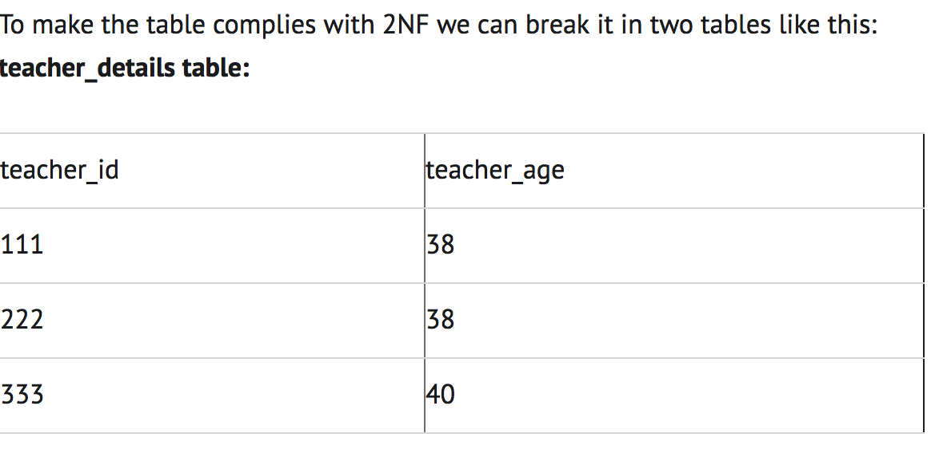
Second Normal Form

Slide 109
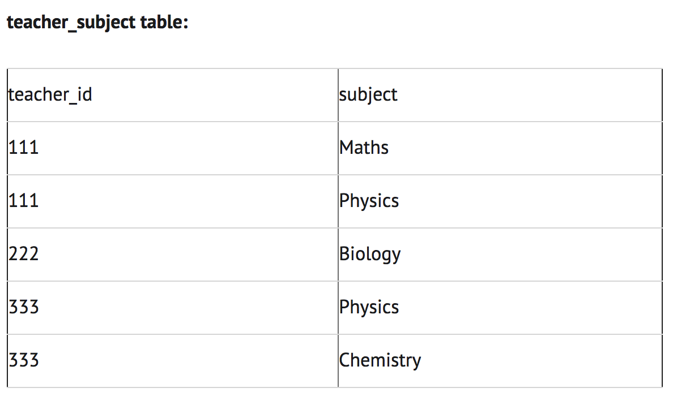
Second Normal Form

Slide 110
Table Violating Second Normal Form
PART (Primary Key) | WAREHOUSE (Primary Key) | QUANTITY | WAREHOUSE ADDRESS
P0010 | Warehouse A | 400 | 1608 New Field Road
P0010 | Warehouse B | 543 | 4141 Greenway Drive
P0010 | Warehouse C | 329 | 171 Pine Lane
P0020 | Warehouse B | 200 | 4141 Greenway Drive
P0020 | Warehouse D | 278 | 800 Massey Street

Slide 111
Tables Conforming to Second Normal Form
PART (Primary Key) | WAREHOUSE (Primary Key) | QUANTITY
P0010 | Warehouse A | 400
P0010 | Warehouse B | 543
P0010 | Warehouse C | 329
P0020 | Warehouse B | 200
P0020 | Warehouse D | 278
PART_STOCK TABLE
∞
1
WAREHOUSE TABLE
WAREHOUSE (Primary Key) | WAREHOUSE_ADDRESS
Warehouse A | 1608 New Field Road
Warehouse B | 4141 Greenway Drive
Warehouse C | 171 Pine Lane
Warehouse D | 800 Massey Street

Slide 112
Third Normal Form
A table design is said to be in 3NF if both the following conditions hold:
Table must be in 2NF
Transitive functional dependency of non-prime attribute on any super key should be removed.
Super Key:
A super key is a set or one of more columns (attributes) to uniquely identify rows in a table.

Slide 113
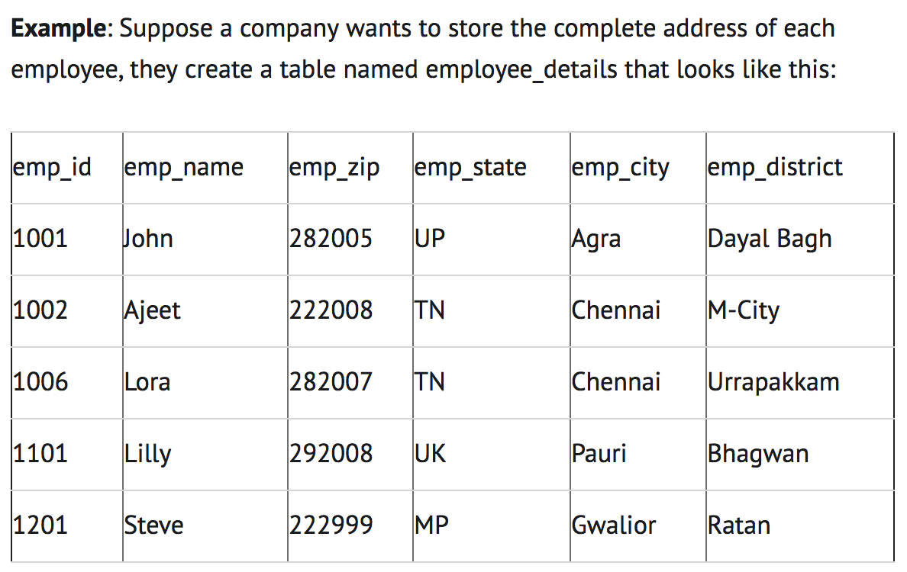
Third Normal Form

Slide 114
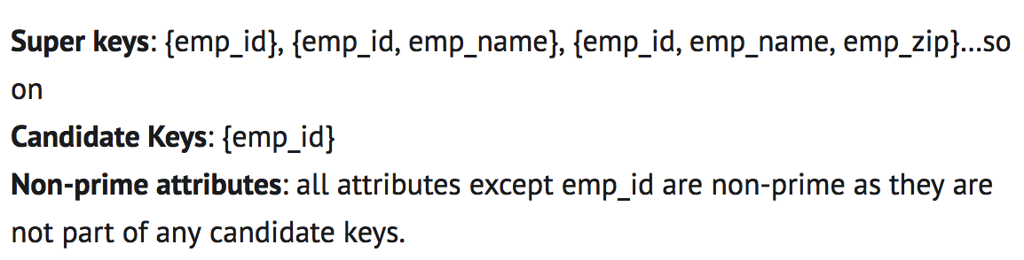
Third Normal Form
Here, emp_state, emp_city & emp_district dependent on emp_zip.
And, emp_zip is dependent on emp_id that makes non-prime attributes (emp_state, emp_city & emp_district) transitively dependent on super key (emp_id).
This violates the rule of 3NF.

Slide 115
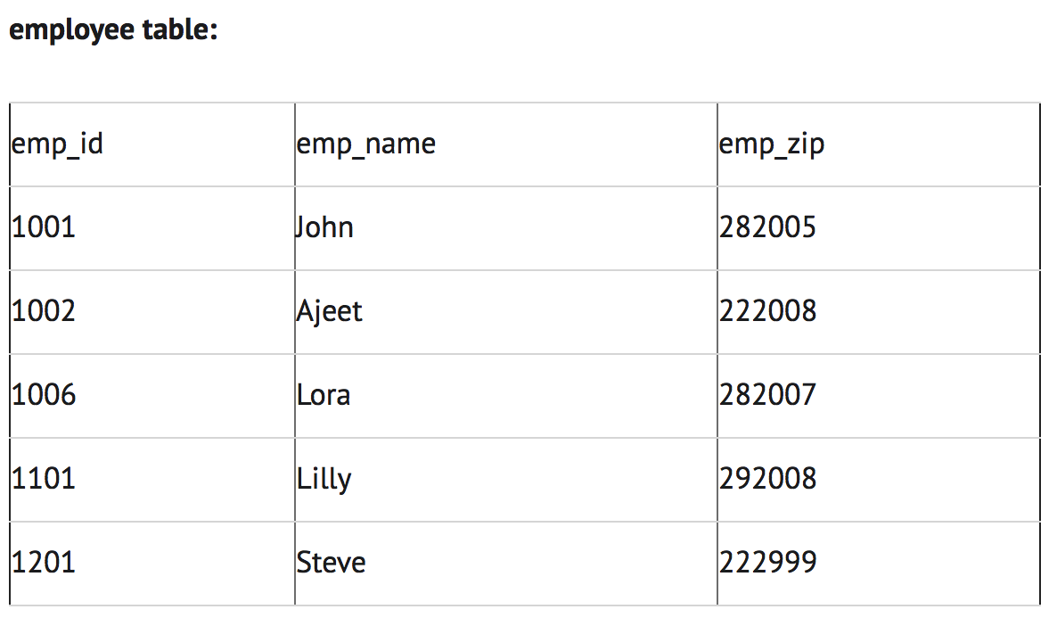
Third Normal Form

Slide 116
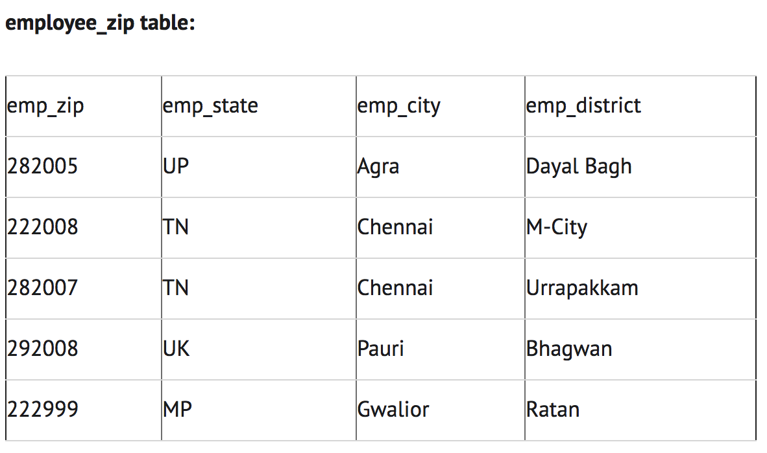
Third Normal Form

Slide 117
Table Violating Third Normal Form
EMPLOYEE_DEPARTMENT TABLE
EMPNO (Primary Key) | FIRSTNAME | LASTNAME | WORKDEPT | DEPTNAME
000290 | John | Parker | E11 | Operations
000320 | Ramlal | Mehta | E21 | Software Support
000310 | Maude | Setright | E11 | Operations

Slide 118
Tables Conforming to Third Normal Form
EMPLOYEE TABLE
EMPNO (Primary Key) | FIRSTNAME | LASTNAME | WORKDEPT
000290 | John | Parker | E11
000320 | Ramlal | Mehta | E21
000310 | Maude | Setright | E11
∞
DEPARTMENT TABLE
1
DEPTNO (Primary Key) | DEPTNAME
E11 | Operations
E21 | Software Support

Slide 119
Boyce Codd Normal Form (BCNF)
It is an advance version of 3NF that’s why it is also referred as 3.5NF.
BCNF is stricter than 3NF.
A table complies with BCNF if it is in 3NF and for every functional dependency X->Y, X should be the super key of the table.

Slide 120
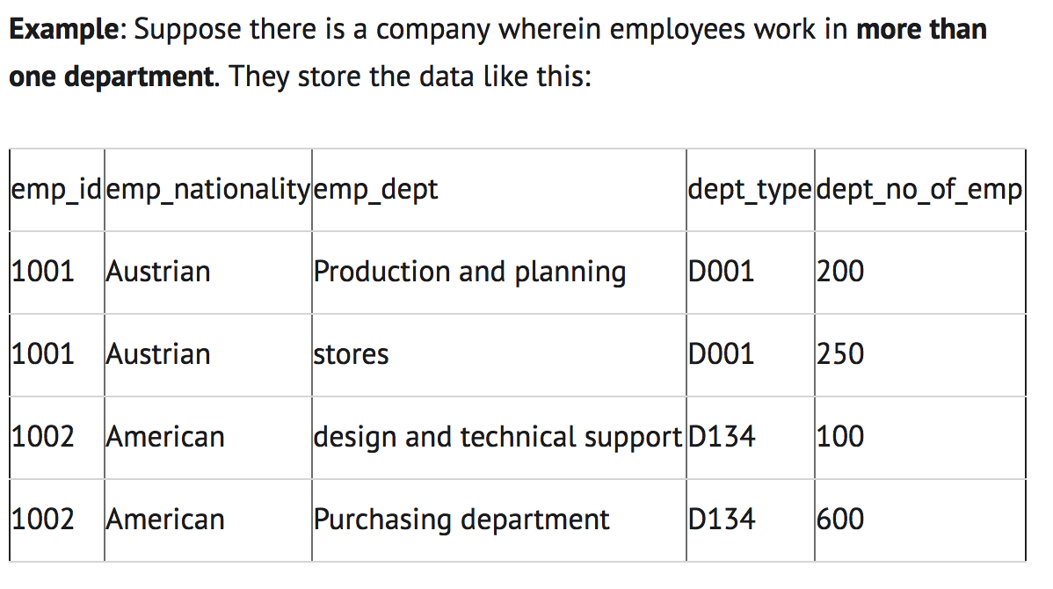
Boyce Codd Normal Form (BCNF)

Slide 121
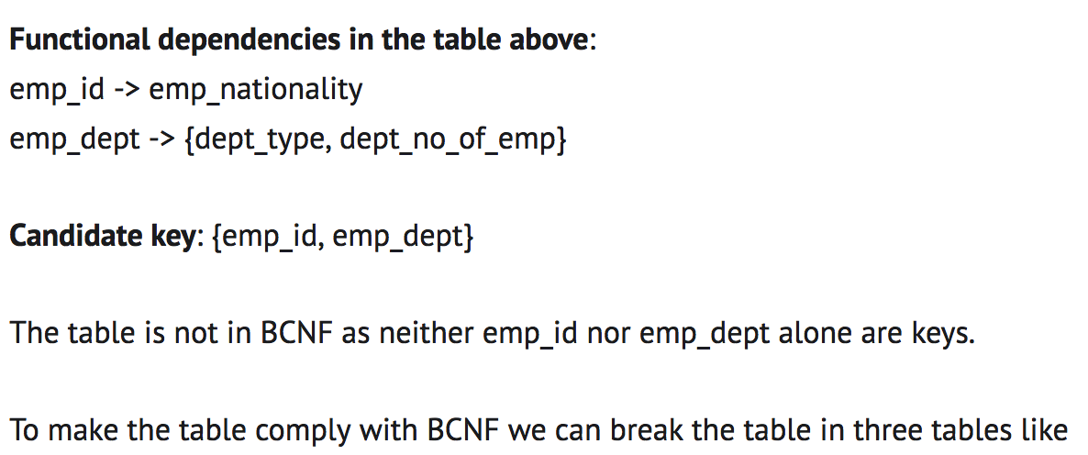
Boyce Codd Normal Form (BCNF)

Slide 122
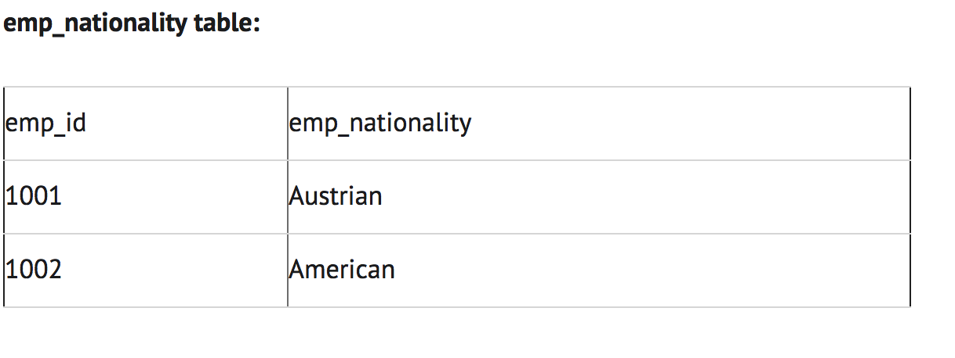
Boyce Codd Normal Form (BCNF)

Slide 123
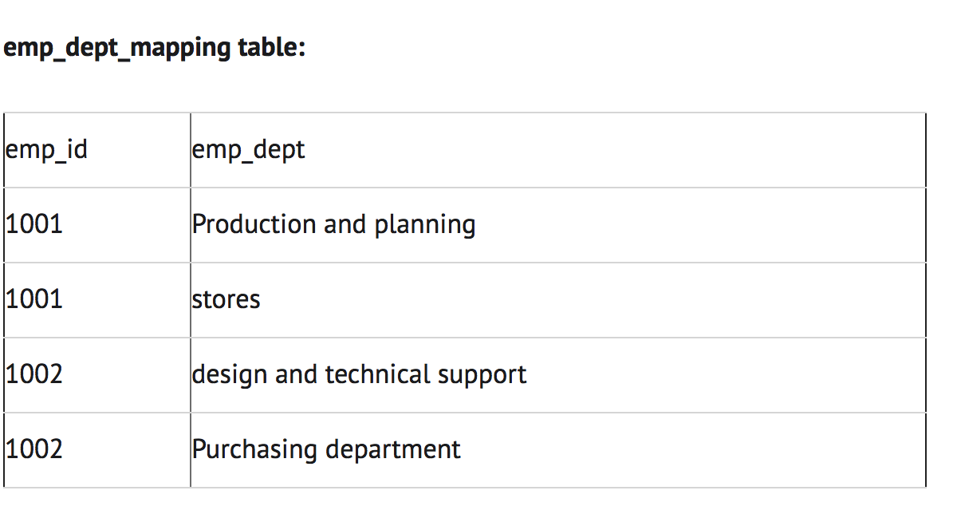
Boyce Codd Normal Form (BCNF)

Slide 124
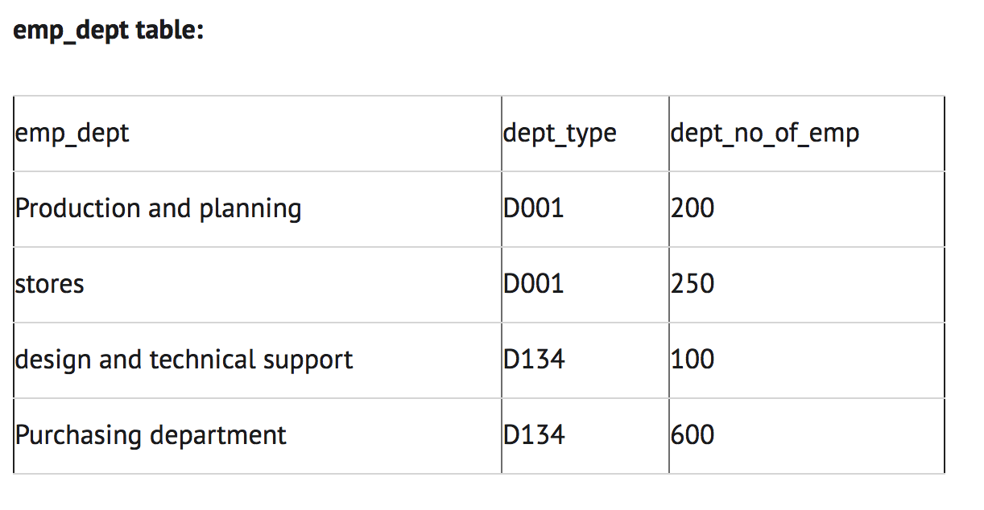
Boyce Codd Normal Form (BCNF)

Slide 125
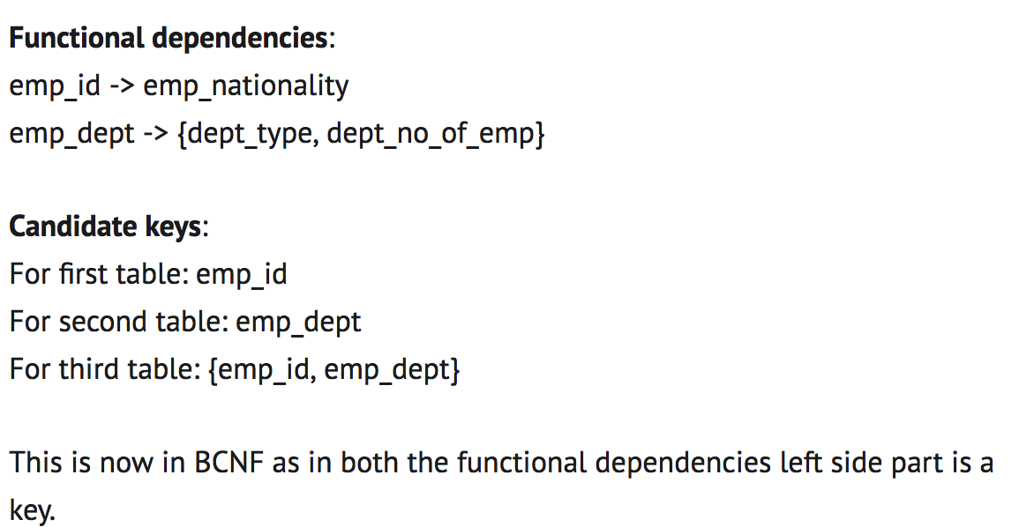
Boyce Codd Normal Form (BCNF)

Slide 126
Example 1
Un-normalized Table:
Student# | Advisor# | Advisor | Adv-Room | Class1 | Class2 | Class3
1022 | 10 | Susan Jones | 412 | 101-07 | 143-01 | 159-02
4123 | 12 | Anne Smith | 216 | 101-07 | 159-02 | 214-01

Slide 127
Table in First Normal Form
No Repeating Fields
Data in Smallest Parts
Student# | Advisor# | AdvisorFName | AdvisorLName | Adv-Room | Class#
1022 | 10 | Susan | Jones | 412 | 101-07
1022 | 10 | Susan | Jones | 412 | 143-01
1022 | 10 | Susan | Jones | 412 | 159-02
4123 | 12 | Anne | Smith | 216 | 101-07
4123 | 12 | Anne | Smith | 216 | 159-02
4123 | 12 | Anne | Smith | 216 | 214-01

Slide 128
Tables in Second Normal Form
Redundant Data Eliminated
Table: Students
Table: Registration
Student# | Advisor# | AdvFirstName | AdvLastName | Adv-Room
1022 | 10 | Susan | Jones | 412
4123 | 12 | Anne | Smith | 216
Student# | Class#
1022 | 101-07
1022 | 143-01
1022 | 159-02
4123 | 201-01
4123 | 211-02
4123 | 214-01

Slide 129
Tables in Third Normal Form
Data Not Dependent On Key is Eliminated
Table: Registration
Table: Advisors
Advisor# | AdvFirstName | AdvLastName | Adv-Room
10 | Susan | Jones | 412
12 | Anne | Smith | 216
Student# | Class#
1022 | 101-07
1022 | 143-01
1022 | 159-02
4123 | 201-01
4123 | 211-02
4123 | 214-01
Table: Students
Student# | Advisor# | StudentFName | StudentLName
1022 | 10 | Jane | Mayo
4123 | 12 | Mark | Baker

Slide 130
Example 2
Un-normalized Table:
EmpID | Name | Dept Code | Dept Name | Proj 1 | Time Proj 1 | Proj 2 | Time Proj 2 | Proj 3 | Time Proj 3
EN1-26 | Sean Breen | TW | Technical Writing | 30-T3 | 25% | 30-TC | 40% | 31-T3 | 30%
EN1-33 | Amy Guya | TW | Technical Writing | 30-T3 | 50% | 30-TC | 35% | 31-T3 | 60%
EN1-36 | Liz Roslyn | AC | Accounting | 35-TC | 90%

Slide 131
Table in First Normal Form
EmpID | Project Number | Time on Project | Last Name | First Name | Dept Code | Dept Name
EN1-26 | 30-T3 | 25% | Breen | Sean | TW | Technical Writing
EN1-26 | 30-TC | 40% | Breen | Sean | TW | Technical Writing
EN1-26 | 31-T3 | 30% | Breen | Sean | TW | Technical Writing
EN1-33 | 30-T3 | 50% | Guya | Amy | TW | Technical Writing
EN1-33 | 30-TC | 35% | Guya | Amy | TW | Technical Writing
EN1-33 | 31-T3 | 60% | Guya | Amy | TW | Technical Writing
EN1-36 | 35-TC | 90% | Roslyn | Liz | AC | Accounting

Slide 132
Tables in Second Normal Form
Table: Employees and Projects
Table: Employees
EmpID | Project Number | Time on Project
EN1-26 | 30-T3 | 25%
EN1-26 | 30-T3 | 40%
EN1-26 | 31-T3 | 30%
EN1-33 | 30-T3 | 50%
EN1-33 | 30-TC | 35%
EN1-33 | 31-T3 | 60%
EN1-36 | 35-TC | 90%
EmpID | Last Name | First Name | Dept Code | Dept Name
EN1-26 | Breen | Sean | TW | Technical Writing
EN1-33 | Guya | Amy | TW | Technical Writing
EN1-36 | Roslyn | Liz | AC | Accounting

Slide 133
Tables in Third Normal Form
Table: Employees_and_Projects
Table: Employees
EmpID | Project Number | Time on Project
EN1-26 | 30-T3 | 25%
EN1-26 | 30-T3 | 40%
EN1-26 | 31-T3 | 30%
EN1-33 | 30-T3 | 50%
EN1-33 | 30-TC | 35%
EN1-33 | 31-T3 | 60%
EN1-36 | 35-TC | 90%
EmpID | Last Name | First Name | Dept Code
EN1-26 | Breen | Sean | TW
EN1-33 | Guya | Amy | TW
EN1-36 | Roslyn | Liz | AC
Table: Departments
Dept Code | Dept Name
TW | Technical Writing
AC | Accounting

Slide 134
Example 3
Un-normalized Table:
EmpID | Name | Manager | Dept | Sector | Spouse/Children
285 | Carl Carlson | Smithers | Engineering | 6G
365 | Lenny | Smithers | Marketing | 8G
458 | Homer Simpson | Mr. Burns | Safety | 7G | Marge, Bart, Lisa, Maggie

Slide 135
Table in First Normal Form Fields contain smallest meaningful values
EmpID | FName | LName | Manager | Dept | Sector | Spouse | Child1 | Child2 | Child3
285 | Carl | Carlson | Smithers | Eng. | 6G
365 | Lenny |  | Smithers | Marketing | 8G
458 | Homer | Simpson | Mr. Burns | Safety | 7G | Marge | Bart | Lisa | Maggie

Slide 136
Table in First Normal Form No more repeated fields
EmpID | FName | LName | Manager | Department | Sector | Dependent
285 | Carl | Carlson | Smithers | Engineering | 6G
365 | Lenny |  | Smithers | Marketing | 8G
458 | Homer | Simpson | Mr. Burns | Safety | 7G | Marge
458 | Homer | Simpson | Mr. Burns | Safety | 7G | Bart
458 | Homer | Simpson | Mr. Burns | Safety | 7G | Lisa
458 | Homer | Simpson | Mr. Burns | Safety | 7G | Maggie

Slide 137
Second/Third Normal Form Remove Repeated Data From Table Step 1
EmpID | FName | LName | Manager | Department | Sector
285 | Carl | Carlson | Smithers | Engineering | 6G
365 | Lenny |  | Smithers | Marketing | 8G
458 | Homer | Simpson | Mr. Burns | Safety | 7G
EmpID | Dependent
458 | Marge
458 | Bart
458 | Lisa
458 | Maggie

Slide 138
Tables in Second Normal Form
Removed Repeated Data From Table
Step 2
EmpID | FName | LName | ManagerID | Dept | Sector
285 | Carl | Carlson | 2 | Engineering | 6G
365 | Lenny |  | 2 | Marketing | 8G
458 | Homer | Simpson | 1 | Safety | 7G
EmpID | Dependent
458 | Marge
458 | Bart
458 | Lisa
458 | Maggie
ManagerID | Manager
1 | Mr. Burns
2 | Smithers

Slide 139
Tables in Third Normal Form
Employees Table
Manager Table
EmpID | FName | LName | DeptCode
285 | Carl | Carlson | EN
365 | Lenny |  | MK
458 | Homer | Simpson | SF
ManagerID | Manager
1 | Mr. Burns
2 | Smithers
Dependents Table
Department Table
EmpID | Dependent
458 | Marge
458 | Bart
458 | Lisa
458 | Maggie
DeptCode | Department | Sector | ManagerID
EN | Engineering | 6G | 2
MK | Marketing | 8G | 2
SF | Safety | 7G | 1

Slide 140
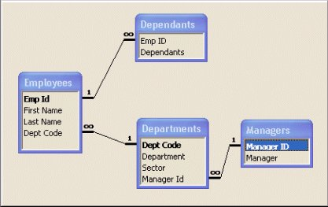
Relationships for Example 3

Slide 141
Example 4
Table Violating 1st Normal Form
Rep ID | Representative | Client 1 | Time 1 | Client 2 | Time 2 | Client 3 | Time 3
TS-89 | Gilroy Gladstone | US Corp. | 14 hrs | Taggarts | 26 hrs | Kilroy Inc. | 9 hrs
RK-56 | Mary Mayhem | Italiana | 67 hrs | Linkers | 2 hrs
Table in 1st Normal Form
Rep ID | Rep First Name | Rep Last Name | Client ID* | Client | Time With Client
TS-89 | Gilroy | Gladstone | 978 | US Corp | 14 hrs
TS-89 | Gilroy | Gladstone | 665 | Taggarts | 26 hrs
TS-89 | Gilroy | Gladstone | 782 | Kilroy Inc. | 9 hrs
RK-56 | Mary | Mayhem | 221 | Italiana | 67 hrs
RK-56 | Mary | Mayhem | 982 | Linkers | 2 hrs

Slide 142
Tables in 2nd and 3rd Normal Form
Rep ID* | First Name | Last Name
TS-89 | Gilroy | Gladstone
RK-56 | Mary | Mayhem
Rep ID* | Client ID* | Time With Client
TS-89 | 978 | 14 hrs
TS-89 | 665 | 26 hrs
TS-89 | 782 | 9 hrs
RK-56 | 221 | 67 hrs
RK-56 | 982 | 2 hrs
RK-56 | 665 | 4 hrs
Client ID* | Client Name
978 | US Corp
665 | Taggarts
782 | Kilroy Inc.
221 | Italiana
982 | Linkers

Slide 143
Example 5
SupplierID | Status | City | PartID | Quantity
S1 | 20 | London | P1 | 300
S1 | 20 | London | P2 | 200
S2 | 10 | Paris | P1 | 300
S2 | 10 | Paris | P2 | 400
S3 | 10 | Paris | P2 | 200
S4 | 20 | London | P2 | 200
S4 | 20 | London | P4 | 300
Table in 1st Normal Form
Although this table is in 1NF it contains redundant data. For example, information about the supplier's location and the location's status have to be repeated for every part supplied. Redundancy causes what are called update anomalies. Update anomalies are problems that arise when information is inserted, deleted, or updated. For example, the following anomalies could occur in this table:
INSERT. The fact that a certain supplier (s5) is located in a particular city (Athens) cannot be added until they supplied a part.
DELETE. If a row is deleted, then not only is the information about quantity and part lost but also information about the supplier.
UPDATE. If supplier s1 moved from London to New York, then two rows would have to be updated with this new information.

Slide 144
Tables in 2NF
Parts
SupplierID | PartID | Quantity
S1 | P1 | 300
S1 | P2 | 200
S2 | P1 | 300
S2 | P2 | 400
S3 | P2 | 200
S4 | P4 | 300
S4 | P5 | 400
Suppliers
SupplierID | Status | City
S1 | 20 | London
S2 | 10 | Paris
S3 | 10 | Paris
S4 | 20 | London
S5 | 30 | Athens
Tables in 2NF but not in 3NF still contain modification anomalies. In the example of Suppliers, they are:
INSERT. The fact that a particular city has a certain status (Rome has a status of 50) cannot be inserted until there is a supplier in the city.
DELETE. Deleting any row in SUPPLIER destroys the status information about the city as well as the association between supplier and city.

Slide 145
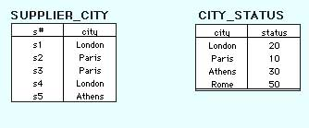
Tables in 3NF
Advantages of Third Normal Form
The advantage of having relational tables in 3NF is that it eliminates redundant data which in turn saves space and reduces manipulation anomalies. For example, the improvements to our sample database are:
INSERT. Facts about the status of a city, Rome has a status of 50, can be added even though there is not supplier in that city. Likewise, facts about new suppliers can be added even though they have not yet supplied parts.
DELETE. Information about parts supplied can be deleted without destroying information about a supplier or a city.
UPDATE. Changing the location of a supplier or the status of a city requires modifying only one row.

Slide 146
End of Chapter Five Thank you ☺

