Slide 1
Chapter – 10: Concurrency Control
Introduction
The process of managing simultaneous operations on the database without having them interfere with one another.
DBMSs are required to allow simultaneous, (concurrent), multi-user access
    multiple users within the one application accessing the same files.
    users in different applications accessing the same files.
Without centralised concurrency control, two types of problem can occur:
The lost update problem.
The so-called “ dirty-read” problem, also described as allowing a transaction to view the partial, (uncommitted), results of another transaction.

Slide 2
Concurrency Control in a Multi-user Environment The ‘lost update’ problem - sample scenario
Consider the relation:
PRODUCT(prod-code,description,unit-price, quantity-onhand)
Assume a particular record in the file is:
P45 Wheelbarrow $25.50 35
Concurrent User 1, (in the Warehouse), has just received a shipment of twenty P45s.
Concurrent User 2, (a salesman), has just received an order for ten P45s.
CU1, (Concurrent User 1), and CU2 initiate transactions which each read the same P45 record. In each CWA (currentwork area), the field Q-O-H, Quantity-On-Hand, shows 35.
CU2’s transaction reduces Q-O-H by 10, and rewrites the record, (overwriting the old record), with Q-O-H of 25.
CU1’s transaction, a moment later, increments Q-O-H by 20 to 55, and rewrites the record, overwriting the existing record, (the one just written by CU2’s transaction).
Quantity-On-Hand thus shows 55, when it should show
    35 - 10 + 20, i.e. 45. CU2’s update has been “ lost”.

Slide 3
Concurrency Control in a Multi-user Environment The “dirty-read” problem - similar sample scenario
Consider again the relation:
PRODUCT(prod-code,description,unit-price, quantity-onhand)
Assume again a particular record in the file is:
P45 Wheelbarrow $25.50 35
Concurrent User 1, (in the Warehouse), has just received a shipment of twenty P54s. (Note: P54s – not P45s.)
Concurrent User 2, (a salesman), has just received an order for ten P45s.
CU1 initiates the Warehouse update transaction, but by mistake keys in “P45”, instead of “ P54”. The transaction reads the P45 record with Q-O-H of 35, updates it to 55, and rewrites it (in a shared memory area for example).
A moment later, CU2’s transaction reads CU1’s update showing the value of Q-O-H as 55.
Just then, CU1, realising the error, aborts the transaction, which executes rollback.
A moment later, CU2’s transaction, having decremented QO- H, rewrites it as 45.
Quantity-On-Hand thus shows 45, when it should show 35 - 10 = 25. By viewing the uncommitted results of CU1’s

Slide 4
Concurrent Executions
Multiple transactions are allowed to run concurrently in the system. Advantages are:
  increased processor and disk utilization, leading to better transaction throughput: one transaction can be using the CPU while another is reading from or writing to the disk
  reduced average response time for transactions: short transactions need not wait behind long ones.
Concurrency control schemes – mechanisms to achieve isolation, i.e., to control the interaction among the concurrent transactions in order to prevent them from destroying the consistency of the database
  Will study in Chapter 14, after studying notion of correctness of concurrent executions.

Slide 5
Schedules
Schedules – sequences that indicate the chronological order in which instructions of concurrent transactions are executed
  a schedule for a set of transactions must consist of all instructions of those transactions
  must preserve the order in which the instructions appear in each individual transaction.

Slide 6

Example Schedules
Let T₁ transfer $50 from A to B, and T₂ transfer 10% of the balance from A to B. The following is a serial schedule (Schedule 1 in the text), in which T₁ is followed by T₂.

Slide 7

Example Schedule (Cont.)
Let T₁ and T₂ be the transactions defined previously. The following schedule (Schedule 3 in the text) is not a serial schedule, but it is equivalent to Schedule 1.
In both Schedule 1 and 3, the sum A + B is preserved.

Slide 8

Example Schedules (Cont.)
The following concurrent schedule (Schedule 4 in the text) does not preserve the value of the the sum A + B.

Slide 9
Serializability
Basic Assumption – Each transaction preserves database consistency.
Thus serial execution of a set of transactions preserves database consistency.
A (possibly concurrent) schedule is serializable if it is equivalent to a serial schedule. Different forms of schedule equivalence give rise to the notions of:
  1. conflict serializability
  2. view serializability
We ignore operations other than read and write instructions, and we assume that transactions may perform arbitrary computations on data in local buffers in between reads and writes. Our simplified schedules consist of only read and write instructions.

Slide 10
Conflict Serializability
Instructions l_{i} and l_{j} of transactions T_{i} and T_{j} respectively, conflict if and only if there exists some item Q accessed by both l_{i} and l_{j}, and at least one of these instructions wrote Q.
1. l_{i} = read(Q), l_{j} = read(Q). l_{i} and l_{j} don’t conflict.
2. l_{i} = read(Q), l_{j} = write(Q). They conflict.
3. l_{i} = write(Q), l_{j} = read(Q). They conflict
4. l_{i} = write(Q), l_{j} = write(Q). They conflict
Intuitively, a conflict between l_{i} and l_{j} forces a (logical) temporal order between them. If l_{i} and l_{j} are consecutive in a schedule and they do not conflict, their results would remain the same even if they had been interchanged in the schedule.

Slide 11
Conflict Serializability (Cont.)
If a schedule S can be transformed into a schedule S´ by a series of swaps of non-conflicting instructions, we say that S and S´ are conflict equivalent.
We say that a schedule S is conflict serializable if it is conflict equivalent to a serial schedule
Example of a schedule that is not conflict serializable:
T₃ T₄
read(Q)
write(Q)
write(Q)
We are unable to swap instructions in the above schedule to obtain either the serial schedule < T₃, T₄ >, or the serial schedule < T₄, T₃ >.

Slide 12

Conflict Serializability (Cont.)
Schedule 3 below can be transformed into Schedule 1, a serial schedule where T₂ follows T₁, by series of swaps of non-conflicting instructions. Therefore Schedule 3 is conflict serializable.

Slide 13
View Serializability
Let S and S´ be two schedules with the same set of transactions. S and S´ are view equivalent if the following three conditions are met:
  1. For each data item Q, if transaction T_{i} reads the initial value of Q in schedule S, then transaction T_{i} must, in schedule S´, also read the initial value of Q.
  2. For each data item Q if transaction T_{i} executes read(Q) in schedule S, and that value was produced by transaction T_{j} (if any), then transaction T_{i} must in schedule S´ also read the value of Q that was produced by transaction T_{j} .
  3. For each data item Q, the transaction (if any) that performs the final write(Q) operation in schedule S must perform the final write(Q) operation in schedule S´.
As can be seen, view equivalence is also based purely on reads
and writes alone.

Slide 14
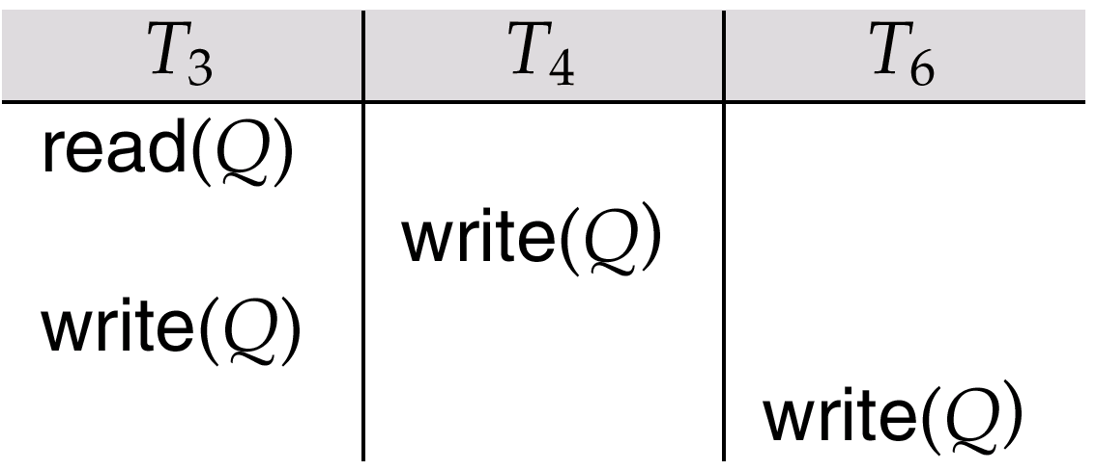
View Serializability (Cont.)
A schedule S is view serializable it is view equivalent to a serial schedule.
Every conflict serializable schedule is also view serializable.
Schedule 9 (from text) — a schedule which is view-serializable but not conflict serializable.
Every view serializable schedule that is not conflict
serializable has blind writes.

Slide 15
Lock-Based Protocols
A lock is a mechanism to control concurrent access to a data item
Data items can be locked in two modes :
1. exclusive (X) mode. Data item can be both read as well as
written. X-lock is requested using lock-X instruction.
2. shared (S) mode. Data item can only be read. S-lock is
requested using lock-S instruction.
Lock requests are made to concurrency-control manager. Transaction can proceed only after request is granted.

Slide 16

Lock-Based Protocols (Cont.)
Lock-compatibility matrix
A transaction may be granted a lock on an item if the requested lock is compatible with locks already held on the item by other transactions
Any number of transactions can hold shared locks on an item, but if any transaction holds an exclusive on the item no other transaction may hold any lock on the item.
If a lock cannot be granted, the requesting transaction is made to wait till all incompatible locks held by other transactions have been released. The lock is then granted.

Slide 17
Lock-Based Protocols (Cont.)
Example of a transaction performing locking:
T₂: lock-S(A);
read (A);
unlock(A);
lock-S(B);
read (B);
unlock(B);
display(A+B)
Locking as above is not sufficient to guarantee serializability — if A and B get updated in-between the read of A and B, the displayed sum would be wrong.
A locking protocol is a set of rules followed by all transactions while requesting and releasing locks. Locking protocols restrict the set of possible schedules.

Slide 18

Pitfalls of Lock-Based Protocols
Consider the partial schedule
Neither T₃ nor T₄ can make progress — executing lock-S(B) causes T₄ to wait for T₃ to release its lock on B, while executing lock-X(A) causes T₃ to wait for T₄ to release its lock on A.
Such a situation is called a deadlock.
  To handle a deadlock one of T₃ or T₄ must be rolled back
  and its locks released.

Slide 19
Pitfalls of Lock-Based Protocols (Cont.)
The potential for deadlock exists in most locking protocols. Deadlocks are a necessary evil.
Starvation is also possible if concurrency control manager is badly designed. For example:
  A transaction may be waiting for an X-lock on an item, while a sequence of other transactions request and are granted an S-lock on the same item.
  The same transaction is repeatedly rolled back due to deadlocks.
Concurrency control manager can be designed to prevent starvation.

Slide 20
Multiple Granularity
Allow data items to be of various sizes and define a hierarchy of data granularities, where the small granularities are nested within larger ones
Can be represented graphically as a tree (but don't confuse with tree-locking protocol)
When a transaction locks a node in the tree explicitly, it implicitly locks all the node's descendents in the same mode.
Granularity of locking (level in tree where locking is done):
  fine granularity (lower in tree): high concurrency, high locking overhead
  coarse granularity (higher in tree): low locking overhead, low concurrency

Slide 21
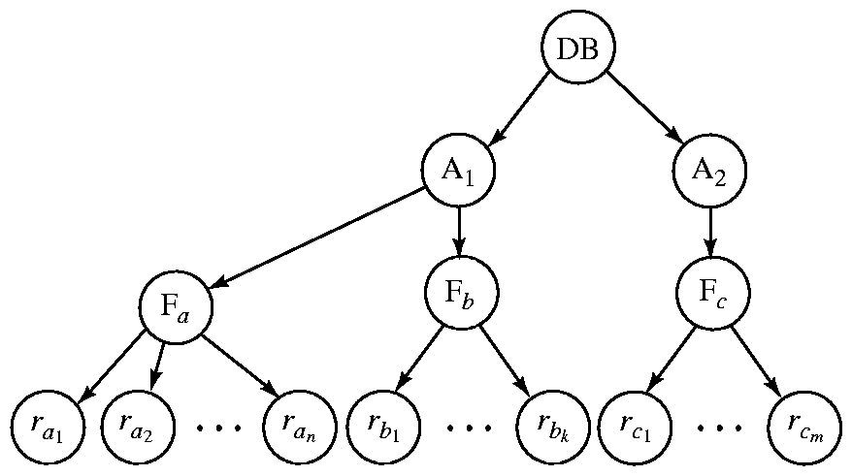
Example of Granularity Hierarchy
The highest level in the example hierarchy is the entire database.
The levels below are of type area, file and record in that order.

Slide 22
Intention Lock Modes
In addition to S and X lock modes, there are three additional lock modes with multiple granularity:
  intention-shared (IS): indicates explicit locking at a lower level of the tree but only with shared locks.
  intention-exclusive (IX): indicates explicit locking at a lower level with exclusive or shared locks
  shared and intention-exclusive (SIX): the subtree rooted by that node is locked explicitly in shared mode and explicit locking is being done at a lower level with exclusive-mode locks.
intention locks allow a higher level node to be locked in S or X mode without having to check all descendent nodes.

Slide 23
Compatibility Matrix with
Intention Lock Modes
The compatibility matrix for all lock modes is:
IS
IX
S
S IX
X
IS
✓
✓
✓
✓
×
IX
✓
✓
×
×
×
S
✓
×
✓
×
×
S IX
✓
×
×
×
×
X
×
×
×
×
×

Slide 24
Multiple Granularity Locking Scheme
Transaction T_{i} can lock a node Q, using the following rules:
1. The lock compatibility matrix must be observed.
2. The root of the tree must be locked first, and may be locked in
any mode.
3. A node Q can be locked by T_{i} in S or IS mode only if the parent
of Q is currently locked by T_{i} in either IX or IS
mode.
4. A node Q can be locked by T_{i} in X, SIX, or IX mode only if the
parent of Q is currently locked by T_{i} in either IX
or SIX mode.
5. T_{i} can lock a node only if it has not previously unlocked any node
(that is, T_{i} is two-phase).
6. T_{i} can unlock a node Q only if none of the children of Q are
currently locked by T_{i}.
Observe that locks are acquired in root-to-leaf order,
whereas they are released in leaf-to-root order.

