Slide 1
DBMS Chapter-1 Introduction

Slide 2
Chapter Contents
Concept and Applications
Objectives and Evolution
Needs of DBMS
Data Abstraction
Data Independence
Schema and Instances
Concept of DDL, DML and DCL
Database Manager and Users

Slide 3
Let us a look at a real world application first.

Slide 4


Slide 5


Slide 6
More data ….

Slide 7
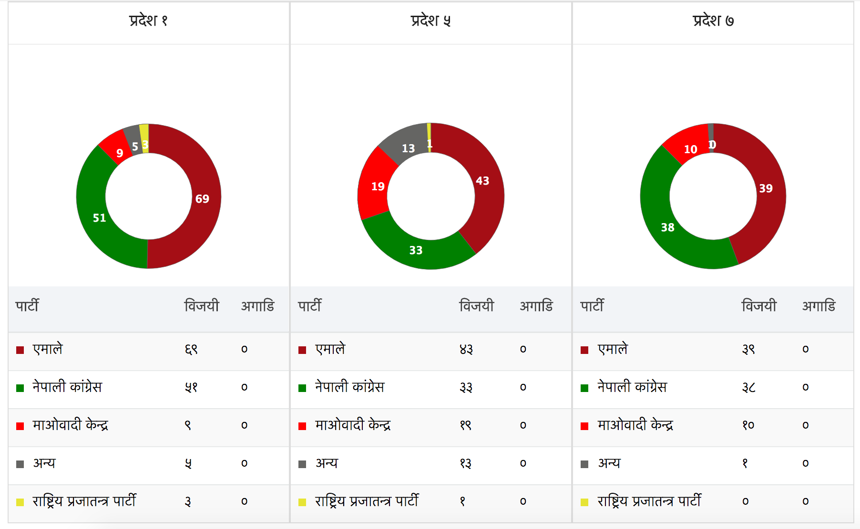

Slide 8
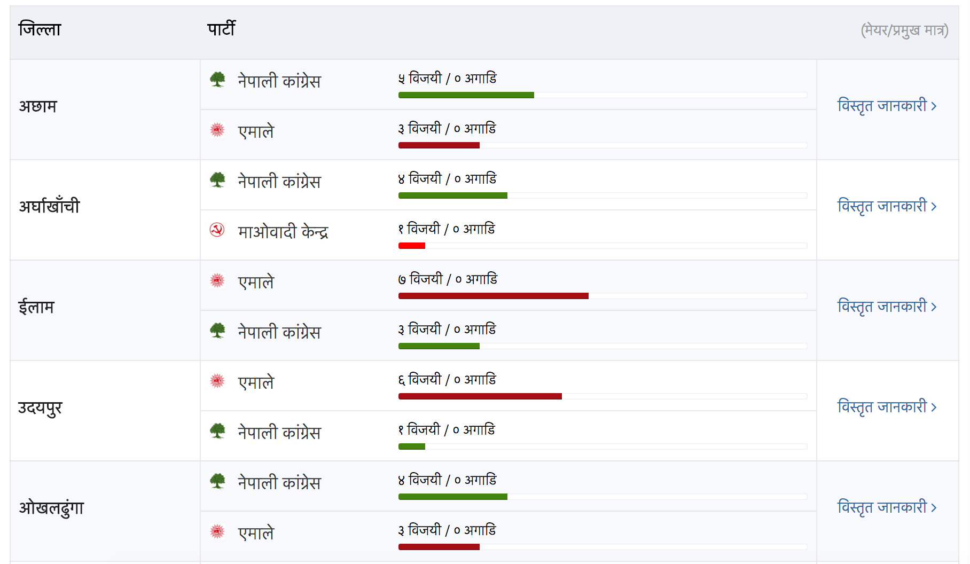

Slide 9
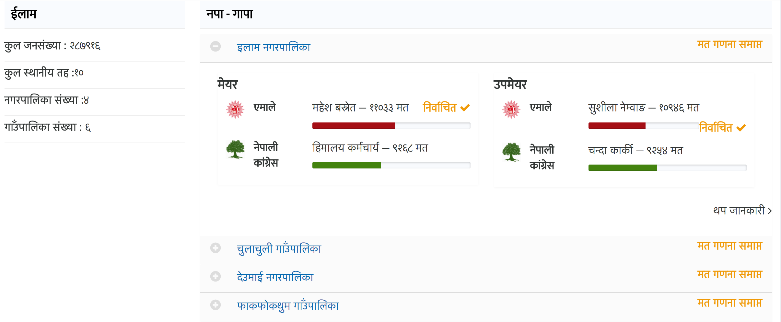

Slide 10
What are the differences?
Twitter
Full Name
Email
Password

Slide 11
Election Database
Provinces
Name, Description, other data
Districts
Name, Description, other data
Municipalities
Name, Description, other data

Slide 12
Twitter
UserID | FullName | Email | Password
TweetId | Retweets | Replies | Likes

Slide 13
Election
ProvinceId | Name | Description | DistrictID | Name | MunicipalityId | Name

Slide 14
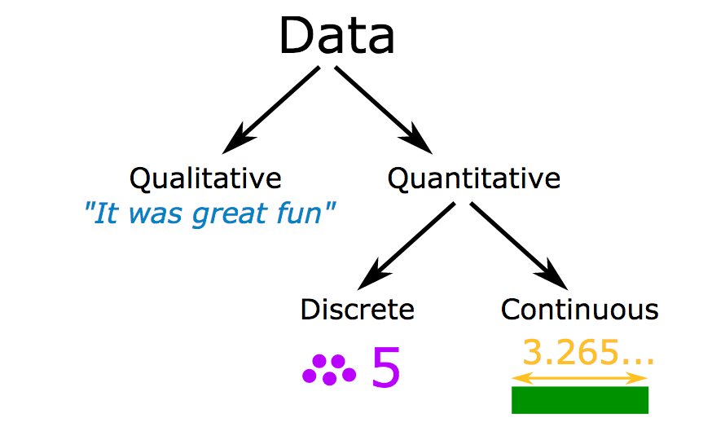
Data
Collection of raw facts, values, numbers, characters

Slide 15
Database
Any collection of related data
A database is a persistent, logically coherent collection of inherently meaningful data, relevant to some aspects of the real world.
Self describing collection of integrated records
Notes:
Persistent: which can be written down somewhere
Logically Coherent: to stick together

Slide 16
Database Management System
Is a collection of programs that enables users to create and maintain a database.
Computerized record keeping system
Define, populate, manipulate, protect, share
Purpose:
Allow users to define, store, retrieve and update the information contained in the database.
Notes:
Define the structure of database information
Populate database with appropriate information
Manipulate database
Protect database (includes secure access by users and automatic recovery)
Share among multiple users

Slide 17
Applications
Banking
Airlines
Universities
Telecommunications
Credit and Transactions

Slide 18
Applications
Finance
Sales
Human Resources
Manufacturing

Slide 19
Uses of DBMS
Data that is well organized and integrated is useful in decision making.
Effective and efficient management of data.
Query Processing and Management
Easy to understand and friendly
Security and Integrity of data
Data sharing and storage.
Better access to accurate data

Slide 20
Evolution
Several generations and over more than 40 years now.
File Management System
Hierarchical Database System
Network Database System
Relational Database System
NoSQL Database System

Slide 21
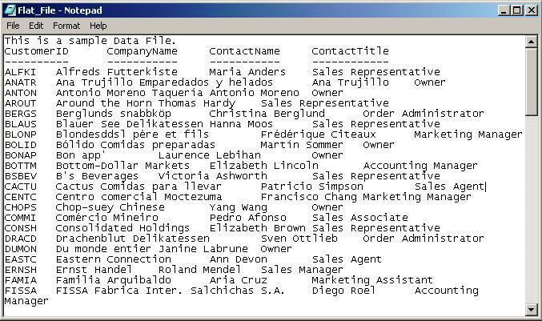
File Management System

Slide 22
File Management System
Data stored in a single large file.
How do we search data?
How do we edit/modify data?
How do we sort data?
Time Consuming

Slide 23
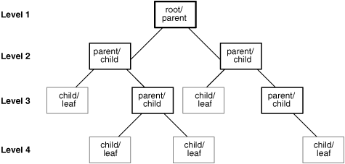
Hierarchical Database System

Slide 24
Hierarchical Database System
Similar to folder structure in laptop
Sub-folders, sub-folders and sub-folders
Finally files in some folders
Every child has one parent(folder/sub-folder)
Eg. Corporate Hierarchy
No relations

Slide 25
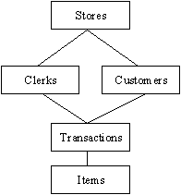
Network Database System

Slide 26
Network Database System
Many to many relationships started from here.
Grouping data as sets
Pointers
Files related as owners/members

Slide 27
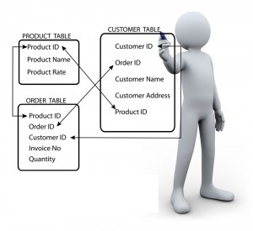
Relational DBMS

Slide 28
Relational DBMS
Data gets organized as tables.
Each record forms a row with many fields and attributes.
Relationship between tables are also formed.
Used by the analytics industry.
An RDBMS is a DBMS which supports relational integrity.

Slide 29
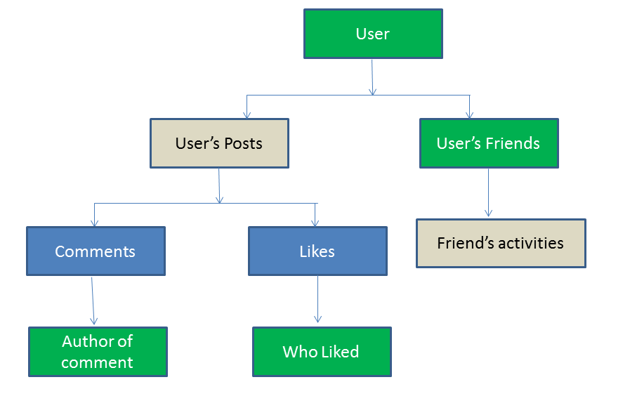
No SQL Database

Slide 30
No SQL Database
Relational databases rely on tables, columns, rows or schemas to organize and retrieve data.
No SQL database means not SQL or not only SQL
Used to store unstructured data eg. User and session data, chatting, messaging, time series data, large video and audio.
Eg. KeyValue, Document, Graph etc..

Slide 31
Need of DBMS
A Data Base Management System is a system software for easy, efficient and reliable data processing and management.
Creation of database
Retrieval of information
Updating
Managing

Slide 32
Need of DBMS
Processing Queries and Object Management
Controlling redundancy and inconsistency
Efficient memory management and indexing
Concurrency Control and transaction management
Access control and ease in accessing data
Integrity Constraints
Notes:
In practical-world applications, data is stored in objects and not files. Application level code needs to be written to handle, store and scan through the data in a file system whereas a DBMS gives us the ability to query the database.
Redundancy refers to repeated instances of the same data.
DBMS makes complex memory management easy to handle.
Several applications allow user to simultaneously access data. This may lead to inconsistency in data in case files are used. Consider two withdrawal transactions X and Y in which an amount of 100 and 200 is withdrawn from an account A initially containing 1000. Now since these transactions are taking place simultaneously, different transactions may update the account differently. X reads 1000, debits 100, updates the account A to 900, whereas X also reads 1000, debits 200, updates A to 800. In both cases account A has wrong information. This results in data inconsistency. A DBMS implements ACID(atomicity, durability, isolation,consistency)
A DBMS can grant access to various users and determine which part and how much of the data can they access from the database thus removing redundancy.
Data stored in databases must satisfy integrity constraints. (eg. Enrollment of student in only one faculty)

Slide 33
Data Abstraction
Database systems are made up of complex data structures
To ease the user interaction with database, the developers hide internal irrelevant details from users.
This process is called data abstraction.
What we see in rows and columns is different when it reaches memory.

Slide 34
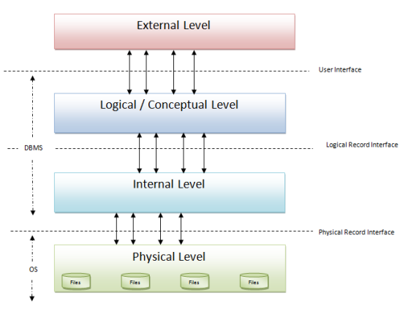
Data Abstraction

Slide 35
External Level
Highest level of data abstraction
Data in the form of rows/columns
Users will have different views based on their access rights.
Student cannot see employees salary
Data is based on lower levels and it will not alter the data at below levels.

Slide 36
Logical/Conceptual Level
Describes the actual data stored in the database in the form of tables and relates them by means of mapping
Will not have information on what a user views at external level.
Any changes done will not effect the external and physicals levels of data.

Slide 37
Physical Level
Lowest level of data abstraction
How the data is stored in the physical memory like magnetic tapes, hard disks etc.
File organizing methods like hashing, sequential, B+ tree comes into picture.
Complex for developers to design at this level.

Slide 38
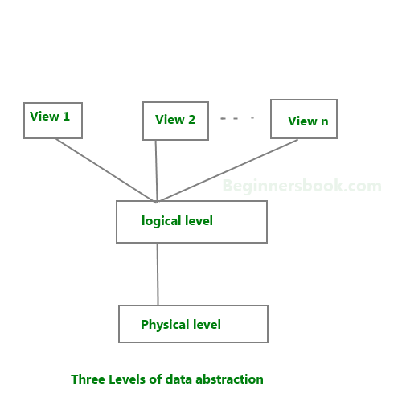
Data Abstraction

Slide 39
Data Independence
Ability to define a schema definition in one level without effecting a schema definition in the next higher level.
Two levels:
Physical Data Independence
Logical Data Independence

Slide 40
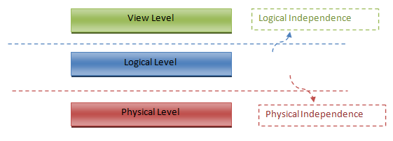
Data Independence
Upper Levels are not affected by changes in lower levels. Two Types.

Slide 41
Physical Data Independence
Ability to modify the physical schema without requiring any change in application programs.
Modifications are necessary to improve performance, file structures change, compression techniques.
Easy to achieve physical data independence.

Slide 42
Logical Data Independence
Ability to modify the conceptual schema without requiring any change in application programs.
Difficult to achieve logical level independence.
Application depends on logical structures and any change in data might require change in applications.

Slide 43
Schemas
How do we access our files in computer lab?
Login Id and password and then browse.
Database is a program that each student is exercising and each user is considered as schemas.
Their files and folders are considers as objects of schema.

Slide 44
Schemas
Database has objects like tables, views, indexes, constraints, procedures etc,
All these objects are owned by particular user which is called schema.
Schema owns ownership of all its objects.

Slide 45
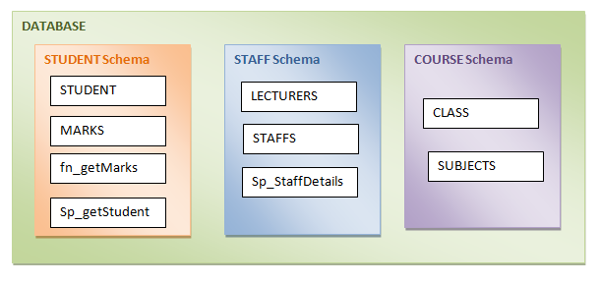
Schemas

Slide 46
Instances
Imagine a database with EMPLOYEE and DEPARTMENT tables.
Each tables have their own set of records.
Various operations are being executed in both the tables.
There will change in data at some time due to continuous operations happening in tables.
At particular part of time, there would be only one set of data that exists which is called instance of a database.

Slide 47
Instances
At any particular point of time, what is the state of database with data values in its object is called database instance.
It changes from time to time.

Slide 48
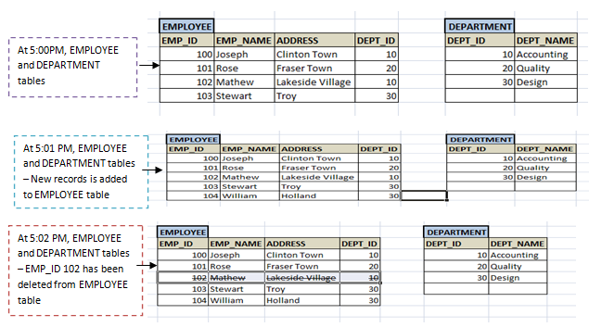
Instances

Slide 49
DDL, DML, DCL, TCL

Slide 50
Data Definition Language (DDL)
Deals with database schemas and descriptions, of how the data should reside in the database.
CREATE
ALTER
DROP
TRUNCATE
COMMENT
RENAME

Slide 51
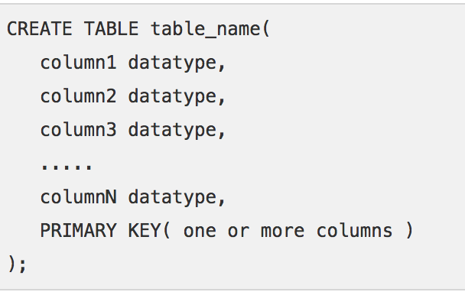
DDL - CREATE
To create database objects like (table, index, views, stored procedure, functions and triggers)

Slide 52
DDL-ALTER
Used to add, delete or modify columns in an existing table.
ALTER TABLE table_name ADD column_name datatype;
ALTER TABLE table_name DROP COLUMN column_name;
ALTER TABLE table_name MODIFY COLUMN column_name datatype;
ALTER TABLE table_name MODIFY column_name datatype NOT NULL;

Slide 53
DDL - DROP
Used to remove a table definition and all the data, indexes, triggers, constraints and permission specifications for that table.
Also can be used to drop the database completely.
DROP DATABASE DB_NAME;
DROP TABLE TABLE_NAME;

Slide 54
DDL - TRUNCATE
Delete the complete data from an existing table.
This won’t remove the table structure.
TRUNCATE TABLE table_name;

Slide 55
Data Manipulation Language (DML)
Deals with data manipulation.
Used to store, modify, retrieve, delete and update data in database.
SELECT – retrieve data from database
INSERT – insert data into a table.
UPDATE – updates existing data within a table.
DELETE – Delete all records from a database table.
MERGE – UPSERT operation (insert or update)
CALL – call a PL/SQL

Slide 56
Data Control Language (DCL)
Concerned with rights, permissions and other controls of the database system.
GRANT – allows users access privileges to database
REVOKE – withdraw users access privileges given by using the GRANT command.

Slide 57
Transaction Control Language (TCL)
Deals with transaction within a database.
COMMIT - commits a transaction.
ROLLBACK – rollbacks a transaction if any error occurs.
SAVEPOINT – to rollback the transaction making points within groups.
SET TRANSACTION – specify characteristics within the transaction.

Slide 58
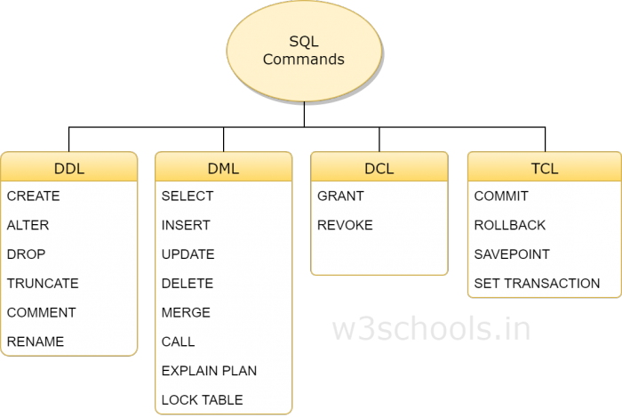
DDL, DML, DCL, TCL

Slide 59
Database Users
Users who really use and take the benefits of database.
Different types of users depending upon the needs and way of accessing data.
Application Programmers
Sophisticated Users
Specialized Users
Stand-alone Users
Native Users

Slide 60
Application Programmers
Users who interact with the database by means of DML queries.
DML queries are written and wrapped in the application programs like C, Java, C++ etc.
Example: Generating a report of employees who work in a department using Python
Python embeds SQL query inside it.

Slide 61
Sophisticated Users
Database developers who write SQL queries to select/insert/update/delete data.
Do not use any application/programs to request database.
Directly interact with the use of SQL queries.
Scientists/Analytics/Engineers

Slide 62
Specialized Users
Sophisticated users, but they write special database application programs.
Developers who develop complex programs to meet requirements.
CADD systems, knowledge-based application programs, complex data systems(audio/video)

Slide 63
Standalone Users
Will have stand-alone database for their personal use.
These kinds of database will have readymade database packages.
Also includes menus and graphical interfaces.

Slide 64
Native Users
Users who use the existing application to interact with the database.
Example: Online booking system, ticket booking system, ATMS etc.
Interact with application to fulfill their requests.

Slide 65
Database Managers
Also known as Database Administrators (DBA)
Life cycle of a database starts from designing, implementing and administration of it.
Database needs to be designed perfectly so that it works without any issues.
After design, it needs to be installed.
And then user will begin using it.

Slide 66
Database Managers
As data grows, database grows as well
Performance slowly comes down due to huge data.
Accessing data becomes a challenge.
Memory management would be essential.
These administration/maintenance of database is done by Database Administrators
A good performing database is in the hands of a DBA.

Slide 67
Responsibilities of DBA
Installing and upgrading DBMS Servers
Responsible for installing new DBMS servers.
Upgrading when new versions arrive in market.
If failure comes when upgrading, DBA needs to revert the changes back to the older version.
Maintaining service packs/hot fixes/patches to the DBMS servers.

Slide 68
Responsibilities of DBA
Design and Implementation
Designing and implementing database is also DBA’s responsibility.
Able to decide proper memory management, file organizations, error handling, log maintenance for the database.

Slide 69
Responsibilities of DBA
Performance Tuning
Database is normally huge, and have lots of tables , data, constraints, and indices.
Performance will vary from time to time.
Due to design issues and more data, performance degrades
Responsibility of DBA to tune performance.
Optimization of queries.

Slide 70
Responsibilities of DBA
Migrate database servers
Users may shift from one database to another or from one server to another.
Responsibility of DBA to make sure that migration happens without any failure
Also, make sure there is no data loss.

Slide 71
Responsibilities of DBA
Backup and Recovery
Proper backup and recovery programs needs to be developed by DBA and has to be maintained by him/her.
One of the main responsibility of DBA.
Crashes might happen so backup is important and recovery of data is important.

Slide 72
Responsibilities of DBA
Security
Responsible for creating various users
Assign users to roles
Giving users various access rights for database, tables etc.

Slide 73
Responsibilities of DBA
Documentation
Must Properly document all the activities so that other person can resume in his/her absence.
Maintain documents of all installation, backup, recovery and security methods.
Various reports is kept about database performance.

Slide 74
End of Chapter One Thank you ☺

