Slide 1
DBMS Chapter-2 Data Models

Slide 2
Chapter Contents
Logical, Physical and Conceptual Model
E-R Model
Relation with UML Class Diagrams
Alternate Data Models
Network Data Model
Hierarchical Data Model

Slide 3
Data Models
Defines how the logical structure of database is modeled.
Fundamental entities to introduce Abstraction in database.
How data is connected to each other and how they are processed and stored inside the system.
Simple representation of complex real world data structures, mostly graphical.

Slide 4
Data Models
A database model shows the logical structure of a database, including the relationships and constraints that determine how data can be stored and accessed.
Logical structure of a database.
It describes the design of database to reflect entities, attributes, relationship among data, constraints etc.

Slide 5
Types of Data Models
Logical Data Model
Conceptual Data Model
Physical Data Model

Slide 6
Conceptual Data Model
Identifies the highest-level relationships between the different entities.
No Attribute is Specified
No Primary Key is Specified.
Information we get is the entities that describe the data and the relationships between these entities.

Slide 7
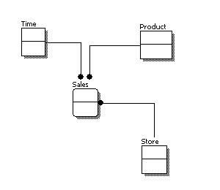
Conceptual Data Model

Slide 8
Logical Data Model
Describes data in as much detail as possible.
Includes all entities and relationships among them.
All attributes for each entity is specified.
Primary Key for each entity is specified.
Foreign Keys are identified.
Normalization Occurs at this level.

Slide 9
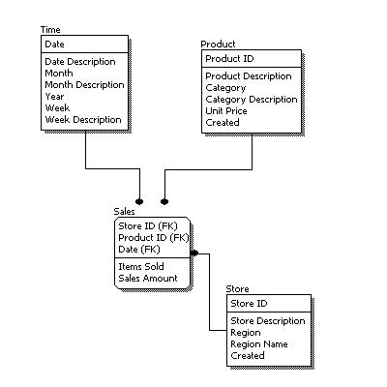
Logical Data Model

Slide 10
Physical Data Model
Represents how the model will be built in the database.
Shows all table-structure, including column name, column data type, column constraints, primary key, foreign key, and relationships between tables.

Slide 11
Physical Data Model
Features include:
Specification of all tables and columns.
Foreign Keys are used to identify relationships between tables.
De-normalization may occur based on requirement.
Physical model might be different for different RDBMS.
Example: Data Type of column in MySQL and SQL Server.

Slide 12
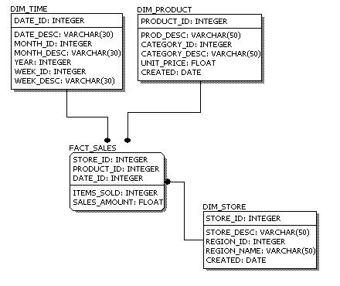
Physical Data Model

Slide 13
Data Models
Complexity increases from Conceptual to Logical to Physical.
Start with Conceptual Data Model
Understand at high level what are the different entities in our data and how they can relate to each other.
At Logical, understand the details of the data without worrying on how it is implemented.
At Physical, finally we know how to implement our data model in the database of our choice.

Slide 14
Database Design – Summary as of now
Before we look to create and use a database we will look at how to design a database.
Need to Consider:
What tables, keys, and constraints are required?
What is the database going to be used for?

Slide 15
Database Design – Summary as of now
Conceptual Design: Build a model independent of the choice of DBMS.
Logical Design: Create the database in a given DBMS
Physical Design: How the database is stored in a hardware.

Slide 16
Entity/Relationship Modeling
E/R modeling is used for conceptual design.
Entities: objects or items of interest.
Attributes: facts about, or properties of, an entity
Relationships: links between entities
Example:
In a College database, we might have entities for Students, Modules and Lectures.
Students might have attributes such as their ID, Name, and Course, and could have relationships with Modules (enrollment) and Lectures(tutor/tutee)

Slide 17
Entities
An entity can be a real world object, either animate or inanimate that can be easily identifiable.
In College database, students, teachers, classes or courses offered can be considered as entities.
All these entities have some attributes or properties that give their identity.

Slide 18
Entities Set
Is a collection of similar types of entities.
An entity set may contain entities with attributes sharing similar values.
For Example, a Students set may contain all the students of a college, likewise Teachers set may contain all the teachers of a college from all faculties.

Slide 19
Attributes
Entities are represented by means of their properties , called attributes.
All attributes have values.
Example: A student entity may have name, class, and age as attributes.
There exists a domain or a range of values that can be assigned to attributes.
Example: a student’s name cannot be a numeric value. It has to be alphabetic. A student’s age cannot be negative.

Slide 20
Types of Attributes
Simple Attribute
Atomic values, which cannot be divided further.
A student’s phone number is an atomic value of 10 digits.
Composite Attribute
Made up of more than one simple attribute
A student’s complete name may have first_name and last_name

Slide 21
Types of Attributes
Derived Attribute
Attributes that do not exists in physical database, but their values are derived from other attributes present in database.
Age can be derived from date of birth.
Average Salary can be derived as well.
Single-value Attribute
It only contains single value. Eg. Social Security Number
Multi-value Attribute
It contains multiple values. Eg, choice of sports, subjects offerred

Slide 22
Relationships
The association among entities is called a relationship.
For example: An Employee works_at a department, a student enrolls in a course.
Here, works_at and enrolls are called relationships.

Slide 23
Constraints
An E-R enterprise schema may define certain constraints to which the contents of a database most conform.
Mapping Cardinalities and Participation Constraints are the two most important type of constraints.

Slide 24
Mapping Cardinalities
Mapping Cardinalities or cardinality ratios, express the number of entities to which another entity can be associated via a relationship set.
Useful in defining binary relationships.

Slide 25
Mapping Cardinalities
Cardinality defines the number of entities in one entity set, which can be associated with the number of entities of another set via relationship set.
One-to-One
One-to-Many
Many-to-One
Many-to-Many

Slide 26
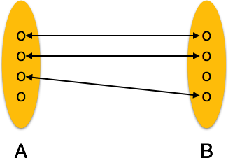
One-to-One
One entity from entity set A can be associated with at most one entity of entity set B and vice versa.

Slide 27
One-to-One Examples
One Employee belongs to one organization.
One Person has one passport.
A book is published by one company.
A shark lives in one place.
Employee and Employee Details

Slide 28
One-to-One Example
users
id | name | email | username | password
1 | Ram | ram@ncit.com | ram123 | ram
2 | Shyam | shyam@ncit.com | shyam123 | shyam
3 | Hari | hari@ncit.com | hari123 | hari
user_details
id | user_id | phone | address1 | address2
1 | 1 | 09791212 | Ilam | Malapath
2 | 2 | 09791234 | Jhapa | Birtamode
3 | 3 | 09791245 | Morang | Biratnagar

Slide 29
One-to-One Example
users
id | name | email | username | password
1 | Ram | ram@ncit.com | ram123 | ram
2 | Shyam | shyam@ncit.com | shyam123 | shyam
3 | Hari | hari@ncit.com | hari123 | hari
user_details
user_id | phone | address1 | address2
1 | 09791212 | Ilam | Malapath
2 | 09791234 | Jhapa | Birtamode
3 | 09791245 | Morang | Biratnagar

Slide 30
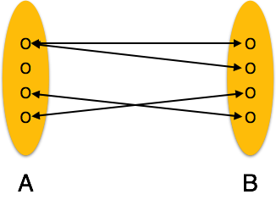
One-to-Many
One entity from entity set A can be associated with more than one entities of entity set B, however an entity from entity set B, can be associated with at most one entity of set A.

Slide 31
One-to-Many Example
universities
id | name | email | address | phone
1 | PU | pu@web.com | Pokhara | 09791212
2 | KU | ku@web.com | Dhulikhel | 09791234
3 | TU | tu@web.com | Kathmandu | 09791245
colleges
id | name | address | university_id
1 | NCIT | Balkumari | 1
2 | COSMOS | Satdobato | 1
3 | KU | Dhulikhel | 2
4 | IOE | Pulchowk | 3

Slide 32
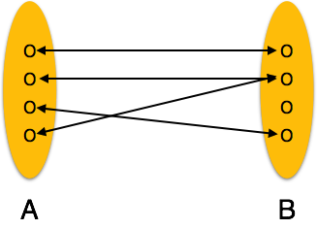
Many-to-One
More than one entities from entity set A can be associated with at most one entity of entity set B, however an entity from entity set B can be associated with more than one entity from entity set A.

Slide 33
Many-to-One Example
One to Many: One university has many colleges.
Many to One: Many Colleges are associated with one university.

Slide 34
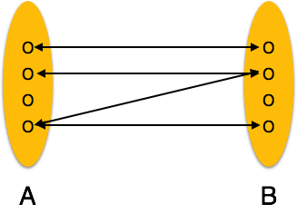
Many-to-Many
One entity from A can be associated with more than one entity from B and vice versa.

Slide 35
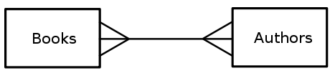
Many-to-Many Example

Slide 36
Many-to-Many examples
authors
id | name | email | Phone
1 | Ram | ram@ncit.com | 0980988
2 | Shyam | shyam@ncit.com | 0980989
3 | Hari | hari@ncit.com | 0980987
books
id | name | version | date
1 | Lord of the Rings | 1 | 2007
2 | Game of Thrones | 2 | 2011
3 | Karnali Blues | 1 | 2012

Slide 37
Many-to-Many examples
book_authors
Junction Table
Intermediate Table
Join Table
book_id and author_id are Foreign Keys
id | book_id | author_id
1 | 1 | 1
2 | 1 | 2
3 | 1 | 3
4 | 2 | 3
5 | 2 | 2
6 | 3 | 1
7 | 3 | 3

Slide 38
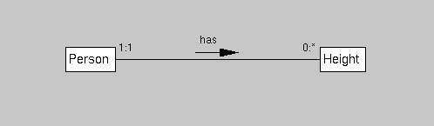
Participation Constraints
The participation of an entity set E, in a relationship set R is said to be total if every entity in E participates in at least one relationship in R.
If some entities in E participate in relationship in R, the participation of entity set E in relationship R is said to be partial.

Slide 39
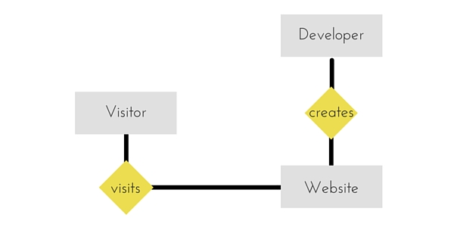
E-R Diagram
ER Diagram is a visual representation of data that describes how data is related to each other.

Slide 40
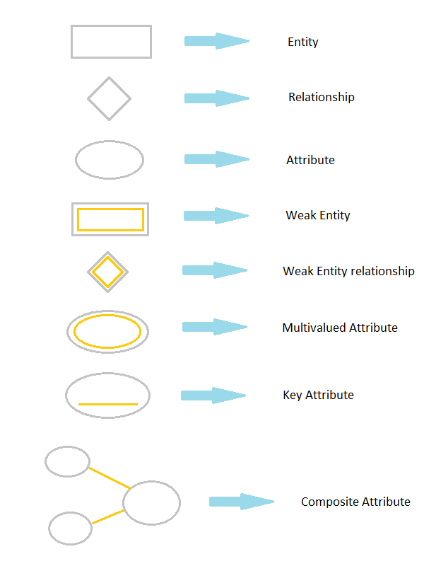
Symbols and Notations

Slide 41
Symbols and Notations

Slide 42
Symbols and Notations

Slide 43
Components of ER Diagram
Entity
Attributes
Relationships

Slide 44
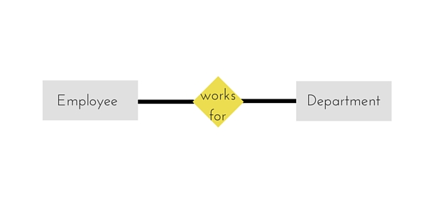
ERD - Entity
Entity can be any object, place, person or class.
Represented by rectangles.

Slide 45
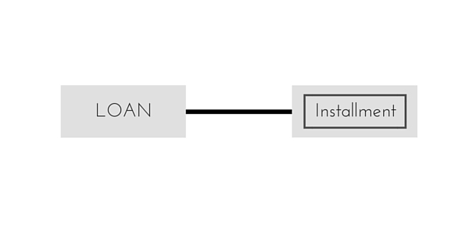
ERD – Weak Entity
Entity that depends on other entity.
Doesn’t have key attribute of their own.

Slide 46
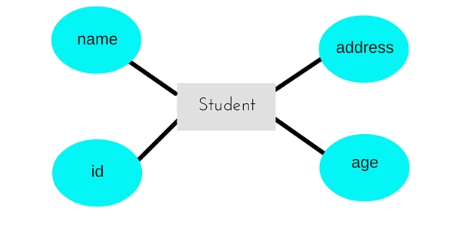
ERD - Attribute
Describes a property or characteristic of entity.

Slide 47
ERD - Key Attribute
Represents main characteristics of an Entity.
Generally Primary Key.

Slide 48
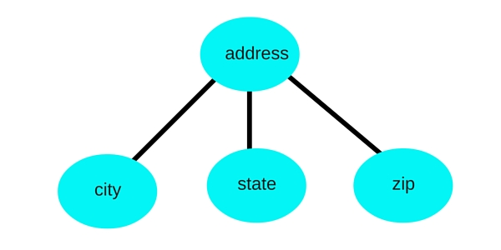
ERD – Composite Attribute
An attribute can also have their own attributes which are known as Composite Attribute.

Slide 49
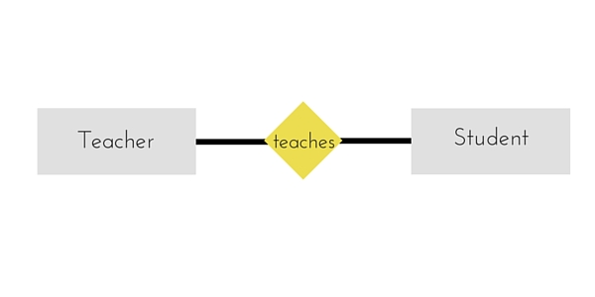
ERD - Relationships
Relations between entities

Slide 50
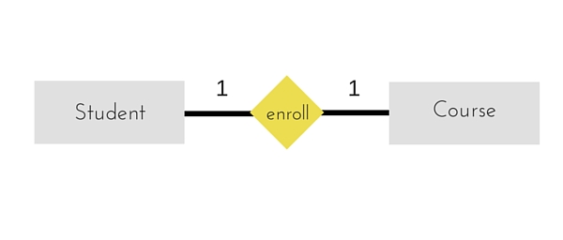
ERD – One-to-One

Slide 51
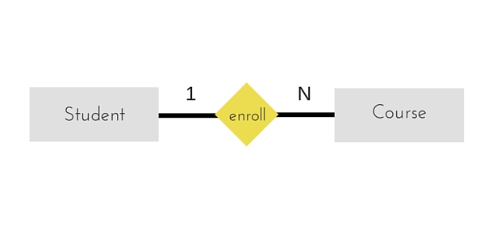
ERD – One-to-Many

Slide 52
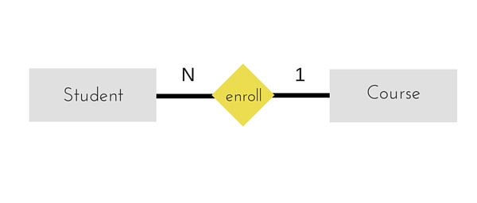
ERD - Many-to-One

Slide 53
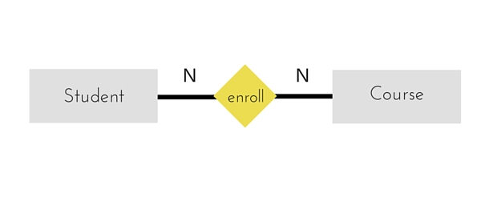
ERD – Many-to-Many

Slide 54
ER Diagram - Example
A university consists of a number of departments. Each department offers several courses.
A number of modules make up each course. Students enroll in a particular course and take modules towards the completion of that course.
Each module is taught by a lecturer from the appropriate department, and each lecturer tutors a group of students

Slide 55
ER Diagram - Example
Identify Entities.
Identify Attributes.
Identify Relations.

Slide 56
Example - Entities
A university consists of a number of departments.
Each department offers several courses.
A number of modules make up each course.
Students enroll in a particular course and take modules towards the completion of that course.
Each module is taught by a lecturer from the appropriate department, and each lecturer tutors a group of students

Slide 57
Example - Relationships
A university consists of a number of departments.
Each department offers several courses.
A number of modules make up each course.
Students enroll in a particular course and take modules towards the completion of that course.
Each module is taught by a lecturer from the appropriate department, and each lecturer tutors a group of students

Slide 58
Example – ER Diagram
Department
Course
Module
Lecturer
Student

Slide 59
Example – ER Diagram
Each department offers several courses
Department
Course
Module
Lecturer
Student
Offers

Slide 60
Example – ER Diagram
A number of modules makes up each courses.
Department
Course
Module
Lecturer
Student
Offers
includes

Slide 61
Example – ER Diagram
Students enroll in a particular course.
Department
Course
Module
Lecturer
Student
Offers
includes
Enrolls In

Slide 62
Example – ER Diagram
Students takes modules.
Department
Course
Module
Lecturer
Student
Offers
includes
takes
Enrolls In

Slide 63
Example – ER Diagram
Each module is taught by a Lecturer
Department
Course
Module
Lecturer
Student
Offers
includes
teaches
takes
Enrolls In

Slide 64
Example – ER Diagram
A lecturer from the appropriate department.
Department
Course
Module
Lecturer
Student
Offers
Empoys
includes
teaches
takes
Enrolls In

Slide 65
Example – ER Diagram
A lecturer from the appropriate department.
Department
Course
Module
Lecturer
Student
Offers
Empoys
includes
teaches
takes
Enrolls In
Tutors

Slide 66
Generalization
A bottom up design process.
Two lower level entities combine to form a higher level entity.
Higher level entity can also combine with other level entity to make further higher level entity.

Slide 67
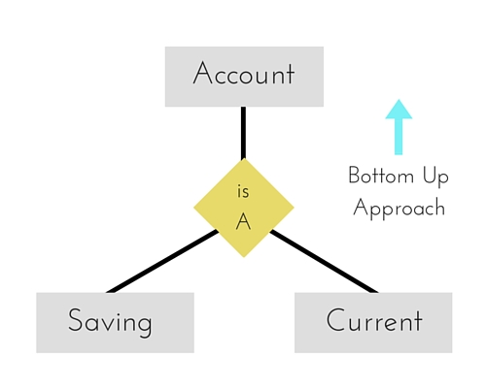
Generalization

Slide 68
Specialization
Opposite of Generalization.
Top down approach in which one higher level entity can be broken down into two lower level entity.
Some higher level entities may not have lower-level entity sets at all.

Slide 69
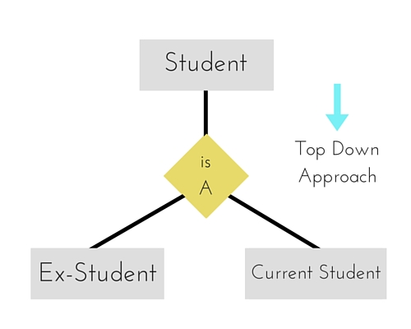
Specialization

Slide 70
Aggregation
A process when relation between two entity is treated as a single entity.
Here, the relation between Center and Course, is acting as entity in relation with Visitor.

Slide 71
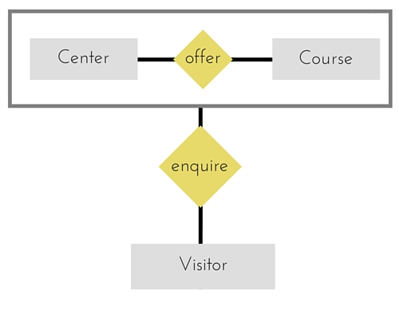
Aggregation

Slide 72
Relation with UML Diagrams
UML is a language (design) which is frequently used for developing and building software applications.
UML comprises a collection of graphical data to describe and design computer systems that are built utilizing an object-oriented approach.
UML is free of an execution language.

Slide 73
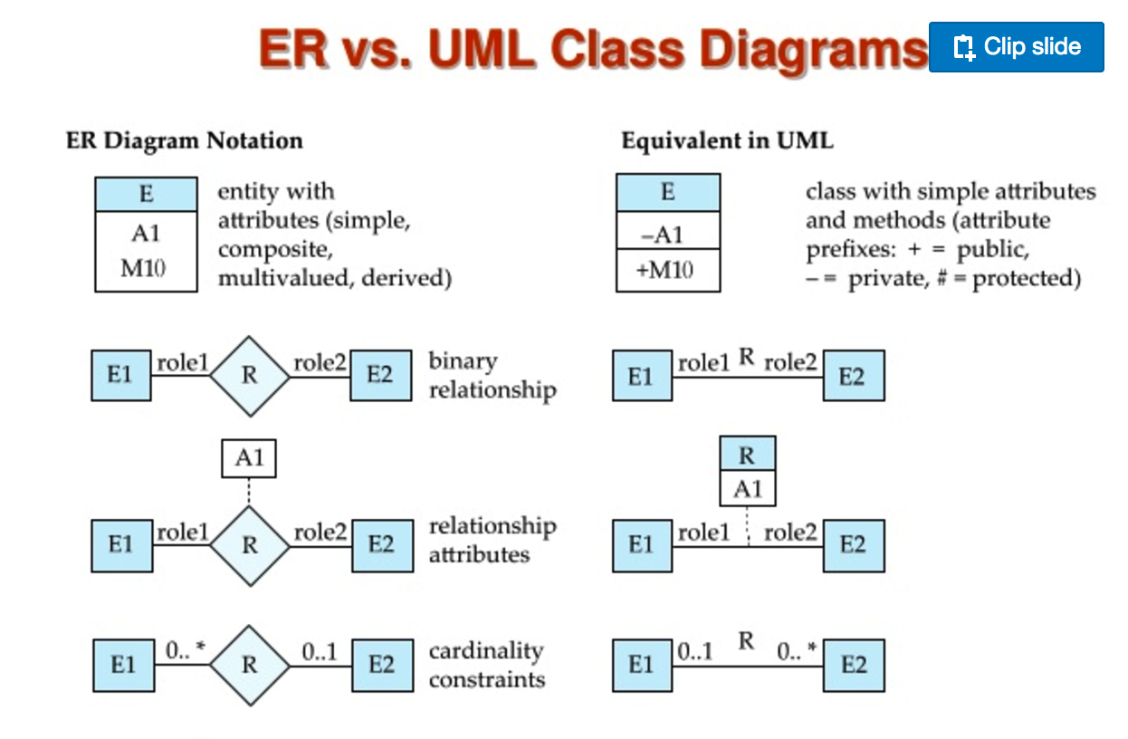

Slide 74
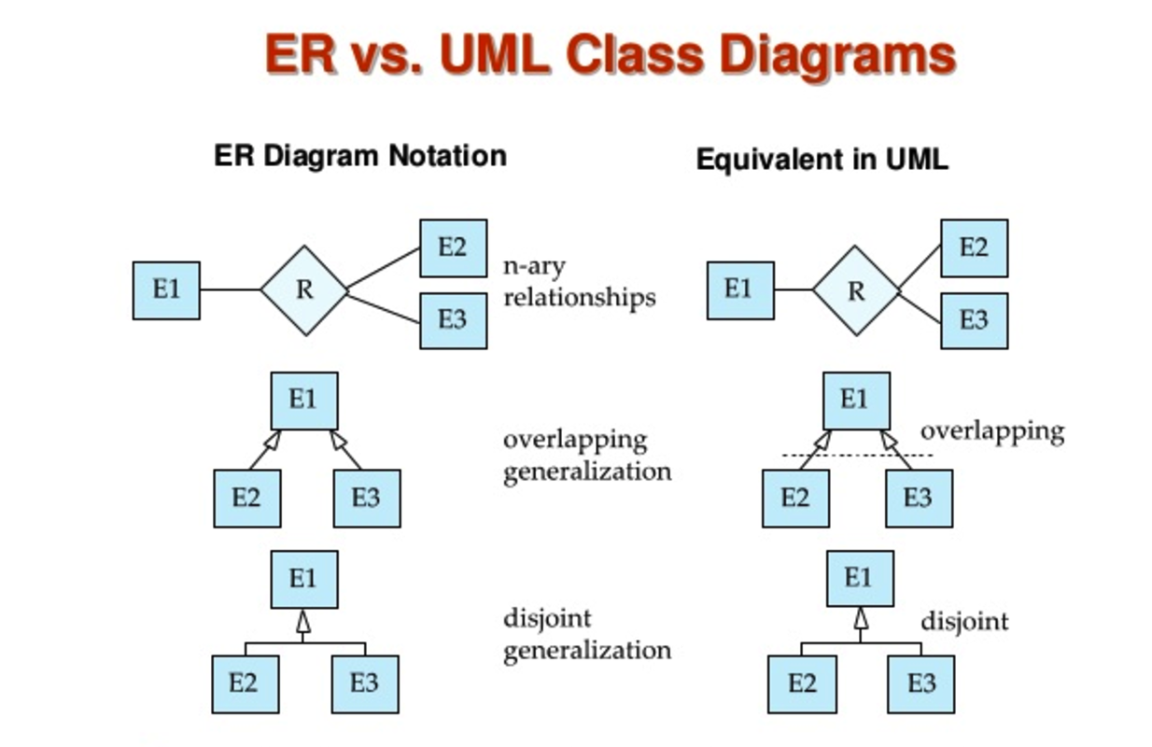

Slide 75
ER and UML
Features | UML | ERD
Abbreviation | Unified Modeling Language | Entity Relationships Diagram
Description | UML is the most prevalent and consistent modeling language which is mainly utilized for object oriented systems. | Entity Relationship diagrams are mainly used in structured investigation and theoretical modeling. The rational design of a database can be graphically represented using ER Diagrams.
Main Terms | The main terms of the UML language are (i) class, (ii) object, (iii) association and (iv) attributes. | The main terms of the ER Diagrams are (i) entity, (ii) instance of an entity, (iii) relationship and (iv) attributes.

Slide 76
ER and UML
Features | UML | ERD
Role Information | UML includes role information. | ER Diagrams does not include role information.
Comments | UML supports graphical representation of comments and also these comments can be linked to any object of UML. | ER Diagrams does not support comments.

Slide 77
ER and UML
Features | UML | ERD
Objective | The main objectives of UML are: (i) Model structures by utilizing the concepts of object orientation. (ii) Launch a clear coupling to theoretical as well as accessible artefacts. (iii) Deal with the issues in intricate and operation-critical systems. (iv) Develop a process that is well-suited and helpful for both people and devices. | The main objectives of ERD are: (i) Confine the entire obligatory or essential data. (ii) Guarantee that data does not get reproduced unnecessarily. (iii) Place information in a conventional and a reasonable position. (iv) ERD cannot model data that are copied from other already modelled data.

Slide 78
ER and UML
Features | UML | ERD
Benefits | UML has several advantages: (i) UML is an Open source (ii) UML includes several graphical terms to specify, visualize, construct and document the systems (iii) UML is completely free from any particular programming language (iv) UML can be used from a common primary design to a more precise, comprehensive design throughout the whole SDLC (software development life cycle) (v) UML is utilized to model huge as well as composite systems | ER Diagrams includes several advantages: (i) With ER Diagrams, a developer can get a wide vision of the data that is to be enclosed in the database (ii) ERD works as a documentation device (iii) ERD is used for representing and communicating the rational composition of the database (iv) ERD is very plain and easier to learn

Slide 79
ER and UML
Features | UML | ERD
Benefits | (vi) UML offers better perceptive of the product to the clients and the manufacturers (vii)UML supports various application fields (viii) Also currently, UML is supported by several software packages (ix) UML works fully according to the experience and the requirements of the user commune (x) UML offers better engineering (reverse) support | (v) In ERD it is simple to move the construct inside the relational tables (vi) ERD operates as an outline of a database (vii) ER Diagrams can be easily converted to network or hierarchical information

Slide 80
ER and UML
Features | UML | ERD
Language Conventions | UML has the following language conventions: (i) UML classes or instances are represented as rectangles. (ii) UML functions or use cases are represented as ovals. (iii) Instances in UML are always underlined and the types are not. (iv) The abstract class name in UML is revealed in italics. (v) In UML, an interface is represented by a rectangle, preceded with term «interface». | ER diagrams have following language conventions: (i) Rectangles are used for ERD entities. (ii) A double rectangle is used for representing a weak entity in ERD. (iii) A diamond symbol represents ERD Relationships. (iv) An eclipse symbol represents ERD attribute. (v) Ellipse symbol with an underline is used for representing a key attribute in ERD.

Slide 81
Alternate Data Models
Network Data Model
Hierarchical Data Model

Slide 82
Hierarchical Data Model
Organizes data in a tree like structure, where each record has a single parent or a root.
Sibling records are sorted in particular order.
That order is used as the physical order for storing the database.
Good for describing many real-world relationships.

Slide 83
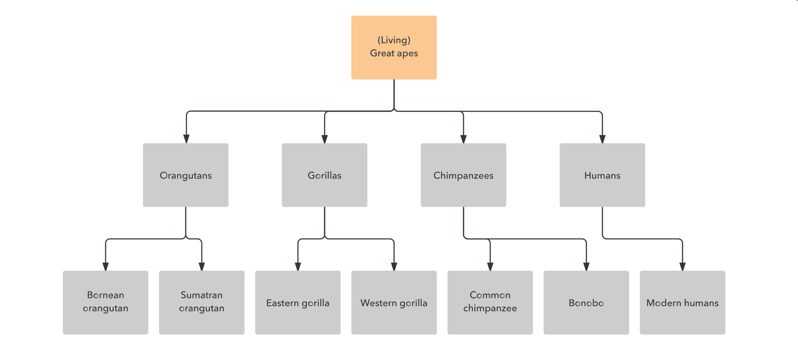
Hierarchical Data Model

Slide 84
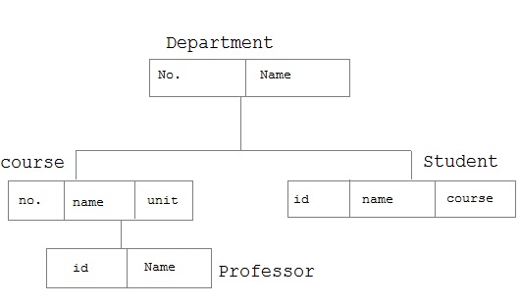
Hierarchical Data Model

Slide 85
Network Data Model
Builds on the hierarchical model by allowing many-to-many relationships between linked records, implying multiple parent records.
Constructed with sets of related records.
Each set consists of one owner or parent record and one more member or child records.
A record can be a member or a child in multiple sets, allowing this model to convey complex relationships.

Slide 86
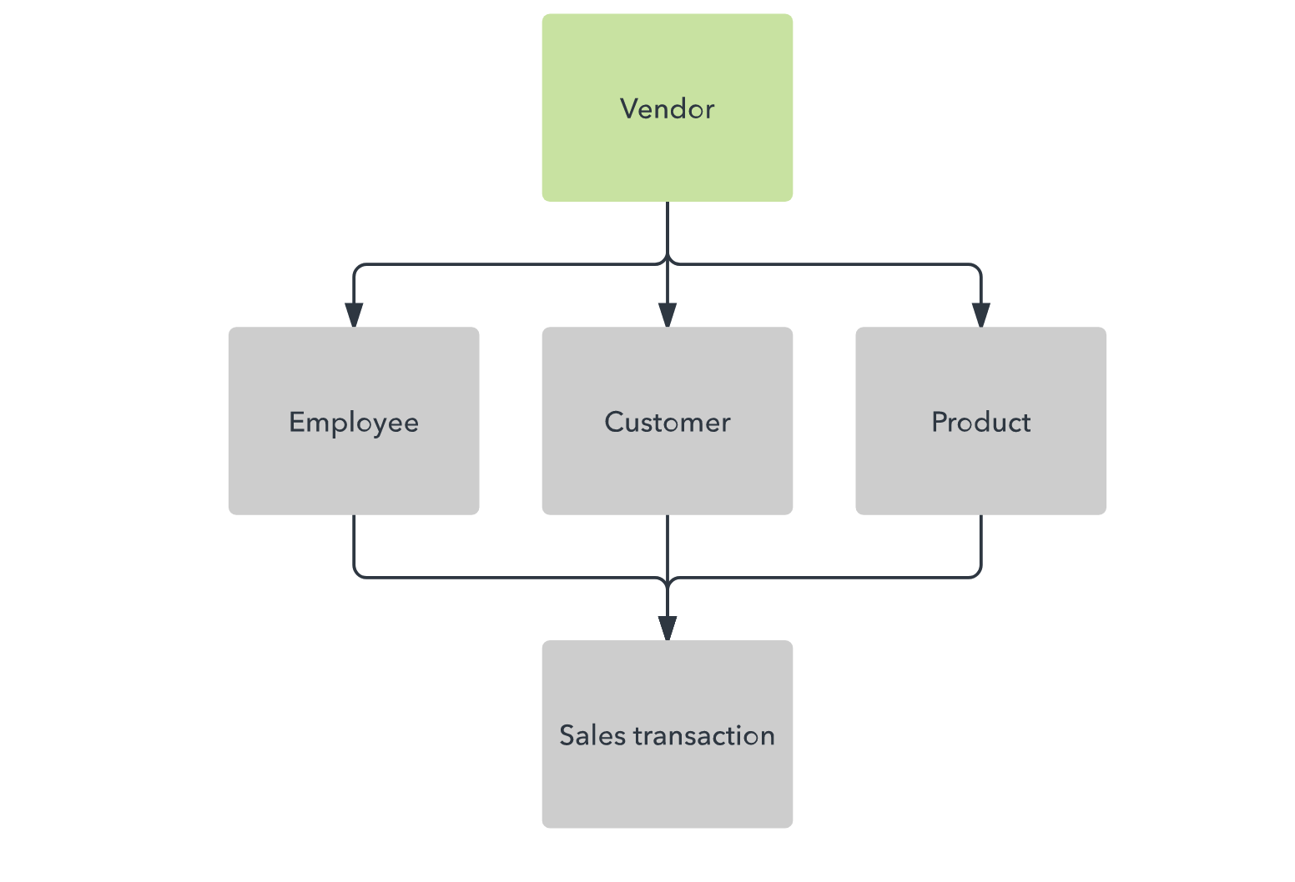
Network Data Model

Slide 87
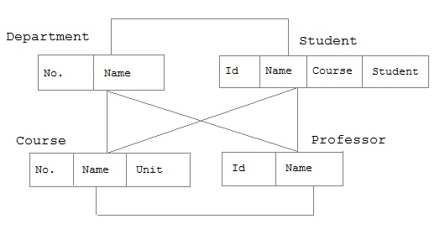
Network Data Model

Slide 88
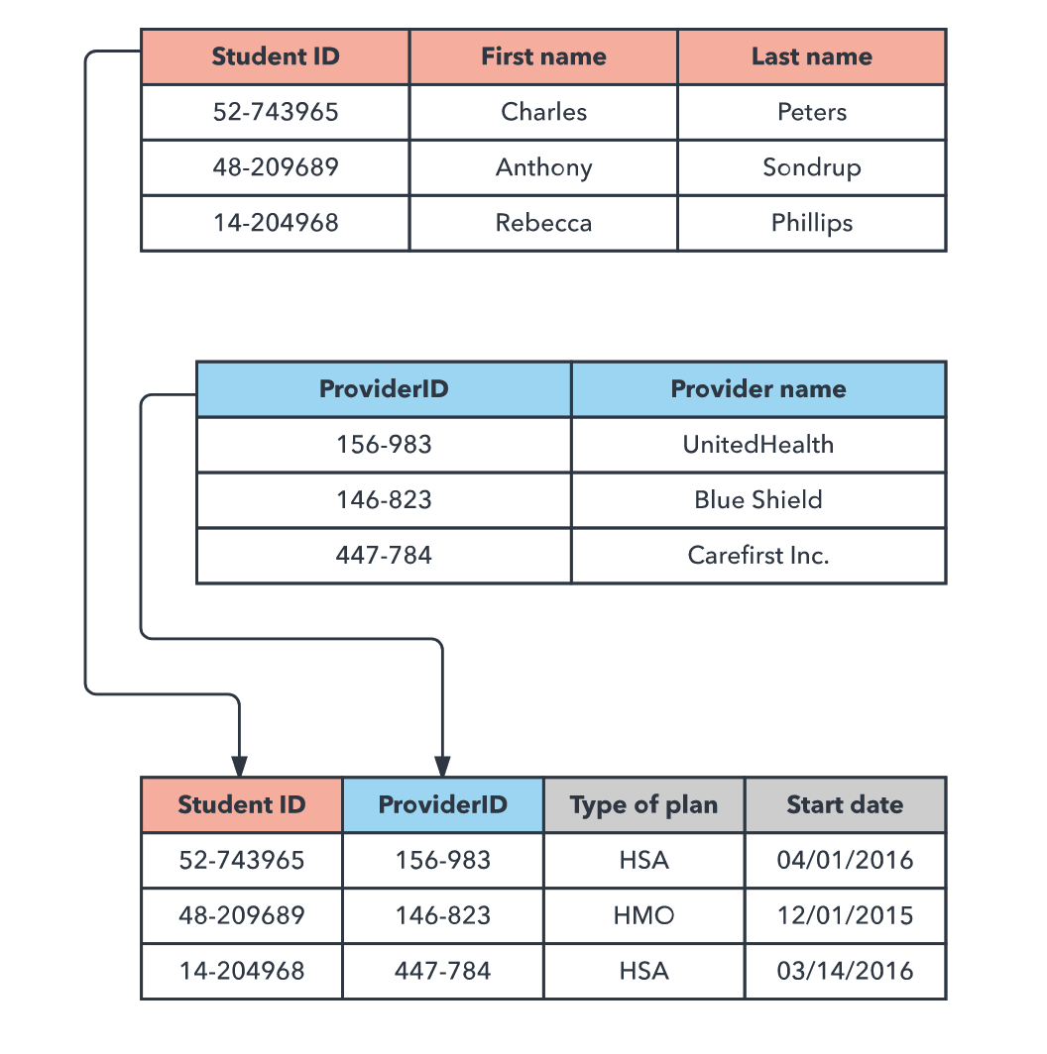
Relational Data Model

Slide 89
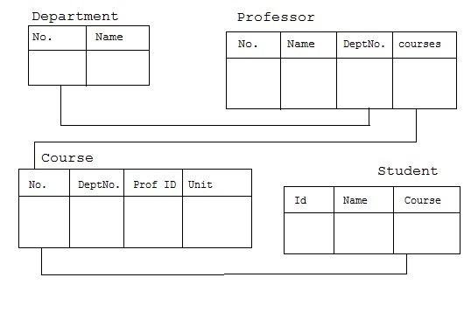
Relational Data Model

Slide 90
ER Diagram: Example 1
We want to represent information about products in a database.
Each product has a description, a price and a supplier.
Suppliers have addresses, phone numbers, and names.
Each address is made up of a street address, a city, and a postcode.

Slide 91
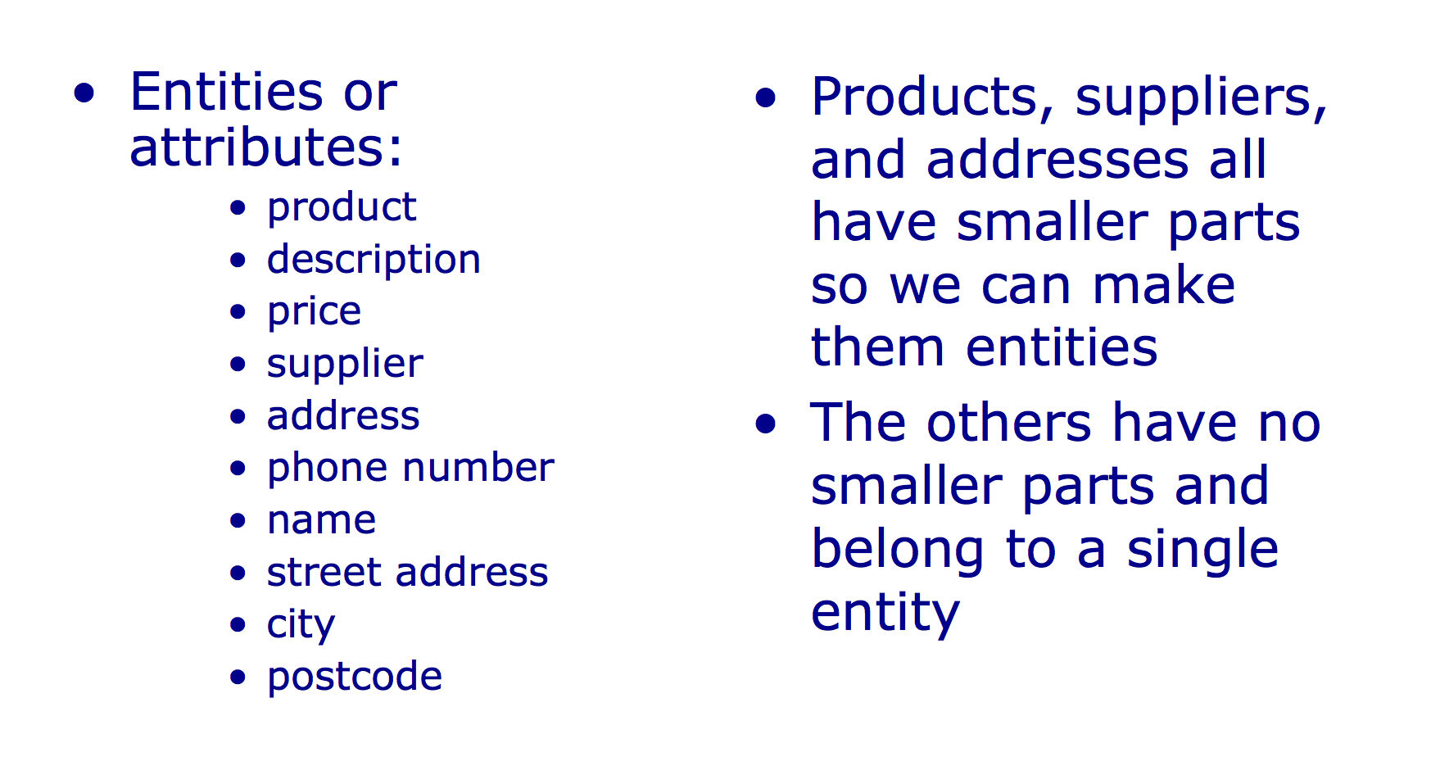
ER Diagram: Example 1

Slide 92
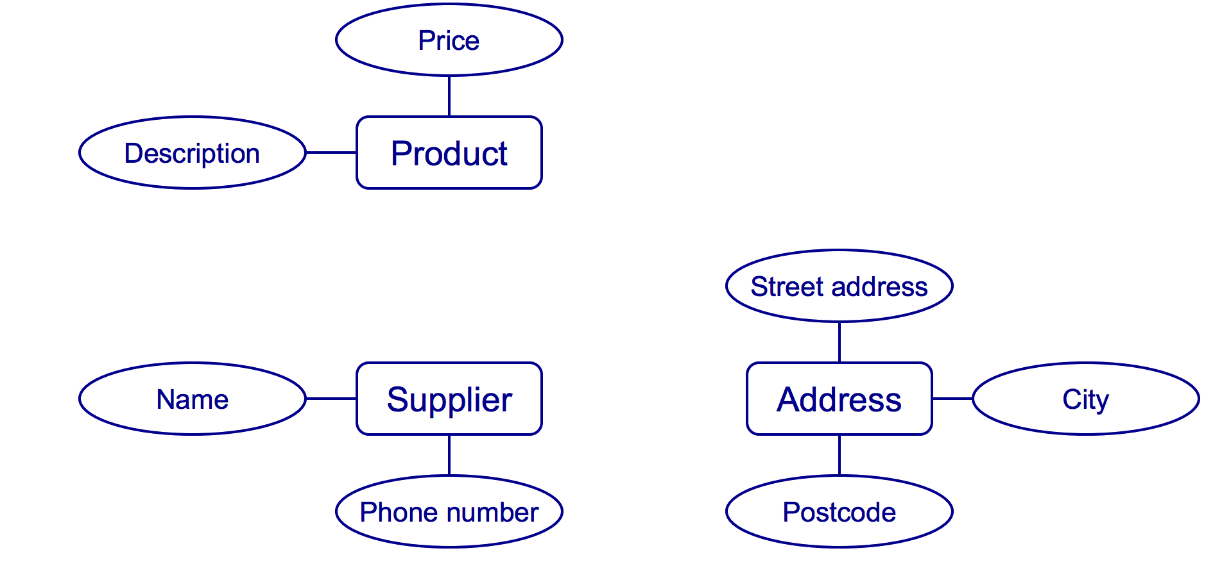
ER Diagram: Example 1

Slide 93
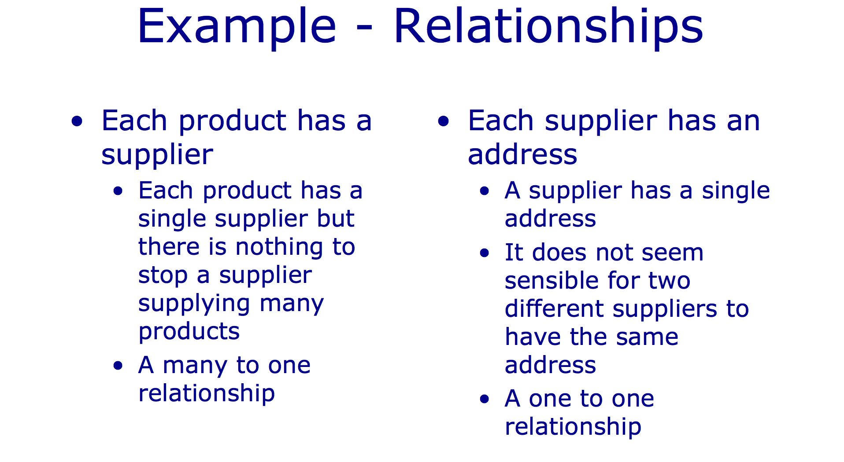
ER Diagram: Example 1

Slide 94
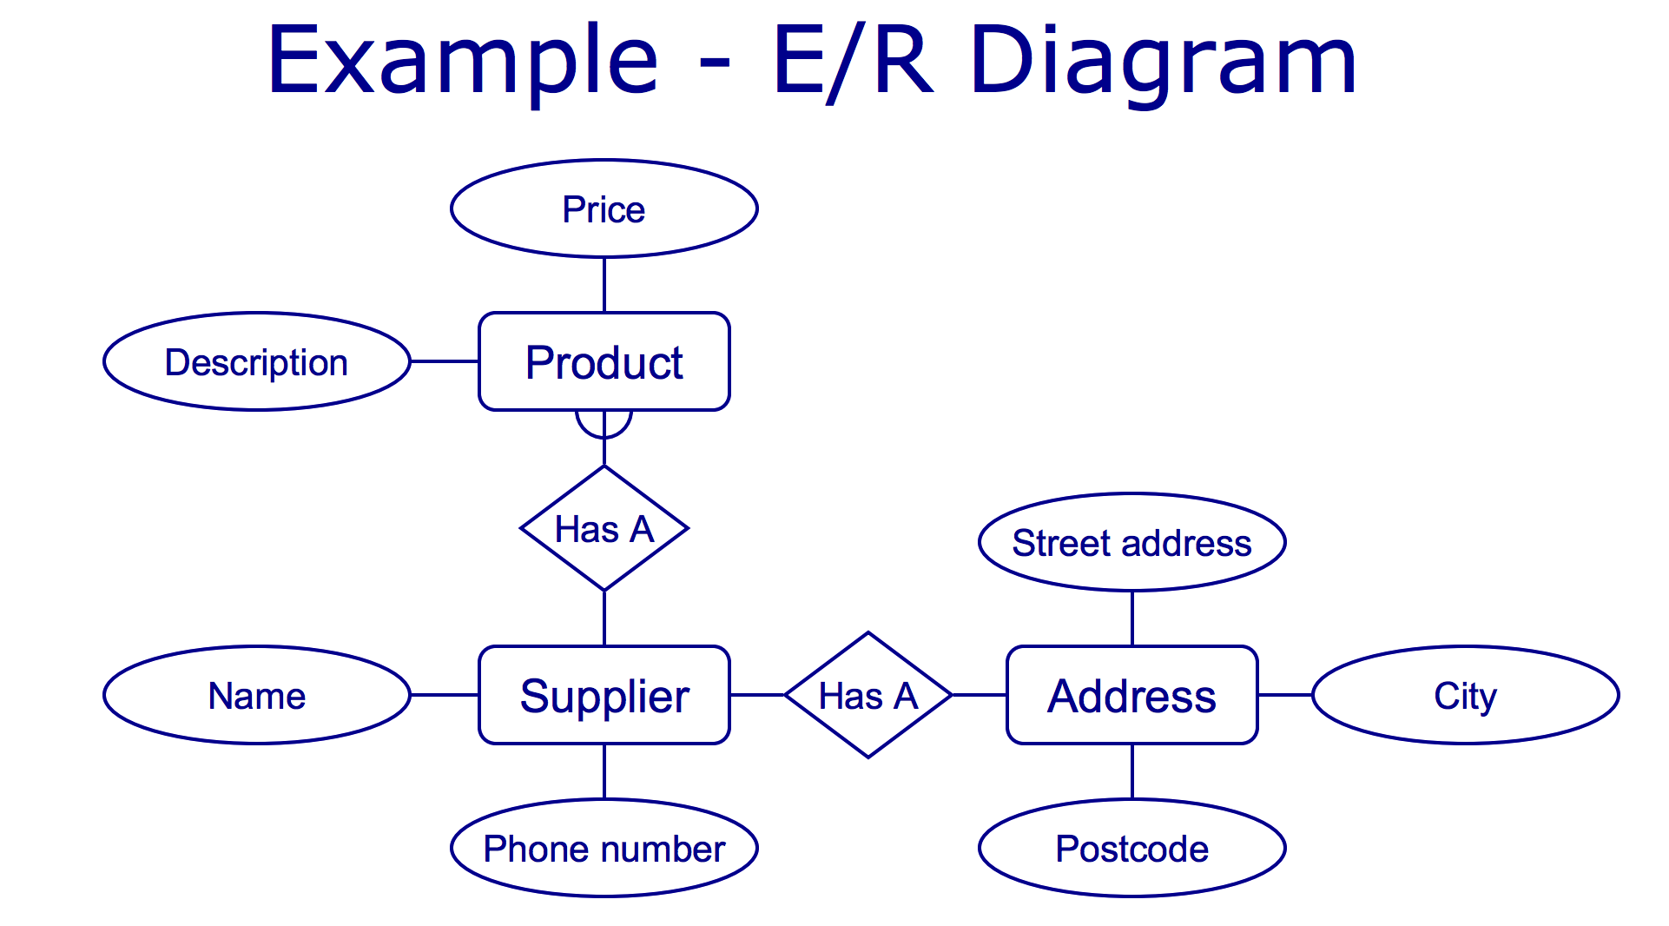
ER Diagram: Example 1

Slide 95
End of Chapter Two Thank you ☺

