Slide 1
A Project Presentation on Student Portal

Slide 2
Presented By
Akash Khadka(04-BCT-071)
Bibek Timalsina(12-BCT-071)
Tirtha Raj Karki (44-BCT-071)

Slide 3
OUTLINES
Introduction
Problem Statement
Objectives
Features
Applications
Requirements
Literature Review
Methodology
Work Completed
Work Remaining
Problems Faced
Gantt Chart
References

Slide 4
Introduction
1
Students portal is a web portal where all information and study materials thats student needs can be found.
A web project which provides platform for students to access education materials
Helps to solve problems faced by engineering students in daily basis

Slide 5
Problem Statements
College websites are mostly commercial and management based used as a means of advertisement
Current Solutions are Expensive and Maintenance Cost
Current Solutions are targeted for College Administration and provides little to no coverage for Students Education

Slide 6
Objectives
Create Educational Platform for College students
Provide Common Knowledge Sharing Platform to Share Study Materials/Events
Provide Discussion Forum for Study Related Discussion and ExtraCurricular activities
Provide Platform to archive projects and study materials

Slide 7
FEATURES
MultiTenant Platform for Onboarding Multiple Clients
Separate URL and Branding For Each Clients
Client Controlled Student Onboarding and Feature Functionality

Slide 8
FEATURES
Event Creation
Discussion Forum
Upload/Download Study Materials
Online Repository for Storing Projects
Event Notification System
Login and Authentication System

Slide 9
APPLICATIONS
Targeted for Education Institution
Can be Implemented and Modified to be used by Organizations and Media Outlets

Slide 10
System Requirements
Hardware
OS: windows XP or latest
1GB RAM
10GB space on hard disk
Software
XAMPP
PHP 7.0
Javascript and jQuery
CSS
Boostsrap 4.0

Slide 11

Literature Review
This is not the first idea that we have generated
The website that share the similar ideas are student university and Gothenburg universitysavannah
This exixting student webpages does not provides platfoem to upload projects or live notification features

Slide 12
College Enrollment process
first
second
third
last
College Register for Portal
College Administrator Enroll Students
Student Logs In and Access Feature
Student and Teachers Sets Events and Forum
Colleges Request for System
Initial Setup and Branding
College Administrator Login Credentials are Forwarded
Admin Defines Faculty
Enroll Students and Send Registration Email
Students and Teacher Sign Up
Create Events/Forums/Downloadable Contents

Slide 13
Methodology
Start
Requirement Gathering
Quick
Design
Building
Prototype
Engineer
Product
Redefining
Prototype
Evaluation/ Testing
Stop

Slide 14
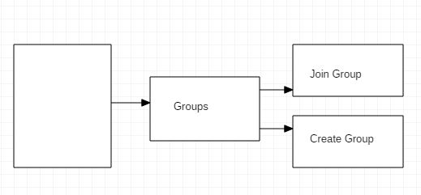

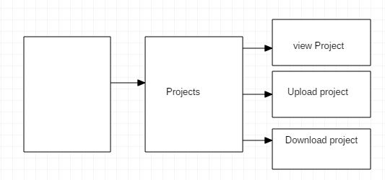
Block Diagram
Block diagram of group section
Block diagram of project section

Slide 15
Work Completed
Admin panel:
Users
Download categories
Projects
Roles and permission
Tags
Subjects
Events

Slide 16
Users:
Projects
Downloads
Events
Pages
Projects
Downloads
Events
Multitenancy

Slide 17
Work Remaining
Live notification feature For Events
Discussion forums
Search Feature for Events/Projects/Downloadable Contents
Announcement and Notices

Slide 18
Problem Faced
Multiple file difficult to upload
Multitenancy implimentation
Difficulty while maintaining database for multiple organization
To assign roles and permission

Slide 19
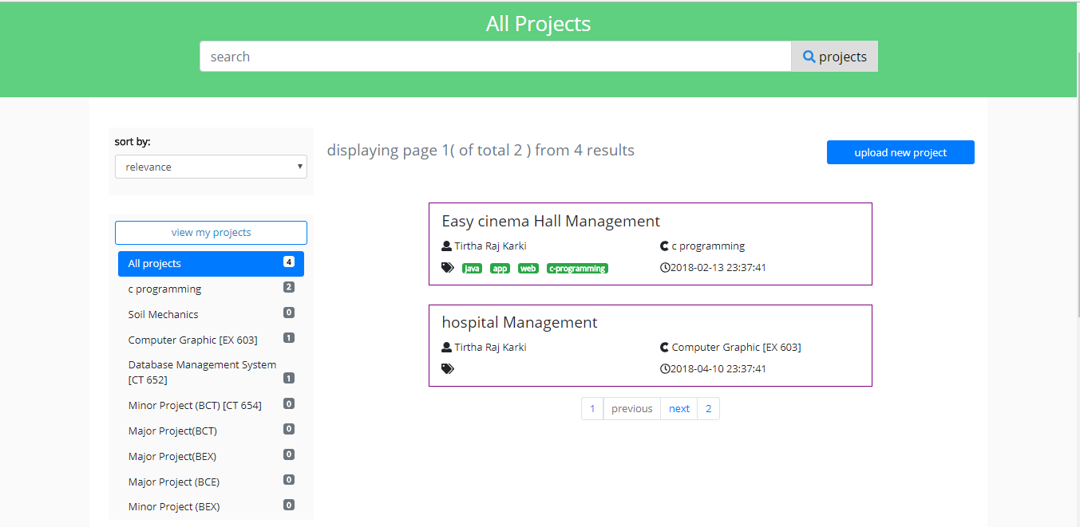

Slide 20
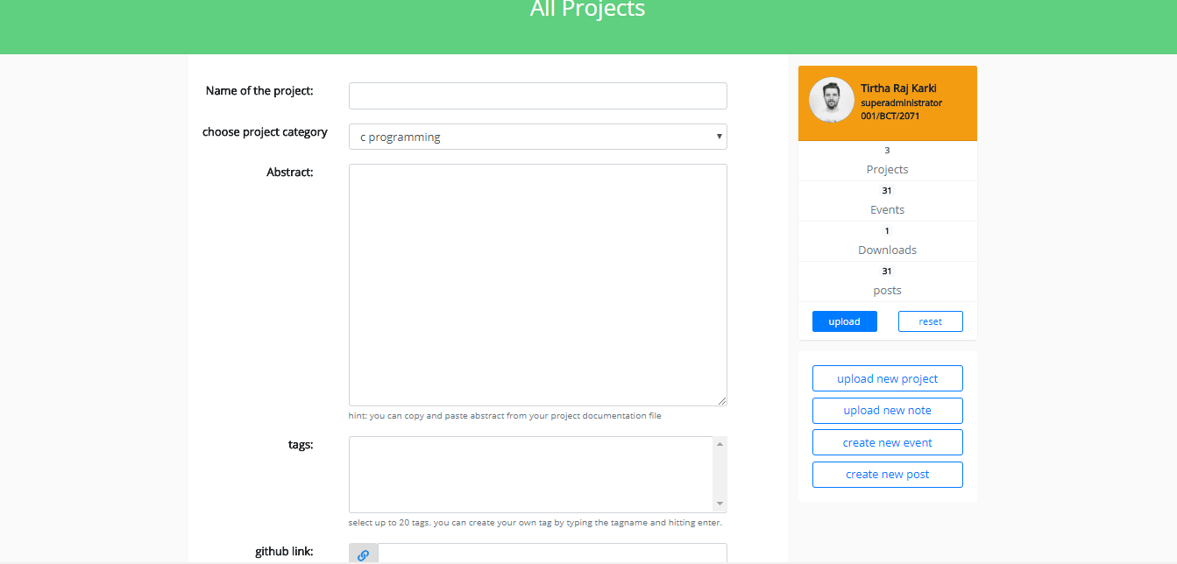

Slide 21
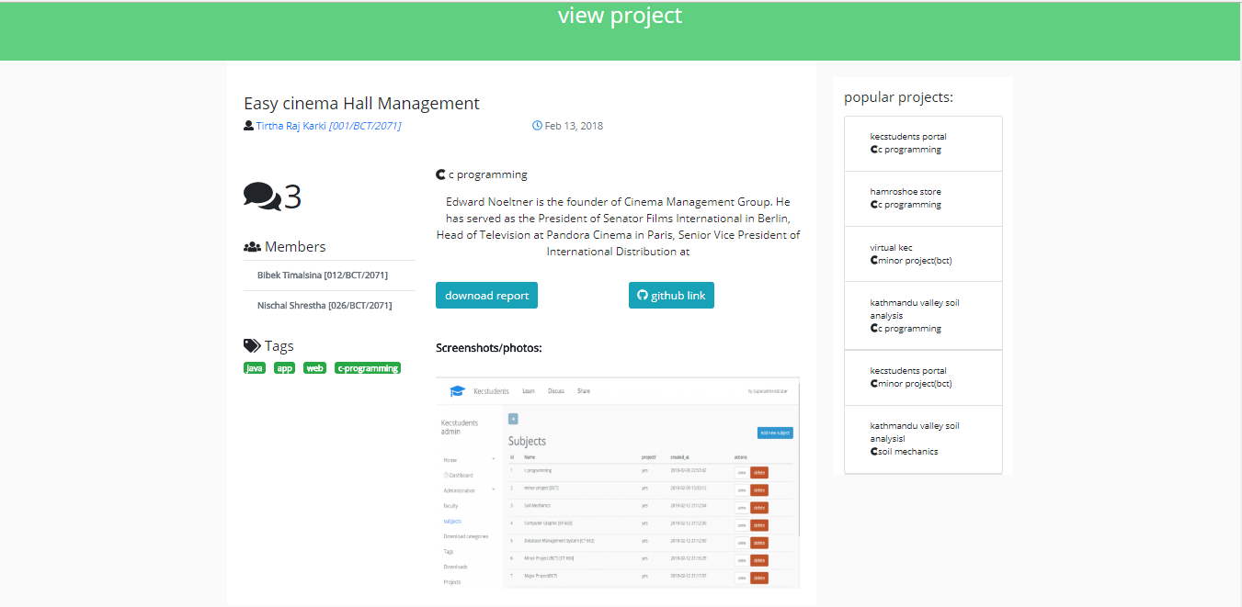

Slide 22
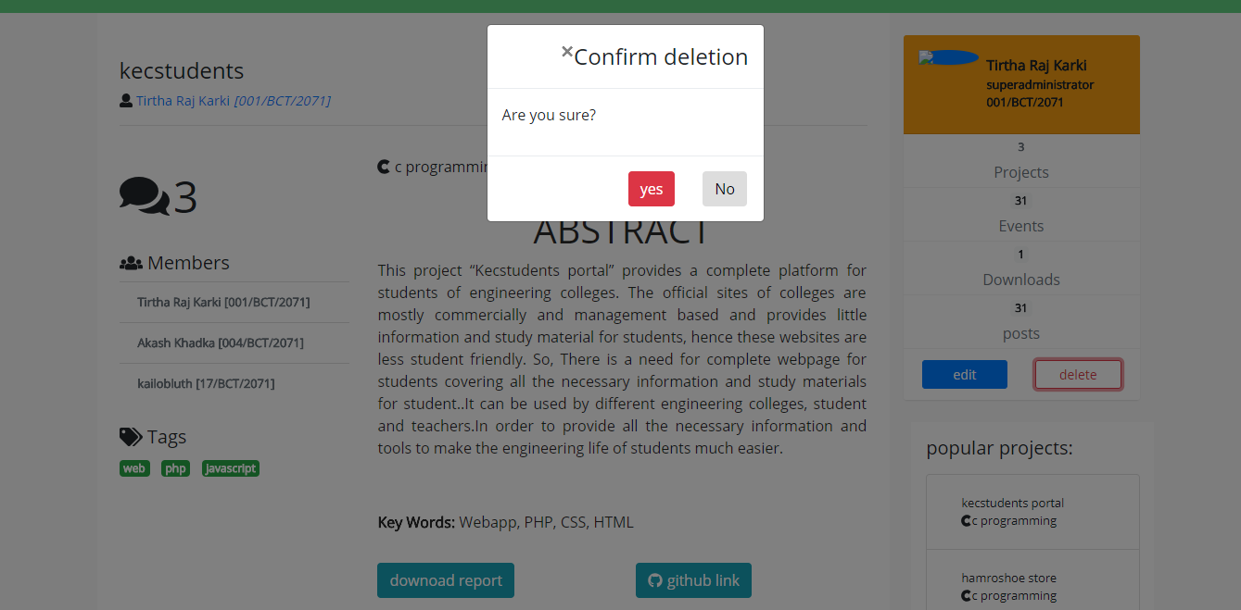

Slide 23
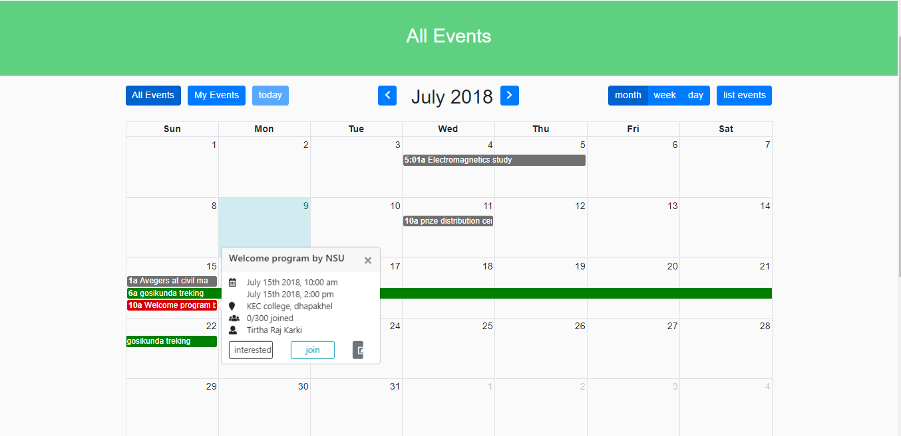

Slide 24
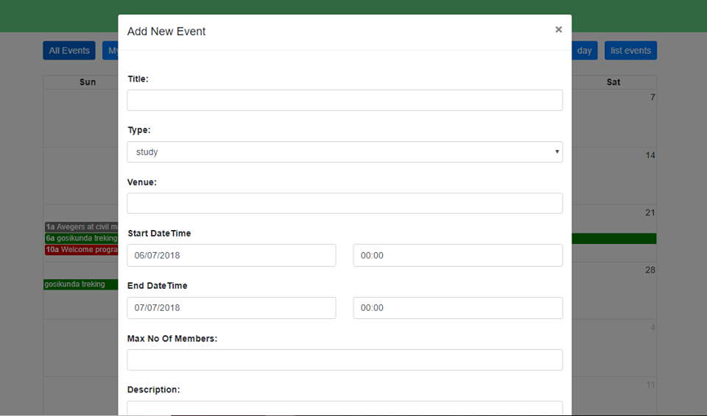

Slide 25
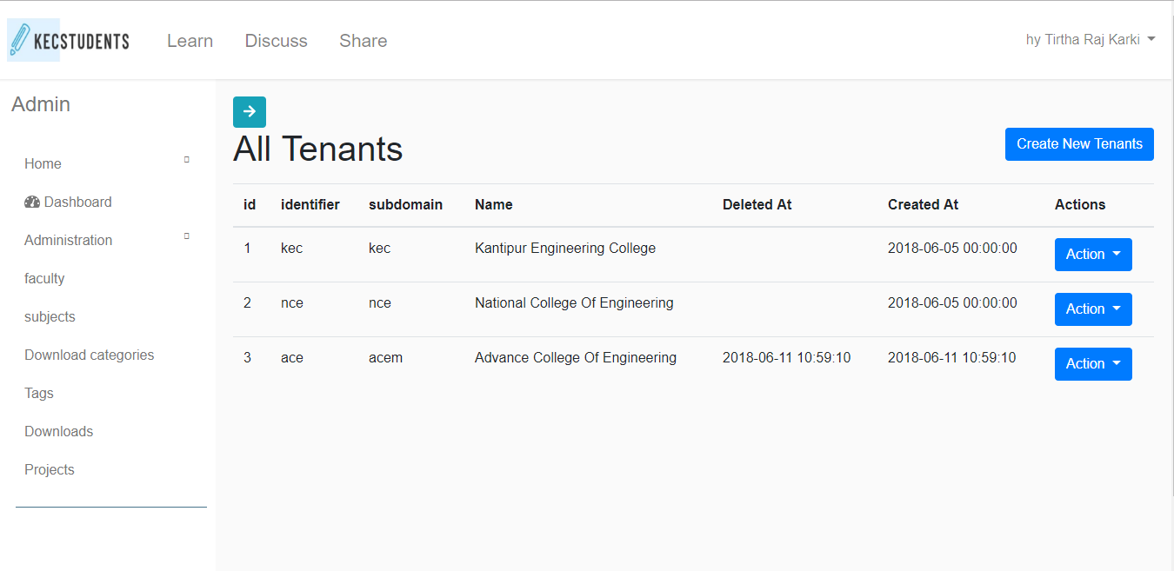

Slide 26
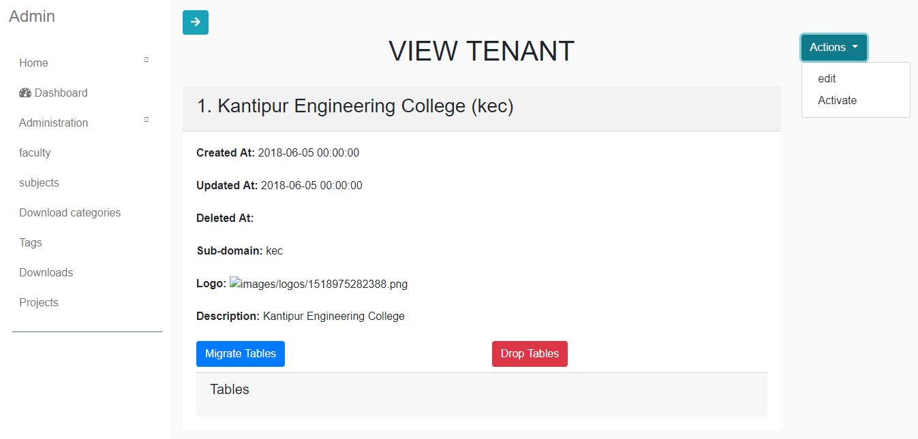

Slide 27
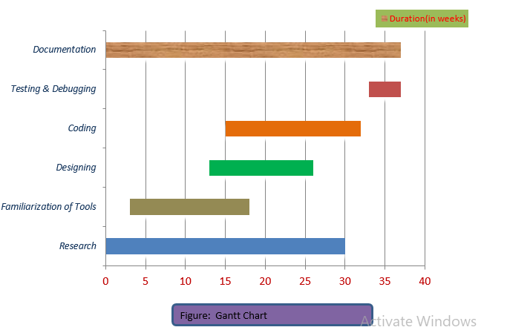
Gantt Chart

Slide 28
Referance
[1] https://www.savannahstate.edu/students/ [Accessed 17 Dec. 2017].
[2]https://studentportal.gu.se/english;jsessionid=sogdf3ur4nt91slu05kfrnsom?skipSSOCheck=true&referer=https%3A%2F%2Fwww.google.com.np%2F [Accessed 19Dec. 2017].

Slide 29
Thanks!
Any questions?
You can find me at @username & user@mail.me

