Slide 1
Day 8: Pangenomics
MMB-127

Slide 2
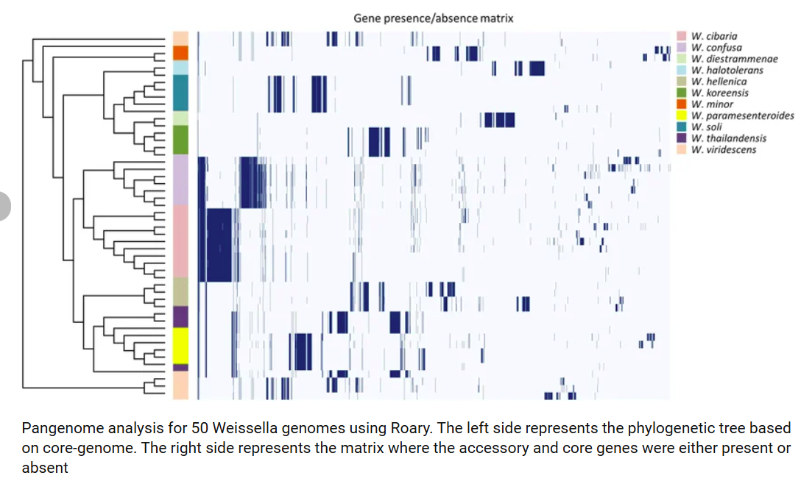
Pangenomics
A pangenome is the complete set of genes found across all strains of a species or group
Kim et al., 2022

Slide 3
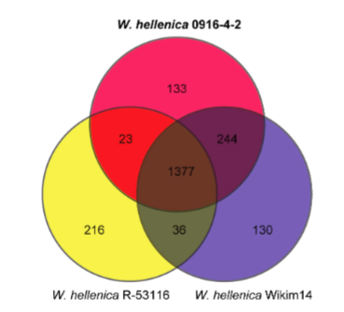
Core genes and accessory genes
Core genome: genes present in all (or nearly all, e.g., ≥99%) genomes.
Accessory genome: present in some genomes
Core
Kim

Slide 4
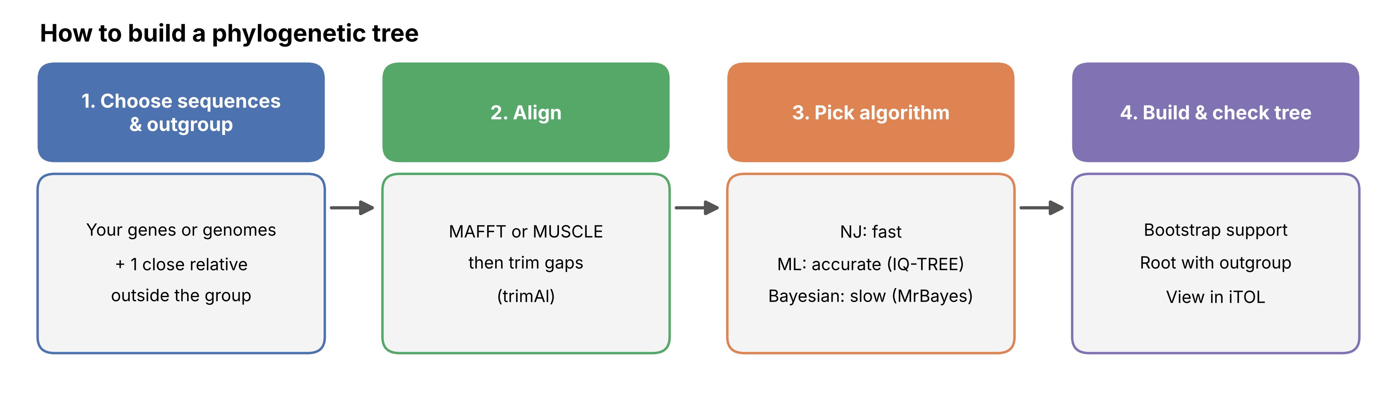
Building a phylogenetic tree

Slide 5
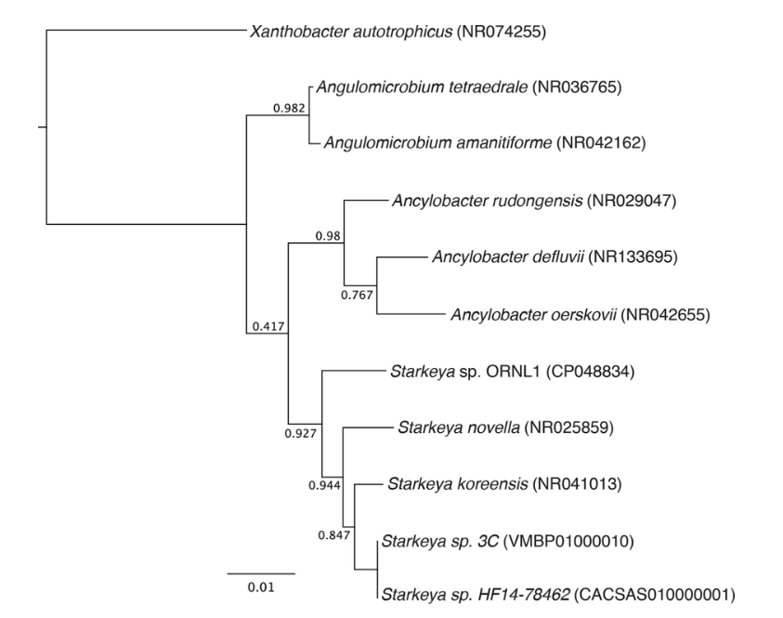
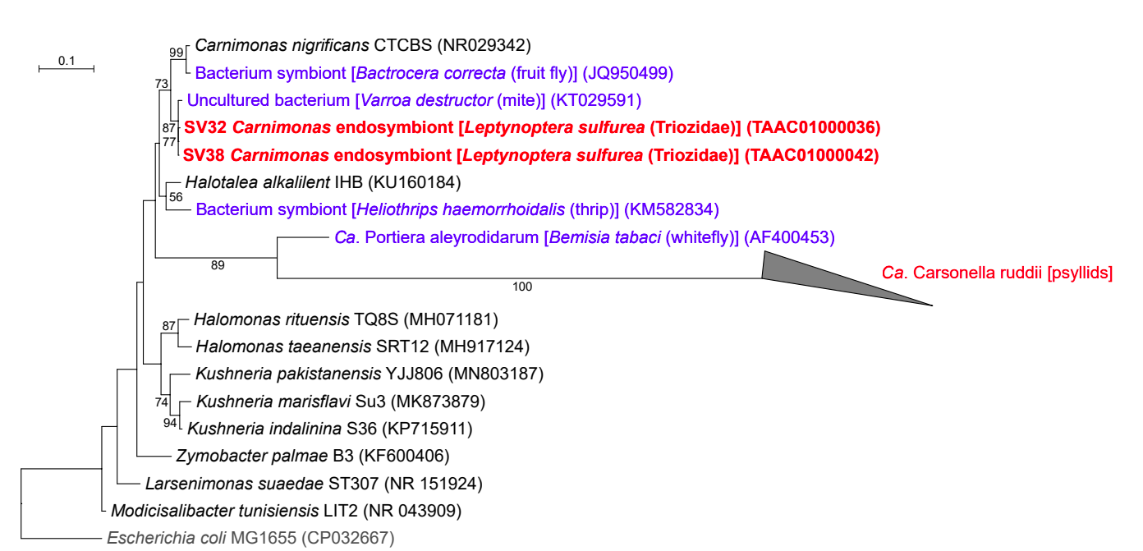
Building a phylogenetic tree
Bootstrap support tells you how strongly your data back each branch (clade)
  FastTree calculates local support values using an SH-like (Shimodaira–Hasegawa-like) test (0-1).
  IQ-TREE support values: Standard bootstrap (0-100).
Podar et al., 2020
Nakabachi et al., 2022

Slide 6
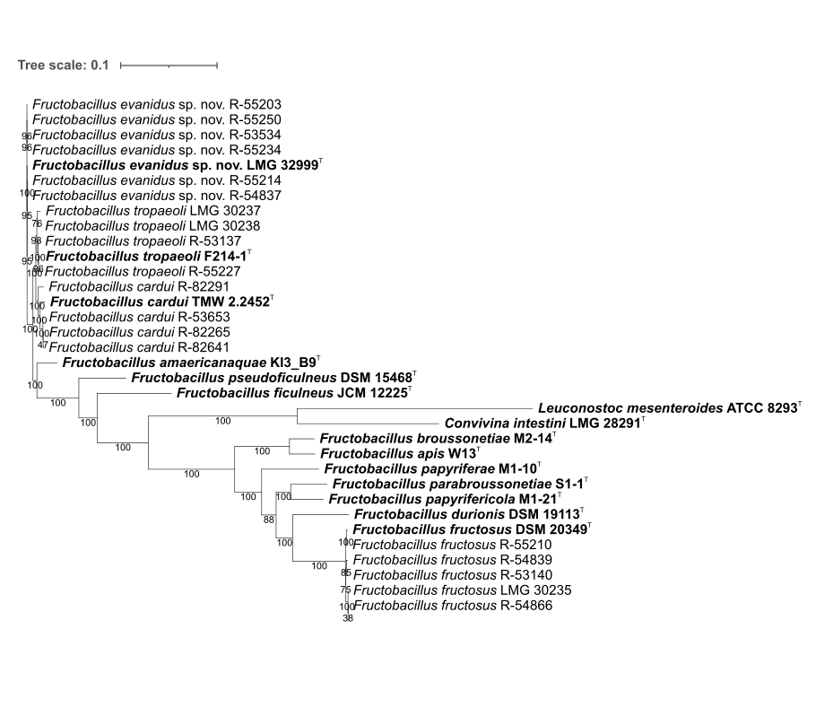
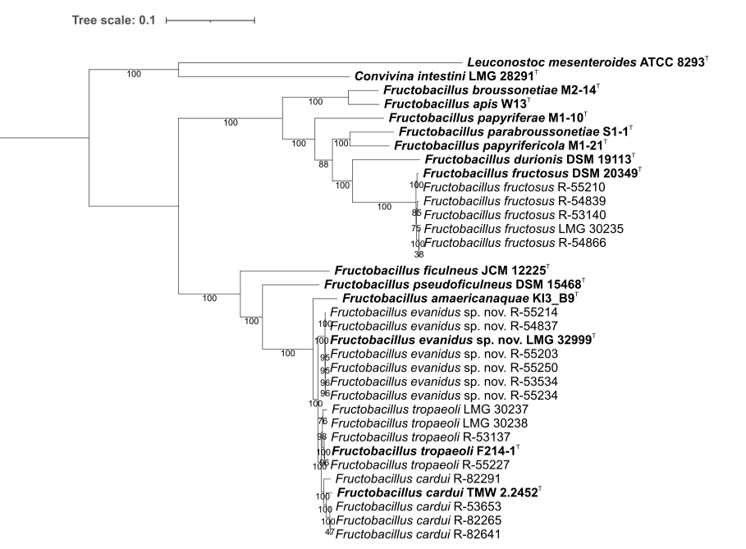
Building a phylogenetic tree
Root your phylogenetic tree
Unrooted tree
Rooted tree

