Slide 1
NexVerde
Where performance meets the planet.
Sustainable Data Centre Proposal
Commissioned for Birdy Capital

Slide 2
Who We Are
NexVerde — Built for this.
12
€200M+
ISO 50001
years in sustainable infrastructure
in delivered projects across Europe
certified · EU Taxonomy aligned
Speaker: Person A · 2 min

Slide 3
Your Brief
What you asked for — and what we commit to.
TIER III
NET-ZERO
€50M / 4 YRS
99.982% uptime Fully redundant systems
Carbon trajectory Measurable milestones
On budget On time delivery
Full brief in your private portal
Speaker: Person A · 3 min

Slide 4
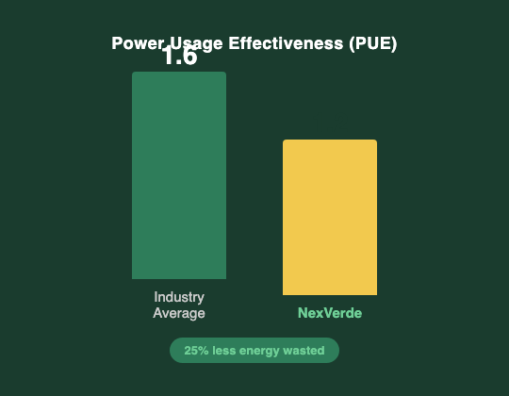
Technical Architecture
The build.
Modular design — scalable from day one
Tier III redundancy: N+1 on all critical systems
Liquid cooling core · Air-side economisation
Full schematics in your portal
Speaker: Person B · 5 min

Slide 5
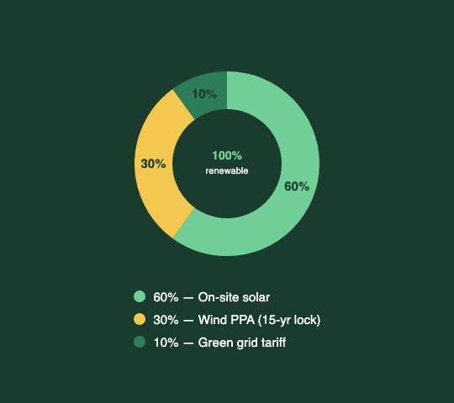
Energy Mix
Your energy — 100% renewable.
60%
On-site solar arrays
30%
Wind PPA — locked 15 yrs
10%
Certified green grid backup
100% renewable from day one — contractual guarantee.
Speaker: Person B

Slide 6
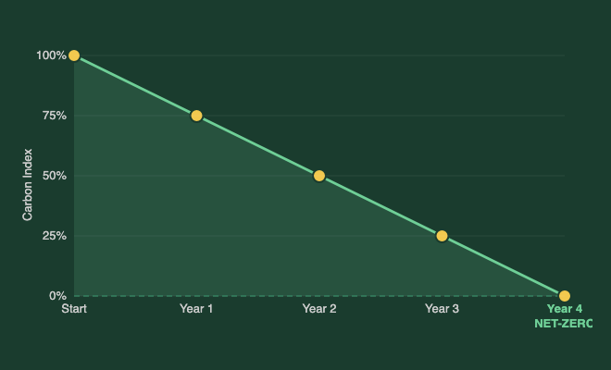
Sustainability
Not just compliant — leading.
EU Taxonomy · CSRD · EN 50600
Net-zero Y4 — operational, not offset
Circular hardware lifecycle
30% less embodied carbon
Speaker: Person B · 4 min

Slide 7
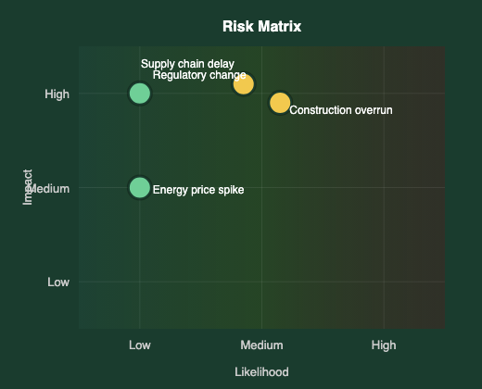
Risk Register
Four risks. All managed.
Risk | Likelihood | Impact | Mitigation
Supply chain delay | Medium | High | Pre-ordered long-lead items
Energy price spike | Low | Medium | 15-yr wind PPA locked
Regulatory change | Low | High | EU-aligned from day one
Construction overrun | Medium | High | 8% contingency built in
Speaker: Person B · 3 min

Slide 8
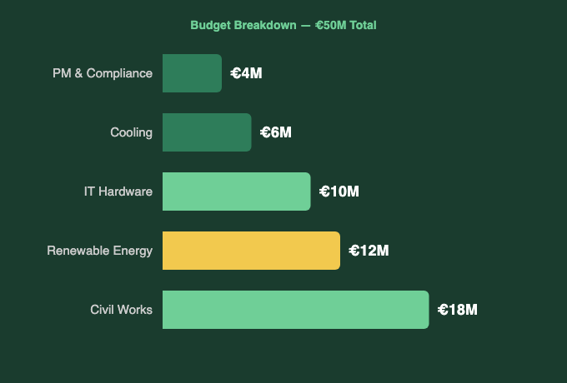
Financial Overview
€50M. Fully allocated.
€50M
Total investment
Year 6
Breakeven
12%
IRR
Speaker: Person A · 4 min

Slide 9
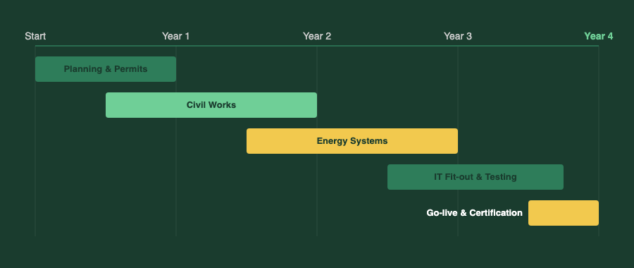
Roadmap
4 years. 4 phases.
Speaker: Person A · 2 min

Slide 10
Next Steps
Three steps to begin.
01
02
03
Sign Letter of Intent
Detailed design delivered
Kick-off meeting
by [date]
Week 6
Week 8
Your portal is live — login details on the card in front of you.
Speaker: Person A · 2 min

