Slide 1
Sports Adages Explored through Data Analysis
Presented by:
Hunter Carraway
Austin Dickerson
Matt Fleischer
Karl Meyer

Slide 2
Sports Adages Explored through Data Analysis
Which of the following help a NCAAF football team win the most efficiently?
Offense wins games.
Defense wins championships.
Punting puts the other team in difficult-to-overcome situations.
Our goal is to predict the winner of each game depending on the correct metric.

Slide 3
Data And Data Sources
Variable | Measure | Type | Source
Team | Categorical | String | ESPN
Pass Yards/ Game | Average Yds | Double | ESPN
Rush Yards/Game | Average Yds | Double | ESPN
Win Percentage | # G Won / # G Played | Double | ESPN
Yards Against/Game | Average Yds | Double | ESPN
Net Punt | Average Yds | Double | ESPN
Punt Ret Yds/Game | Average Yds | Double | ESPN
Winning Record (6+) | T/F from Win Percent | Boolean | Created

Slide 4
Analysis of Numerical Summaries
Winning Record | Yes | No | Total
Total | 71 | 48 | 119
Winning Record skewed left because FCS teams involved (95-16)
Max of Yds/Game (Baylor) is an outlier
(Q3 + 1.5 x IQR) = 588.25
All 3 numerical variables are very uniformly distributed (mean ≈ median)
 | YDSG | YDSAG | Net Punt
Count | 119 | 119 | 119
Mean | 412.00 | 397.42 | 37.06
Std Deviation | 64.73 | 55.33 | 3.42
Minimum | 256.00 | 252.00 | 31.30
1st Quartile | 367.00 | 366.00 | 35.85
2nd Quartile | 411.00 | 398.00 | 36.90
3rd Quartile | 455.50 | 426.50 | 38.25
Maximum | 619.00 | 528.00 | 42.40

Slide 5
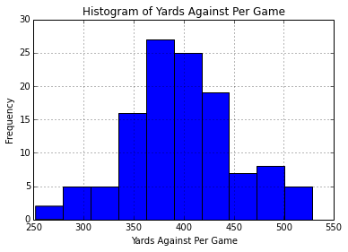
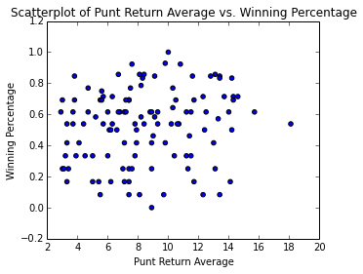
Visualizations

Slide 6
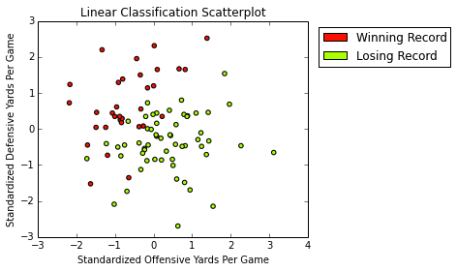
Visualizations
After standardizing both YDSG and YDSAG, we see a clear difference between winning record and losing record.
This scatterplot suggests that an above average defense trumps an above average offense when it comes to having a winning record.

Slide 7
Machine Learning Algorithm
•We employed a linear regression model, using certain features from our data, to determine which contributed most to a higher winning percentage
•A feature is an important feature if it is marked with an *, meaning its p-value is below 0.05

Slide 8
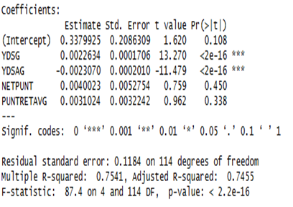
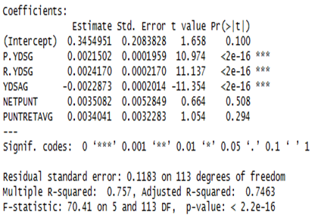
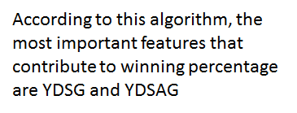
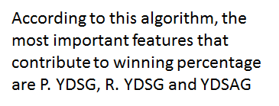
Results

Slide 9
Conclusions & Recommendations
Our results are as expected, both algorithms show that the most important values were the offensive yards per game (both passing and running) and yards allowed by the defense per game.
The linear classification algorithm using just offensive yards and defensive yards allowed per game proved a fairly accurate predictor of whether or not a team would have a winning record.
We recommend not reading too far into the second regression algorithm, because it contains factors that are not entirely independent (Rush Yards and Pass Yards Per Game).
We recommend that further regression analysis should be undertaken, potentially including a dimensionality reduction and testing other variables that may correspond to winning games.
We recommend that future analysis includes looking into the definability of certain teams into a strong defensive or offensive team, and their winning percentage based on their individual players’ statistics--much harder.

