Slide 1
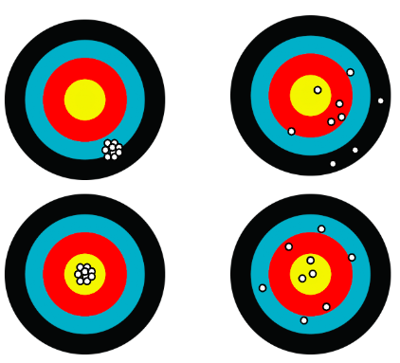
More Bias
Less Bias
Less Bias
More Variance

Slide 2
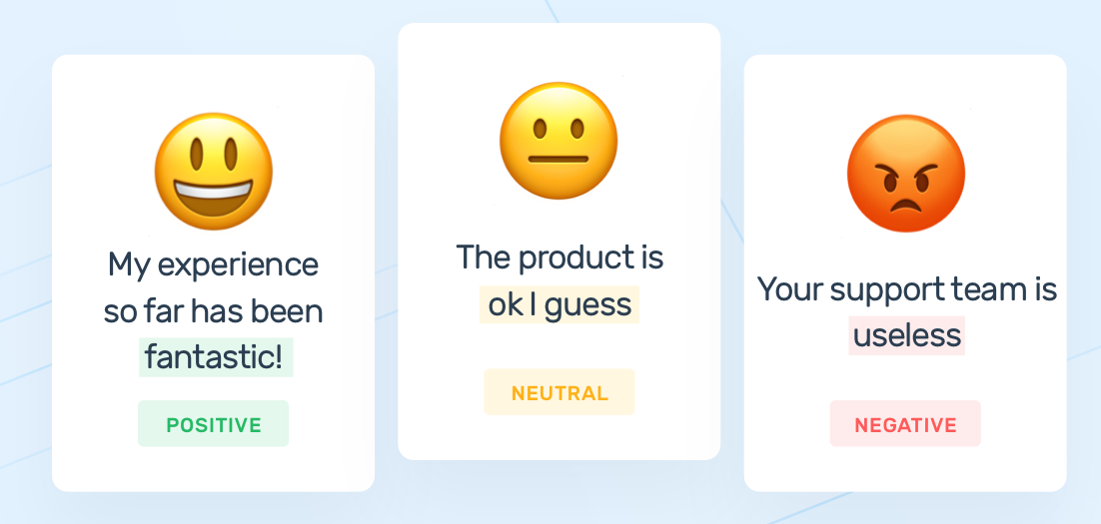



Sentiment Analysis
The product
is ok I guess
My experience
so far has been
fantastic!
Your support team
is useless
My experience so far has been
fantastic! - Client
Neutral
Positive
Negative

Slide 3
x₂
x₂
Margin
Optimal hyper-plane
Support Vectors
Maximum
margin
x₁
x₁

Slide 4
x₂
+d
-d
H
H₁
H₀
H₂
x₁

Slide 5
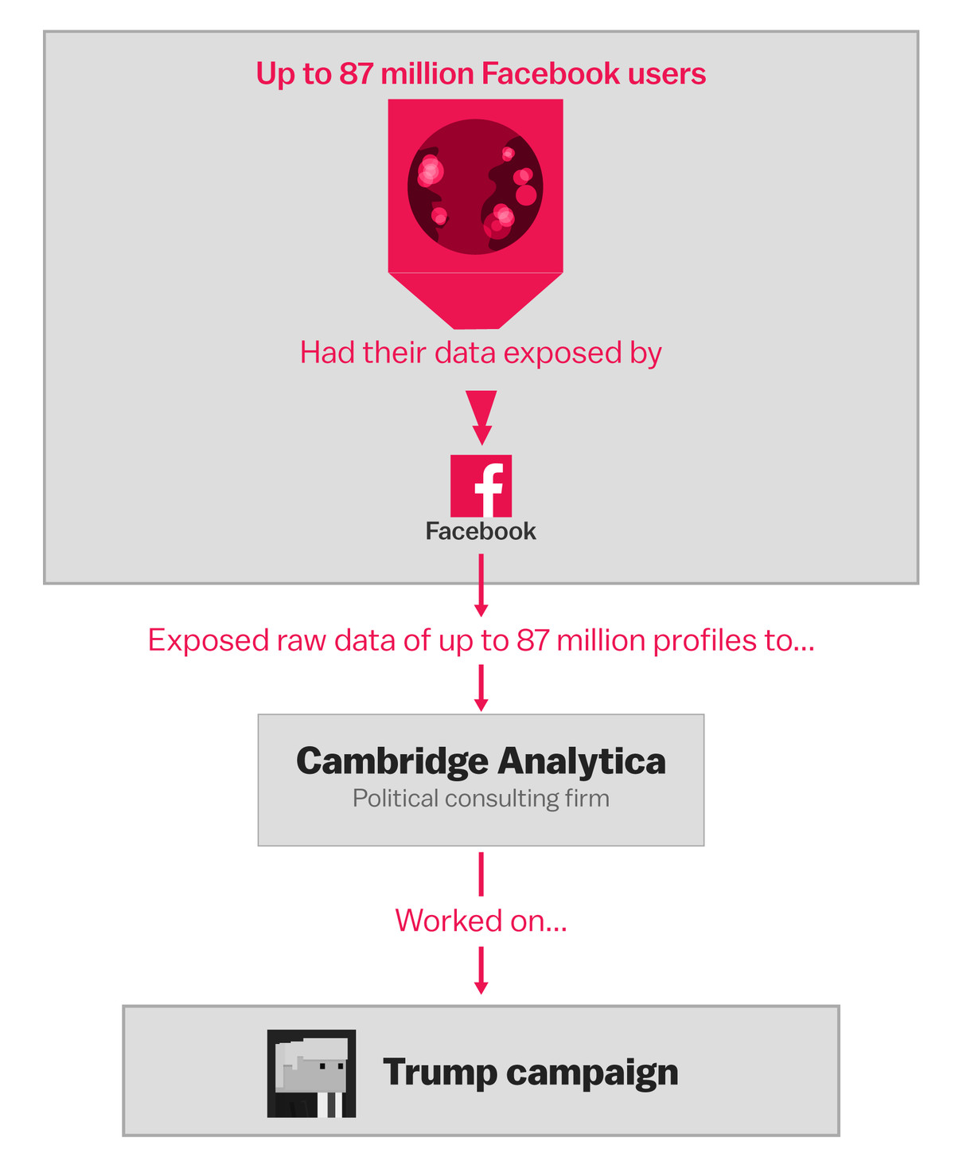

Up to 87 million Facebook users
Had their data exposed by
Facebook
Exposed raw data to…
Cambridge Analytica
Political consulting firm
Worked on…
Trump campaign

Slide 6
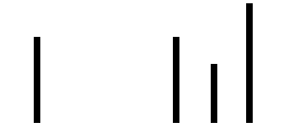
a b c
Exhibit 1
Exhibit 2

Slide 7
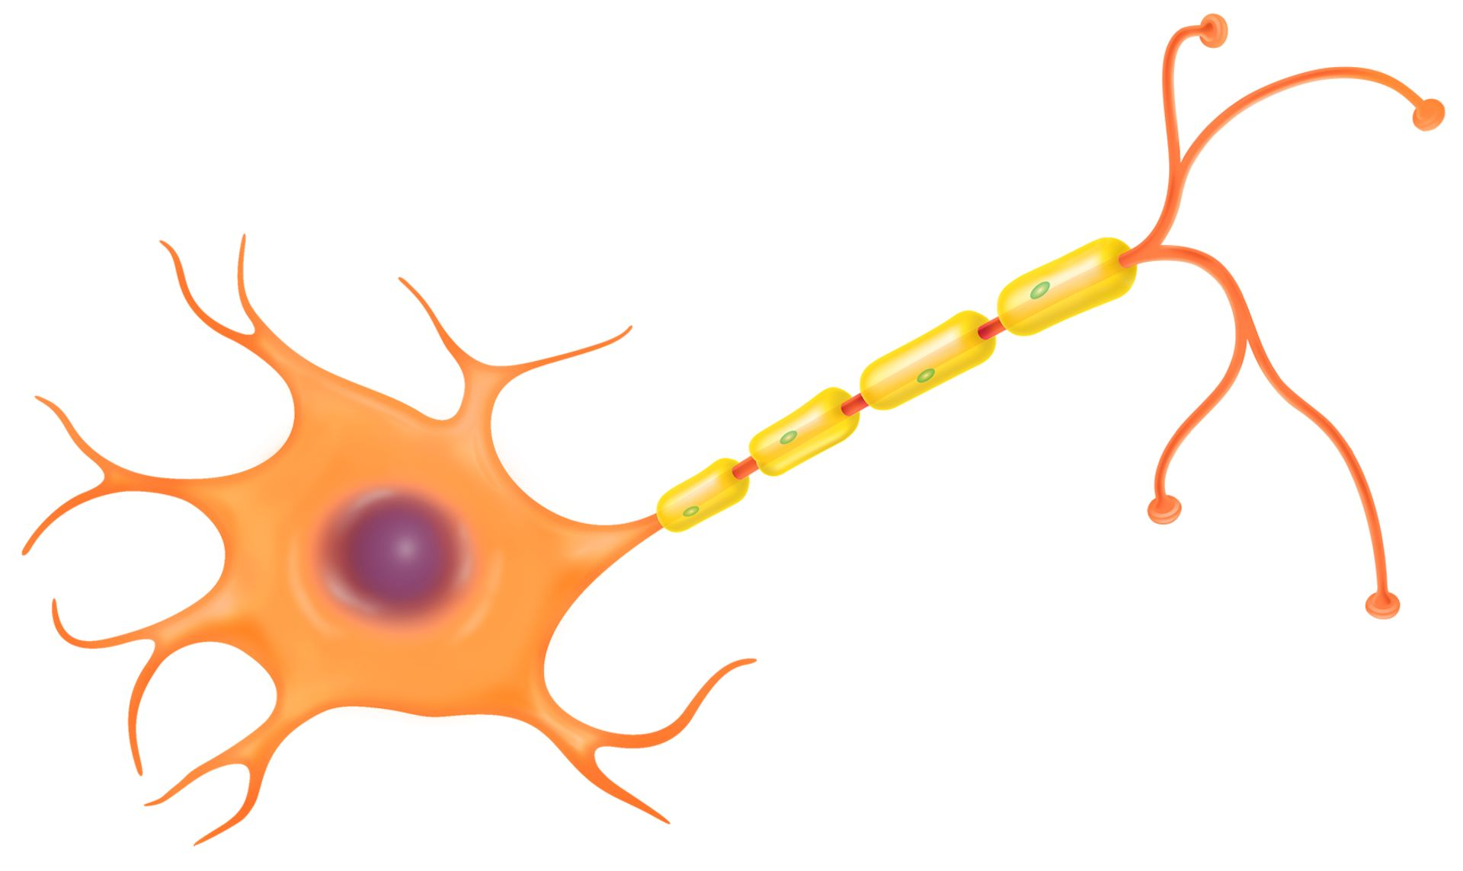
Dendrite
Soma
Axon

Slide 8
Write Python Code to connect to “Full-archive search” endpoint
Data Collection
Write code to connect to API
Design Queries for filtering
Start process of collection

Slide 9
Data Preparation
Write code to access JSON data
Write code to clean tweets
Design DB to store tweets
Write code to store data
Create stored procedures into DB
Create tables into DB
Integrate all code scripts and start process

Slide 10
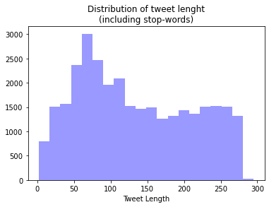
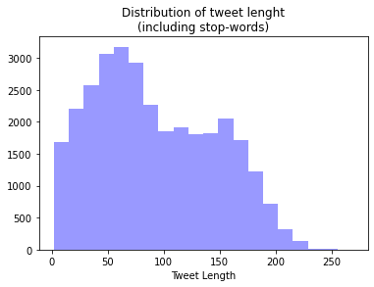
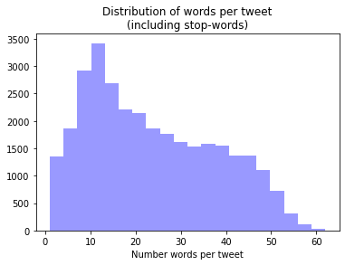
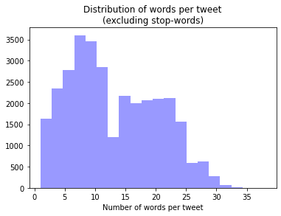

Slide 11
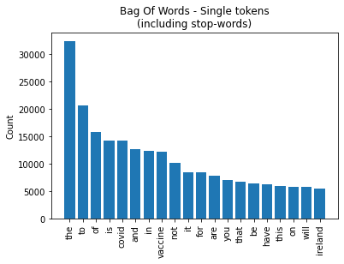
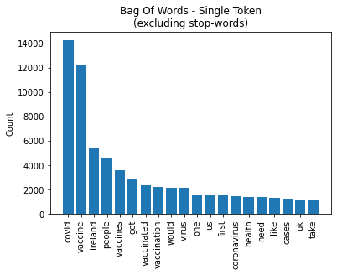
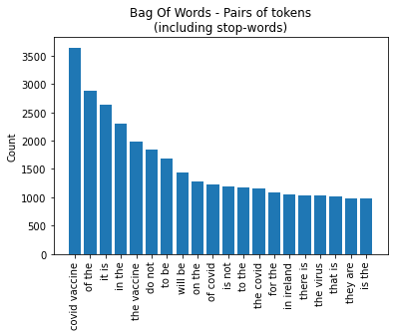
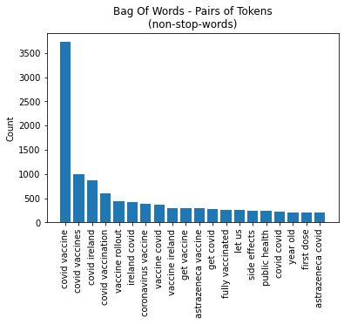

Slide 12
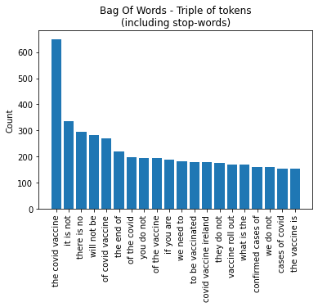
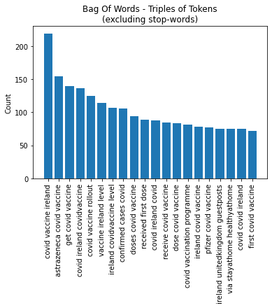

Slide 13
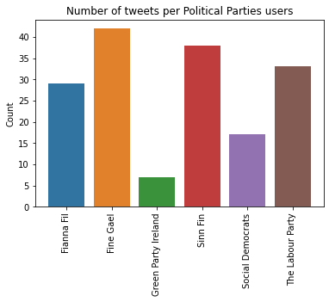
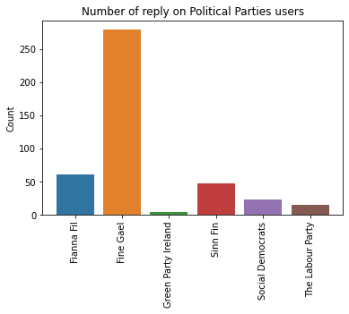
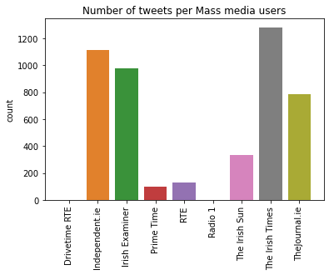
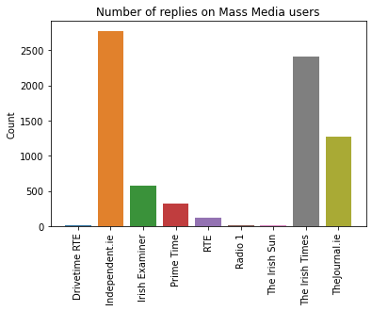

Slide 14
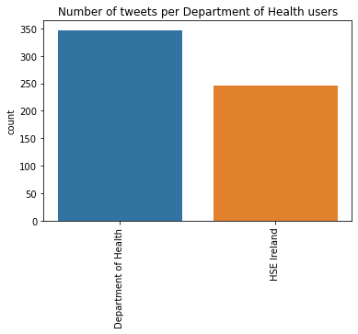
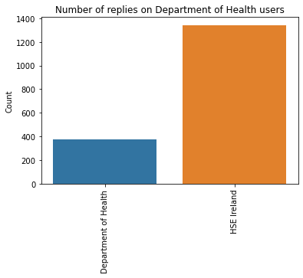

Slide 15
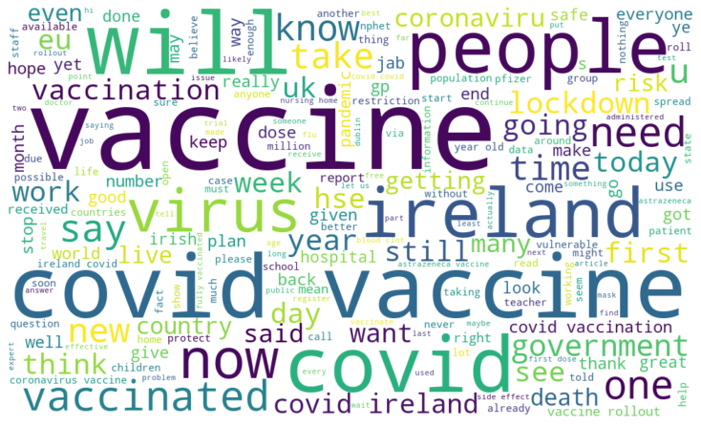

Slide 16
Starting
point
Data Collection
Data Preparation
Data Exploration
Labelling
Data
Modelling
Ending
point
Deployment
Evaluation

Slide 17
Data Collection Main tasks
Write main code to connect to API
Start process of collection
Design batches
Design code to read batches and build queries

Slide 18
Data collection process
Start
Obtain batch list to automatically design queries
Build URL to connect to endpoint
Call Twitter API
Is there a batch?
No
End
Build query according to batch definition and date in process
Save JSON response into folder
No
Yes
Yes
Date in process <= today?
Date in process is 2020-01-01
Increase date in process in one day
Register request and batch info into DB

Slide 19
Data Preparation
Access to file repository from DB and get list of JSON files.
Insert user, place and referenced tweet into DB
Upgrade table to indicate
Clean and normalize tweet
Insert tweet into DB
Start again until date in process is equal to today

Slide 20
Labelling process
Start
According to score and threshold, label tweets
Save label into database
Select cleaned global tweets from DB
Get compound score using VADER
Next tweet
Yes
Is there unlabelled tweets?
No
End

Slide 21
Modelling process Based model
Remove duplicated tweets
Remove tweets less or equal to two-length.
To deal with imbalance distribution, resample dataset
Split data into train (70%) and test (30%).
Pipeline
TfidfVectorizer
SGDClassifier
Default
n-gram = 1
With
loss = 'hinge’ for linear SVM
Default
TDF = True

Slide 22








Slide 23



Heroku hosting (USA*)
Database (MX*)
Dash APP
MySQL
Full-archive search endpoint
Migration to remote DB
Daily tweets collector
Scrapping covid vaccine dates
Twitter API
Classify using my_sentiment_model.sav
Cleaning and normalization process
Python script
Localhost(IE*)

