Slide 1
Screencast
MSc Data Analytics
Karla Cepeda – D00242569
Dissertation 2021

Slide 2
Sentiment Analysis on COVID-19 vaccines in Ireland
Identify the sentiment on the Covid-19 vaccines in Ireland.
Collect tweets from 1 January 2020 to 13 August 2021.
Train and test a ML model to classify tweets.

Slide 3
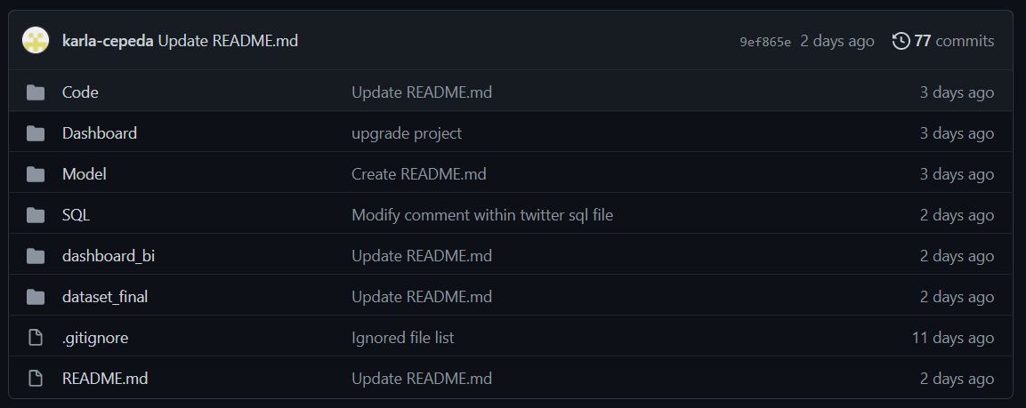
Structure of the project

Slide 4
Structure of the code
To organize the code, a three-layer architecture has been used. This is a well-established software application architecture that organizes applications into three layers.
Presentation Layer
Logic
Layer
Data Access
Layer
Class Layer
Configuration Layer
Notes:
Presentation layer. This is the user interface.
Logic layer. This is were data is processed
Data access layer. This is were data is stored and managed.
Other layers:
Class layer. Includes generic classes and methods.
Configuration layer. Contains all credentials and constant values.

Slide 5
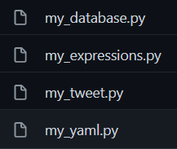
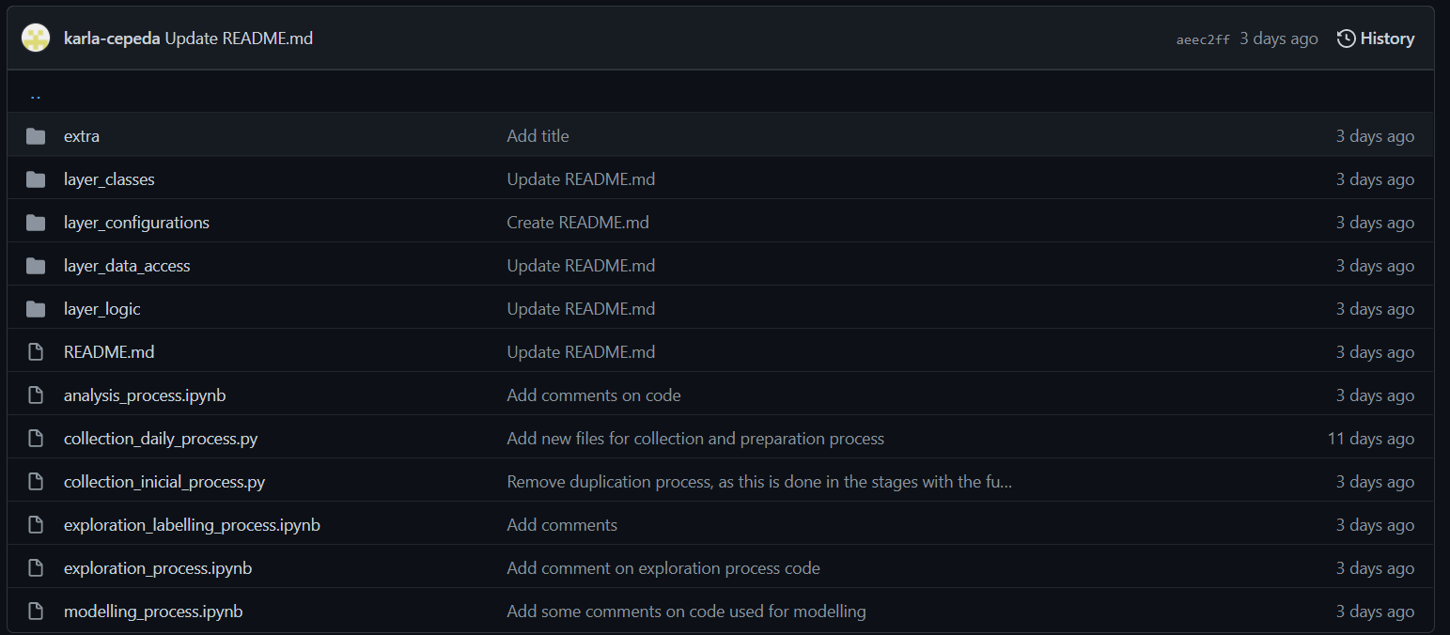


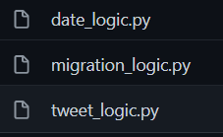
Structure of the code

Slide 6
Structure of the code
Presentation Layer

Slide 7
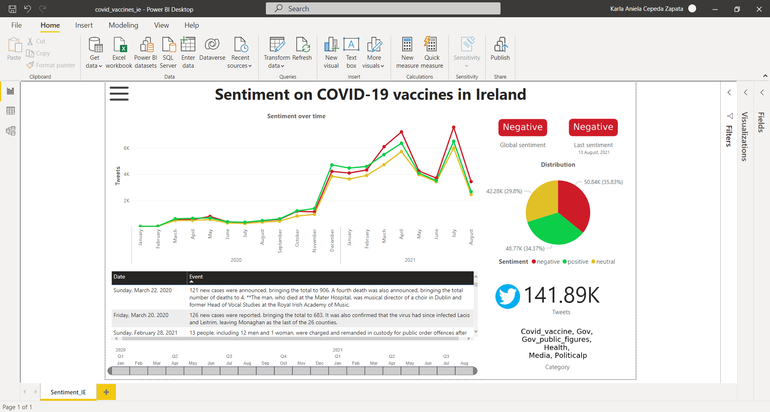
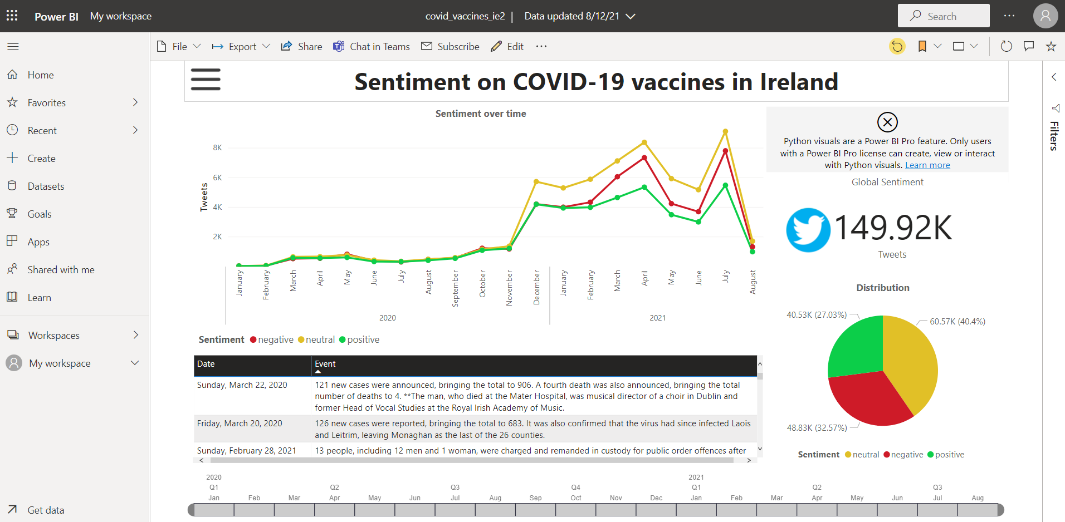
Dashboard (Power BI)

Slide 8



Dashboard (Dash)
Heroku hosting (USA*)
Database (MX*)
Dash APP
MySQL
Full-archive search endpoint
Migration to remote DB
Daily tweets collector
Scrapping covid vaccine dates
Twitter API
Classify using my_sentiment_model.sav
Cleaning and normalization process
Python script
Localhost(IE*)

