Slide 1
Pet Feeder
Boga Karla
Gota Timeea
Michliuc Cristina
Toader Diana

Slide 2
What it does?
We have a smart pet feeder equipped with a ultrasonic sensor that detects when my pet is nearby. When detected, the system weighs the food in the bowl using a weight sensor. If the food level is insufficient, the feeder's door opens to dispense more food until the desired weight is reached. Additionally, a photoresistor monitors ambient light levels to detect nighttime conditions. If it’s dark and the pet approaches, an LED light automatically turns on to provide visibility. This ensures my pet is fed appropriately, regardless of the time of day.

Slide 3
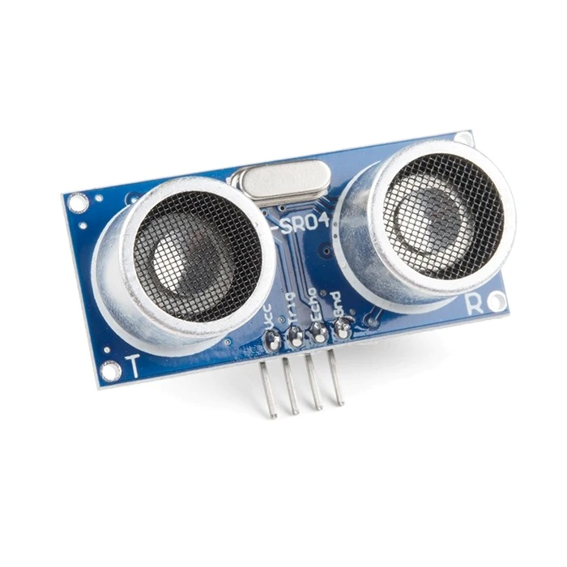
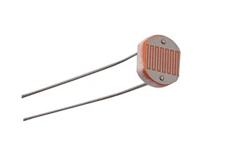
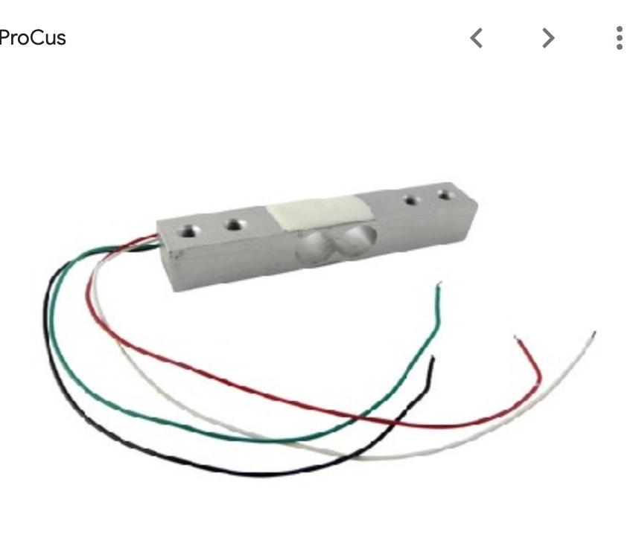
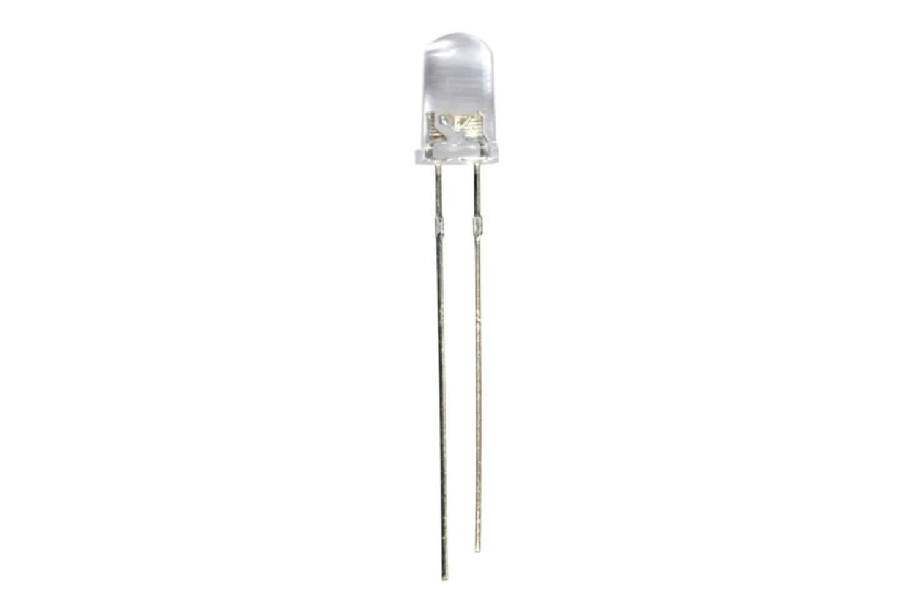
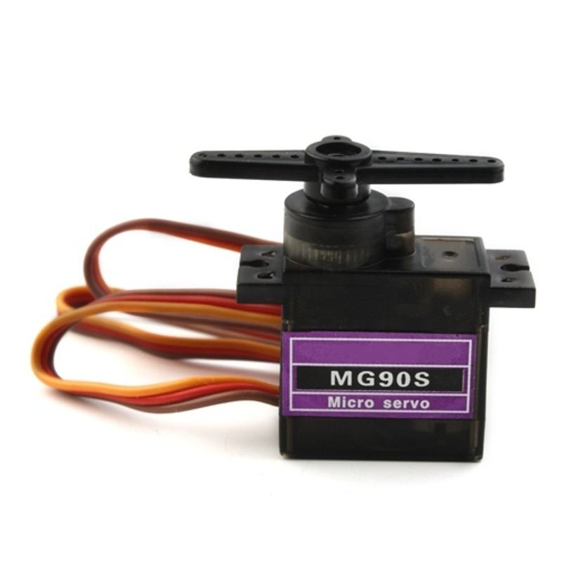
Components
Ultrasonic Sensor
Photoresistor
Weight Senzor
LED
Servo Motor
To detect when the pet approaches the bowl
To detect when it is night
To weigh the amount of food
To light up the bowl at night
To open and close the pet feeder door

Slide 4
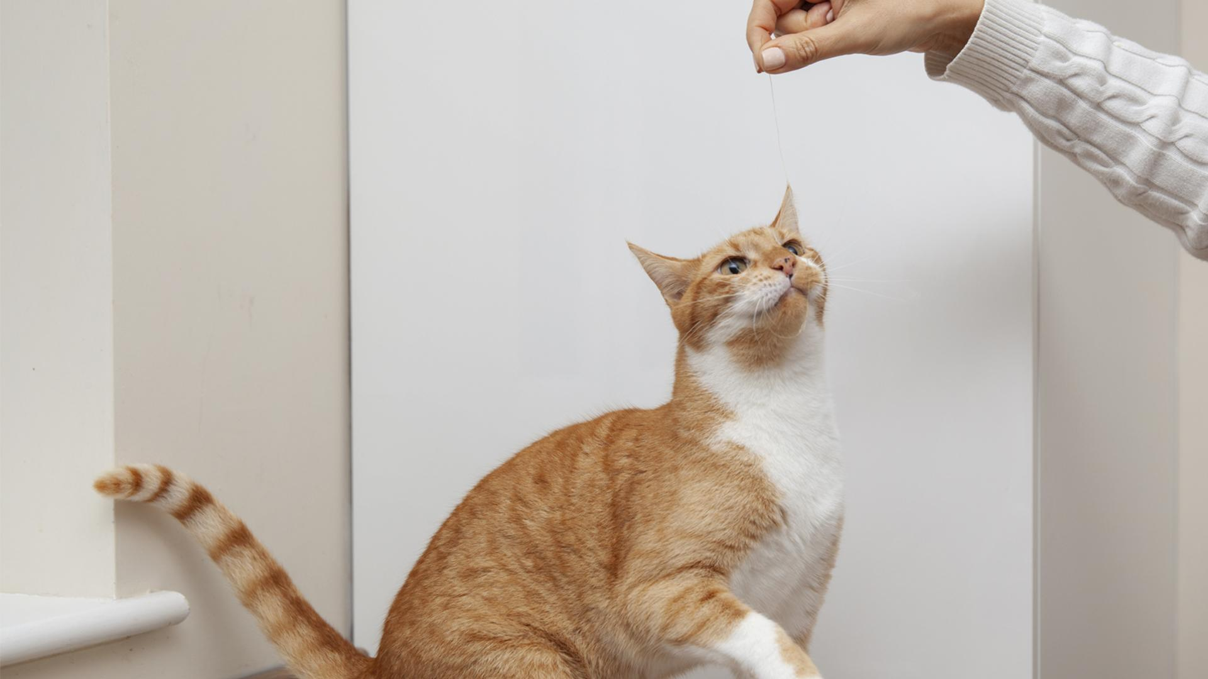
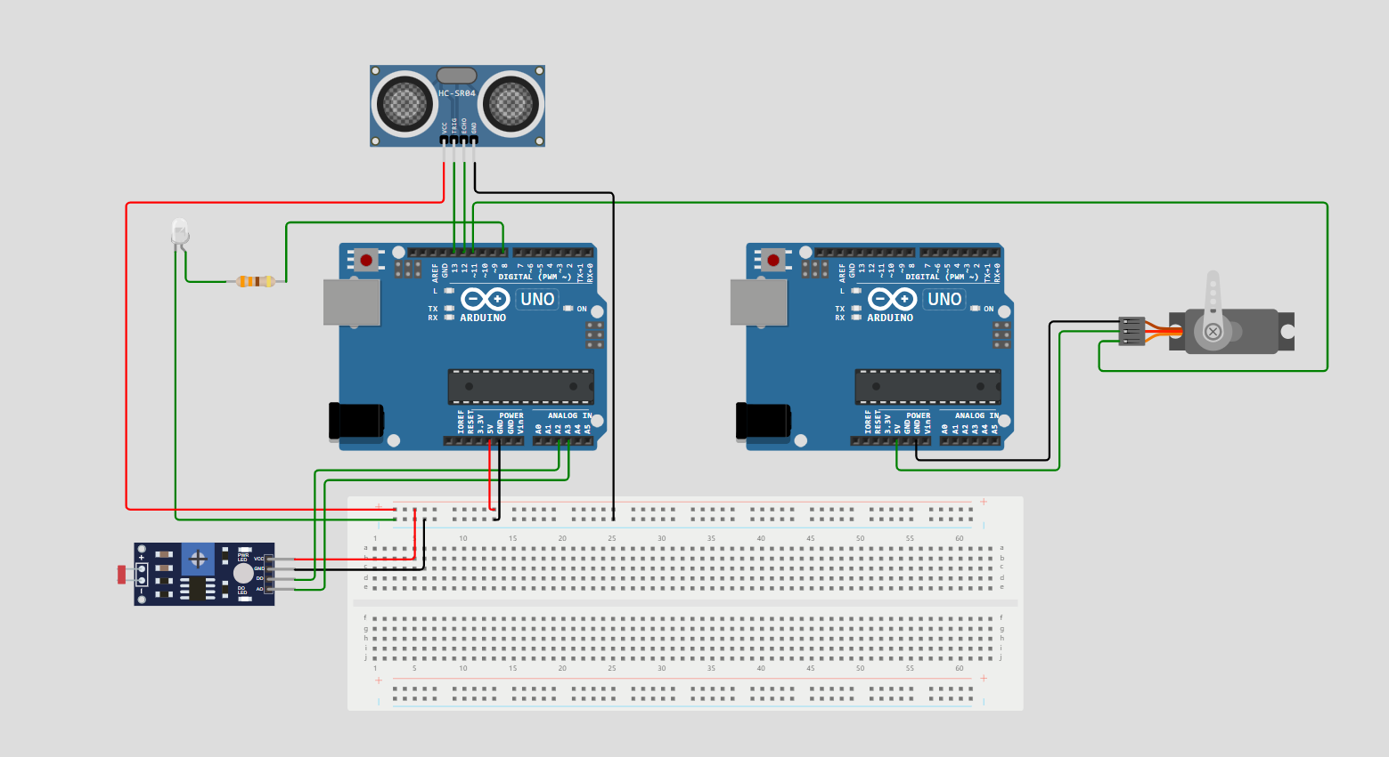
A picture is worth a thousand words
Electrical Scheme:
This is not very accurate because we didn’t find th weight sensor in wokwi.

Slide 5
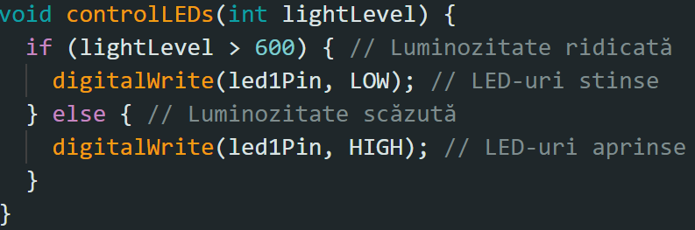
LED’s setup

Slide 6
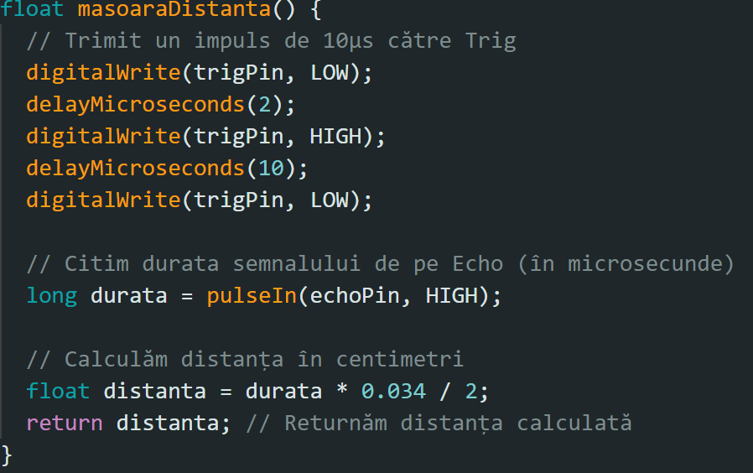
Ultrasonic Sensor’s Setup

Slide 7
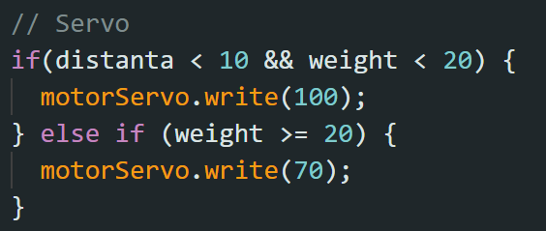
Main Loop

Slide 8
Conclusions
In conclusion, this project ensures that your animal has food both day and night without having to get out of bed to feed it.
Improvements:
we can bring to this project can be the addition of a timer that activates the door of the pet feeder only after a period of time. In this way, we no longer risk fattening the pet.
we can add a 7 segment display to show the quantity of the food delivered in the bowl.

Slide 9
Thank You!

