Slide 1



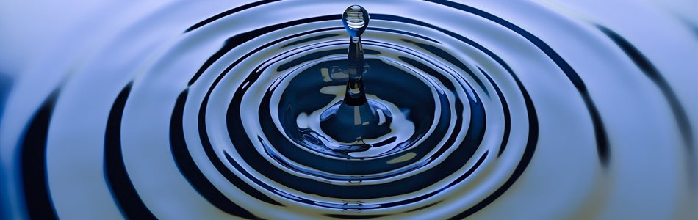
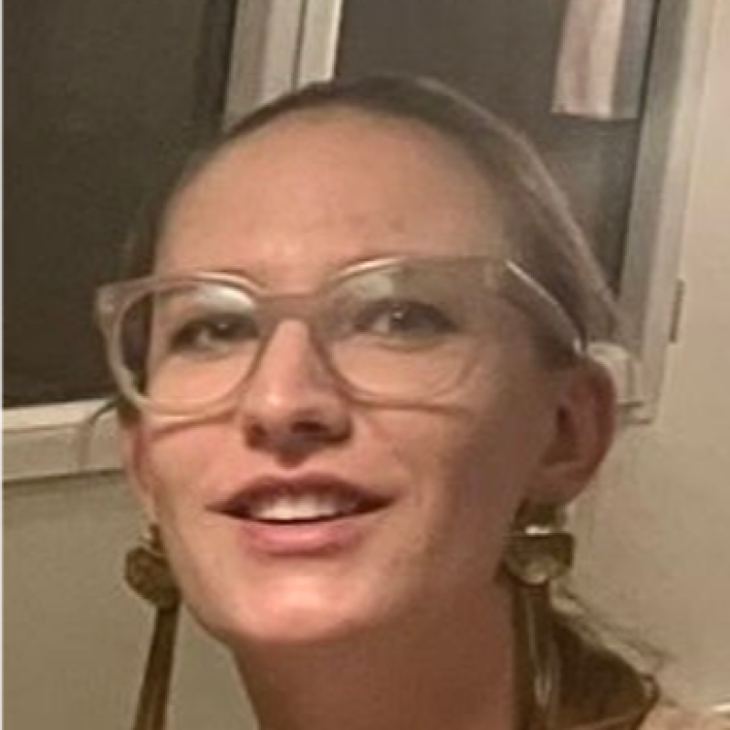
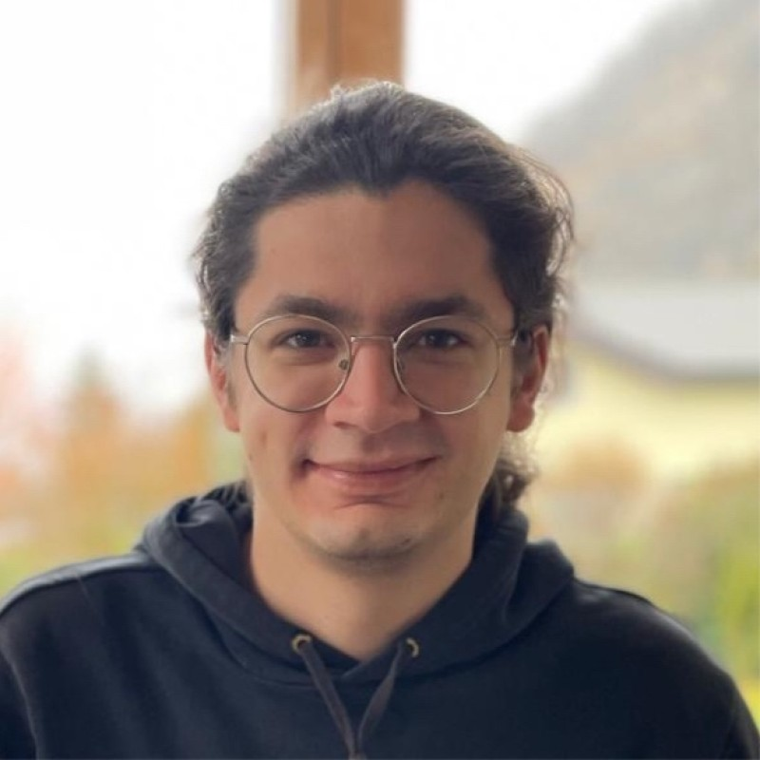
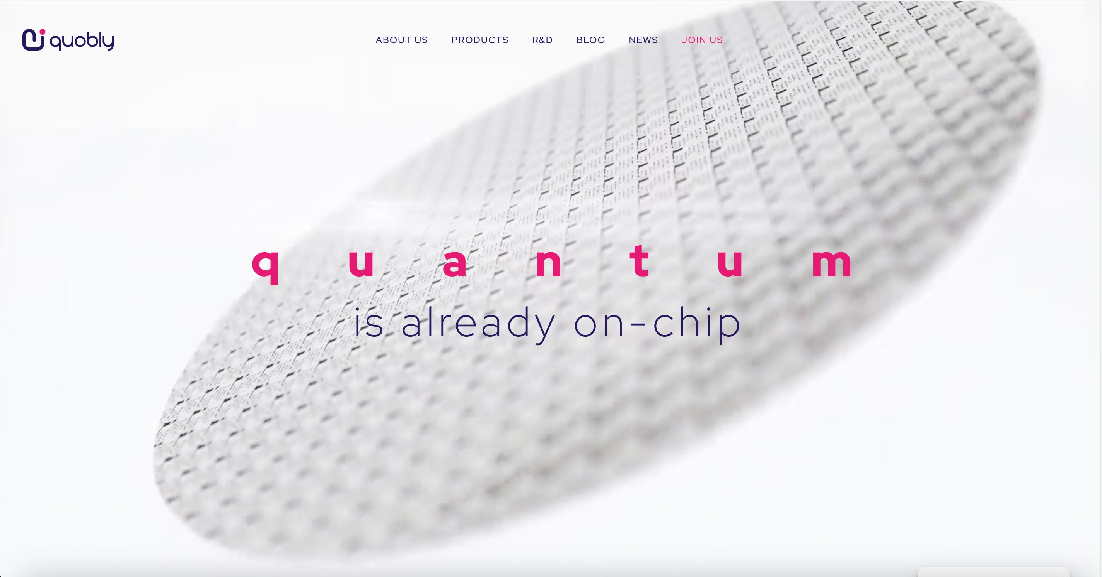
Teratec Masterclass:
Quantum Computing for Multiphysics Simulation
Romain Logean
Silicon Spin Qubits
Karla Baumann
Fluid Dynamics
[October 20, 2026] | [14h-16h CET ]
Quantum Solutions
Karla BAUMANN
Quantum Solutions Architect
Romain LOGEAN
Quantum Solutions Architect
Notes:
Event announcement template. Replace bracketed placeholders: title, date and time, speaker photos, names and roles, and the four use-case cards.

Slide 2
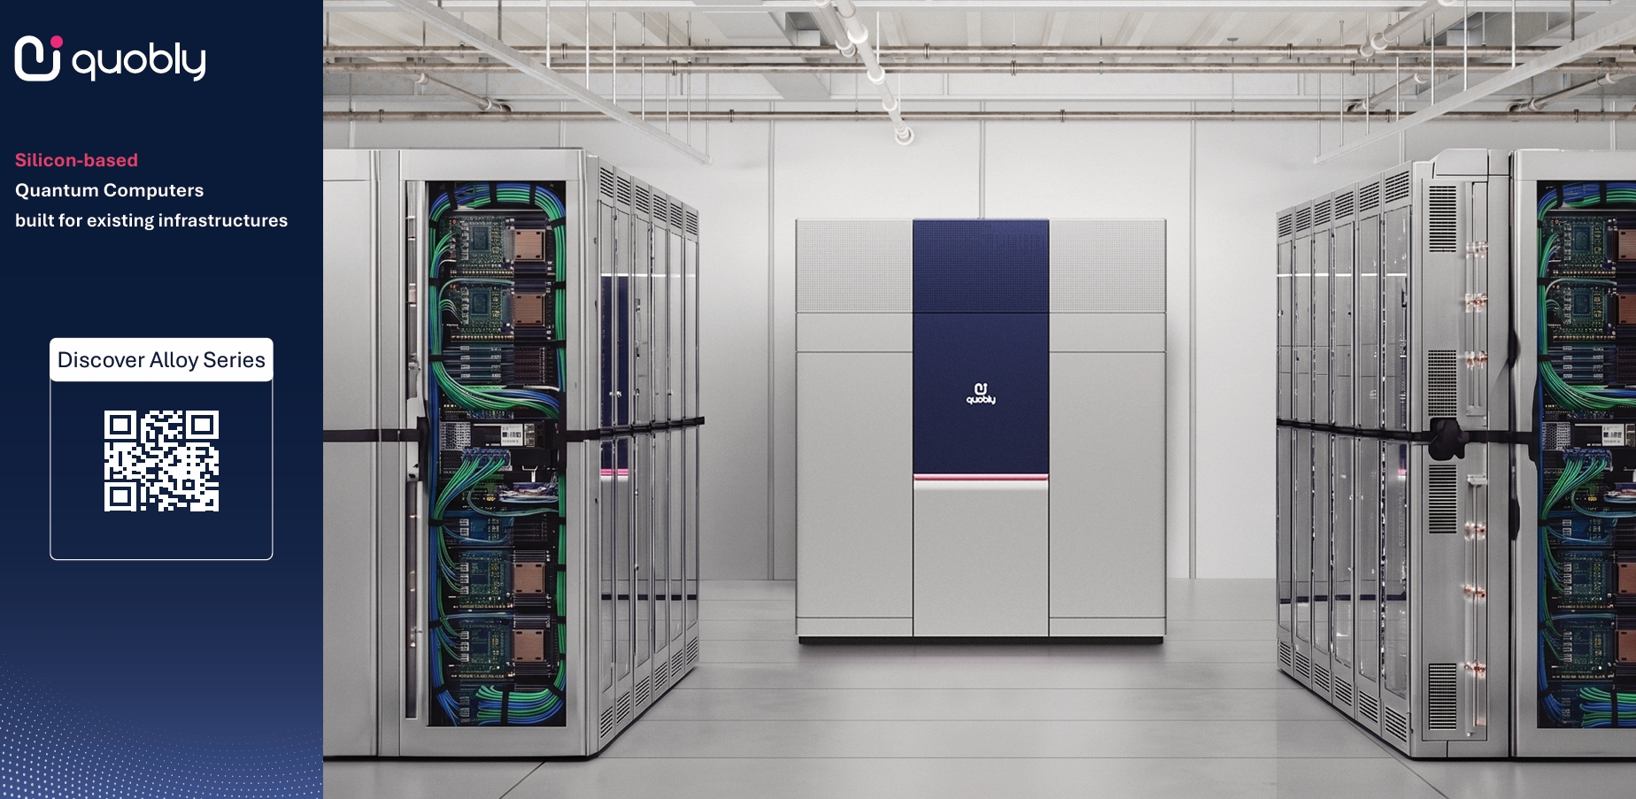

Slide 3

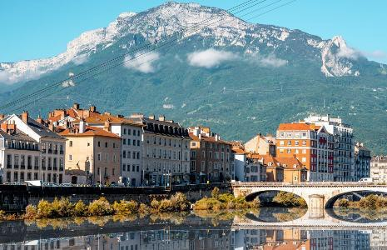
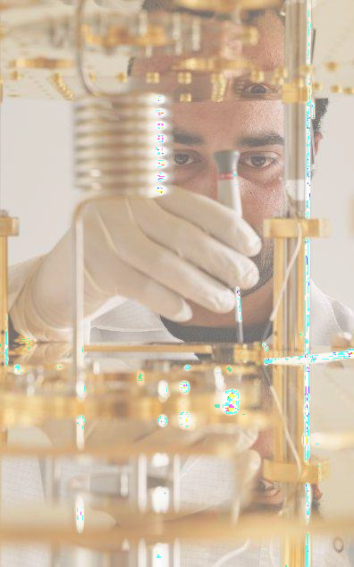
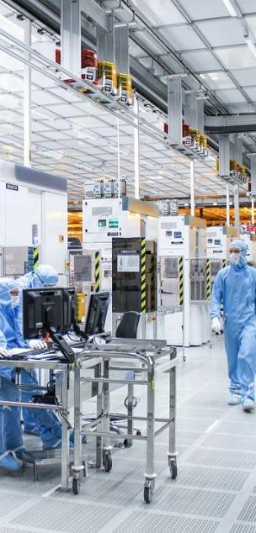



Quobly in 2026
120+
5^{Locations}
Grenoble FR (HQ) Paris FR Sherbrooke CA Singapore
Taiwan
Headquarters in Grenoble, France
Spin-off in 2022 from
People
3
X
By mid 2028
€10M
Revenue
First commercial contract
through PROQCIMA
54%
20+
65
PhDs
Exclusive partnership to develop our proprietary QSOI® qubit technology
and produce million-
qubit chips
18
partnerships
Patents families
Nationalities
June 2026: Quobly secures 115M€

Slide 4
Agenda
01
Context and overview
[Karla Baumann]
[10:00]
02
Algorithmic foundation
[Karla Baumann]
[40:00]
03
[Romain Logean and Karla Baumann]
[65:00]
Differential equations on silicon spin qubits:
a hands-on tutorial
04
Conclusions
[Karla Baumann]
[05:00]
Notes:
Agenda template with five rows. Delete or duplicate rows as needed.

Slide 5
Context and Overview
01
Why are we interested in quantum computing for mulitphysics simulation and what is happening
Notes:
Section divider template.

Slide 6
Why quantum? The simple version
Simulating physics means keeping track of an enormous number of values
CLASSICAL COMPUTER
QUANTUM COMPUTER
More detail, many more numbers
Every qubit doubles the capacity
1 qubit
2 values
10 qubits
1,024
20 qubits
≈ 1 million
16 cells
64 cells
256 cells
30 qubits
≈ 1 billion
Halve the cell size in 3D and you need 8× more cells
50 qubits
≈ 1 quadrillion
MULTI-SCALE
nm
µm
mm
m
9 orders of magnitude, one model
Classical codes resolve one scale, model the rest
atoms
grains, eddies
cracks, droplets
wings, engines
Classical: add hardware, add capacity. Quantum: add one qubit, double it.
Notes:
Plain-language version. Left: a simulation chops space into cells and stores numbers for each one; finer detail multiplies the cells (2D: halving cell size gives 4x the cells, as drawn; 3D gives 8x). Today's largest supercomputers already draw tens of megawatts to do this (TOP500 June 2026: the No. 1 system uses 42 MW).
Right: n qubits describe 2^n values at once, so each extra qubit doubles the capacity. 2^10 = 1,024; 2^20 ≈ 1.05 million; 2^30 ≈ 1.07 billion; 2^50 ≈ 1.13 quadrillion (storing that classically would take about 18 PB). Bar lengths grow with the number of qubits; the values double with each one.
Multi-scale: real problems couple scales from nanometres (atoms, molecules) to metres (wings, engines, plants), about 9 orders of magnitude. Classical solvers cannot resolve all of them at once, so they resolve one scale and model the others (turbulence models, homogenised materials). Because quantum capacity grows exponentially, fine and coarse scales could share one encoding; this is a research goal, not yet demonstrated at scale.
If asked: you cannot read all 2^n values back out; quantum algorithms are designed to return the specific quantities you need, such as drag, average velocity or energy.

Slide 7
Why quantum-accelerated multi-physics simulation
Differential equations describe almost every physical system; the hardest classes exceed classical compute
01 · LINEAR
02 · NONLINEAR
03 · STOCHASTIC
Linear PDEs and ODEs
Nonlinear PDEs
Stochastic DEs
Equations Heat/diffusion, wave, Poisson, Maxwell, Schrödinger
Equations Navier–Stokes, Burgers, reaction–diffusion, nonlinear elasticity, MHD
Equations Langevin, Fokker–Planck / Kolmogorov, stochastic Navier–Stokes, Black–Scholes
Models Heat transfer, acoustics, electromagnetics, structural vibration, pressure solves
Models Turbulence, aerodynamics, combustion, fracture and large deformation, plasma
Models Noisy turbulence, weather and climate ensembles, molecular dynamics, risk and uncertainty
Native fit: Hamiltonian simulation and quantum linear-system solvers
Embed in a larger linear system: Carleman, Koopman–von Neumann, lattice Boltzmann
Kolmogorov embedding: linear in observable space; dissipation and noise keep it efficient
Increasing difficulty: nonlinearity, dissipation, noise →
Re^{9/4}
Grid points to resolve 3D turbulence directly; cost explodes at industrial Reynolds numbers
2^{n} → n
Grid values stored in the amplitudes of only n qubits
poly(log N)
Cost of provable algorithms for observables, under stated conditions
Notes:
Message: almost every engineering simulation is a differential equation, and the classes move from linear (native to quantum hardware) through nonlinear (needs embedding) to stochastic (where the Kolmogorov approach turns noise and dissipation into an advantage).
Bottom row: (1) Direct numerical simulation of 3D turbulence needs about Re^(9/4) grid points (Kolmogorov scaling; see Pope, Turbulent Flows, 2000). (2) Amplitude encoding stores 2^n values in n qubits; reading them all out is not possible, so algorithms target observables. (3) Poly(log N) cost holds only under conditions such as dissipativity, sparsity and noise (Berry et al., Commun. Math. Phys. 2017; Liu et al., PNAS 2021; Bravyi et al., arXiv:2507.06198).

Slide 8
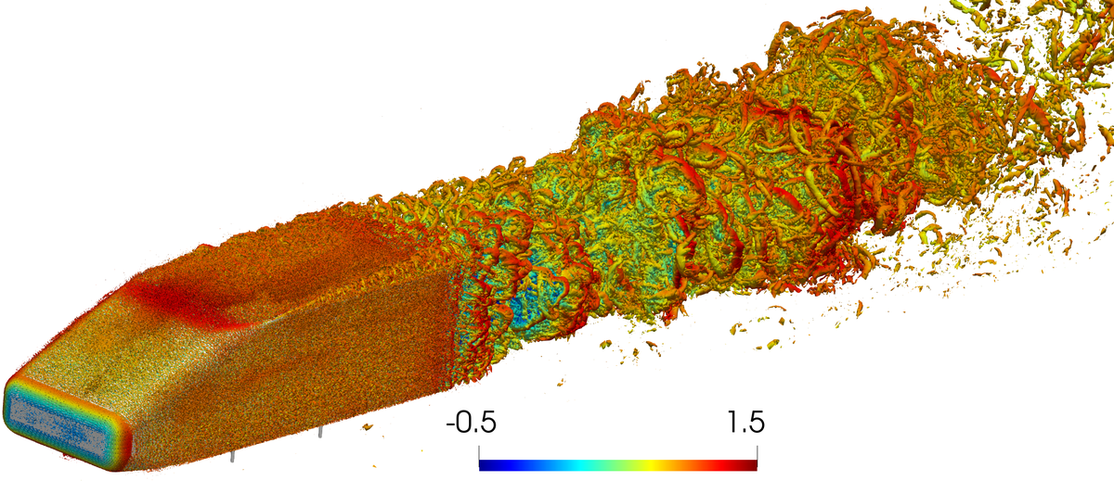
Fluid turbulence
Highly turbulent regimes are beyond the capacity of classical computers (also future generations)
Navier–Stokes turbulence is a challenging nonlinear dissipative system.
Re ~ 10⁸
Re ~ 10⁴
N ∝ Re²
Range of scales accurate simulations must resolve
What current methods reach
Approximate scaling of the number of degrees of freedom

Slide 9


What is happening in quantum-based simulation
CFD and partial differential equations on real quantum computers
01
First nonlinear partial differential equation solved
SCALE RESULTS
Using VQA-based spectral methods with QUICK-PDE, a Qiskit Function by ColibriTD, running on 50+ qubit chips (IBM Heron)
Inviscid Burgers equation, Euler equation, and material deformation
Ansys, working with NVIDIA's CUDA-Q platform, simulated uniform advection-diffusion of a 2D sinusoid
02
First real CFD hardware demos achieved
Using lattice Boltzmann methods: 3D fluid simulations now running on 50+ qubit chips (IBM Heron R3)
39
262,144 × 262,144
qubits
grid
Nonlinear Navier–Stokes flow with obstacles demonstrated
Near-term quantum computer simulations: 2D Poiseuille flow and an unsteady acoustic wave
03
Quantum remeshing and efficient encoding for fracture mechanics
<0.2%
5,043
Method experimentally validated on Quandela's photonic quantum processor Ascella
relative error (Poiseuille)
-dimensional matrix solved (acoustic)
Cracking fracture mechanics on a quantum processor

Slide 10
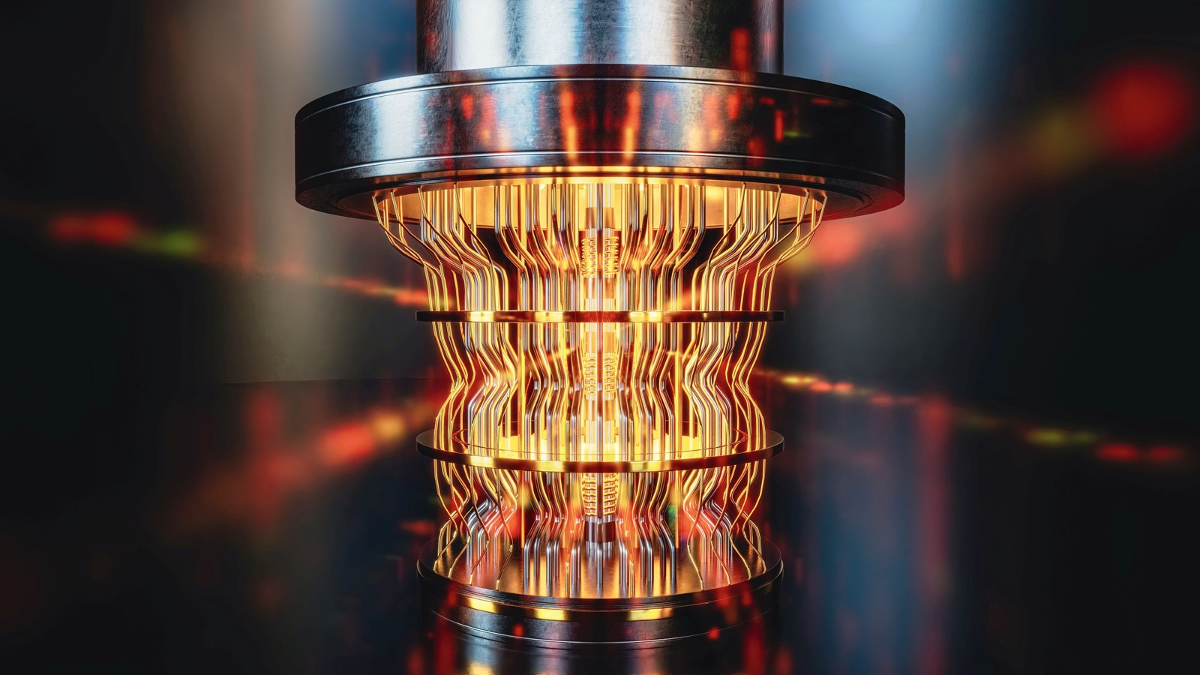
What can a quantum computer handle and what not?
Many classical problems feature two major hurdles for quantum computing:
NONLINEARITY AND NON-UNITARITY (DISSIPATION)
Nonlinearity
Dephasing
Loss of orthogonality
Loss of information
Inevitable problem at high Reynolds number
Dissipation cannot be dealt with exactly by deterministic unitaries
But quantum computers are fundamentally linear and unitary machines

Slide 11
Algorithmic Foundation
02
What enables quantum-accelarated multiphysics simulation
Notes:
Section divider template.

Slide 12
The basic toolbox
From nonlinear PDE to quantum algorithm
1
2
3
4
Linearize
Solve linear ODE
Building blocks
Readout
Embed the nonlinear system in a larger linear one
Turn dx/dt = Ax + b into unitary operations
Access the matrix A and evolve under it
Extract only the quantities needed
Carleman
LCHS
Block encoding
Expectation values
Koopman–von Neumann
Schrödingerisation
QSP / QSVT
Amplitude estimation
Lattice Boltzmann + Carleman
Linear-system solvers
Hamiltonian simulation
Correlation functions
Main cost drivers: linearization error, norm of A × simulation time, stability of A, state preparation and readout.
Notes:
Walk left to right. Linearization trades nonlinearity for dimension; Carleman converges for dissipative, weakly nonlinear systems, and the lattice Boltzmann form keeps the nonlinearity tied to the Mach number. Step 2 maps the linear, generally non-unitary ODE onto unitary evolution: LCHS writes it as a linear combination of Hamiltonian simulations, Schrödingerisation as a Schrödinger equation in one extra dimension. Step 3 is the hardware-facing layer: block encodings of A, QSP/QSVT and Hamiltonian simulation, which is where the SDK example later connects. Step 4: we never read out the full state, only observables.

Slide 13
Essential references
TOOL | AUTHORS | REFERENCE
Carleman (dissipative) | Liu, Kolden, Krovi, …, Childs | PNAS 118, e2026805118 (2021)
Koopman–von Neumann | Joseph | Phys. Rev. Research 2, 043102 (2020)
Lattice Boltzmann + Carleman | Sanavio, Succi | AVS Quantum Sci. 6, 023802 (2024)
LCHS | An, Liu, Lin | PRL 131, 150603 (2023)
Schrödingerisation | Jin, Liu, Yu | PRL 133, 230602 (2024)
Linear ODEs via QLSA | Berry, Childs, Ostrander, Wang | Commun. Math. Phys. 356, 1057 (2017)
Optimal linear solver | Costa et al. | PRX Quantum 3, 040303 (2022)
Block encoding, QSVT | Gilyén, Su, Low, Wiebe | STOC 2019, 193–204
Qubitization | Low, Chuang | Quantum 3, 163 (2019)
Stochastic nonlinear ODEs | Bravyi, Byrne, Zayats, Zhuk | arXiv:2606.08349 (2026)
Review | Tennie, Laizet, Lloyd, Magri | Nat. Rev. Phys. 7, 220 (2025)
Best single entry point: the review
Notes:
One key reference per tool, in the order of the pipeline. The Tennie et al. review in Nature Reviews Physics is the best single entry point for the audience.

Slide 14
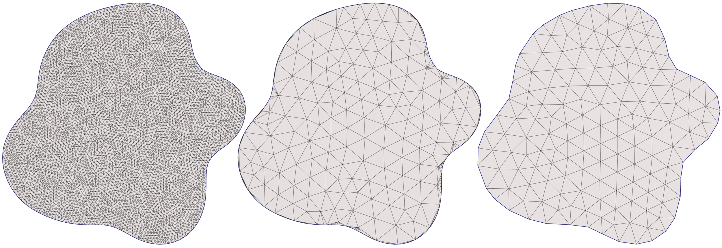
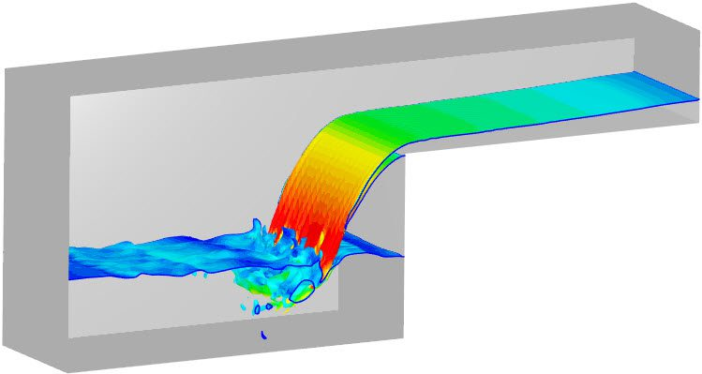
Quantum-enhanced simulation
Quantum offers speed-up
Meshing–remeshing
Quantum encoding strategy is solver-independent
Meshing = mapping a discretized physical grid to qubit amplitudes (works for any algorithm: VQA, QPE, QSVT)
Remeshing = cheap, fixed unitary upgrading solution/state from coarse grid to initial state for finer grid (also solver-independent: state-preparation subroutine)
QLBM
Local, lattice-based, naturally suited to multiphase/interface problems
Kolmogorov/Hamiltonian-based
A quantum advantage for highly nonlinear and dissipative problems, suitable for turbulence

Slide 15
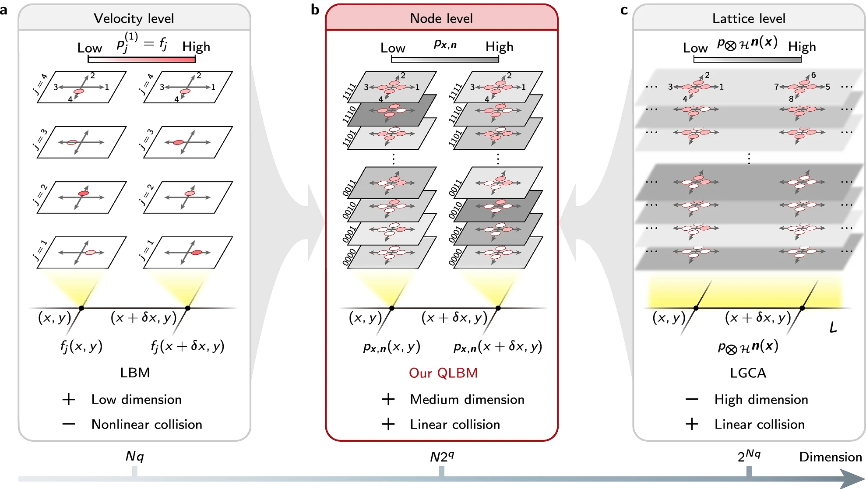
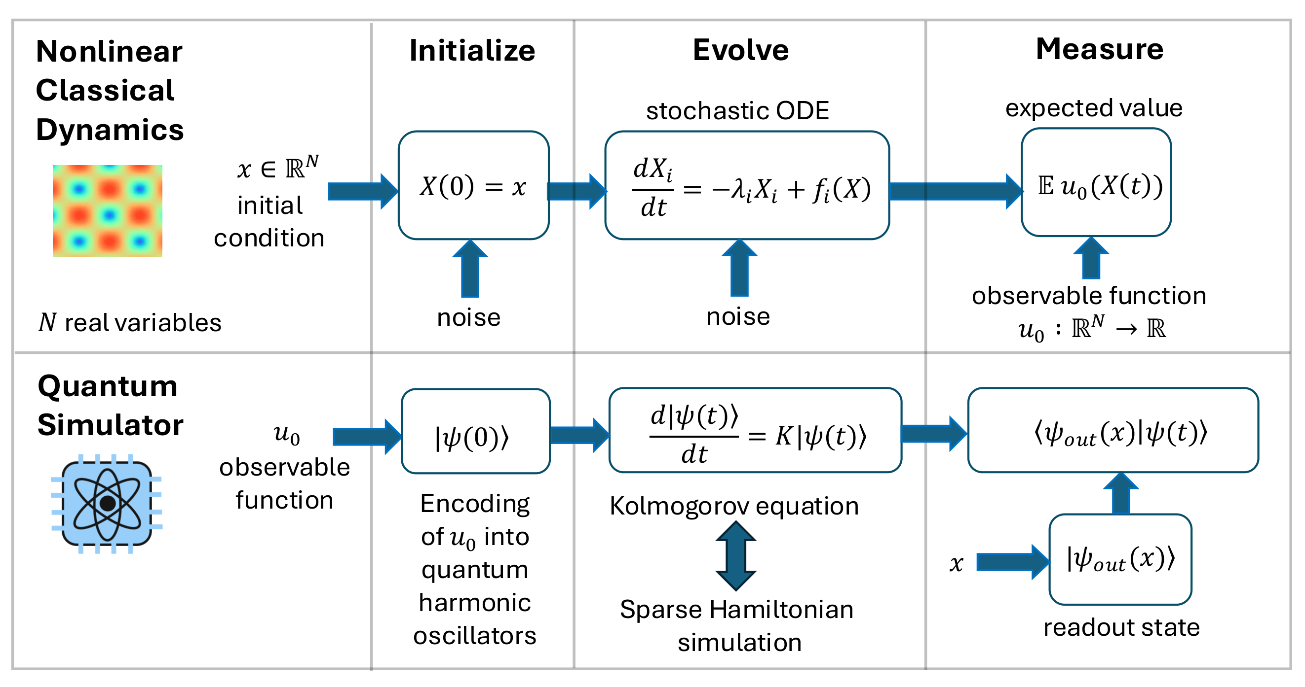
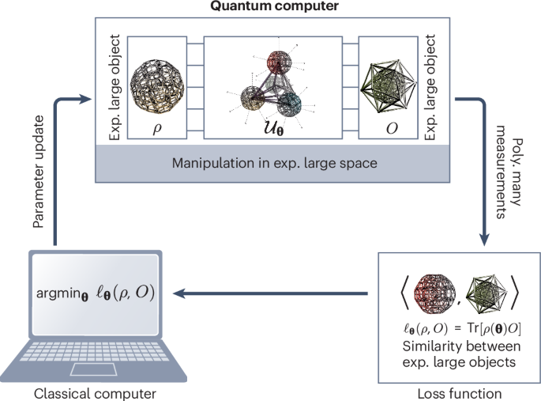
Quantum approaches for multiphysics simulation
QUANTUM NATIVE
QUANTUM NATIVE
HYBRID QUANTUM-CLASSICAL
Lattice Boltzmann Method (LBM)
Kolmogorian Simulation (KS)
Variational Quantum Algorithms (VQA)
Its algebraic structure maps naturally to quantum hardware, possibly replacing traditional mesh-based solvers
Embeds the backward Kolmogorov equation into the Fock space of N quantum harmonic oscillators via second quantization. The generator K = −A + B + C is sparse, enabling efficient Hamiltonian simulation on a quantum computer.
Quantum handles the linear algebra bottleneck (Poisson/pressure solve, ~90% of classical compute time); classical handles the rest. Suitable for meshing–remeshing techniques.

Slide 16
Quantum approaches for multiphysics simulation
CLASSICAL LATTICE BOLTZMANN METHODS
FTQC · QUANTUM NATIVE
Simulate fluid flow by tracking particle distribution functions on a discrete lattice
Distributions are evolved through streaming and collision steps
Recovers the Navier–Stokes equations in the continuous limit
Lattice Boltzmann Method (LBM)
Leading quantum-native approach
Its algebraic structure maps naturally to quantum hardware, replacing traditional mesh-based solvers
Quantum offers speed-up
2^{n} lattice sites
encoded in n qubits
Computationally very expensive!
Represents the distribution function across many lattice sites in a superposition

Slide 17
Quantum Lattice Boltzmann Method for fluid dynamics
Streaming is naturally unitary; collision is the quantized bottleneck
PER-TIMESTEP QUANTUM CIRCUIT LOOP
Why LBM suits quantum circuits
1
Encode: Distribution functions f_{i} written into qubit amplitudes via Ry rotation gates
Unlike Navier–Stokes, LBM's nonlinearity (collision) and nonlocality (streaming) are decoupled. Streaming is nonlocal but linear, collision is nonlinear but purely local. This separation is what makes LBM more quantum-tractable than attacking Navier–Stokes directly.
2
Collide: Nonlinear, non-unitary relaxation toward equilibrium, handled via SVD+LCU, Carleman linearization, or block-encoding
Current empirical status
3
Stream: Exactly unitary; conditional shift / SWAP operations move f_{i} to neighboring lattice sites, no approximation needed
Validated benchmarks: Couette & Poiseuille flow (Qiskit); ~11–13 qubits, circuit depth 5,000–20,000 depending on grid resolution
Turbulent demo: vortex-pair merging (Re = 350) and 2D decaying isotropic turbulence (Re = 51) via hybrid LGCA-style collision
4
Measure: Extract macroscopic density & velocity via limited observables (full tomography is prohibitive)
Bottleneck: circuit depth (collision + measurement/re-encoding), not qubit count; qubits scale only logarithmically with grid size
5
Reinitialize: Re-prepare the quantum state for the next timestep. State does not persist coherently across steps
Bottom line: real, benchmarked progress, but depths in the 10⁴ range mean today's pilots should target small, simplified 1D/2D cases, not full 3D flows.

Slide 18
Non-linear dynamics, turbulence, and Navier–Stokes
« Here we show that strongly nonlinear (R≫1) classical dynamics with a quadratic nonlinearity can be efficiently simulated on a quantum computer provided that the simulated system is both dissipative and noisy. »
Efficient quantum simulation of strongly nonlinear stochastic dynamics
New Kolmogorov-equation embedding and regularization framework
Poly(log N), polynomial-in-t quantum algorithm for observables
Applicable to turbulence models (2D Navier–Stokes vortex flow)
Strong evidence for a quantum advantage / BQP-completeness
[Bravyi et al., 2025] arXiv:2507.06198

Slide 19

Efficiency – quantum advantage
Conditions for the algorithm to be efficient
01
02
03
ODE is quadratic, sparse, and divergence-free
The initial condition of the ODE is noisy
Initialization noise rate p is not too small: ‖x‖²/p = O(1)
We are interested in the regime when the number of variables N is large enough that storing the full description of the system and its solution in a classical computer memory is impractical.
[Bravyi et al., 2025] arXiv:2507.06198

Slide 20


Use case: fluid dynamics
2D Navier–Stokes equation (NSE) for incompressible fluid flow
PDE: INFINITE-DIMENSIONAL FUNCTION SPACE
FINITE-DIMENSIONAL QUADRATIC ODE SYSTEM
Galerkin projection
The coefficients c_{ijk} come from Navier–Stokes nonlinearity
Note that incompressible vorticity-formulated NSE is naturally divergence-free, which is exactly the structural condition the algorithm requires.
The basis functions φ_{i} encode spatial structure
Increasing N → better approximation of the PDE
[Bravyi et al., 2025] arXiv:2507.06198

Slide 21
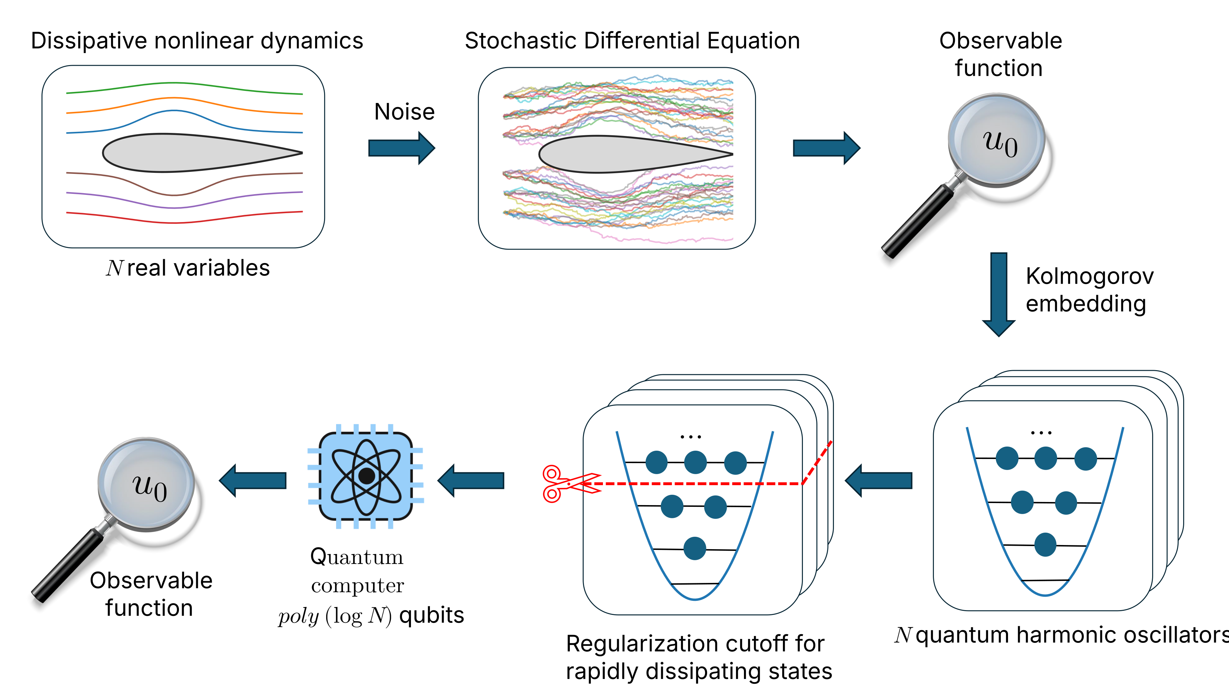
Outlook: follow-up paper
« We call the second-quantized Kolmogorov differential operator the Kolmogorian, in analogy with the Hamiltonian of quantum mechanics. »
NEW RESULT
Drops the sparsity restriction: handles all-to-all interactions, a significant generalization
LIMITATION
BQP-completeness is not reproven for the dense/all-to-all case
"Quantum algorithms for stochastic nonlinear differential equations" by Sergey Bravyi, Adam Byrne, Mykhaylo Zayats, Sergiy Zhuk, submitted 6 June 2026, arXiv:2606.08349

Slide 22
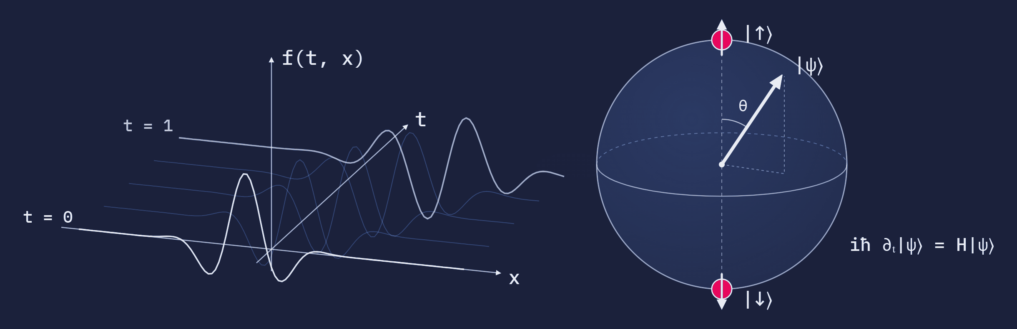
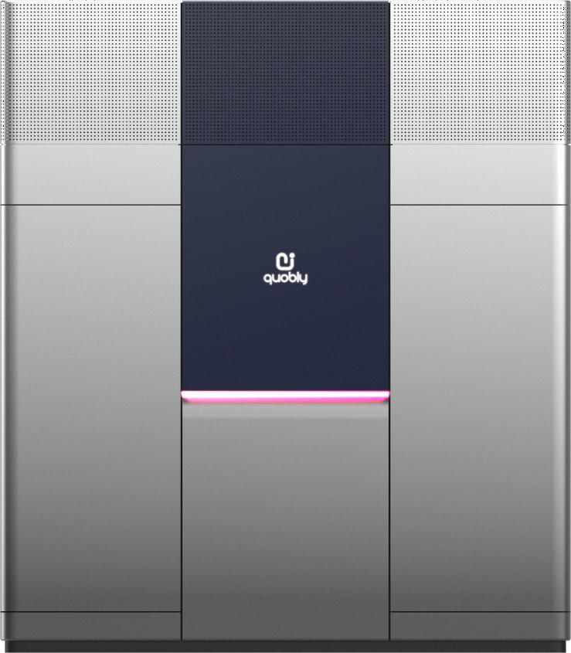
Differential equations on silicon spin qubits
03
SpinPulse examples
Notes:
Section divider template.

Slide 23

Tutorials
Notes:
Section divider template.

Slide 24
An open-source Python package from Quobly: it simulates spin qubit circuits at the pulse level, not the gate level.
Gate-level simulation
SpinPulse — pulse level simulation
Gates are fixed matrices
One Kraus channel per gate, drawn independently
The environment forgets between gates
Gates are control signals with a duration
The device Hamiltonian is integrated under them
One noise trace covers the whole circuit
SpinPulse allows non-Markovian noise simulation, which is not possible with gate-level simulations.
“The SpinPulse library for transpilation and noise-accurate simulation of spin qubit quantum computers” by Benoît Vermersch, Oscar Gravier, Nathan Miscopein, Julia Guignon, Carlos Ramos Marimón, Jonathan Durandau, Matthieu Dartiailh, Tristan Meunier, Valentin Savin, submitted 15 January 2026, arXiv:2601.10435

Slide 25
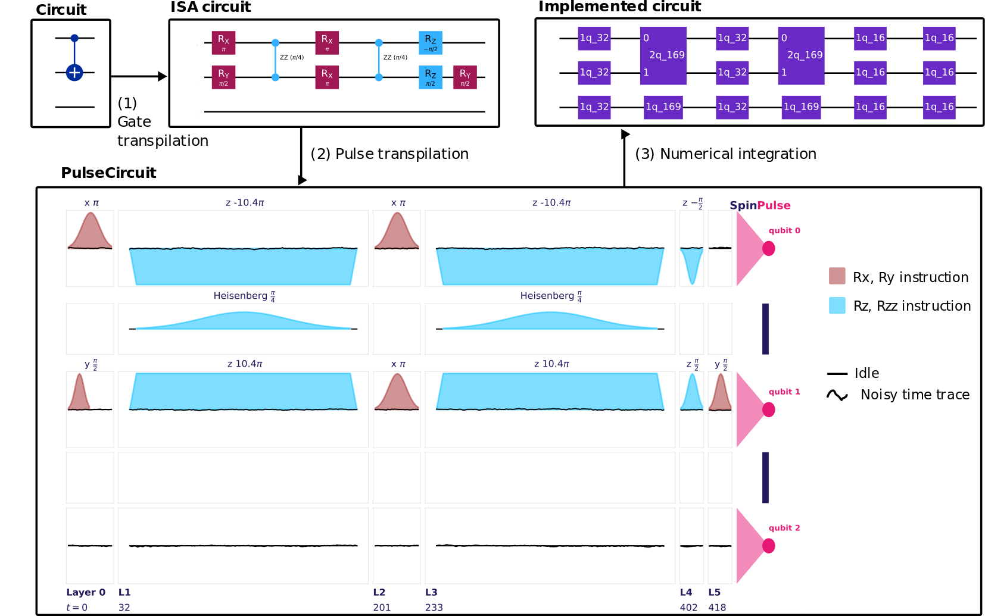
Workflow
(1) Gate transpilation
Rewritten into the native gate set: RX, RY, RZ, RZZ.
(2) Pulse transpilation
Each gate becomes a signal with a duration; idle times synchronize the qubits.
(3) Numerical integration
The Hamiltonian is integrated step by step, noise included.

Slide 26
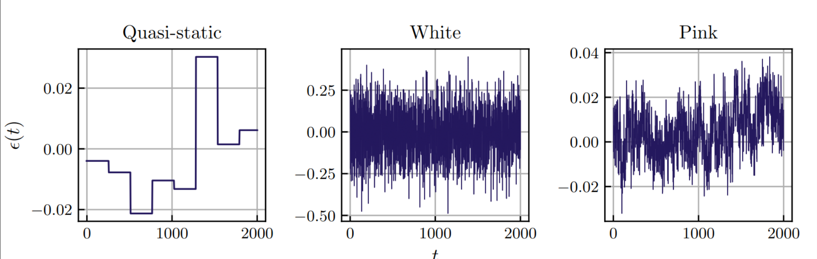
Noise integration
Three noise types are available: quasi-static, white and pink, the 1/f noise that dominates in spin qubits.
Quasi-static noise
White noise
Pink noise
1 — Draw a trace
2 — Simulate on it
3 — Average
A noise trace ε(t) is generated for the whole circuit, with the spectrum of the chosen type.
The circuit is integrated on that trace: every gate sees a consecutive slice of the same ε(t).
A new trace is drawn and the process repeats. Fidelities are averaged over all realizations.
Pink noise has more weight at low frequencies: it drifts over many gates, so their errors are correlated.

Slide 27

Alloy forge and qBraid
Run it in the cloud
qBraid — cloud notebooks with real QPUs and simulators
100 h of free CPU time per month
Alloy Forge — simulator of Quobly's Pioneer QPU
Up to 10 qubits, free
Based on SpinPulse code, with Quobly’s hardware specs already set
You can use Alloy Forge for free, directly on qBraid or by sending your code from your own laptop with an API key.

Slide 28
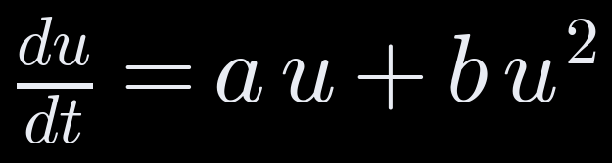
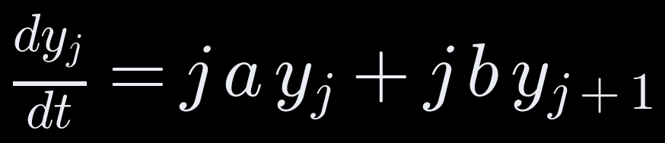
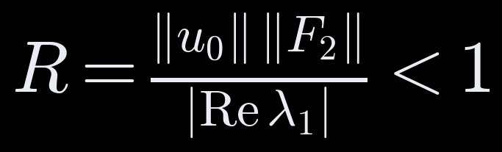
Trade nonlinearity for dimension
STEP 1 · CARLEMAN LINEARIZATION
Introduce yⱼ = uʲ: each power couples only to the next, giving an infinite linear chain
Truncate at order N: dy/dt = A(N)·y, and y₁ approximates u
For a PDE on n grid points: dimension n + n² + … + nᴺ, but only about N·log₂ n qubits
Convergence proven for R < 1: nonlinearity weak compared with dissipation
Liu et al., PNAS 118, e2026805118 (2021)
Live session notebook · Step 1
Notes:
Carleman trades nonlinearity for dimension. Each new variable is a power of the solution, and the chain rule couples power j only to power j+1, so the system is linear but infinite. Truncating gives a finite linear ODE. For PDEs the state is the tensor powers of the discretized field; the dimension explodes, but amplitude encoding needs only logarithmically many qubits. The theorem of Liu et al. guarantees convergence when R is below 1.

Slide 29
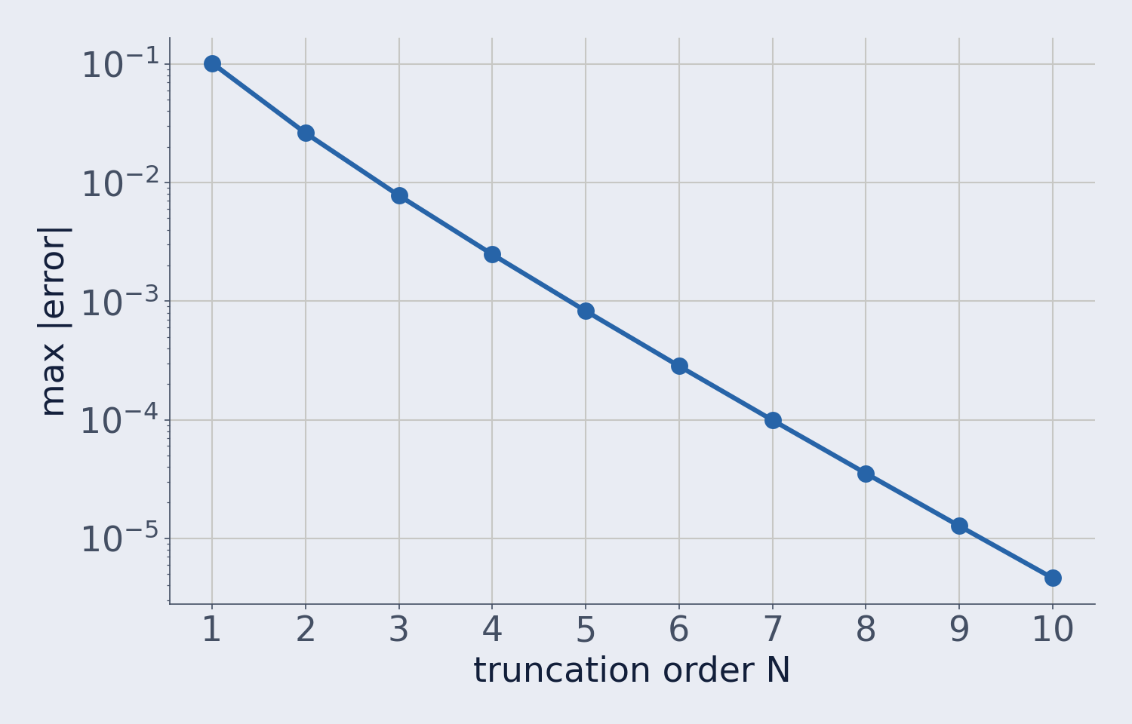
Error falls geometrically with N
STEP 1 · RESULTS
Viscous Burgers, 6 grid points
N | Dimension | Qubits | Rel. error
1 | 6 | 3 | 2.2 × 10⁻¹
2 | 42 | 6 | 8.8 × 10⁻²
3 | 258 | 9 | 3.3 × 10⁻²
4 | 1,554 | 11 | 1.2 × 10⁻²
R ≈ 4.9, outside the theorem, yet the error still falls. R < 1 is sufficient, not necessary: worst-case bounds can overestimate resources.
du/dt = −u + 0.5u², u₀ = 0.8, t ∈ [0, 4]
Live session notebook · Step 1
Notes:
Left: the scalar warm-up. Each extra order cuts the error by about a factor of 3, from 0.1 at N = 1 to 5e-6 at N = 10. Right: the Burgers equation on 6 grid points. The dimension multiplies by 6 per order, while the qubit count grows by about 3. R is about 4.9, well outside the convergence theorem, and still the error decreases: convergence bounds are conservative, so resource estimates based on them can be pessimistic.

Slide 30
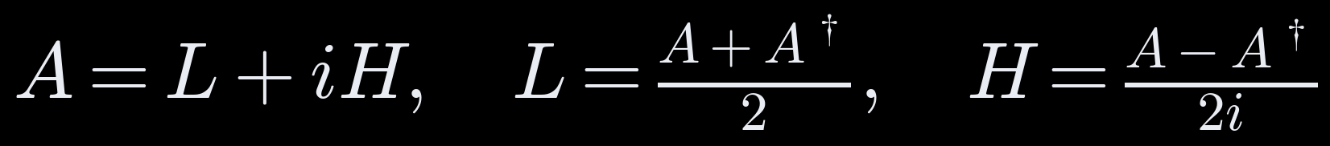
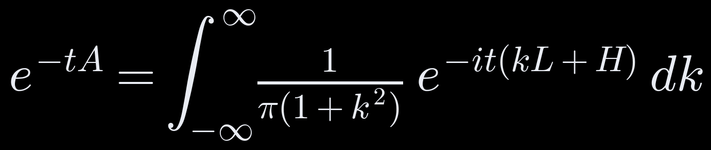
Non-unitary dynamics from unitaries
STEP 2 · LINEAR COMBINATION OF HAMILTONIAN SIMULATIONS
After linearization, dy/dt = −A·y has a non-unitary propagator e^(−tA)
Split A into two Hermitian parts, L and H
If L ⪰ 0 (dissipative), e^(−tA) is a weighted integral of Hamiltonian simulations
M quadrature nodes give a sum of M unitaries, implemented by LCU on ⌈log₂ M⌉ ancilla qubits
An, Liu, Lin, PRL 131, 150603 (2023)
Live session notebook · Step 2
Notes:
After Carleman we have a linear ODE, but its propagator is not unitary, so it cannot be a quantum circuit. LCHS writes it as an average over unitary evolutions with the Cauchy kernel as weight. The condition L positive semidefinite is dissipativity; sometimes a change of variables is needed first, as the damped oscillator in the homework shows. Discretizing the integral gives a finite sum of unitaries, which is exactly what LCU implements.

Slide 31
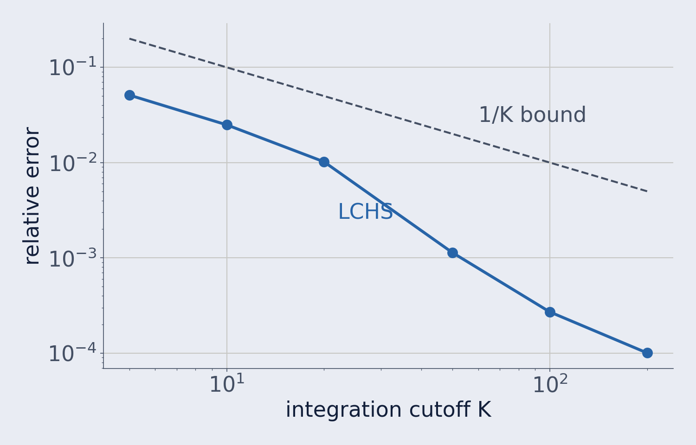
Rebuilding e^(−tA) from unitaries
STEP 2 · RESULTS
10⁻⁴
relative error at K = 200, down from 5 × 10⁻² at K = 5, using unitaries only
Guaranteed error is O(1/K) because the kernel has heavy tails
Cancellations make it faster here; cost estimates use the bound
Improved kernels decay almost exponentially (An, Childs, Lin, 2023)
4 × 4 dissipative test matrix, t = 1
Live session notebook · Step 2
Notes:
The blue line is the reconstruction error of the matrix exponential from the discretized LCHS integral; the dashed line is the guaranteed 1/K bound. A larger cutoff means longer simulation times k t, so the kernel tail translates directly into circuit depth. In this example the oscillating factor cancels part of the tail; in the homework's damped oscillator L has a zero eigenvalue and the error follows the bound exactly.

Slide 32
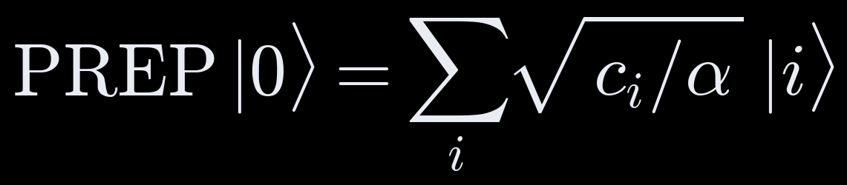

A matrix inside a unitary
STEP 3 · BLOCK ENCODING BY LCU
A / α
∗
A = Σᵢ cᵢ Pᵢ (Pauli strings), α = Σᵢ |cᵢ|
U is unitary; the matrix A, scaled by α, sits in its top-left block
∗
∗
|0⟩
PREP
SELECT
PREP†
Cost scales with α: about α·t queries to U for simulation, α·‖A⁻¹‖ for linear systems
Live session notebook · Step 3 · Gilyén, Su, Low, Wiebe, STOC 2019
Notes:
A block encoding is the interface between a matrix and the hardware: every downstream algorithm, whether QSVT, LCHS or a linear solver, only ever calls U. The LCU construction prepares the weights on an ancilla register, applies each Pauli string controlled on the ancilla, and unprepares. The normalization alpha is the sum of the absolute coefficients, and query counts scale with it, so a small alpha is the main practical optimization.

Slide 33
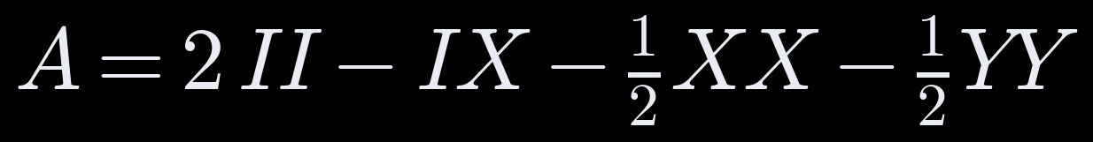
The 1D Laplacian on two qubits
STEP 3 · RESULTS
Quantity | Value
Pauli terms | 4
Ancilla qubits | 2
Normalization α | 4.00
Spectral norm ‖A‖₂ | 3.62
α × top-left block = A | exact
2
−1
0
0
−1
2
−1
0
0
−1
2
−1
0
0
−1
2
The encoding is exact; the price is α 10% above ‖A‖₂. On the 8-point periodic Laplacian, Pauli LCU gives α = 5, a shift-operator encoding α = 4.
Live session notebook · Step 3
Notes:
The four-point stencil decomposes into four Pauli strings, so two ancilla qubits suffice. The notebook verifies that U is unitary and that alpha times its top-left block reproduces A exactly. The overhead alpha over the spectral norm is about 10% here, and it grows on larger grids, because the cyclic shift needs more Pauli strings; encoding the shift directly as an incrementer circuit keeps alpha at 4. The periodic 8-point case is in the homework.

Slide 34
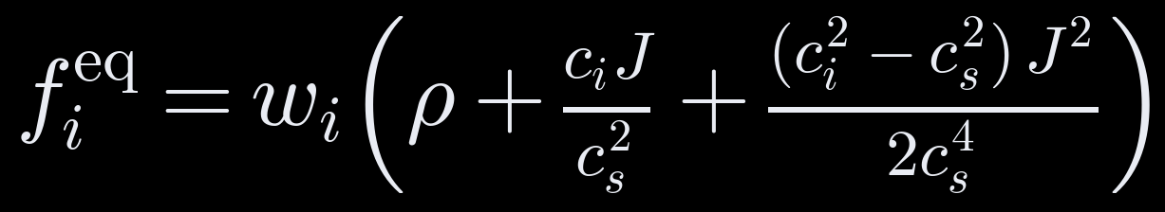
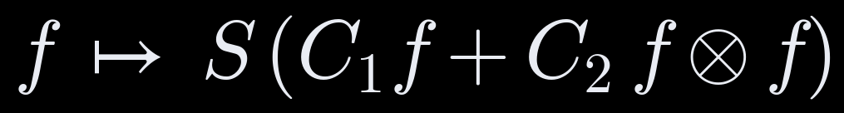
Move the nonlinearity into a local collision
LATTICE BOLTZMANN + CARLEMAN
Navier–Stokes: the nonlinearity u·∇u grows with the Reynolds number, where Carleman fails
Lattice Boltzmann: populations fᵢ stream along velocities cᵢ and relax toward a local equilibrium
Streaming S is a permutation: a shift circuit on qubits
Collision is quadratic in f, with strength set by the Mach number u/cₛ
D1Q3: cᵢ ∈ {0, +1, −1}, cₛ² = 1/3, viscosity ν = cₛ²(1/ω − 1/2)
Lattice Boltzmann notebook · Itani, Succi, Fluids 7, 24 (2022) · Sanavio, Succi, AVS Quantum Sci. 6, 023802 (2024)
Notes:
Lattice Boltzmann describes the same flow with particle populations. Streaming is linear and is a permutation, so on qubits it is a shift. All the nonlinearity sits in the collision, which with a polynomial equilibrium is local and quadratic: exactly the form Carleman needs. The strength of the quadratic term is set by the flow speed relative to the lattice sound speed, the Mach number, rather than by the Reynolds number.

Slide 35
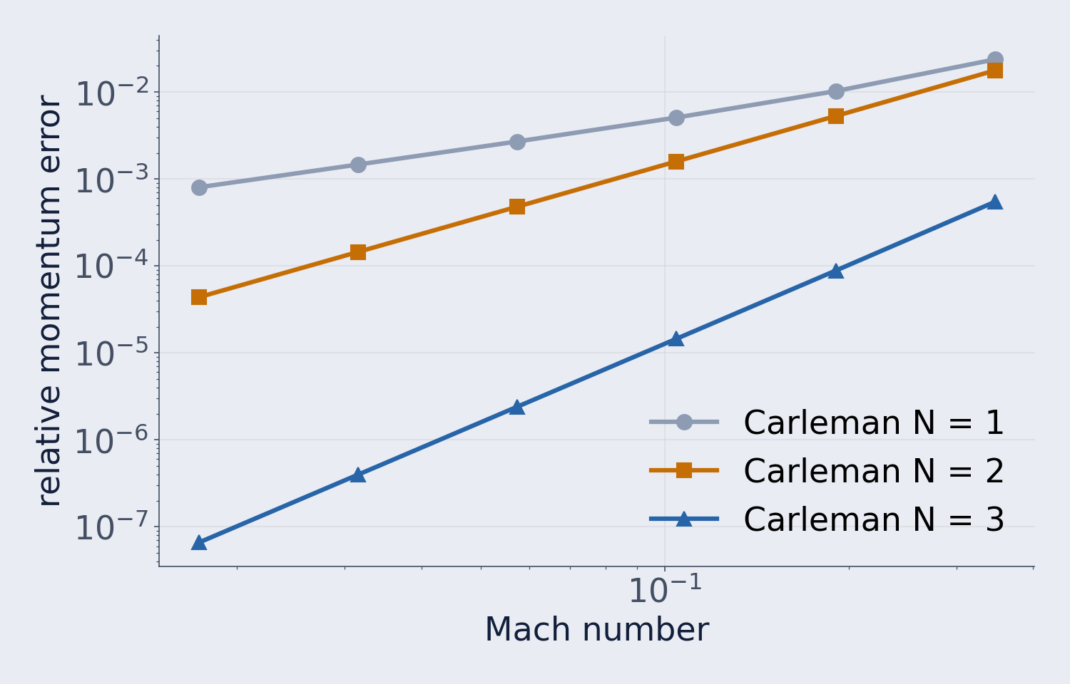
The Mach number controls the error
LATTICE BOLTZMANN · RESULTS
Carleman size at Ma = 0.17
N | Dimension | Qubits | Rel. error
1 | 24 | 5 | 9.1 × 10⁻³
2 | 600 | 10 | 4.4 × 10⁻³
3 | 14,424 | 14 | 6.7 × 10⁻⁵
At Ma ≈ 0.02, third order reaches 7 × 10⁻⁸. Low-Mach flows are the natural regime: each extra order cuts the error by orders of magnitude.
D1Q3, 8 sites, ω = 1, error after 20 time steps
Lattice Boltzmann notebook
Notes:
At fixed viscosity, the truncation error grows with the Mach number for every order, and the gap between orders is largest at low Mach. The dimension grows like (3n) to the N, but the qubit count only linearly in N: 14 qubits for third order on 8 sites. The open challenges are the depth of the collision circuit and readout, not the register size.

Slide 36
Viscosity still matters
LATTICE BOLTZMANN · RESULTS
ω | ν | Re | N = 1 | N = 2 | N = 3
0.5 | 0.500 | 1.6 | 1.0 × 10⁻¹ | 5.1 × 10⁻³ | 2.3 × 10⁻⁴
1.0 | 0.167 | 4.8 | 9.1 × 10⁻³ | 4.4 × 10⁻³ | 6.7 × 10⁻⁵
1.5 | 0.056 | 14.4 | 2.7 × 10⁻² | 1.0 × 10⁻² | 1.1 × 10⁻³
1.8 | 0.019 | 43.2 | 2.0 × 10⁻² | 2.5 × 10⁻² | 7.9 × 10⁻³
At ω = 1.8 (Re ≈ 43) the second order no longer improves on the first, and the third gains only a factor of 3. Over-relaxation amplifies truncation errors step by step: lattice Boltzmann helps, but high Reynolds numbers remain open.
Lattice Boltzmann notebook · Ma = 0.17, 8 sites, relative momentum error after 20 steps
Notes:
This is the honest caveat. Moving omega toward 2 lowers the viscosity and raises the Reynolds number; convergence in N slows, and at omega 1.8 the second order is no better than the first. This matches the literature, where Carleman lattice Boltzmann works up to moderate Reynolds numbers. The stochastic approaches discussed later target the strongly nonlinear regime.

Slide 37
Every path ends in Hamiltonian simulation
SUMMARY
01
02
03
04
Nonlinear → linear
Non-unitary → unitary
Matrix → circuit
Evolution → gates
Carleman, on the PDE or lattice Boltzmann form
LCHS
LCU block encoding
Hamiltonian simulation
WHAT IT BUYS
WHAT IT BUYS
WHAT IT BUYS
WHAT IT BUYS
A linear ODE or map
A weighted sum of Hamiltonian simulations
Access to A inside a unitary
e^(−iHt) on hardware
MAIN COST DRIVER
MAIN COST DRIVER
MAIN COST DRIVER
MAIN COST DRIVER
Order N; Mach and Reynolds numbers
Kernel tails, number of nodes
Normalization α
Steps, native gates
Next: running e^(−iHt) on a model of our spin qubit hardware with the SDK
Optional homework: assignment notebook with solutions
Notes:
The three steps of the live session, and the lattice Boltzmann variant, all reduce the problem to Hamiltonian simulation. That is the hand-over to the SDK example, where we run it on a model of the spin qubit hardware.

Slide 38
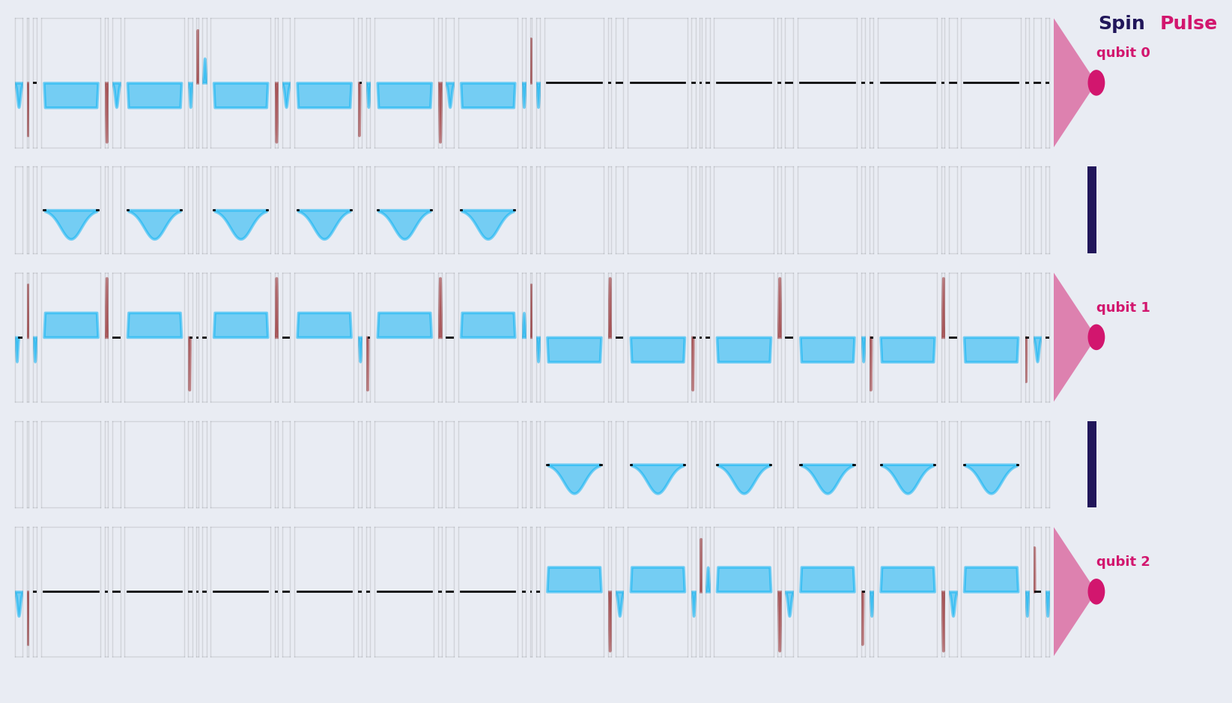
Running e^(−iHt) on a spin qubit model
SPINPULSE · FROM CIRCUIT TO PULSES
1
Trotter circuit for H = J Σ(XX + YY + ZZ) + h Σ X on 3 spins
2
Transpile to native Rx, Ry, Rz, Rzz on a linear chain
3
Pulses: drive on qubits, exchange on couplers
4
Simulate under 1/f noise, T2* = 5000
r | Rzz | 1-qubit | Duration
1 | 12 | 55 | 3,382
4 | 48 | 200 | 7,302
8 | 96 | 392 | 9,662
12 | 144 | 584 | 12,158
One Trotter step: qubit lines and the two couplers
Gates grow linearly with r, duration does not: exchange time scales with the rotation angle
Masterclass notebook, Part 5 · SpinPulse (Quobly), arXiv:2601.10435 · durations in model time units
Notes:
Every path in the toolbox ends in Hamiltonian simulation, so here we run e^(-iHt) for a 3-spin Heisenberg chain on a pulse-level model of a silicon spin qubit processor with SpinPulse. The Trotter circuit is transpiled to the native gate set, Rx, Ry, Rz and Rzz on a linear chain, then turned into pulses. Without noise the pulses reproduce the circuit with fidelity 0.998 to 1. The gate count grows linearly with the number of Trotter steps, but the duration grows much more slowly, because an exchange pulse lasts in proportion to its rotation angle and the total angle per bond is fixed by J times t.

Slide 39
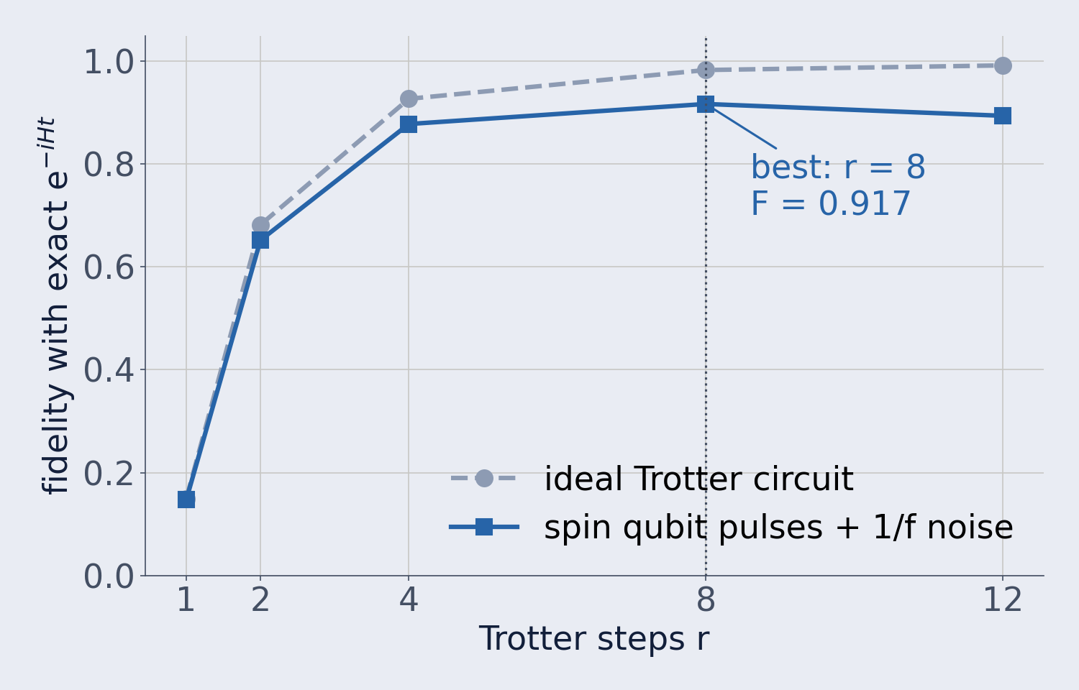
Noise sets the best number of Trotter steps
SPINPULSE · RESULTS
r = 8
fidelity 0.917 on the noisy model, against 0.983 for the ideal circuit
Without noise, more steps always help
With noise, each step adds pulses and time: fidelity peaks, then falls
The optimum moves with T2*; dynamical decoupling is the next experiment
3-spin Heisenberg chain, J = 1, h = 0.5, t = 1; 1/f noise, T2* = 5000
Masterclass notebook, Part 5 · mean fidelity over 10–40 noise realizations
Notes:
The dashed line is the ideal Trotter circuit compared with the exact propagator: it rises monotonically towards 1. The solid line is the same circuit as spin qubit pulses under 1/f noise. Trotter error falls with more steps while accumulated noise grows, so the fidelity peaks at about eight steps and then drops. The exact numbers vary slightly between runs because the noise is sampled and the transpiler is not seeded, but the peak position was stable in every run. In the notebook, participants can change T2* or switch on spin-echo dynamical decoupling and see the optimum move.

Slide 40
When does the Fock-space trick pay off?
BOSONIC / FOCK-SPACE ENCODINGS ON REAL QUANTUM HARDWARE
NONLINEAR, DISSIPATIVE CFD
NONLINEAR, DISSIPATIVE CFD
HARDWARE MODEL
Kolmogorian solver
+
QALB lattice Boltzmann
Spin qubits (SpinPulse)
Bravyi et al., arXiv:2606.08349
Itani et al., arXiv:2304.05915
Resource estimates for both approaches
WHY THE BOSONIC TRICK WORKS IN BOTH
Map each classical variable to a bosonic mode: nonlinear dynamics become linear evolution in Fock space
“Quantum advantage” here is not a yes/no property of the algorithm. It is a narrow, quantitatively locatable region of (initial condition, noise rate, dissipation rate, encoding choice) space, and this project built the tools that find its boundary.
Kolmogorian solver
QALB lattice Boltzmann
d|ψ⟩/dt = (−A+B+C)|ψ⟩: linear in Fock space
Dissipation sets the Fock-space cutoff
Kowalski mapping quantizes the BGK collision
Fock cutoff sets the Carleman order
Why it matters: qubits grow only with the log of the Fock-space size, cost is poly(log N), and Bravyi et al. show the problem is BQP-complete, evidence for a quantum advantage
Notes:
Framing: two approaches to nonlinear, dissipative CFD, the Bravyi et al. Kolmogorian solver and the QALB lattice-Boltzmann algorithm (Itani, Sreenivasan, Succi), both resource-estimated on a spin-qubit hardware model (SpinPulse).
Bosonic trick: both papers map each classical variable to a bosonic mode (quantum harmonic oscillator), so the nonlinear dynamics become linear evolution in Fock space. Bravyi et al. (arXiv:2507.06198, 2606.08349): the backward Kolmogorov equation becomes d|psi>/dt = (-A + B + C)|psi>; A = sum of lambda_i a_i^dagger a_i, so dissipation sets the oscillator frequencies and noise sets the mass; a cutoff sum lambda_i m_i <= k keeps only low-dissipation states, with qubit count O(k/lambda_1 log N). QALB (Itani, Sreenivasan, Succi, arXiv:2304.05915): builds on Kowalski's bosonic framework; the Fock-space truncation sets the Carleman order; streaming and collision are both unitary; it avoids extra variables for densities coupled from neighbouring sites; qubits scale logarithmically with the truncated Fock-space size. Why it matters: Bravyi et al. (arXiv:2507.06198) prove the problem BQP-complete, which they present as evidence for quantum advantage; the runtime is polynomial in log N, t, J and 1/lambda_1.
Methods: LCHS complexity (An/Liu/Lin arXiv:2303.01029, An/Childs/Lin arXiv:2312.03916) · Kolmogorian block-encoding (Bravyi/Byrne/Zayats/Zhuk arXiv:2606.08349) · QALB (Itani/Sreenivasan/Succi arXiv:2304.05915) · spin-qubit pulse noise (SpinPulse) · surface-code overhead (standard rotated-code estimates)

Slide 41
Toy-model feasibility map: NISQ spin qubits
KOLMOGORIAN SOLVER · SINGLE-MODE TOY MODEL, λ = 1.0, J = 0.15, TARGET ε = 0.01
0.04
n=2
n=3
n=4
∞
∞
∞
REDUCED VARIABLE
0.1
n=1
n=2
n=3
n=4
∞
∞
y₀ = x₀ · (2λ / q)^{1/2}
0.25
n=1
n=2
n=2
n=3
n=4
∞
From Theorem 1 (Bravyi et al.): advantage requires Σᵢ xᵢ²/pᵢ = O(1), which collapses to y₀² here. Large x₀ with small q gives large y₀, which is hard regardless of x₀ or q individually. That is why the dashed contours run diagonally.
noise rate q
0.6
n=2
n=1
n=2
n=2
n=3
n=4
y₀ = 7
1.5
n=2
n=2
n=1
n=2
n=2
n=3
y₀ = 4
4
n=2
n=2
n=2
n=1
n=2
n=2
FEASIBILITY TEST
|v_{D}(t, x₀) − v_{Dref}(t, x₀)| < ε
0.3
0.6
1.0
1.6
2.5
4.0
y₀ = 1
y₀ = 2
Smallest Fock truncation D = 2ⁿ matching a much larger reference D_{ref} within ε sets the qubit count n, checked against SpinPulse's purity threshold.
initial-condition norm x₀
feasible
hardware fails (purity < 0.5)
infeasible even noiseless
Notes:
Each cell gives the qubit count n needed to reach the target accuracy for that initial-condition norm x0 and noise rate q. Blue cells are feasible on spin qubits; cells with a magenta outline are algorithmically fine but the hardware purity drops below 0.5; dark cells are infeasible even without noise (n up to 4 is not enough). The dashed contours are lines of constant y0 = x0·sqrt(2λ/q) with λ = 1, computed from the formula, which is why they run diagonally.

Slide 42
Unary overtakes binary at D ≳ 8
ENCODING COST AND PURITY ON SPIN QUBITS
Same physics, different Fock-to-qubit mapping
binary: n_{qubits} = log₂ D
unary: n_{qubits} = D
C = J(â†²â − â†â²) ⇒ C_{n,n±1} ≠ 0
Only neighboring Fock levels connect, so unary uses purely local gates: linear gate growth vs. binary's near-quartic.
Purity = Tr(ρ²), simulated; unary at D ≥ 8 estimated as ≈ exp(−c·n_{2q}) from the gate count
Fewer local gates beat fewer qubits: unary overtakes binary at D ≳ 8
Methods: LCHS complexity (An/Liu/Lin arXiv:2303.01029, An/Childs/Lin arXiv:2312.03916) · Kolmogorian block-encoding (Bravyi/Byrne/Zayats/Zhuk arXiv:2606.08349) · QALB (Itani/Sreenivasan/Succi arXiv:2304.05915) · spin-qubit pulse noise (SpinPulse) · surface-code overhead (standard rotated-code estimates)
Notes:
Left chart: two-qubit gate counts for the same cubic coupling operator and Trotter steps. Binary grows near-quartically (0, 6, 172, 848); unary grows linearly (0, 32, 96, 224). Right chart: purity under SpinPulse spin-qubit noise. Binary: 1.00, 1.00, 0.98, 0.58 (directly simulated). Unary: 1.00, 1.00 simulated at D = 2 and 4; 0.88 and 0.73 at D = 8 and 16 estimated from the gate count. Unary wins once D is about 8 or larger.

Slide 43
Conclusions
04
Notes:
Section divider template.

Slide 44
Conclusions
QUANTUM FOR CFD AND MULTI-PHYSICS SIMULATION
01 · WHY QUANTUM
02 · WHY ENCODING
03 · THE BUSINESS EDGE
Capacity that doubles
Encoding unlocks it
Integrate early, scale later
Simulation is bookkeeping: every cell of a model is a number to store and update
How the problem is written onto qubits decides whether the advantage appears
High stakes: ≈ €100k and weeks per CFD iteration, 50–100 iterations per project
Every qubit doubles the capacity: 50 qubits hold about a quadrillion values
Smart encodings turn nonlinear flows into a form quantum computers handle naturally
Fits the workflow: a specialized step at meshing and simulation, not a replacement solver
Many scales, one model: room to resolve atoms, eddies and wings together
The payoff sits in a known regime: we can find it before investing at scale
First-mover value: shape solver interfaces and benchmarks while standards form
Next step: find the CFD and multi-physics problems in your portfolio where quantum pays off, and build the quantum step into the workflow now, ready to scale with the hardware
Notes:
Why quantum (see the simple-version slide): a simulation stores and updates a number for every cell; finer detail multiplies the cells. n qubits hold 2^n values, so each added qubit doubles the capacity (2^50 ≈ 1.1 quadrillion). That capacity could let fine and coarse scales share one model; this is a research goal, not yet shown at scale.
Why encoding: the mapping of the problem onto qubits (for example the bosonic / Fock-space encoding used by the Kolmogorian solver and by QALB) is what turns nonlinear flow equations into linear quantum evolution. Whether it pays off depends on the regime (initial condition, noise, dissipation, encoding choice), and our tools locate that regime. Caveat if asked: only selected quantities can be read out, not all 2^n values.
Business: one high-precision CFD iteration costs about 100k EUR and takes weeks; projects need 50-100 iterations. Near term, quantum is a specialized step inside the existing workflow (meshing and simulation), not a replacement. Integrating early lets a software vendor shape interfaces and benchmarks.

